Slide 1
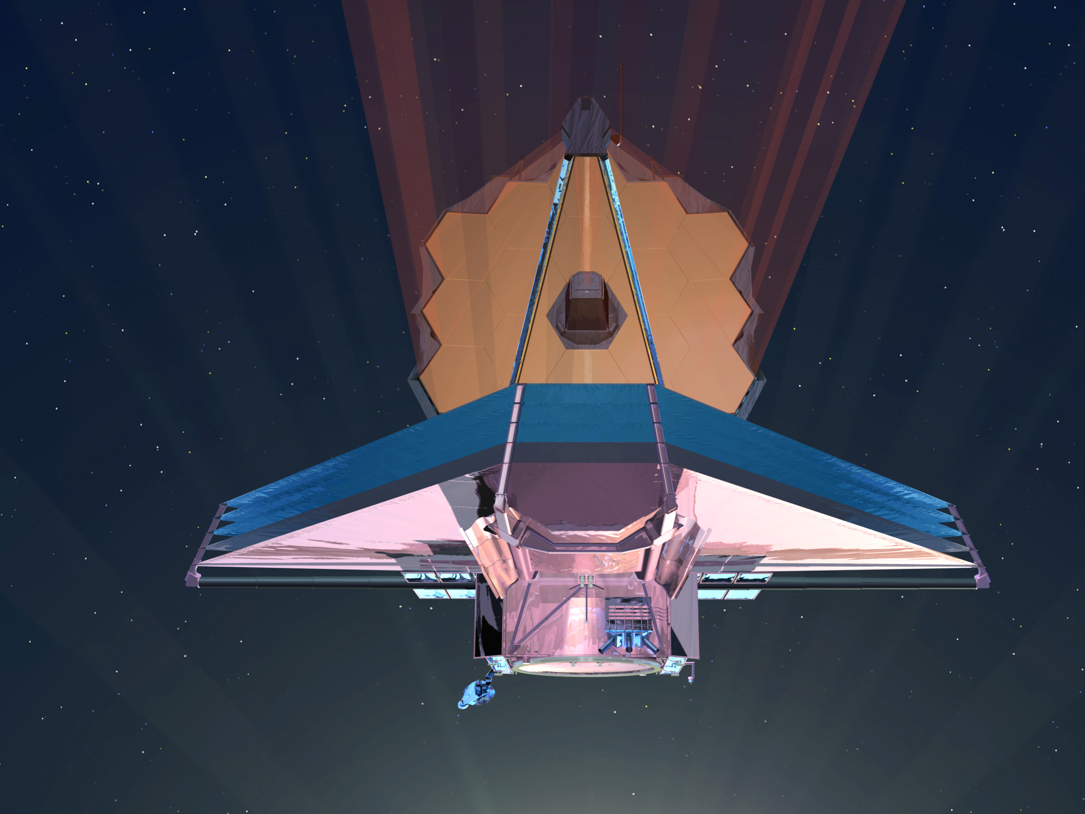
Systems Engineering of the
James Webb Space Telescope
Mike Menzel
GSFC Mission Systems Engineer
October 1, 2013

Slide 2
Abstract and Challenges
Abstract: This presentation will give an overview of the JWST system and describe some of the more unique systems engineering challenges of this “first of its kind” mission. The presentation will also describe some of the systems engineering techniques used by the team to address these challenges to achieve launch readiness in 2018.
Present an overview of the James Webb Space Telescope via the frame work of the Systems Engineering Process.
  Project Overview
  Science Objectives
  Requirements
  Design and Performance
  Technology Development, Challenges and Risk
  Verification
  Status and Summary

Slide 3
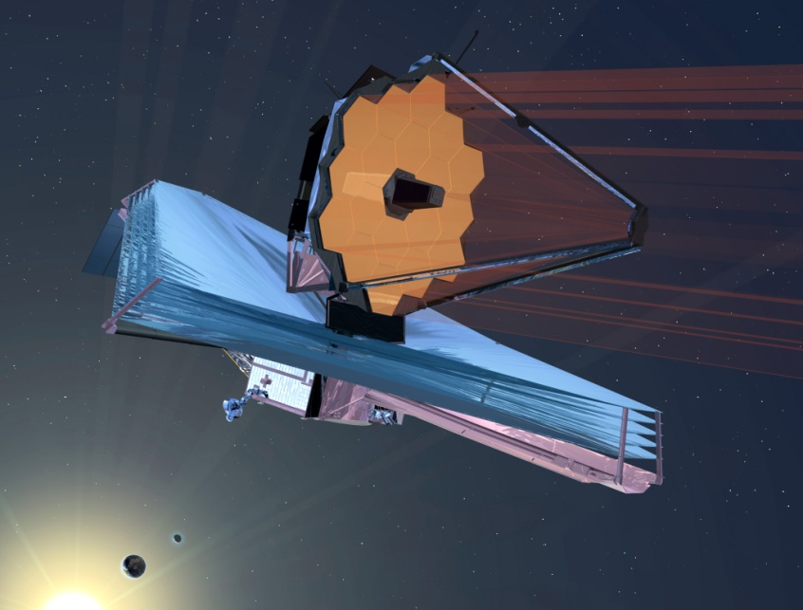
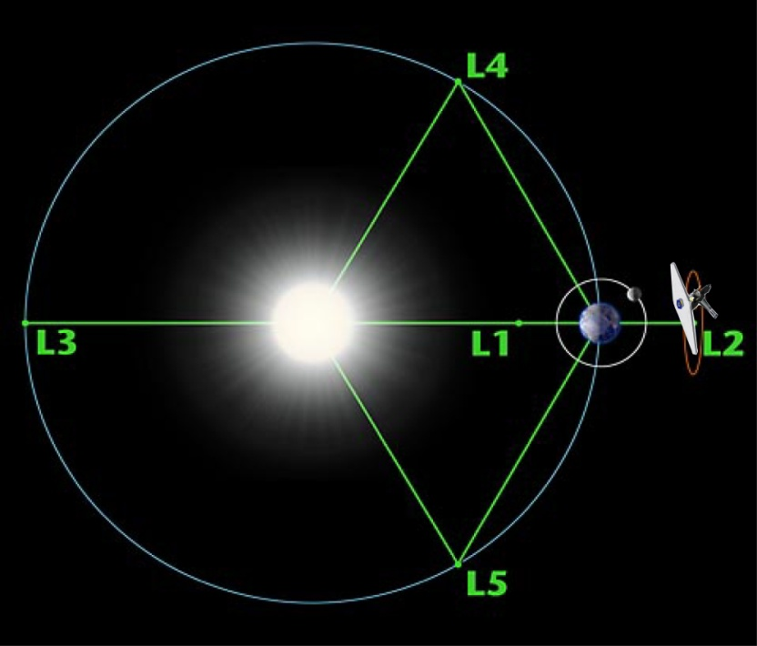
JWST Project Overview
Mission Objective: Study the origin and evolution of galaxies, stars and planetary systems by providing Infrared imagery and Spectroscopy
JWST Team:
  Mission Lead: GSFC
  International Collaboration with ESA and CSA
  Prime Contractor: Northrop Grumman Space Technology with Ball Aerospace as Telescope Subcontractor
  Ground Segment: Space Telescope Science Institute
  Science Instrument Providers:
    Near Infrared Camera (NIRCam): University of Arizona
    Near Infrared Spectrometer (NIRSpec): ESA
    Mid Infrared Instrument (MIRI): JPL / EC
    Fine Guidance Sensor / Near Infrared Imager and Slit-less Spectrograph (FGS-NIRISS): CSA
Observatory Description:
  Deployable telescope w/ 6.5m diameter segmented adjustable primary mirror
  Cryogenic operating temperature telescope and instruments
  Deployable Sunshield to allow passive cooling of telescope and instruments
  Launch in 2018 to Sun-Earth L2
  5-year science mission (10-year goal)

Slide 4
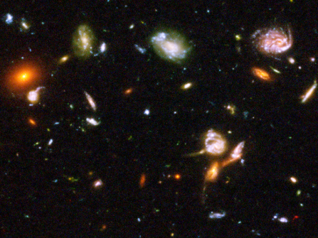
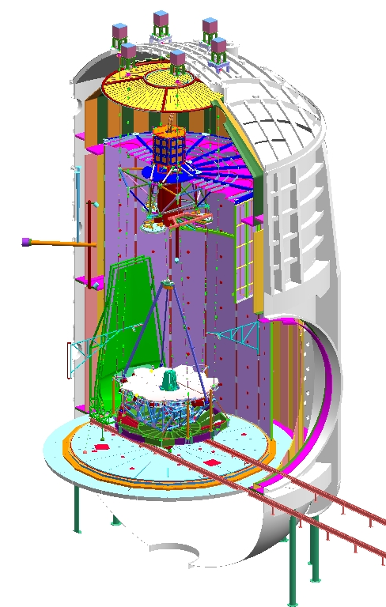
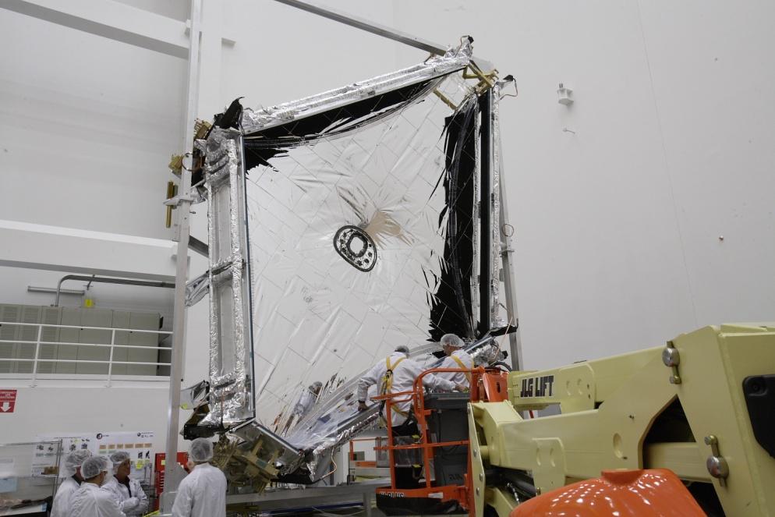
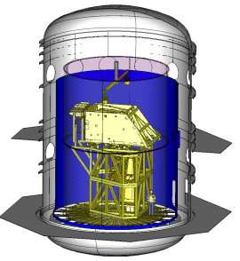
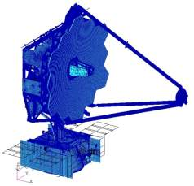
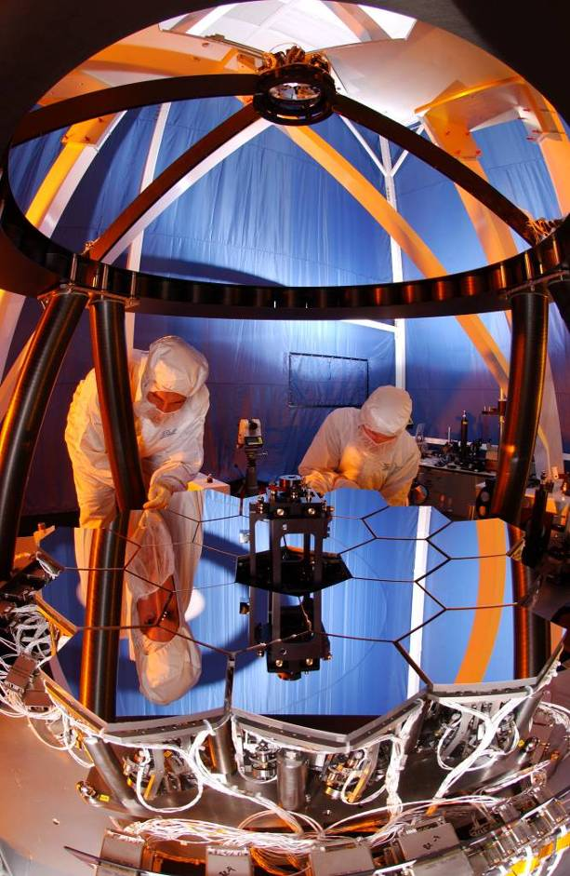
What Does Systems Engineering Do?
Science Objective:
Detect and Investigate
the First Light Sources
Study the Assembly of
Galaxies Since First Light
Study the Birth of Stars
Study the evolution of
Planetary Systems
Formulate Mission Requirements
Sensitivity
Image Quality and Resolution
Field Of View
Data Throughput
Observing Efficiency
Design the
System
WFE Budget
Power Budget
Mass Budget
Systems Analyses and
Performance Assessments
Risk Management and
Technology Development
Verification of the
“As Built” System
Notes:
-This is how I explain systems engineering to general public and for those who actually do it, they know it is never this sequential or linear. In fact most of these tasks are done in any number of cyctels during the various phases of a program. Each cycle beconing a little less hard as you converge toward an answer, hopefully by the time you are verifying the system.
-I’ll also say that all the tasks of GPR 7123 are in this summary
Understand Objectives
Mission Environments
Ops Concept Development
Requirements ID
Arch Development
Prodcut Implementation
Integration
Validation and Verification
Transition

Slide 5
JWST Science Objectives
Science Objective:
Detect and Investigate
the First Light Sources
Study the Assembly of
Galaxies Since First Light
Study the Birth of Stars
Study the evolution of
Planetary Systems
Scientists considered what telescope would replace the HST in 1989, and in 1990 the “HST and Beyond Committee” recommended a large Infrared telescope to address 4 science themes:
  Detection of First Light and Re-Ionization
  Evolution of Galaxies over Cosmic History
  Birth of Stars and Planetary Systems
  Evolution of Planetary Systems
Recently an additional yet related area of investigation has become important; the study of exoplanets.

Slide 6
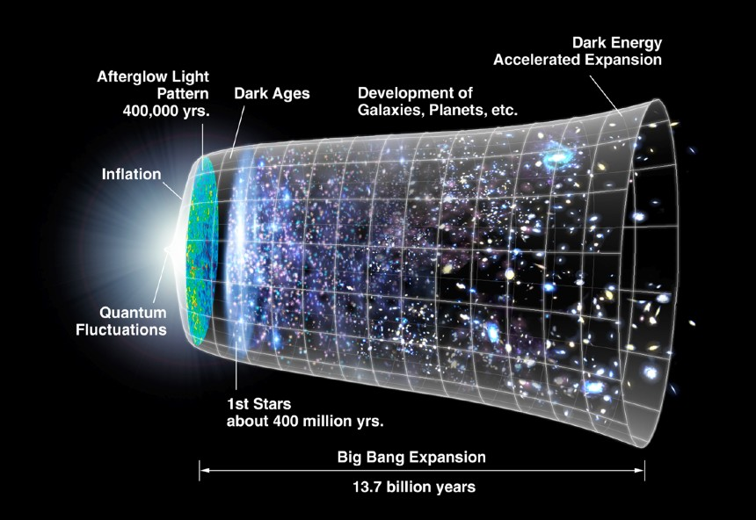
First Light and Re-Ionization
Notes:
JWST is being designed to address four themes of the Origins Program, and the first of these is to see first light objects in our universe.
It is believed that our universe originated in an event nicknamed the Big Bang approximately 13.7 billion years ago. Within a second of this event, there was a period of extreme expansion, where the size of the universe increased by many orders of magnitude. This sudden expansion is called inflation. After that, expansion proceeded at a much more gradual pace.
The matter of the universe began to cool down, and after about 400,000 years this gas became transparent to radiation. The universe entered what are nicknamed the dark ages. No sources of light were present, no stars or galaxies, just dark matter and conventional gas that consisted of 75% H and 25% He.
At about 180 to 200 million years after the big bang, the gas was enough for molecular hydrogen to form. Molecules can act as an agent to increase gas cooling to possibly enable the formation of stars. Sometime between 200 and 400 million years, the first stars turned on, but with a mixture of only H and He it is not clear what kind of “stars” could form. In order to form without dust and heavy elements which are very effective at cooling gas, these objects must have been much larger than the stars we know today.

Slide 7

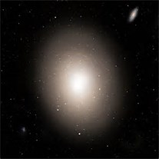

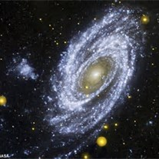
How Galaxies Evolve Over Cosmic History
Galaxies in the Distant – Early Universe
Seem to Lack Structure
Galaxies in the Nearby – Contemporary Universe
Have Structure, Ellipticals and Spirals
How do
Galaxies Like
These…
Evolve into
Galaxies Like
These
Notes:
When we take a picture there are galaxies at all distances and therefore ages seen. Closer ones are contemporary and farther ones or more primordial. Therefore we can see the various evolutionary phases of galaxies.
Contemporary / “present day” galaxies are those which are relatively close to us (therefore within one of two billion LY) are generally structured. They come in two main morphological types, Elliptical galaxies and spiral galaxies. These account for about 97% of the galaxies
Approximately 77% of the nearby galaxies are spirals
Approximately 20% are ellipticals
The remainder are called irregular galaxies
The farthest galaxies we see with distances corresponding to light travel times of 10 billion years or more and are fairly small and irregular.

Slide 8
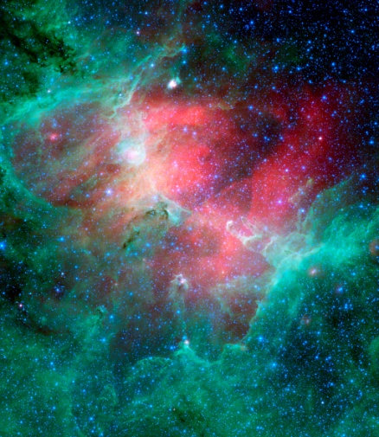
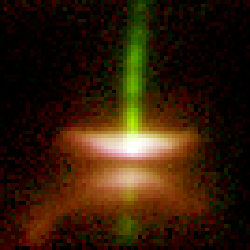
The Birth of Stars and Planetary Systems
Star Forming Regions in Giant
Molecular Complexes
Formation of Disks and Bi-Polar Jets
Near Young Stellar Objects
Notes:
Today we see star formation occurring in Large Molecular Clouds such as the one shown on the left. Although some of the basics of star formations are understood, there are many phenomena which are still a mystery. We know that dust and heavy elements cool the gas of these clouds such that their gravity can overcome gas pressure and start their collapse.
But there are many phenomena such as turbulence, rotation, and magnetic fields which can oppose and obstruct star formation. In addition there are phenomena such as bipolar jets, as shown in the picture of Herbig-Haro 30 shown on the right. This object shows a dust lane typical of debris disc that forms as a result of the rotation. It is believed that such discs will evolve into solar systems.

Slide 9
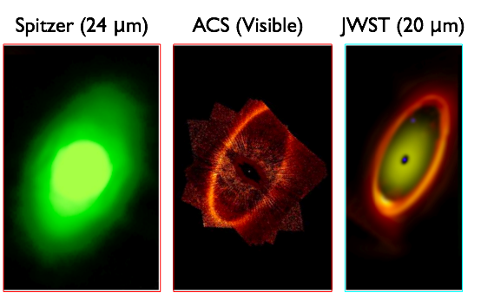
The Origins of Life and the Formation and Evolution of Planetary Systems
Notes:
Circumstellar discs are seen around stars such as Fomalhaut, Vega, Beta Pictoris. These discs evolve into solar systems.
Phenomena such as planet formation, planet migration and the formation of habitable zones in these solar systems are mysteries.
For example, the existence of water in the inner part of the solar system is not understood. The heat from the sun should have cleared the inner part of the early debris disc from volatiles. Therefore many believe that the water that is currently on the earth may have been deposited from comets that originate in the outer solar system.

Slide 10
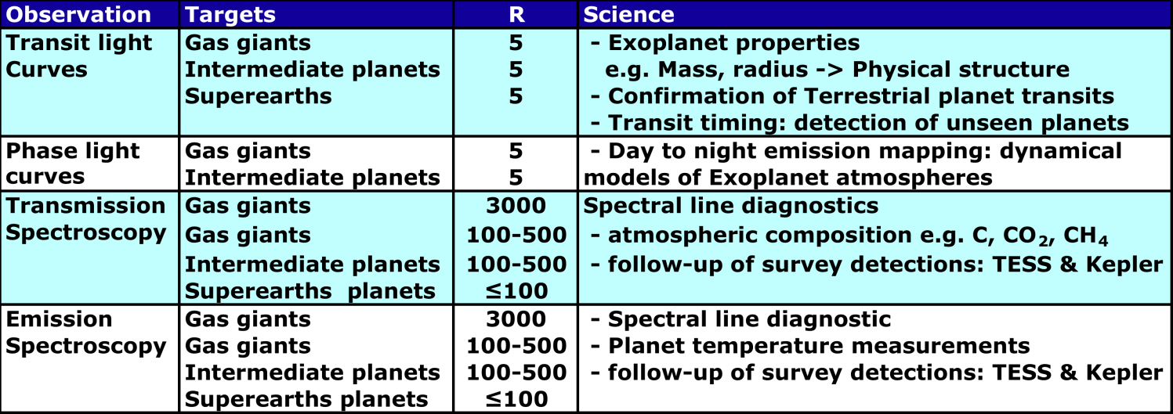
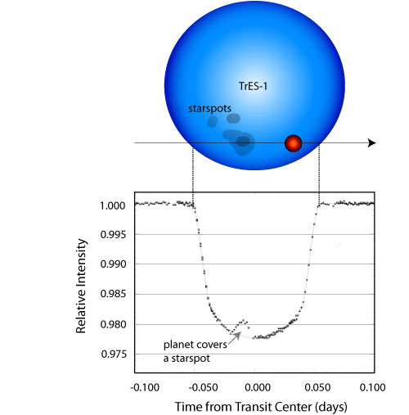
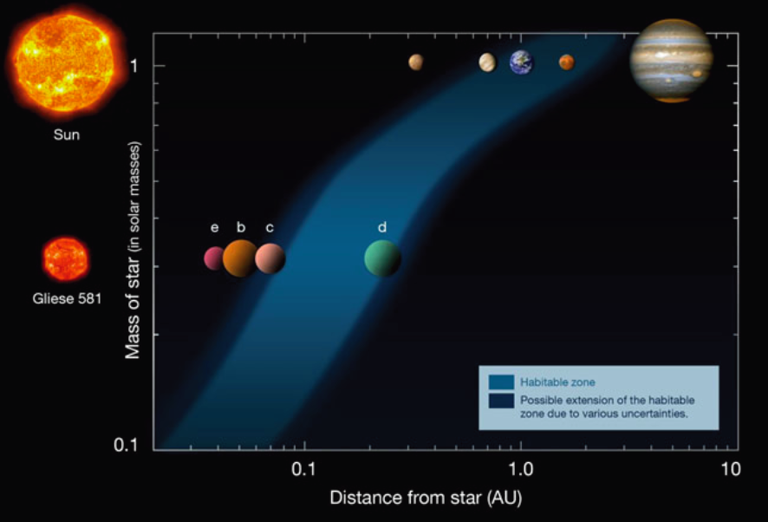
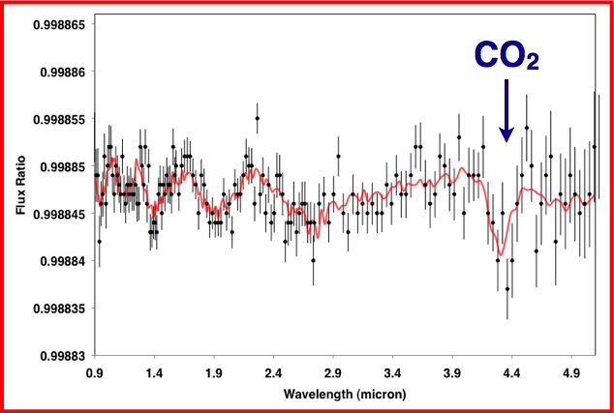
Transiting Exo-Planets
Simulated spectrum of a superearth
Notes:
Finally since the inception of JWST astronomers have discovered over a a thousand exo-planets, planets around other stars. These planets are extrenmely hjard to see since they are 1 billion times fainter than their parent and from the earth appear to be in glare of these stars. Most of these planets have been found by spacecraft such as Kepler which detects the periodic changes in the stars light as they transit or eclipse these stars. Enhancement of this technique can be used to potential the composition of their atmospheres.
It is even hoped by some (myself included) that JWST might even image some of the more earth like planets of the closer stars.

Slide 11
JWST Systems Engineering
Science Objective:
Detect and Investigate
the First Light Sources
Study the Assembly of
Galaxies Since First Light
Study the Birth of Stars
Study the evolution of
Planetary Systems
Formulate Mission Requirements
Sensitivity
Image Quality and Resolution
Field Of View
Data Throughput
Observing Efficiency
Design the
System
WFE Budget
Power Budget
Mass Budget
Systems Analyses and
Performance Assessments
Risk Management and
Technology Development
Verification of the
“As Built” System

Slide 12
Requirements Formulation
Formulate Mission Requirements
Sensitivity
Image Quality and Resolution
Field Of View
Data Throughput
Observing Efficiency
Engineering requirements are derived from these science objectives. The following are the primary “drivers’ for the system:
  Spectral Coverage
  Radiometric Sensitivity
  Image Quality and Resolution
  Field of View and Celestial Coverage
  Data Throughput
  Observing Efficiency
The derivation of engineering requirements must involve preliminary “sizing” of key system attributes to establish feasibility.

Slide 13
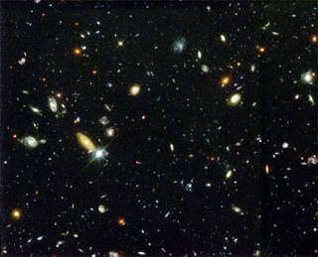
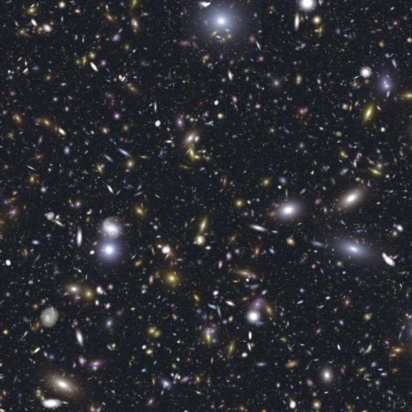
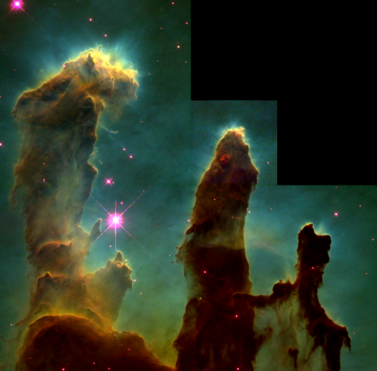
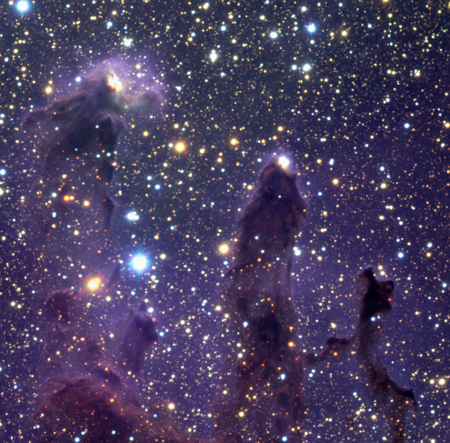
Science Requires an Infrared Telescope
Light emitted by
young stars is blue
After traveling 13 billion years thru a
universe that has been expanding
light waves are stretched and become
red or infrared
Hubble Deep Field image
shows galaxies out to z~5.
JWST must operate in the Near Infrared (NIR)
wavelengths (0.6 to 5 mircons)
JWST will view the universe at
red-shift of 10 or greater to
search for the first galaxies
JWST must operate in the Mid Infrared (MIR)
wavelengths (5 to 28 microns)
M16 viewed in visible light shows dusty
pillars and cocoons. Stars are being born
in this dust, but this same dust obscures
our view of them.
Infrared light can penetrate dust. By
observing in the infrared we can see into these
dust cocoons. M16 viewed in the IR
shows objects hidden by this dust.
λ = 0.6 microns
λ = 5 microns
λ = 28 microns
JWST Wavelength Coverage
Visible
Near Infrared
Mid Infrared

Slide 14
Driving Requirements: Radiometric Sensitivity
Sensitivity: Detect 11 nanoJanksy Point Sources with a Signal to Noise Ratio of 10 for exposure time of 10,000 sec.
Infrared Spectrum between 1.4 μm and
2.6 μm, centered at 2.0 μm (R = 1.68)
High Signal Collection
Zodiacal Background
25 m² Aperture, 6.5 m Diameter
Optical Transmission > 52%
Distant Galaxy
Detector Quantum Efficiency > 80%
Encircled Energy > 59% to 80 mas
Low Noise
Low Stray Light Levels (Zodi Limited to λ = 10 μm)
JWST collects 1 photon per second, and registers one electron every 4 seconds.
Cold Optics T < 55 K
Low Electronics Noise
JWST collects 3 photons per second from the Zodi Background and registers 3 electrons from this background every 4 seconds.
NIR Detectors Cooled to T < 40 K for 0.1e-/s Dark Currents
Total Electrical Noise < 9e-
Notes:
To see the first stars we must be able to detect very dim objects indeed. These objects are estimated to be between 11 and 1 nano-Jansky. One Jansky is 10^-26 W/m^2/Hz. And if that doesn’t clear it up, 20 nJy can be simulated by putting a childs night light (approximately 5 watts) on the moon and looking at from the earth.
To achieve this capability we need excellent light collection. Even with a 6.5 m diameter, 25 sq m aperture Webb will only collect 1 photon per second from these sources ansd will only actually record 1 of these out 3 collected. (The human eye typically collects about 1 million per second from the bright stars we see at night)
The other aspect to detection is noise control. Even if JWST generated no noise, the backgound light of our solar system (Zodiacal light) will generate 3 times more photon than the signal we are trying to detect.

Slide 15
Signal to Noise and Exposure Time
The critical metric used to quantify the ability to detect a faint source is the signal to noise (S/N). Equation 1 defines this for a JWST imager in terms of :
  The Source Counts (S)
  In-Field Background Counts (Z)
  Added Background Counts due to the Observatory (B) (aka stray light)
  Dark Current Counts (D)
  Electrical Read Noise Counts (Rd)
Equation 2 shows how exposure time varies with the rates of these parameters to achieve a given S/N. Note that the exposure time varies with square of the inverse of the source brightness (s)
= Encircled energy in photometric aperture
F_{ν} = Source flux density in Wm⁻²Hz⁻¹
= Central passband wavelength in meters
Δλ = Wavelength passband width in meters
A_{OTE} = OTE collection aperture in m²
τ_{OTE} = OTE transmission
τ_{SI} = Science Instrument transmission
= Detector quantum efficiency
h = Planck’s constant
B_{νZodi} = Zodi radiance at OTE entrance in Wm⁻²Hz⁻¹sr⁻¹
= Solid angle of photometric entrance aperture in sr
B_{νSL} = Stray Light effective radiance at OTE entrance in Wm⁻²Hz⁻¹sr⁻¹
N_{pixels} = Number of pixels in the photometric aperture
I_{DC} = Dark current per pixel in e/s
r = Read noise per reset per pixel in e

Slide 16
How a 10 nanoJanksy Point Source Appears Compared to Anticipated Background
Electron Counts for a 10 nJy Point Source at
= 2 Micron (R=5) Over 20 pixels For a
10,000 Sec Exposure
Each Background Pixel Accumulates 1883 Counts
Each Pixel Within the Core of the Point Source Image
Accumulates 2017 Counts

Slide 17
How a 1 nanoJanksy Point Source Appears Compared to Anticipated Background
Electron Counts for a 1 nJy Point Source at
= 2 Micron (R=5) Over 20 pixels For a
1,100,000 Sec Exposure
Each Background Pixel Accumulates 207077 Counts
Each Pixel Within the Core of the Point Source Image
Accumulates 208454 Counts

Slide 18
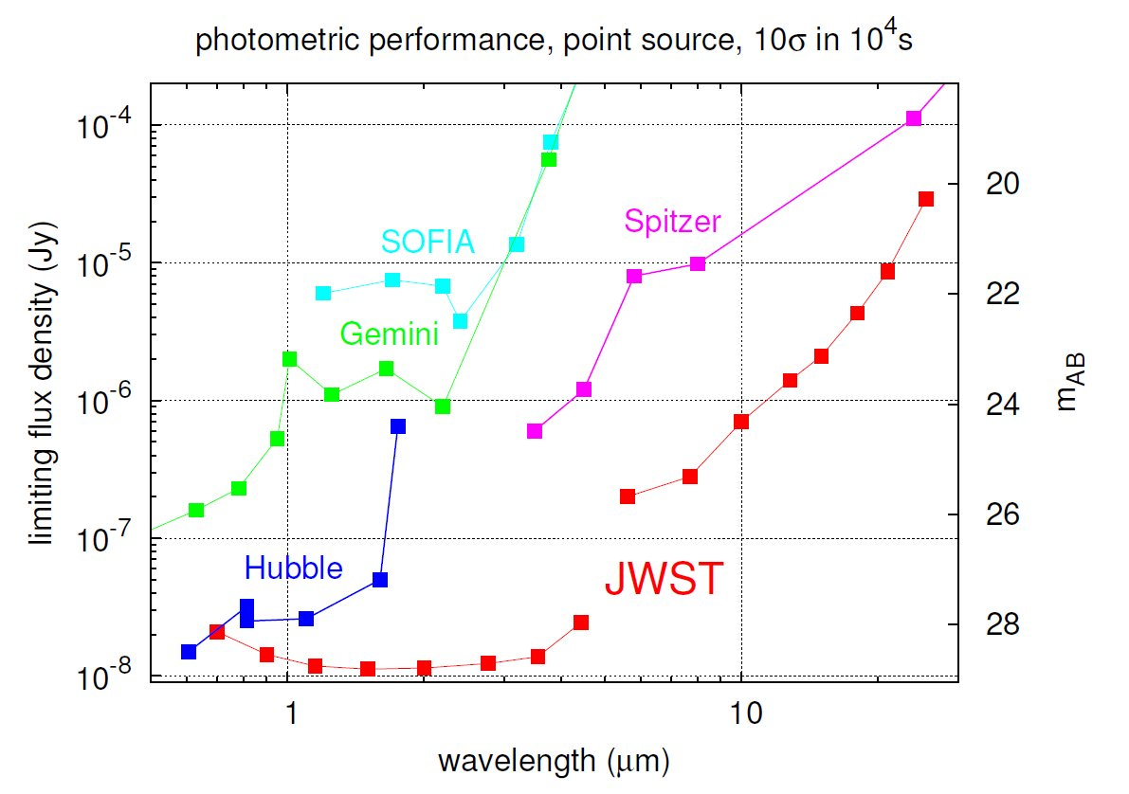
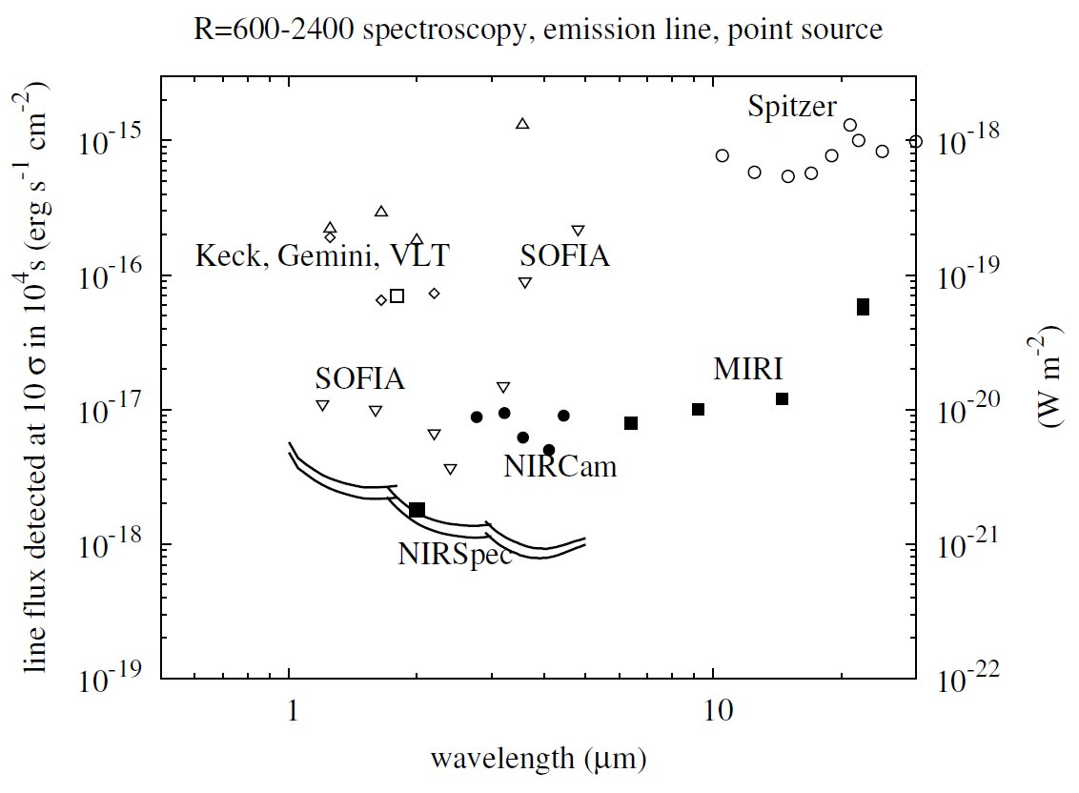
Sensitivity Comparisons
(Imaging and Spectroscopic)
About 100 times
More sensitive at
λ = 2 μm
About 100 times more
Sensitive than Keck,
Gemini at λ = 2 μm
Imaging sensitivity is measured by the faintest point source flux that can be detected to a signal to noise of 10, in a 10,000 sec (2.78 hour) exposure.
  Limiting flux in Janskys (Jy = 10⁻²⁶ wm⁻²Hz⁻¹) for various observatories are plotted above.
Within the bands where there is commonality, JWST is between and 100 times more sensitive than HST. (WFC3)
JWST is roughly 100 times more sensitive than comparable ground base observatories. (Gemini)
Spectroscopic sensitivity is measured by the faintest line source flux that can be detected to a signal to noise of 10, in a 10,000 sec (2.78 hour) exposure.
  Limiting flux in wm⁻² for various observatories are plotted above.
JWST is roughly 100 times more sensitive than comparable ground base observatories. (Keck, Gemini and the VLT)

Slide 19
Infrared Observatories Must be Very Cold
Both the telescope and the instruments glow in the infrared. To make sure this glow does not overwhelm the faint signal, both the telescope and instruments must be cold.
  Colder than 55 K. (-223° C or -369°F)
  At ambient temperature (300K) the primary mirror would emit over 350 photons at a wavelength of 2 μm.
JWST is designed to emit less radiation than the natural background out to a wavelength of 10 μm. To achieve this, the optics temperature must be less than 55 k.
  The graph to the right compares the thermal emission of the Primary Mirror to that of the natural background (Zodiacal Light ) vs wavelength.
Additionally the science Instruments detectors themselves must be cold, or they would generate electronic noise. (Dark Current Noise).
  The Near Infrared detectors are HgCdTel detectors and must operate colder than 40K.
  The Mid Infrared detector is Si:As and must operate at 6K.
Thermal Emission of the Primary Mirror and The Zodi Background
Zodiacal Background
Radiance (MJksy/ Ster)
Primary Mirror
Wavelength (microns)

Slide 20
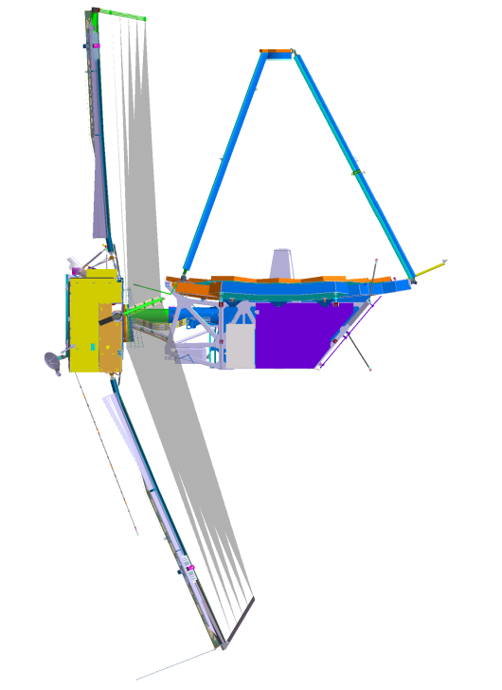
Cooling JWST
A 6-meter telescope and its instruments are too big to refrigerate. Therefore we must allow them to cool down “passively” .
  Get it far away from local heat sources, (The Earth, (300K) and the Moon)
  Keep sunlight off the telescope and instruments
Locate the telescope at a point in space called the 2nd Lagrangian Point. This is a stable point 1.5 million km from the Earth opposite the Sun.
  The sun, earth and moon are always on the same side of the observatory.
A sunshield (umbrella) can shade the telescope from all 3 of these bodies.
  This sunshield can also shade the telescope from those electronics that must run hot.
The NIR detectors are cooled by dedicated radiators which dump their dissipated power directly to cold space. (Cold Space is 7K)
The MIR detector must be cooled actively by a cryo-cooler to 6K.
Telescope and
Science Instruments
Sun Light
200,000 Watts
.0.85 Watts
Radiators to
Cool the Detector
Sunshield

Slide 21
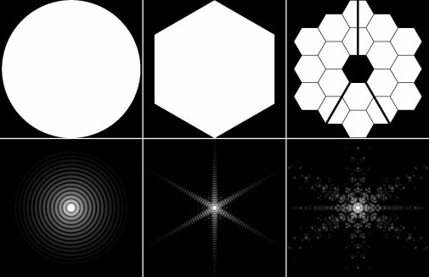
Driving Requirements: Image Quality or Resolution
Image quality requirements are driven by the need to resolve detail (resolution).
If a system has the best possible image quality, then the resolution is determined by size and shape of the telescope aperture. Diffraction from the aperture spreads light into a “Point Spread Function” (PSF).
  The illustration on the upper right shows point spread functions for various aperture shapes.
Resolution is commonly specified by the ability of a telescope to discern two stars at a minimum angle apart, θ. Therefore the ½ width of the point spread functions must be smaller than θ.
  This is illustrated on the lower right which shows the cross-section of the point spread functions of two stars in proximity to one another.
For JWST, the resolution is required to be 0.084 arcsec.
θ
Notes:
The ability to distinguish small detail or image quality, is limited by the size and quality of the optics due to diffraction. Even if the optics were made perfectly with no defects they would not focus a point source like a distant star to point, but instead focus it into a small blur pattern called the point spread function. The size of this pattern is determined by the size of the primary, the larger the primary the smaller the PSF. The details of the outer part of the pattern is determined by the actual shape of the primary.
The central parts of the pattern are generally pretty similar and oftern approximated by the so-called Airy Function. The resolution of the telescope is specified by the min angular distance at which two point sources can be distinguished.
When you add imperfections or WFE to the system, these PSFs get broader (more blurred) and resolution gets degraded. If however the sum of all these errors is less than about l/14 then they will not be noticeable from the unavoidable affects of diffraction and we have a diffraction limited system.

Slide 22
Wavefront Error Budgets
Point Spread Function (PSF)
Image Quality: Diffraction limited at a wavelength of 2.0 μm,
therefore Strehl Ratio > 80%, Total Wavefront Error (WFE) < 150 nm
Max of Ideal PSF
Static Wavefront Error of Optics < 100 nm
Imperfections in the figure of the optics due to fabrication errors.
80 mas
80 mas
Max of Ideal PSF
Line of Sight Error < 7 milliarcsec (mas), equivalent to ~72 nm of WFE
Pointing errors of the boresight of the telescope / instruments.
80 mas
80 mas
Max of Ideal PSF
Wavefront Error Stability due to Figure Vibrations and Long Term Drift < 63 nm
Vibrations of frequency higher than the control system.
Thermal drifts following observatory slews.
80 mas
80 mas

Slide 23
JWST Systems Engineering
Science Objective:
Detect and Investigate
the First Light Sources
Study the Assembly of
Galaxies Since First Light
Study the Birth of Stars
Study the evolution of
Planetary Systems
Formulate Mission Requirements
Sensitivity
Image Quality and Resolution
Field Of View
Data Throughput
Observing Efficiency
Design the
System
WFE Budget
Power Budget
Mass Budget
Systems Analyses and
Performance Assessments
Risk Management and
Technology Development
Verification of the
“As Built” System

Slide 24
JWST Systems Design
Design the
System
WFE Budget
Power Budget
Mass Budget
Systems design involves establishing system elements, decomposing and allocating requirements to them, defining their functions, interactions and interfaces, and allocating system and resources. The products of system design are:
  Hierarchical Diagrams
  Functional Flow Diagrams and Operations Concepts
  System Schematics and Data Flow Diagrams
  Resource and Performance Budgets
  Element and Subsystem Specifications and Interface Requirements Documents
These products are generated by iterations of parametric and trade studies.

Slide 25
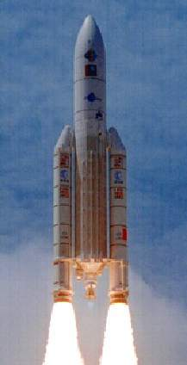
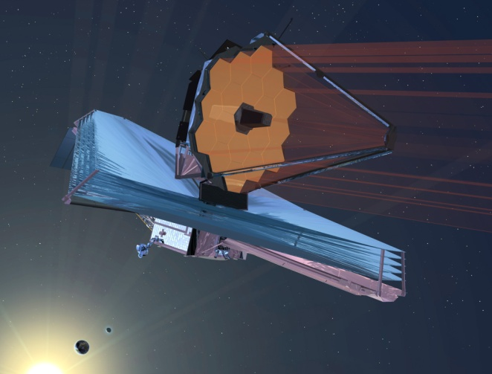
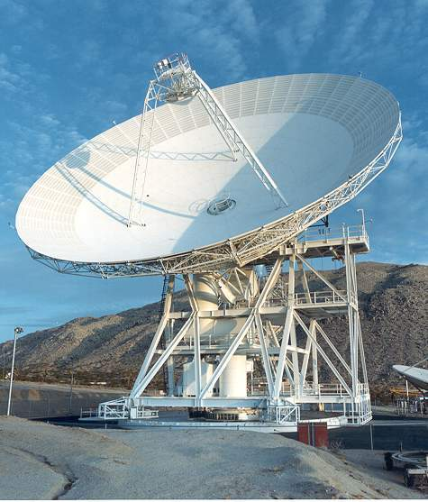
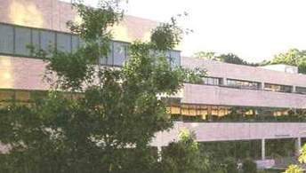
System Hierarchy
James Webb Space Telescope System
Launch Segment
Observatory Segment
Ground Segment
Space Telescope Science
Institute
JWST Observatory
Deep Space Network
Ariane Launcher
Optical Telescope Element
(OTE)
Science and Operations Center (SOC)
Launch Vehicle
Institutional Systems
Payload Adapter
Integrated Science Instrument
Module (ISIM)
Common Systems
Launch Site Services
Spacecraft Element (SE)
Spacecraft Bus
Provided by NASA
Provided by ESA
Provided by NGST
Provided by CSA
Sunshield
Provided by STScI
Notes:
System consists of 3 segments as shown:
The launch system consists of the Ariane 5 launch system provided by ESA
The observatory segment is provided by our prime NGST with the ISIM provided by GSFC and the SIs provided by ESA, CSA, European Consortium and JPL and the Uof A
The Ground Segment is provided by the STScI with contributions from the prime, and NASA

Slide 26

Typical Science Instruments Cameras and Spectrometers
Camera / Imager
Filter Wheel
Focal Plane
Electronics
Data Output
To Observatory
Collimator
Imager
Detector
Pick-Off Mirror
Pick-Off Mirror
Detector
Collimator
Imager
Collimator
Imager
Slit
Grating
Telescope
Data Output
To Observatory
Filter Wheel
Focal Plane
Electronics
Spectrometer

Slide 27
JWST Science Instrument Compliment
Science Instrument | Science Functions | Design Features and Capabilities
NIRCam University of Arizona | Wide field images with low spectral resolution. Short Wave (SW) channels 0.6 μm < λ < 2.3 μm Long Wave (LW) channels 2.4 μm < λ < 5.0 μm Special filters for Wave Sensing and Control | Two redundant modules each with one 2’ x 2’ SW images and one 2’ x 2’ LW image Eight HgCd Te 2048 x 2048 pixels SW detectors and two 2048 x 2048 pixel LW HgCdTe detectors. 18 μm pixel pitch Refractive optics
NIRSPec ESA | Multi-Object spectroscopy, 100 simultaneous spectra Waveband 0.6 mm < λ < 5.0 mm Medium to High resolution spectral resolution (R = 100 to 1000) | Four microshutter arrays each with 171 x 365 programmable slits. Each slit aperture 0.203” x 463” Total 9.7 sq arcmin FOV Two 2048 x 2048 pixel LW HgCdTe detectors 18 μm pixel pitch
MIRI ESA / JPL | Mid infrared imaging between 5 mm < l < 27 mm Single slit spectroscopy High resolution Integral Field Spectroscopy from 4.9 mm < l < 28.8 mm | 1.4’ x 1.9’ imager FOV One 1024 x 1024 pixel Si:As detector for imager 5” x 0.6” FOV slit spectrometer with one 1024 x 1024 pixel Si:As detector 7” x 7” FOV Integral Field Spectrometer with 4 channel beam slicer and one 1024 x 1024 pixel Si:As detector
FGS / NIRISS CSA | Medium spectral resolution (R=100) NIR imaging Fine guidance sensing the observatory fine pointing control system | 2.2’ x 2.2’ FOV for medium spectral resolution imaging with one 2048 x 2048 pixel LW HgCdTe detector. Two 2.3’ x 2.3’ FOV for fine guider using two 2048 x 2048 pixel LW HgCdTe detecors.

Slide 28
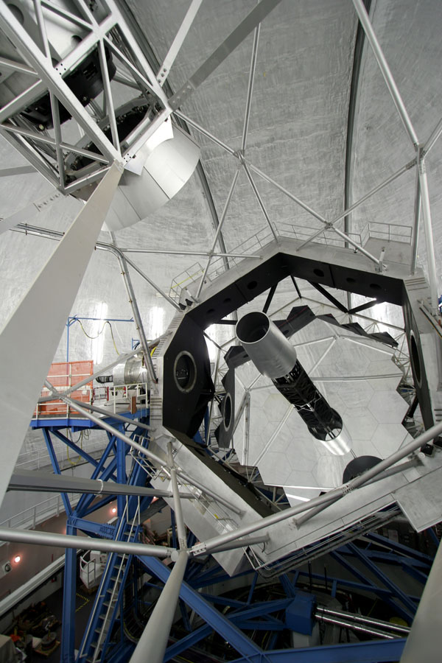
Segmented Mirror Design
The Keck 10 m Telescope uses a segmented primary mirror design with 36 individually controlled hexagonal segments.
The segments are easier to manufacture and to maintain.
The 10 meter Diameter
Keck I Primary Mirror
JWST adopted an 18 segment primary mirror design.
Each segment will be controllable in 7 degrees of freedom.
In addition to the advantages of manufacturability and maintainability, the segmented design was necessary to stow in the Launch Vehicle.
The Keck I Telescope on Maunea Kea
Summit in Hawaii
The 6.3 meter Diameter
JWST Primary Mirror

Slide 29
Tri-Mirror Anastigmatic Telescope Design
Integrated
Science
Instrument
Module (ISIM)
Secondary
Mirror
Primary Mirror
Tertiary Mirror
Fine Steering
Mirror
Notes:
The JWST telescope is a tri-mirror anastigmatic, using 3 powered or curved mirrors instead of two as used by HST. This 3rd mirrors allows JWST to have improved image quality over a wider instantaneous FOV.
HST is a Ritchey-Chretien system with 2 curved mirrors (Hyperboloids) that corrects both spherical aberration and coma over an appreciable FOV
The 3rd mirror allows for added correction of astigmatism (ellipse, hyperboloid, ellipse)
The primary is an 6.6m diameter f/1.2 ellipse, and the overall system is f/20.
In addition JWST uses a 4th mirror that is flat but that moves at a rate of ~1 per second (control bandwidth 0.6 Hz) to correct for pointing errors. The mirror is called the Fine Steering Mirror, and is controlled by a pointing system that uses a Fine Guidance Sensor to sense telescope mis-pointings (every 64 mSec). The command resolution is about 1 mas and the total range of the FSM is 100 mas in object space.

Slide 30
Data System Design Schematic
229 Gbits/12 hours
Science Packets
0.4 Gbits/12 hours
Guider Packets
On-Board Processing by SIs
And ISIM C&DH
Science Data Packetization
Averaging Frames into Groups
FGS Imagery at 16 Hz
Determination of Guide Star Centroid
Observatory Recorder
471 Gbits Capacity (MR-130)
458 Gbits Science Data Part.
12.6 Gbits Eng. Data Part.
0.2 Gbits Critical Tlm Part
SI Focal Plane
Arrays & Electronics
16 bit A/D Conversion
6.3 Gbits/day
Tlm and 0.2
Gbits/day
Critical Tlm
GS Centroids
On-Board SCE Processing
CFDP PDU
CCSDS CADU
Reed-Solomon Encoding
Convolutional Encoding
On-Board Telemetry Processing
By SCE
Telemetry Collection and Packetization
Real-Time Routing
40 kbps Real
Time Telemetry
Observatory
Telemetry
Sensors
40 Kbps S Band Downlink
28 Mbps Ka Band Downlink
Science User
Science Operation Center
Processing
Image Data Extraction
Decompression
Science
Data
10 Gbits / 30min Stored Data
DSN Processing
CFDP File Processing
Decoding
Data Archive
NISN
Real Time Data

Slide 31
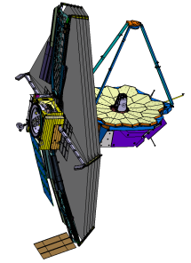
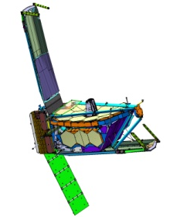
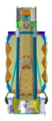
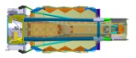
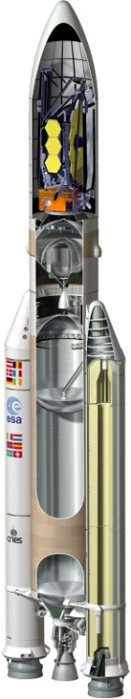
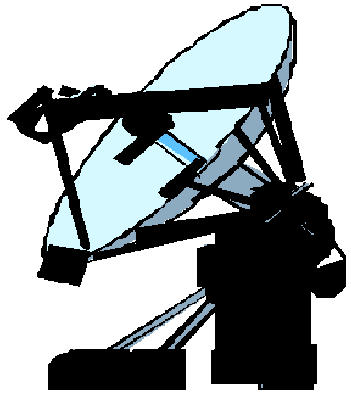
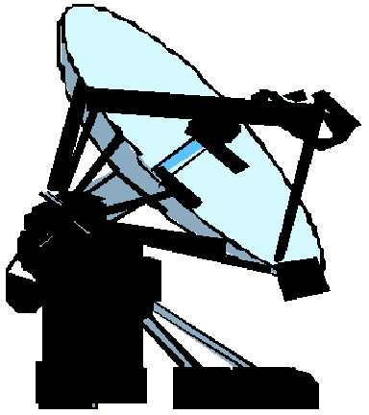

JWST System Architecture
Communications Coverage Provided
For all Critical Events
SOC Available 24 Hours, 7 Days per Week
Until Telescope Phased
Observatory Deployments
Solar Array
High Gain/ Medium Antennas
Sunshield
Optical Telescope Element
L2 Point
Ariane 5 Upper
Stage Injects JWST
Into Direct Transfer
Trajectory
Observatory – Upper Stage
Separation
L2 Lissajous
Orbit
L2 Transfer
Trajectory
Ariane 5
Launch
System
S-Band Tlm Link ( 2Kbps)
S-Band Cmd Link (0.25 Kbps)
S-Band Ranging
Ka-Band Science Link ( Selectable 7, 14, 28 Mbps)
S-Band Tlm Link (Selectable 0.2 - 40 Kbps)
S-Band Cmd (Selectable 2 and 16 Kbps)
S-Band Ranging
Nominal 4 Hour Contact Every 12 Hours
S-Band Tlm Link ( 2Kbps)
S-Band Ranging
Communications
Services for Launch
(TDRS, ESA, Malindi)
Deep Space Network
Space Telescope Science Institute
Science & Operations Center
NASA Integrated Services Network
Ariane PPF S5
GSFC Flight Dynamics Facility
Notes:
Start with the launcher. Puts us almost in a direct inject trajectory.
After separation the observatory gets us there and deploys
We have identified the assets necessary for communications coverage for all critical events.
TDRSS East, TDRSS Z and the ESA Malindi Ground Station are one set of such assets
Arrangements for these stations is in work by the Ground segment
34 meter DSN subnet to be provided, as documented in JWST Deep Space Network Service Agreement.
70 meter antenna available for emergencies
S-band Cmd Link at 2090.7521 MHz. The data rates are specified in FG-1901:
Low Rate: 0.25 Kbps from separation to L2
Medium Rate: 2 Kbps from separation to L2
High Rate: 16 Kbps from HGA/MGA deployment to L2
S-Band Tlm Link at 2270.5 MHz. The data rates specified in FG-1895
200 bps via either omni for all ranges
1 Kbps via SCE omni for all ranges
2 Kbps via SCE omni for range less than 7x10^5 km
4 Kbps via SCE omni for range less than 5x10^5 km
8 Kbps via SCE omni for range less than 3x10^5 km
20 Kbps or 40Kbps via MGA for range less than 1.8x10^6km
Ka-Band High Data Link at 25.9 GHz. Selectable downlink rates as shown as specified in FG-1885. Offset Quadraphase Shift Key modulation.
Ground Station parameters called out in FG 795:
G/T > 54 dB/K
DSN Pointing Loss <0.5 dB
Elevation Angle >10 degrees
RHCP with axial ratio <1 dB

Slide 32
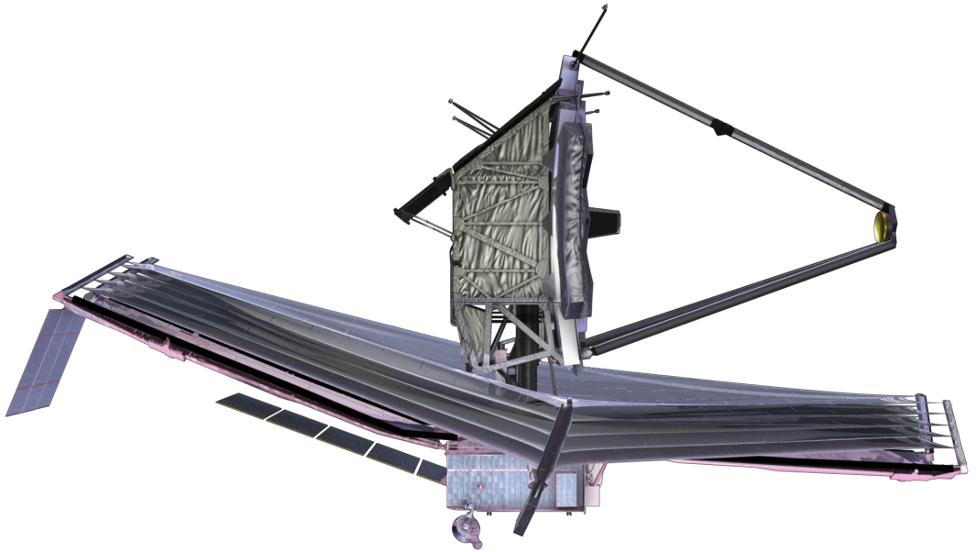
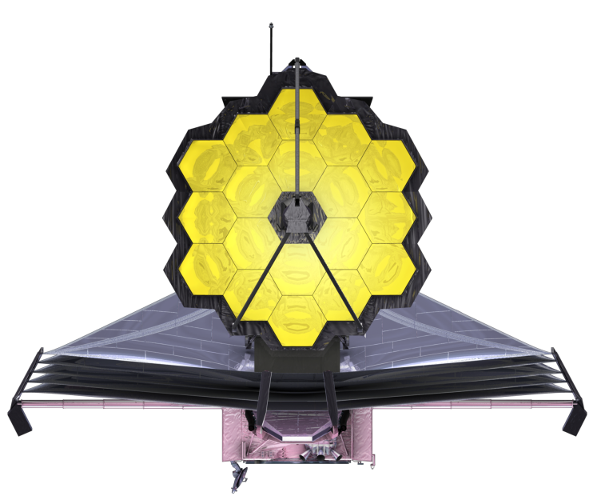
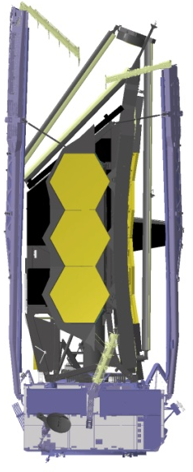
JWST Observatory Summary
Deployed Configuration
6.100 m
6.600 m
21.197 m
14.625 m
Stowed Configuration
Optical Telescope Element (OTE) diffraction limited at 2 micron wavelength.
  25 m² , 6.35 m average diameter aperture.
  Instantaneous Field of View (FOV) ~ 9’ X 18’.
  Deployable Primary Mirror (PM) and Secondary Mirror (SM).
  18 Segment PM with 7 Degree of Freedom (DOF) adjustability on each.
Integrated Science Instrument Module (ISIM) containing near and mid infrared cryogenic science instruments
  The NIRCam SI functions as the on-board wavefront sensor for initial OTE alignment and phasing and periodic maintenance.
Deployable sunshield for passive cooling of OTE and ISIM.
Mass: < 6530 kg .
Power Generation: 2000 Watts Solar Array.
Data Capabilities: 471 Gbits on-board storage, 229 Gbits / 12 hours science data.
Science Data Downlink: 28 Mbps.
Life: Designed for 10 years of operation.
10.661 m
4.472 m
Notes:
Correction IFOV should be about 9’x18’ (arcminutes not arcseconds)
Top level layout drawing for observatory L327601

Slide 33
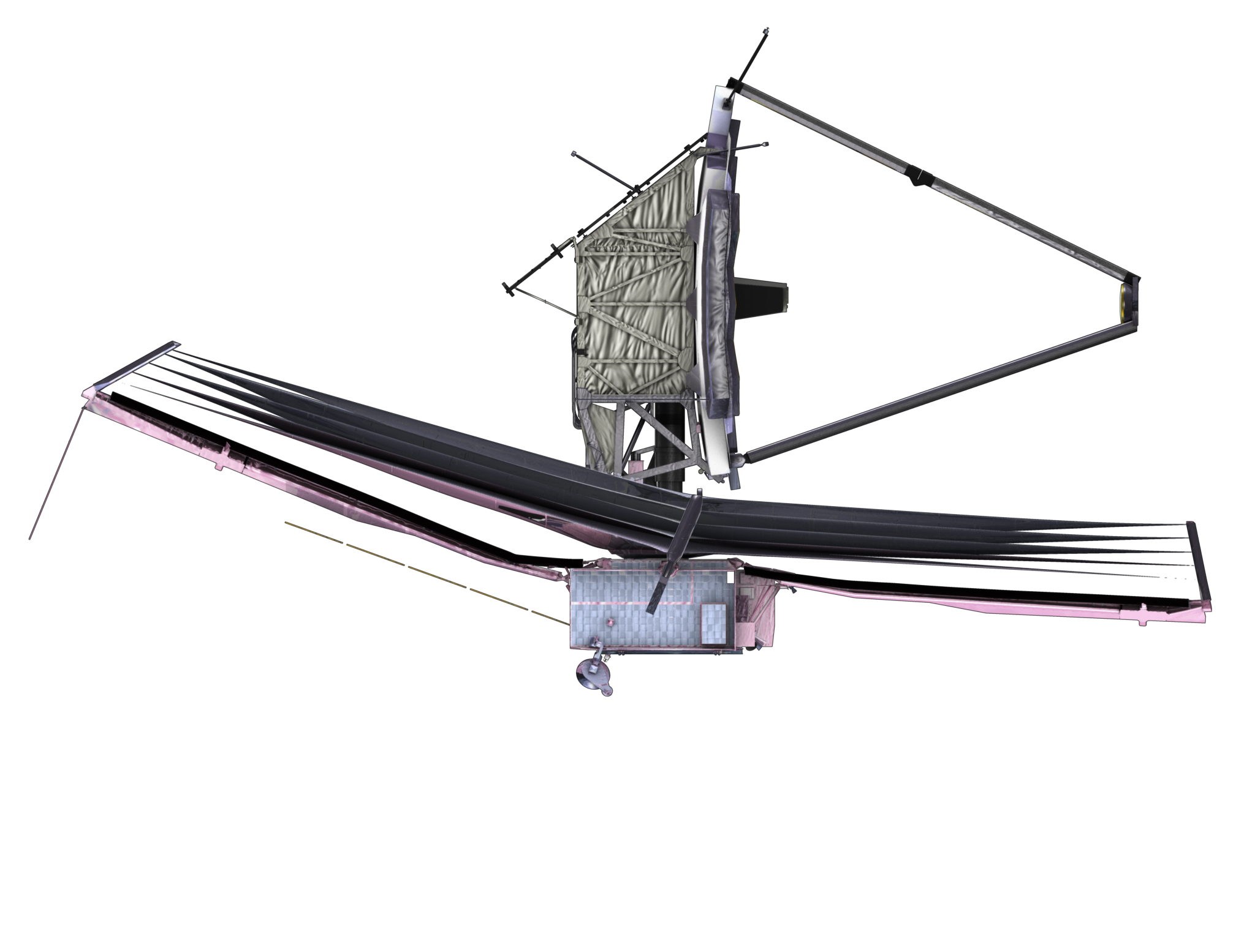
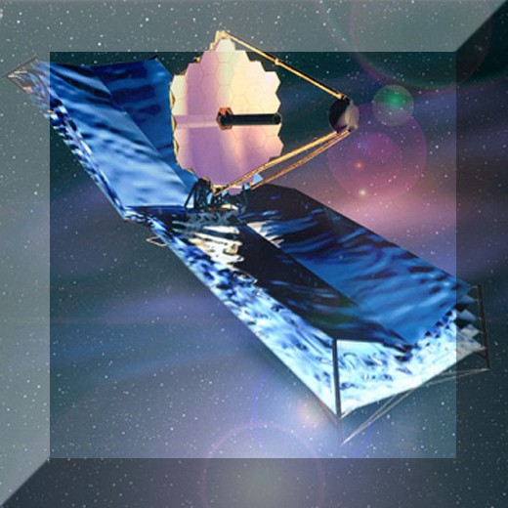
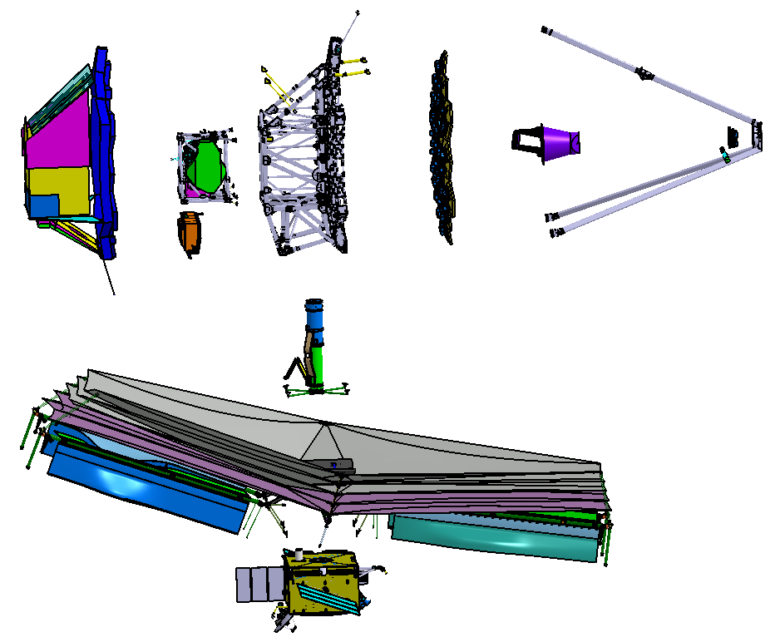
The JWST Observatory Elements and Regions
Integrated Science Instrument Module (ISIM)
Located inside an OTE provided ISIM Enclosure
Contains 4 Science Instruments (NIRCam, NIRSpec
MIRI, FGS / NIRISS)
OTE Backplane
/ ISIM Enclosure
Optical Telescope Element (OTE)
6 meter Tri-Mirror Anastigmatic
18 Segment Primary Mirror
Thermal Region 1
Components cooled to
cryogenic temperatures
Cryogenic Radiators
(Fixed and Deployed)
Thermal Region 2
Components maintained at
ambient temperatures on cold
side of the observatory
ISIM Electronics
Compartment (IEC)
Aft Optics
Subsystem
OTE Secondary
Mirror
OTE Primary Mirror
OTE Deployment
Tower
SS Layer 5
SS Layer 1
Momentum
Trim-Tab
Sunshield (SS)
5 layers to provide thermal
shielding to allow OTE and ISIM
to passively cool to required
cryogenic temperatures
Solar Array
Thermal Region 3
- Components maintained
at ambient temperatures
Spacecraft Bus
Contains traditional
“ambient” subsystems
Notes:
Sunshield is 15m x 19 m and has about 200 Kwatts of solar incident on it. (15 *19 = 285*2/3 square meters * solar constant of 1353 watts/sq meter)
Must attenuate thermal power to about 1 watt
Sunshield Layer 1 is uses a low solar absorptance-to-emittance ratio coating which reflects majority of the visible solar flux. Other layers use reflective IR coatings to channel heat out of the sides.
Layer 2 is a redundant laye for 1 both use a alloyed silicon coating
Others layers use Vacuum Deposited Aluminum
Kapton E is the membrane material (2 mil and 1 mil)
Rough split of mass OTE: 2420 kg, ISIM 1464, SCE 2367, propellant 270kg
Power: ISIM 310 watts , SC Bus about 900 Kw, OTE 50 watts, ISIM Region 1 about 400 mWs, Cryo-Cooler about 400 watts.
Temperatures are roughly aas follows:
OTE PM Surface 40K to 50K
OTE BSF 30K to 80K
OTE BP 40K to 60K
ISIM Radiators: 31K to 33K
Sunshield Layer 5 35K to 132K
Sunshield Layer1 ~400K

Slide 34
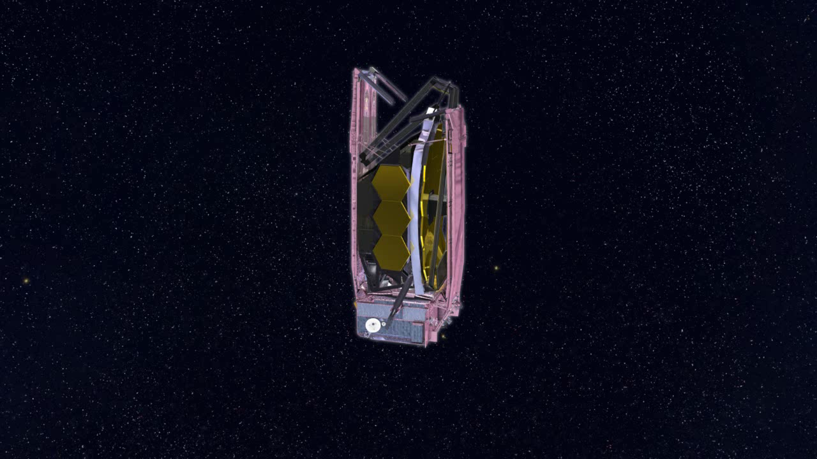
JWST Observatory Deployment
Notes:
Deployments occur over the first 2 weeks of the mission. The solar array is deployed at launch +32 minutes, and the final deployment at about launch +10 days.
The majority of deployments are not time critical. The only one that is so far is the deployment of the solar array.

Slide 35
JWST Mission Orbit and Key Events
Y_{RLP} Axis
MCC-1a Maneuver
L+12 hours
Corrects LV Injection errors
Observatory Deployments
L+2.7 d to L+ 10 d
Sunshield Deployment to
Release of PMSAs and SMA
L+ 6 Months
Commissioning
Complete
Kilometers
Earth
L2 Point
X_{RLP} Axis
Kilometers
MCC-2 Maneuver
L+ 30 d
Trim Maneuver
Moon’s Orbit
Observatory Cool-Down to Temperatures
Sufficient For NIRCam Ops
L+10 d to L + 25 d

Slide 36
JWST Trade Studies
There have been dozens of system and subsystem level trade studies which led to the formulation of the JWST design.
  Many had to be conducted in parallel
  Many were very complex and very pervasive
  Required significant coordination from systems engineering
Among the more significant of these trades:
  Science Instrument Complement
  Thermal Architecture / ISIM Electronics
  Momentum Management
  Mission Orbit Geometry
  Telescope Optics Material
  Data Compression
  Cosmic Ray Correction
  Science Instrument Detector
  MIRI Cooling

Slide 37
Hierarchical List of Major JWST Trade Studies
Mission Trade Studies
Orbit Trade
Momentum Management Trade
Observation Plan Executive Trade
Launch Vehicle Adapter Trade
Science Assessment Team (SAT) Mission Rescope Trades
Encryption / Authentication Trade
Ground Segment Trades
Design Reference Mission Studies
Scheduling Flexibility Studies
Science Operations Studies
Observatory Segment Trade Studies
ISIIM Electronics Compartment Trades
Alternate Backplane Support Trade
MIRI Cryo-Cooler vs Dewar Trades
Sunshield Configuration Trades
OTE / ISIM Interface Trades
Omni Antenna Trade
OTE Deployment Tower Trades
IC&DH to CTP I/F Trade
ISIM Radiator Trades
Stray Light Control Trades
Sensitive Surfaces Protection Studies
Verification / I&T Trades
Plum Brook vs JSC Trade
OTE / ISIM Metrology Trade
OSIM Trade
Observatory Transportation Trade
OTE / ISIM Test Trades
Electrical End-to-End Testing Trade
Contamination Control Trades
ISIM Element Trade Studies
NIR FPE ASIC Trade
NIRCam 3-DOF POM Trade
ISIM Contamination Prevention
Elimination of FGS C&DH Trade
IRSU Trade
OTE Trade Studies
WFSC Trades
PMSA to Backplane Interface Trade
PMSA Be Delta Frame Trade
SCE Trade Studies
Monopropellant vs Bi-Propellant Trade
Spacecraft Structure Trade
Solar Array Drive Trade
Lithium Ion Battery Trade

Slide 38
Coordination of the System Trade Space
Thermal Accommodation Options
SI Options
NIR Detector Options
Deployable
Radiators
FPE Architecture Options
NIRSpec, NIRCam
and FGS InSb Detectors
FPE on BSF Under ISIM
Radiator on –V1
Fixed
Radiator Config.
Lower Power
Full SI Complement
(NIRCam, NIRSpec, MIRI
FGS with TF)
Current FPE
Design
Current Power
(168 Watts)
ICE Box Accommodation
Options
NIRSpec and NIRCam
InSb Detectors and FGS
HgCdTe Detectors
MIRI Cooling Options
Deployable
Radiators
OTE Prescription
Options
Full SI Compliment with
No FGS TF
Cryo-Cooler
FPE on BSF Under ISIM
Radiator High on –V1
Lower R2
Power
ICE Boxes in
R3
NIRCam HgCdTe
NIRSpec, and FGS
InSb Detectors
Fixed
Radiator Config.
Split FPE
Power / HK SC
A/D Region 2
F/20 OTE
NIRSpec MSA
Reduced Plate Scale
84 Watts R2
84 Watts R3
5 Year Life
Deployable
Radiators
Reduced Box
Power
F/16.7 OTE
Full SI Compliment with
Reduced NIRSpec FOV
NIRCam and NIRSpec
HgCdTe Detectors and
FGSInSb Detectors
Cryostat
FPE on BSF Under ISIM
Heat Transported to SCE
Pre-Amp with Longer
Analog Cables
ICE Boxes
in R2
Reduced Life
Fixed
Radiator Config.
Power Duty
Cycling
Full SI Compliment with
Integral Field NIRSpec
NIRCam and FGS
HgCdTe and NIRSpec
InSb Detectors
InSb Option (TBR)
Deployed
Radiators
ASICs on FPAs
To Perform A/D
FPE on Triangular Support
Radiator on +V2
HgCdTel Option
NIRCam, NIRSpec and
FGS HgCdTe Detectors
Fixed
Radiator Config.
ICE and IC&DH Testing Options
OTE Testing Accommodation Options
A.Test Flight ICE and IC&DH
Boxes on SC with ETU’s for
ISIM Testing
Sunshield Stowage
Options
Test Sources at Cass Focus
OTE Segmentation
Options
Phase Retrieval
B.Test ICE and IC&DH
Boxes with ISIM, ETU’s
With SC then Perform Penalty
Test on SC after Final Integration
Proposal SS Stowage
(with Mid Hinges)
OTE Light Thru ISIM
with FP Ref. Sources
OTE Optical
Material Trade
36 Segment 29.4m²
Aperture (No Hexapods)
Current Reference C
onfiguration as of 6-1-03
SS Stowage
(without Mid Hinges)
Relay Mirror
C.Test ICE and IC&DH
Boxes with ISIM, Delay SC
Environmental testing Until After
Boxes are Integrated
ULE
Relay
Optics
Hexapods
Proposal SS Stowage
(with Mid Hinges)
Beam Splitter
30 Segment 25m²
Aperture
Knife Edge Test
D. Electrically Mate the SCE to
OTE-ISIM for Cryogenic Testing
At Plum Brook
No Hexapods
SS Stowage
(without Mid Hinges)
Afocal-Athermal
Relays In
OTE-ISIM Field
Removable
Relays
Be
E. Test ICE&IC&DH with ISIM
At GSFC, then delive ICE to SCE
And use EU ICE boxes at Plum Brook
Reduced Volume ISIM
With OTE Shifted in Fairing
Flight Relays
18 Segment 25m²
Aperture (Hexapods)
Reduced Volume ISIM With
OTE in Proposal Location
SI Image Processing Only
F. Provide 2 sets of Identical Flight
ICE and IC&DH Boxes
Combination of Above Solutions
H. Use flight ICE and IC&DH boxes for ISIM
cryo performance tests. Replace with EU boxes
for ISIM acoustics, modal, vibration and TV.
Install flight boxes into SCE for SCE tests.

Slide 39
Thermal Architecture / ISIM Electronics Trade
Early architecture trades considered where to locate the science instrument processing electronics.
  Options are shown on the figure below.
  If the boxes were too far from the SI’s electronics noise would be too high
The trade concluded that ambient boxes needed to be located on the cold side of the observatory.
  The solution is shown on the right
  If these boxes were located in the warm spacecraft we would NOT be able to test the final ISIM with its electronics without breaking the harness connections. THERE ARE OVER 2500 WIRES!
Selected Option
JWST Science Instruments
Cryogenic ASIC A-to-D
Converters
Processing Electronics
on the Hot Side of the
Observatory
Cryogenic Processing
Electronics on the Cold
Side of the Observatory
Combination of
Cryogenic and
Ambient Electronics
ISIM Electronic Compartment (IEC)
Houses 10 electronics boxes that operate at ambient temperatures
Total dissipation 225 watts
Must reside in proximity to the ISIM instruments to limit electronics noise
Ambient Processing
Electronics on the Cold
Side of the Observatory

Slide 40
JWST Systems Engineering
Science Objective:
Detect and Investigate
the First Light Sources
Study the Assembly of
Galaxies Since First Light
Study the Birth of Stars
Study the evolution of
Planetary Systems
Formulate Mission Requirements
Sensitivity
Image Quality and Resolution
Field Of View
Data Throughput
Observing Efficiency
Design the
System
WFE Budget
Power Budget
Mass Budget
Systems Analyses and
Performance Assessments
Risk Management and
Technology Development
Verification of the
“As Built” System

Slide 41
Systems Analysis and Performance Assessment
Systems Analyses and
Performance Assessments
Performance assessments of the observatory are accomplished with analytic mechanical, thermal, control and optics models.
Critical performance metrics such as thermal distortion, jitter, Line of Sight Errors and stray light levels requires multiple models for their computation. Integrated Modeling refers the process which coordinates these models. The coordination includes:
  Physical configurations
  Boundary Conditions and Cases
  Uncertainty Factors and model accuracy
The modeling process can be time consuming and so it is performed in cycles similar to the process of “Load Cycles”.

Slide 42
Integrated Modeling
Guidelines for model conventions are in the “Math Models Guidelines Document” (NGST D36124)
Inputs
Outputs
Integrated Modeling
Torque Models
Torque Tables
Disturbances
Dynamics and
Controls Models
MATLAB/Simulinkb
Observatory
Control System
Design
LOS Jitter
Optical
Modeling
Code V
Finite Element
Generator
PATRAN
Structural
Model
NASTRAN
Point Spread Functions
And Stabilities
Observatory
Optical Design
CAD Models
CATIA
Optical Transfer
Function Model
IPAM
Optical
Modeling
Code V
Observatory
Mechanical
Design
Stray-Light Models
ASAP
Stray-Light Levels
Observatory
Thermal Design
Thermal Models
TSS / SINDA
Interpolator
PATRAN
Stowed Frequencies
& Strength Margins
Field of Regard
Temperature Maps

Slide 43
JWST Integrated Modeling Cycles
Establish Goals
For Cycle
Determine System
Configurations to be
Analyzed
Construct / Debug
System Models
Freeze
Models
Run
Analyses
Review Results
Prepare for
Next Cycle
Modeling Cycle
Begin Planning For
Next Cycle
SDR-1 Cycle
SDR-2 Cycle
SDR-3 Cycle
SDR-4 Cycle
SRR
SDR
Analytical models are run in cycles (much like the familiar “Load Cycles”)
  Typically 2 to 3 cycles between major reviews, each taking between 3 to 6 months
These cycles address system level performance issues
  Used for major system level trade studies
  For Requirements / Architecture Validation
  In the later part of the Program for verification
The pedigree of the models and the specific configuration of the architecture they represent is managed by the Integrated Modeling Working Group

Slide 44
List of Primary TPMs

Slide 45
JWST Systems Engineering
Science Objective:
Detect and Investigate
the First Light Sources
Study the Assembly of
Galaxies Since First Light
Study the Birth of Stars
Study the evolution of
Planetary Systems
Formulate Mission Requirements
Sensitivity
Image Quality and Resolution
Field Of View
Data Throughput
Observing Efficiency
Design the
System
WFE Budget
Power Budget
Mass Budget
Systems Analyses and
Performance Assessments
Risk Management and
Technology Development
Verification of the
“As Built” System

Slide 46
Technology Development and Risk Management
Risk Management and
Technology Development
Systems Engineering and Product Engineering identify areas in need of Technology Development and formulate plans to mature them, according to the NASA schedule for Technology Readiness Level (TRL)
  Plans are documented as Technology Development Plans
Systems Engineering participates in a continuous process of Risk and or Issue Identification and Risk Management.

Slide 47
JWST Technology Readiness Metric

Slide 48
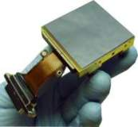
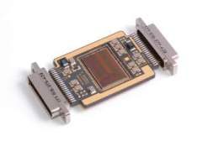
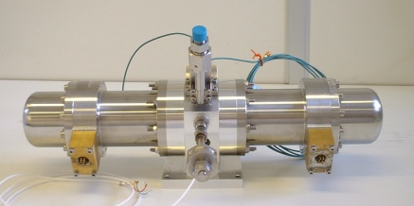

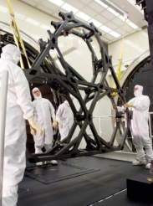


Critical Technology Development Items
JWST adopted a strategy of early development of critical technology items.
Ten critical items (Shown below and on the right) were initially identified and programs to mature their TRL were initiated.
JWST instituted a Technology Non-Advocate Review (T-NAR) in January 2007.
  Nine of the ten Items were assessed to be TRL 6 or higher at this T-NAR.
  All items were assessed to be at TRL 6 by the Program NAR which was held in March of 2007.
NIR Detector
Cryogenic ASIC
MIR Detector
Microshutter Arrays
Heat Switches
MIR Cryo-Cooler
Wavefront Sensing & Control
Large Cryogenic Composite Structures
Primary Mirror Segment
Sunshield Membrane Material

Slide 49



Comparison of JWST to HST
System Challenges
JWST
Challenges
JWST Deployments
Over 6m dia. Into a
5m LV Fairing
½ the mass of HST
Over 6.5 times the
light collecting area
of HST
Order of magnitude
colder than HST.
Roughly 4000 kg
needs to be cooled
below 50K
Notes:
The aperture of HST is computed as follows:
Area of 2.4 m dia primary = 4.524 m²
Secondary Mirror Obscuration = 0.493 m²
Obscuration from 3 Mirror Pad Supports = 0.132 m²
Estimated 2% dust coverage = 0.078 m²
Light Collecting Area = 3.821 m²
The difficulties of a cryogenic mission should not be overlooked. For example things manufactured in ambient will distort and change their shape when cooled down to cryo. That means that we had to figure and polish the mirrors to be distorted at ambient so that when they cooled down, they would undistort to the correct shape.
Illustrate with how much contraction we experienced in the primary mirror
Material selections

Slide 50
Cryogenic Design Challenges
0.398 W
0.265
0.809 W
0.014
LEGEND
ISIM Radiators
(XXX)
Heat Dissipation [W]
0.376
0.057
Absorbed Solar Heating
0.003
0.088
Reflected Solar
ISIM Bench, Instruments
Conducted Heat
PMBA, PMSA, AOS, SMSS (0.001 W)
Detector Dissipation
0.407
OTE/ISIM MLI, PTR, Diag Shld
Net Radiated Heat Between Two Groups
0.072
The observatory thermal architecture must manage hundreds of thousands of watts on its hot side and hundreds of milli-watts on its cold side.
Milli-watt errors on the cold side will affect detector temperatures
0.045
Heat Radiated to Space
Heat Flows are in Watts [W]
0.45
0.74
0.078
0.083
27.8
7.21
14.7
0.009
0.185
IEC & MLI/SLI
212
12.6
(225 W)
1.86
4.6
5.81
DTS / Harness
16.5
0.27
1.8
17.2
126
142
1,980
Layer 5
2,040
90,290
Layer 4
4.90
5.97
Layer 3
953
Layer 2
Spacecraft Bus & Core Region
20,080
(Bus Power 1020 W)
Layer 1
20,011
19,224
91,380
87,785
Solar Input 218, 400 W

Slide 51


Approach to Cryogenic Challenges
Provide robust thermal margins for uncertainties and verification margin.
Characterize and optimize the design of the sunshield.
Core Thermal Test
Focus Area
Design a well insulated IEC which directs its heat load in the proper directions.
Characterize and optimize the design of the Core area.

Slide 52



1/3 Scale Sunshield Model Validation
Thermal balance tests of a 1/3 scale engineering model of the sunshield were performed in December 2009 to correlate the thermal models.
The test went well, but there was a mechanical failure one of the pulleys that held the layers in place, which corrupted some of the measured data.
Despite the pulley anomaly, the level of correlation of the test data and model predicts translate to roughly 6.6% in terms of cryogenic radiator margin.
T [K]
1/3-Scale Sunshield Thermal Model
1/3 Scale Sunshield Test Article Being
Loaded in the Thermal Chamber

Slide 53


Core Thermal Balance Test
Thermal balance tests of a full scale engineering model of the core region were performed in May 2009 to correlate the thermal models of this region.
The design performed as expected and even with ambient IEC with > 200 watts of dissipation, cryogenic temperatures were achieved.
The level of correlation of the test data and model predicts translate to roughly 6.2% in terms of cryogenic radiator margin.
T [K]
Core Test Article Being Loaded into
the Thermal Vac Chamber
Core Thermal Model

Slide 54


IEC Directional Baffle Test
+V3
Tests to confirm the directionality of the IEC radiator baffles were conducted in Spring of 2011.
The test results demonstrated that the baffles behaved as predicted for emission directionality.
10~25°
+V1
~20°
Bolometers
Thermal Emission vs Angle
Baffles on
Radiator
Panel
IEC Baffle Test Set-Up

Slide 55
Vibration Damping at Cryogenic Temperatures
Ambient
Cryogenic
Response of Key
Optical Elements
Degrade Image Quality
Response of Key
Optical Elements
Increases
Spacecraft Disturbance Source
Reaction Wheels
Cryo-Cooler Compressor
Spacecraft Disturbance Source
Reaction Wheels
Cryo-Cooler Compressor
Mechanical vibrations from sources such as Reaction Wheels or Cryo-Cooler Compressors propagate thru the structure to excite modes of the optical elements. The response of these elements degrades image quality.
At ambient temperatures, most structures have vibration damping ratios of roughly 0.3 to 0.2% of critical damping
At cryogenic temperatures the damping ratio of structures decreases dramatically, to levels roughly 0.05% of critical damping. This results in increased image quality degradation.
Careful vibration isolation and additional provisions to increased damping are required.

Slide 56


Backplane Stability Test Article (BSTA)
The BSTA is a full scale 1/6th substructure cut out of the flight PMBSS design, shown on the right.
The BSTA demonstrated fabrication techniques and was subjected to:
  Thermal Stability Tests
  Cryo Damping Measurements
Test results were used to correlate / anchor analytical models used to predict thermal cool down structural stability and vibration propagation.
Damping measurement results are shown below.

Slide 57

Magnetic Dampers
Analytic modeling of the deployed dynamics of JWST identified modes which had the greatest impact to Line of Sight (LOS) or Wavefront Errors (WFEs).
  Not surprisingly motions of the secondary mirror relative to the OTE have significant impact to LOS and WFE.
Incorporating Tuned Magnetic Dampers (TMDs) to the Secondary Mirror Struts provided the damping to reduce these errors.
TMDs work by allowing a conductor to move in a magnetic field provided by permanent magnets. Eddy currents in the conductor induced by this movement set up an Electromotive Force (EMF) which opposes this motion. (See figure on lower right from Bronowicki, Brennan and Simonian¹).
Unlike visco-elastic dampers, these TMDs have no issues operating at cryogenic temperatures.
TMDs Placed on the Secondary
Mirror Struts at these Locations
Basic Operation for Magnetic Dampers

Slide 58
JWST Systems Engineering
Science Objective:
Detect and Investigate
the First Light Sources
Study the Assembly of
Galaxies Since First Light
Study the Birth of Stars
Study the evolution of
Planetary Systems
Formulate Mission Requirements
Sensitivity
Image Quality and Resolution
Field Of View
Data Throughput
Observing Efficiency
Design the
System
WFE Budget
Power Budget
Mass Budget
Systems Analyses and
Performance Assessments
Risk Management and
Technology Development
Verification of the
“As Built” System

Slide 59
Verification
Verification of the
“As Built” System
The verification program proves that the “as-built” system meets its requirements in a flight-like environment and is ready for deployment.
  Verifies both performance and workmanship.
Ultimately the verification process produces a complete set of Requirements Verification Reports (RVRs) for each requirement or requirements set proving the systems compliance.
  These reports will consolidate the results of Inspections, Tests and Analyses.
  A set of detailed Expanded Verification Matrices (EVMs) and “Thread” Roadmaps show the necessary interplay of these Inspections, Tests and Analyses.
The overall verification process is documented in a System Verification Plan, which shows the coordination of these activities with the Integration and Test Program.

Slide 60

Challenges of JWST System Tests
To test the 6 m diameter cryogenic telescope we need either another 6 m cryogenic telescope as a test source or a 6 m cryogenic test flat.
To simulate the thermal environment, a “black” shroud colder than 30K needs to enclose the cold side to make sure thermal emission from the observatory doesn’t bounce back.
  Requires a two stage shroud system, GHe and LN₂
Thermal radiation from the Observatory’s hot side has to be “strictly” prohibited from leaking to the cold side of the observatory
  Careful blanketing and a large chamber to minimize bounces of thermal radiation. (Small Fill Factor)
Finally the observatory must be supported with gravity off-loaders to maintain its 0-g shape, particularly the sunshield.
  The off-loaders cannot introduce excessive radiative or conductive perturbations that alter the thermal environment.
The vacuum chamber must be very large, the Ground Support Equipment complicated and the Optical Test Equipment as demanding as the flight telescope.
Vacuum Vessel
Collimator
Telescope
Support
Structure
& 1-g
Off-Loaders
Thermal
Photons
Small
Conductive
Heat Flow
GHe Shroud
(23K)
Thermal
Blankets
LN₂ Shroud (77K)
Observatory Level Testing is Not Practical

Slide 61



Verification Using Analytical Models
The verification of the on-orbit performance of JWST will involve analytical models which are correlated / anchored to “as-built” hardware by tests at lower levels of assembly.
  This proves that what is mathematically modeled is what was actually built.
Observatory system models are then assembled from these lower level models. The observatory level models are then correlated as practical to the as built observatory by system level tests.
  This proves the interfaces are modeled correctly.
The correlated models such as those shown on the right will be used to predict and verify the on-orbit performance of:
  Thermal Performance
  Optical Thermal Stability
  Dynamics
  Stray Light
Tests at high levels of assembly will be conducted to verify “workmanship” and behavior of critical interfaces
Structural Dynamics Models
Stowed
Deployed
Thermal Models
Stowed
Deployed

Slide 62
From EVM Entry To EVM Metric
A piece of the Observatory Spec Expanded Verification Matrix
Illustrating verication flow of OBS-145 “Command Verification”
When the 3.7-level
RVR is written
When the Step
Is performed
When the 3.2-level
RVR is written
Verifies | Requirement Text | Verification Step | Ver Type | Verification Description | Verification Activity | RE POC | RVR | Step Ver Pt | Comp Ver Pt | Final Ver Pt
OBS-145 Cmd Validation | The Observatory shall validate all commands prior to execution.
OBS-145 Partial Trace Verify @ OTE lvl | OBS-1846 Cmd Verification/Validation OTE-322 Cmd Verification/Validation For all cmds, prior to execution, the OTE shall perform tests associated with the CCSDS cmd protocol, verify checksums if used, and verify that the executable portion of the cmds met applicable rqmts for structure | OTE to verify OTE-322 | Partial Verification | See verification for OBS-144 | ADU Performance Test | Rich Rifelli | RVR | OTE SO | OTE SO
OBS-145 Partial Trace Verify @ SC lvl | OBS-396 Cmd Verification/Validation SC-430 Cmd Verification/Validation For all cmds, prior to execution, the SC shall perform tests associated with the CCSDS cmd protocol, verify checksums if used, and verify that the executable portion of the cmds met applicable rqmts for structure | SC to verify SC-430 | Partial Verification | See verification for OBS-144 | JWST-CDH-101 CCSDS COP-1 Protocol (Cmd Decoding & Validation) | Mallen/Arisumi | RVR | SC I&T | SC I&T
OBS-145 Partial Trace Verify @ ISIM lvl | OBS-584 Cmd Verification/Validation ISIM-275 ISIM Cmd Verification/Validation For all cmds, prior to execution, the ISIM shall perform tests associated with the CCSDS cmd protocols, verify checksums if used, and verify that the executable portion of the cmds met applicable rqmts for structure | ISIM to verify ISIM-275 | Partial Verification | See verification for OBS-144 | ISIM-TST-20701 ISIM SFT | Lionel Mitchell | RVR | ISIM I&T | ISIM I&T
OBS-145 Partial |  | OBS I&T | Partial Verification | Final verification is OBS I&T | GSEG-1 portion of OBS I&T | Mallen/Arisumi |  | OBS I&T
OBS-145 Validate |  |  | Validation | Validate ISIM-275 during JSC Testing | JSC | Lionel Mitchell |  | JSC Val
OBS-145 Full |  |  | Full Verification | SET: document RVRs for OTE-322, SC-430, ISIM-275 complies SET to generate RVR after OBS I&T that compliance was established with OTE, SC, ISIM and Ground Segment. | Review of Records Review of OBS I&T results | Rick Sabatino | RVR | OBS I&T |  | OBS I&T

Slide 63

Image Quality/WFE Verification Roadmap
Notes on the Roadmap
Shows Data used in final as-built models – NOT a chronological flow
  For example, shows one 1-g and 0-g model. In reality these models will be developed in parallel and both alignment and figure data will be updated as it becomes available
Analysis is generally needed to convert test data into the form needed for input into the model. This detail is not shown
Assume data from each test/analysis includes both measurement data and uncertainty data

Slide 64

JWST Telescope Testing
All optical components, Primary Mirror (PM), Secondary Mirror (SM), Tertiary Mirror (TM) and Fine Steering Mirror (FSM) are individually tested.
The figure of the primary mirror is verified by testing with a Center of Curvature Interferometer (CoC IF)
The performance of the “conic” match of the PM, SM and TM is verified by using three 1 meter auto collimating flats, and a pass and ½ test from Forward Sources located near the cassegrain focus.
Separate sources at the cassegrain focus pointing Backward test the optical performance of the Aft Optics Subsystem.
The physical layout of this test equipment is illustrated on the right of the ray diagram
This complement of tests verifies that the flight telescope can achieve the required performance with more than 100% of the range of all the actuators.
CoC IF
Auto Collimating
Flat Mirror
SM
Forward Source
Backward Source
FSM
PM
TM
Focal Plane

Slide 65

Optical Testing at the Johnson Space Center
Chamber Isolator Units
6 isolators to limit external vibration sources from impacting the optical test results
Controls vibration to near flight levels
Center of Curvature Optical Assembly (COCOA)
Contains multi-wavelength interferometer system that allows the 18 segment primary mirror (PM) to be phased and the figure adjusted with the flight actuators
Hexapod system allows the alignment system to track the PM during testing
Contained multiple features to assist in the alignment of the PM
Contains absolute distance measuring interferometers to track mirror distortion during thermal testing
Auto collimating Flat Mirrors (ACFs)
Three, 1.5m flats that provide the ability for end-to-end optical testing through the telescope optical chain and into the flight instruments
Provides the ability to complete a wavefront sensing and control exercise.
Cryo Position Metrology (CPM)
Four photogrammetry systems on rotating booms inside thermal and pressure controlled canisters
Allows measurements of hardware to 100 microns inside the cryo cavity
AOS Source Plate and Cable Support
Inward light sources to allow the tertiary mirror to be evaluated against the flight ISIM instrument suite
Outward sources that allow the entire optical train to be evaluated and a wavefront sensing and control system to tested
Space Vehicle Thermal Simulator (SVTS) and Sunshield Simulator
Provides interfaces for electrical and thermal hardware that attaches to the flight spacecraft
Simulates the flight spacecraft thermally to replicate the flight thermal conditions
Deep Space Edge Radiation Sink (DSERS)
Deep space thermal simulators allow the flight radiators operate in flight configuration
Absolute Distance Measuring (ADM)
Lieca ADM allows the PM radius of curvature and conic to be measured at cryo.

Slide 66





JWST Integration & Test Flow
SC Avionics Tests
SC Panel I&T
SC Core Structure I&T
SC Propulsion I&T
Sunshield Component Tests
Spacecraft Bus /Sunshield I&T (NGST)
2016
EP Sunshield Observatory Core
& Sub-Scale Sunshield Thermal Tests
Cryo-Cooler I&T
Pathfinder OTE I&T
AOS I&T
Observatory
I&T (NGST
SMA I&T
PMSA I&T
2018
DTA I&T
Flight OTE
Ambient
I&T (GSFC)
OTE- ISIM
I&T (GSFC)
OTE-ISIM
Cryogenic
Testing (JSC)
SMSS I&T
2016
2017
Flight OTE Structural I&T (NGST)
Spacecraft Element I&T Activity
Cryo-Cooler I&T
Optical Telescope Element I&T Activity
Science Instrument I&T
ISIM Element I&T Activity
ISIM Structure
2012
ISIM I&T
Cryo-Cooler I&T Activity
Observatory I&T Activity
IEC I&T
2014
Notes:
JWST too big to fully test at the observatory l;ike normal observatories, had to be tested analytically and final verification done with analytical models

Slide 67
Program Status

Slide 68








Observatory Status
ISIM Structure
OTE Backplane Structure
Science Instrument
NIRSpec
FGS
Telescope Optics
NIRCam
MIRI
Sunshield Membranes
Notes:
All the optics are 100% done and satisfy their optical requirements. Each is generally good to about a wavefront error of about 25 nm each. (A human hair is about 180 microns in diameter so these mirrors are good to about 1.4 x 10-4 of a human hair, one and one half ten thousandths!)
The telescope backplane, the structure that supports the mirrors is about 75% complete. Being manufactured at ATK in Utah.
The ISIM structure, the structure that holds all the science instruments precisely in place is about 90% done. The structure is being manufactured and tested at GSFC.
All the science instruments are scheduled to be delivered by the end of 2012.
NIRSpec: Integration, vibration, EMC, and first cryo cycle completed.
MIRI: Optical module vibration, alignment, and final cryo-vacuum testing completed. Delivery date to GSFC April 2012.
FGS: Completed vibration and EMC/EMI testing. Currently in cryovac testing. Expected delivery to GSFC June 2012.
The sunshield is about 40% complete shown is Layer 3 template
The spacecraft bus was intentionally left to last, since it is the least risky of all the elements.

Slide 69

Six PMSAs in the Last XRCF Cryo Test, #8
Viewers look on from the Gallery as the test stand is removed from the carriage in preparation for removal of the PMSAs, packing and return to BATC.

Slide 70


Mirror Segments in Their Storage Containers

Slide 71
JWST Flight Science Instruments
Mid Infrared Instrument (MIR)
Fine Guidance Sensor (FGS)
Near Infrared Camera (NIRCam)
Near Infrared Spectrometer (NIRSpec)

Slide 72

Sunshield Membranes (1 of 2)
Template Layer 5 in test stand at full tension (3 x flight load) for shape measurements
Notes:
72

Slide 73

Modifications to the JSC Vacuum Chamber

Slide 74
Closing Thoughts on JWST Systems Engineering

Slide 75
Personal Lessons Learned from JWST (1 of 3)
Tactics for Leading Large Teams:
  Need to delegate to trustworthy leads.
    I believe in having a redundant deputy
  Need to find correct balance between a flat org and a hierarchical
  Do not underestimate the needs of the bureaucracy, as well as management, public and independent review visibility.
  Need efficient communication channels. (More is not always better!) Make sure the mechanisms are in place to have the CORRECT info communicated.
  Get the team into a temporal cadence. (regular meetings, status reports, etc)
  Find ways to minimize stove-piping.

Slide 76
Personal Lessons Learned from JWST (2 of 3)
System Engineering Challenges / Practices:
  Cost efficiency, and operating in cost constrained conditions.
  Getting accurate cost data to support “good” engineering decisions
    Avoiding biased estimates so that parties get the answers they want
  Verification will rely less and less on tests and more on modeling. Need to establish guidance. (required MUFs, burn downs, best practices, etc.)
  Have sanity checks to check analytical models. Try to do these yourselves.
  Carefully consider cross-check tests as part of your test program.
  The test facilities and ground support equipment for jobs as big as this are system onto themselves. They require considerable systems engineering.
  Have sanity checks to check analytical models. Try to do these yourselves.

Slide 77
Personal Lessons Learned from JWST (3 of 3)
Program Management:
  Relationship with the Program Manager, must balance program direction and cooperation, with technical independence.
    We are lucky here at GSFC in as much as most of the Program Managers have excellent engineering backgrounds.
  Contractor management is an art, and very dependent on the contractors involved. Do not underestimate its difficulty.
  International collaboration is the way of the future. Must be cognizant of ITAR, foreign norms and engineering practices, etc.
Pure Technical (The “if I could do it again wish list”):
  Would have required articulating Pick-Off Mirrors on all the science instruments.
  Would request that NASA establish environmental standards for the L2 environment, in particular the plasma environment.

Slide 78


Telescopes Then and Now
In 1970 when most of the senior scientists and engineers on JWST were growing up, the Mount Palomar Telescope was the largest telescope in the world.
Located in hills of San Diego County, California.
Its massive primary mirror was 5.1 meters in diameter, and the telescope was approximately 17 meters long.
The telescope and its mount weighed in at 545 tons or 495,000 kg.
Forty one years later, we find ourselves making JWST which will be bigger than Palomar and launched into outer space!
Located beyond the moon, 1.5 million kilometers from the Earth.
Its primary mirror will be 6.1 meters in diameter, and the telescope length will be 8 meters
JWST will weigh 6530 kg, (~1 /100 of the Palomar Telescope)

Slide 79
Comparison To the 10 m Keck I Telescope
When one factors in the
light lost from the
atmosphere, the Keck I
Telescope’s light
collecting power is ~50%
less at a wavelength of 2
microns. Therefore its
equivalent aperture in
space is:
The 10 meter Diameter
Keck I Primary Mirror
The Keck I Telescope on Maunea Kea
Summit in Hawaii
The 5 meter Diameter
Equivalent Keck
The 6.3 meter Diameter
JWST Primary Mirror

Slide 80
Summary
The James Webb Space Telescope will be one of the premier astronomical tools of the next couple of decades, with the potential to address some of the most fundamental questions before us.
It is truly a first of its kind space observatory and has offered the Systems Engineering Team some very unique and difficult challenges.
  Cryogenic Design of Large Observatories
  Constrained Technical Resource (aka Mass)
  Verification by Analysis
  In a very real sense JWST will re-write the books on astronomy AND engineering of future space observatories.
  I consider myself very lucky to be a part of this Team and this Program!

Slide 81
Possibles

Slide 82
Typical Trade Study Plan
Updates from Other
Concurrent System
Trades
-BSF Trade
-Sunshield Trade
-ISIM Enclosure Trade
Jan 15, 2004
April 15, 2004
July 15, 2004
Document Study
Results to Date
In EM.
Status of models
for each option
-Resource
Allocations for each
Select Most
Likely Option
for Cycle 1
Development and
Define Initial
Trade Space for
Cycle 2
Cycle 1 Analysis
Cycle 2 Analysis
CAD Layout
Thermal
Analysis
Cycle 1 Option
Upgrade
Mass Props
Volume / Layout
Launch Locks
etc
Optical
Analysis
Review of Cycle 1
Results, Select Cycle
2 Trade Options
Cycle 2 Review
Final Selection
Structural
Analysis
Cycle 2 Alternate 1
Controls
Analysis
Cycle 2 Alternate 2
Initial Trade Space
IPT Assessments
Refine Cycle 2
Trade Space
-Eliminate options
From initial trade space
Preliminary Development
Of Cycle 2 Trade Space
Cycle Review Products
Feb 28, 2004
Design Analyzed
-CAD Models
-Thermal Design / Models
-Structural Design / Model
-Resource Allocations
-Schematics
Results of Analysis
-Thermal Margins
-Structural Margins
-WFE and WFE Stability
-LOS Performance
IPT Assessment
-Costs
-Schedule
-I&T Impacts / Testability
-Risks

Slide 83

Factors Driving JWST Momentum Management
The large sunshield, observatory attitude changes, and shadowing effects conspire to produce unbalanced torques which allow significant momentum accumulation.
  Sunshield geometry is designed to minimize momentum accumulation
  Sunshield has a +5° on-orbit adjustability for further minimization
  Momentum accumulation (Nms/day) is plotted as a function of Roll and Pitch attitude as shown lower right. (Torque Tables)
  For a given RWA size this drives unload frequency.
In order to avoid plume impingements on the cold side, thrusts are only made away from the sun
  Therefore momentum unloads are not done by means of a pure couple, and therefore impart a residual ΔV disturbance
In order to perform orbit determination, the observatory must have limited disturbances in a 21 day period. This limits momentum dumping:
  1 dump in this period between days 4 and 17
  Remaining momentum dumped at day 22 just before station keeping
Since orbital perturbations resulting from the interim dump are naturally amplified over time and cannot be corrected when they occur, this dumping impacts the stationkeeping ΔV budget
+5° adjustability
Roll
Pitch
Solar Pressure
4.62 x 10⁻⁶ N/m²

Slide 84
Momentum Management Studies (1 of 2)
Momentum Management Working Group performed a trade study to consider methods to address momentum management.
  Study concluded in October and results documented in Report 05-JWST-0402
Study used best available observatory configuration at that time, realizing that analyses would need to be repeated as observatory design evolved
Teams Recommendations:
  Increase observatory momentum storage capacity by allowing RWAs to run thru zero
    This increases capacity from 40 Nms to 123 Nms
    Analysis indicated jitter and dynamic WFEs were within spec even at low wheel speeds except for isolated “poke-thrus”, as shown on right
  Formulate specific requirements for momentum management in order to allow scheduling to be workable
  Modify ΔV and propellant budgets to allow one 40 Nms momentum dump in the 21 day orbit determination period
Teams Recommendations (Cont):
  Hold option to unload momentum components with yaw thrusters in a true “couple” configuration if needed.
  Hold option to incorporate magnetic dampers on the cold side of the observatory to mitigate jitter risks if needed.

Slide 85
Momentum Management Studies (2 of 2)
Studies were conducted by the STScI as part of the MMWG to determine requirements for observatory torque which would allow minimization of momentum unloads via observation scheduling
  A scheduling metric was defined, the P factor as shown to the right
  In random walk simulations, visits could be manageably scheduled to reduce momentum build up when P<0.5
  From these studies 2 limits on the RMS torques were defined
    LV1 and LV4 as shown in figure on right
Further studies by STScI indicated sensitivity of scheduling effectiveness to the roll offset
  Offset = Roll value of min RMS torque
    A non-zero roll offset is caused by observatory asymmetries relative to the V1-V3 plane
  Studies indicated offsets larger than 1.5° significantly degraded scheduling effectiveness
Proposed requirements for observatory torque:
  LV1 < 8.6 Nms/day
  LV4 < 11.8 Nms/day
  Roll Offset < 1.5°
-4
-1
+1
4
LV1 = RMS Torque (Nms/day) over a +/-1° range
LV4 = RMS Torque (Nms/day) over a +/-4° range

Slide 86
First Cut at Observatory Design to LV1 and LV4 Requirements
Following the Momentum Management Trade Study, design changes were incorporated into the observatory as part of the SDR-3 analysis cycle.
  Elimination of the MIRI Dewar
  Sunshield shape changed to have straight edges to solve stray light concerns
  Observatory CG box enlarged based on a preliminary tolerance assessment
  Sunshield shape constraints modified, including boom length and containment shell angles
Preliminary results of torque assessment was presented at the Sunshield Concept design Review on 12/8/05
  LV1 = 13.65 Nms/day and LV4 = 14.53 Nms/day
  Since then adjustments of sunshield parameters have been identified which lower these values to 10.22 Nms/day and 11.49 Nms/day respectively.
  Further degrees of freedom are still to be exercised, among them redefinition of the allowable volume for the observatory CG
    The Momentum Management Trade sensitivity studies are being used to determine the optimum set of “knobs” to turn to keep torque at controllable levels

Slide 87
The Mass Challenge

Slide 88
The Observatory Mass Issue
The JWST Project has faced a mass challenge since its inceptions, however in late 2011, mass increases due to unexpected high probability threats (Pendings) and lower probability threats (Potentials) started to be indentified:
  Spacecraft Bus increases from harness
  Mass impacts due to CLA5++
Although the Project was carrying 217 kg of mass reserve, these increases had the potential to decrease this to unacceptable levels if uncorrected.
A series of mass reduction activities was initiated to address these threats and to lower overall observatory mass.
  Mass savings greater than 200 kg was required at the start of this effort.
The effort concluded in April of this year. Necessary mass savings and threat mitigation was achieved and as of today the JWST observatory is 101 kg under its mass allocation of 6456. In addition to this the Project Office is holding 164 kg of mass reserves.
This mass savings was achieved WITHOUT ANY LOSS OF PERFORMANCE or INCREASE to RISK.

Slide 89

Recent Mass Trends

Slide 90

Long Term Trends for JWST Mass Margin

Slide 91
Mass Control Methods that Helped
A realistic Mass Control Plan.
A Mass Control Board to make sure that the realistic estimates of the mass and High and Low Probability mass threats are always known and reviewed.
When systems trades are performed make sure they do not close too early.
  Try to coordinate trades so that systems engineering has a menu of options to maximize mass savings and minimize systems performance impacts.
Have a notional / “strawman” plan for the release of System Mass Reserves.
  The first one to mass trough may not always be the highest risk.
  Look at the history of mass growth of other programs.
Sensitize the team to keep an eye out for opportunities. The largest mass saving came from an area where mass growth was expected, the RTG effort.

Slide 92
Engineering Challenges Ahead
The Critical Design Review (CDR) of the Spacecraft Bus is scheduled for December of this year. The final spacecraft subsystem CDRs are finishing up now, as are the system level analyses to support the Bus CDR.
  Challenges to spacecraft pointing performance are being identified and addressed. These issues were not unexpected.
The Project is entering the Verification and Testing Phase.
  There will undoubtedly be issues problems uncovered.
  The engineering team is preparing the analytical models necessary for these tests. These models are being developed not only for the purposes of verification, but also to trouble shoot potential problems.
The engineering teams will developing “What If Scenarios” for both Flight and Test to explore work around solutions.

Slide 93
Summary
The James Webb Space Telescope is truly a first of its kind space observatory and has offered the engineering team some very unique and difficult challenges.
  Cryogenic Design of Large Observatories
  Constrained Technical Resource (aka Mass)
  Verification by Analysis
  The JWST Team has met these challenges, and has kept the Project moving. The team looks forward to the transition from design to verification and test.
  In a very real sense JWST is writing the book for the engineering of future space observatories.

Slide 94

Chamber A Capability Enhancements
 | Apollo | JWST
Chamber Vacuum | < 1x10⁻⁵ Torr | < 5x10⁻⁶ Torr (lower is desired)
Environment Temperature | < 100K | < 20 K, stable to ± 0.25 K per day for 5 consecutive days at steady state
Test Duration | 2 weeks | 4 months
Vibration Sensitive | No | Yes
Cleanliness | Generally Clean | ISO Class 7
Test Emergency Systems | Human Safety | Thermal, Optical, Contamination considerations

Slide 95
JSC Chamber A Functional Tests
Functional testing of the JSC Chamber A was completed in August 2012.
Tests included:
  Bakeout
  Cryo-Cycles
  Accelerated Cool-down Evaluation
  Controlled Warm-Up Evaluation
Achieved 12 K Temperature on the Gaseous He Shroud and a vacuum level of 10⁻⁸ Torr.
In addition, ran the He Compressor for 90 continuous days.

Slide 96
Systems Engineering Team Key Contacts
Observatory Scientists
M. Niedner (Dep. Tech.)
M, Clampin (Observatory)
C. Bowers (Dep. Observatory)
R. Kimble (I&T)
M, Greenhouse (ISIM)
G. Sonneborn (Ground)
Lead Mission Systems Engineer: Mike Menzel
Deputy: Mike Davis
GSFC Led SE Product
Risk Management
C. Calhoon
R. Sengupta
NG Led SE Product
MSE Review Board
A. Sherman, J. Pitman
Ground SE
F. Wasiak
W. Jackson
M. Jordan
Obs. CE
J. Arenberg
Obs. SE
R. Jue
D. Lee
LV SE
J. Lawrence
M. Bussman
A Cho
Requirements
L. Dell
E. Bujanda
MSE Analysis
D. Muheim
G. Mosier
M. Levine
SE Discipline Engineers
Electrical
R. Ivancic
R. Meloy
J. McCloskey
A. Jamil
Optical
K. Mehalick
G. Golnik
P. Lightsey
Observatory Integration
& Interfaces
G. Potter (MDI)
B. Wang (Mass)
A. Lo (Alignment)
S. Gordon (I/F)
B. Brown (EDI)
ISIM SE
R. Lundquist
J. VanCampen
I&T SE
D. Bundas
Verification
M. Davis
E. Bujanda
Thermal
S. Thomson
P. Knollenberg
Software
R. Sabatino, B. Vreeland
Fault Management
T.Ford
J. Wider, P. Badzey
Mechanical
J. Lawrence
R. Hejal
S. Irish (Analysis)
M. McGinnis (TD)
A.Stewart (Depl)
M. Kirkpatrick (Depl)
Contamination
E. Wooldridge
SCE Bus SE
H. Schurr, J. Hammann
M. Bussman (GSFC)
Sunshield SE
J. Smolik
J. Cooper (GSFC)
OTE SE
R. Rifelli
W. Hayden (GSFC)
Cooler SE
P. Knollenberg
K. Banks (GSFC)
Materials & Parts
C. Magurany
Deployed
Dynamics
G. Walsh, R. Hejal
Reliability
J. Evans, M Samuel
Product Team SE Draw Eng. Support from Discipline Eng.
Safety
S. Pollard
GNC & Orbit
Dynamics
P. Maghami
L. Meza
K. Richon
Updated 04/04/13

Slide 97
3.5 Communication Paths to External Organizations
Standing Review Board and External Review Committees
IIRPs as Required
Periodic Reports
JWST Project Scientists and
Science Users
GSFC AETD
JWST Program Management
Weekly Reports
Monthly Review with Code 500 ETA
Monthly Review with Branches
Peer Reviews as Required
Weekly Reports
Monthly Review
Weekly Top Ten
Participate in Science Working Group
Weekly Tag-Up with PM
Weekly Reports
Monthly Review
Weekly Top Ten
JWST Systems Engineering Team
Communications by Means of IPT SE
MSE Weekly Meeting
Weekly Reports
Architecture Working Group
Discipline Working Groups as Required
Giver / Receiver Lists
Communications by Means of IPT SE
MSE Weekly Meeting
Weekly Reports
Architecture Working Group
Discipline Working Groups as Required
Giver / Receiver Lists
Communications by Means of IPT SE
MSE Weekly Meeting
Weekly Reports
Architecture Working Group
Discipline Working Groups as Required
Giver / Receiver Lists
JWST OTE, SCE Bus and
Sunshield IPTS
JWST ISIM, OTIS and
SI IPTS
JWST
Ground Segment

Slide 98
Figure 3-2 Forming Working Groups with the Correct Skill / Responsibilities
Working Groups with the necessary skills to address problems and the authority to make decisions on the element levels were formed
Systems Engineering had the responsibility to make sure the teams had the correct make-up in terms of stake-holders.
Working Groups had to cut across the stove-pipe organization. Management buy in for participation in these groups is usually obtained in the Top Ten Management Meeting
Project Management
Systems
Engineering
Segment /
Element
Segment /
Element
Segment /
Element
Segment
Systems
Segment
Systems
Segment
Systems
Segment
Electrical
Segment
Electrical
Segment
Electrical
Working Group
Assigned
To Address Study
Or Area of Concern
Segment
Mechanical
Segment
Mechanical
Segment
Mechanical
IPT
IPT
IPT

Slide 99
Behavior of Space Vehicle Materials at Cryogenic Temperatures
Be Mirror Segments
Composite
Support
Structure
At 50K, the strain for Be is roughly -310 x 10⁻⁵ so the 6 meter primary mirror will contract by 1.9 cm. (3/4”).
The mirror support structure is composite and does not contract as much.
The mirror interface flexures must be carefully accommodate this mismatch without distorting the mirrors.
At 50K the difference in the slopes of the curves becomes important as small changes in operational temperature can produce distortions which degrade optical performance

Slide 100


Cryo Null Figuring the Optics
Optical surfaces deform at cryogenic temperatures due to non-uniformities and anisotropies of material properties.
The process of Cryo-Null Figuring is used to compensate for these deformations.
The process uses iterations of measurements at ambient and cryogenic temperatures with figure correction at ambient. The Process is illustrated on the right.
The final Wavefront Error Maps of a mirror segment resulting from this process is shown below.
Perfect Mirror Figure at Ambient
The Mirror Deforms at Cryogenic
Temperatures. Wavefront Error
Measurements at Cryo Identifies
Deformed Regions.
Ambient Wavefront Error Map
Cryogenic Wavefront Error Map
At Ambient Temperatures, the Mirror
is Re-Figured to Compensate the
Wavefront Errors of these Regions
After Cool Down to Cryogenic Temperatures
the Mirror Deforms to the Desired Figure

Slide 101

Composite Cryogenic “Total Surface Figure”
 | Total Figure XRCF Measurement | Very High Freq Sub Aperture Tinsley Measurement | Metrology Uncertainty
A1 | 17.7 | 2.9 | 8.0
A2 | 21.9 | 3.4 | 8.0
A3 | 21.0 | 5.8 | 8.0
A4 | 16.8 | 3.2 | 8.0
A5 | 15.7 | 5.0 | 8.0
A6 | 44.0 | 4.5 | 8.0
B2 | 17.8 | 5.7 | 8.2
B3 | 18.2 | 4.2 | 8.2
B5 | 18.0 | 3.9 | 8.2
B6 | 17.0 | 4.0 | 8.2
B7 | 22.2 | 4.3 | 8.2
B8 | 23.3 | 4.6 | 8.2
C1 | 21.5 | 5.1 | 8.2
C2 | 19.5 | 6.0 | 8.2
C3 | 17.8 | 3.2 | 8.2
C4 | 39.2 | 5.0 | 8.2
C5 | 20.1 | 4.2 | 8.2
C6 | 23.3 | 5.4 | 8.2
Weighted RMS | 23.2* | 4.6 | 8.1
Requirement = 25.8 nm rms
Total Measurement + Uncertainty = 25.0 nm rms
B7
22.2
C2
19.5
C1
21.5
B2
17.8
A6
44.0
B8
23.3
A3
21.0
A5
15.7
C6
23.3
C3
17.8
A2
21.9
A4
16.8
B5
18.1
A1
17.7
B3
18.3
C5
20.1
C4
39.2
B6
17.0
Total = rss(23.2, 4.6, 8.1) = 25.0 nm rms
* Composite Figure
The Tinsley HF number for C2 is only an estimate.

Slide 102
Wavefront Sensing and Control (WFSC)
The deployment sequence requires that the telescope and all its individual segments must be aligned on orbit.
A process called Wavefront Sensing and Control will be used to systematically do this alignment.
This process was developed as part of the effort to correct the original Hubble Space Telescope optical error.

Slide 103

Testbed Telescope (TBT)
Used to Validate WSFC Algorithms
Primary use is in validation of Flight Algorithms and software
Will also use to test JSC I&T process
WFSC Testbed Telescope is a 1/6th scale, fully functional model of the JWST telescope with performance traceable to JWST (TMA, 18 7-dof segments, etc.).
Used to perform TRL-6 end to end testing.
Multi-Instrument Multi-Field and Vignetting measurements added late to the plan.

