Slide 1
Improving the Design Process of the REgolith Imaging X-ray Spectrometer (REXIS) Using Model-Based Systems Engineering (MBSE)
Mark Chodas
9/15/2014
NASA GSFC Systems Engineering Seminar

Slide 2
Overview
Research Overview
Motivation
MBSE/SysML Introduction
Methodology
Metric Description
REXIS Overview
Science Goals
Design History
Case Studies
Interface Uncertainty Case Study
Design Consequence Case Study
Conclusions
BLUF
Information extracted from system models can improve the efficiency of the design process

Slide 3
Research Motivation
Spacecraft frequently experience cost and schedule overruns
Complex spacecraft are more likely to fail or be impaired
Better systems engineering reduces cost/schedule overruns and manages complexity
Improving systems engineering in formulation will reduce cost/schedule overruns and enable more complex missions

Slide 4
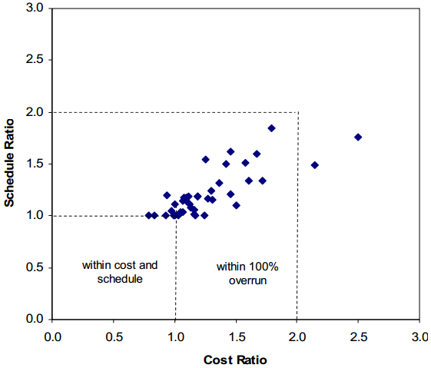
Research Motivation
Spacecraft frequently experience cost and schedule overruns
Complex spacecraft are more likely to fail or be impaired
Better systems engineering reduces cost/schedule overruns and manages complexity
Cost and schedule overruns for selected NASA projects between 1992 and 2007. The average cost overrun is 27% and the average schedule overrun is 22% with cost and schedule overruns being correlated [1].
[1] D.L. Emmons, M. Lobbia, T. Radcliffe, and R.E. Bitten. Affordability Assessments to Support Strategic Planning and Decisions at NASA. In Aerospace Conference, 2010 IEEE, 2010.
Improving systems engineering in formulation will reduce cost/schedule overruns and enable more complex missions

Slide 5
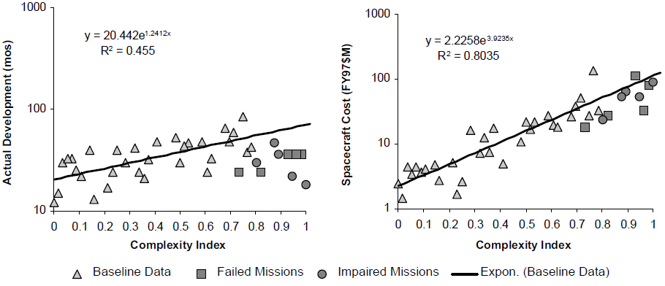
Research Motivation
Spacecraft frequently experience cost and schedule overruns
Complex spacecraft are more likely to fail or be impaired
Better systems engineering reduces cost/schedule overruns and manages complexity
Failed and impaired missions tend to be more complex than average, yet have shorter schedules and tighter budgets than typical of project of their complexity [2].
[2] D.A. Bearden. A complexity-based risk assessment of low-cost planetary missions: when is a mission too fast and too cheap? Acta Astronautica, 52(26):371 - 379, 2003.
Improving systems engineering in formulation will reduce cost/schedule overruns and enable more complex missions

Slide 6
Research Motivation
Spacecraft frequently experience cost and schedule overruns
Complex spacecraft are more likely to fail or be impaired
Better systems engineering reduces cost/schedule overruns and manages complexity
Increased systems engineering effort can decrease cost overruns and schedule overruns. The dashed lines represent the 90% confidence bounds [3].
[3] E.C. Honour. Understanding the Value of Systems Engineering. In Proceedings of the INCOSE International Symposium, pages 1-16, 2004.
Improving systems engineering in formulation will reduce cost/schedule overruns and enable more complex missions

Slide 7
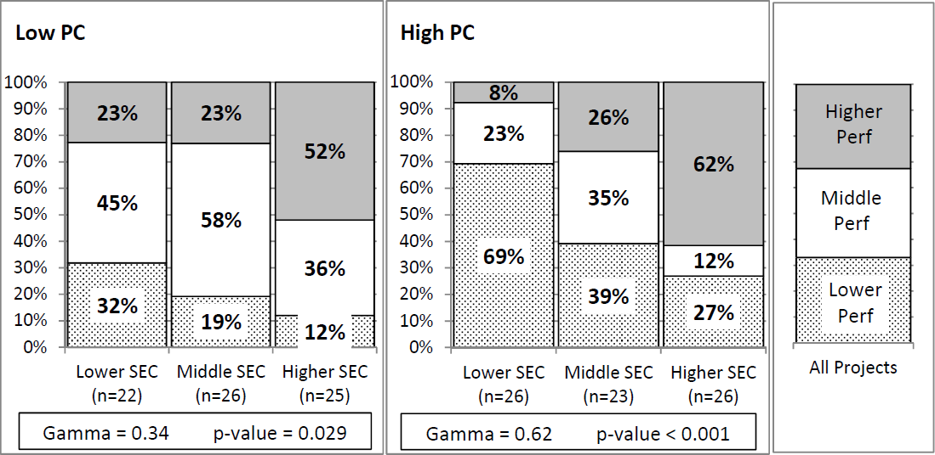
Research Motivation
Spacecraft frequently experience cost and schedule overruns
Complex spacecraft are more likely to fail or be impaired
Better systems engineering reduces cost/schedule overruns and manages complexity
Increased systems engineering capabilities results in better performance. The effect in higher challenge projects is even stronger [4].
[4] Joseph P Elm and Dennis Goldenson. The Business Case for Systems Engineering Study: Results of the Systems Engineering Effectiveness Survey. Technical report, Carnegie Mellon University, 2012.
Improving systems engineering in formulation will reduce cost/schedule overruns and enable more complex missions

Slide 8
Model-Based Systems Engineering
Descriptive models, instead of documents, are the information storage and communication medium [8]

Slide 9
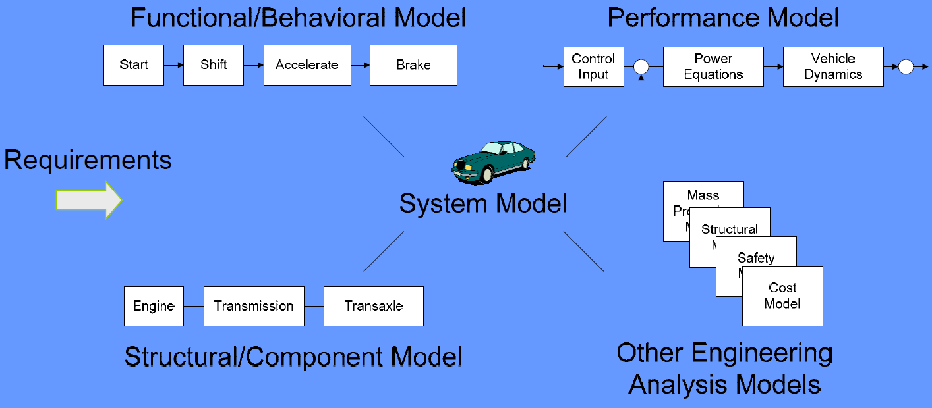
MBSE System Model Scope
System model must capture information about all aspects of system [8].

Slide 10
The Systems Modeling Language
SysML diagrams capture different types of system information. Diagrams can be linked together [10].

Slide 11
Applications of SysML
Requirements engineering
Implement requirements as constraints on the model, instead of as text statements within the model [11]
System Description
Using SysML allows study of more mission concepts within the same timeframe [12]
Integration with Analysis Tools
Graph transformations to support dynamic analysis in Simscape™ [13]
Integration with Phoenix ModelCenter® allows analysis in a range of tools [14]

Slide 12
Previous Research
Design can be thought of as a series of decisions and MBSE can improve decision making [5,6]
Detecting places where future changes will take place improves system development [7]
MBSE allows greater insight into the system under development [8]
System topology currently not well captured
The topological information captured in a system model can assist in decision making and illuminate areas of future change

Slide 13
Research Hypothesis
Hypothesis
Implementing model-based systems engineering will improve the design process
Research Objective
To determine if implementing model-based systems engineering results in a more efficient design process
By comparing a hypothetical REXIS design process incorporating information from system models against the historical REXIS design process
Methodology
Model the REXIS design at each design milestones in SysML
Inspect the SysML models to extract information that was not known at the time and can improve the design process
Measure how the information extracted from the model improves the design process

Slide 14
Overview
Research Overview
Motivation
MBSE/SysML Introduction
Methodology
Metric Description
REXIS Overview
Science Goals
Design History
Case Studies
Interface Uncertainty Case Study
Design Consequence Case Study
Conclusions

Slide 15
Methodology
Create SysML models of design at points in design history
System models contain topological information about the system
Interfaces
Interface uncertainty
Custom SysML extension
Design consequences
Custom SysML extension
Inspect models to extract information that is helpful to the design process
Measure how the new information can improve the design process

Slide 16
Interface Uncertainty
Knowledge about an interface at a point in time lies in an abstraction hierarchy
More abstract interfaces are more uncertain
All interfaces must be at the lowest level of abstraction in a finalized design
Interfaces with abstraction must change
Modeled in SysML as an abstraction hierarchy of interface blocks and association blocks

Slide 17
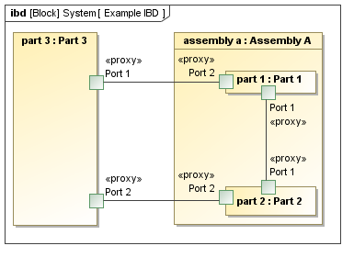
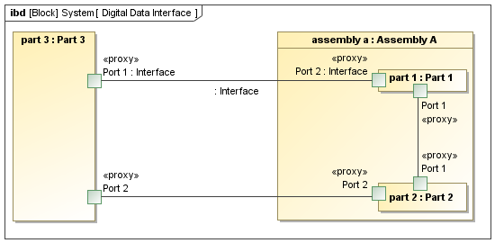
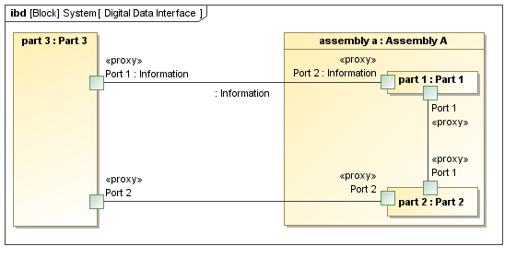
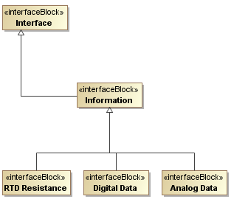
Interface Uncertainty Example
Increasing design maturity

Slide 18
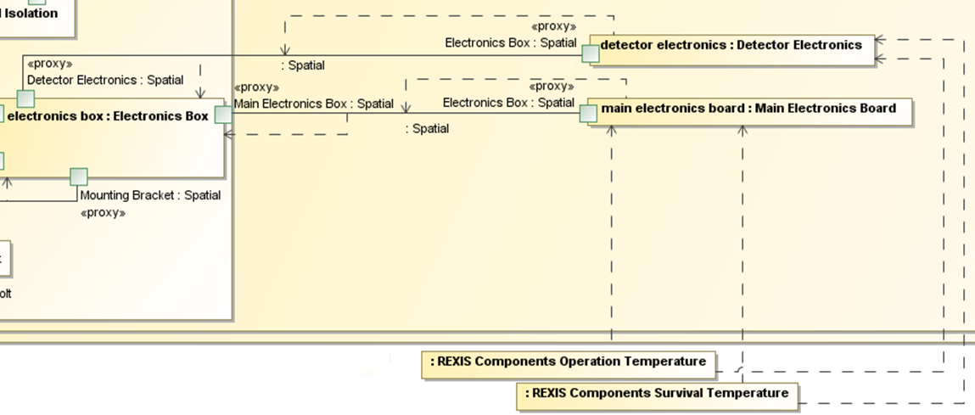
Design Consequence
Captures how the ramifications of requirements or design decisions flow through the system
A requirement or design decision may result in:
Components being added/removed
Changes in properties of existing components
Tracing design consequence reveals how each requirement and design decision impacts the system
Modeled in SysML using Dependencies that flow from the source requirement or design decision through the system

Slide 19
Overview
Research Overview
Motivation
MBSE/SysML Introduction
Methodology
Metric Description
REXIS Overview
Science Goals
Design History
Case Studies
Interface Uncertainty Case Study
Design Consequence Case Study
Conclusions

Slide 20
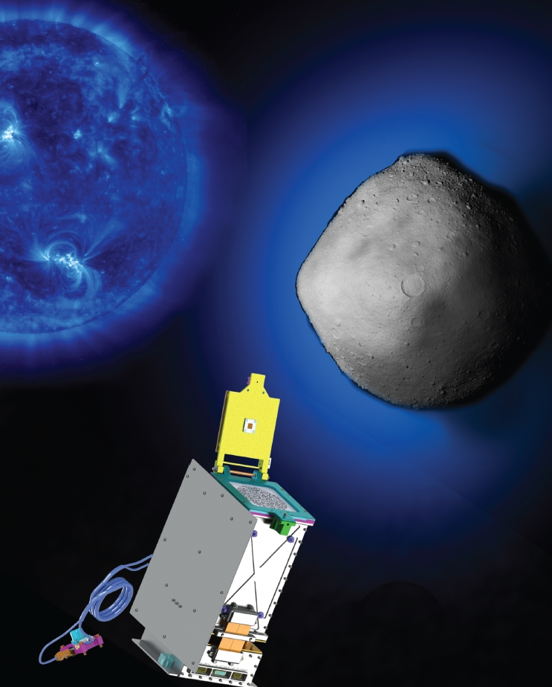
REXIS Science Goals
X-ray fluorescence (XRF) of Bennu surface stimulated by incident solar X-rays
Fluorescent line energies depend on the electronic structure of the matter
Provides a unique elemental signature
Line strengths reflect element abundance
Photons are fluoresced from the surface of Bennu, some of which enter REXIS
Concept heritage from NEAR, Hayabusa
Imaging and detector heritage from astrophysics
Sun
Solar X-rays
Bennu
X-ray fluorescence
(XRF)
SXM
REXIS
SXM shown to scale

Slide 21
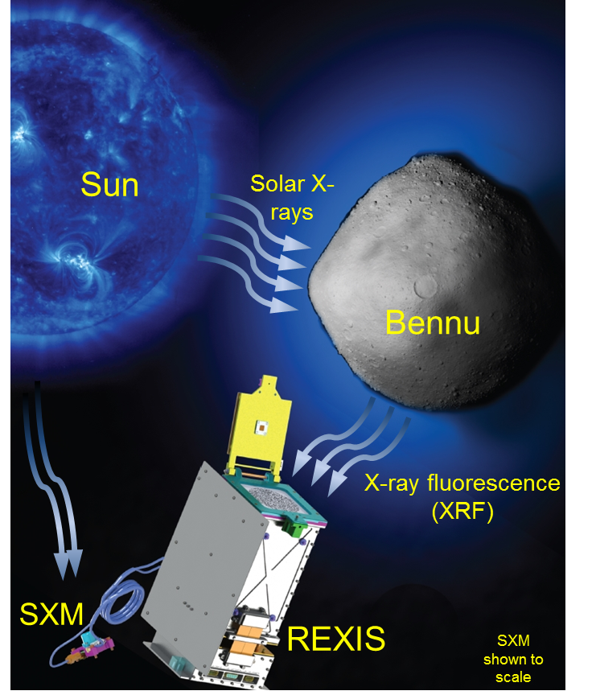
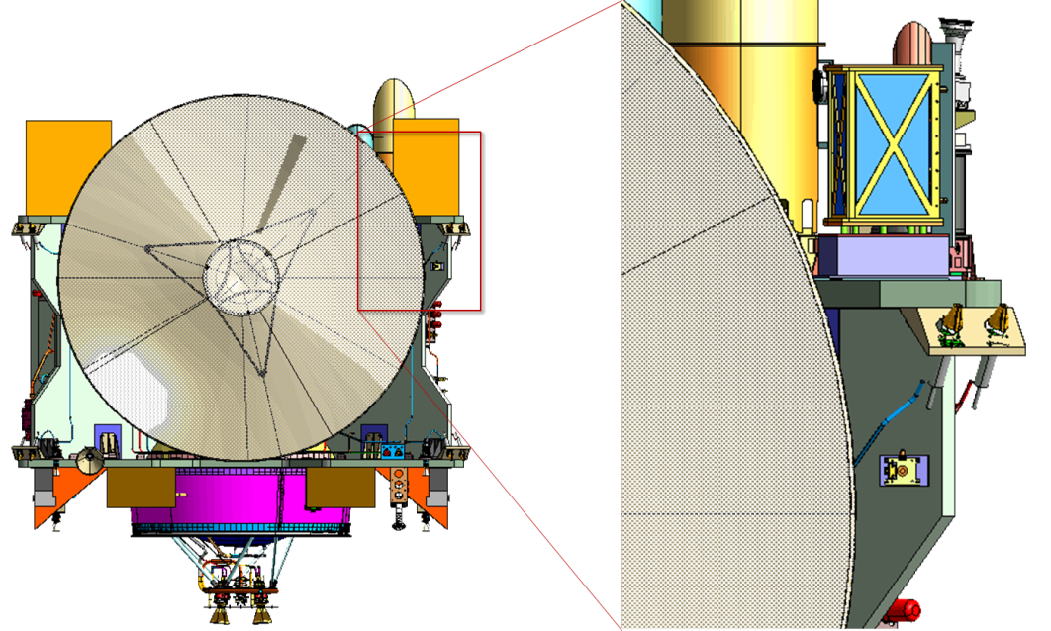
REXIS Science Goals
One of five instrument on the OSIRIS-REx asteroid sample return mission scheduled for launch in 2016
Measures X-rays that are fluoresced from Bennu
Fluorescent line energies depend on the electronic structure of the matter
Provides a unique elemental signature
Line strengths reflect element abundance
Spectrometer
SXM

Slide 22
REXIS CDR Spectrometer Design

Slide 23
REXIS Design History Overview
SysML Models created for SRR, SDR, and PDR
SysML models created at SRR, SDR, and PDR
From Fall 2011 through Spring 2012, REXIS team composed primarily of undergraduates
With grad students and faculty mentors
From Summer 2012 to present, REXIS team composed primarily of grad students
With faculty mentors and undergraduate volunteers

Slide 24
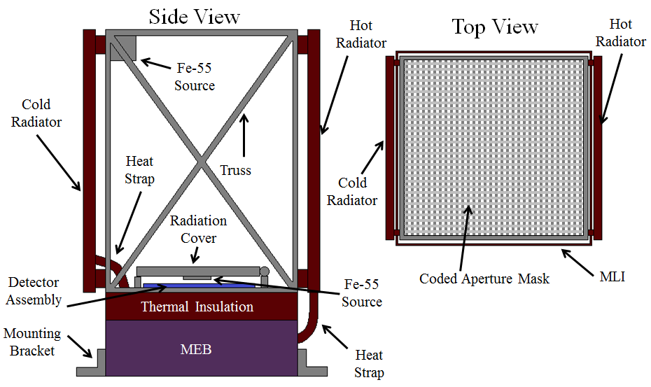
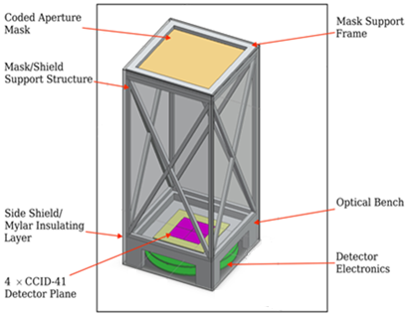
REXIS SRR Design
SRR design largely reflects proposal design
Model Statistics
28 parts
109 ports

Slide 25
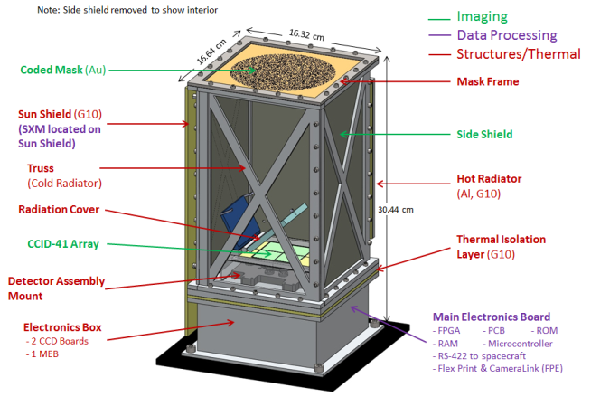
REXIS SDR Design
Electronics Box coupled to S/C deck
Removal of Cold Radiator
Addition of Radiation Cover
Model Statistics
57 parts
210 ports

Slide 26
REXIS PDR Design
Model Statistics
150 parts
577 ports
Removal of Hot Radiator
Standoffs for thermal isolation

Slide 27
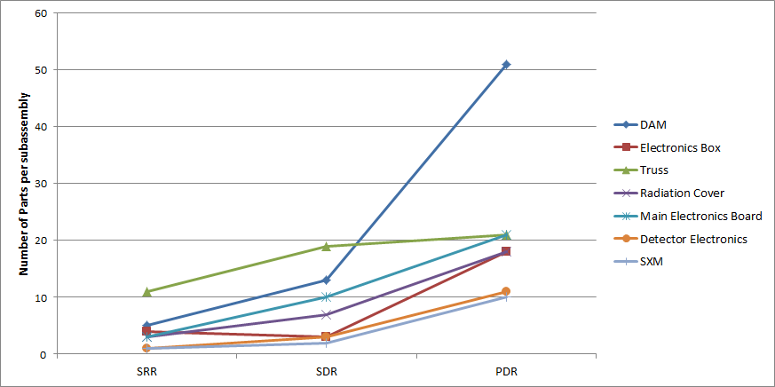
Design History Statistics
Parts per Assembly
All assemblies experienced parts growth

Slide 28
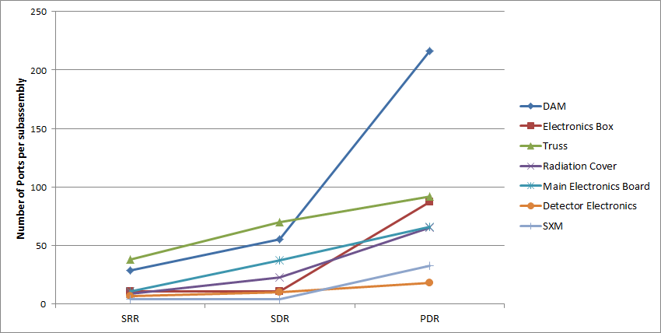
Design History Statistics
Ports per Assembly
All assemblies experienced interface growth

Slide 29
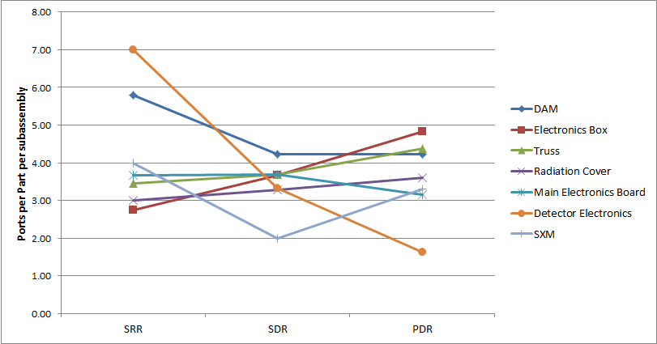
Design History Statistics
Ports Per Part in each Assembly
Agrees fairly well with previous research on the typical number of interfaces per part [9]

Slide 30
Overview
Research Overview
Motivation
MBSE/SysML Introduction
Methodology
Metric Description
REXIS Overview
Science Goals
Design History
Case Studies
Interface Uncertainty Case Study
Design Consequence Case Study
Conclusions

Slide 31
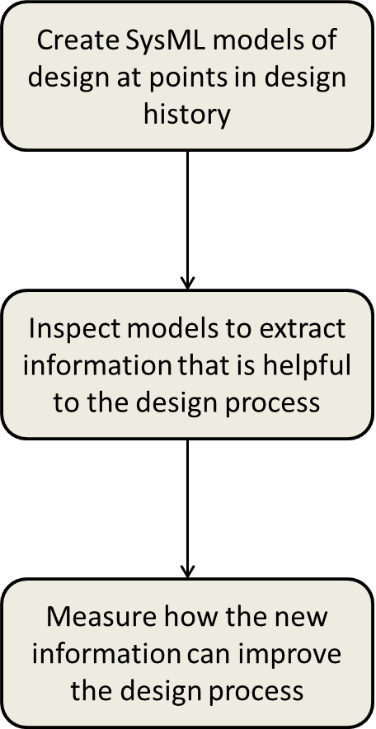
Interface Uncertainty Case Study
How well does interface uncertainty predict future growth or size of assemblies?
Case Study Methodology
Incorporate interface uncertainty in REXIS SysML models
Quantify interface uncertainty in each REXIS assembly
Examine correlation of interface uncertainty to future assembly growth
Examine correlation of interface uncertainty and final assembly size

Slide 32
Quantifying Interface Uncertainty
Step 1:
Modeling REXIS in SysML
Step 2:
Quantifying Interface Uncertainty
Step 3:
Predicting Assembly Growth
Step 4:
Predicting Assembly Size
$$IU=\frac{1−N_{LA}}{N_{LA}}$$
IU = Interface Uncertainty
N_{LA} = Number of Interfaces at the Lowest Level of Abstraction
IU_{A} = Interface Uncertainty of Assembly A
where:
$${IU}_{A}=\frac{1}{3}$$

Slide 33
Interface Uncertainty Over Time
Step 1:
Modeling REXIS in SysML
Step 2:
Quantifying Interface Uncertainty
Step 3:
Predicting Assembly Growth
Step 4:
Predicting Assembly Size
Ports Per Part in each Assembly over Time
All assemblies experienced a decrease in uncertainty over time as expected

Slide 34
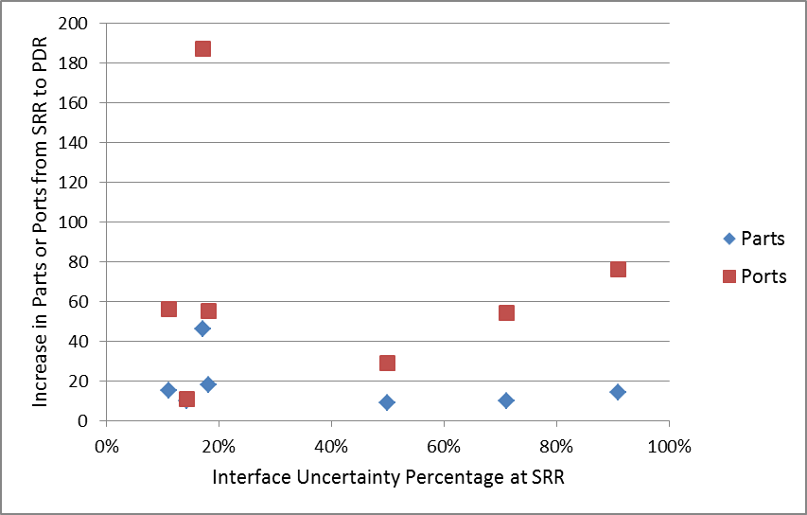
Predicting Assembly Growth
Step 1:
Modeling REXIS in SysML
Step 2:
Quantifying Interface Uncertainty
Step 3:
Predicting Assembly Growth
Step 4:
Predicting Assembly Size
Increase in Parts or Ports As Predicted By Interface Uncertainty at SRR
Interface uncertainty alone did not predict future increases in parts or ports

Slide 35
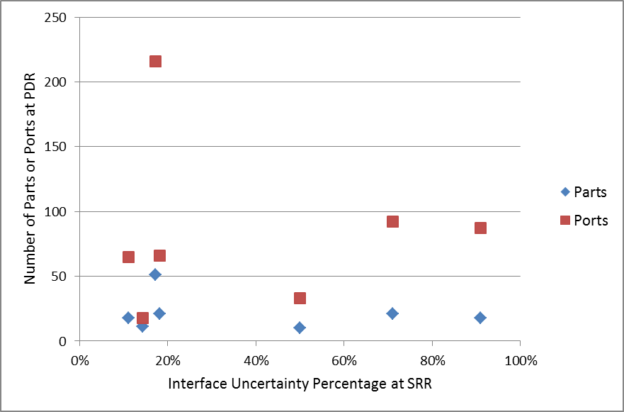
Predicting Assembly Size
Step 1:
Modeling REXIS in SysML
Step 2:
Quantifying Interface Uncertainty
Step 3:
Predicting Assembly Growth
Step 4:
Predicting Assembly Size
Total Assembly Size As Predicted By Interface Uncertainty at SRR
Interface uncertainty alone did not predict future size of an assembly

Slide 36
Case Study Conclusions
Interface uncertainty alone unable to predict future assembly growth or final assembly size on REXIS
Some subassemblies did show expected trend but not where parts matured into multiple parts and interfaces
May work well as part of a more comprehensive metric that also captures part uncertainty
With tweaks, interface uncertainty may be predictive
Using fraction of abstract interfaces to measure uncertainty unrealistically weights each interface evenly
Some interfaces evolved into many new parts and interfaces while other evolved into only a few parts or interfaces

Slide 37
Design Consequence Case Study
Can tracing design consequence through the system improve decision making?
Case Study Methodology
Incorporate design consequences into REXIS SysML models
Inspect models to find design insights
Create alternative timeline based on information extracted from the model
Compare alternative timeline to historical timeline

Slide 38
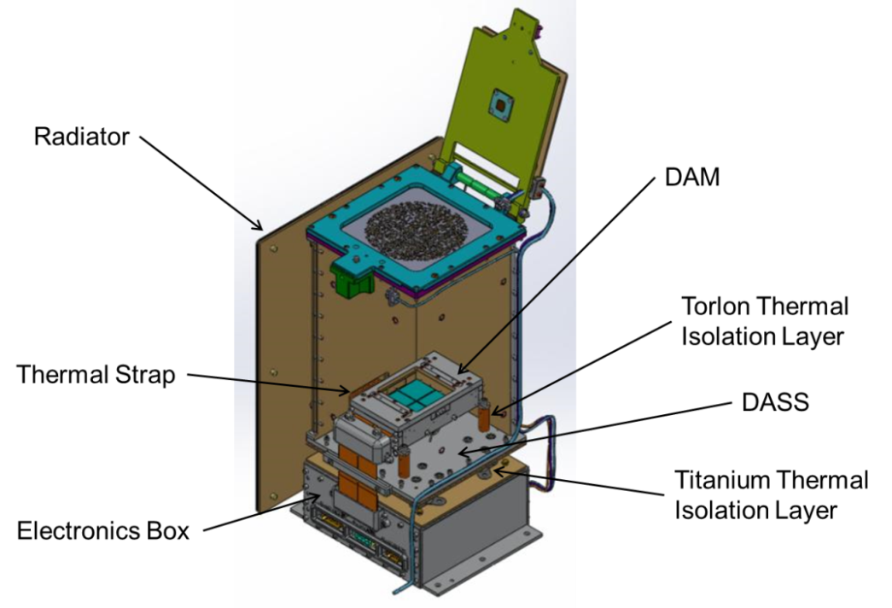
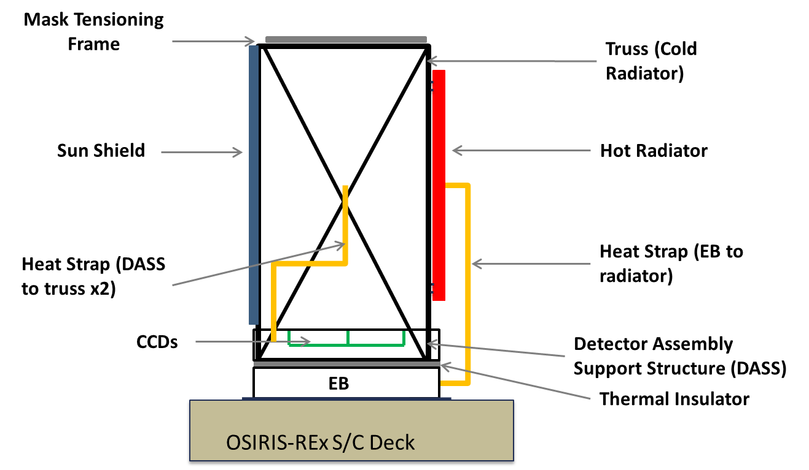
Thermal System Timeline
Historical Thermal System Timeline
SDR Thermal Design
CDR Thermal Design

Slide 39
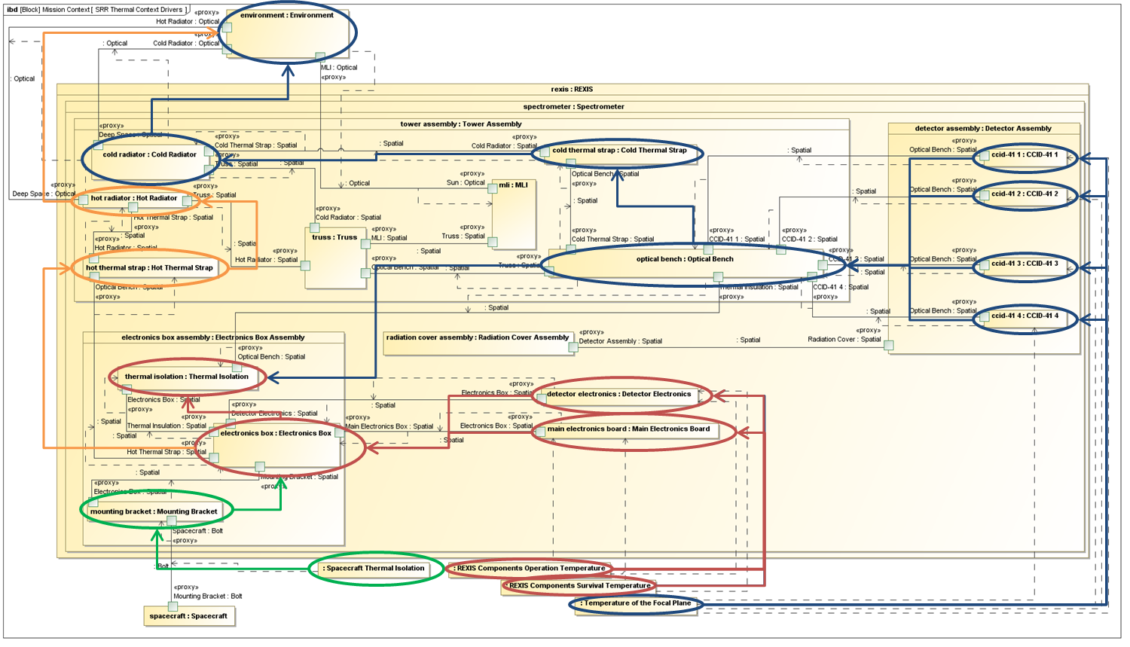
Inspecting the SRR Model
Step 1:
Modeling REXIS in SysML
Step 2:
Inspecting the Model
Step 3:
Constructing Alternate Timeline
Step 4:
Comparing Timelines
Spacecraft thermal isolation requirement drives second radiator
SysML model of Thermal System Design at SRR

Slide 40
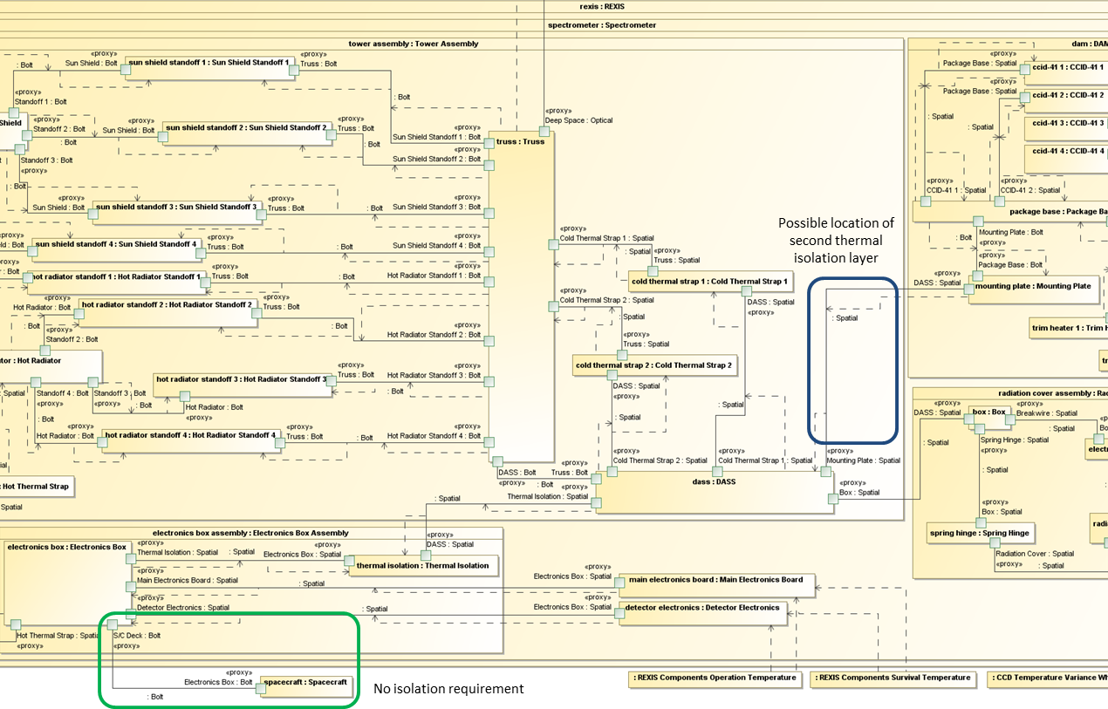
Inspecting the SDR Model
Step 1:
Modeling REXIS in SysML
Step 2:
Inspecting the Model
Step 3:
Constructing Alternate Timeline
Step 4:
Comparing Timelines
Removal of spacecraft thermal isolation requirement not reflected in design. Opportunity to introduce second thermal isolation layer.
SysML model of Thermal System Design at SDR

Slide 41
Constructing Alternate Timeline
Step 1:
Modeling REXIS in SysML
Step 2:
Inspecting the Model
Step 3:
Constructing Alternate Timeline
Step 4:
Comparing Timelines
Couple Electronics Box to Deck
Remove Hot Radiator
Add second thermal isolation layer

Slide 42
Comparing Timelines
Step 1:
Modeling REXIS in SysML
Step 2:
Inspecting the Model
Step 3:
Constructing Alternate Timeline
Step 4:
Comparing Timelines
Historical Thermal Design Timeline
Model-Based Design Timeline
Model-based design timeline is more efficient than historical design timeline

Slide 43
Case Study Conclusions
Design consequence tracing revealed information about the REXIS design before it was known historically
Information extracted from the system models reduced design iteration and rework
Modeling design consequences on REXIS provides the opportunity to make the design process more efficient

Slide 44
Overview
Research Overview
Motivation
MBSE/SysML Introduction
Methodology
Metric Description
REXIS Overview
Science Goals
Design History
Case Studies
Interface Uncertainty Case Study
Design Consequence Case Study
Conclusions

Slide 45
Summary and Conclusions
Thesis investigated how model-based systems engineering can improve the design process
System models captured topological information
Interfaces, interface uncertainty, and design consequences
Interface uncertainty not a good predictor of future REXIS assembly growth or final size
Design consequence tracing highlighted important REXIS design information
Implementation of MBSE on REXIS would have improved the design process

Slide 46
Thank You! Questions?

Slide 47
Bibliography
[1] D.L. Emmons, M. Lobbia, T. Radcliffe, and R.E. Bitten. Affordability Assessments to Support Strategic Planning and Decisions at NASA. In Aerospace Conference, 2010 IEEE, 2010.
[2] D.A. Bearden. A complexity-based risk assessment of low-cost planetary missions: when is a mission too fast and too cheap? Acta Astronautica, 52(26):371 - 379, 2003.
[3] E.C. Honour. Understanding the Value of Systems Engineering. In Proceedings of the INCOSE International Symposium, pages 1-16, 2004.
[4] Joseph P Elm and Dennis Goldenson. The Business Case for Systems Engineering Study: Results of the Systems Engineering Effectiveness Survey. Technical report, Carnegie Mellon University, 2012.
[5] G.A. Hazelrigg. A Framework for Decision-Based Engineering Design. Journal of Mechanical Design, 120(4):653-658, 1998.
[6] C. Paredis. Model-Based Systems Engineering: A Roadmap for Academic Research. In Frontiers in Model-Based Systems Engineering, 2011.
[7] E. Fricke, B. Gebhard, H. Negele, and E. Igenbergs. Coping with Changes: Causes, Findings, and Strategies. Systems Engineering, 3(4):169-179, 2000.
[8] S. Friedenthal, R. Griego, and M. Sampson. INCOSE Model Based Systems Engineering (MBSE) Initiative. In INCOSE 2007 Symposium, 2007.
[9] D.E. Whitney, Q. Dong, J. Judson, and G. Mascoli. Introducing knowledge-based engineering into an interconnected product development process. In Proceedings of the 1999 ASME Design Engineering Technical Conferences, 1999.
[10] S. Friedenthal. Model Based Systems Engineering (MBSE) with SysML. NASA GSFC Systems Engineering Seminar, June 8, 2010. http://gsfcir.gsfc.nasa.gov/download/colloquia/3358/slides/Model-based+systems+engineering+%28MBSE%29+with+SysML-1/download.pdf
[11] Y. Bernard. Requirements Management within a Full Model-Based Engineering Approach. Systems Engineering, 15(2):119{139, 2012.
[12] T. Bayer, Seung Chung, B. Cole, B. Cooke, F. Dekens, C. Delp, I Gontijo, and D. Wagner. Update on the Model Based Systems Engineering on the Europa Mission Concept Study. In Aerospace Conference, 2013 IEEE, 2013.
[13] Y. Cao, Y. Liu, and C. Paredis. System-Level Model Integration of Design and Simulation for Mechatronic Systems Based on SysML. Mechatronics, 21(6):1063{1075, 2011.
[14] D. Kaslow, G. Soremekun, H. Kim, and S. Spangelo. Integrated Model-Based Systems Engineering (MBSE) Applied to the Simulation of a CubeSat Mission. In Aerospace Conference, 2014 IEEE, pages 1{14, 2014.

