Slide 1
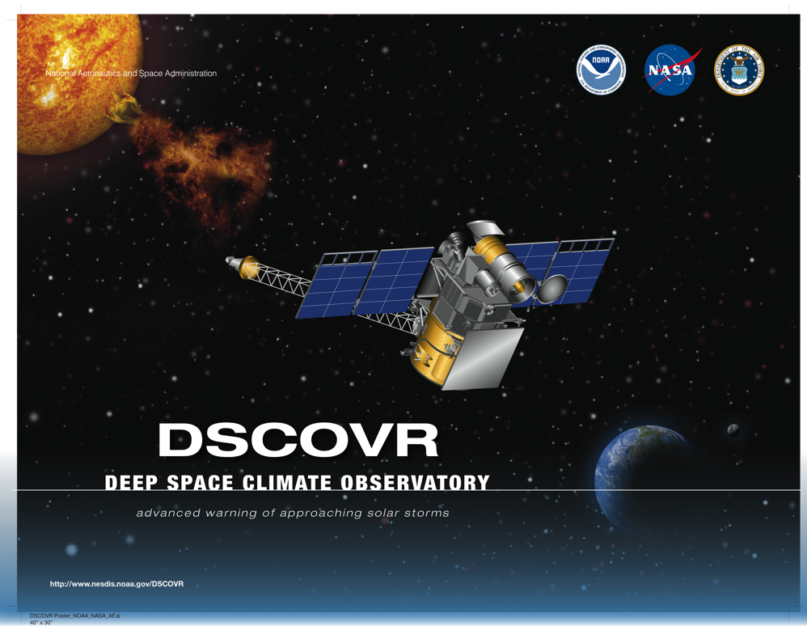
DSCOVR: Refurbishing a Spacecraft After a Decade of Storage
Gary T. Meadows
NASA DSCOVR Mission Systems Engineer

Slide 2
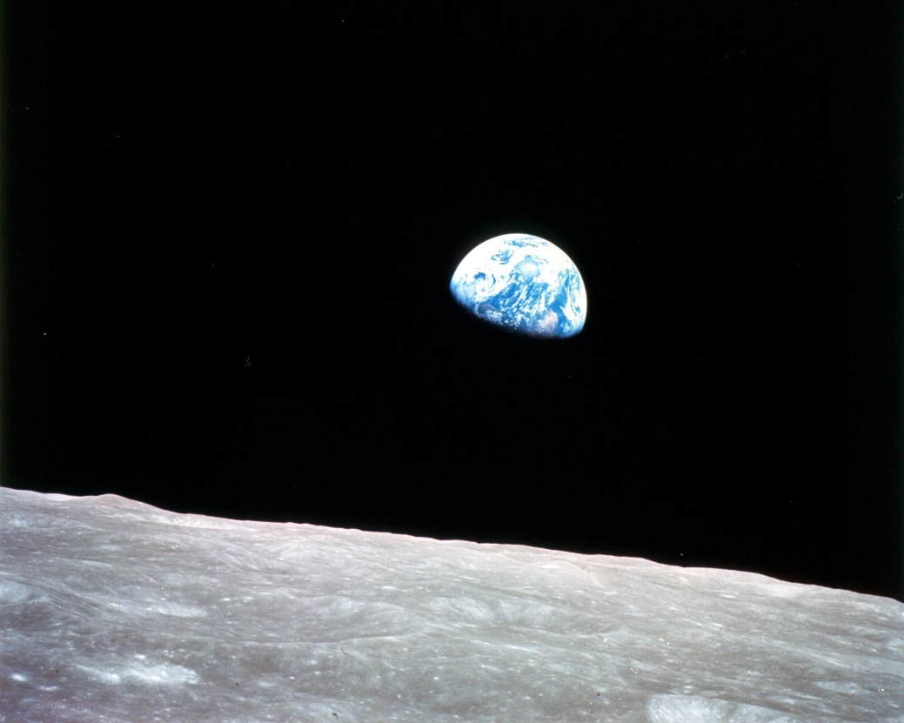

The Beginning
Apollo 8
Dec. 24, 1968
Commander Frank Borman
Command Module Pilot Jim Lovell
Lunar Module Pilot William Anders
Apollo 17
Dec. 7, 1972
Commander Eugene A. Cernan
Command Module Pilot Ron Evans
Lunar Module Pilot Harrison H. Schmitt

Slide 3


The Vision: Triana
1998: Then Vice President Al Gore challenged NASA to place a satellite at the L1 Lagrange Point to provide a continuous real-time view of the sunlit side of the earth
Named Triana after Rodrigo de Triana who first spotted America from Christopher Columbus’ ship La Pinta in 1492
Goddard sprang into action designing to a very tight schedule, planning for a launch in early 2001 from the space shuttle

Slide 4
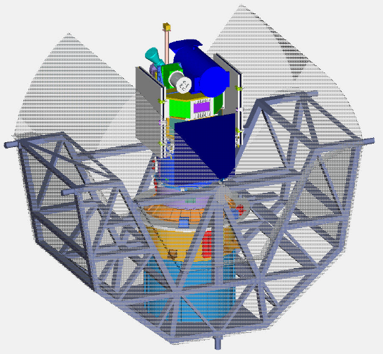
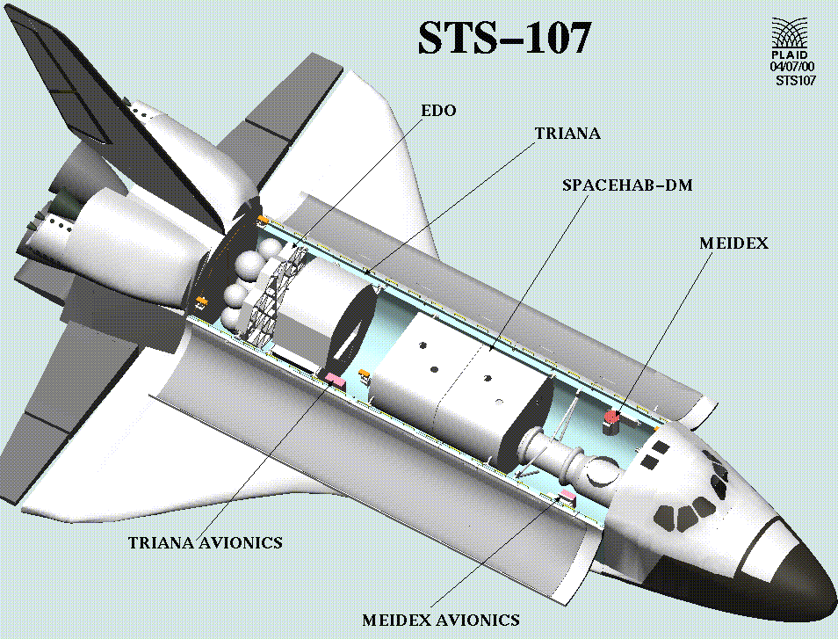
Triana Development
NASA procured a camera equipped with filters for RGB images to study atmosphere and aerosols (EPIC)
A radiometer was added to study solar energy balance (NISTAR)
The heliophysics community was outraged at the idea of sending a spacecraft to L1 and not studying the sun, so an instrument incorporating a magnetometer, Faraday Cup, and Electrostatic Analyzer was added (Plasmag)
Triana was manifested for launch on STS-107 (which was the Columbia flight that failed during re-entry and resulted in the death of the seven astronauts)

Slide 5

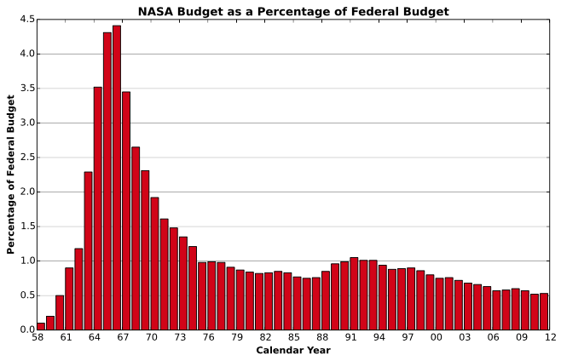

“Goresat” Politics
In May, 1999, House Republicans amended NASA’s budget request bill and removed Triana, effectively terminating it
Later that year, NASA’s Inspector General reported that the project was out of control with a questionable science merit
The IG recommended a virtual earth view built from images by existing spacecraft

Slide 6
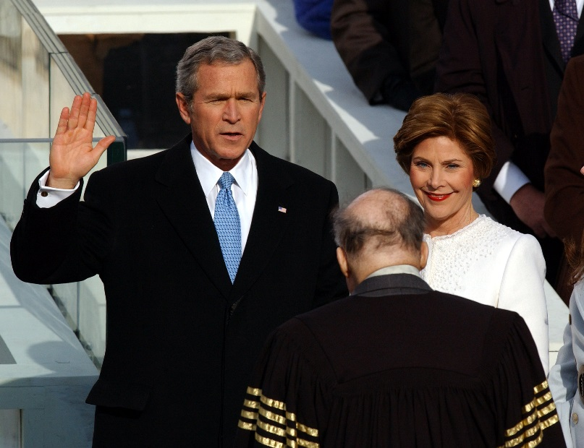
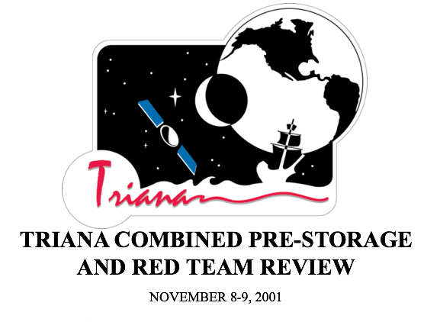
Redemption and Cancellation
In March, 2000, the National Research Council released a report supportive of the science and budget
Triana development continued at GSFC as a Class D mission with a very tight schedule and budget
Following George W. Bush’s inauguration in January, 2001, Triana was quickly canceled
Triana completed environmental testing and was placed in storage in the GSFC SSDIF cleanroom in November, 2001

Slide 7

NOAA Gets Involved
NOAA’s responsibilities include monitoring space weather and providing a warning system for solar storms and coronal mass ejections that could disrupt satellites, harm astronauts, or inflict damage on national resources
The L1 Lagrange orbit is uniquely suited to detect solar events and transmit the information to earth before the event
Existing L1 spacecraft include WIND (1994), SOHO (1995) and ACE (1997)
All of these spacecraft are getting old and the Plasmag instrument that was added to Triana was an excellent fit to provide continuity

Slide 8
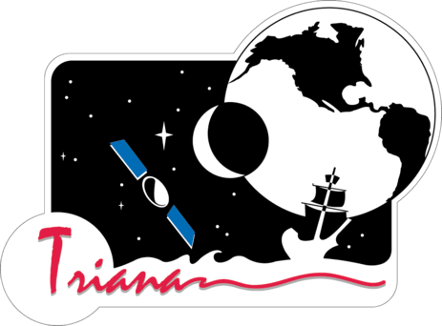


DSCOVR Resurrection
In 2008 the spacecraft was removed from storage and tested to confirm that it was still healthy
In 2009, the “Serotine Report” determined the feasibility and by 2011 work was ramping up to refurbish the old Triana spacecraft with a new name: Deep Space Climate Observatory (DSCOVR)
The White House Office of Science and Technology Policy (OSTP) provided funding for the earth-pointing instruments EPIC Telescope and NISTAR instruments, which were refurbished by the manufacturers

Slide 9
DSCOVR Master Plan
Having successfully gone through environmental testing, Triana was considered a “fully qualified spacecraft bus”
The DSCOVR Team would do the following:
  Revise the bus where needed in order to fulfill NOAA’s primary mission requirements of space weather monitoring
  Revise the concept of operations accordingly
  Adapt the spacecraft for a SpaceX Falcon-9 Launch Vehicle instead of the Shuttle
  Refurbish necessary components and re-test the bus
Focusing on just some of the problems & solutions in this presentation
  Many issues had to be resolved across all disciplines
  E.g. NISTAR & EPIC Contamination, Thruster Plume Impingement on boom and ESA, Battery conversion from NiCd to Li Ion, etc.

Slide 10
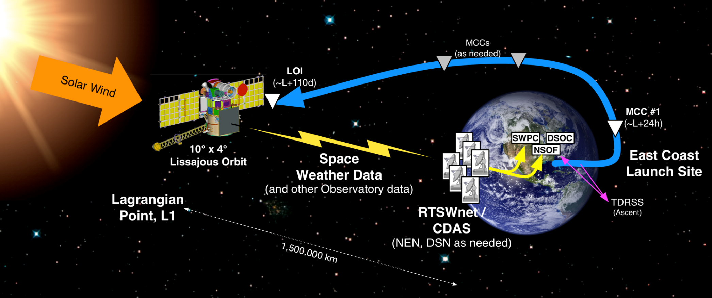
DSCOVR Mission Overview
Primary science objective: provide solar wind thermal plasma and magnetic field measurements to enable space weather forecasting by NOAA
Secondary science objectives: image the Sun lit disk of Earth to determine ozone, aerosol, cloud cover, cloud height, vegetation, and leaf area indices and to measure the Earth reflected irradiance

Slide 11
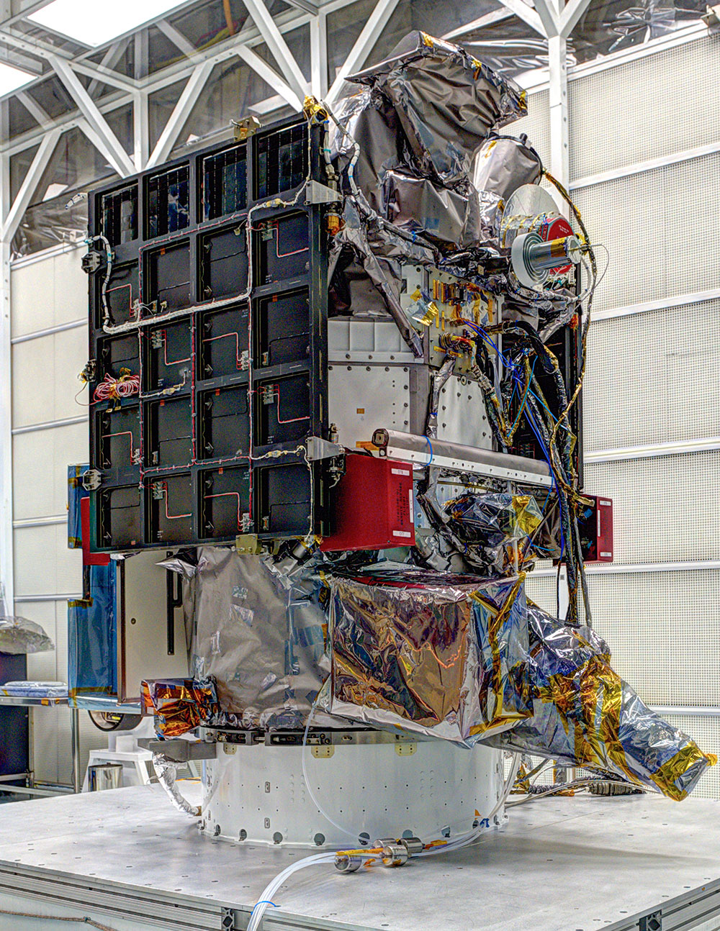
DSCOVR Spacecraft Overview
Mission Description
  Category 2, Risk Class D
  Single string spacecraft
  2 year design life (5 years of propellant)
Organizations
  NOAA – NSOF, SWPC, Ground Stations
  NASA – Payload, Ground System, DSOC
  US Air Force – Launch Vehicle
Spacecraft
  3-axis stabilized spacecraft
  Lissajous orbit at Earth-Sun L1
  570 kg, 340 W
Launch Vehicle
  Falcon 9 v 1.1 with First Stage Legs and Fins
  Payload Fairing: 5.2m diameter, 13m long
  First DOD Launch of a Falcon 9 v1.1
Launch Readiness Date
  January 29, 2015 1835 EST (2335 UTC)
  CCAFS Space Launch Complex-40

Slide 12
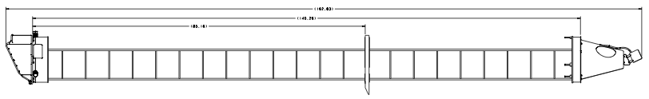
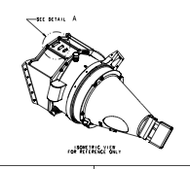
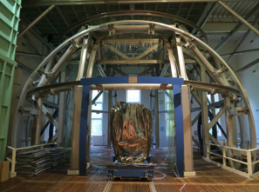
Modifications to Meet Mission Requirements
Relocated Magnetometer to end of boom with “witch hat” extension
Installed magnetic shielding material on reaction wheels
Added struts to upper deck to correct for insufficient strength
Developed concept of operations to meet NOAA space weather forecasting requirements
Re-engineered fusing strategy to improve reliability
Performed magnetic characterization on components and measured Observatory signature at GSFC mag facility
Designed and developed MOC for delivery to NOAA, DSOC for Earth Science data processing, and SDVF for sustaining engineering

Slide 13
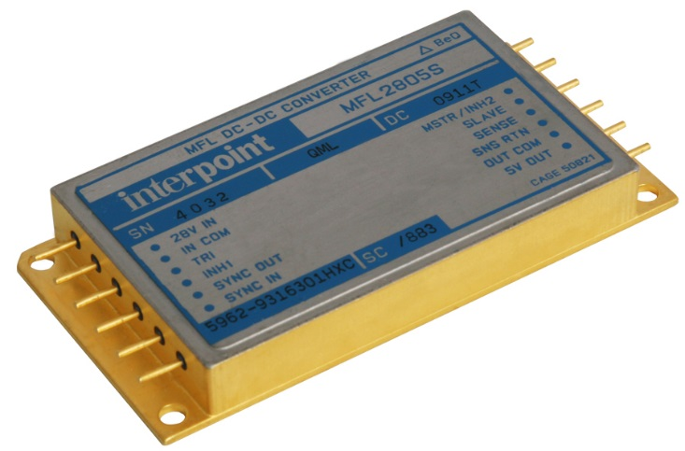
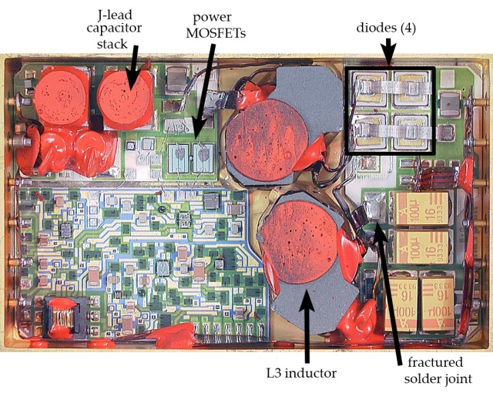
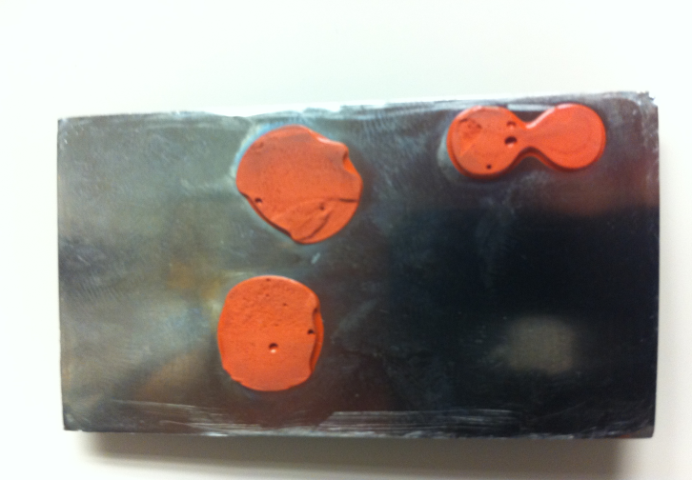
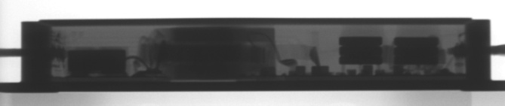
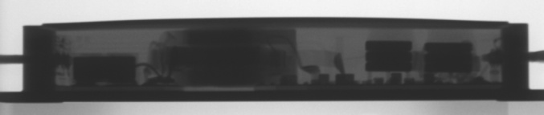
It Begins: Parts Problems
Some Interpoint DC-DC converters of that era were found to fail under vacuum if internal bond adhered to the lid,
DSCOVR Single String Design was not tolerant to failed DC-DC Converters!
EO-1 & MAP stiffened the lids by bonding reinforcement to the lids
The DSCOVR Team evaluated the risk and determined that the faulty parts were in several components
Decided that the risk of flying with these components was unacceptable
However, limited schematics, no spare printed circuit boards, and risk associated with removing and opening electronics components raised the stakes

Slide 14
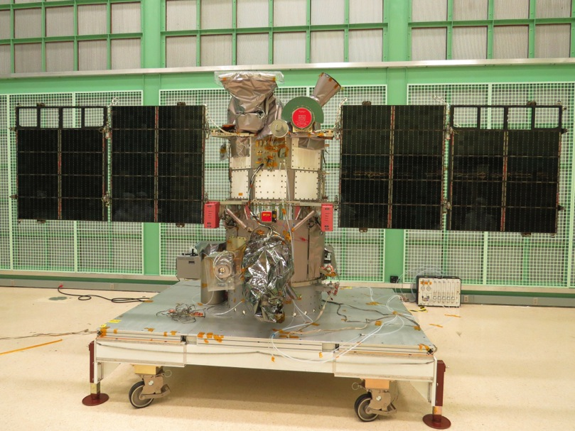
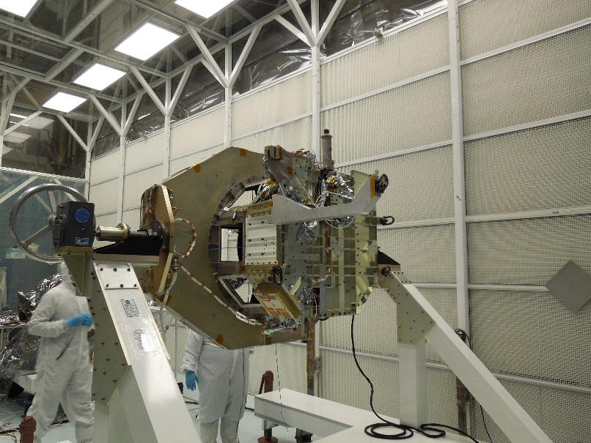
Spacecraft Disassembly
When attempting to remove the first electronics box from the spacecraft, found that the harness had to be disconnected from the inside
The only way to get to it was to separate the propulsion module from the avionics and instruments
This was not part of the plan!
Assembled a turnover dolly and split the propulsion module from the avionics so that boxes could be removed

Slide 15
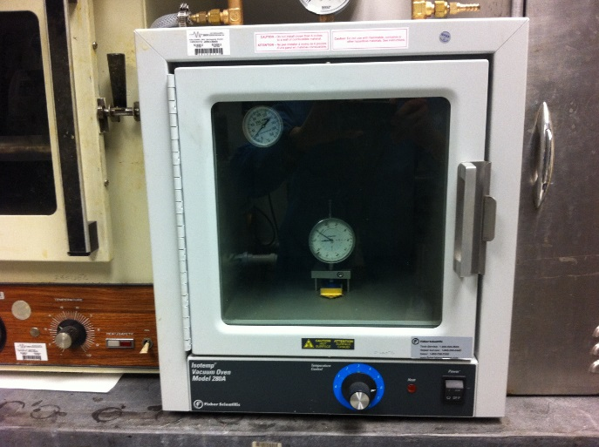
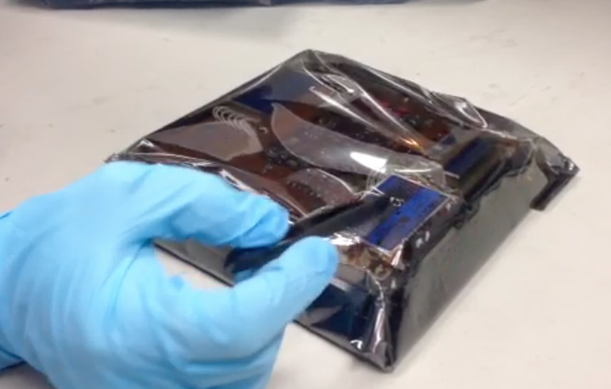
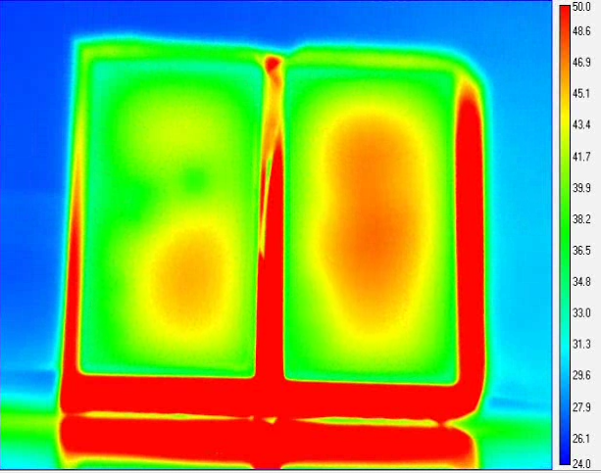
Interpoint Parts Resolution
Deflection Test
Tap Test
The Project worked with the GSFC parts branch to come up with a non-invasive way to determine if the DC-DC converter lids had bonded to the components underneath
Determined criteria for vacuum deflection to determine whether the lid adhered to the components (<21 mil bond intact; >27 mil = OK)
Power node tested first, OK at 41 mil
CompHub deflected to 23.5 mils – was it ok or not?
Developed ”tap test” and later “thermal test” with parts engineers
Replaced one converter in the NISTAR Instrument
UHUB was redeemed by schematics that were (finally) found in a box in Bldg 11
Thermal Test

Slide 16
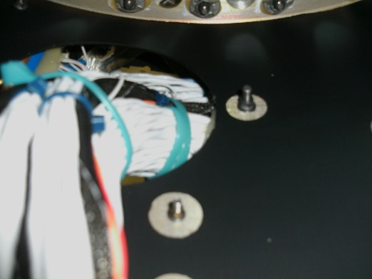
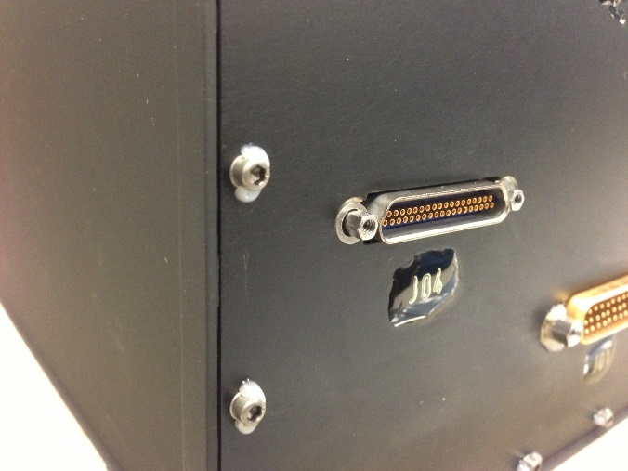
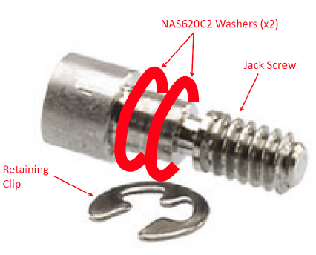
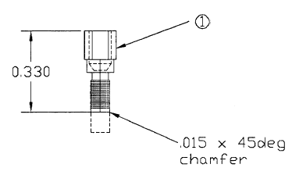
Workmanship Issues
Harness
  Upon separating the prop module from the spacecraft, numerous harness problems were found…
  Tight wires (“banjo springs”)
  Routing across sharp corners and access holes
  Bend radius violations
  Undertook a significant harness rework effort
Jackscrews
  Numerous (frustrating) jackpost/jackscrew problems in the Triana bus
  Spun in component when removing or re-installing
  Overtightening
  Jackpost too short or jackscrew too long
  Impact of opening boxes

Slide 17
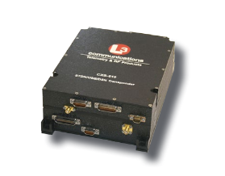
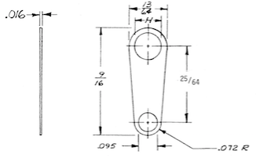
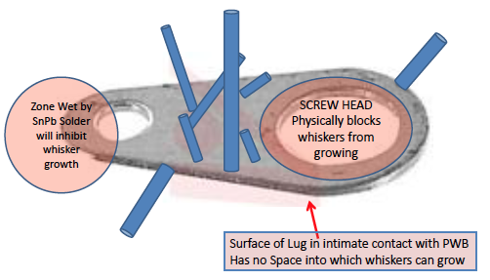
Transponder Tin Whisker Risk
The original Triana L-3 Communications S-Band transponder had been taken by EO-1 following detection of a failure in thermal vacuum
The bad EO-1 unit was repaired by L-3 and placed back on the Triana bus
L-3 Materials list indicated presence of internal tin-plated lugs that posed a failure risk from tin whiskers
Monte Carlo analysis by Code 562 determined rough likelihood of failure
Spare transponder was re-qualifed after a decade of being stored on a shelf in RF engineers’ office
Ultimately did not need the spare – flight unit had no anomalies and flight history with no failures
Code 562: Parts, Packaging, and Assembly Technologies Branch
Code 561: Flight Data Systems and Radiation Effects Branch

Slide 18
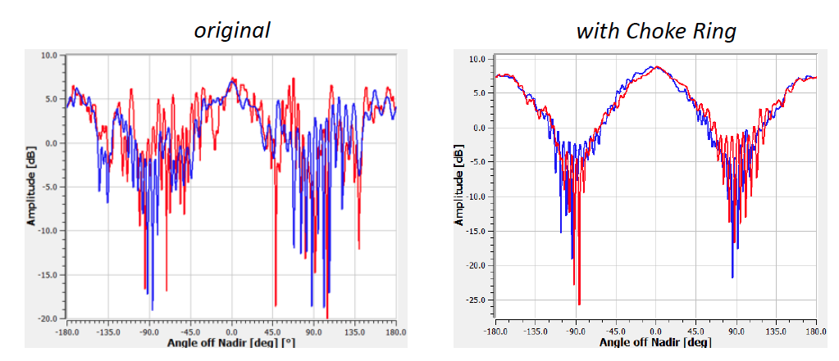
Antenna Coverage
Analysis determined that omnis had significant null areas and signal lost to backlobes
Fabricated and added “choke rings”
Rotated High Gain Antenna 90 degrees and added line delay to reduce signal reception interference with omnis

Slide 19
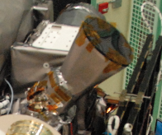
Star Tracker Shade
Ball had identified a problem with the CT633 Star Tracker light shade performance
  DSCOVR needed ~60 degree exclusion
  The tracker delivered ~90 degree exclusion
Slight contractual issue arose since the star tracker had long-since been purchased and accepted
Shade was out of production
Ball located a suitable shade in their star tracker test facility
Ball stripped and re-coated the shade, installed on the DSCOVR tracker, and re-certified it

Slide 20
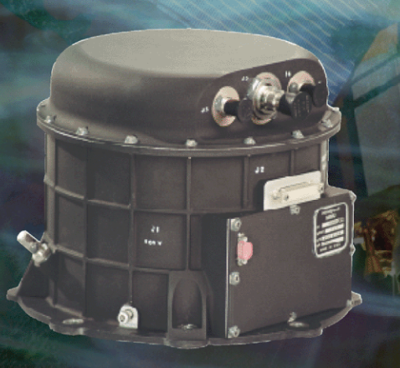
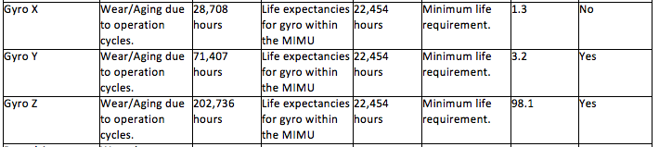
MIMU Refurbishment
Stored spacecraft bus can become a flight parts warehouse
LRO project removed and flew the Triana Honeywell MIMU due to a delivery schedule
LRO MIMU was provided to Triana upon receipt
This is a ring laser gyro and notable degradation of laser was seen in one axis
Gyro unit refurbishment by Honeywell, qualified, and returned to DSCOVR

Slide 21
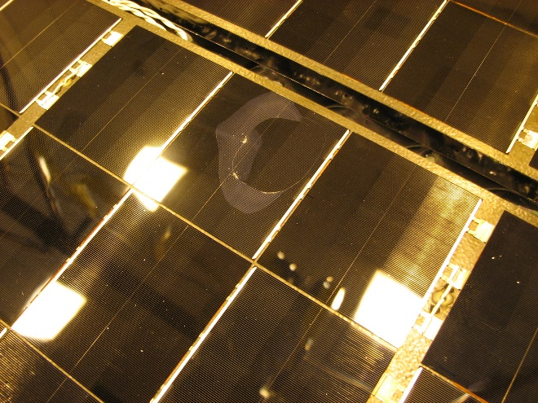
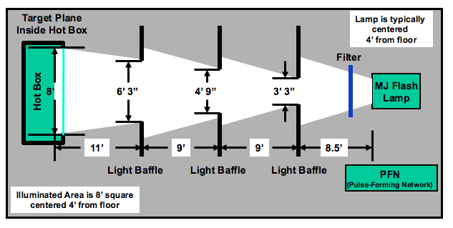
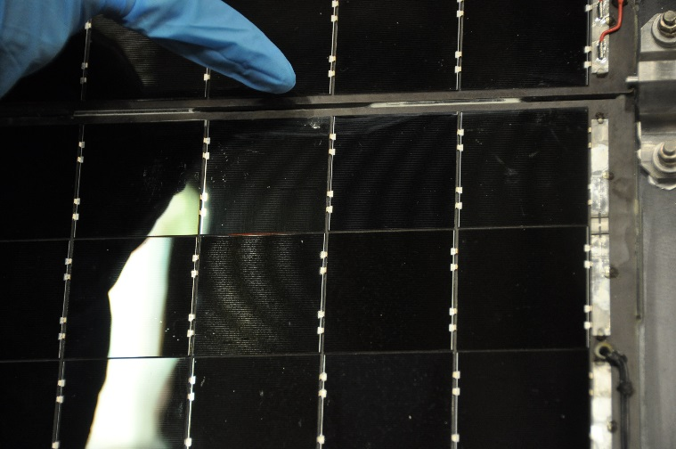
Solar Array Verification
GLORY used the same solar array design and experienced cell ”blowouts” under vacuum
DSCOVR array was tested in thermal vacuum and subjected to LAPSS testing
No major problems… a couple of cracked cells but array found to be acceptable
GLORY Cell ”Blowout”
DSCOVR cracked cell
LAPSS Test Layout

Slide 22
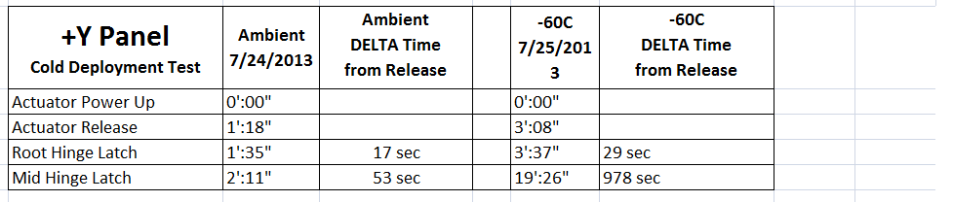
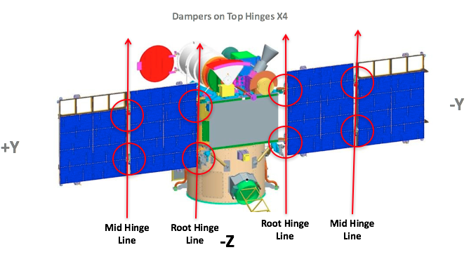
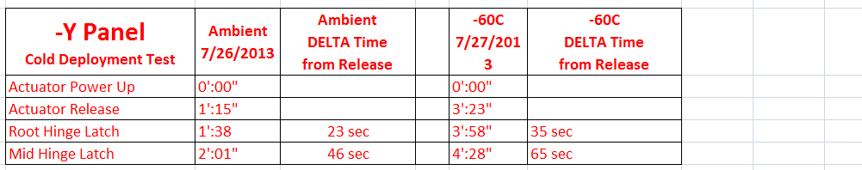
Solar Array Damper Anomaly
Solar array design allowed for deployment without G-Negation because hinge lines were vertical
Each hinge had two springs, so removal of a spring and successful deployment demonstrated 2X torque margin
Under cold conditions (-60 degC), the +Y panel middle hinge took 978 seconds to full deploy
Root hinges took ~ 30 seconds and –Y middle hinge took ~60 seconds

Slide 23
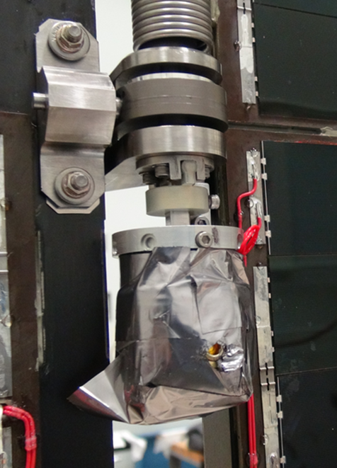
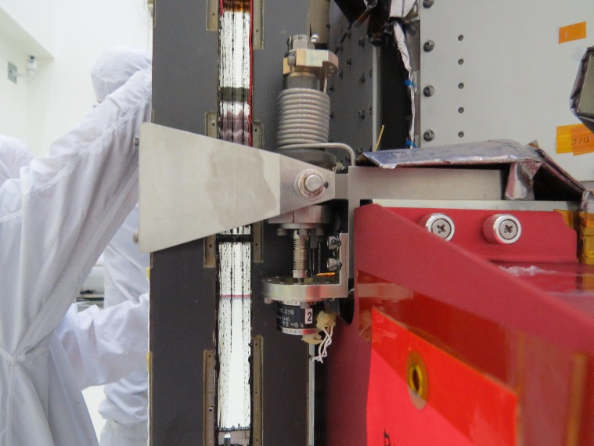
Damper Resolution
Determined that damper blankets suffered from adhesion problems and interfered with the hinges
Thermal analysis revealed that blanketing was unnecessary to maintain temperature margins through deployment
Resolution was to fly without blankets on dampers

Slide 24
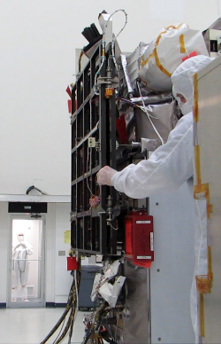
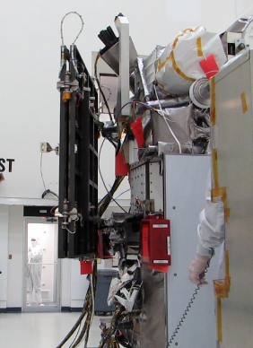
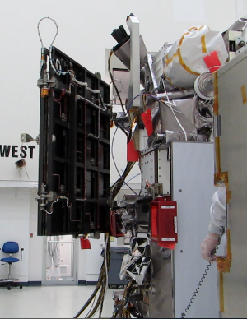
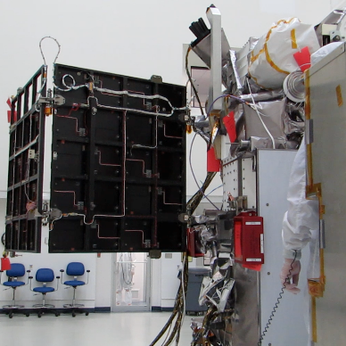
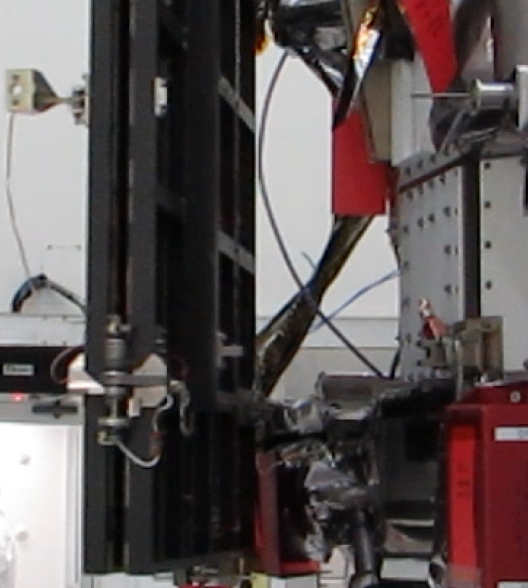
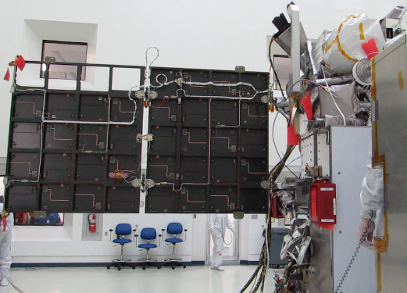
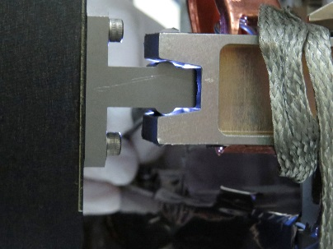
S/A Deployment Anomaly
During pre-launch testing in Florida, solar array deployment hung up and had to be pushed by hand to deploy
Lengthy investigation determined that lower snubber had shifted and had to be re-centered
Never able to conclusively determine when the shift occurred
Launched with slight risk because root cause not found, but deployment was done with one spring removed so 2X margin was retained versus the test
Stowed
Released
Outer Panel Release
In Progress
Fully Deployed
Lower Snubber

Slide 25


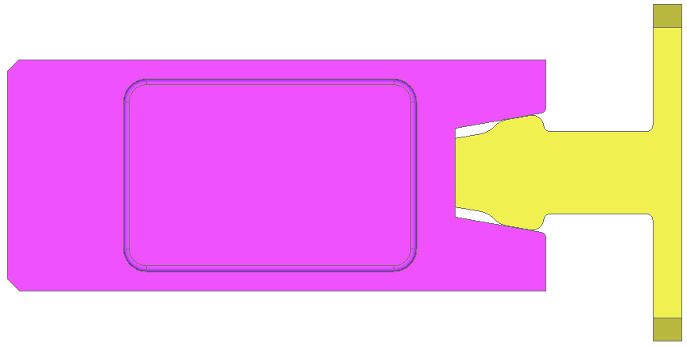
Other Solar Array Problems
Triana Snubber design could jam
Restraint arm negative margin identified through analysis

Slide 26



Bent Thruster
Approximately 1 year into the refurbishment, someone noticed that one of the thrusters had been bent upwards by 45 degrees
Investigation followed but time of actual event was never determined
Could have happened during storage activities up until it was noticed
Considering there were very few spares on the entire spacecraft, a stroke of luck was that DSCOVR had a spare Dual-Thruster module
Cut out damaged module, welded in the spare, X-Rayed and tested, limited by tank max. pressure

Slide 27

Propulsion Line 5 Temp
During DSCOVR thermal balance testing, the temperature of the exterior portion of Prop Zone 5 was significantly cooler than expected (Hydrazine freezing temp = 2°C)
  Cold Balance minimum = 5.4°C
  Hot Balance minimum = 1.9°C
  Safehold minimum = 7.4°C
Both Triana and DSCOVR testing programs demonstrated this behavior

Slide 28


Prop Line 5 Resolution
Add Auxiliary Heater to augment existing heaters
Located power source with sufficient capacity
Mocked up system and tested in cold chamber
Opened blankets and installed thermostats and heaters to exposed prop line

Slide 29

Shipping to Launch Site

Slide 30

Launch on SpaceX Falcon-9
February 11, 2016

Slide 31

View from Falcon-9

Slide 32


Significant Post-Launch Anomalies
Digital Sun Sensor Interface
  Binary vs. Gray Code
  Reversed Polarity
Faraday Cup Grounding
  Traced Back to Adaptation from WIND Mission
Plasmag Data Processing Unit Memory Radiation Susceptibility
  8086 Assembly Language Patch
CompHub Reboots
  No Root Cause Identified
  Flight Software Lab RAD6000 Failures

Slide 33
The Results

Slide 34

Monday, June 22: Major Shock
Solar wind speed jumped
to ~800 km/s, the fastest
DSCOVR observed so far
Density compression at
the shock is ~3. Typical
interplanetary shock
compression is 1.5-2.
Strong shock was coupled
with strong Bz South
magnetic field (< -30 nT)
making the event even
more geoeffective.

Slide 35


Multi-Spacecraft Observation of IP Shock

Slide 36

High Time Resolution Magnetometer Data
Example of interplanetary shock in 50 sample/sec high-resolution data

Slide 37



The Crown Jewel
July 20, 2015

Slide 38

Lunar Transit (Photobomb)
July 5, 2016

Slide 39

epic.gsfc.nasa.gov

Slide 40

Lessons Part 1
”Fully Qualified Spacecraft Bus”
Class D
Severe Schedule and Cost Pressure
Small Team
There was a considerable risk of failure
Political ramifications if Al Gore had become president and Triana had failed
Do not underestimate Class D spacecraft risk
Under similar circumstance, need a very experienced project team to avoid making mistakes that could be catastrophic to the mission

Slide 41

Lessons Part 2
Documents Matter
  Refurbishment and problem resolution was much more difficult due to lack of documentation
  Rush to complete and store Triana meant not all documentation was completed
  Triana “Docushare” system was excessed (this system was a data repository separate from Configuration Management)
  Retained some WOAs and PR/PFR information
  Contractor analyses and documents need to be received and stored with internal documentation
Manage for the long term
  Consider format obsolesence
  Source files of PDF documents
  Models and analyses
Treat stored spacecraft as an active project

Slide 42

Lessons Part 3
GSFC has experts in specific areas that might not make sense to retain in a for-profit environment
  E.g. Parts, radiation effects, tin whiskers experts
  Allows us to to address problems and drive down risks to full mission success
  On the downside, this can drive up GSFC costs
Take problems seriously
  Understand the problem
  Develop and evaluate solutions
  Balance risk of damage during repair with risk of flying as-is
  Test solution on mockup/ETU/etc. (if possible)
  Implement solution
  Test implementation

Slide 43

Lessons Part 4
The best design can be jeopardized by poor workmanship
Own your mistakes
  Bent thruster example – not out on a witch-hunt, just wanted to determine how it happened and take steps to prevent repeats
  Management and technical leads should make it clear that the punishment for making a mistake and owning it is outweighed by penalty for covering it up

Slide 44

What Made Us Successful

Slide 45
Backup Slides
5
BACKUP

Slide 46

Sun-facing Side
EPIC
Solar Arrays
NISTAR
Omni Antenna
(+X side)
Omni Antenna
(-X side)
Faraday Cup
Electron
Spectrometer
Attitude Sensors:
Star Tracker
Digital Sun Sensor
Inertial Reference Unit (+Y side, not shown)
Magnetometer
Boom
+Z
+Y
+X

Slide 47

Earth-facing Side
~1.2m
NISTAR
3 Cavity Radiometers
EPIC
30 cm Telescope
2K x2K CCD (10 channels)
Faraday Cup
SMEX-Lite
Spacecraft Bus
~2.0m
GaAs Solar Arrays)
High Gain Antenna
138 kbps downlink
2 kbps uplink
5W Transmitter
Magnetometer
Propulsion Module

