Slide 1
Perspectives on Risk in Space System Development
Jesse Leitner
Chief SMA Engineer, NASA GSFC

Slide 2
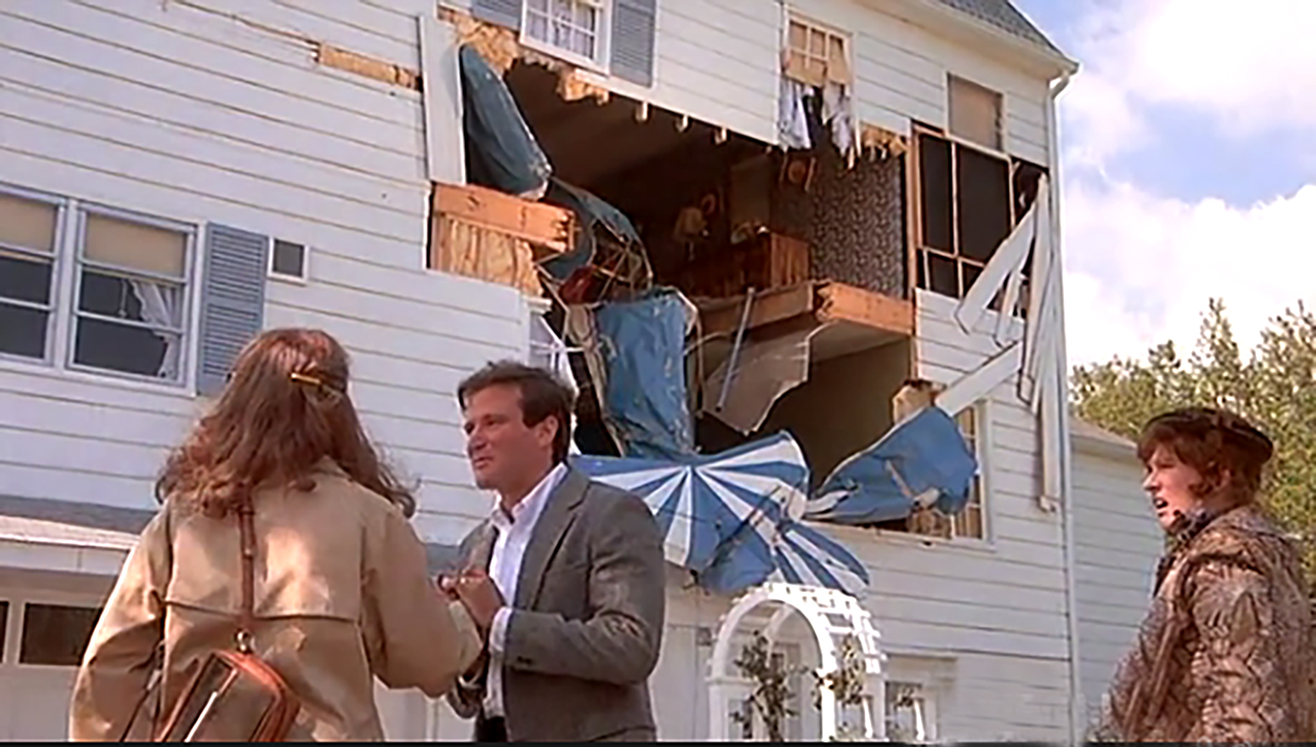
Risk
We'll take the house. Honey, the chances of another plane hitting this house are astronomical. It's been pre-disastered. We're going to be safe here.
From: The World According to Garp, Warner Bros., 1982
Notes:
Garp was possibly a budding reliability engineer with a scenario in front of him that we frequently encounter. However, he may missed some things that would have been important to make this assessment. Is this house on a high-traffic path to a nearby airport? How many crashes have we seen in this area? Is there any supporting data to compare this crash to a lightning strike or to a monthly occurrence?

Slide 3
Agenda
What is Risk?
Loosely Used Risk Terms in NASA
Why Do We Worry About Risk?
Risk vs. Possibility
Balanced Risk
Perspectives of Risk (Stakeholder, Developer)
Risk as a Development Tool
Acceptance of Risk at Different Levels and Times
Risk Classification
What is Risk-based SMA?
Ugly vs. Risky
Risks of Conformance and Nonconformance

Slide 4
What is Risk?
Definition: the combination of
a) the probability (qualitative or quantitative) that an undesired event will occur, and
b) the consequence or impact of the undesired event
In short, risk is an expectation of loss in statistical terms
Flavors of risk (consequences)
Technical (failure or performance degradation on-orbit)
Cost ($ it will take to fix the problem)
Schedule (time to fix the problem)
Safety (injury, death, or collateral damage)
Notes:
It is important to be explicit about what we mean when we say risk. This will be clear when we contrast risk with “possibility”.

Slide 5
Anatomy of a Risk
Context
Impact/Criticality
Concern
Statistics
Uncertainty
Structured risk statement
Likelihood
Consequence

Slide 6
Risk as a Common Language
Risk is the common communication language between all of the technical and nontechnical disciplines in a project
Finance
GN&C
PM
Thermal
RISK
Electrical
Systems Engineering
Schedulers
Science Team

Slide 7
Loosely Used Risk Terms in NASA
Baseline risk: the normal level of risk in developing and assembling a product
This can be considered as risk that is accepted by a project initiation without further tracking or debate
Generally we do not track risks within the baseline
Experienced developers mitigate baseline risks
Credible risk: risk having likelihood category of at least “1” on the pertinent risk scale (note that in GSFC’s risk scale there are 5 categories and 1 is the lowest risk category)
There are an infinite number of risks that are not credible for any project
Notes:
These terms are used quite often within NASA but it is difficult or impossible to find definitions anywhere. A “1” on the likelihood scale does not mean likelihood of 1 (100%), but it means the lowest probability range given the particular risk type (technical, cost, schedule, safety). For a technical risk, 1 is from 0.1% to 2%.

Slide 8
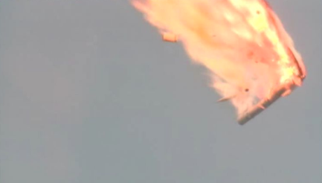
Why Do We Worry About Risk?
We don’t want bad things to happen
The only way to avoid risk is to avoid doing anything
Understanding risk is key to engineering the system
Establishing requirements
Responding to undesired or unexpected events
Choosing between different options
Communicating risk is key to portraying the status of a project in development
Photo: Tsenki TV Webcast
Proton Failure
Notes:
Risk is not just a general catchall for the things that we worry about in a project, but it is also a means to guide how we prioritize activities.

Slide 9
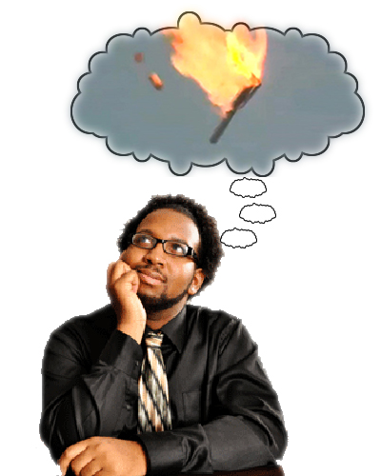
Risk vs. Possibility
Failure modes and mechanisms can appear through
Analysis and simulation
Observation
Prior experiences
Brainstorming “what if” scenarios
Speculation
These all constitute possibilities
There is a tendency to take action to eliminate severe consequences regardless of the probability of occurrence
When a possibility is combined with an environment, an operating regime, and supporting data, a risk can be established—this is core to the engineering process
Lack of careful and reasoned analysis of each possibility in terms of the conditions that results in the consequence and the probability of occurrence will result in excessive cost and may increase the overall risk
Notes:
When we become overwhelmed by trying to eliminate the possibilities, we end up driving up our risk posture, although we may intend to be acting conservatively.

Slide 10
Balanced Risk (maintaining a level waterbed)
A systems approach of looking across all options to ensure that mitigating or eliminating a particular risk does not cause much greater risk somewhere in the system
Try to maintain the level waterbed
Pushing too hard on individual risks can cause other risks to be inordinately high
Notes:
This is not to imply that all risks will be the same level in our desire to maintain a level waterbed, but too much attention on individual risks or possibilities will frequently cause some risks to inflate undesirably, because resources are always limited.

Slide 11
Unbalanced Risk Example
General safety requirements dictate that anything considered "safety" requires 3 inhibits.
Unfortunately, many elements prior to launch vehicle separation that are tied solely to mission success are put under the safety umbrella.
This means that by default, many items such as premature deployment of solar arrays or other appendages are considered a safety issue for the on-orbit portion, even if they have no range safety effect, and they prompt a decision that it is always better to have more inhibits even if such a design prompts an even greater risk of mission failure due to one of the inhibits not releasing.
Ultimately, under the guise of “safety” we may end up with a less reliable system that is not more safe if we are not diligent with system-level thinking
Reliability
without 3 inhibits
Reliability with 3 inhibits
Notes:
In our desire to promote a safety culture that includes safety of hardware, an unintended, unfortunate consequence is that depending on the circumstances and the types of systems involved, some items that tie only to mission success or reliability are captured under the more conservative safety umbrella and therefore supersede items not considered safety; and this can result in a less reliable system if unchecked.

Slide 12
The Battle of Wills
Each of two or more sides has a perspective, philosophy, or, in the worst case principle
All are conflicting, and generally based on past experience in some context
The heels dig in, and personalities take over
It’s time to frame the risk on both sides of each perspective

Slide 13
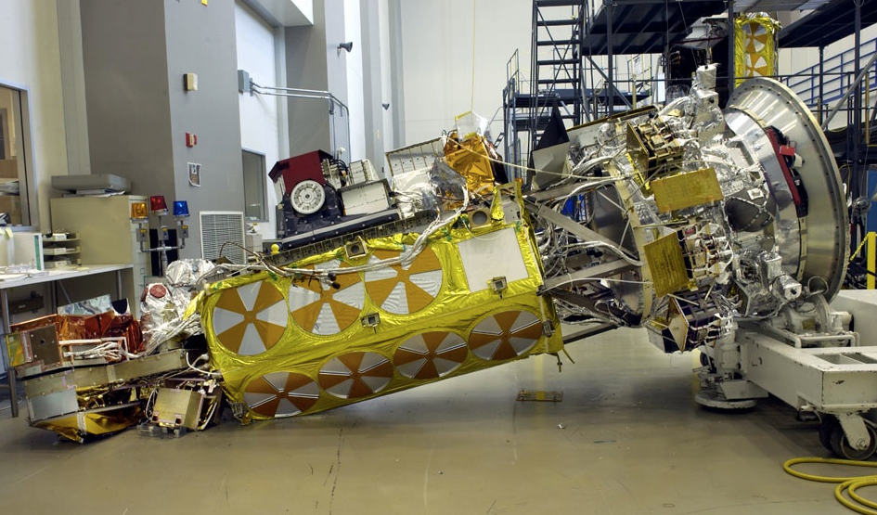
Perspectives of Risk—What Attributes are Used to Paint the Risk Picture?
Stakeholder
Developer
Well-established requirements and processes followed
Assessment from independent review team
Project risks presented
Problem records
Waivers
Experiences in integration and test
Project risks tracked
Team internal dynamics and confidence
PI/PM/systems engineer confidence
What do you mean you’re not following the NASA Lifting Standard?
We know how to do this—we’ve done it before.
Notes:
The perspective of risk between the developer and the stakeholder can be vastly different, and risk is seen through different products and observations between the two.

Slide 14
Risk Acceptance at Different Levels and Times
The primary stakeholder(s) (MDAA, Center Director, NOAA, user community, etc.) accept(s) risks for project mission success
Risk acceptance is delegated to the project to manage real-time, day-to-day development
Stakeholder has right of refusal through risk communication
Safety and Mission Assurance ensures the risks are properly captured and communicated
Many risks based on programmatic concerns are accepted from day one
Most technical risks need not be accepted until launch
Many risks involve items that are buried into a system such that removal will be very painful and are for all intents and purposes accepted early on
Programmatic risks that have not been fully mitigated will frequently become technical risks, i.e., there may be a latent defect that survived through I&T
Notes:
The stakeholder is the only one who can accept risk, but the project is delegated authority, with the stakeholder’s right to refusal. The project brings the stakeholder into the decision process when it is not clear that a risk would be acceptable by the stakeholder. Most risks are programmatic until close to launch, at which point, many remaining risks may be converted to technical.

Slide 15
What is Risk Classification?
Establishment of the level of risk tolerance from the stakeholder, with some independence from the cost
Cost is covered through NPR 7120.5 Categories
If we were to try to quantify the risk classification, it would be based on a ratio of programmatic risk tolerance to technical risk tolerance.
For Class A, we take on enormous levels of programmatic risk in order to make technical risk as close to 0 as possible. The assumption is that there are many options for trades and the fact is that there must be tolerance for overruns.
For Class D, there will be minimal tolerance for overruns and a greater need to be competitive, so there is a much smaller programmatic risk “commodity” to bring to the table.
The reality is that the differences between different classifications are more psychological (individual thoughts) and cultural (longstanding team beliefs and practices) than quantitative.
There is one technical requirement from HQ associated with risk classification: single point failures on Class A missions require waiver.

Slide 16
Risk Classification—(NPR 7120.5 Projects)
Class A: Lowest risk posture by design
Failure would have extreme consequences to public safety or high priority national science objectives.
In some cases, the extreme complexity and magnitude of development will result in a system launching with many low to medium risks based on problems and anomalies that could not be completely resolved under cost and schedule constraints.
Examples: HST and JWST
Class B: Low risk posture
Represents a high priority National asset whose loss would constitute a high impact to public safety or national science objectives
Examples: GOES-R, TDRS-K/L/M, MAVEN, JPSS, and OSIRIS-REX
Class C: Moderate risk posture
Represents an instrument or spacecraft whose loss would result in a loss or delay of some key national science objectives.
Examples: LRO, MMS, TESS, and ICON
Class D: Cost/schedule are equal or greater considerations compared to mission success risks
Technical risk is medium by design (may be dominated by yellow risks).
Many credible mission failure mechanisms may exist. A failure to meet Level 1 requirements prior to minimum lifetime would be treated as a mishap.
Examples: LADEE, IRIS, NICER, and DSCOVR

Slide 17
Risk Classification—(Non-NPR 7120.5 Projects)
NPR 7120.8 “class”—Technical risk is high
Some level of failure at the project level is expected; but at a higher level (e.g., program level), there would normally be an acceptable failure rate of individual projects, such as 15%.
Life expectancy is generally very short, although instances of opportunities in space with longer desired lifetimes are appearing.
Failure of an individual project prior to mission lifetime is considered as an accepted risk and would not constitute a mishap. (Example: ISS-CREAM)
“Do No Harm” Projects—If not governed by NPR 7120.5 or 7120.8, we classify these as “Do No Harm”, unless another requirements document is specified
Allowable technical risk is very high.
There are no requirements to last any amount of time, only a requirement not to harm the host platform (ISS, host spacecraft, etc.).
No mishap would be declared if the payload doesn’t function. Note: Some payloads that may be self-described as Class D actually belong in this category. (Example: CATS, RRM)
7120.8 and “Do No Harm” Projects are not Class D

Slide 18
What is Risk-Based SMA?
The process of applying limited resources to maximize the chance for safety & mission success by focusing on mitigating specific risks that are applicable to the project vs. simply enforcing a set of requirements because they have always worked
Risk-based SMA is now GSFC policy—GPR 8705.4
Notes:
This would be another form of knowledge-based SMA. This is an alternative to requirements based SMA, where many of the activities are based more on “how we’ve always done it” as opposed to being based on the specific risks involved.

Slide 19
Attributes of Risk-Based SMA
Upfront assessment of reliability and risk, e.g. tall poles, to prioritize how resources and requirements will be applied
Evaluating all risk categories (safety, technical, and programmatic) together to assure all factors are considered
Early discussions with developer on their approach for ensuring mission success (e.g., use of high-quality parts for critical items and lower grade parts where design is fault-tolerant) and responsiveness to feedback
Judicious application of requirements based on learning from previous projects and the results from the reliability/risk assessment, and the operating environment (Lessons Learned—multiple sources, Cross-cutting risk assessments etc.)
Careful consideration of the approach recommended by the developer
Characterization of risk for nonconforming items to determine suitability for use—project makes determination whether to accept, not accept, or mitigate risks based on consideration of all risks
Continuous review of requirements for suitability based on current processes, technologies, and recent experiences
Consideration of the risk of implementing a requirement and the risk of not implementing the requirement.
Note: Always determine the cause before making repeated attempts to produce a product after failures or nonconformance's
Notes:
Requirements will be assigned based on the specific project attributes, but even after they are assigned, there is always an opportunity to question them.

Slide 20
Ugly vs. Risky— Does Ugliness = Riskiness?
Notes:
Does a board that has many features that we don’t like, such as white wires, dead bugs, cut traces, abundant staking compound, etc., necessarily entail more risk than one that doesn’t? There are proven approaches implementing these “kludges” reliably, but the real question is what led to those changes. If we were to respin the board while ignoring the factors that led to the changes, would we then be at a lower risk level?

Slide 21
Risk of Conformance vs. Risk of Nonconformance
Were requirements imposed based on an understanding of the risks within a project?
What are the risks associated with the enforcement of requirements?
What is the risk associated with a particular nonconformance?
Should we immediately assume that a nonconforming item is risky for the application?
In many cases there is a good reason why a product is nonconforming
Do not reject a nonconforming item without understanding the risk.
Determine the cause of NC before reproducing the item.

Slide 22
Summary
Risk is a central element of space system development
Understanding of risk is key to effectively engineering the system
This understanding is used to prioritize resources in development and to convey the status to the project stakeholders
Confusion between severity of consequence, scenarios, probability and relationship to other categories (safety, technical, and pro-grammatic) can lead to unnecessarily high costs, unbalanced risk, and an overall higher risk posture for a project.

Slide 23
Backups to Draw From

Slide 24
Risk as a Development Tool
Preliminary Risk Assessment
Requirements Development
Product Development and Deployment
Risk Identification
Project Risk Database
Prioritization of Resources
Project Communication to Stakeholders
ATP/Resource Allocation
Notes:
Risk plays many roles in project development

Slide 25
Risk Classification Trends
Stepping from A, B, … “Do No Harm” results in:
More control of development activities at lower levels; people actually doing the work
Less control by people who are removed from the development process
Less burden by requirements that may not affect the actual risks for the project
More engineering judgment required
Less formal documentation (does not relax need to capture risks nor does it indicate that processes should be blindly discarded)
Greater understanding required for reliability and risk areas to ensure that requirements are properly focused, risk is balanced to enable effective use of limited resources, and that good engineering decisions are made in response to events that occur in development
Emphasis on Testing/Test results to get desired operational confidence
Greater sensitivity to decisions made on the floor

Slide 26
Class D at GSFC
What is Class D? = Highest risk posture for missions governed by NPR 7120.5
What is Class D not?—A catch-all for projects that are not NPR 7120.5 Classes A-C
Is there a problem unique to Class D at GSFC?
No
There is an unbalanced approach to risk that affects Class D more than others
There is a lack of definition of how key processes for mitigating risk vary across all risk classifications
These problems even affect Class A
GSFC Class D Constitution addresses some of the programmatic processes such as management structure, waivers, etc.
GPR 8705.4 effort and new organizational structure addresses the technical processes
Organizational changes in 300 will provide the infrastructure for implementation
Implementation has already begun

Slide 27
Class D (and below)—Dos & Don’ts
Do:
Streamline processes (less formal documentation, e.g., spreadsheet vs. formal software system for waivers, etc.)
Focus on tall poles and critical items from a focused reliability analysis
Tolerate more risk than A, B, or C (particularly schedule risk)
Capture and communicate risks diligently
Rely more on knowledge than requirements
Put more authority in the hands of PMs and PIs
Have significant margin on mass, volume, power (not always possible, but strongly desirable)
Have significant flexibility on performance requirements (not always possible, but strongly desirable)
Don’t:
Ignore risks!
Reduce reliability efforts (but do be more focused and less formal)
Assume nonconforming means unacceptable or risky
Blindly eliminate processes

Slide 28
Defects vs Mission Success
Risk can be characterized by number of defects that affect performance or reliability
and the impact of each. Defects are generally of design or workmanship.
Random vibe
Functional FMEA
4 T cycles
Random vibe
4 T cycles
GOLD rules
QPL parts
Internal review
S/W engineering and QA
S/W engineering and QA
1st tier QA
Safety EMI
Closed Lloop GIDEP and alerts
Sine burst
Safety EMI
FPGA requirements
Sine burst
Number of Residual Design Defects
Number of Residual Workmanship Defects
Sine sweep
Workmanship requirements
Prohibited materials
Independent review 1
2nd tier QA
EM work
EMC
Detailed design FMEA
Fastener integrity
Acoustic
4 more T cycles
Independent review 2
Full EMI/EMC
Full EMI/EMC
Full PRA
3rd tier QA
Mission Success Activities
Mission Success Activities
Note: A thorough environmental test program will ensure most risks are programmatic (cost/schedule) until very late, when time and money run out.

Slide 29
Defects vs Mission Success as a function of risk classification
Closed Loop GIDEP and alerts
Workmanship requirements
Generally-representative example, prioritization may vary by mission attributes or personal preference or experience.
4 T
cycles
Random vibe
Functional FMEA
Sine burst
Safety EMI
GOLD rules
QPL parts
First tier QA
S/W engineering and QA
Internal review
Closed loop GIDEP and alerts
Number of Residual Defects
FPGA requirements
Workmanship requirements
Sine sweep
Prohibited materials
2nd tier QA
Independent review 1
EM work
Fastener integrity
Acoustic
EMC
4 more T cycles
Design FMEA/FTA
Independent review 2
Full EMI/EMC
3rd tier QA
Full PRA
DNH 7120.8
Class D
Class C
Class B
Class A
Mission Success Activities

Slide 30
Other Activities With Cost & Risk Reduction Implications
Nonconformance handling
Is the requirement that is not met important for the current project in its environment?
Is the nonconforming item critical?
What is the risk for this project of the nonconformance?
Cost/schedule
Technical
Work orders and procedures
Anomaly resolution
Documentation
Root cause analysis
Lessons learned for same project or others

Slide 31
Cost vs Time to eliminate a defect
Removing layers results in some defects not being caught, and some being caught later.
Mission
Cost +
The more layers that are removed, the later defects are likely to be caught (if they are caught), the more work that has to be “undone”, the more testing that has to be redone, and the more likely the project is to suffer severe programmatic impact and/or to fly with added residual risk.
Cost to remove a single defect
Launch
date
Time at which defect is caught

Slide 32
GPR 8705.4
GSFC implementation of NPR 8705.4
Risk Classification Definitions
Nonconformance handling
Do not reject without understanding the risk
Determine cause of NC before reproducing the item (even from different vendor)
Guidelines for activities vs mission class
Ultimately will be one element used to develop project Mission Assurance Requirements vs mission class
How does a project demonstrate that they are developing a Class “X” product?
How do we convey to a vendor what we expect for Class “X”?

Slide 33
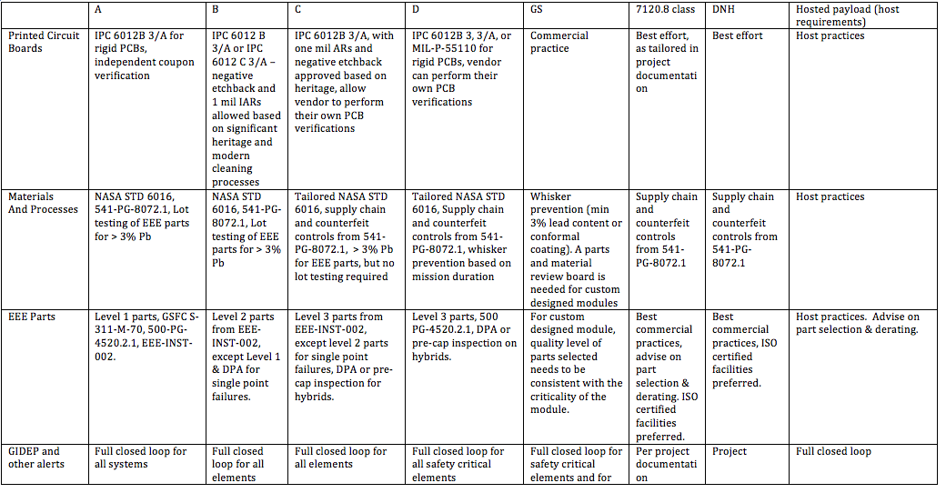
Mission Success Activities vs. Risk Posture (example elements in draft)
*Excerpt from previous draft of GPR 8705.4

Slide 34
Risk Classification—All Levels
Class A missions can have Class D elements
Non-critical
Highly redundant
Deliveries with acceptable “defects”
Class D mission can have Class A elements
Critical elements
Only available
Spares from other projects

Slide 35
Class D (and below) Categories
Science Mission (NPR 7120.5) | Research/Technology (NPR 7120.8) | Do No Harm
Cost > = mission success Schedule flexible (low priority) ~6 mo.–2 yr. life Project failure = mishap Medium technical risks (may fly with many yellow risks) | Very low cost individual projects Schedule flexible (low priority) High technical risk Very short lifetime (< ~3 months) Success is determined over multiple projects, e.g., 85% success over one year’s worth Project failure is not a mishap | Only requirement—do no harm to personnel or other property (e.g. ISS) Schedule flexible (low priority) Very high technical risk Lifetime is best effort Project failure is not a mishap

Slide 36
Best Applicability of a Streamlined Class D Approach
Simple design (few critical elements)
Short mission life
Clear and static science objectives and goals
Sufficient, but not overreaching
Robust design (tolerant to variance in workmanship)
Stable and repeatable manufacturing processes (with known process variances)
High Margins (to allow more design flexibility)
Mass
Power
Volume
Specifications: Dimensions, Materials
Prior flight experience (with critical components in the same environment)

Slide 37
Center Challenges and Perceived Challenges for Low Cost Implementation In-house at GSFC
GSFC directives and standards (more detail in backup)
A dozen or so GPRs, Center wide PGs and standards for workmanship, environmental test, and GOLD rules
Mostly handled by common practices
Risk classification is not handled well for those that have significant impact
Software requirements are the biggest burden, without particular basis in risk
NASA directives and standards
Numerous NPRs, NPDs, and standards
Similar statement to above applies
Engineering resource budgeting—not closely tuned to streamlined implementation

Slide 38
The GSFC Quality Triangle
Commodity Risk Assessment
Risk based usage guidelines
Risk layering requirements per risk class
Nonconforming and out-of-family item risk assessment
Learning through risk assessments, research, and testing
Quality Engineering
Upfront involvement in design
Design for manufacturability
Assurance of process engineering and qualified processes
SME support for supply chain management
Inspection
Nonconformance and problem identification in developed hardware/software
Management Systems
ISO and AS9100 quality
NCR follow-ups with vendors
Audits and assessments
Supply Chain Management
Lessons learned capture
Notes:
Here is how quality should work in the new organization. The CRA provides the derating and usage guidelines as well as the risk layering requirements based on the risk classification (some people in CRA will just be matrixed over for a small percentage of time while others will be permanent full time) [Note: need to include required/prohibited materials & processes as well]. The CRA will also determine action/impact when those requirements are not met.
Quality engineering will use the requirements established by CRA (and be a contributor to that process). QE will have some upfront involvement in the design and early development to facilitate design for manufacturability. They will facilitate process engineering achieves requirements where they exist (see note above) including qualified and controlled processes. They will work collaboratively with Management Systems to identify technical criteria, and compliance, for supplier capability and qualified processes. They will inspect the items and identify nonconformances and problems or concerns. They provide their assessments to the CRA group for a project-specific “tactical” risk assessment, then to the management systems branch for follow-up with the vendor. Management systems will explore special procurement options (PODs w/ IDIQ, etc.) for blanket purchases for the Center when needed to achieve supply management objectives.
The CRA provides the ultimate disposition to the management systems group for lessons learned capture, and back to quality engineering to bring to the project decision process and risk board. Management systems maintains the records of nonconforming, out-of-family, and other items of concern, while CRA learns from the process and improves its ability to perform risk assessments, and possibly updates requirements or guidelines.

Slide 39
CRAE: Commodity Risk Assessment Engineer
Commodity: Tangible or intangible entity that has a major impact on risk, cost or schedule for GSFC projects
Expert in key discipline area with background and experience with reliability and risk
Responsible and empowered to assign risks based on warnings, alerts, environments, and “what we are stuck with”
Establishes testing programs and protocols to keep up with current design practices and common parts and components
Sets the policies for the risk-based decisions on use of parts, components, and processes
Establishes layers of risk reduction based on risk classification (ownership of GPR 8705.4)
Determines the acceptability and risk of alternate standards or requirements, or deviations and non-conformances
Answers, “are we okay?”, “why are we okay?”, “how okay are we?”
Provides risk assessment to the project for the project to decide how they want to disposition

Slide 40
Commodity Areas
Standard Spacecraft Components
Printed Circuit Boards
Digital Electronics (especially FPGAs and ASICs)
Power Systems
Capacitors/inductors
Transistors
Resistors
Hybrid microcircuits
Optocouplers
On-board processors
Workmanship/Printed Wiring Assemblies/Packaging/Components
Software
Materials
Radiation
Environmental testing
Contamination
Connectors
ESD

