Slide 1
Chief Engineer, ISTD

Slide 2
Overview
Pre-Historic
Early History at Goddard
1974-1980
1980-1990
1990-1995
1995-2000
2000-2010
2010-Present
2

Slide 3
Prehistory
The Metal Oxide Semiconductor Field Effect Transistor (MOSFET) was invented in 1959—same year Goddard is born.
Dave Dargo hired by GSFC in 1961 to establish semiconductor capability in B11.
The first Goddard p-channel MOS (PMOS) integrated circuits were developed in the late 1960s under D. Dargo (and supplied to the IMP, HEAO-A and HEAO-B, IUE, OSO-1 ISEE, ISPM, EGRET, GRO missions (and others) throughout the late 1960s and into the 1980s.
–From this point forward we are THE semiconductor center at NASA for many years even decades to come.
Aug/Sep of 1974 Dargo hires me and Gerry Lamb. The group now has 3 engineers and 6 technicians plus the section head/engineer (Dargo).
The Branch has two sections: Microelectronics Device Fabrication and Electronics Design/Packaging
NOTE: We are part of the Mechanical Systems Division developing microelectronics—there simply is no other place for us to fit in at that time. In 1976 we are transferred into the newly formed Instrument Division as the Electronic Instrument Techniques Branch (where we have remained ever since but with differing branch titles and organizational codes (756, 724, 718, 553).
3

Slide 4
Dave Dargo 1977

Slide 5
Early History
Complementary MOS (CMOS) patented in 1964. Jhabvala develops Goddard’s first CMOS IC’s in 1975 and the first rad hard PMOS devices in 1976. We develop the first NASA Charged-Coupled Devices (CCDs)~1977.
John Mather comes to Goddard in 1976 to start on the Cosmic Background Explorer (COBE). In 1977 we are enlisted to test and develop detectors from the near Infrared (IR) to the very far IR (200µm) for the COBE study. In 1979 the decision is made to build COBE by and at Goddard. We are now making, packaging and testing custom PMOS, CMOS and making, packaging and testing custom cryogenic detectors operating at temperatures ~1.6K (-271C).
However, in the late 1970s to early 1980’s the commercial availability of custom CMOS ICs skyrockets–we can focus now on more unique and exotic technologies. We can readily purchase all types of ICs.
We evolve to the all-encompassing Semiconductor Devices and Detectors Research, Development, Test and Packaging Center at NASA

Slide 6
Summary: 1974–1980
Design, layout, fabricate, test and package custom MOS integrated circuits (ICs) for many missions (all done by hand):
Standard PMOS
Standard CMOS
Radiation hard PMOS and CMOS
Silicon gate CCDs
DMOS
VMOS
Amorphous silicon devices (future solar cell panels)
Start single element infrared detector development (~1976), testing methods and characterization at T<4.2K.
Start outside collaborations with the medical profession which we will generally continue.
Implement SUPREM and SPICE programs but requires modem access to remote mainframes.
We achieve Large Scale Integration (LSI) of ~1,000 transistors/IC. This is the state-of-the-art (worldwide) in the 1970s and there are only a few labs in the world capable. We are the first to develop space flight-quality rad hard (ion-implanted) PMOS ICs. These devices are used by NASA, international programs (with ESA), and universities.

Slide 7
Remember~1980
Laptops are still 20 years into the future.
The internet is still 15 years into the future.
IC layout software is 10 years into the future.
Desktop computers are 10 years into the future.
-AND-
Smart phones are more than 25 years into the future.

Slide 8
Remember, in the Year 1980–continued…
Reliance on scientific calculators (which are very expensive)
No phone mail
Library is prime source of information—very long time-delay
All documentation is done on a typewriter
All presentations are hand-drawn
All papers are typed and drawings done by draftsmen/women
No digital cameras (everything is film)
(George Orwell’s “1984” is still 3 years into the future)
“2001 A Space Odyssey” takes place in the very far future (now in the very far past)
Fabrication Technology Limitations:
Labs are typically class 10,000, which limits technology development.
All masking is contact (no projection or steppers), and this also limits technology development.
Mask data is sent by magnetic tape
No convection ovens
No dry etching
No indium bump bonding process
No sputtering
Ion implantation limited to ~200keV
No MOCVD
No MBE

Slide 9
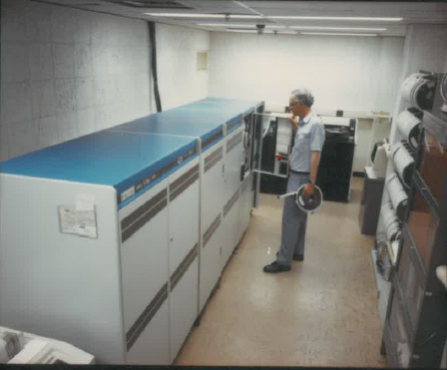
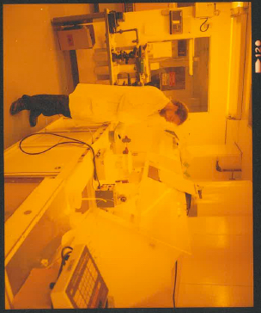
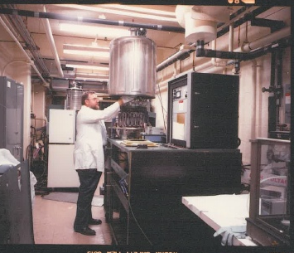
Semiconductor Fabrication Facilities
(Prior to the DDL)
Primary wafer fabrication occurs in the B 11 south wing rooms S7-S32.
Below: S19—Photolithography, wet chemical processing (hazardous and non-hazardous), mask aligning.
VAX computer room. Device layouts transferred to magnetic tape. Vast improvement over punch card data entry.
Behind S31-to S7 is a continuous lab (aka “light tunnel”) which was the E-beam evaporation facility and some test stations.
Behind S7 (Christine’s lab now) was the 80keV and then 200keV boron (from a BF₃ source) ion implanter—quite hazardous.
In the penthouse was our silox deposition system using silane and phosphine gases stored outside on the roof for doped oxide deposition.
High temperature furnaces (up to 1400C) are still in S14 and additional furnaces were in S19A. The furnaces in S14 were also used for doping from a liquid BBr₃ source and are still there.

Slide 10
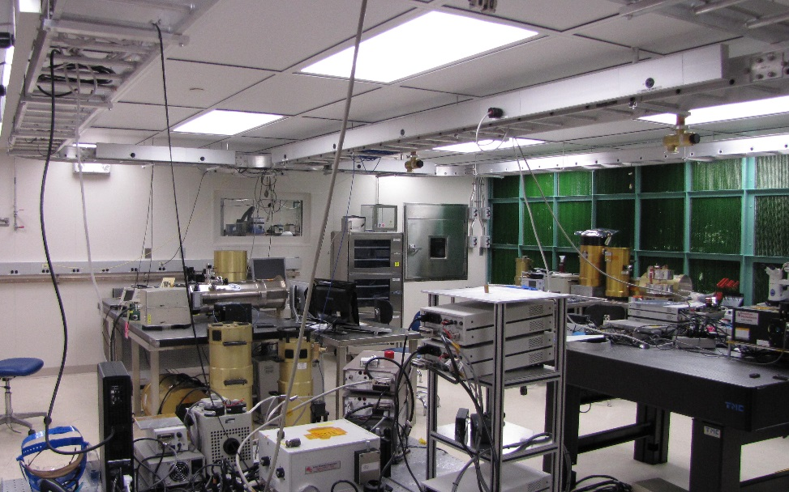
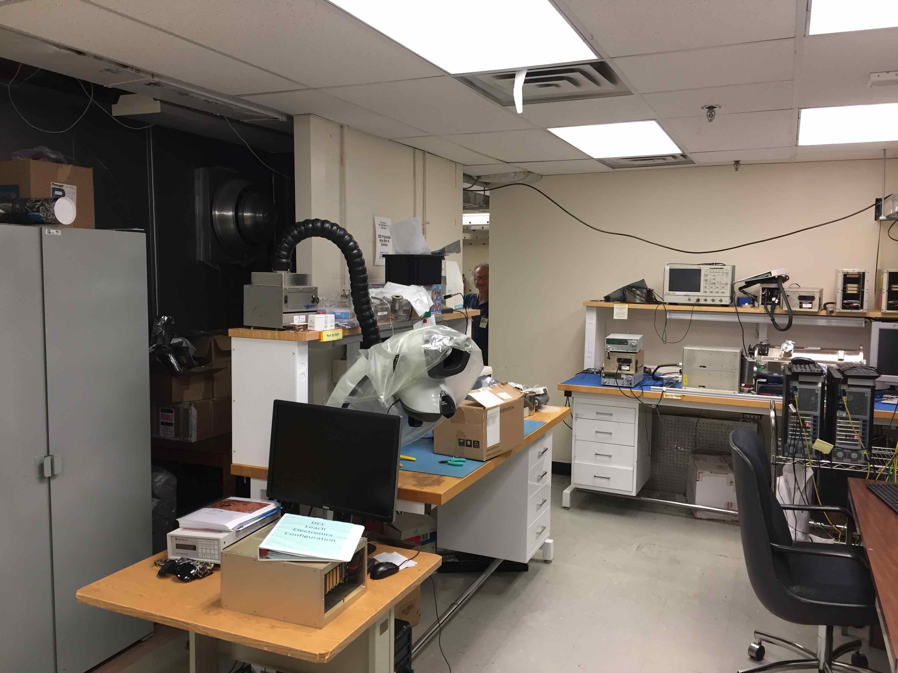
Facilities
Then (1970~1991)
S19
S27-31
Now 2018

Slide 11
Minimum IC Mask-Aligner Printable Feature Size (Typically the FET Channel Length) 1975
NASA
1975

Slide 12
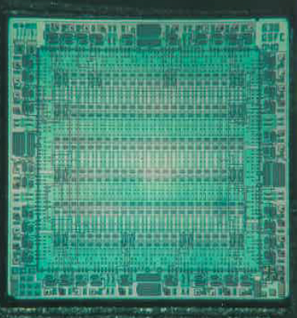
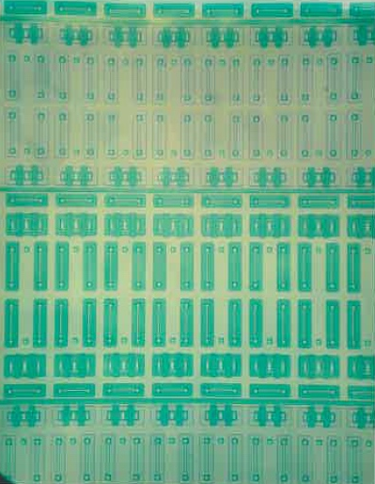
Custom CMOS Gate Array
Approximately 1,000 transistors, diodes and feedthroughs This is the state-of-the-art in 1976

Slide 13
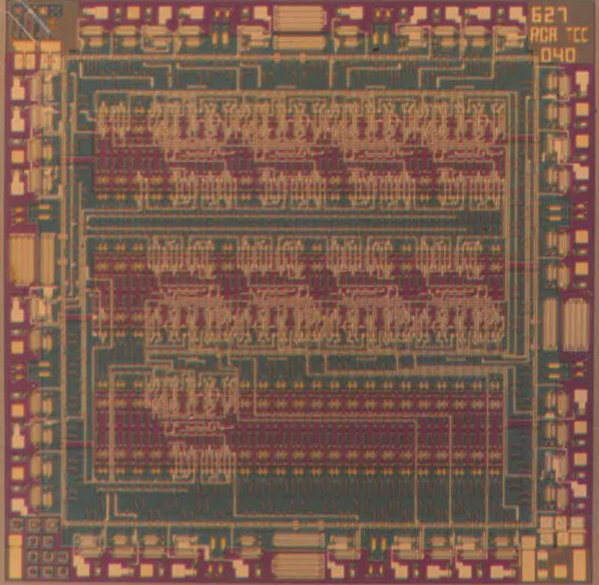
Custom CMOS Gate Array, 1976
My pride and joy to this very day!
Actual size
CMOS 9-bit synchronous counter IC

Slide 14
Custom Linear CCD Shift Register/Delay Line

Slide 15
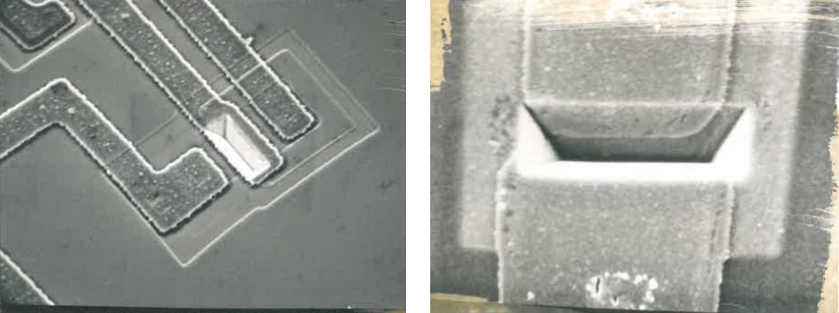
The Minimum FET Channel Length is~10 µm in 1975 (This defines the technological performance limit)
The channel length is the defining IC performance parameter. We developed new ways to make the transistor smaller:
DMOS
VMOS/double-diffused VMOS
From these technology developments new fabrication techniques were incorporated and refined: anisotropic etching, precise ion implantation, new diffusion sources (boron nitride solid source, spin-on oxides).

Slide 16
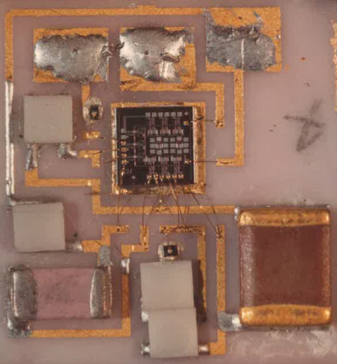
Medical Applications
We developed fetal pH and EKG monitoring systems with telemetry, 1977.
We developed a platinum implantable electrode array and hybrid electrical stimulation module for damaged nerve regrowth experiments, 1979.

Slide 17
Single Element Detectors Fabricated for the Cosmic Background Explorer (COBE) 1977-1980
Wavelength λ (µm) | Candidates
1.25 | Si:In InSb Ge
2.2 | Si:In InSb (PV) HgCdTe
3.5 | Si:In Si:Bi Si:Ga InSb
5 | Si:In Si:Bi Si:Ga
8–15 | Si:As Si:Ga Si:Bi
15–30 | Si:Sb
40–80 | Ge: Be Ge:Ga
80–120 | Ge:Ga
120–200 | Ge:Ga (stressed)
200–300 | Si Bolometer Ge Bolometer
We explore all varieties of “interesting” elemental compounds under a wide range of conditions such as operating temperature range, pressure, voltage, radiation, thermal conduction and most importantly—wavelength responsivity. These are very formative years for the entire industry.

Slide 18
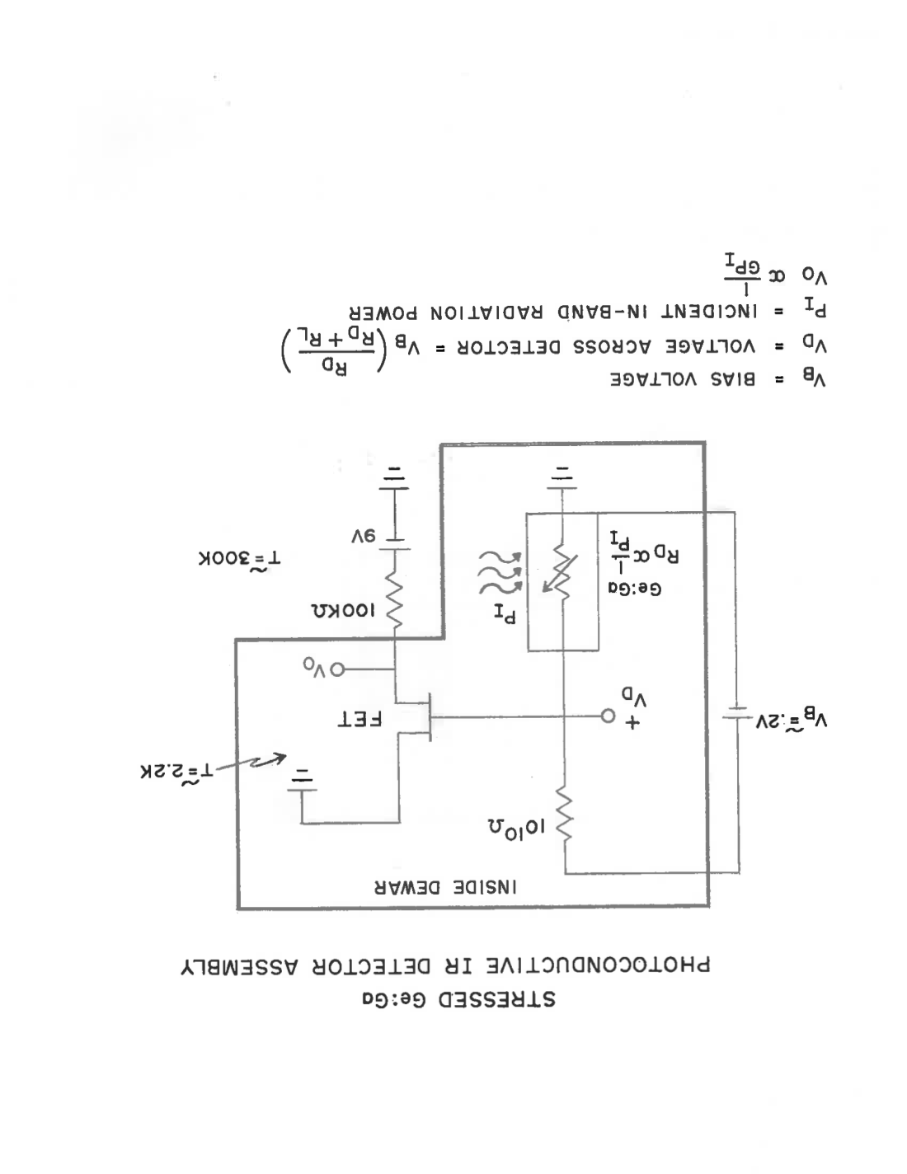
Single-element Ge:Ga bolometer (stressed)
1979
Required Very High Load Resistor (10¹⁰Ω) at Τ~2.2Κ
ALL THE DETECTORS ON COBE WERE SINGLE ELEMENTS

Slide 19
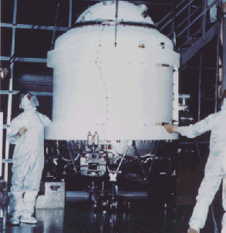
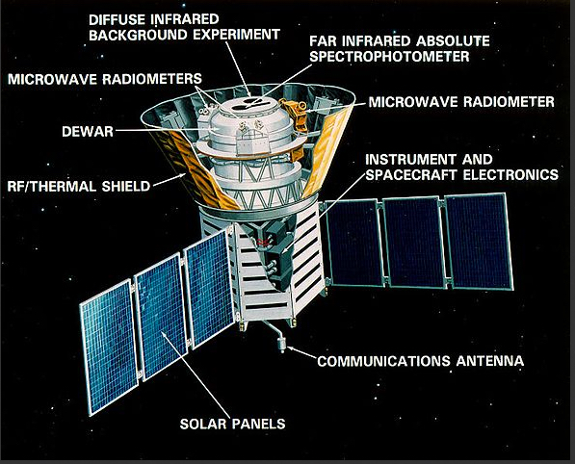
Cosmic Background Explorer 1976–1989
The Liquid Helium tank (T=4.2K/-269 ºC)
There were a total of 14 single element detectors covering the wavelength region from 1µm to 10,000µm.

Slide 20
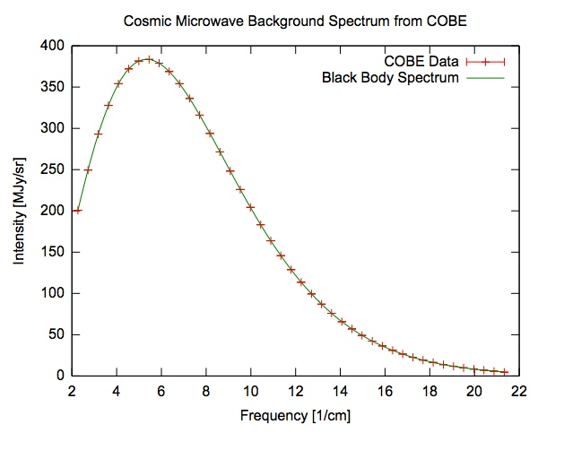
Nobel Prize in Physics Awarded for COBE
27 years after COBE development started at NASA GSFC, John Mather won the 2006 Nobel Prize in Physics for results achieved by COBE.
This branch was a major contributor to COBE detector development, testing and assembly for all 3 instruments (FIRAS, DIRBE and DMR). All data was collected by single element detectors!!!
We also were responsible for the Internal Reference Source and Light Scatterometer subassemblies. Devices developed here were precursors for devices used in future missions: Spitzer Space Telescope, WISE, ASTRO-F, SPIRE, JWST, OVIRS, Lucy and to Ames, UCB, Cal Tech
New devices were conceived and invented (many with H. Moseley). Concepts for future missions formulated (bridge chips, micro-filament sources–3-D devices).
Some future missions that benefitted:
Gravity Probe B
Spitzer Space Telescope
New Horizons (to Pluto)
OSIRIS Rex
James Webb Space Telescope
COBE Data
2.7K Blackbody Spectrum

Slide 21
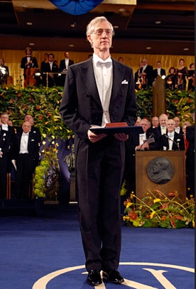
Nobel Prize Awarded to John Mather for COBE 2006
This occurred 27 years after we started working on it.

Slide 22
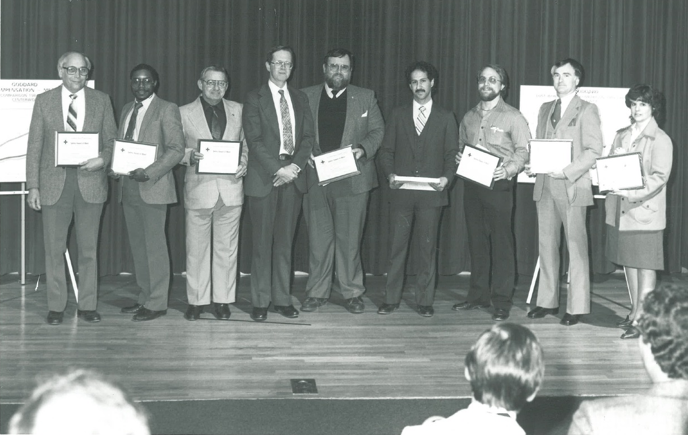
COBE Award Presented to the Microelectronics/ Detector Fabrication Group 1987

Slide 23
1980-1990 Decadal Summary
Focus starts to shift to advanced detector/microelectronics research, development and testing
This is what we are working on:
First PbS integrated detector arrays developed at GSFC
Charge Coupled Device array development
PbHgS
PtSi
Pd₂Si
High T_{c} Superconductors
GaAs Quantum Well detector element
GaAs laser diodes
GaAs ICs and FETS
high value micro-resistors (>10⁹Ω)
new micro-blackbody sources
Ge JFETs
InSb JFETs
Si JFETs
Silicon bolometers
x-ray bolometers
PC HgCdTe
and this is the beginning of the CCD and QWIP array era.
We explore new devices for cryogenic applications, detector arrays and custom devices for unique NASA applications

Slide 24
SUMMARY continued 1980-1990
Basic R&D for cryogenic applications:
Large format readout chips
New cryogenic testing methods to ~1.4K
New packaging techniques to survive cryogenic applications (epoxies, substrates, wiring)
New temperature sensors and new measuring instrumentation such as ellipsometers, profilometers, blackbody sources, FTIR, spectrum analyzers, low noise pre-amps, temperature monitors, electrometers, low-noise bias supplies, etc.
Branch gets Valid Logic System for IC layout!!
We now have the first computer systems to help in design, analysis, layout, testing and documentation (to some degree).
But--we are still doing all this engineering/physics/chemistry R&D in the ground-floor labs in B11. This is now a major safety issue.

Slide 25
Starting in the early 1980s
the Branch dramatically increases professional hiring (1st wave)
1983~1992
Geoge Alcorn
Christine Allen
Vince Bly
Andre Burgess
Audrey Ewin
Marilyn Fortin
Steve Graham
John Jackson
Kathy Kost
Around 1987 the focus of the Branch is now expanded to:
Design and manage the build of the new QA/DDL facility (B30 and the DDL)
X-ray to sub-millimeter detector technology and detector array development
Detector characterization
Detector-based instrument development
Multiple project support (emphasis on detectors)
Carl Kotecki
Danny Krebs
Anh La
Don Lokerson
Bob Martineau
John McHale
Pete Monti
Sridhar Manthripragada
John McCloskey
Brent Mott
Trang Nguyen
Caleb Principe
Ken Reed
Bob Stanley
Carl Stahle
Rosalind Steptoe
Peter Shu
Jeff Travis

Slide 26
Turning Point: 1985–1990
Three important events affect the lab late in this decade
We were (and had been for many years) a major safety concern at the Center (safety incidents have occurred here and in nearby labs).
In 1985, the US and Japan signed the Semiconductor Trade Agreement. I was appointed to assist the US Dept. of Commerce as the Technical Advisor. This allowed me to see first-hand, the “new” state-of-the-art in the major Japanese Semiconductor Fabrication Facilities for the next 7 years (and also S. Korea).
This led to the inception of the new semiconductor development lab in 1987 enabling NASA to build new types of instruments.

Slide 27
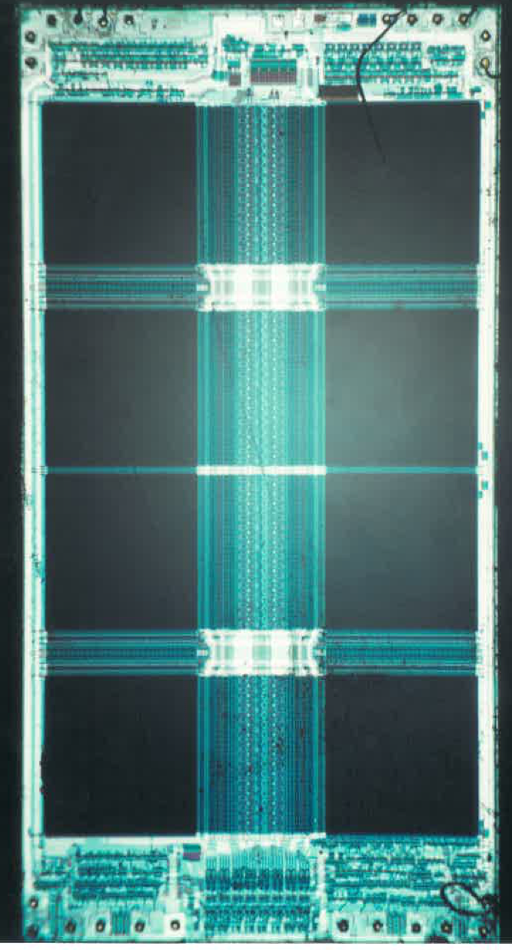
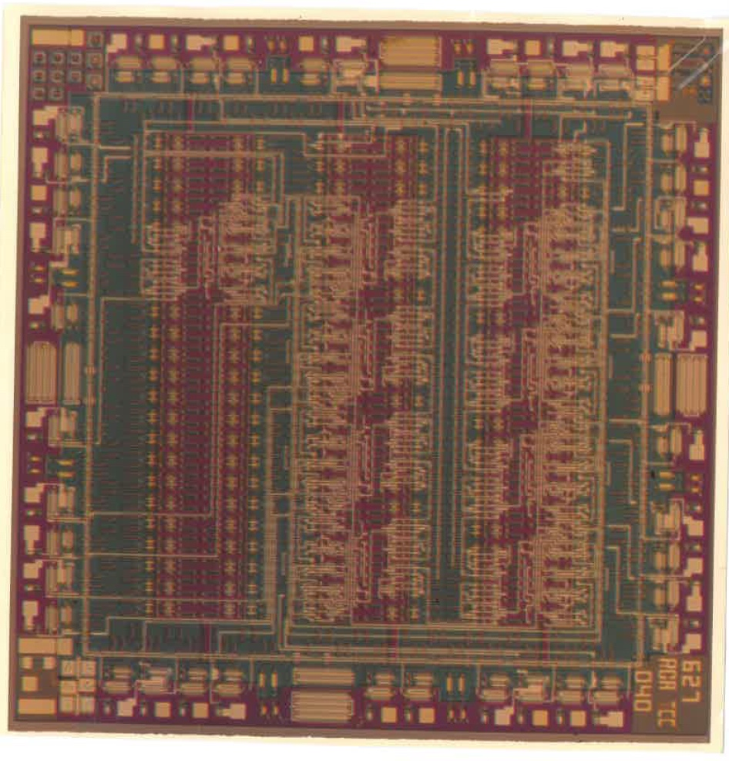
Hitachi 256K DRAM 1985
32,000 transistors and 32,000 capacitors (64,000 devices). Just 1 of 8 cells!
My 1976 “pride and joy” with 1,000 devices total.
In 1985 there is no internet. Cable TV was a rarity. Information was not rapidly disseminated hence we relied entirely on technical journals (with a long time delay) so this was a complete epiphany to me and to NASA. We are, almost instantaneously, way behind in integrated circuit processing capability.

Slide 28
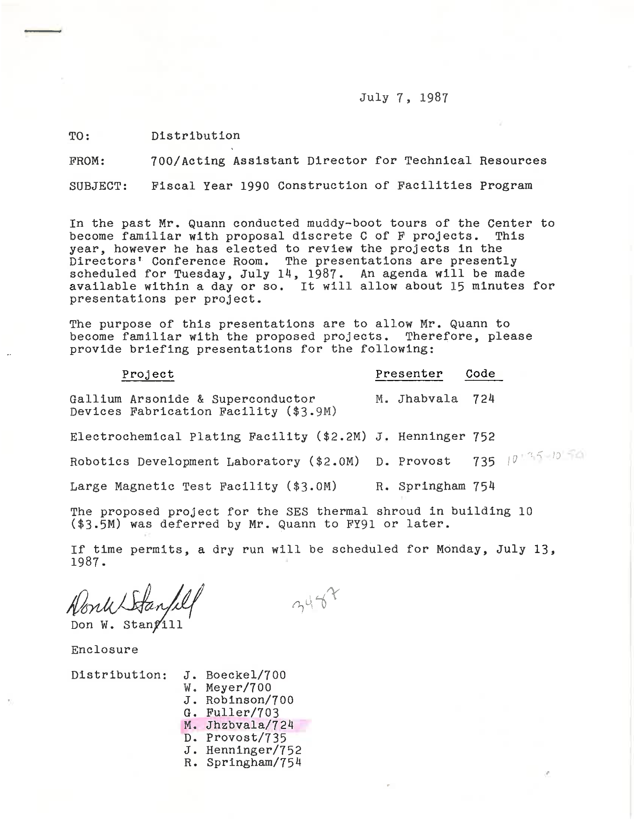
3rd significant event in the 1980s
January 28, 1986
Space Shuttle Challenger Explodes--NASA is paralyzed for >2 years
All launches delayed
Projects idle and schedules revised
Limited new work, but…
–July 14, 1987–
We make the first presentation to add an addition to building 11 known then as the “Gallium Arsenide and Superconductor Devices Fabrication Facility” which eventually becomes the DDL.

Slide 29
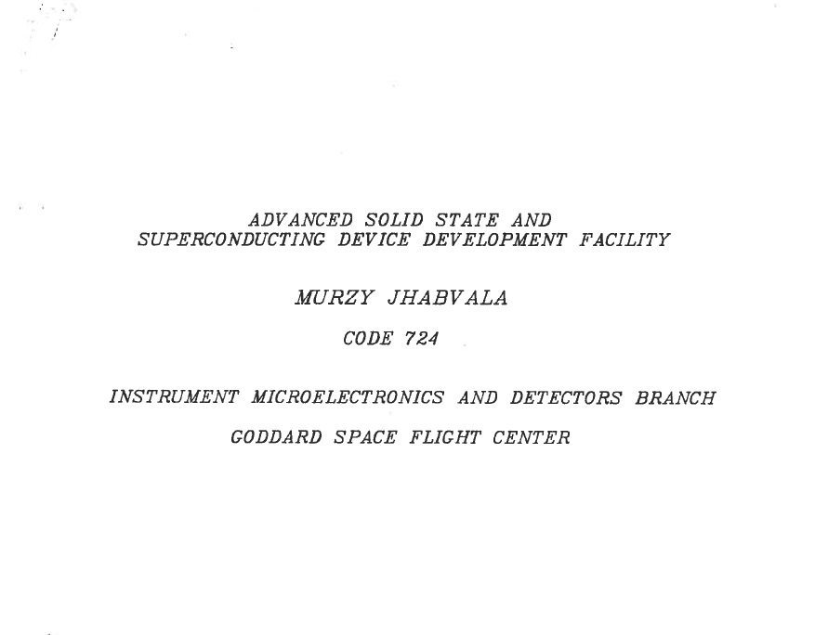
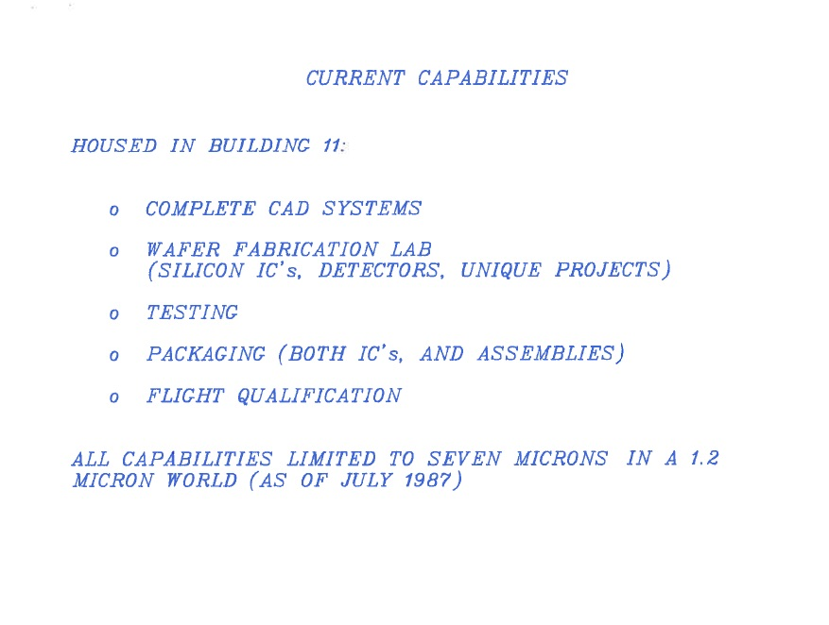
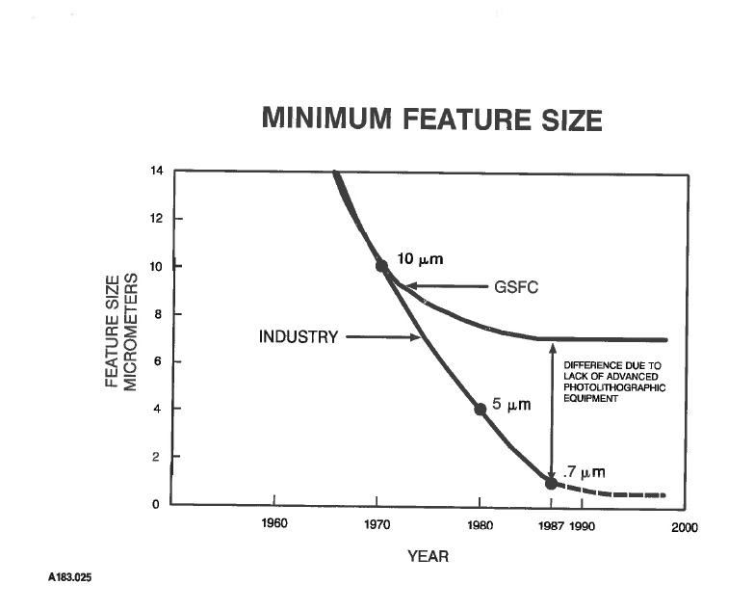
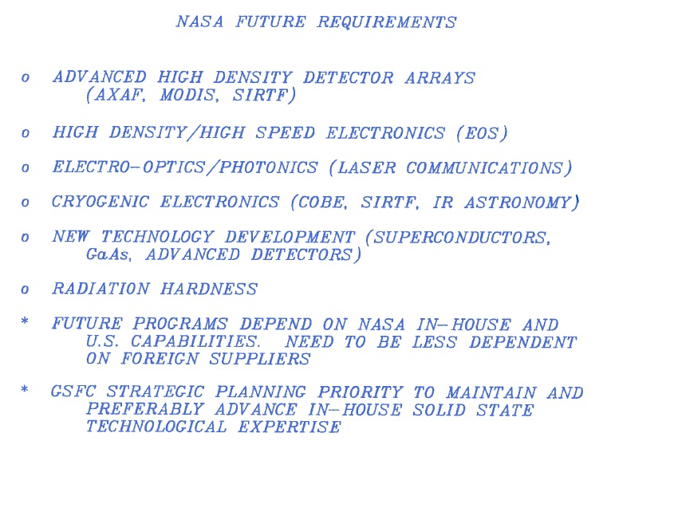
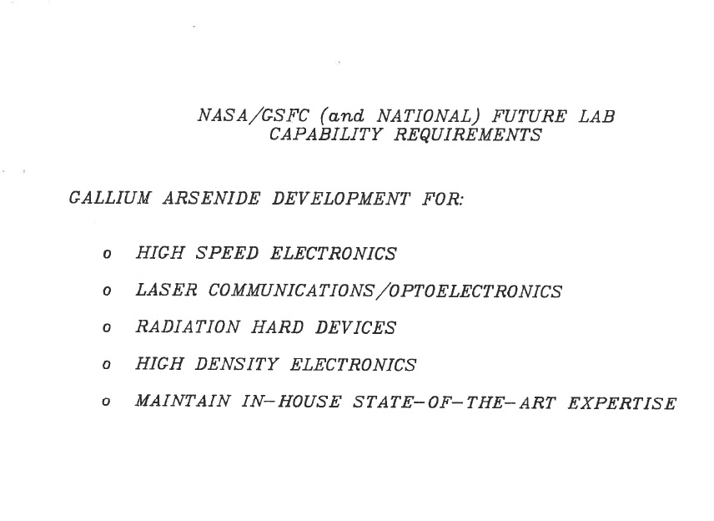
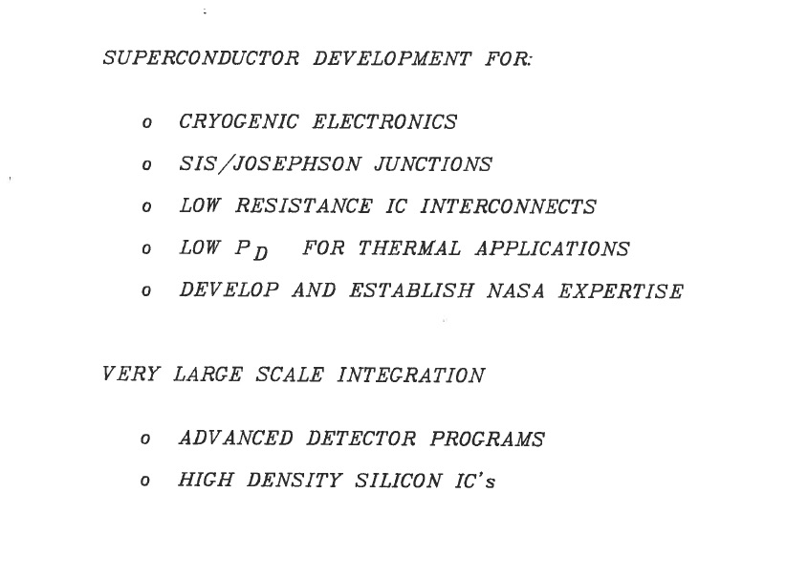
The DDL “Sales Pitch” July 14, 1987
What we didn’t envision was MEMS

Slide 30
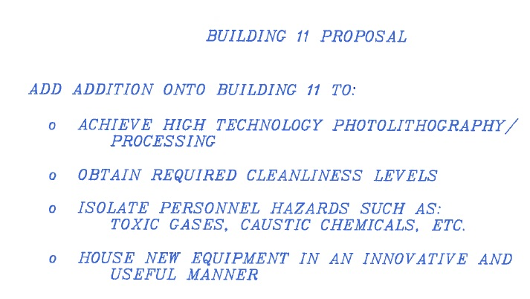
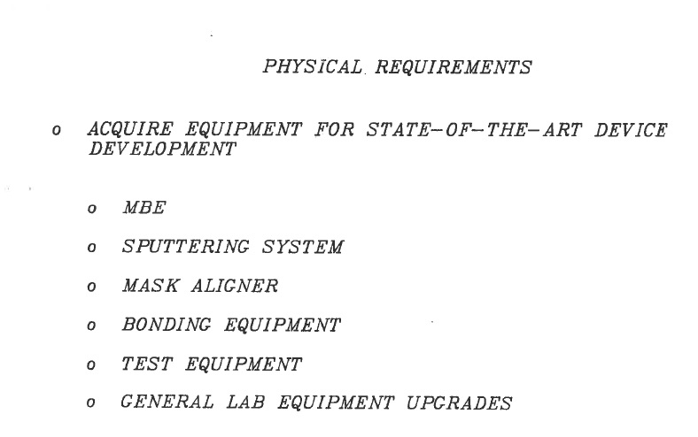
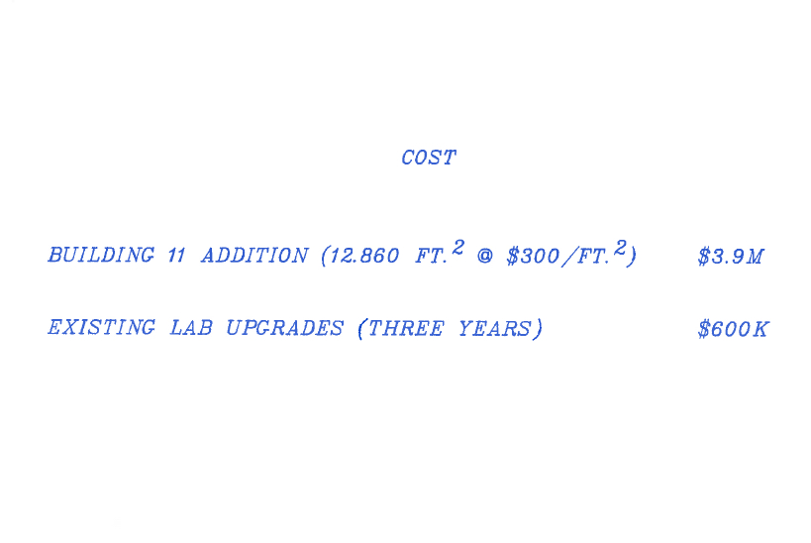
The DDL “Sales Pitch” July 14, 1987

Slide 31
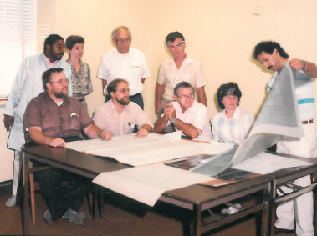
New Detector Development Laboratory (DDL) Architectural Design Meeting, ~1989
The DDL/B30 was completed in July of 1994

Slide 32
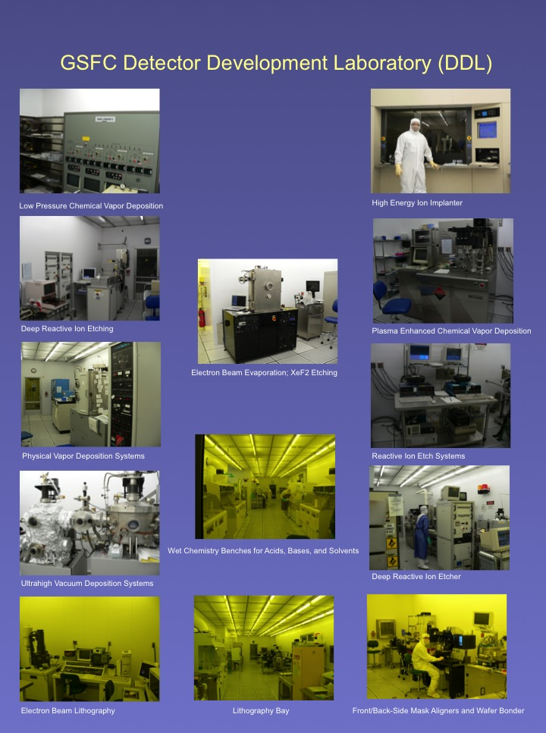
Then versus Now

Slide 33
Single element versus Multi-element (arrays)
Starting around 1981 the detector field evolved from single element detector photon detection to multi-element, area-array detector imaging–from the ultraviolet to the far infrared.
This was a major leap in technology enabled by the availability of lab computers.
However, the Branch (Ravi Kaipa) has to develop its own data acquisition and display programs (DDAP)—commercial sources don’t yet exist.

Slide 34
NASA Science Missions Require Detectors
In the late 1970’s detectors were just one pixel! That is, they were a single piece of material with two electrodes to extract the electrons. The iPhone X has more than 2.5 million pixels.
We were limited to just detecting photons—we could not readily make an image.
Many different materials could be implemented to detect various wavelengths. The most sensitive infrared detectors needed to operate at very cold temperatures ranging from <1K-50K (-272 to -223ºC).
To achieve and maintain these cryogenic temperatures was very complicated (and still is)--especially on a satellite.

Slide 35
First 8-Element PbS–FET
Linear Integrated IR Detector Arrays
1981

Slide 36
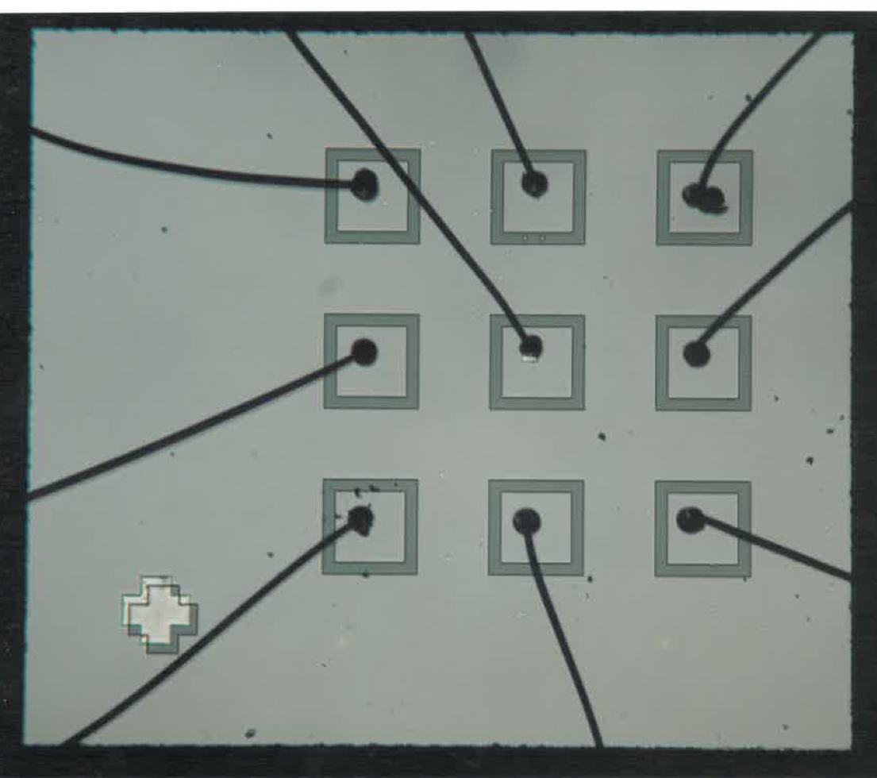
PtSi 9-Element IR Detector Array
1983

Slide 37
Charge Coupled Device Design, Fabrication and Testing
(effort initiated to support MODIS-T)
1989
We develop pinned photodiode/CCD imagers
Start of long collaboration with J. Janesick and R. Bredthauer
We collaborate for the development and implementation of large format CCDs
Hubble Space Telescope/WF/PC I
MODIS
ASTER
MISR
Triana
SAGE
GAMS
Terrestrial imaging over Canada and Africa
Solar imaging at the NSO
FBI
UMASS for medical x-ray imaging
(others I can’t remember)

Slide 38
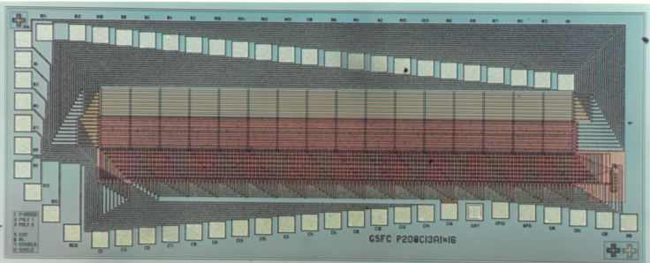
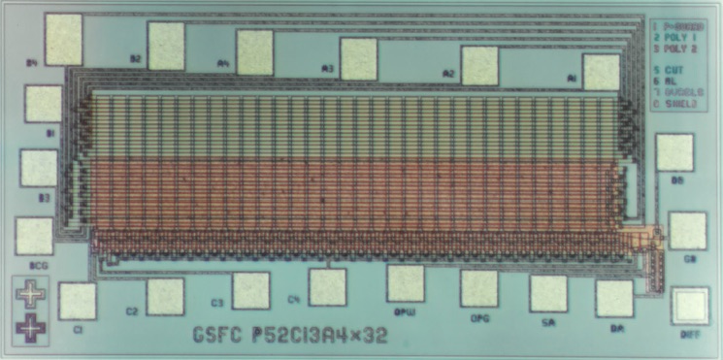
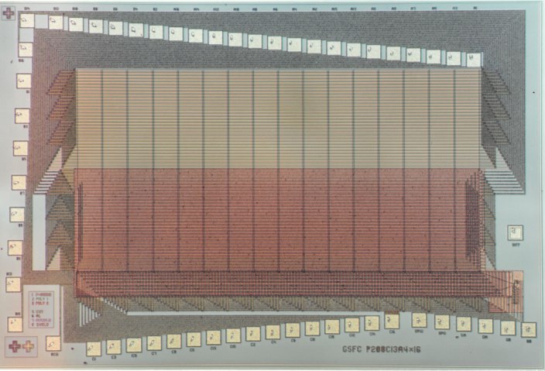
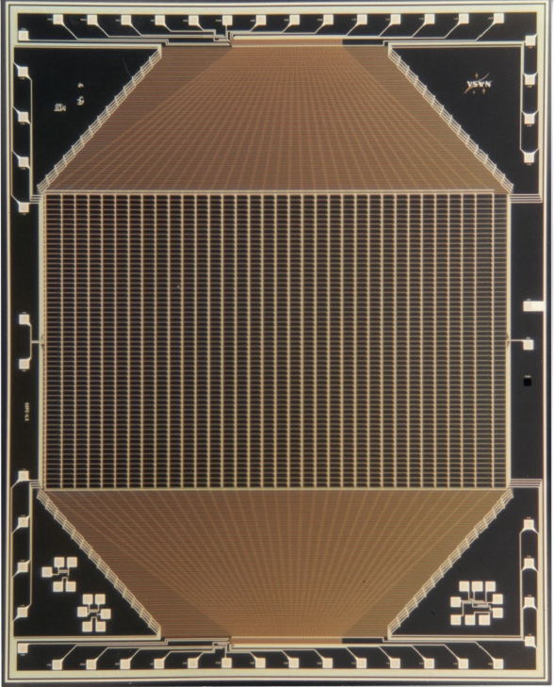
Early CCD Imagers Developed in the Branch
1989

Slide 39
Detector Technologies 1993
Detector | Format | Source | Temperature | Wavelength
Si X-ray bolometers | 1x12 | In-house | 0.1K | X-ray
TI-Japan CCDs | 1024x1024 | JPL | 300K | 0.4–0.8 micron
Pinned photodiode/CCD array | 30x34 | In-house | 200–300K | 0.4–0.8 micron
PtSi photodiode/CCD array | 484x366 | Loral | 60K | 1.5–1.8 microns
InSb array | 58x62 | Hughes/SBRC | 5k | 3–5 microns
Si:As BIB array | 128x128 | Rockwell | 10K | 3–28 microns
GaAs QWIP array | 128x128 | Rockwell | 10K | 8–12 microns
PC HgCdTe array | 1x10 | In-house | 0.35K | 9–16.7 microns
Si monolithic bolometers | 2x18 | In-house | 0.35K | Far IR
PbS, PbSe | 1x64 | In-house/Itek | 300K | 1–4 microns
Ge:Ga | Discrete | In-House | 1.8K | 80–120 microns
Stressed Ge:Ga | Discrete | In-House | 1.8K | 120–200 microns
Variety of extrinsic Si detectors: Si:Sb:As, Si:Ga

Slide 40
GaAs Quantum Well Infrared Photodetectors
1988-1992
In 1988 we receive a small grant from DARPA to make a single element QWIP (aka 1x1 array).
Metallic-Organic CVD becomes commercially available to deposit precise layers of III-V materials. We experiment by making GaAs IR laser diodes–great fun!
We specify and obtain the first quantum well structures (with R. Mulpuri/GMU). Fabricate the first QWIP element and optically couple by angling the element edge.
In 1990 we develop 128 x 128 element QWIP array with ATT/Bell Labs and Rockwell Science Center. Perform first infrared imaging (~9 µm) versus photon detection.
Perform many lab and some airborne imaging experiments (quite a novelty back then).

Slide 41
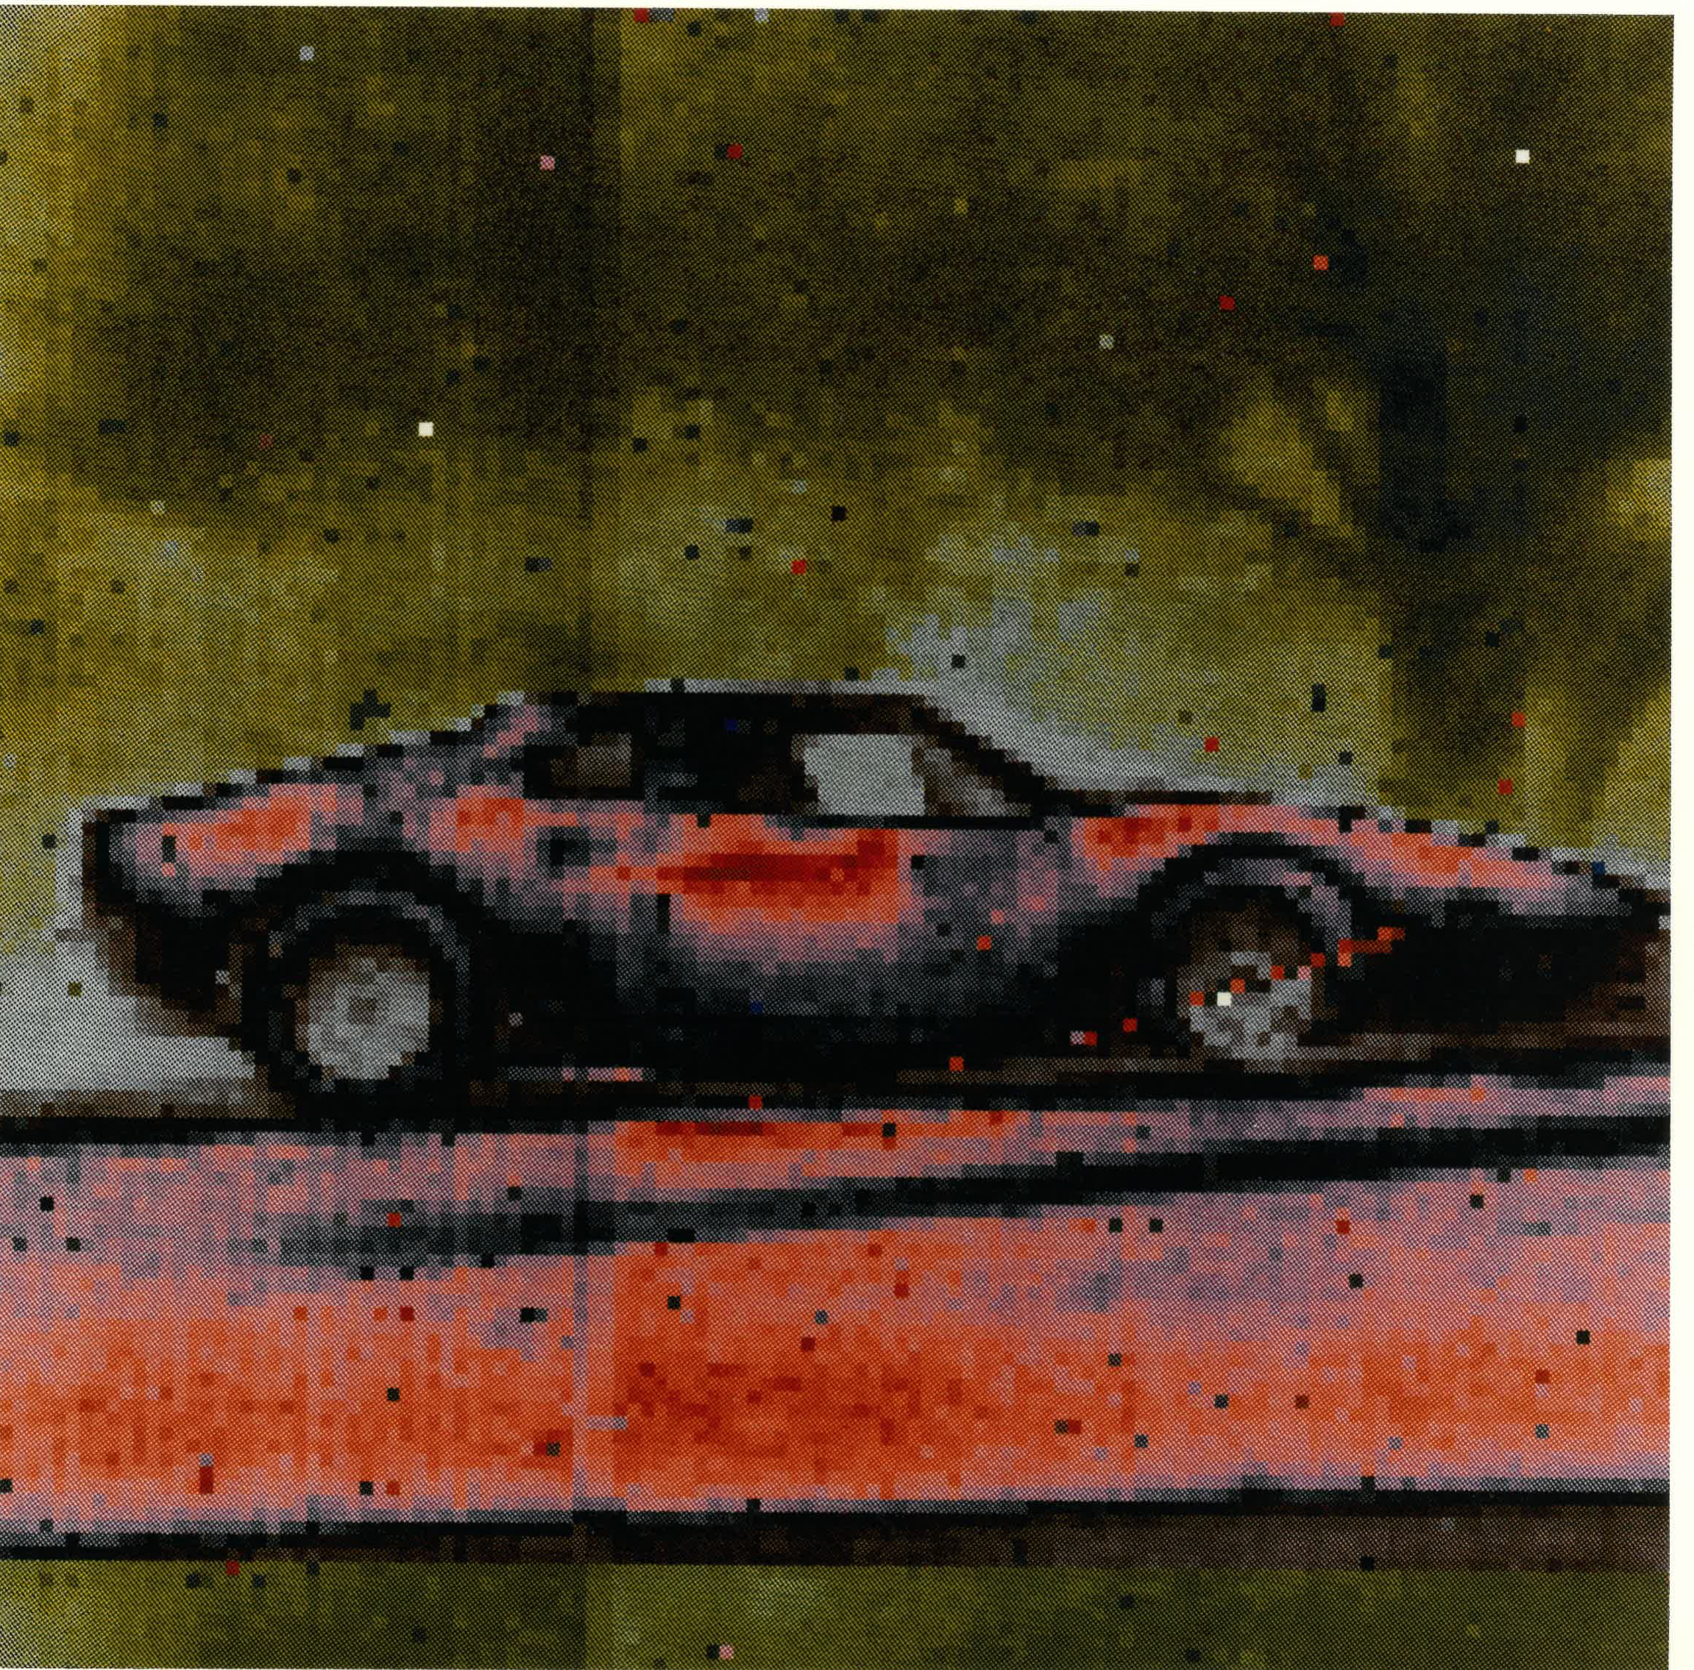
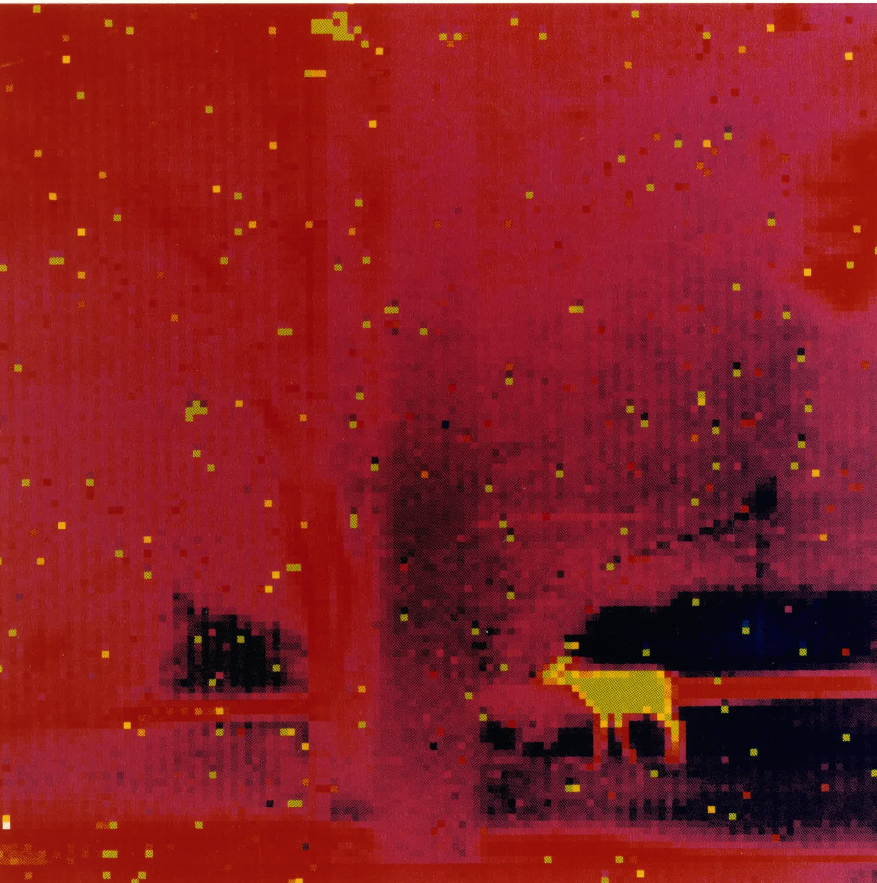
The First QWIP Array Images 1991
128x128 Far Infra-Red Array Radiometric Imager (FIRARI)
Deer outside the lab at midnight

Slide 42
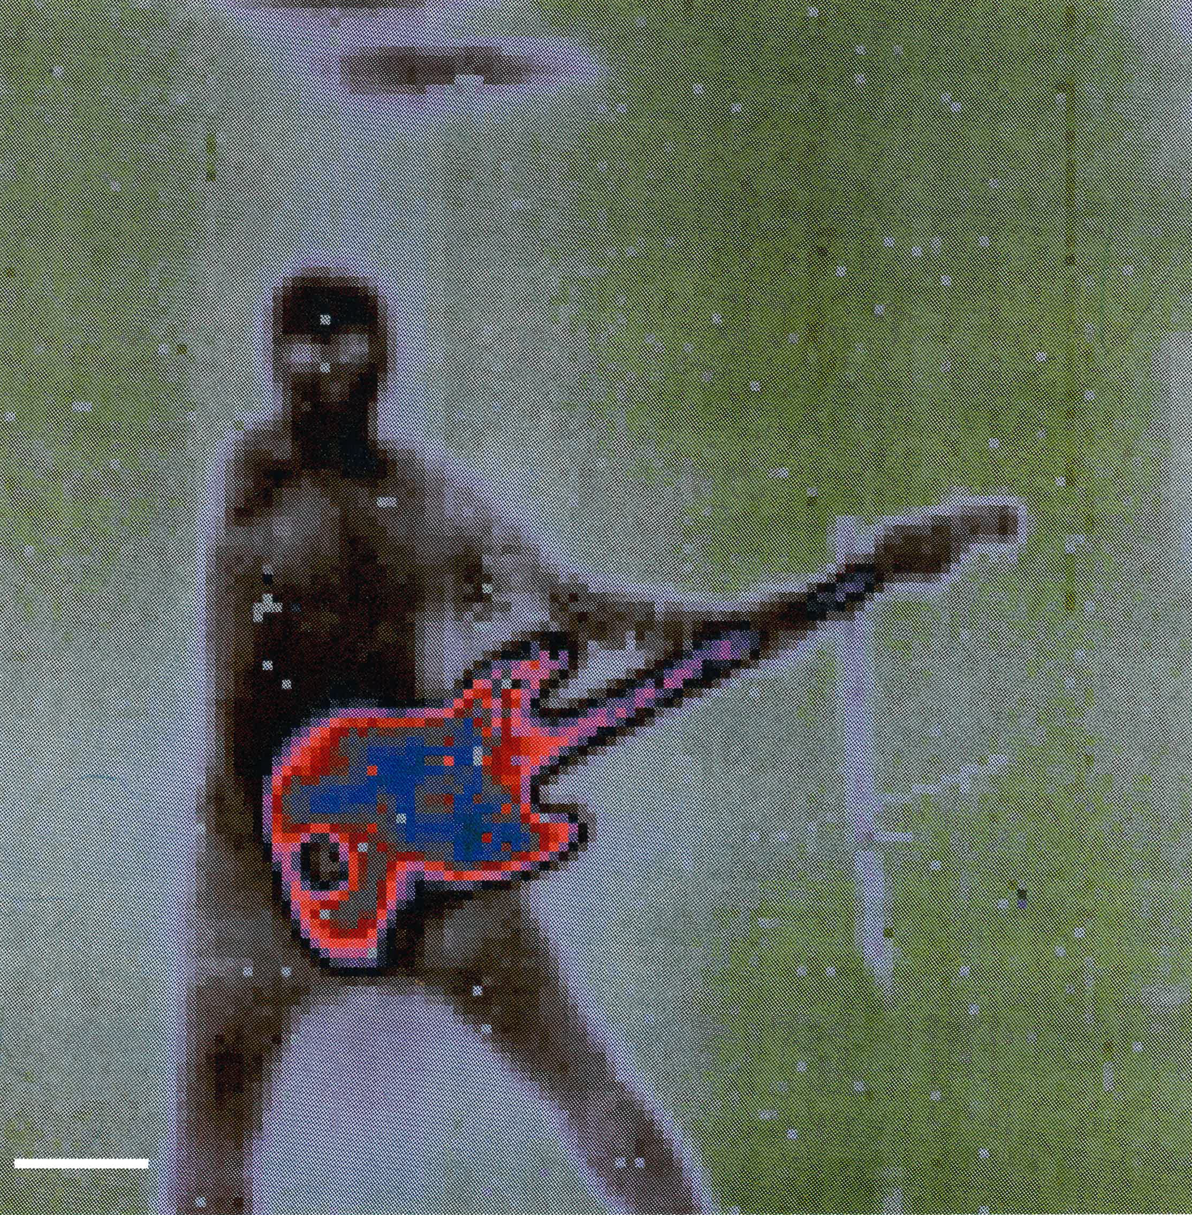
Our electronics engineer on bass guitar QWIP IR Image at 9.3µm; T=35K (-238C)

Slide 43
First 128 x128 QWIP Camera (FIRARI) 1991

Slide 44
First 128 x128 QWIP Camera Airborne Mission 1991
Tank of liquid helium actually flew on the plane with us.

Slide 45
First 128 x128 QWIP Camera Airborne Mission at Wallops, 1991
LHe tank
Shoreline
Above: NASA Sky Van (notice the LHe tank in the back.
Right: View looking out of the open bay of the plane. We are tethered to posts within the plane (so we don’t fall out). Clearly, safety is our number one concern!

Slide 46
Jupiter Shoemaker-Levy Comet Impact, 1993–1994
We enter into ground-based astronomy
The Shoemaker-Levy comet was predicted to collide with Jupiter in July of 1994. Many labs geared up for this historical event.
We prepared to image this event in the near infrared with a 256 x 256 (65,536 pixels) HgCdTe array that was be used on the Hubble Space Telescope instrument. This would be our first on-site astronomical IR imaging experiment at the telescope in Haleakala, Maui. We manned this camera in shifts.
We (Jhabvala/Reuter/Babu) had last minute technical problems but managed to solve them just in time (in my hotel room with the spring from a ball-point pen).

Slide 47
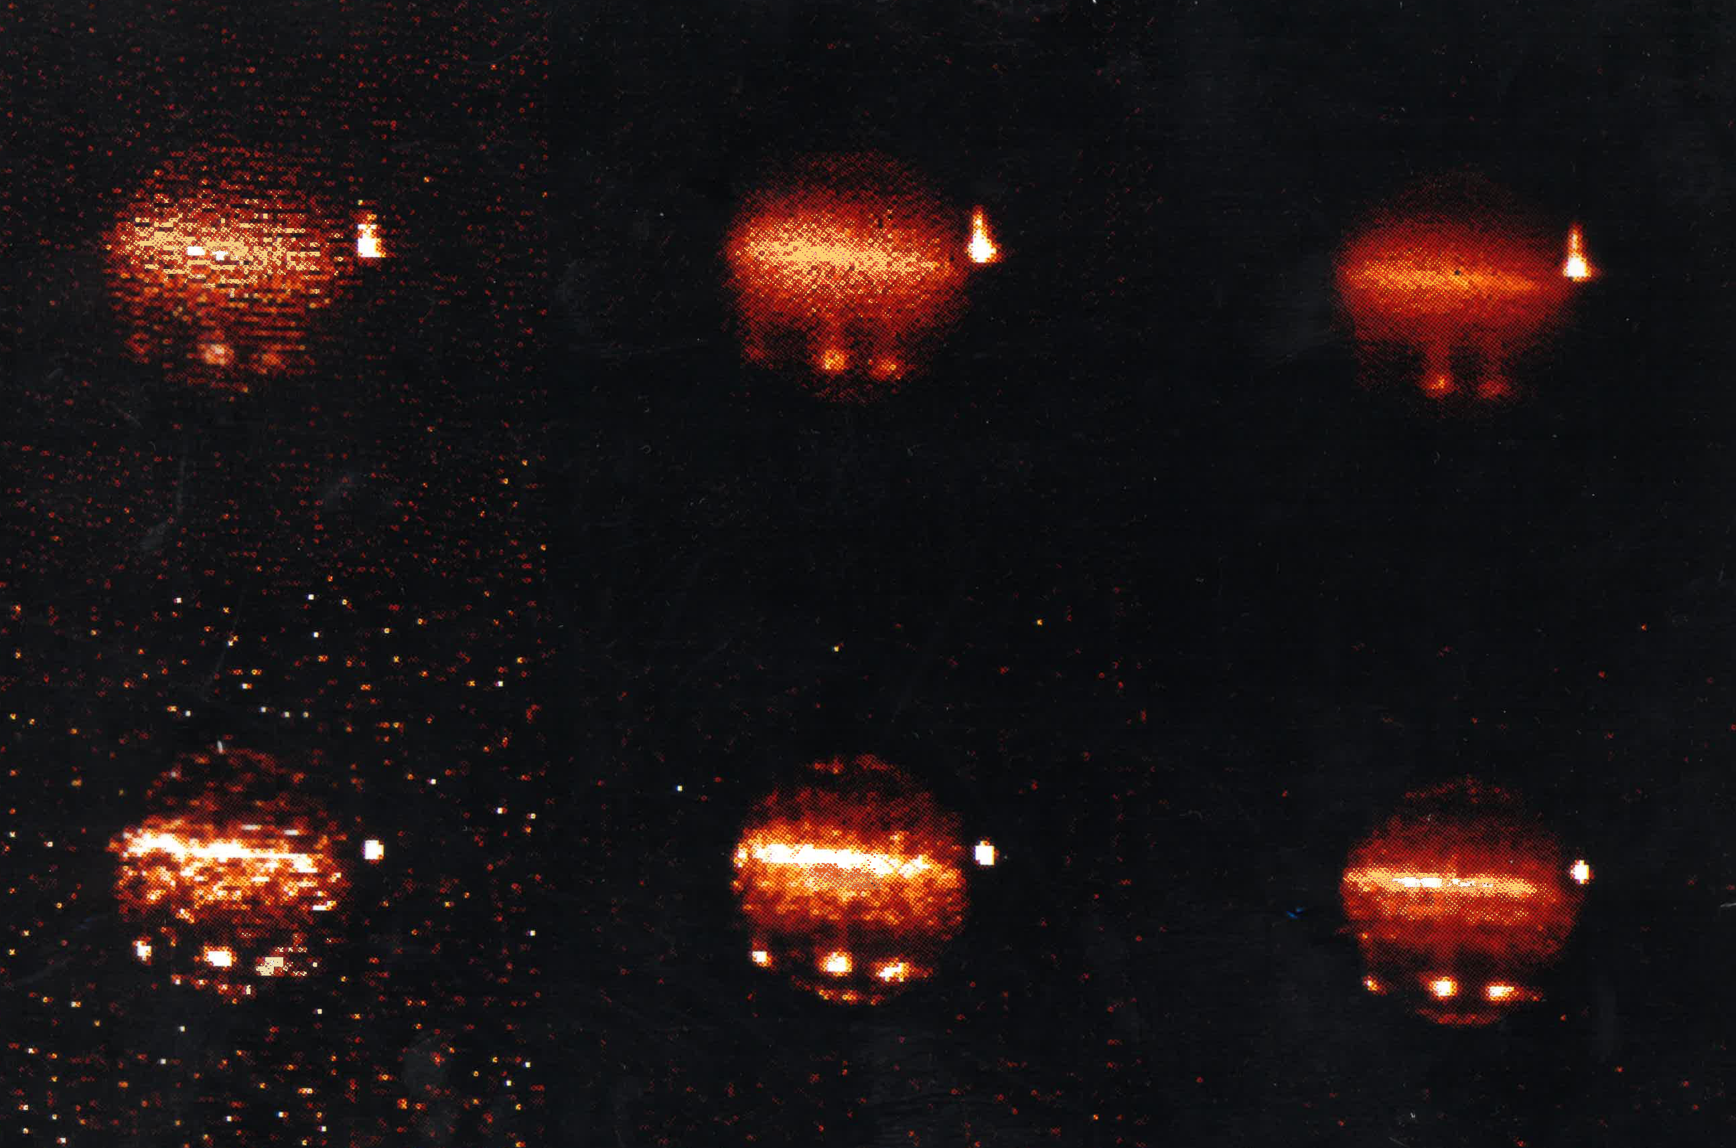
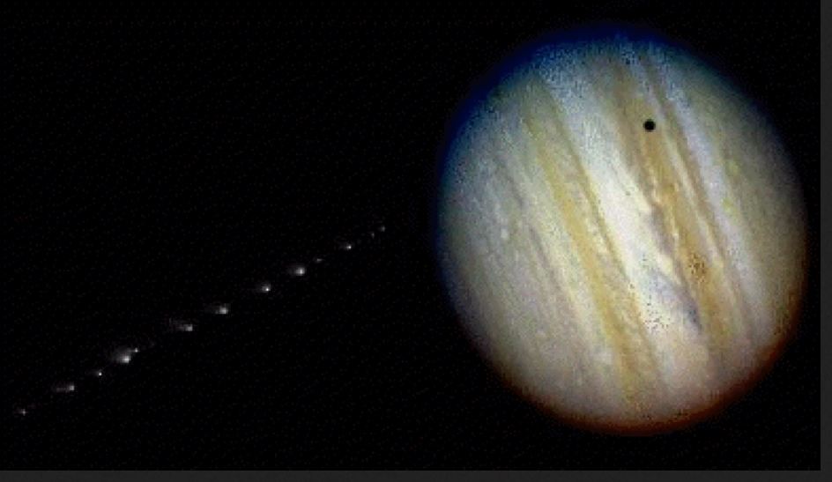
Jupiter, 1994
Jupiter—Comet Shoemaker-Levy Impact at 2.2μm. False color image of three impact sites and the Jupiter moon Io taken on July 19, 1994 at Haleakala, Hawaii by the Solid State Device Development Branch of the NASA Goddard Space Flight Center.
Near IR (2.2µm) NICMOS/HST HgCdTe 256x256 array prototype. The array was mounted into an IR Labs LN2 dewar and configured into a camera that was placed at the focal plane of the DoD AMOS telescope on Haleakala (alt. 10,013 ft), Maui, HI, July 18, 1994.
Visible HST image of Comet Shoemaker-Levy en route to Jupiter

Slide 48
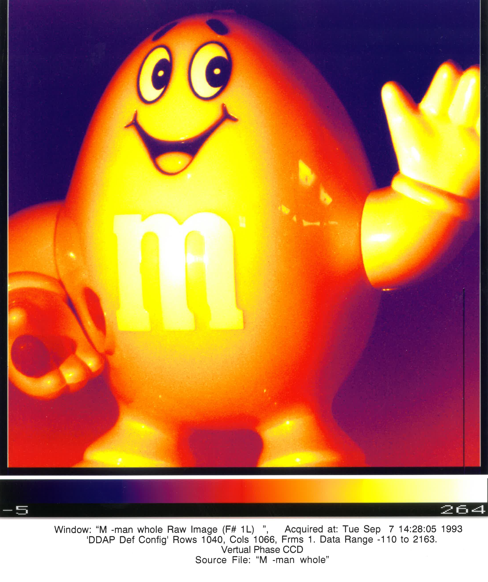
m&m man; 1k x 1k CCD Image 1994

Slide 49
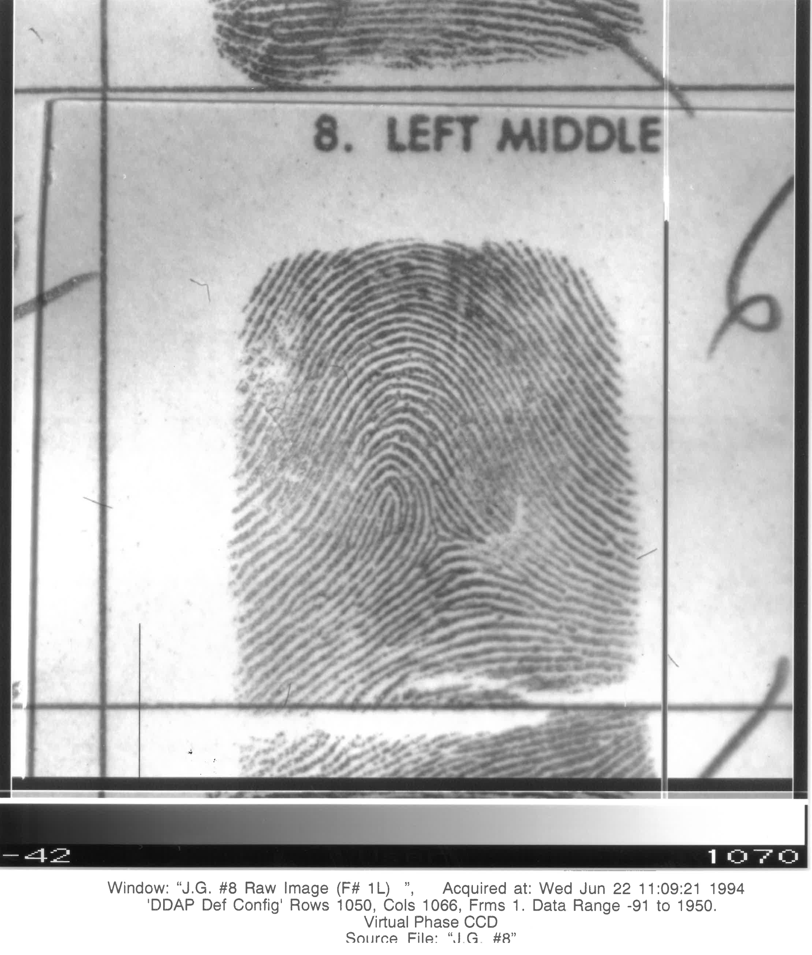
FBI Fingerprint with 1k x1k CCD imager 1994

Slide 50
Many Branch-Interagency and Industry Affiliations
In the 1990s (partial list)
Agencies with which we have joint programs
Kirtland AFB–PtSi Camera
NSA–mutual processing support
NRL–advanced CVD support/CCD design
National Solar Observatory–CCD camera development, CCD screening
DARPA–HgCdTe technical support and array development (with LTV)
FBI–CCD fingerprinting
Night Vision Lab for IR laser diodes
NASA Ames
NASA Langley
Industry Collaborations
AT&T/Rockwell Science Center–GaAs QWIP
Itek/Hanscom AFB–PbS, PtSi
Westinghouse ATL–numerous joint projects, mask fabrication support
Loral–custom CCD fab, GeSi/Si
Raytheon/Santa Barbara Research Center–InSb, SiAs BIB arrays
Photometrics–4k x4k CCD camera development
EG&G Judson–custom HgCdTe development
LIRIS–custom HgCdTe development
Univ. of MD–III-V detectors, Ge epi
George Mason Univ.–materials processing
UCB–UV detector development
Q-DOT–CCD amplifiers
Univ. of Rochester–IRAC
UCLA–IRAC

Slide 51
Projects supported by the Branch
1993-2003
GOES (NOAA weather satellite)
ISTP/SOHO-MAMA, CCDs (we will eventually take this over from Ball Aerospace)
Cassini/CIRS PC HgCdTe fabrication
AXAF Si x-ray microcalorimeter development
Pluto Fast Flyby IR camera development (to become New Horizons/Ralph a decade later)
Hubble Space Telescope WF/PC II
NICMOS/HST
Shuttle IR Telescope –BIB detector and calibrators
STIS–MAMA detectors, CCD support
LEISA
IRAC/SIRTF (aka Spitzer Space Telescope)
ASTRO-E
TRIANA
HAWC
SHARC
EOS
AIRS
NGST (aka James Webb space Telescope)
BASE-ASIA
SAFARI 2000
Gravity Probe B

Slide 52
Microelectronics for Commercial Applications in the 1980’s and 1990’s
X-ray CCD imaging for digital mammography, dentistry and injuries with NIH and UMASS.
Digital CCD fingerprint cataloguing for the FBI.
Directional hearing aid system.
Ingestible temperature sensor pill (for military personnel).
Implantable electrodes
Consult on FES development with the Case Western and the Cleveland VA
Collaborate with Georgetown U. medical school for electrical stimulation of nerve regrowth
Consult on the insulin pump development and pacemaker development at APL and Medtronic
Collaborate with the UCSF/Gallo for “rat backpack telemetry” system
Collaborate with GER, Inc for overflight agricultural/pollution monitoring using the QWIP cameras
Note: This is also Nona Cheeks second career at Goddard (now as Division Chief)

Slide 53
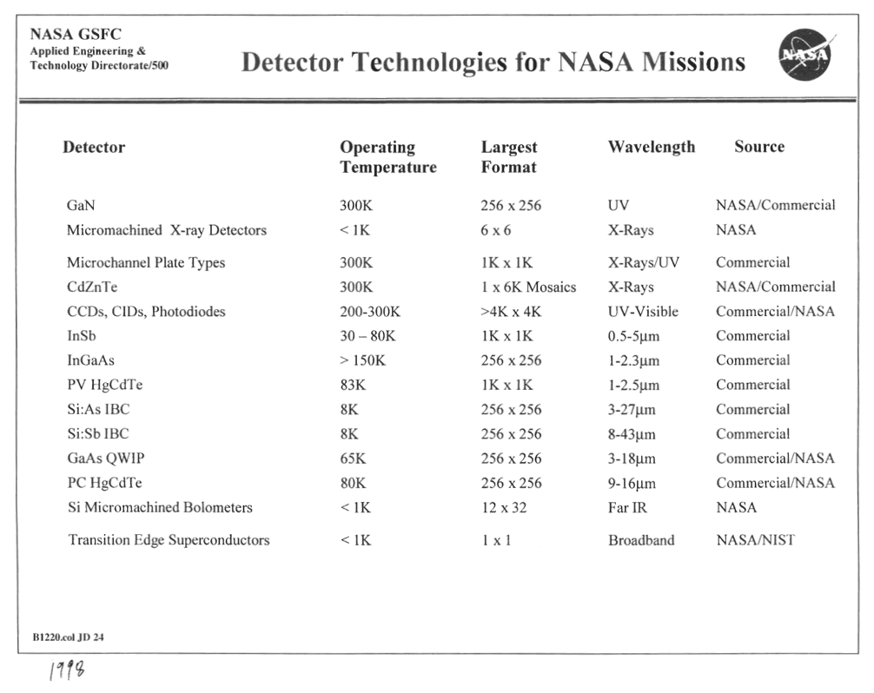
Detector Technologies, 1998

Slide 54
Micro Electro-Mechanical Systems (MEMS)
Late 1990s
With the advent of new, precise dry etching equipment we are able to now make devices that were previously impossible to make with wet etching techniques
Silicon bridge chips
Polysilicon infrared blackbody calibrators
Micromirrors
Microshutters
Pop-Up Detectors
X-ray calorimeters
We develop in-house indium bump bonding capabilities for large format detector array/silicon readout hybridization

Slide 55
Spitzer/IRAC (H. Moseley)
The Detector Characterization Laboratory is born
Nov 20, 1997
We become the detector test facility for the Infrared Array Camera (IRAC) InSb and Silicon BIB detectors. This is the inception of the Branch Detector Characterization Laboratory (DCL). Over 35 arrays (256x256) are tested and documented from T=6K to 20K. Lays the groundwork for future DCL Flight programs.
We design and fabricate new focal plane components. We build the focal planes using new technologies and methods:
Kevlar suspension
Low thermal conductivity silicon bridge chips
New bonding methods with APL
We build the internal reference/calibration assembly:
Design, fabricate and qualify the microfilament blackbody sources that will be used on numerous future programs, and currently for the 2017 LUCY project.

Slide 56
1997
Slides from this point forward are no longer made from earlier
vu-graph presentations.
Finally enter the era of desktop computing.

Slide 57
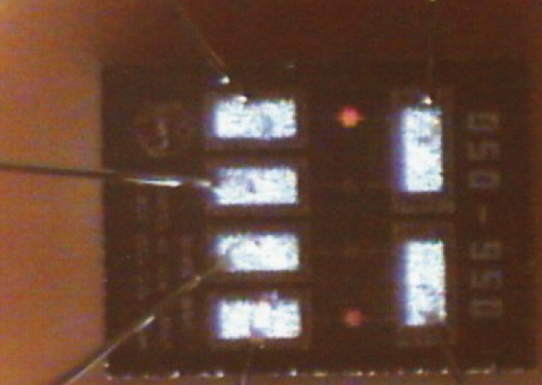
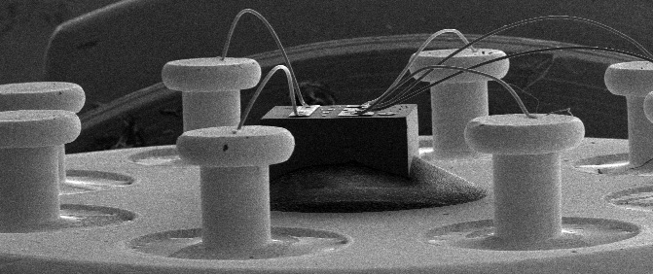
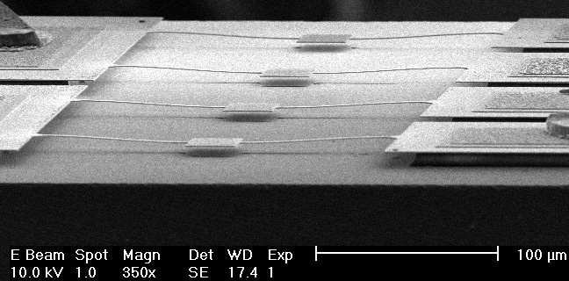
Polysilicon Blackbody Sources For Spitzer/IRAC, 1997
Two elements at ~950C
Silicon “chip” with 4 light sources
Single strand of hair
Electron microscope image of the chip

Slide 58
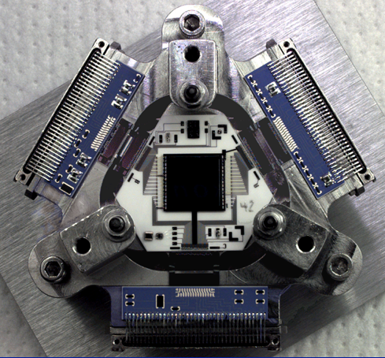
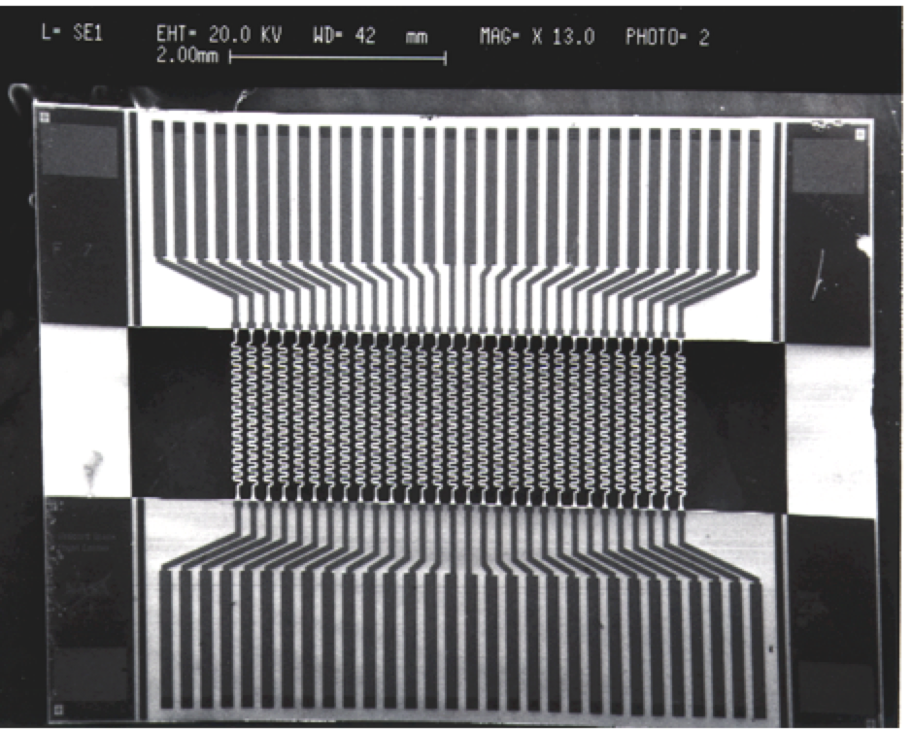
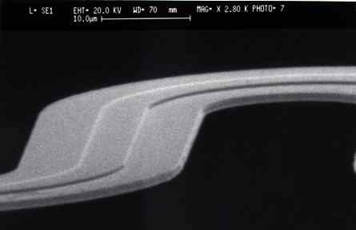
Silicon Bridge Chips Spitzer Infrared Array Camera, 1998
Detector assembly operating at T~30K
Low thermal conductivity micro-wires (1 µm thick)
Electron microscope image of one wire

Slide 59
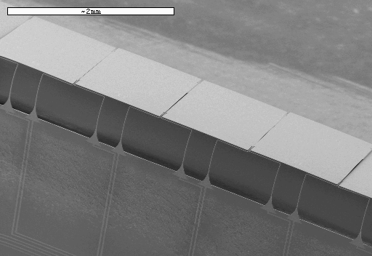
Pop-Up Detectors (very long wavelength IR) 1998
The thinned silicon is actually folded
Rows are aligned to make a 2-D array
Folding fixture

Slide 60
Gravity Probe B Detector Hybrid (1998)
Custom, “perfectly” matched, GSFC low noise, JFET-based detector hybrid for Gravity Probe B mission.

Slide 61
X-Ray Calorimeters

Slide 62
Microshutters, 1997–2017

Slide 63
Basic Microshutter Array
100 um
200 um
Microshutter array cells
Front side of a single shutter

Slide 64
62,415 Element Microshutter Array 4.1 cm x 4.2 cm Square
F051 CLOSE
Failed open RT: 23 (0.0369%); Partial fail open RT: 14 (0.0224%)
F051 OPEN
Failed closed RT: 138 (0.2211%); Partial fail closed RT: 18 (0.0288%)

Slide 65
Meeting with Václav Klaus, President of the Czech Republic
This image was specially prepared for
President Václav Klaus with the Microshutter Array technology developed for NASA’s James Webb Space Telescope at the NASA Goddard Space Flight Center in Greenbelt, Maryland USA
NASA Goddard Space Flight Center

Slide 66
Shift to Large In-House Project Support
1998
I focus on:
JWST Microshutters (for 10 years)
New Horizons (MCT detectors)
QWIP development (with ESTO)
Large format
Broadband
Multispectral
Hyperspectral
QWIP camera field experiments/collaborations (USGS, ARL, JPL, QmagiQ, Northwestern U, South Africa, Thailand, Brazil)
Landsat 8/TIRS QWIP focal plane development
Internal reference source assemblies (JWST all 3 instruments, NASA/Ames, Cal Tech ASTRO-F, WISE, OVIRS, LUCY
Strained Layer Superlattice (SLS) detector development
Euclid (ESA/NASA joint mission)
Compact SLS dual band IR camera development and deployment for the Space Station (with F. Cepollina/C. Tucker)

Slide 67
Starting in the early 2000s the Branch again dramatically increases professional hiring (2nd wave) 1998-2017
The Detector Characterization Lab becomes well established
The Detector Development Lab is substantially more staffed
Shahid Aslam (Ish)
Sachi Babu
Manuel Balvin
Emily Barrantine
Ari Brown
Steve Cagiano
Jay Chervenak
Kevin Denis
Mitra Dutta
Roger Foltz
David Franz
Larry Hess
Mike Hickey
Wen-Ting Hsieh
Don Jennings
Duncan Kahle
Emily Kan
Eric Kan
Dan Kelly
Ed Leong
Mary Li
George Manos
Laddawan Miko
Tim Miller
Peter Nagler
Brian Ottens
Amil Patel
Betsy Pugel
Jack Sadleir
Joe Santos
Thomas Stevenson
Mahmooda Sultana
Augustyn Waczinski
Yiting Wen
Tony Zheng

Slide 68
Noticeably absent is our extensive external technology transfer collaborations

Slide 69
Quick Recap
Most of these projects occurred before 2000
In situ fetal pH monitoring and telemetry (Johns Hopkins)
In situ fetal EKG monitoring and telemetry (Johns Hopkins)
Ingestible temperature monitoring pill
Pacemaker
Insulin pump (APL)
Implantable platinum-based electrodes (California VA)
Implantable nerve stimulator (Georgetown University)
Functional Electrical Stimulation (Cleveland VA)
Direction discriminating hearing aid
CCD for x-ray imaging (UMASS)
Rat backpack for brain electrode telemetry (addiction studies with UCSF)
QWIP for non-invasive cancer detection (Omnincorder)

Slide 70
Landsat 8 and 9 QWIP-based Focal Plane 2008–2018
Three 640x512 QWIP arrays attached to a custom developed silicon substrate. Operating temperature is 42K (-231ºC).
The focal plane assembly with the 10.8 and 12.0µm filters over each array

Slide 71
Landsat 8 Thermal IR Sensor (TIRS) Flight Instrument
QWIP Wafer with 33 Arrays
Focal Plane Assembly with 3 QWIP arrays
Full TIRS Instrument Assembly
Focal Plane Assembly
with filters
Telescope

Slide 72
First Application of a QWIP Detector in a NASA Orbiting Satellite Mission
The Landsat Data Continuity Mission (LDCM) Thermal Infrared Sensor (TIRS)
Launched date: February 11, 2013 10:06am PST
Mission duration: 3 Years
Two instruments: Vis/NIR (OLI) and Thermal IR (TIRS)
Orbit altitude: 700 km
Ground resolution: 1850 km/frame; 100 m/pixel
Launch vehicle: Atlas V 401

Slide 73
1k x1k QWIP Camera, 2005

Slide 74
1k x1k QWIP Camera (with Compact Mechanical Cooler): 2007

Slide 75
Development of Miniature Cryocoolers
The liquid helium-based camera system is now an electric–based compact camera system

Slide 76
IR Camera R&D Evolution Summary
Evolutionary advances of our QWIP detector program at Goddard during the last ~10 years. From top left: Liquid helium dewar with 256 x 256, λ_{p}=9.1μm (in 2000); 512 x 640 4-band (4<λ<13.5μm) QWIP with our first mechanical cooler (2005); 1K x 1K, 8<λ<12μm QWIP with 5W cooler (2007, note thermal hand images on pants pockets); and 320 x 256, λ_{p}=8.4μm QWIP ”camcorder” (2008). Bottom row are false color images captured with their corresponding camera.

Slide 77
Cat Cave
Location is about 40 miles east of Barstow, CA in the Mojave Desert (Pisgah lava field)

Slide 78
Cat Cave Ground-based Infrared Images
Cat cave with experimenter for scale (below)
Daytime around noon (top right)
Night around 2 am (bottom right)

Slide 79
Airborne QWIP Camera Experiments Over the US Mojave Desert

Slide 80
Cat Cave Night QWIP Camera Aerial Image
3,000 feet altitude, 5:37am, April 13, 2011

Slide 81
QWIP Camera Observations at Kitt Peak, AZ, October 2012 (led by D. Jennings, A. Lunsford)

Slide 82
Kitt Peak QWIP Video of a Solar Flare (3-5 and 8-10 µm)
Flares

Slide 83
320x256 Dual Band QWIP Camera Big Bear Solar Observatory with D. Jennings and K. Turck/553 October 16, 2018

Slide 84
Culmination of Almost 30 Years of QWIP & Recent SLS R&D
A new technology and instrument for the International Space Station based on Strained Layer Superlattice (SLS) detectors—an evolutionary advance stemming from the QWIP technology:
More than ten times as sensitive
Much warmer operating temperature (70K vs 42K)
Very broad spectral response
Our SLS–based instrument system (CTI) is expected to be launched by SpaceX to the International Space Station in December 4, 2018

Slide 85
Compact Thermal Imager for the International Space Station
Based on the newly developed SLS detector technology
Operates at ~68K (-205C)
IR band selection is electronically selected

Slide 86
Our Latest Autonomous Thermal Imager (ATI) August, 2018
Based on the newly developed SLS detector technology
Operates at ~68K (-205C)
1k x 1k, 18µm pixels
4-12 µm spectral response
Operates on a single 24-28 VDC supply
No operator or laptop required, fully autonomous–hit start and walk or fly away!!!
First airplane flight November 14, 2018

Slide 87
First ATI Images! November 14, 2018 4,000 ft
B23
B22
B36
B12

Slide 88
First ATI Images! November 14, 2018 4,000 ft
B33
B32

Slide 89
The Branch
2010-2018 and beyond
NASA Projects
Microshutters
PIPER
Gismo
ASTRO-E
HAWC+
ATHENA
HIRMES
PIXIE
WFIRST
OVIRS
Lucy
Euclid
TIRS
CLASS
BETTII
ATI
Technology Developments
Photon Sieves
Micro-spectrometers
Next generation microshutters
Superconducting parametric amplifiers
FEMTA micro-propulsion
Thermopiles
GaN solar-blind UV detectors
Phononic waveguides
Single photon counting KIDs
Metal mesh filters
Graphene chemical sensor
Quantum dot spectrometers
3D printing
Low temp CVD
SLS imaging systems

Slide 90
Sad Note
My favorite CMOS furnaces from 1975 being excessed Sep 18, 2018- RIP

Slide 91
Happy Note!!
A special thanks to Nona Cheeks for making this presentation possible.
Thanks also to: Mahmooda Sultana, Samantha Kilgore and Lindsay Macleod for all their support.

Slide 92
Happy Note2!!

Slide 93
We can’t do it without our
expert contractors (2017)
Guan, Bing
Holliday, David
Hu, Ron
Hwang, Tsuwei
Kluengpho, Vorachai
Kim, Kyowon
Leong, Edward
Lindsay, Decosta
Mah, Jonathan
Meier, Lane
Merchant, Christopher
Mikula, Vilem
Moetakef, Pouya
Munoz, Ronnie
Oh, Lance
Peretz, Eliad
Sansebastian, Marc
Somnasri, Robert
Tucker, Corey
Turck, Kyle
Askarov, Atilla
Bennett, Chris
Boehm, Nicholas
Brekosky, Regis
Cillis, Analia
Chang, Meng-Ping
Cheung, Stephanie
Cho, Benjamin
Cho, Jay
Costen, Nicholas
Cottingham, David
Datesman, Aaron
Degumbia, Lantrinh
Del Cid, Carlos
Delo, Gregory
Devasia, Archana
Fox-Rabinovitz, Joseph
Gardner, Glen
Glebov, Boris
Goodwin, Amber
Val-Addo, Derek
Wang, Frederick
Wassell, Edward
Williams, Elissa
Williams, James

