Slide 1
Model Based Systems Engineering
Title: Model Based Systems Engineering: Model development, model use, and model re-use during Phase A
GSFC Systems Engineering Seminar
August 07, 2018

Slide 2

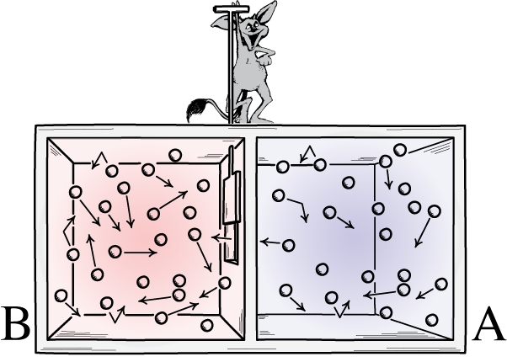
Recap – What we discussed last October
James Maxwell

Slide 3
Can better knowledge of the system enable the reduction of its ‘entropy’?
Model-Based Systems Engineering (MBSE): The formalized application of modeling to support system requirements, design, analysis, verification and validation activities beginning in the conceptual design phase and continuing throughout development and later life cycle phases”
Maxwell: …such a being, whose attributes are still as essentially finite as our own, would be able to do what is at present impossible to us.

Slide 4
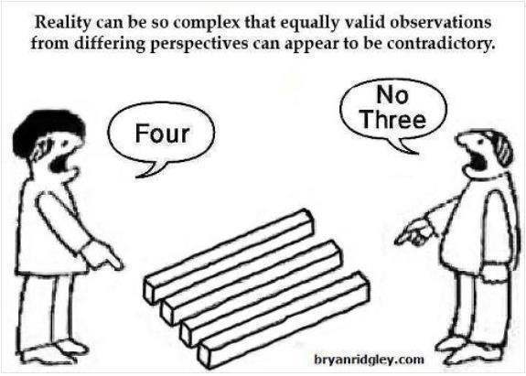


Recap: The Case for Change
Performing Science isn’t getting any easier! (SMD: Success of one mission demands more capability from the next)
SE Environment within NASA may have opportunity for improvement (SE Tech Fellow workforce surveys)
Sound Engineering is based upon rigor and clarity (Power Point Engineering conclusion from Challenger Accident Report)
SE needs to evolve to meet the demand (JPL Internal IOM 3100-09-040, T Bayer, 24 Oct 2009)
SE needs to evolve to meet the demand (Observations from GSFC Systems Engineering Branches)

Slide 5


Recap: MBSE offers process improvement throughout the SE cradle-to-grave cycle
Process efficiencies:
Reduced effort, time and cost in executing SE processes
Automatic generation of documents, briefing materials, etc.
Enhanced quality and integrity in system architectures
Improved and earlier detection of design errors, wrong or missing requirements, conflicting interface definitions, etc.
Clearly articulated concepts
Improved support for program reviews, decision milestones, etc.
Improved reuse of known-good designs and exiting architectural elements
Ready availability of information on system baselines
Improved communication and shared understanding among disciplines, teams, and stakeholders
Improved tools for requirements analysis, allocation, and tracing
Payoffs from Object-Orientation - Abstraction/Inheritance, Modularity, Loose Coupling, Interface Management, and others
Framework for modeling and simulation at multiple levels
More rapid communication within team
Faster convergence on multi-discipline / multi-organizational problems

Slide 6
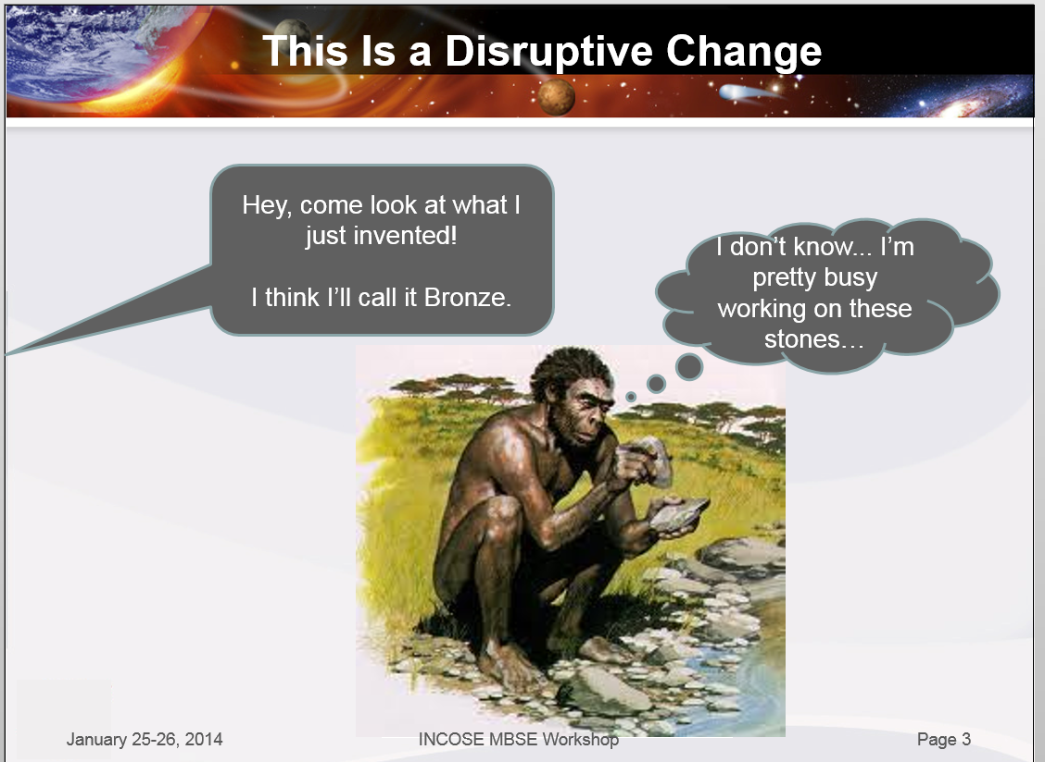

Recap: MBSE - an exercise in culture change
Disruptive innovation – not really a software change, rather a change in the approach to Systems Engineering activities and information management
Barriers to change are real, even when improvement is a goal
  Vocabulary
  Quality Assessment
  Transferability
  Stakeholder Assessment

Slide 7
Agenda
Model Based Systems Engineering
  Systems Engineering at NASA
  NASA Mission Life Cycle: Systems Engineering in Phase A
  Systems Engineering and System Architecture
Model Development and Use: The MEME-X System Model (Phase A Concept Study)
MBSE Lessons Learned and Possible Future Application

Slide 8
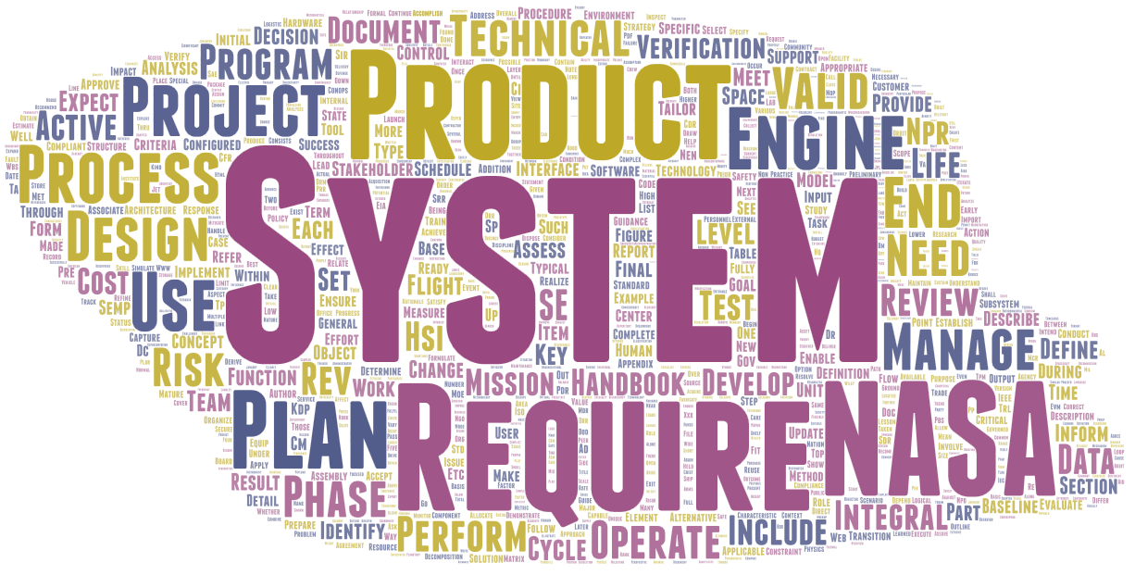
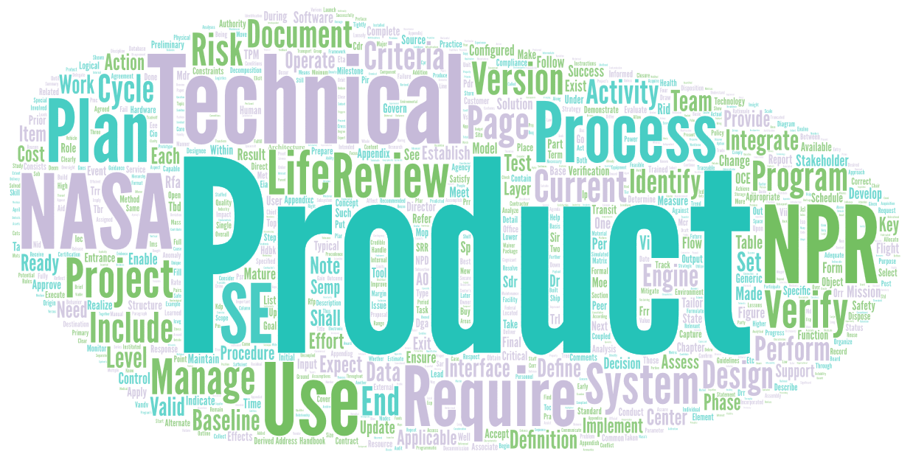
Systems Engineering at NASA
NPR 7123.1B
NASA SE Handbook, 2016
At NASA, “systems engineering” is defined as a methodical, multi-disciplinary approach for the
design, realization, technical management, operations, and retirement of a system.

Slide 9
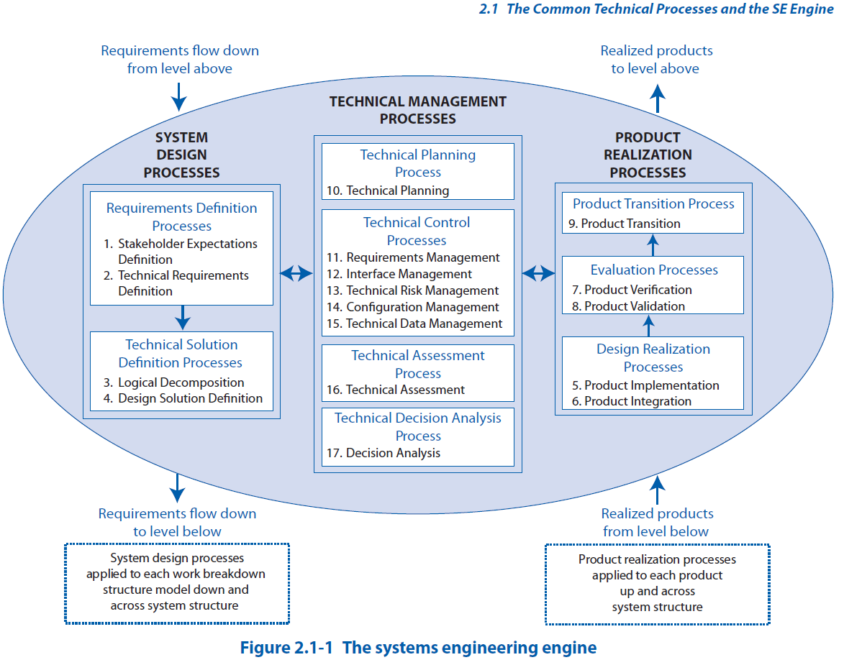
Systems Engineering at NASA

Slide 10
Systems Engineering at NASA

Slide 11
Systems Engineering at NASA – Key Decision Point B
Mission Definition Review/System Definition Review for Projects and Single-project Programs.
The following primary technical products for hardware, software, and human system elements are available to the cognizant participants prior to the review:
** Defined architecture, including major tradeoffs and options ready to be baselined after review comments are
incorporated.
** Allocation of requirements to next lower level ready to be baselined after review comments is incorporated.
** MOPs, TPM, and other key driving requirement ready to be approved.
**Initial trending information on the mass margins (for projects involving hardware), power margins (for projects that are powered) and closure of review actions (RFA, RID, and/or Action Items).
* Product is required for programs /projects covered by NPR 7120.5
** Product is required per NPR 7123.1

Slide 12
Systems Engineering at NASA – Key Decision Point B
Other MDR/SDR technical products listed below for both hardware and software system elements have been made available to the cognizant participants prior to the review:
Supporting analyses, functional/timing descriptions, and allocations of functions to architecture elements
*Updated SEMP
Preliminary interface definitions
Initial technical resource utilization estimates and margins
* Preliminary operations concept
Preliminary system safety analysis
Software criteria and products, per
NASA-HDBK-2203, NASA Software Engineering Handbook
Describe the System Architecture
Explain why this architecture is the right one
* Product is required for programs /projects covered by NPR 7120.5
** Product is required per NPR 7123.1

Slide 13
“Architecture”
Policy Document | Number of Appearances
NPR 7120.5E | 40
NPR 7123.1B | 22
NASA SE Handbook (2007) | 146
NASA SE Handbook (2016) | 117
Much like the other elements of functional decomposition, the development of a good system level architecture is a creative, recursive, collaborative, and iterative process that combines an excellent understanding of the project’s end objectives and constraints with an equally good knowledge of various potential technical means of delivering the end products.

Slide 14
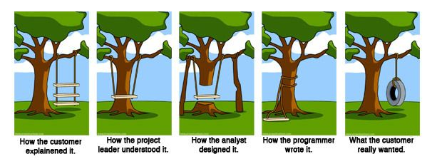
What is this “Architecture” of which you speak?

Slide 15
What is this “Architecture” of which you speak?
Fundamental concepts or properties of a system in its environment embodied in its elements, relationships, and in the principles of its design and evolution¹
The fundamental organization of a system embodied in its components, their relationships to each other and to the environment, and the principles guiding its design and evolution²
The structure of components, their relationships, and the principles and guidelines governing their design and evolution over time.³
A Solution to a Set of Problems⁴
Notionally: Architecture = Structure, Behaviors, and Rules (Requirements) of a system, within the context of a Defined Problem
¹ISO/IEC 42010
²ANSI-IEEE 1471-2000, Recommended Practice for Architectural Description of Software-Intensive Systems, http://standards.ieee.org/reading/ieee/std_public/description/se/1471-2000_desc.html
³DoD Integrated Architecture Panel, 1995, based on IEEE STD 610.12
⁴One of the links from a “Google” search of “What is Architecture?”

Slide 16
So…what is MBSE, and how does it relate to Architecture?
Model-Based Systems Engineering (MBSE): The formalized application of modeling to support system requirements, design, analysis, verification and validation activities beginning in the conceptual design phase and continuing throughout development and later life cycle phases”
Ok…but what does it look like?

Slide 17
Architecture Design: System Modeling
Systems Engineering
Technical System Development
Technical Information Management (Including Communication)
System Model – System Architecture
“Description of System” (Technical Information)
Mathematical abstractions for analysis
Effective automation
Precise language for description of systems to perform tasks
…a methodical, multi-disciplinary approach for the design, realization, technical management, operations, and retirement of a system.

Slide 18
“System Models”
SysML
A general purpose modeling language for engineering systems
Supports the analysis, design and verification of complex systems
Graphical notation
Modeling Environment
“Modeling Tool” – Cameo Systems Modeler (Magic Draw) is one
Enables creation of models
Provides display and export of “model artifacts”
“Rule set” for model elements

Slide 19
So…what is MBSE?
Systems Engineering
Technical System Development
Technical Information Management
System Model – System Architecture
“Description of System”
SysML
A general purpose modeling language for engineering systems
Mathematical abstractions for analysis
Effective automation
Supports the analysis, design and verification of complex systems
Graphical notation
Modeling Environment
“Modeling Tool” – Cameo Systems Modeler (Magic Draw) is one (of many)
Enables creation of models
Provides display and export of “model artifacts”
Precise language for description of systems to perform tasks
…a methodical, multi-disciplinary approach for the design, realization, technical management, operations, and retirement of a system.
“Rule set” for model elements

Slide 20
“An” Architectural Framework – Pre-Phase A
Document/Deliverable¹ | Notes
Preliminary Mission/Instrument Concepts Report | Includes trades and reports from PDLs as available
List of Technical Trades | Needs to include trades by the science team as well that effect requirements
Functional Block Diagram | Systems Configuration is reviewed with this diagram as well as terminology of components, this includes Mission/Instrument Architecture
Requirements Table | Include listing margins, sensitivities, etc. as possible in this table. Includes requirements for functional, performance, interface, operational and others. 4.2.2.1 of Reference 4.
Materials Equipment List (MEL) | Includes margin and allocation summary (Appendix C)
CONOPS | This can be a table, document, or both. Include power and data rates during each step and create a summary/graphic for proposal
Preliminary SE Documents | May include drafts for Systems Engineering Management Plan (SEMP), Systems Review Plan and Risk Management Plan. Also start on the Systems Requirements Document (SRD) if possible
TMR Presentations | Baseline Design should be completed with this review
Support or contribute towards the following:
Document/Deliverable | Notes
Stakeholders Identification | Includes org chart
Science Traceability Matrix
Schedule | Includes I&T flow
Reviews | Support as required
Costing Exercises | Includes Price/H, RAO and Grass Roots Cost estimating
Model Philosophy | This is the build strategy for the instruments and spacecraft. Include capturing GSE requirements and “mirror” instruments needed for I&T as well.
Risk Management Matrix | Identify and help track technical risks
Staffing Support and Management | Assist PM with identifying and managing technical leads and others needed to support the proposal
Concept of Operations | Architecture
What | Structure, Behavior
Where | Behavior
Why | Rules/Requirements
When | Behavior
Who | Structure, Behavior
How | Structure, Behavior
¹Pre-Phase A (Advanced Studies) Systems Engineering Development Products – Ed Amatucci White Paper

Slide 21
“Another” Architectural Framework – Pre-Phase A
Concept of Operations | Architecture
What | Structure, Behavior
Where | Behavior
Why | Rules/Requirements
When | Behavior
Who | Structure, Behavior
How | Structure, Behavior
Documents for a Typical Pre-A Concept¹
Instrument Overview (ISE Report)
Mission Sub team Reports
  Flight Dynamics
  Mission Ops
  Bus Mechanical
  Bus Power
  Bus Thermal
  Bus Propulsion
  Bus ACS
  Bus C&DH
  Bus Comm
  Bus Flight Software
  I&T
  Launch Vehicle
  Radiation
  Orbital Debris
  System Reliability
Instrument Subteams
  Mechanical
  Mechanisms
  Thermal
  Detectors
  Electrical Harness
  Instrument Avionics
  Mechanical Drive Electronics
  Instrument Control
  Optics
  Metrology
  Stray Light/Radiometry
  Cryogenics
  Instrument Flight Software
  I&T
Technology Development
Science Team Report
  Major Science Questions
  Design Reference Missions
  Measurement Technique
  Modes of Observation
  Effectiveness trade study
Top level Requirements and Design Characteristics
Science Mission Traceability Matrix
Mission & Subsystem Design, Functional, and Performance Requirements Table
Mission Interface Requirements Table
Project Schedule
Project Cost
Risks
Project Management Plan
Review Team Briefings
¹DiPietro, David; “Systems Engineering & Advanced Concepts Branch Technical Note SE-2013xxxx Example Space Mission Concept Design Study Process”, 2013

Slide 22

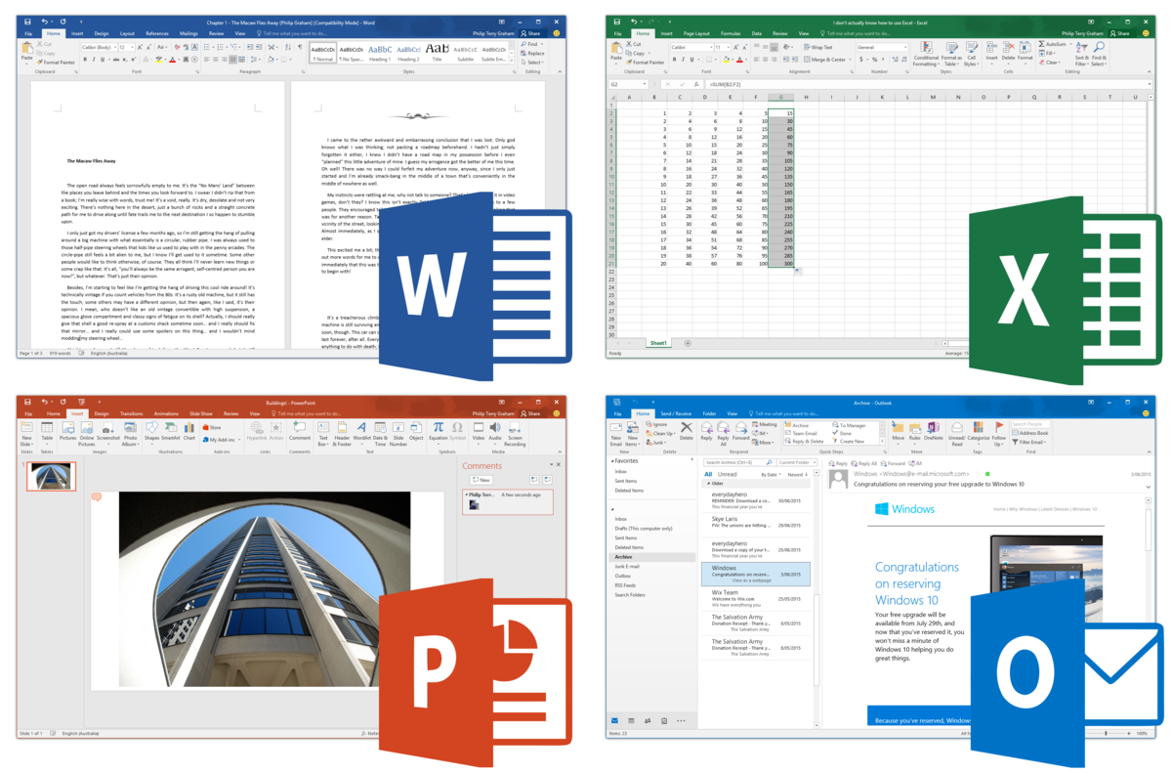
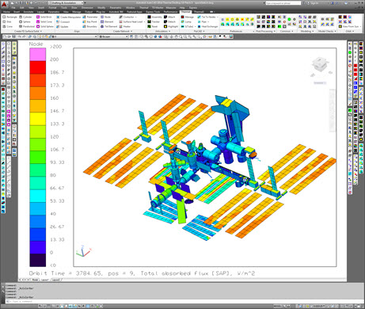
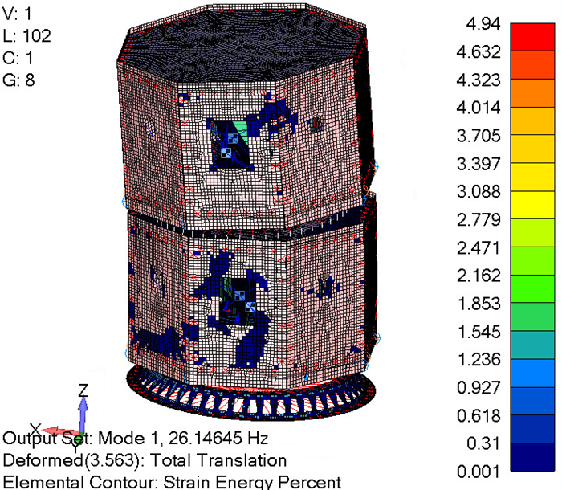
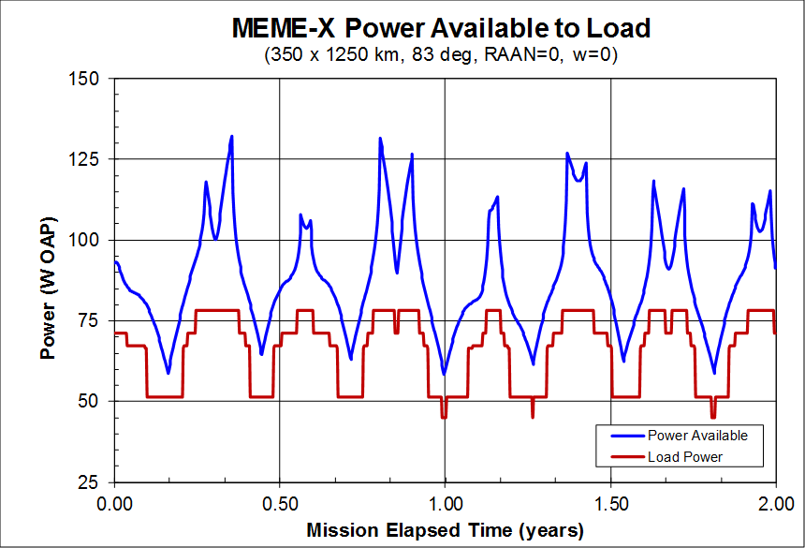
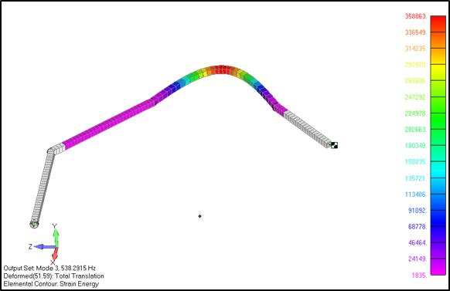
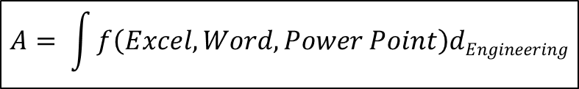
Systems Engineering
** Defined architecture, including major tradeoffs and options ready to be baselined after review comments are incorporated.
** Allocation of requirements to next lower level ready to be baselined after review comments is incorporated.
** MOPs, TPM, and other key driving requirement ready to be approved.
**Initial trending information on the mass margins (for projects involving hardware), power margins (for projects that are powered) and closure of review actions (RFA, RID, and/or Action Items).
Develops & Manages
$$A= \int{f\left(Excel,Word,Power Point\right)dEngineering}$$
A multitude of sometimes redundant, sometimes obsolete, oftentimes out-of-sync documents, spreadsheets, e-mails or whatever…
-An un-named SE

Slide 23

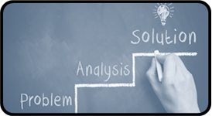
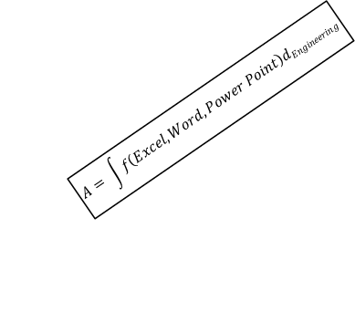
Systems Engineering
** Defined architecture, including major tradeoffs and options ready to be baselined after review comments are incorporated.
** Allocation of requirements to next lower level ready to be baselined after review comments is incorporated.
** MOPs, TPM, and other key driving requirement ready to be approved.
**Initial trending information on the mass margins (for projects involving hardware), power margins (for projects that are powered) and closure of review actions (RFA, RID, and/or Action Items).
$$A= \int{f\left(Excel,Word,Power Point\right)dEngineering}$$
SE Documents
SE Team Manages “Team Interfaces” for information management, as it establishes “System Interfaces”

Slide 24
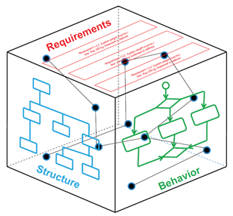
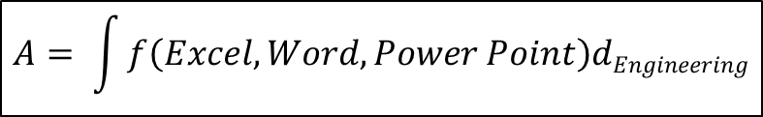
[MB] System Engineering
** Defined architecture, including major tradeoffs and options ready to be baselined after review comments are incorporated.
** Allocation of requirements to next lower level ready to be baselined after review comments is incorporated.
** MOPs, TPM, and other key driving requirement ready to be approved.
**Initial trending information on the mass margins (for projects involving hardware), power margins (for projects that are powered) and closure of review actions (RFA, RID, and/or Action Items).
Standardized Interfaces
Develops & Manages
$$A= \int{f\left(Excel,Word,Power Point\right)dEngineering}$$

Slide 25

[MB] System Engineering
** Defined architecture, including major tradeoffs and options ready to be baselined after review comments are incorporated.
** Allocation of requirements to next lower level ready to be baselined after review comments is incorporated.
** MOPs, TPM, and other key driving requirement ready to be approved.
**Initial trending information on the mass margins (for projects involving hardware), power margins (for projects that are powered) and closure of review actions (RFA, RID, and/or Action Items).
More Standardized Interfaces
Maxwell: …such a being, whose attributes are still as essentially finite as our own, would be able to do what is at present impossible to us.
Drives
Develops & Manages

Slide 26
[MB] System Engineering
** Defined architecture, including major tradeoffs and options ready to be baselined after review comments are incorporated.
** Allocation of requirements to next lower level ready to be baselined after review comments is incorporated.
** MOPs, TPM, and other key driving requirement ready to be approved.
**Initial trending information on the mass margins (for projects involving hardware), power margins (for projects that are powered) and closure of review actions (RFA, RID, and/or Action Items).
Contains
SE Documents
Drives
Develops & Manages
Helps Create

Slide 27
System Modeling
So far…
Re-visited the MBSE case for change
Really drove home the point about “System Models”, how they capture the “System Architecture” and their use in the NASA life cycle (‘Up and Out’ as well as ‘Down and In’)
Next Steps…
Lets look at a Phase A activity
How do we model the Architecture?
How do we share and collaborate on the Architecture?

Slide 28
Phase A
What was required of Systems Engineering?
Defined architecture, including major tradeoffs and options ready to be baselined after review comments are incorporated.
Concept of Operations / System Concept Definition

Slide 29
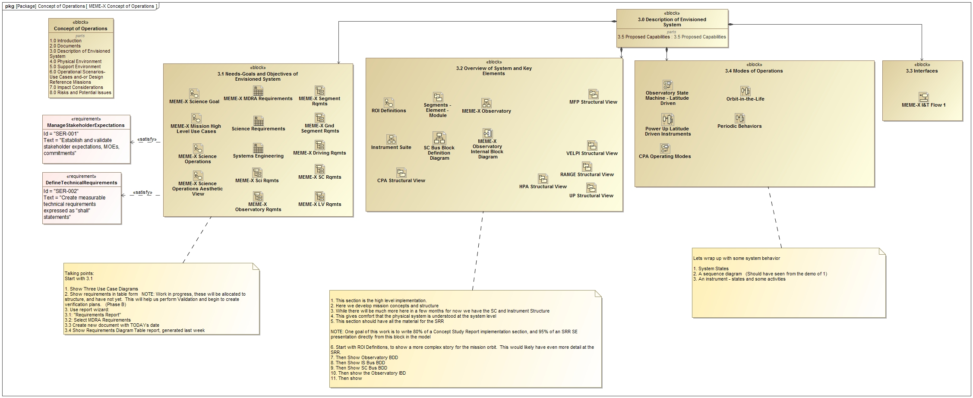
Focus: Lets look at the Concept of Operations, which articulates much of the architecture

Slide 30

Expectations Management
Three things necessary to do good Model Based Systems Engineering
Experience in the system of interest
Discipline Experience in areas being modeled
Experience in Modeling
This experience
Strong Mission Systems Engineering
Strong Science Team
Less experience on Instrument Systems Engineering
Novice Modeling Experience
So…
The model chased the design
Modeling of behaviors is in early stages

Slide 31
Model Demonstration
Needs-Goals and Objectives of Envisioned System
The Science Goal: The “System Level” use case
Science Operations: The “Mission Level” use case
Requirements
Overview of System and Key Elements
ROI Definitions: A description of the Regions of Interest (From the flight mechanics perspective)
Structural Viewpoint:
  Mission Segments
  Observatories, Spacecraft and Instrument Suite
  Spacecraft subsystems
  Payload elements
Preliminary Behaviors

Slide 32
Model Demonstration (See Backup)

Slide 33
Model Development – model use
During this activity, the “MBSE” system model was chasing the system design
Followed a “document based” approach
  ICDs” were shared amongst team iteratively, and converged on the “Technical Baseline Package” – the current design of record
  Built a model from that information to capture the “System of Record”
Structural Diagrams
  Used to capture the system configuration
  Block definition diagrams, consistent with MEL
  Internal Block Diagrams consistent with SC and Instrument “ICDs”
  “Black Box” and “White Box” ICDs from model are consistent with SC and Instrument “ICDs”
Behaviors are being developed, and potential use for Site Visit are being explored

Slide 34
Recap: MBSE offers process improvement throughout the SE cradle-to-grave cycle
Process efficiencies:
Reduced effort, time and cost in executing SE processes
Automatic generation of documents, briefing materials, etc.
Clearly articulated concepts
Improved support for program reviews, decision milestones, etc.
Improved reuse of known-good designs and exiting architectural elements
Ready availability of information on system baselines
More rapid communication within team
Faster convergence on multi-discipline / multi-organizational problems
Auto-generation, being explored – not there yet!
Structure diagrams are interconnected and update consistently
Behavior diagrams show promise for clearly articulating concept of operations.
“Organic Navigation” for structure and behavior offers improved review support
  Structure package diagrams, complete with interfaces
  Linkage between state-machine, activity and sequence diagrams
Working in model space “real time” could have helped alleviate confusion on interface definition and specification

Slide 35
Model Re-use
A fair amount of the MEME-X model was built upon the MMS model built last year (from 2005 MDL information)
“Baseline” designs for SC and Instruments are captured in model, and are suitable for re-use
Many Behavior diagrams (Use Case, State Machine, Activity) are re-useable right now
  With much of the drawing work done, re-deploying for a future mission is relatively straight forward
  Enables capturing of detail that might be overlooked in favor of time when developing the next mission
This particular Heliophysics team has many ideas formulating, and this model repository can be leveraged to explore other mission concepts built upon this same platform

Slide 36
Questions?

Slide 37
Model Demonstration (The following slides were not part of the original presentation, rather are screen shots of the model images shown at the time.)

Slide 38
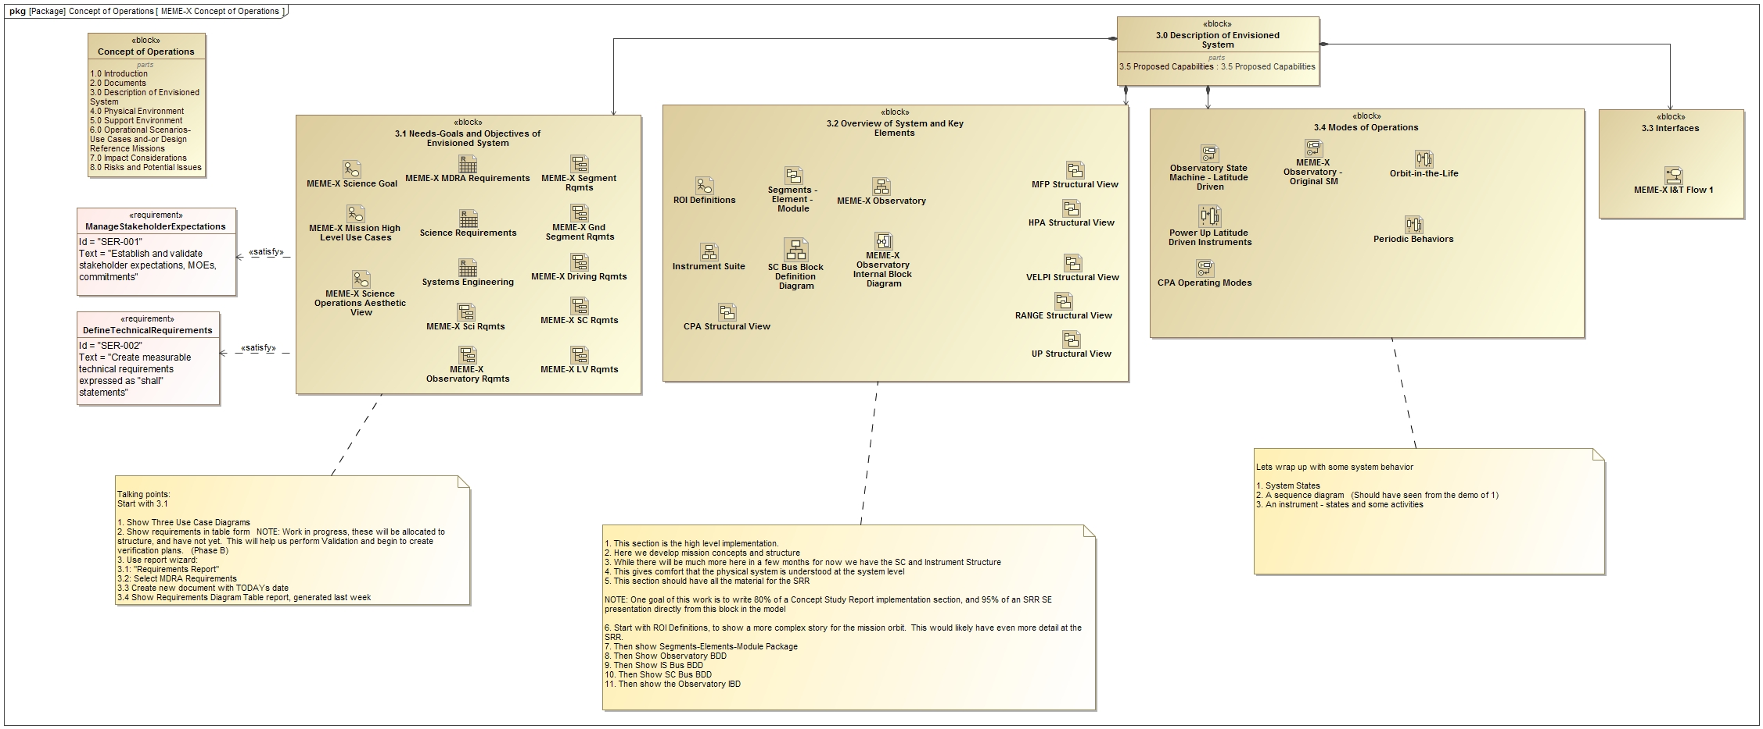

Slide 39
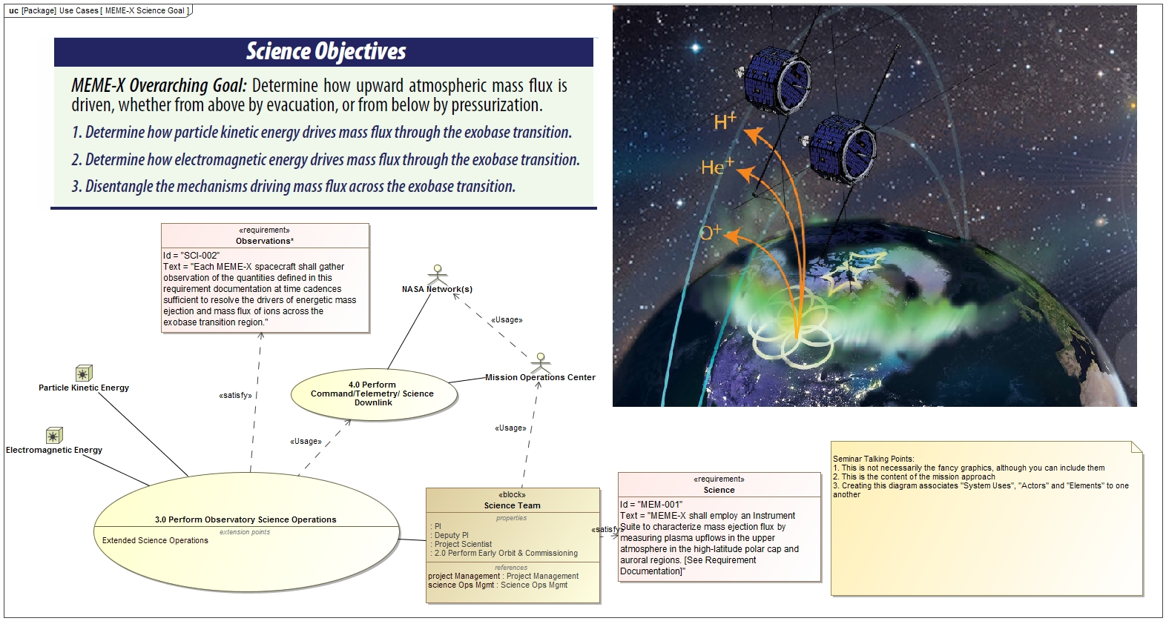

Slide 40
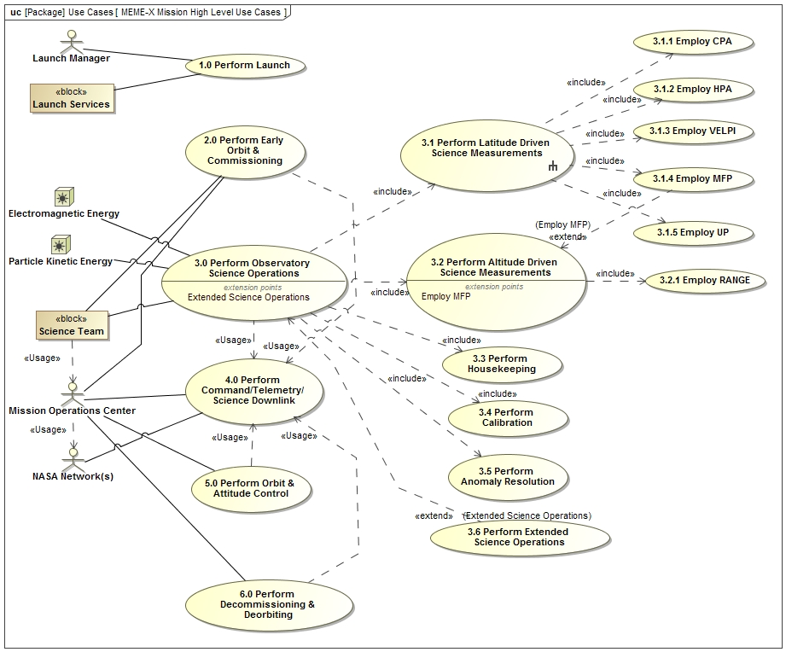

Slide 41
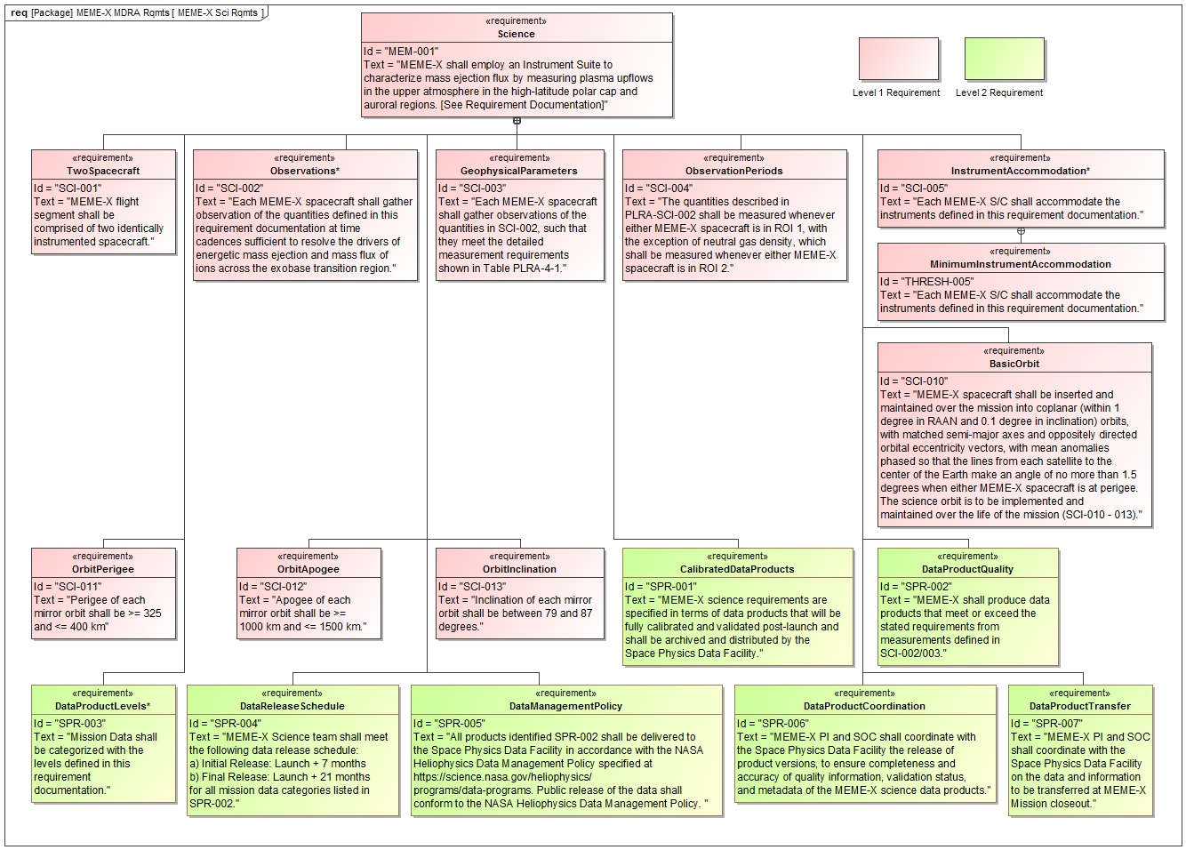
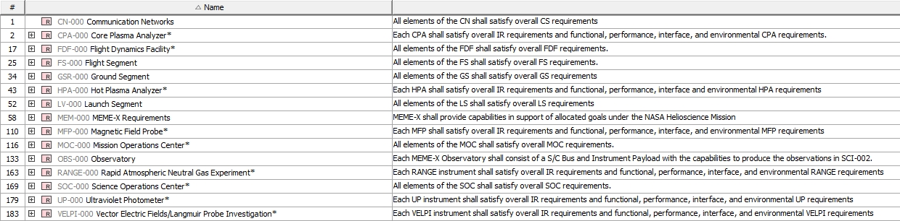

Slide 42
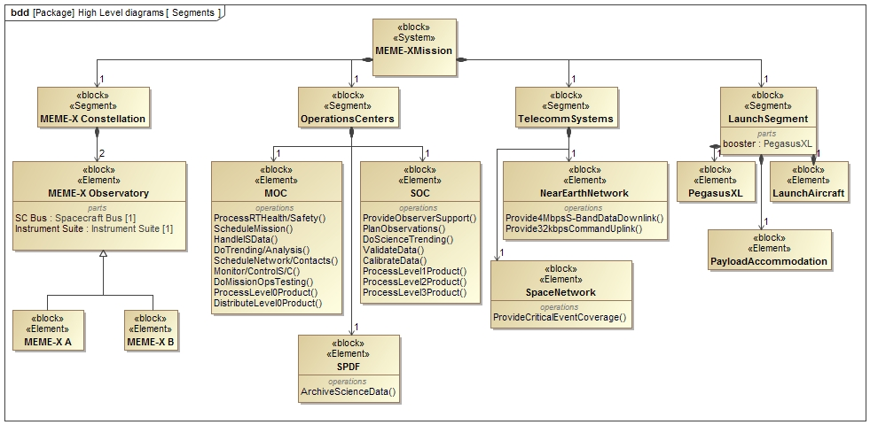

Slide 43
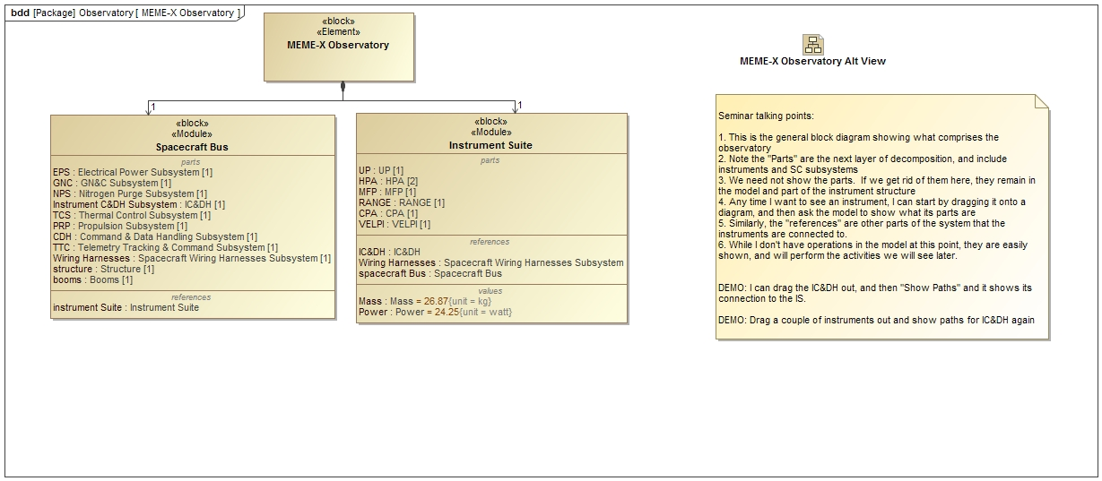

Slide 44
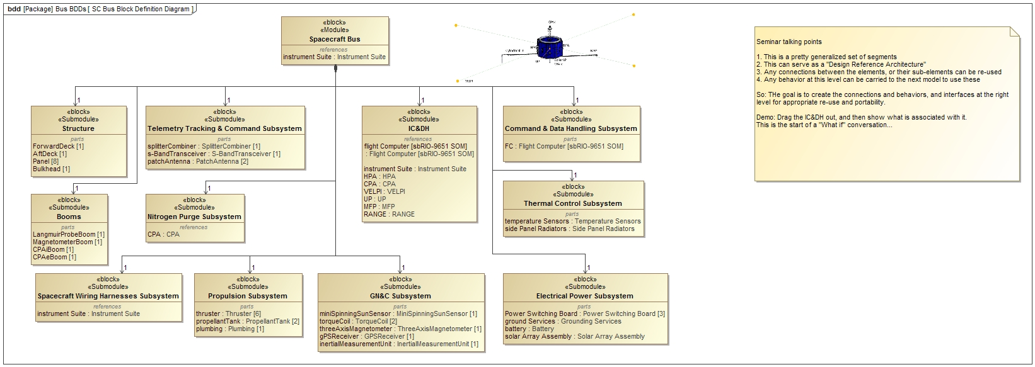

Slide 45
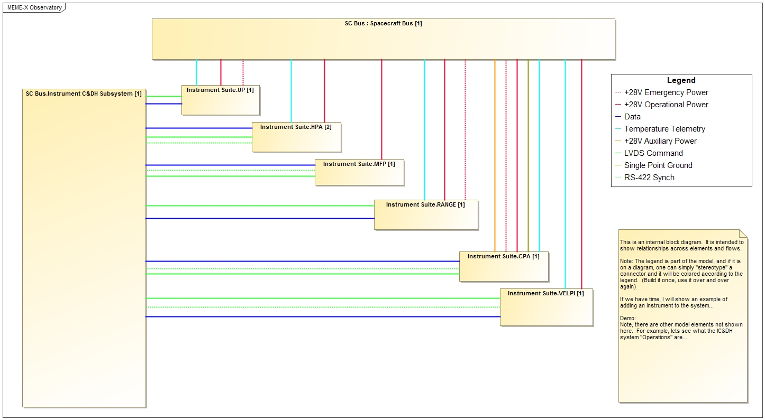

Slide 46
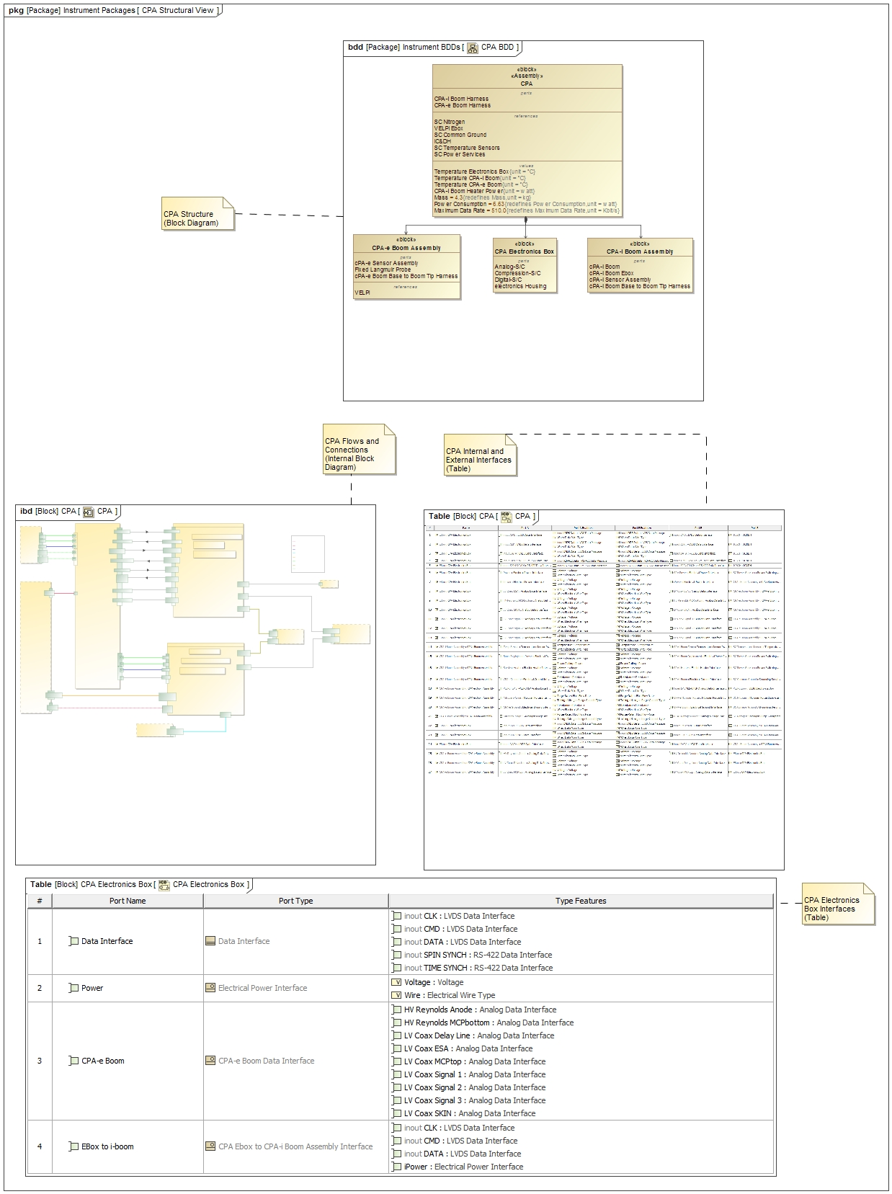
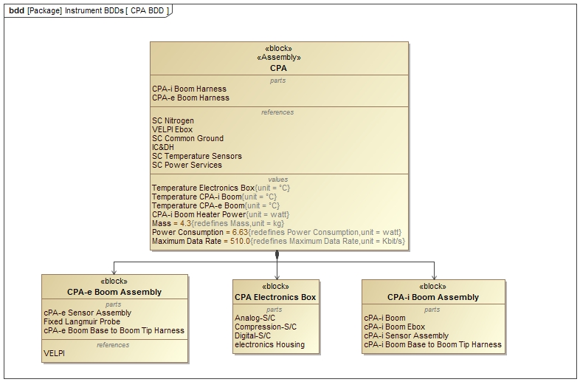

Slide 47
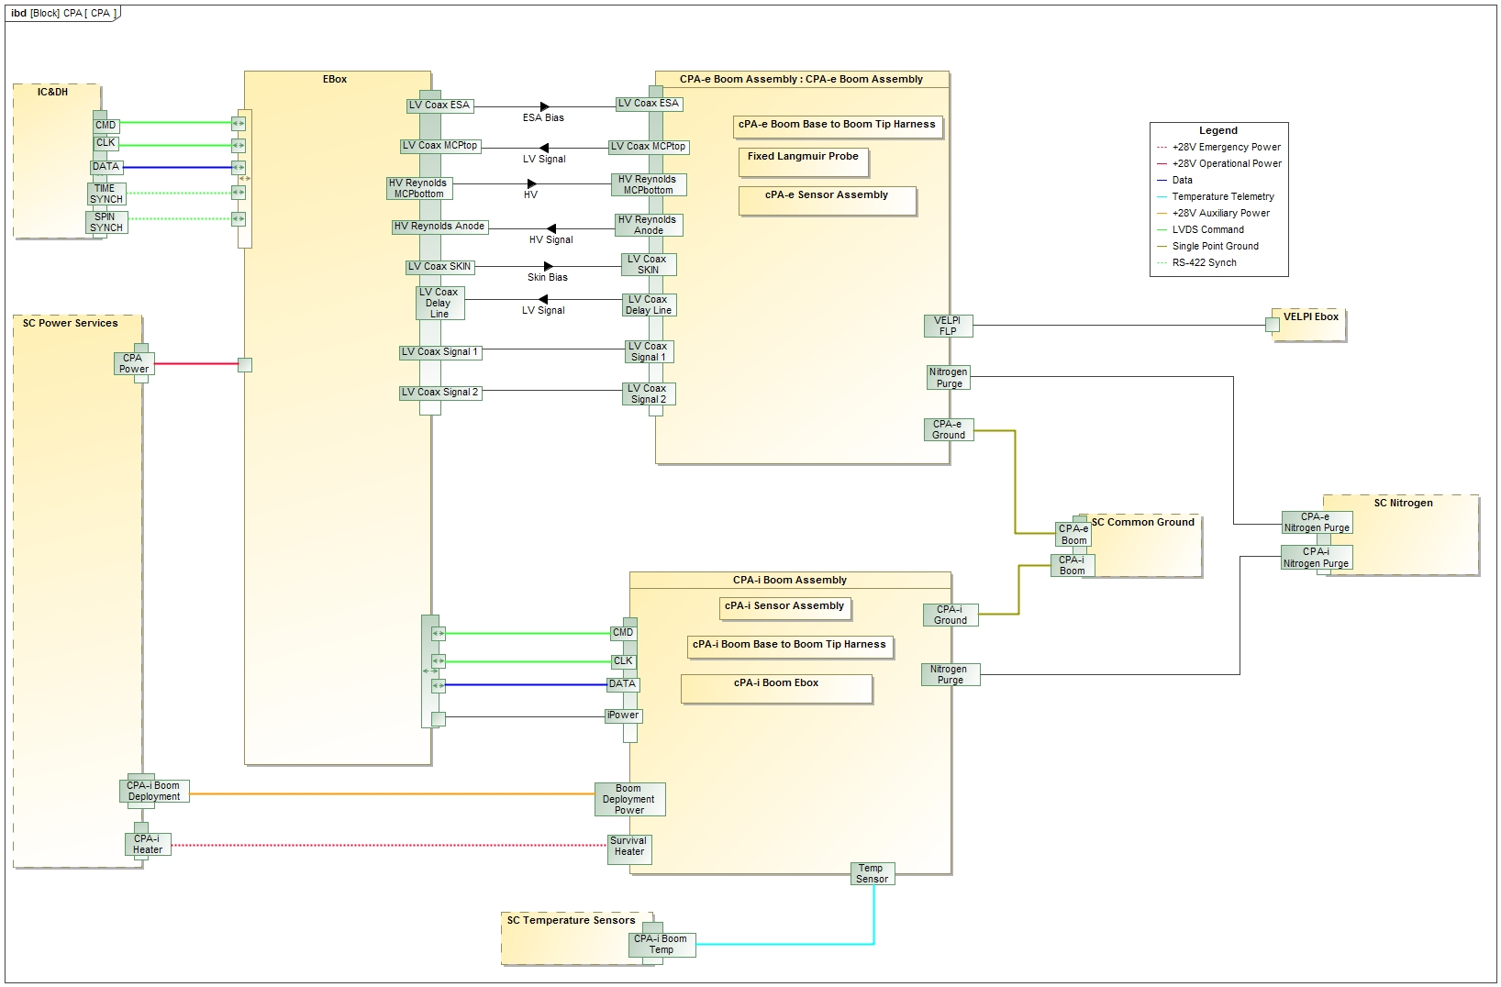
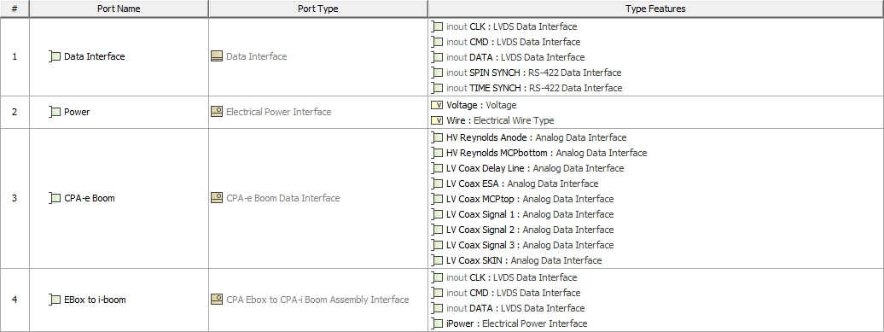

Slide 48
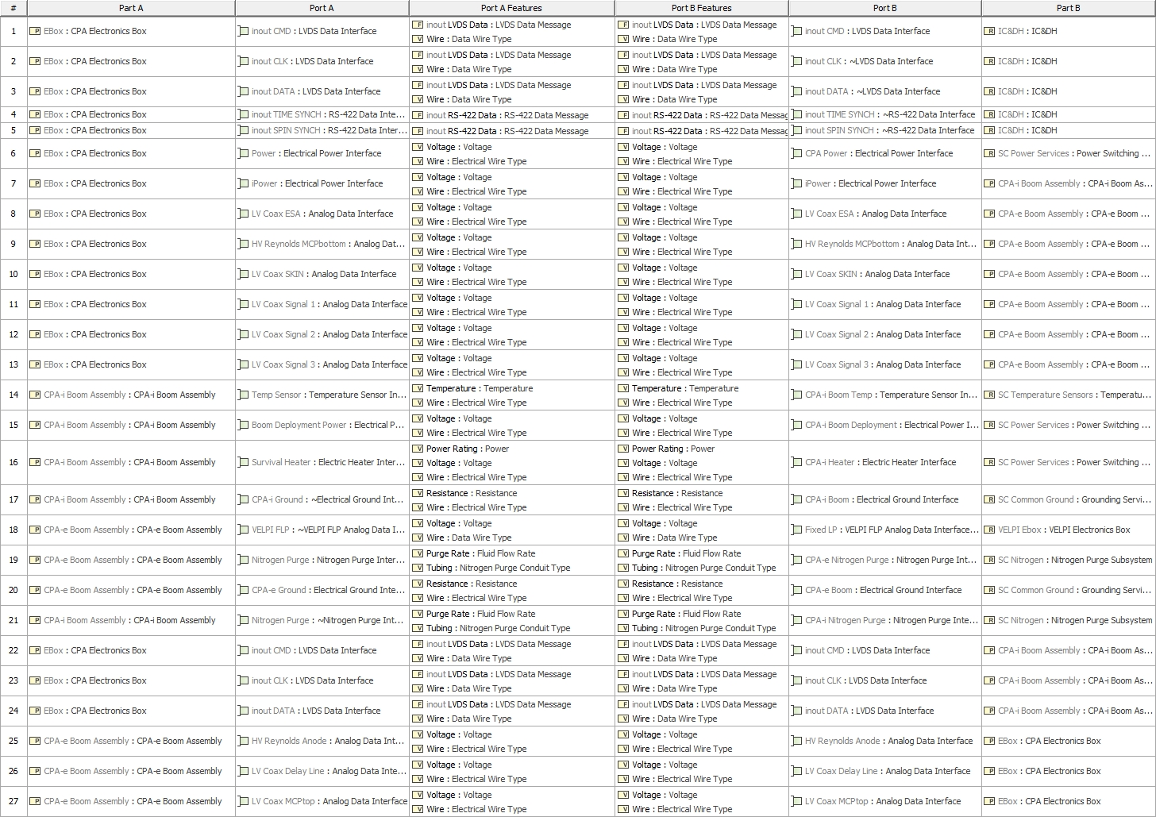

Slide 49
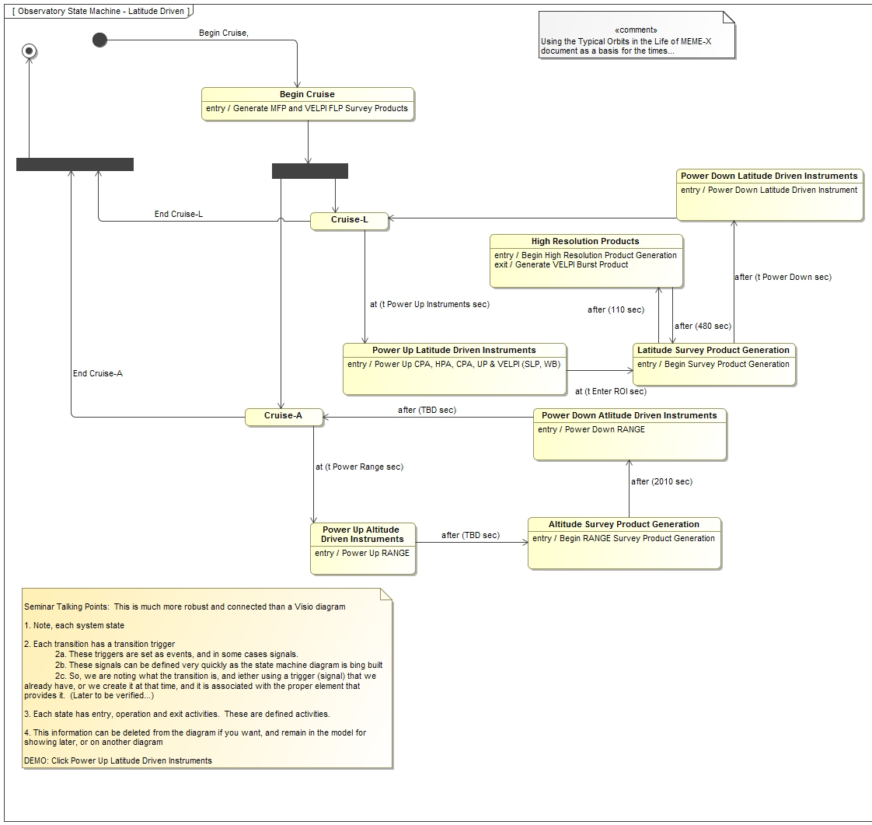
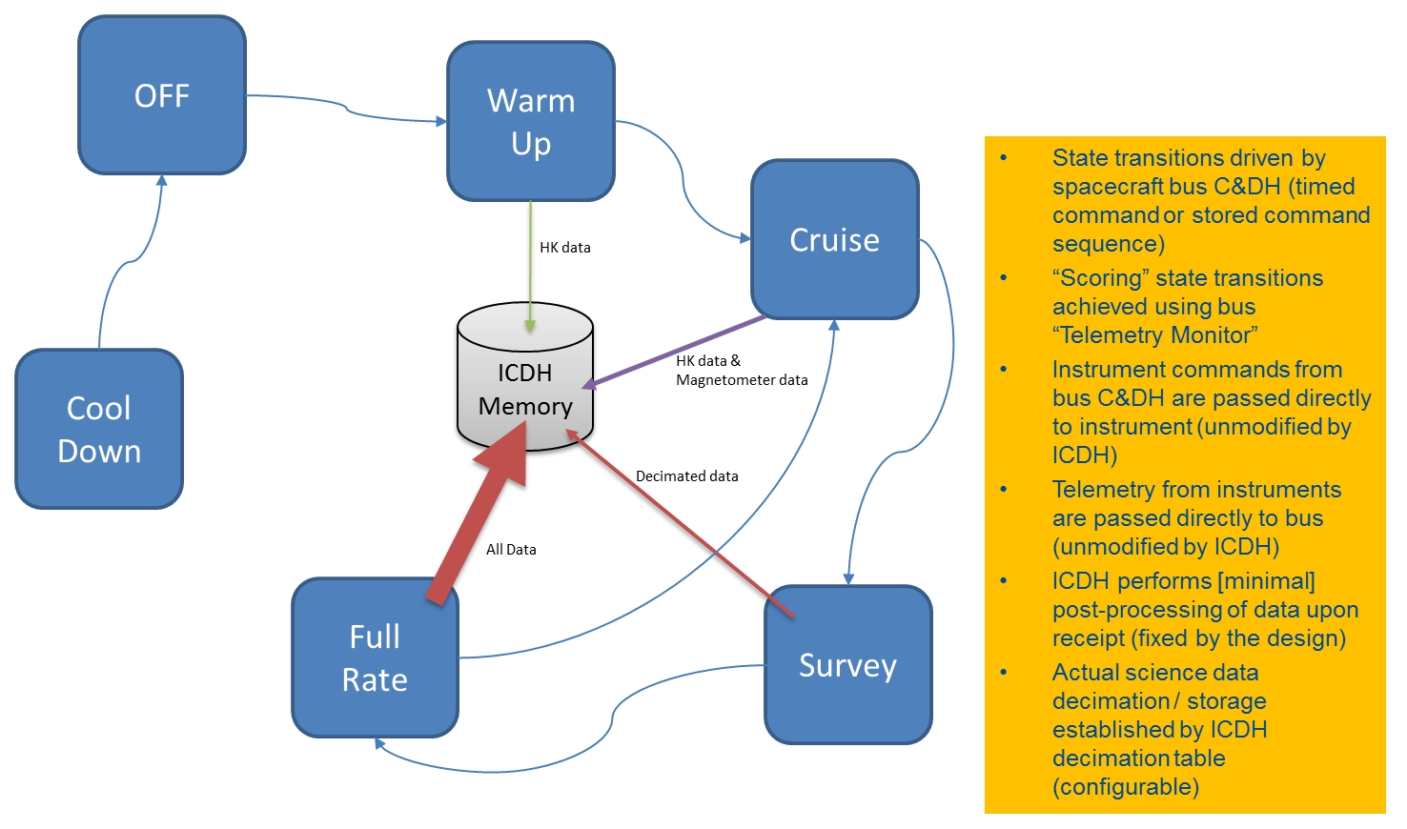

Slide 50
