Slide 1
The Dellingr Challenge: from Conception to Operations Systems Engineering Seminar
Charles Clagett (Charles.E.Clagett@nasa.gov)
Luis Santos (Luis.H.Santos@nasa.gov)

Slide 2
Agenda
Project Formulation
Mission Design
Baseline design
Design maturation
Integration and Testing
Approach
Challenges
Operations
Challenges
Status
Closing Remarks
Lessons learned addressed in each section

Slide 3
Project Formulation – Goals
The Center recognized the importance of SmallSats and wanted to investigate in particular what really takes to develop a CubeSat mission
At the time, it was said universities can do it very quickly and cheaply (<1 year, <$1M)
GSFC formulation for mission proposals utilizes typical processes, making these projects unwinnable
Utilizing HQ resources and IRAD funding to gain much needed experience with the marketplace COTS components and development of a Cubesat
Effort Objectives
For GSFC to develop an understanding of the current state of practice with respect to the capabilities of CubeSat-class platforms to host meaningful science missions
To show, by undertaking a hands-on developmental activity (Dellingr Mission), a path forward toward enhancing technological capability to accomplish more formidable scientific missions with CubeSats
Dellingr Mission objective
Define and develop a mission to conduct a heliophysics science investigation utilizing two, three or four science payloads already in development at GSFC
Design, build, test, and flight qualify a 6U CubeSat within a one-year time period

Slide 4
Project Formulation – Plan
Original objectives were selected to stress the typical Goddard project and engineering approach
Initial Spacecraft Bus budget: 3.2 FTEs, $100k based on university cost claims, instruments cost not part of the budget
Only 2 full-time members (PM and DPM)
Positions were posted, applicants interviewed and selections made
Position 1: Project Manager, Systems Engineer, Procurements, I&T, etc.
Position 2: Deputy Project Manager, Mission Systems Engineer, I&T, etc.
Part-time staff to provide support as needed
Timeline of 1 year
Do no harm risk classification

Slide 5
Project Formulation – Plan
Met with 670 personnel and created a list of payloads in development
Three (3) payloads were selected based on maturity and size
Science Magnetometers (DAGR)
Ion Neutral Mass Spectrometer (INMS)
Compact Relativistic Electron Proton Telescope (CREPT)
Launch opportunity was not defined
An actual launch manifest took years after this point
It was later decided to baseline an ISS orbit due to the availability of such launches, this orbit removed CREPT

Slide 6
Project Formulation – Initial Organization Chart
Luis Santos
Systems, Mechanical,
Structure
INMS
N. Paschalidis (PI)
S. Jones (CoI)
M. Rodriquez (LE)
Michael Hesse
Heliophysics Division
Michael Johnson
ETD
Scott Hesh
Power, Comm,
Custom Card
Boom Mag
L. Kepko (PI)
G. Le (CoI)
T. Bonalsky (LE)
Aprille Ericsson
Technology Manager
Nick Paschalidis
Instruments Manager
Chuck Clagett
Project Manager
Luis Santos
Deputy PM
Scott Starin
GN&C
Internal Mag
E. Zesta (PI)
T. Bonalsky (LE)
Salman Sheikh
C&DH, Harness, Software
CREPT
S. Kanekal (PI)
T. Jamison (LE)
Other
Funding
Dellingr Funding
Chuck Clagett
Systems, Thermal

Slide 7
Project Formulation – Initial Key Philosophies
Minimize paperwork – learn through experience which documentation is vital to drive the project
Streamline reviews
Only apply GSFC processes if critical (no mandatory compliance with NPRs, GPRs and GOLD rules)
Science requirements are negotiable
Design, Build, Test and Fix – Minimize analysis work and focus on system level testing
Use part-time help as needed only
Reliance on subsystem leads
Use ”CubeSat Market” components as much as possible as part of the tech demo
No spare flight hardware or flatsat

Slide 8
Project Formulation – Name
First great team challenge of Dellingr mission, its name
Originally referred to as the “skunkworks” project
Received “cease and desist” letter from Lockheed Martin for the “skunkworks” name
Process took many iterations and conversations
Many acronyms suggested and kept one in place until a name was defined
HeiSt-1 (Heliophysics Satellite 1)
Seem fitting since we were taking any free leftovers hardware we could locate like solar cells, GPS card, reaction wheels, etc.
Finally settled on Dellingr
Wanted to use name instead of acronym
Dellingr is the Norse god of “Dawn”
It represents “Dawn of Cubesats” at GSFC
Credit for name suggestion to Larry Kepko

Slide 9
Mission Design – Initial Key Parameters
Operate for a minimum of 3 months
Operate successfully 3 GSFC instruments for at least 3 consecutive orbits
Ram pointing for INMS
No specific pointing for DAGR
ISS-like orbit (400km, 51.65 deg inclination, 93 minutes)
Use the Planetary System Corporation (PSC) 6U standard
Other key parameters based on CubeSat experience at the time
Use a beacon to locate satellite upon ejection
Use 30-minute and 45-minute timers for deployments and transmissions respectively
Keep batteries at 20% depth of discharge or smaller
Use 3 separation switches
Have software capability to update from the ground

Slide 10
Mission Design– Initial Baseline Approach
Budget and schedule are very aggressive, reuse was viewed as key for success
Leverage and reuse components from other efforts and missions
Use proven cubesat market components
At the time, it was advertised as almost “plug-and-play” utilizing the PC104 CubeSatKit Bus standard
Original plan:

Slide 11
Mission Design– Final General Sequence

Slide 12
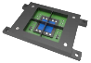
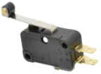
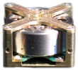
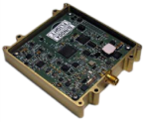
Mission Design – In-House vs. Out-of-house
Cards Stack
Boom Mag and Billingsley Mags
Mags Power and Data
PC/104 Backplane
Boom Rel. Mech., 3.3V
Science Mags
Torquer, FSS,
SPI, +5V
Torquer, CSS
Panel
Panel
GomSpace NanoMind
+8V
2x 3U
2x 2U
+8V
Torquer, FSS, CSS SPI, +5V
Sep Switch
Clyde Space Batteries X3 (90Wh)
Panel
3x
+8V
2x 6U
RBF Switch
Clyde Space EPS
I2C, +5V
Wheel
3x
INMS
SPI, +3.3V, +/-5.0V
Special Services Card
RS232,+3.3V
+5.0V, +8.0V
RS232
+3.3V
SPI
+3.3V
L3 Cadet
GPS Antenna
GPS Card
MEMs Gyro X4
Balun, capacitors, etc.
Antenna Rel. Mech., 3.3V
4x UHF Antenna
In-House
Market Component

Slide 13
Mission Design – Why In-House?
Solar Panels
With the allocated budget, solar panels were very expensive
Learned from Aerospace Corp. an inexpesive way to make solar panels using PCBs as substrate
Used left-over ZTJ solar cells from GPM
Decided to used body mounted solar panels (instead of deployables) to simplify the development and minimize procurement cost
Torquers
Since solar panels will be done in-house, we can embed traces in a loop to effectively create a torquer with no residual field since it doesn’t have a core
Science magnetometer boom (could not find a good boom from the market)
Fine Sun Sensor
Leveraged the IRAD investment in a fine sun sensor developed by WFF
GPS antenna
Decided to use GPS antenna from the FireFly cubesat (smallest we can find)
Vendor did not make the antenna anymore but provided documentation necessary to build it ourselves

Slide 14
Mission Design – Why In-House?
Special Services Card
Since most components are “off-the-shelf”, the SSC provides any connectivity and functionality lacking on purchased components (additional voltages, additional switches, fuses, IO expanders, etc.)
UHF Antenna
Could not find a reliable/proven UHF antenna product from a vendor
Release Mechanism (boom and antenna)
Leveraged the IRAD investment in a miniaturized release mechanism developed by WFF
Software
Decided to use the in-house core Flight Software to minimize software development
Decided to develop ACS algorithms in-house
Mix of previous efforts and mission left-overs and in-house developments reduced initial hardware procurement cost from ~$300k to ~$125k

Slide 15
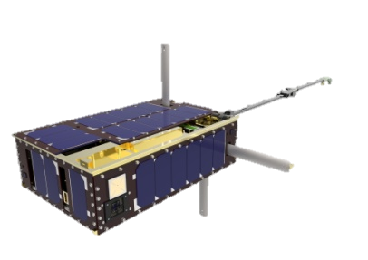
Mission Design – Final Concept of Operations
1- Off (inside deployer)
2- Sep Sws Activate Sat + Timer “On”
4- Deployments and Health Status
3- Timer Completed
5- Bus and Payloads Checks/Tests
Data Link (after timer expires)
Charging Mode
Commission (Ground Command)
RTS
(After predetermined amount of charging orbits)
RTS
(After predetermined amount of charging orbits)
Charging Mode
Dagr Mode
RTS or Anomaly
(1 full orbit with Dagr)
Data Link
INMS Mode
Command
(anomaly assessed)
If Anomaly
Data Link
RTS or Anomaly
(1 full orbit with INMS)
Data Link
Safe Mode
Data Link

Slide 16
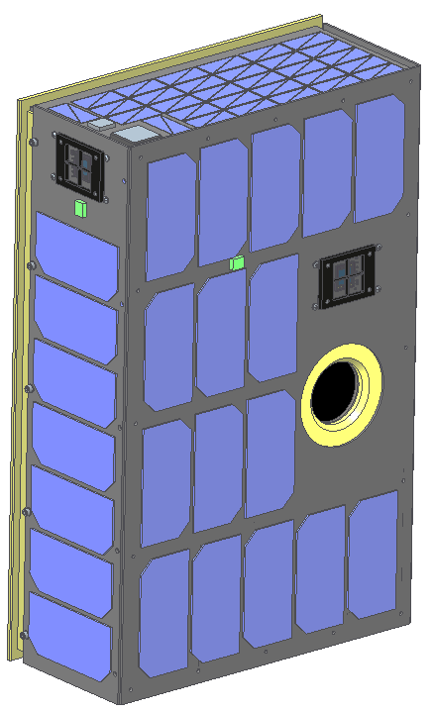
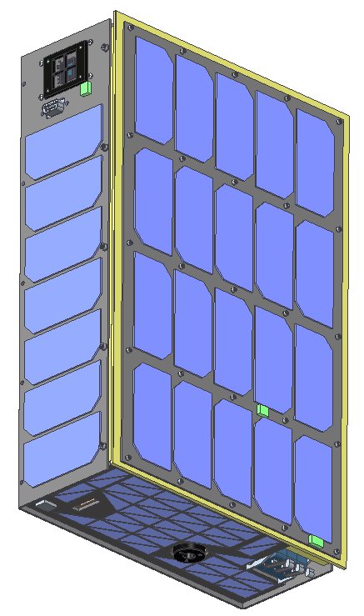
Mission Design – Initial Concept (Outside)
Coarse Sun Sensor
Temp Sensor
TASC Solar Cells
Base Plate
Fine Sun Sensor
GPM Solar Cells
EGSE & RBF
Temp Sensor
Temp Sensor
CREPT
GPM Solar Cells
Coarse Sun Sensor
Coarse Sun Sensor
INMS
Separation Switches

Slide 17
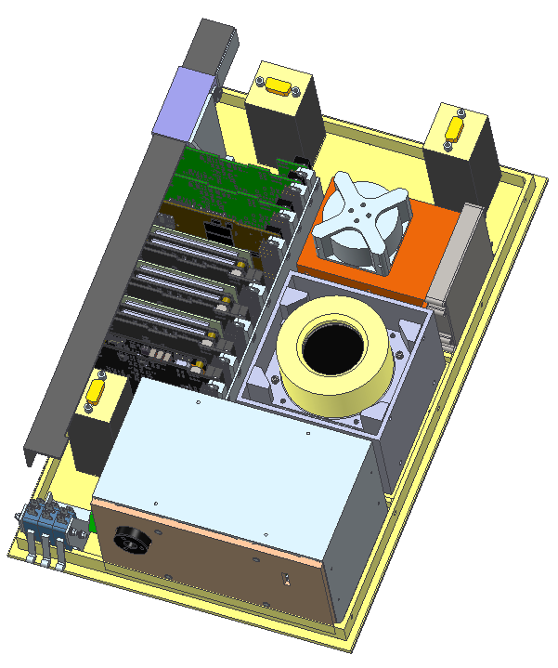
Mission Design – Initial Concept (Inside)
Science Mag Card
Mag Boom
Dellingr Custom Card
3X Science Magnetometer
GomSpace NanoMind
3X Reaction Wheels
Clyde Space Batteries
L3 Cadet
CREPT
Clyde Space EPS
INMS
Separation Switches

Slide 18
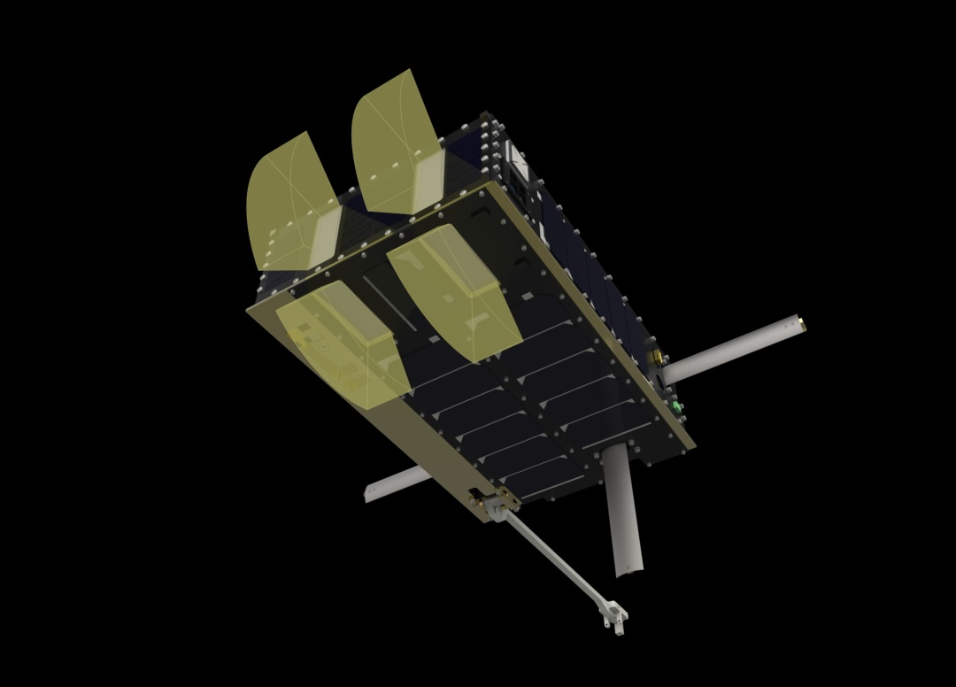
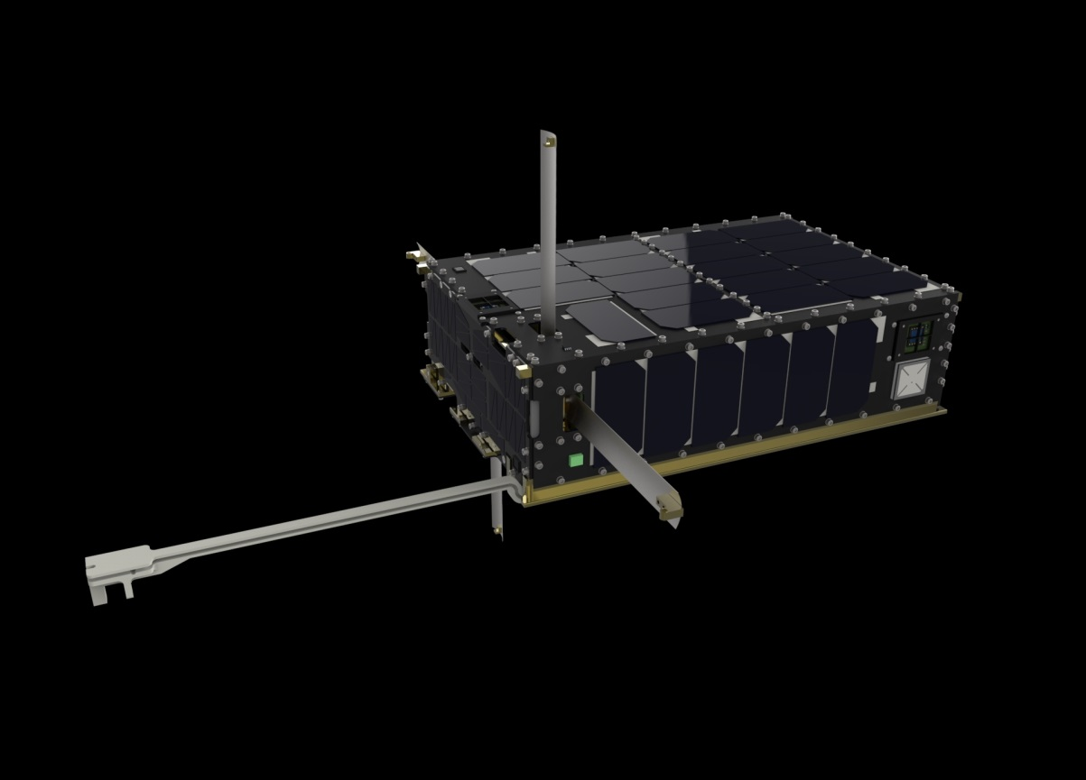
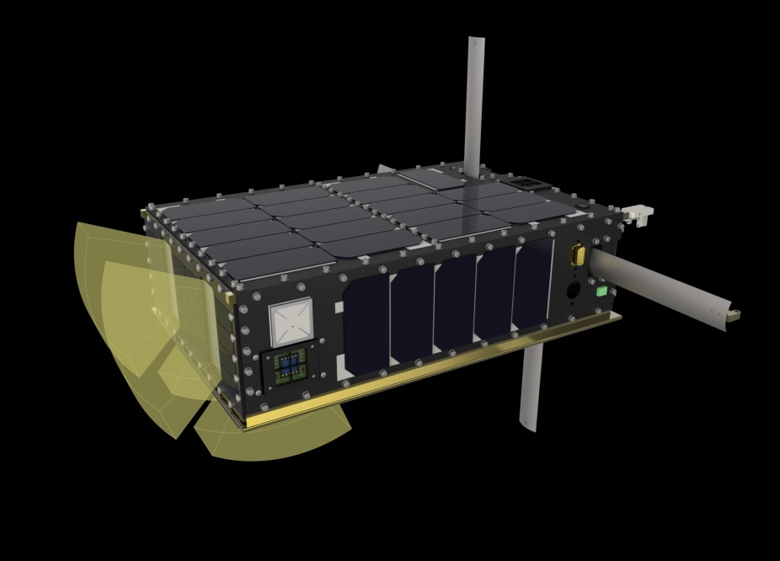
Mission Design – Update 1
Higher fidelity model:
Higher-gain circularly-polarized UHF antenna
GPS antenna
Simplified boom (flip vs. slide)
Eliminated CREPT

Slide 19
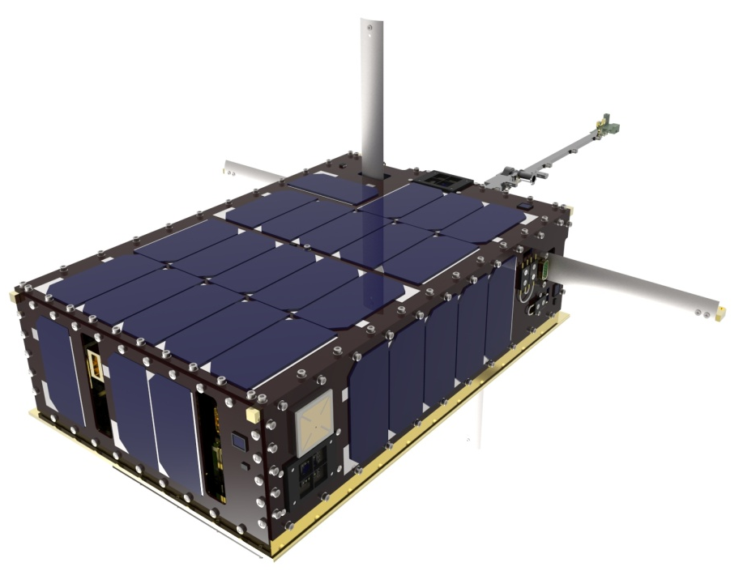
Mission Design – Update 2
Changed boom from single-deploy to a double-deploy system
Added still camera to confirm deployments
Added thermal louver experiment

Slide 20
Mission Design – Safety Requirements
We heard through 3rd parties that ISS requirements for safety are rigorous
Attempted talking to launch provider directly but will not engage unless manifested
Attempted to talk to JSC directly but we were getting requirements without rationale or information about prior agreements for CubeSats
From these conversations, it was realized the batteries procured were not adequate
Did not comply with cell level testing required
Did not comply with the 3 inhibits scheme as defined by them
Current baseline of 90Wh requires additional, costly testing for thermal runaway (80Wh is the limit)
Decided to change to 80Wh due to cost and accept operational impact to mission

Slide 21
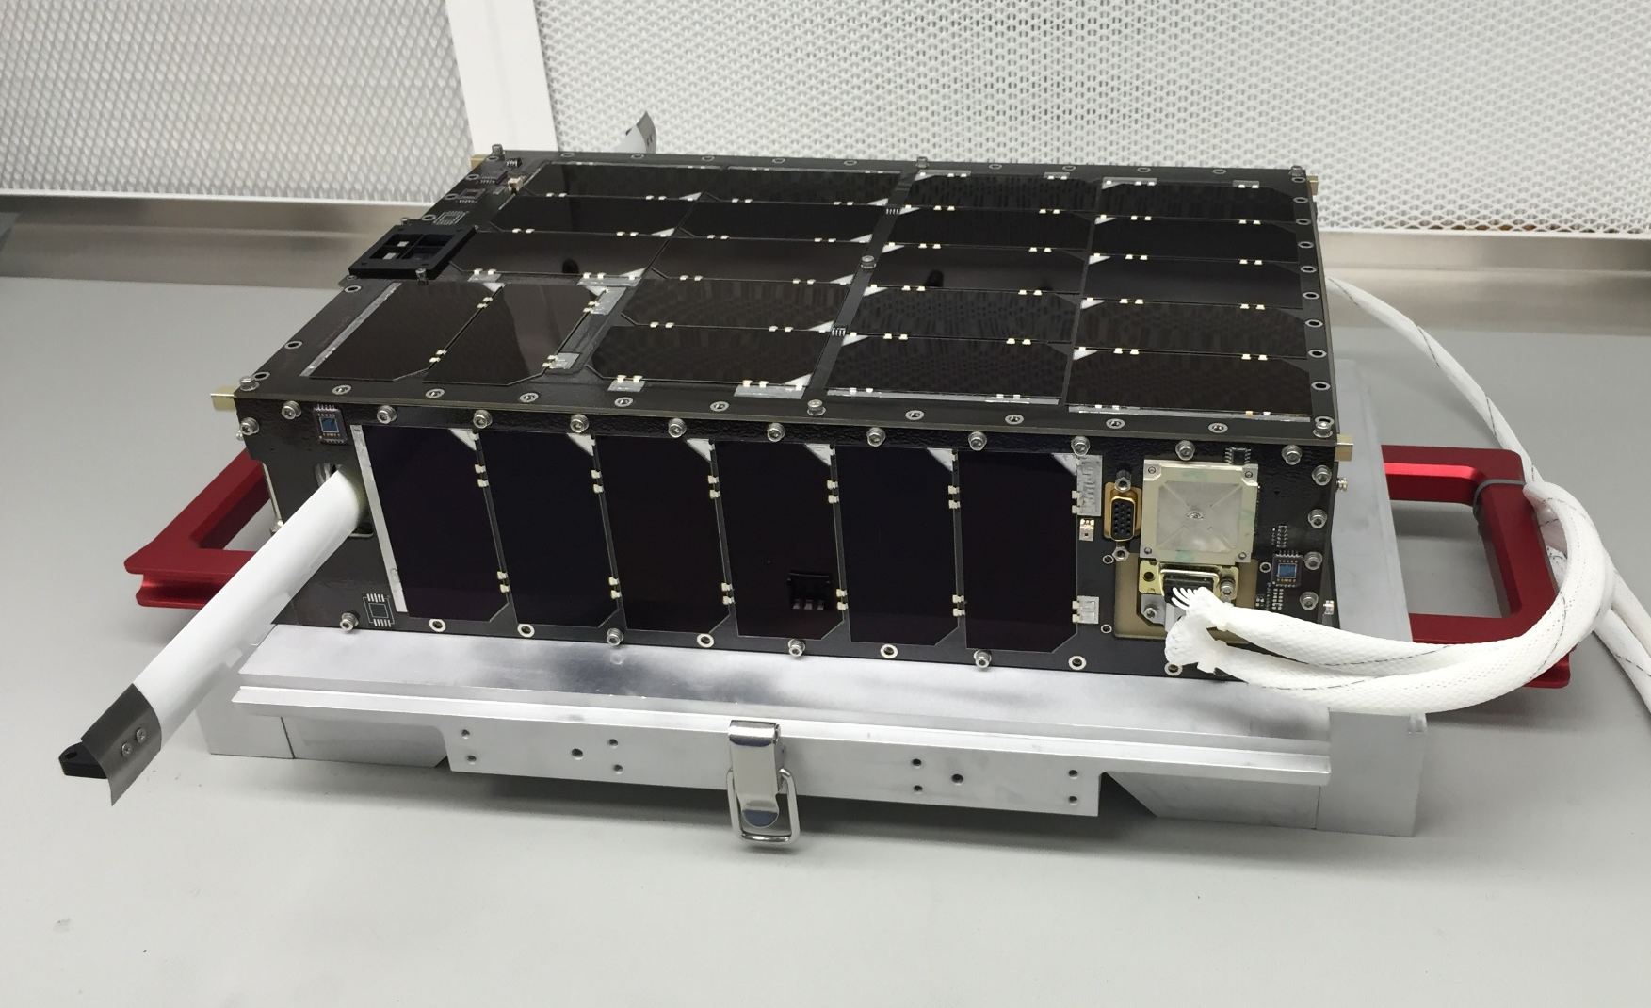
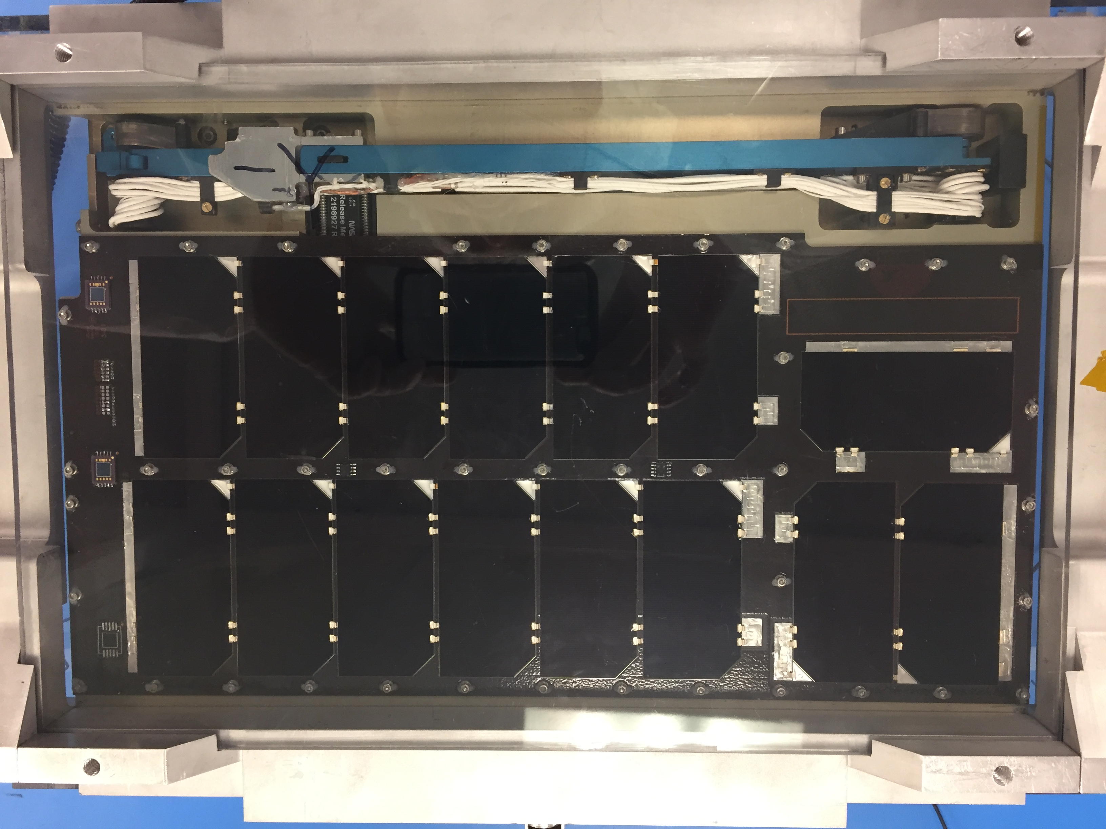
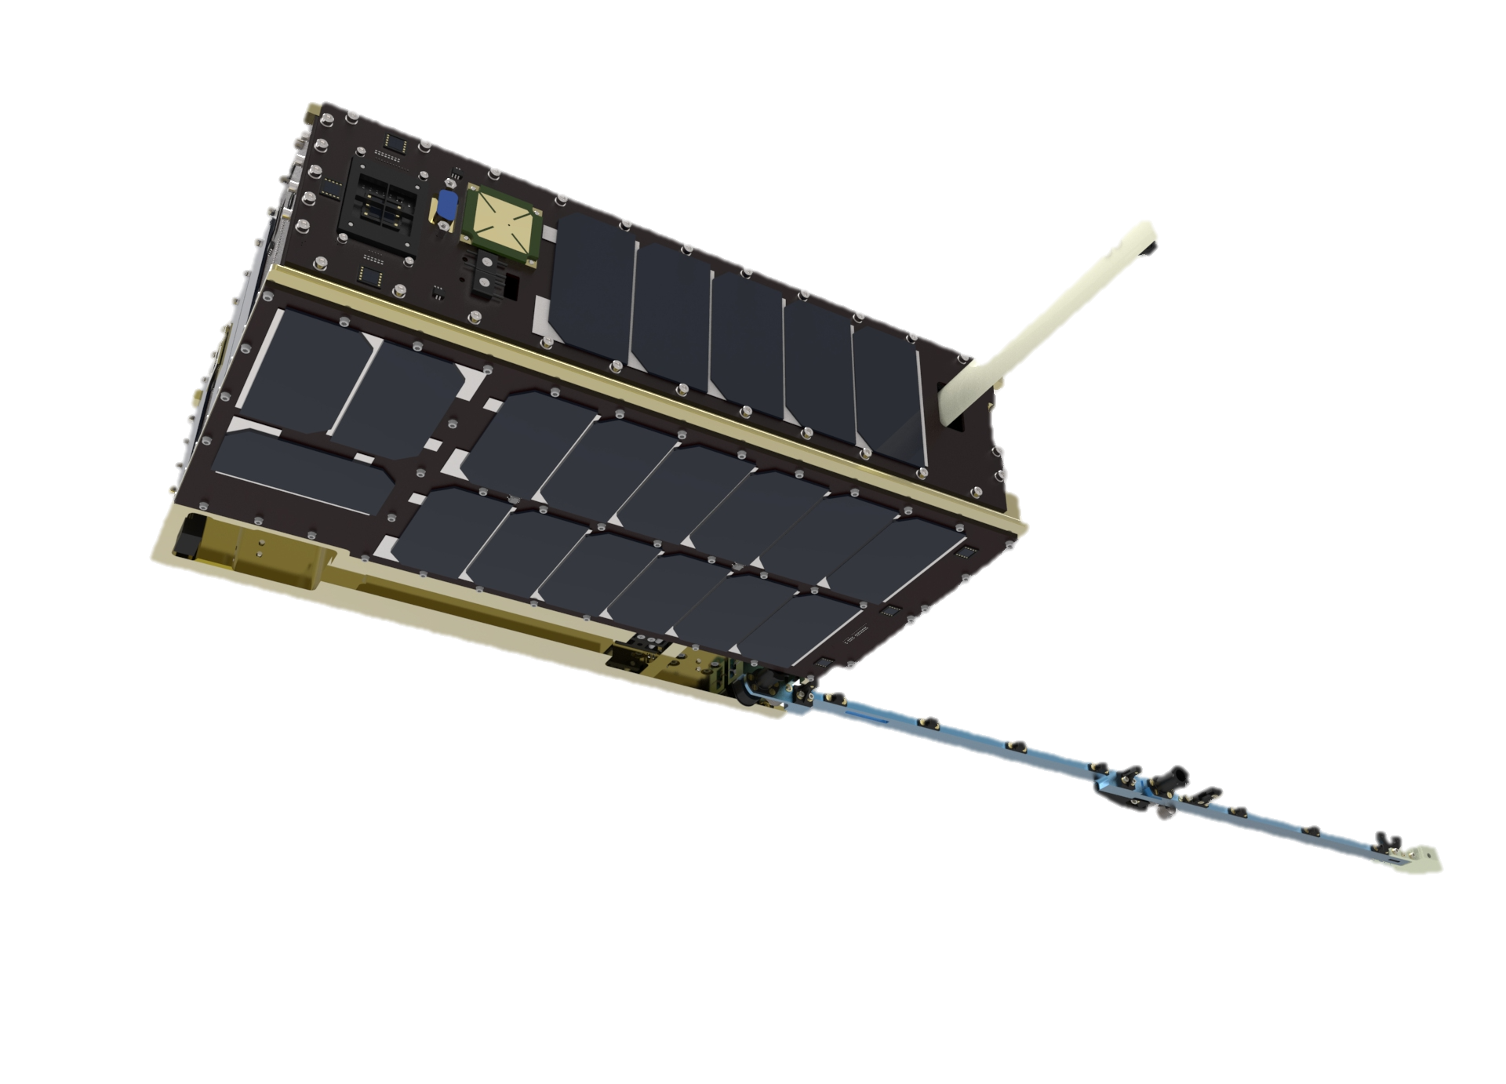
Mission Design – Update 3
Added ISS-rated batteries
Changed antenna to a dipole
Added more cells to the 6U face
Added more sensitive MEMs gyro
Added CubeSat market fine sun sensors
Added inhibit bypass feature

Slide 22
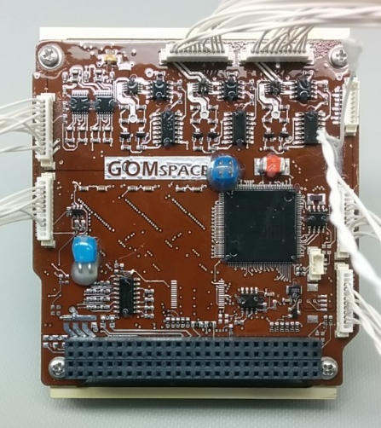
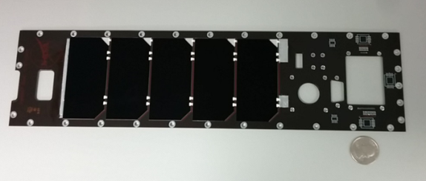
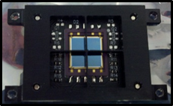
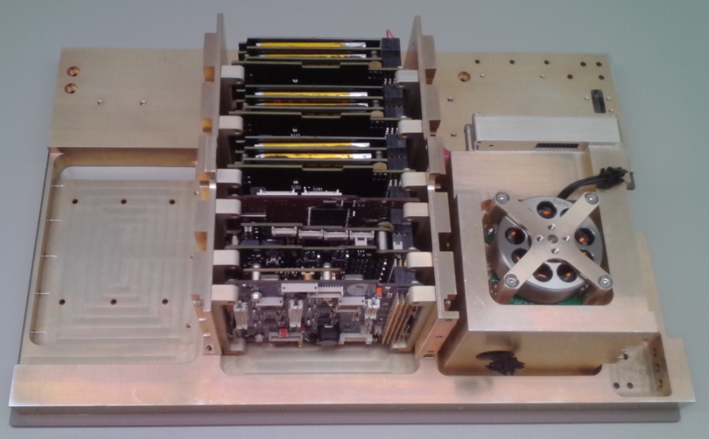
Mission Design – Dellingr Hardware (not all-encompassing)
Special Services Card
C&DH Card
EPS Card
Solar Panel
Fine Sun Sensor
Base plate, card stack, reaction wheels and radio
Flight Boom

Slide 23
Mission Design – Challenges and Lessons Learned
Obtain launch manifest as soon as possible
Safety requirements (use ISS safety requirements to reduce design risk)
CubeSat carrier system requirements
Launch accommodation capability (purge, cleanliness, etc.)
CubeSat components maturity was not as expected/advertised
Not “plug-and-play”
Lack consistent documentation
Delivered product may differ from the one ordered
Design communication system to work from any orientation
Minimize ground intervention by keeping orbit operations simple
Constantly re-negotiate science requirements to save time and resources

Slide 24
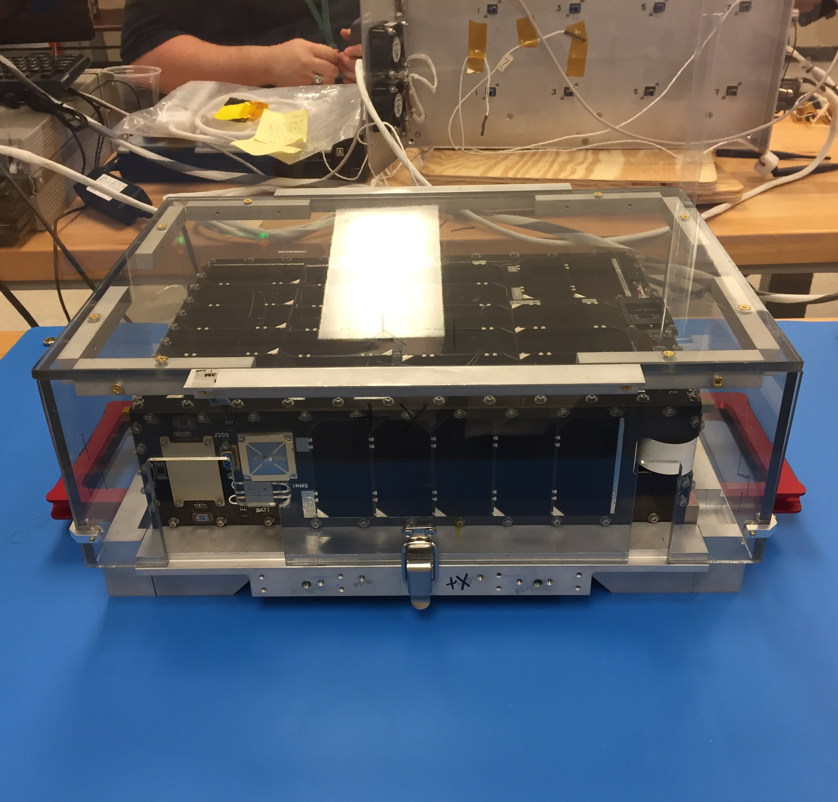
Integration and Testing – Approach
Non-traditional approach to verification & validation due to necessity
Limited resources
Below Class D Mission
Risk reduction effort related to minimum success criteria
Testing based on ConOps activities
Construct tests to serve multiple purposes
Traceability through TDMS CM system, WOAs, procedures, and ITOS logging
Testing generally deferred to system level except for high risk components
Dellingr inside Handling Fixture

Slide 25
Integration and Testing – Flow
Signal integrity test
Separation switches testing
Battery heater and inhibit testing for new batteries
Magnetic Checkout @ Magnetic Calibration Facility
Battery low voltage test – spacecraft reset
TVAC Deployment @ Wallops
Successful release but confirmation switch failed
End-to-End Comm Test @ Wallops
Transmission to Goddard MOC failed
GPS Simulation Test
Functional test (Pre-vibe)
Vibration test 01
Functional test (Post-vibe)
Bakeout
Success
Fail or partial fail
Fix

Slide 26
Integration and Testing – Flow
TVAC
Battery telemetry failed
Radio sending data with errors (Hi FIFO overflow)
SSC release mechanism circuit power output
SPI bus communication (DAGR & WFSS stays on)
Diagnostic port failed
DAGR boom temp. sensor stop functioning
EPS BCR concerns first appeared
Replacement batteries TVAC test
Hi FIFO repaired
Removed EPS (test), SSC & Dagr(rework), solar panels (flash test) and battery swap
Reworked and tested release mechanism to increase reliability
SSC circuit repaired
New EPS received
SSC deployment circuit testing
Mechanical reassembly
Reinstall Dagr, EPS, & SSC to Card Stack
Single-pin harness connections tack-solder (fix Diagnostic port)
Dagr mag head temperature reading fix
Complete reassembly except +Y
Re-arm release mechanisms
Aliveness test
Deployment test in the Lab
WFSS Fix (update firmware, chip select fix)
Success
Fail or partial fail
Fix

Slide 27
Integration and Testing – Flow
Cadet Radio Testing
30-minute timer test
Functional test and GPS simulation
Day-in-the-life
Ground station pass test
Ambient functional test
Bake-out
Regression TVAC
DAGR power consumption the same on all modes
INMS data with unacceptable amount of errors
DAGR data problem in flight software
GPS not getting powered on during some mode transitions
GPS not communicating with FSW
Constant reboot of spacecraft – I2C errors
NanoRacks fit-check
Vibe Test (NanoRacks)
Post-Environmental Functional Test & GPS Simulation
Magnetic test in the lab – Boom mag broken
Dagr boom mag head reinstalled
Mag sensitivity test at facility
Magnetic characterization and momentum management test
Pre-ship day-in-the-life
Final boom magnetometer calibration
Success
Fail or partial fail
Fix

Slide 28
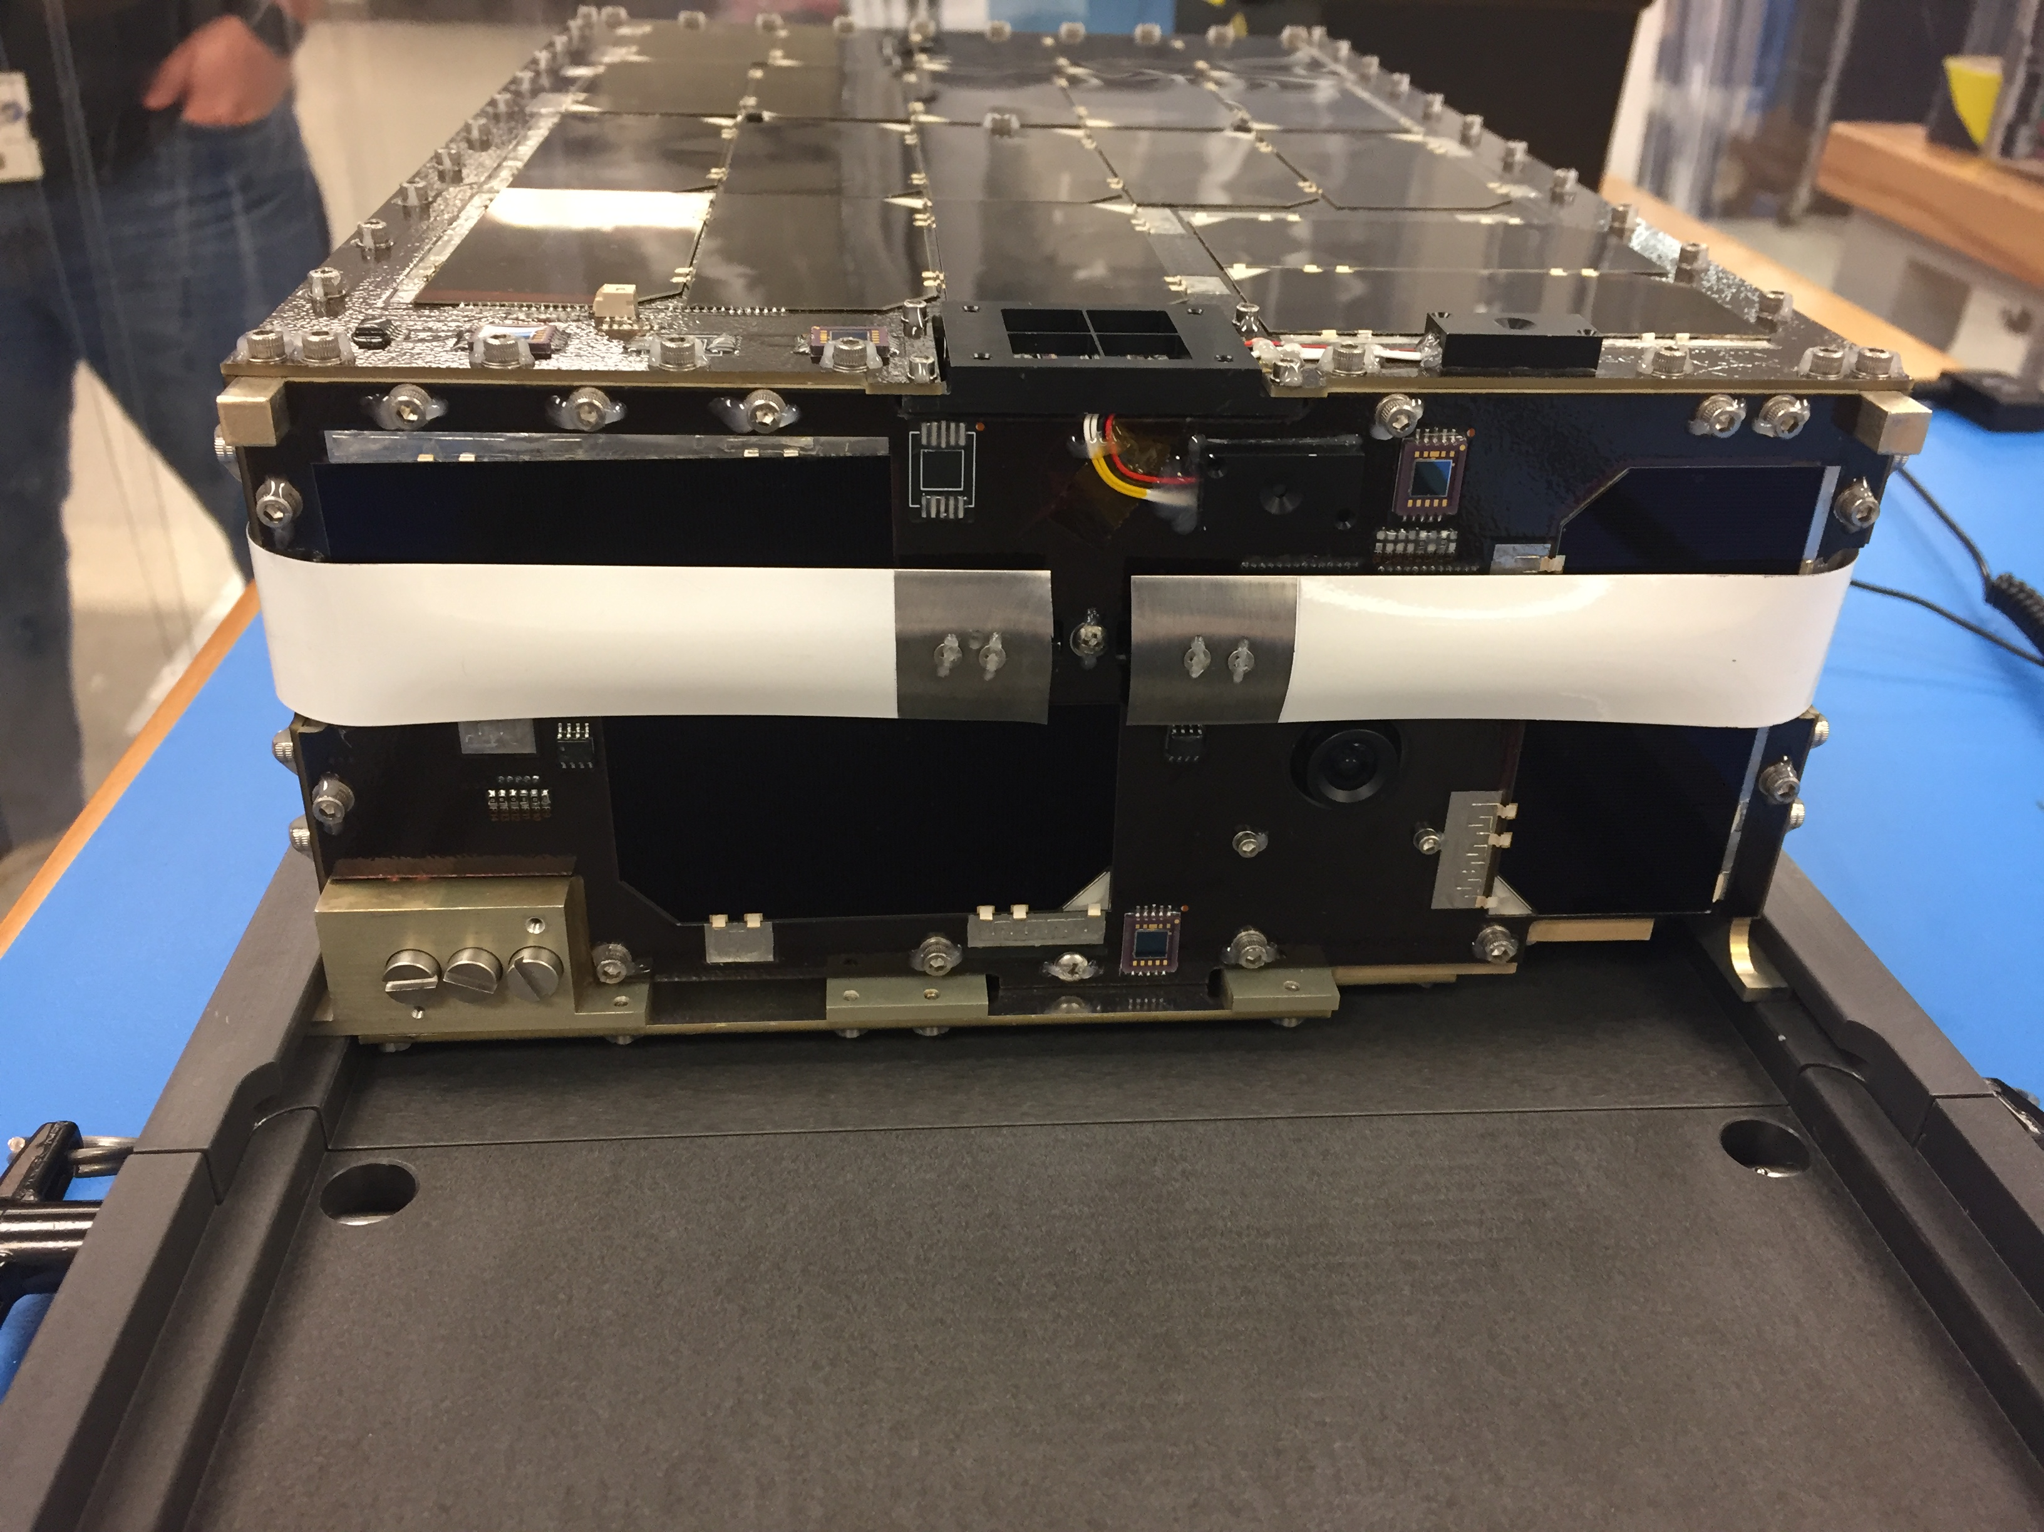
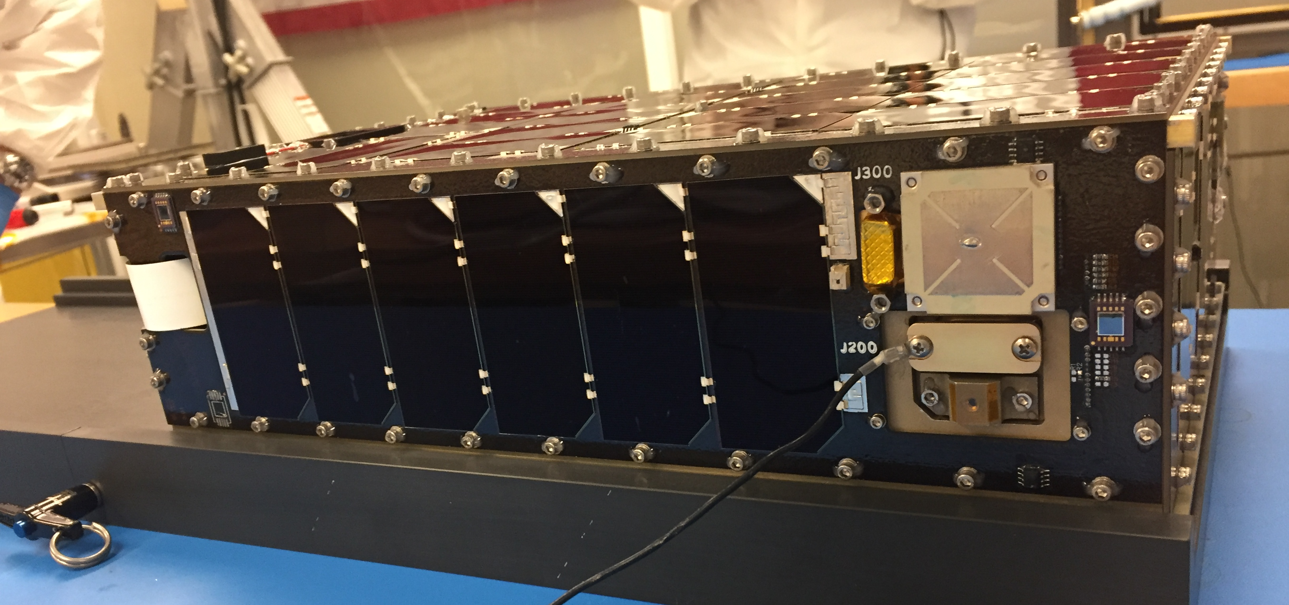
Integration and Testing – Delivery and Deployer Integration

Slide 29
Integration and Testing – Failure Detection and Correction
Philosophy - keep things simple and easy to test
Implementation
Limit checker and relative time sequences
Daily reset to simplify FDC development and watch points
Testing - all testing done on flight unit
Inject undesirable condition, watch system correct itself
Inject undesirable condition, watch system try to start deployment RTS
Inject undesirable condition via test code, watch system respond

Slide 30
Integration and Testing – End of campaign concerns
Boom magnetometer broke during testing with unidentified cause (made mechanical changes)
NanoMind magnetometer bias shifting at random (use boom)
NanoMind resets (unable to recreate problem)
No system-level charging of batteries from solar panels (flash test and BCRs checks performed)
Have experience Cadet radio locking up at random times with unidentified cause (10 min FDC timeout)
Cadet radio overheating during ground pass

Slide 31
Integration and Testing – Challenges and Lessons Learned
Use a 3D printed model for parallel harness development
Have a full flatsat available with hardware in the loop and a physics simulator
Tailor subsystem-level component testing based on experience and confidence of selected hardware
Do not underestimate effort to produce a CubeSat
Efforts between large and small spacecraft are analogous in regards to software, communications, ground system, and ACS
The system still fundamentally needs to perform the same functions with comparable analysis and testing
Many of the lessons learned are old lessons relearned because basic best practices are universal in application regardless of the size of mission

Slide 32
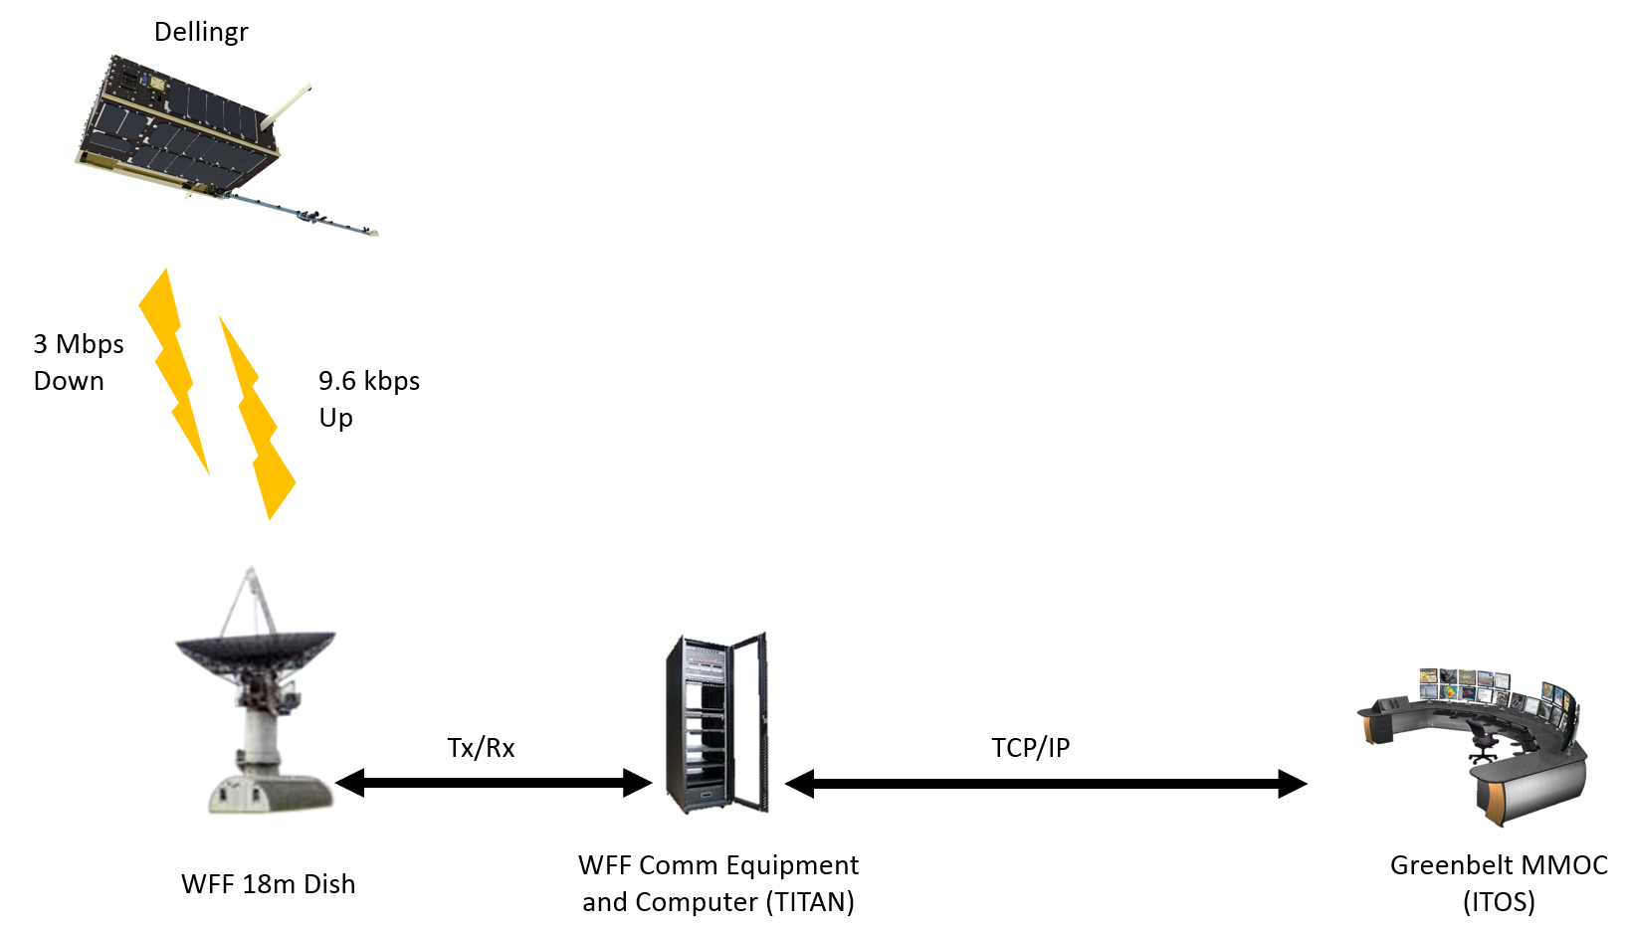
Operations – Ground System
Alternate MOC (ITOS)
TCP/IP

Slide 33
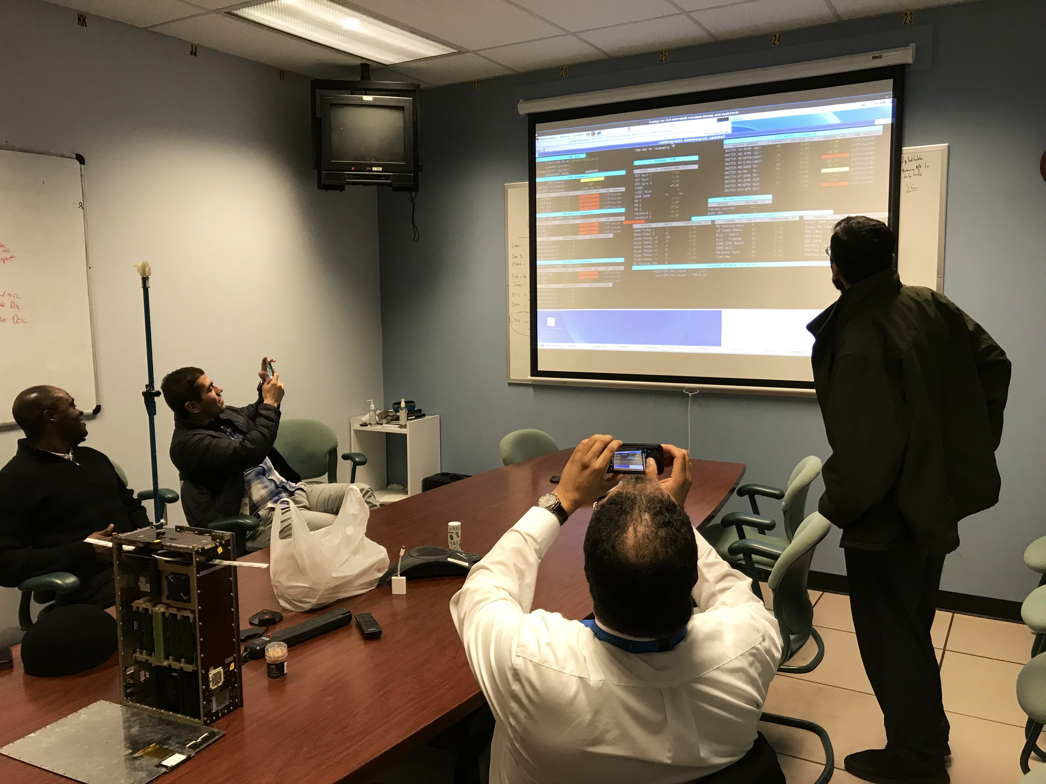
Operations – First Day
Ejected from ISS on November 20, 2017 @ 12:00pm
First contact at 8:00pm

Slide 34
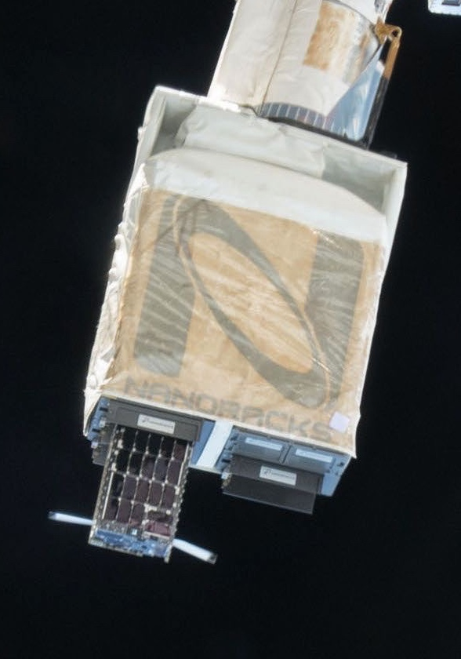
Operations – Deployment Issue
Deployment and initial checkout
Battery voltage vs. packet #
Power system working as expected
We observed antenna and boom deploy in real-time
21 hrs
on inside container
Deployed
First 74 Hours (battery voltage). Satellite turned on inside deployer at unknown time for 21 hours. Dellingr restored nicely upon ejection.

Slide 35
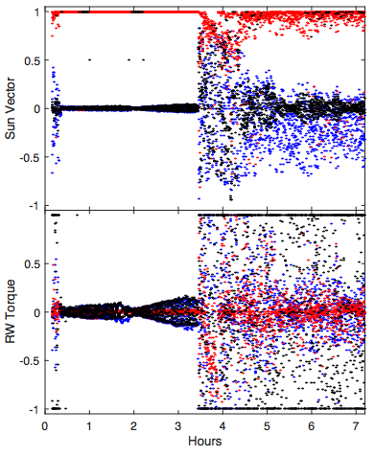
Operations – Fine Sun Sensor Issue
Nov. 30, 2017 | Observed anomalous gyro data Observed sun pointing inaccuracy
Still pointed at sun
Pointed at sun
In-House FSS
Vendor FSS
Stressing the wheels
Vendor FSS
In-House FSS
Notes:
To this day we still have not figured out the issue. But we can live without the gyro.
the plot on right shows the issue. We have 2 FSS - commercial and in house —
Then on December 19th a real punch to the gut. We lost our GPS. You can see here the moment we think it failed.
Critical loss because w/o GPS we could not maintain ram point mode, which was needed for the mass spec.
The INMS measures ion and neutrals in earth’s upper atmosphere. We haven’t had these measurements since the early 80’s. Validating this instrument, and proving we can make these measurements in a cubesat form factor, is really important for heliphysics and for the future upcoming GDC mission.
We enter January bruised but not beaten, and had a plan to recover mass spectrometer science

Slide 36
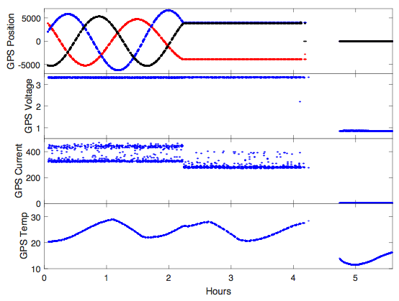
Operations – GPS Issue
Dec. 19, 2017 | GPS unresponsive
Moment GPS failed
GPS
Notes:
To this day we still have not figured out the issue. But we can live without the gyro.
the plot on right shows the issue. We have 2 FSS - commercial and in house —
Then on December 19th a real punch to the gut. We lost our GPS. You can see here the moment we think it failed.
Critical loss because w/o GPS we could not maintain ram point mode, which was needed for the mass spec.
The INMS measures ion and neutrals in earth’s upper atmosphere. We haven’t had these measurements since the early 80’s. Validating this instrument, and proving we can make these measurements in a cubesat form factor, is really important for heliphysics and for the future upcoming GDC mission.
We enter January bruised but not beaten, and had a plan to recover mass spectrometer science

Slide 37
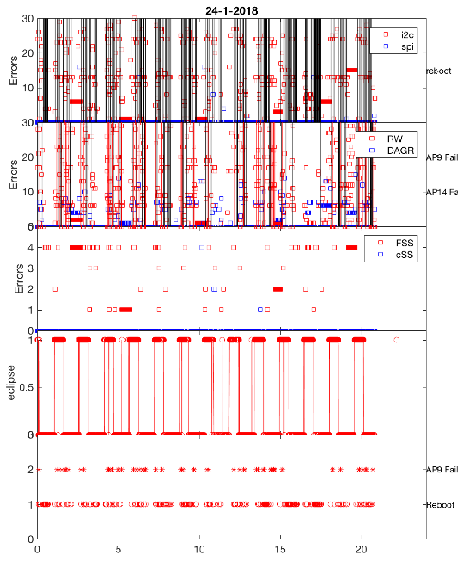
Operations – Resets Issue
CPU having difficulty talking to subsystems
Early January, we started to see a lot of errors on the I2C bus (how the flight computer talks to various subsystems)
By late January, the reset situation had significantly worsened
Notes:
But Dellingr had other ideas.
This is a standard 24-hour plot of errors. top panel in red shows the I2c error per telemetry packet. Black lines are CPU resets.
It was also this time that TZ walked into my office. But w/ resets, couldn’t turn on INMS
Spent much of mid January trying to isolate what was causing the issue.

Slide 38
Operations – Resets Issue
January 26-February 5
January 26, Friday. Last contact with flight computer.
January 29, Monday, windy
January 30, Tuesday, windy
January 31st contact through radio, but couldn’t talk to flight computer
From January 26 - February 5, >13,000 resets. Reboot every 64 seconds, continuously, for 10 days
Crash!
18-031-20:23:04.000000 (2 ) (SC ) ( 73) (RTS Number 001 Started )
18-031-20:23:10.000000 (3 ) (CFE_SB ) ( 17) (Msg Limit Err,MsgId 0x18c2,pipe ACS_CMD_PIPE,sender SCH )
16-122-00:00:12.000000 (2 ) (FM ) (104) (Free Space Table verify results: good entries = 2, bad = 0, unused = 6 )
16-122-00:00:12.000000 (2 ) (FM ) ( 1) (Initialization complete: version 2.3.1.0 )
16-122-00:00:12.000000 (2 ) (FM ) (100) (Child Task initialization complete )
16-122-00:00:12.000000 (3 ) (SC ) (123) (Unbundle RTS OK: /boot/rtsb01.bin, Dest: /ram, RTS Size: 416, RTS Num: 4 )
16-122-00:00:12.000000 (3 ) (SC ) (123) (Unbundle RTS OK: /boot/rtsb02.bin, Dest: /ram, RTS Size: 416, RTS Num: 14 )
16-122-00:00:12.000000 (3 ) (SC ) (123) (Unbundle RTS OK: /boot/rtsb03.bin, Dest: /ram, RTS Size: 416, RTS Num: 16 )
16-122-00:00:13.000000 (3 ) (SC ) (123) (Unbundle RTS OK: /boot/rtsb04.bin, Dest: /ram, RTS Size: 416, RTS Num: 24 )
16-122-00:00:13.000000 (3 ) (SC ) (123) (Unbundle RTS OK: /boot/rtsb05.bin, Dest: /ram, RTS Size: 416, RTS Num: 31 )
16-122-00:00:13.000000 (2 ) (SC ) ( 21) (RTS table file load count = 32 )
16-122-00:00:13.000000 (2 ) (SC ) ( 9) (SC Initialized. Version 2.3.0.0 )
16-122-00:00:13.000000 (2 ) (LC ) ( 56) (WDT verify results: good = 15, bad = 0, unused = 49 )
16-122-00:00:14.000000 (2 ) (LC ) ( 66) (ADT verify results: good = 14, bad = 0, unused = 50 )
16-122-00:00:14.000000 (2 ) (LC ) ( 2) (LC Initialized. Version 0.0.0.0 )
16-122-00:00:16.000000 (2 ) (SEC ) ( 4) (SEC: RESET command )
16-122-00:00:16.000000 (2 ) (SEC ) ( 1) (SEC Initialized. Version 1.0.0.0 )
16-122-00:00:16.000000 (2 ) (FUL ) ( 1) (FUL App Initialized. Version 1.0.0.0 )
16-122-00:00:16.000000 (2 ) (FDL ) ( 1) (FDL App Initialized. Version 1.0.0.0 )
16-122-00:00:16.000000 (2 ) (MM ) ( 1) (MM Initialized. Version 0.0.0.0 )
16-122-00:00:16.000000 (2 ) (CS ) (144) (CS Eeprom Table verification results: good = 8, bad = 0, unused = 8 )
16-122-00:00:16.000000 (2 ) (CS ) (143) (CS Memory Table verification results: good = 0, bad = 0, unused = 16 )
16-122-00:00:16.000000 (2 ) (CS ) (107) (CS Memory Table: No valid entries in the table )
16-122-00:00:16.000000 (2 ) (CS ) (142) (CS Apps Table verification results: good = 0, bad = 0, unused = 24 )
16-122-00:00:17.000000 (2 ) (CS ) (108) (CS Apps Table: No valid entries in the table )
16-122-00:00:17.000000 (2 ) (CS ) (139) (CS Tables Table verification results: good = 46, bad = 0, unused = 26 )
16-122-00:00:17.000000 (2 ) (CS ) ( 1) (CS Initialized. Version 0.0.0.0 )
16-122-00:00:17.000000 (2 ) (MD ) ( 7) (Dwell Tables Recovered: 0, Dwell Tables Initialized: 4 )
18-031-20:24:08.000000 (2 ) (SC ) ( 73) (RTS Number 001 Started )
18-031-20:24:14.000000 (3 ) (CFE_SB ) ( 17) (Msg Limit Err,MsgId 0x18c2,pipe ACS_CMD_PIPE,sender SCH )
16-122-00:00:07.000000 (2 ) (CADET ) ( 1) (L386 CADET: App Initialized using DEFAULTS. Version 1.0.0.0 )
Reboot
Crash!
Notes:
1/26 6127 reset counter
2/5 19832 reset counter
1370 / day - reset every 64 seconds

Slide 39
Operations – Resets Issue
Satellite C&DH not responding
Radio is responding when talking directly to it
Not clear if resets are occurring due to EPS or C&DH
Talked to radio with long transmission bursts to see if the EPS was resetting
No radio resets occurred during experiment, indicating CPU reset only
Radio has a direct IO line to the C&DH CPU for processor reset
Theory:
C&DH is booting up long enough to service the I2C line
EPS watchdog used to reset spacecraft is not being triggered
By enabling IO line for 4 minutes during a pass, the EPS watchdog will not be served and the EPS will perform a system hard reset clearing the problem
IT WORKED!
Notes:
February 6. The mood was dark within the Dellingr team. We were able to reproduce the reboot on the flatsat, traced to driver

Slide 40
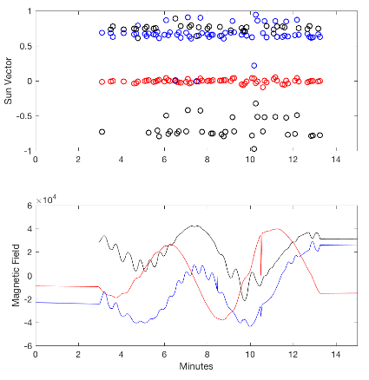
Operations – Science Data!
10 minutes of data during the Feb 6 pass after recovery
“Victory. [WE were] able to turn on INMS in the ION mode. We had no resets between the last pass and this one.”
Notes:
Not just on - but on for 18 hours
So back to business. We turn on INMS mode for several days, then turn on the wheels to dump momentum, repeat until we can upload some permanent fixes.

Slide 41
Operations – Plan to recover science
A key instrument for GDC, and highest priority for Dellingr operations
Required several weeks of outgassing before turning on high voltage (could not turn on in early mission)
Jan 10, 2018 turned on and verified nominal voltages and currents
Loss of GPS requires software patch to recover INMS science mode
Short Term Solution
Long Term Solution
INMS entrance aperture
Use INMS in sun-pointing mode and spin through ram on dayside (requires several uploads)
Use INMS as ram-sensor or run ephemeris propagator on orbit

Slide 42
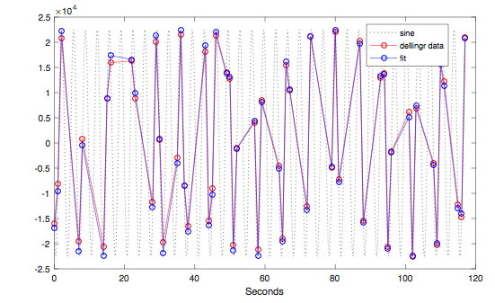
Operations – Uncontrolled Spin Issue
We had a plan for recovering the science
Run the ACS with wheels once per week and run science instruments rest of the time
The satellite entered an uncontrolled spin state by early March
Spinning at around 120 degrees/second
ACS designed for 40 degrees/second
By Mid-March
Communication was terrible
Spin too fast for particle science
Bad power numbers
Spin period of 3.4s
Magnetic Field
2 minutes of data from March 16th
Notes:
I was spot checking the data and noticed that the wheels seemed to be having no effect.
Robert Burns
Having wheels on makes no difference (so they’re off)
So the mood is dark again. In immortal words of the black knight
Communication was terrible, too fast for particle instrument, bad for power…

Slide 43
Operations – Bdot
Despin via B-dot
Write new B-dot app over ~1 week and test it in the “42” simulation environment
Cadet radio effective upload rate in the order of 16 bps even though actual speed is 9,600 bps
App split into 8 pieces, 181 bytes each
Date | Event
29-Mar – 5-Apr-2018 | B-dot V1 upload
12-Apr – 17-Apr-2018 | B-dot V2 upload
1-May – 7-May-2018 | B-dot V3 upload (attempt 1)
8-May – 15-May-2018 | B-dot V3 upload
Notes:
BDot is a tried and true method for attitude control. relies on the fact that magnetic fields want to align. Carefully time the torquers wrt to background field, and you can control the attidue.

Slide 44
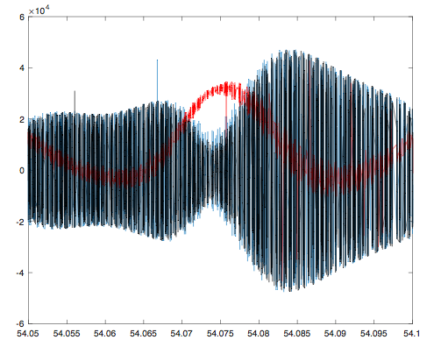
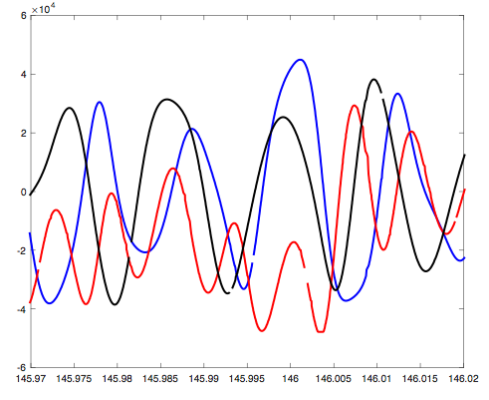
Operations – De-spinning
May 21st - Successful de-spin
3.4s spin
Slow lazy tumble
1.2 hours
1.2 hours

Slide 45
Operations – Current Status
Continue to gather INMS science data (still investigating neutral issue)
Upload a software patch to:
Add diagnostic capability to investigate gyro
Add diagnostic capability to investigate I2C reset problem
Fix ACS software reaction wheel eclipse command
Enable sun pointing again if able to isolate I²C reset problem and find a suitable work around
Continue DAGR science if sun pointing mode is enabled again
Technical successes
Operated DAGR instrument and obtained science data
Operated INMS ion side and obtained science data
Completed thermal louver experiment
Bus operated and continues to operate after 10 months in a limited capacity despite failures, anomalies and challenges

Slide 46
Operations – Summary of Discussed Challenges
Satellite turned on inside deployer
Noisy Sun Sensor causing jittery pointing performance
Never got good data from IMU
Lost GPS capability before science commissioning
Constant CPU resets (I2C errors)
Uncontrollable spin
Flight software patches uploads

Slide 47
Operations – Other Challenges
MOC was not planned to handle so many engineering problems
Mostly setup to update operations parameters and download data
Used alternate MOC to help streamline the recovery process
Used ground testing rack to connect to the ground station
Data from radio was deleted twice on-orbit with no apparent reason
Inherent excessive radio bit-flips aggravated on-orbit
Bit-flips were observed during ground testing
On-orbit performance is significantly worse
Data has to be downloaded more than once to fill gaps

Slide 48
Operations – Lessons Learned
Use a daily reset for failure detection and correction if the concept of operations allows
Maximize the ability to replace flight code on orbit
Make an effort during the development of the software to minimize uploads size
Add as much telemetry as possible and create filter tables to improve the ability to troubleshoot
Consider using redundant components from different sources when having reliability concerns
Plan for longer commissioning period (schedule and staff) in comparison to larger spacecraft
Invest more into ground processing and trending of on-orbit data to identify subtle problems early
Design FDC for handling misbehaving components in addition to failed components
Add flexibility to your software in its ability to reconfigure between different ACS control modes and science instruments
Add hardware diagnostics to the flight software to help isolate problems

Slide 49
Closing Remarks
CubeSat/SmallSat knowledge gain
Develop cost/schedule-effective model (culture change)
Build, Test, Fix and Re-test philosophy
Used mostly components off-the-shelf
Develop “lean” & scalable end-to-end systems (processes and hardware)
Limited formal documentation and CM processes
Operated in a do-no-harm classification for risk, reviews were not gates
Stress the "system“ to develop a GSFC CubeSat/Smallsat culture
CubeSat/SmallSat knowledge obtained is shaping our future
Identify staffing, infrastructure and technology needs
IRADS, technical equipment and other resources are being used to improve infrastructure and technologies
Lay groundwork for future missions and proposals (over 10 proposals and 3 won missions)

