Slide 1
The Advanced Topographic Laser Altimeter System (ATLAS) for the Ice Cloud and Land Elevation Satellite-2 (ICESat-2)
Development, Challenges, Launch and Early Operations
John Cavanaugh/592
ATLAS ISE

Slide 2
Outline
Team Acknowledgements
Instrument Overview
  Background
  Evolution
  Final Design
Development Challenges
  Electronics
  Detectors
  Optics
  Alignment
  Mechanisms
  Lasers
Performance & Verification
  I&T Flow
  Bench Checkout Equipment
Launch and Commissioning
  ATLAS Performance
  Results

Slide 3
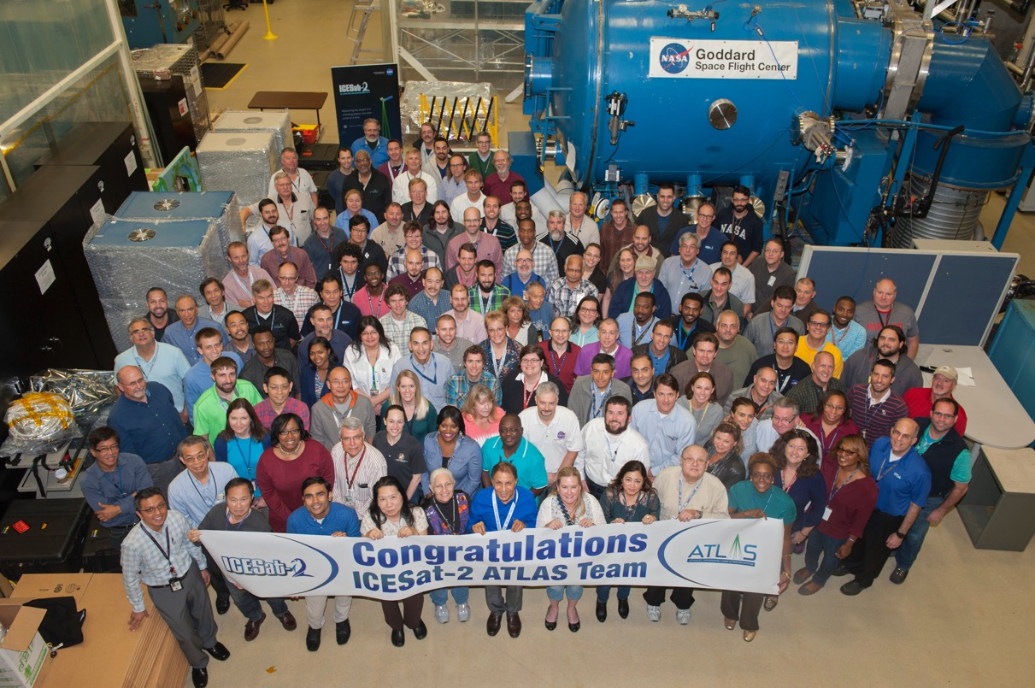
ATLAS Team

Slide 4
ATLAS Team
Adebo | Ajibade-Akonai
Larry | Alexander
Kim | Allgood
Craig | Auletti
Ivelin | Bakalski
Davy | Baker
Sito | Balleza
Brett | Baseley
Mike | Bay
Konrad | Bergandy
Ellen | Bickel
Diana | Blair
Ken | Blumenstock
Meg | Bock
Joseph | Bonafede
Ray | Boucarut
William | Bowers
Heather | Bradshaw
Dann | Brown
Nadia | Brown
Jim | Buchheit
Mike | Burns
David | Burtis
Paula | Cain
Sandy | Calder
Claudia | Carabajal
John | Cavanaugh
John | Chambers
Mike | Chapman
Steve | Chaykovsky
Katie | Cheng
Felix | Chi
Furqan | Chiragh
Chris | Choi
Brian | Clemons
Timothy | Cole
Jeff | Condron
Tom | Correll
Tom | Corris
Alexander | Cramer
Phil | Dabney
Christopher | Dailey
Tom | D'Asto
Daniel | da Silva
Mitch | Davis
Alex | Dea
Amanda | Dean
Erich | de Leon
Bill | Dehaven
Melody | Djam
Peter | Dogoda
Donya | Douglas-Bradshaw
Dave | Durachka
Melissa | Edgerton
Michael | Edick
Bente | Eegholm
Tyler | Evans
Molly | Fahey
Babak | Farrokh
Ali | Feizi
Steven | Feng
Brian | Ferguson
Jose | Florez
Matt | Garrison
Anne | Gaumond
Steven | Gauss
Bruce | Gewirz
Kelly | Gibbs
Amani | Ginyard
Jim | Golder
Peter | Gonzales
Alan | Gostin
Steve | Graham
Adam | Greeley
Greg | Greer
Jacob | Gregory
Danny | Grove
Omar | Haddad
Jake | Hageman
John | Hagopian
Tom | Hall
Sam | Hetherington
Joe | Hickman
Matthew | Hinkle
Stephen | Holland
Richard | Hollenhorst
Eric | Holt
Floyd | Hovis
Dave | Hughes
Tim | Huss
John | Iskander
Jonathan | Jessup
Peggy | Jester
Orson | John
Aldine | Joseph
Michael | Kaiser
John | Kazeva
Anna | Keller
Jim | Kelley
Saman | Kholdebarin
Kory | Kienzle
Jim | Kleinschmidt
Chris | Kolos
Paul | Kottmyer
Jentung | Ku
Michelle | Lacombe
Tracie | Lampe
Henock | Legesse
Joseph | Lestrange
Ed | Leventhal
Pete | Liiva
Carol | Lilly
Nancy | Lindsey
Wei | Lu
Phil | Luers
Roman | Machan
Tim | Madison
Greg | Magnuson
Tony | Melak
Manuel | Maldonado
Tony | Martino
Greg | Martins
Mario | Martins
Jared | Mattick
Vernon | McCarter
Jan | McGarry
Linda | Miner
Jeffery | Mobley
Jack | Murphy
Louis | Nagao
Dave | Neuberger
Stuart | Newman
Bill | Newell
Minh | Nguyen
Felix | Nicolas
Eleanya | Onuma
Dean | Osgood
Melanie | Ott
Michael | Pagen
Shahana | Pagen
Deepak | Patel
Fernando | Pellerano
Jon | Penn
Susanna | Petro
Michael | Plants
Rebecca | Prats
Steve | Price
David | Pullen
Ann | Reese
Luis | Ramos-Izquierdo
Dan | Reed
Fred | Richards
Frank | Robinson
Elionex | Rodriguez
Jack | Saba
Baran | Sahin
Nick | Sawruk
John | Schafer
Andy | Scharmann
Mike | Schoolman
Karl | Schuler
Bill | Seidell
Andrew | Sheckells
Oren | Sheinman
Javad | Shockri
Brian | Simpson
Pranay | Sinha
Steven | Slegel
Scott | Stefanoski
Mark | Stephen
Brandon | Stergiou
Richard | Stickle
Kathy | Strickler
Paul | Stysley
Ed | Sullivan
Cin | Swangwatanaratn
Mike | Swenton
J.P. | Swinski
Buddy | Taylor
Josh | Thomas
Joe | Thomes
Warren | Thompson
Elisavet | Troupaki
Kimathi | Tull
Nzinga | Tull
Jeffrey | Twum
Carlos | Ugarte
Bonnieblue | Valentin
Aleksey | Vasilyev
Steve | Vincent
Nick | Virmani
Sheila | Wall
Mark | Walter
Jahi | Wartts
Greg | Wenzell
Crystal | White
Rhonda | Whitelocke
Donald | Whiteman
Harry | Willems
Donna | Williams
Tyrell | Williams
Guan | Yang
Jenny | Young
Jaime | Zabala
Rene | Zelaya

Slide 5
ATLAS Measurement Concept
ATLAS Pointing
ATLAS
ATLAS Range Measurement
Reference
Ellipsoid
Elevation
Surface
ATLAS Altitude
GPS
Ground-based laser ranging
Measurement concept drives ATLAS
Key Performance Parameters (KPP’s):
Radiometry (signal & stray light)
Alignment (internal & external)
Timing (precision & bias)
ICESat-2 wants to know elevation
ATLAS measures range (time of flight) and absolute pointing
Other elements finish the task

Slide 6
Background
ICESat
  Launch : January 13, 2003
    Decommissioned August 17, 2010
  Geoscience Laser Altimeter System (GLAS)
    DP-Nd:YAG Solid-state laser transmitter
      4-ns pulse
      40-Hz PRF
      Multiwavelength
        1064-nm altimeter
          70-m footprint
        532-nm atmospheric sounder
    1-m telescope receiver
    Si_APD altimeter detector
    SPCM atmospheric detectors
Despite laser issues, ICESat collected a valuable dataset used to evaluate global ice sheets
  This set the stage for ICESat-2

Slide 7
ATLAS Evolution
2007 Earth Science Decadal Survey called for follow-on to ICESat
Initial concept (2007-8) was single beam, similar to GLAS:
  1064-nm only
  70 m beam footprint with 140 m spacing at 50 Hz
  Optional swath-mapper:
    1 laser produces 16 uniformly spaced beams over 3 km swath
      10 m footprint for each beam
      16-ch PMT detector
Switched to photon-counting concept in 2009
2007 Concept
2009 Concept

Slide 8
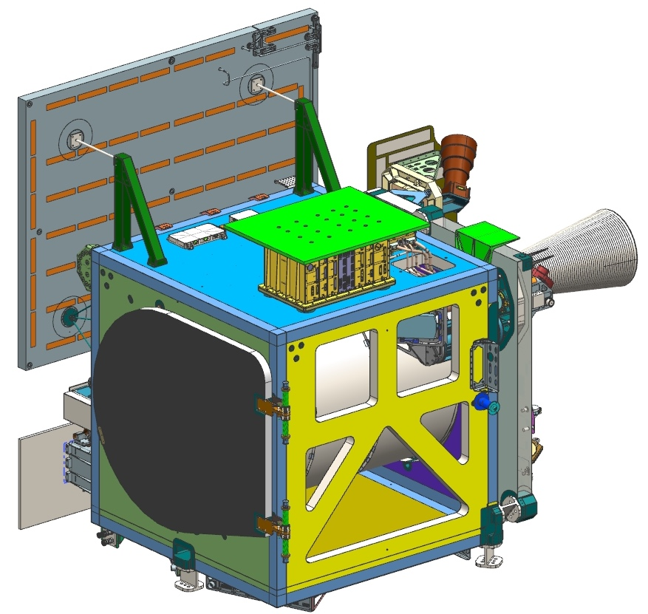
ATLAS Final Design
Instrument Overview
Transmitter
  Solid-state Nd:YVO4 Master Oscillator Power Amplifier (MOPA) Architecture
  Semiconductor laser pump sources
  10 kHz pulse rate
  1.2-ns output pulses
  532-nm output wavelength
    Temperature-tunable to match receiver filter
  Diffractive beam splitter
  6 signal beams
    3 strong, 3 weak
Receiver
  80-cm reflector telescope
  Narrow band 30-pm bandpass filter
    Temperature-tuned to match transmitter
  Single photon detection
Timing
  100-MHz USO
    Gate-delay FPGA-based timing of photon events.
  Range tracking algorithm
    Maintains range gated return signal discrimination via inputs from spacecraft
Alignment
  Transmit/Receive co-boresight alignment maintained by Alignment Monitoring and Control System (AMCS)
    Feedback via Laser Reference System
      Laser spots-TAMS
    Control output adjusts Beam Steering Mirror
ATLAS Instrument
1.7m
X
Optical Bench
Y
Z
1.5m
OB Interface (x3)
Box Structure
2.1m
S/C Interface (x3)
FLT3R
FLT2R
ATLAS Optical Bench

Slide 9
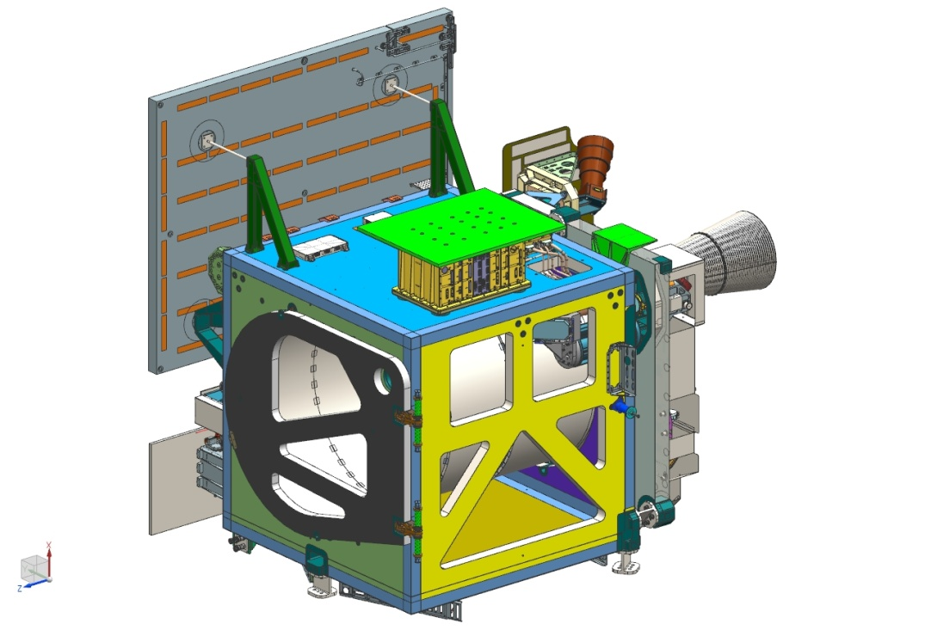
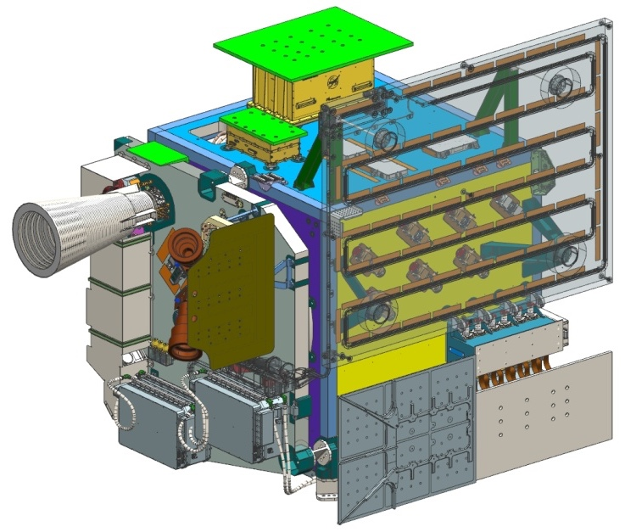
ATLAS Components
LHP Radiator
Composite Box Structure
+X
Lateral Transfer Retro-reflectors (LTRs)
+Z
Optical Bench
+Y
Start Pulse Detectors (SPDs)
Power Distribution Unit (PDU)
Wave Tracking Electronics Module (WTEM)
LRS Electronics
Wave Tracking Optical Module (WTOM)
Deployable RTA/Sunshade Door
+X
S/C Interface Flexures
Optical Filter Assemblies(6) (OFAs)
+Y
+Z
Main Electronics Box (MEB)
Detector Array Assembly (DAA)

Slide 10
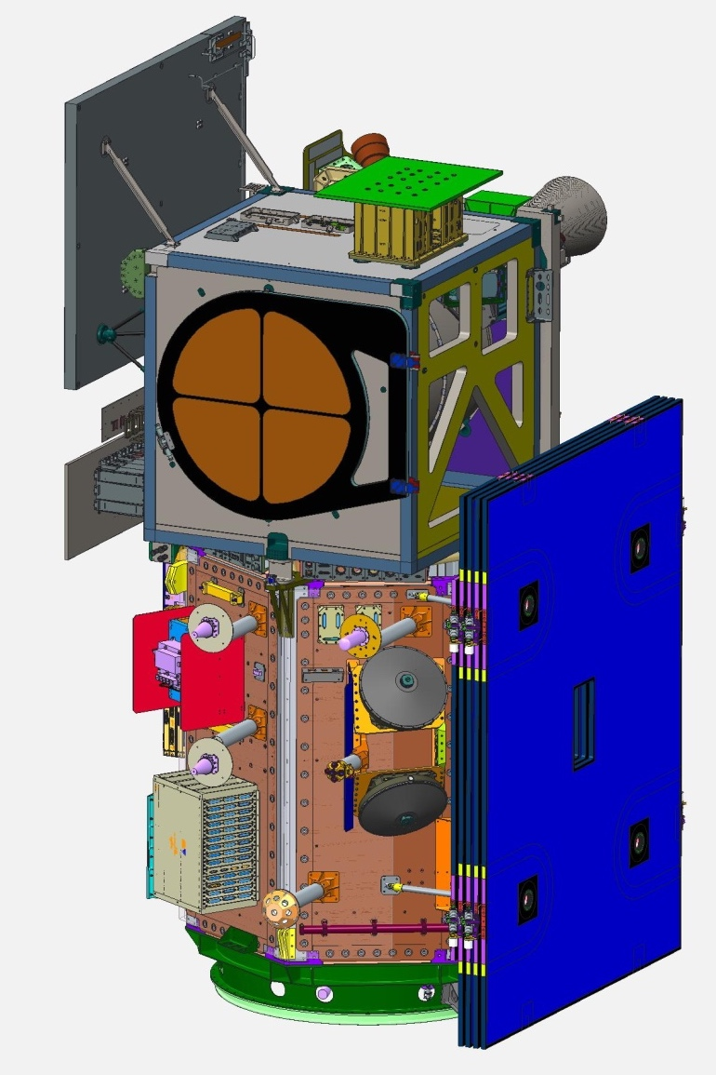
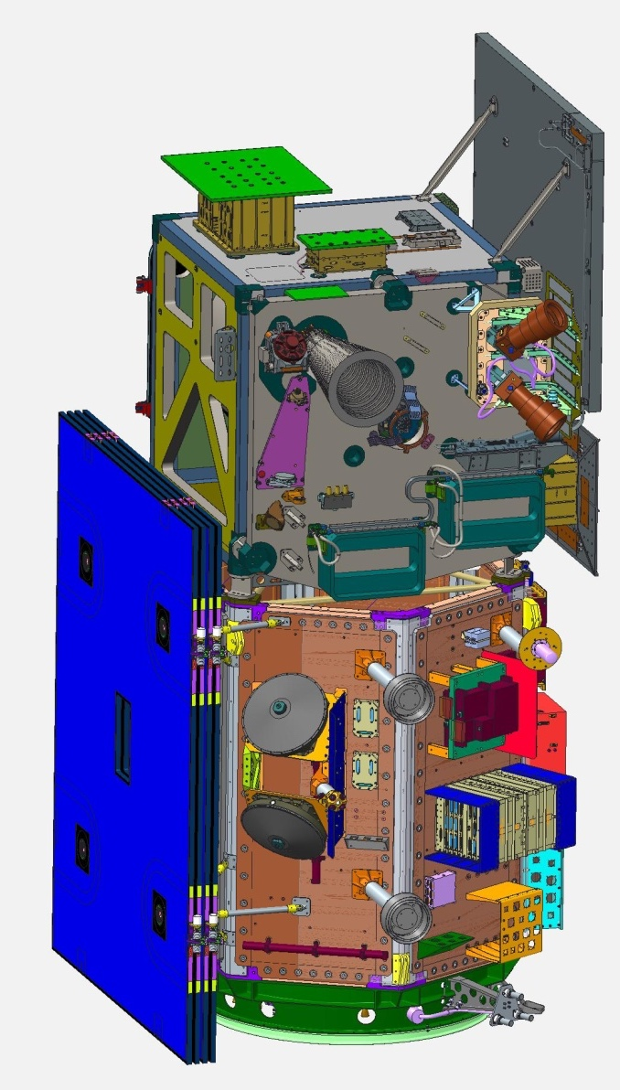
ATLAS on Spacecraft
Laser Radiator
Power Distribution Unit (PDU)
Laser Reference System (LRS)
ATLAS Door (Telescope Behind)
Instrument Mounted Spacecraft Components (IMSC)
Laser Constant Conductance Heat Pipe
+X
+Z
+Y

Slide 11
ATLAS Final Design
Instrument Block Diagram
ICE Sat-2 Spacecraft
Key
LSA Periscope
Beam Steering Mechanism
Optical Fibers
Aperture Door
Beam Expander
Transmitter Optical Path
Fold Mirror
PBC
TAMS
(x2)
532 nm,10 kHz, P-polarized
Laser 1
Laser 2
LSA
Clocks/Pulses
S-polarized
DOE
Power
TEP Fiber
Bundle
Diffractive Optic Element
splits single beam into 6 beams
Commands/Telemetry
6 Laser Beams
to Earth
(Nadir)
SPD and electronics
(x2)
1553
(x2)
SPD 1
Gyro (S/C)
WTOM Input
Fiber Optic
Star trackers x2 (S/C)
Spacewire (x2)
BSM Actuator Power
Stars
(Zenith)
MEB
LRS
LRS electronics
1pps
(x2)
DSM Actuator Power
WTEM
WTOM
TAMS LS (primary A, redundant B)
fiber optics (x4)
Detector Electronics Module (x6)
Detector Modules
Detector Select Mechanism
Laser 1
Board
A
(primary)
(x6)
Detector
Module Array (x6)
ATLAS Laser
Return Energy from Earth
Main
(x2)
Laser 2
PMT
A
Det
(x2)
SPD
RTA
Aft-Optics
Assy
PDU
WTEM
Command I/F Board
fiber optics (x6)
LRS
Board
B
(redundant)
PMT
B
OFM
(x6)
Laser
(x2)
TAMS
BCE DAA Test
Ports
BCE
RTA
Test
Ports
Det Low V
Telescope
0.8m diameter, 3.8 m EFL
Det High V
Detector Array Assembly
Thermal Control
Ops Heater Power
Thermistors (Qty. 62)
Survival Heater Power
Thermistors (Qty. 15) (x2)

Slide 12
ICESat-2-ATSYS-SPEC-0602
Revision E
ATLAS Optical Block Diagram
LSA Periscope
44mm 1/e², 66mm CA dia.,
< 24.5µrad 1/e² dia. divergence
Fold
Mirror
BSM
PBC
Beam Expander
m = 4.4X
TAMS Light Source (520nm):
Fiber Optic Bundle: 400µm, 0.22NA, 1x4 fan-out
532nm, 0.5-0.9mJ,
10kHz, 1.5nsec,
10mm 1/e² Gaussian,
15mm CA dia.,
< 108µrad 1/e² dia.
RTA-OFA Fiber Optics
300 µm, 0.22NA (Qty. 6)
WTOM Input Fiber Optic:
100 µm, 0.22NA
RTA Aft-Optics
Stars
DOE
SPD Fiber Bundle:
200 µm, 0.22NA,
dual w/fan-out
SPD 1
LRS
Laser 1
5P-pol.
Laser 2
S-pol.
LSA
SPD 2
TEP Fiber Bundle: 200 µm,
0.22NA, dual w/fan-out
TAMS, 4 beams
5x15mrad FOV
TAMS
LTR
WTEM
WTOM
WTOM Output Fiber Bundle:
200 µm, 0.22NA, dual w/fan-out
Transmitter
LTR (1%R)
Receiver Telescope Assembly (RTA):
Ritchey-Chretien Telescope + Aft-Optics
0.8m dia., 3.6 m EFL, 0.9deg dia. FOV, telecentric
PMT-A Detector Assembly
(Qty. 6)
Detector
Optics
Tube
(DOT, Qty. 6 )
Deployable Instrument Cover
DSM
6 beams,
3 x 2 array
13.22 x 5.0mrad
4:1 energy ratio
< 35 µrad div.
Detector
Array
Assembly
(DAA)
PMT-B Detector Assembly
(Qty. 6)
OFA-DAA Fiber Optics
400 µm, 0.22NA (Qty. 6)
OFA
(Qty. 6 OFM)
BCE DAA Test Port
Single-Mode, 0.12NA
Fiber-Optic (Qty. 6)
BCE RTA Test Port
400µm, 0.22NA
Fiber-Optic (Qty. 6)
Open Beam
Optical Fibers
Notes:
After functional block

Slide 13
DOE splits single input laser beam into 6 beams
3 x 2 array – 3 ”Strong”, 3 “Weak”
  4:1 energy ratio (Strong:Weak)
13.22 x 5.0 mrad angular separation
Each spot <35µrad divergence (same as input beam)
  Each spot is ~17 m diameter on ground
ATLAS Ground Track Illumination Pattern

Slide 14
ATLAS “State-of-the-Art” Block Diagram
LSA Periscope
Beam Steering Mechanism
Optical Bench
Beam Expander
Fold Mirror
PBC
Gyro (S/C)
Laser 1
Laser 2
Laser Sampling
Assembly
STOP Analysis
“Science” I/F to S/C
Star trackers x2 (S/C)
DOE
Science Algorithm
AMCS Control
(Active Alignment)
I/F to S/C
RAD750 SBC
FSW
Start pulse detectors
and electronics (x2)
ASC
LRS Sunshade
LRS
PCE1/2/3
Harness
(Sabritec)
LRS electronics
MCE
LTRs w/ filters
HKT
WTEM
WTOM
Echo Path
Detector Array Assembly
TAMS
USO
Detector Modules
LVPC
Detector Electronics Module (x6)
DSM
DOOR
(x6)
Detector
Module Array (x6)
MEB
A
A
B
B
OFA
x6
Fiber Optics
PDU
Receiver Telescope
Assy (RTA)
Box Structure
Thermal Control
Contamination
Based on prior requirements/technology/engineering with little change (low risk)
BCE
I&T
Minor departure from prior requirements/technology/engineering (med risk)
Significant departure from prior requirements/technology/engineering (high risk)
F. Pellerano/ATLAS iCDR

Slide 15
ATLAS “State-of-the-Art” Block Diagram Explanations
Significant departure from prior requirements/technology/engineering (high risk)
Laser:
  High 10kHz repetition rate and trillion-shot lifetime (~500x)
  High power (~2x), higher efficiency (~2x)
  Wavelength control (new), spectral width (2x), pulse width (3x)
STOP/Optical bench/AMCS:
  Tight uncorrectable error budget (<30urad) (~5x)
Receiver Telescope Assembly (RTA):
  Large Beryllium telescope with small IFOV and large FOV, which requires better image quality and tighter mechanical distortions (5-10x)
Lateral Transfer Reflectors (LTR):
  In line with the transmit and receiver beam leading to tighter pointing stability requirements (new)
  New coating developed from scratch (new)
Laser Reference System (LRS) and sunshade:
  Back-to-back star trackers with very tight alignment (new)
  Tighter tracking close to within 20Deg of the sun (~2x)
  Sunshade with a 67 vane design (new)
Beam Steering Mechanism:
  Much larger mirror compared to GLAS (~5x)
  Pointing error and stability ~3urad (~5x)
Beam expander:
  All previous GSFC laser altimeters used refractive beam expander designs internal to or directly attached to the laser assembly (new)
  ATLAS reflective, external BE design has tighter alignment and performance requirements (new)
Contamination:
  Laser fluence is not the driver, but a trillion shots is three orders of magnitude higher than previously achieved on GSFC space-based laser altimeters (1000x)
Echo path:
  GLAS had fiber-optic coupled timing calibration signals (Start Pulse and Delay channel), but the open beam ATLAS TEP channel presents significant development and implementation risk due the laser output power and the amount of TEP signal required. (new)
Detectors/Photon Counting Electronics (PCE)/Science algorithms:
  Very challenging photon counting application, pushing Photomultiplier tubes (PMTs) detectors; e.g., large area, high bandwidth, low dead time and low timing jitter. (new)
  New measurement technique with little field data (new)
  Very low signal-to-background ratio. On-board statistical determination of ground return. (new)
  Very high data rates and large volumes of data require on-board science processing (new)
F. Pellerano/ATLAS iCDR

Slide 16
ATLAS Challenges
Electronics
Detector Electronics Modules
  Assembly issues with ROHS-compliant components resulted in failure during ATLAS Avionics TVAC
    Poor solder joints at SMT chokes with Ag/Pd pads:
      Beware of parts with Ag or Ag/Pd finishes.
      • Use solder with Ag in it when possible to prevent leaching.
      • When using Ag-free solder:
      • Keep assembly time short.
      • Minimize exposure to temperatures about solder melting point.
      • Standard reflow will not harm the joint, only long exposures to high temperatures causes separation.
Various exposures of silver-palladium pads to tin-lead solder

Slide 17
ATLAS Challenges
Detectors
Photomultipliers
  Lifetime
    Lifetest performed w/ no issues
  Shock/Vibration
    Detector Array Assembly ssolator system implemented
  Stray Light
    Additional mitigations (blanket & tape) added at instrument level
  Cell phone susceptibility
    Discovered during stray light investigation
    Not an issue for on-orbit operations

Slide 18
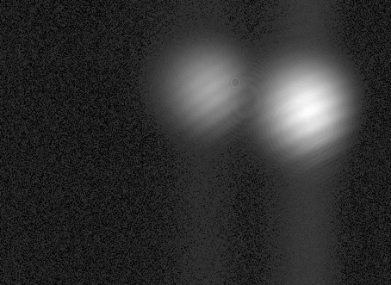
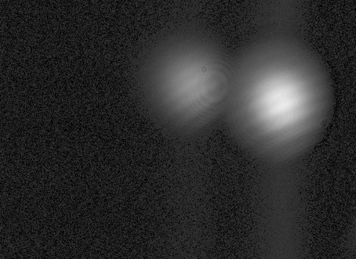
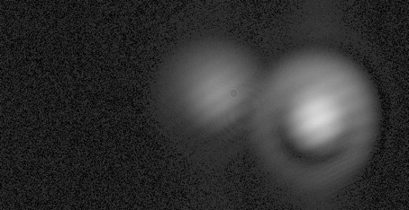
ATLAS Challenges
Optical Components
Transmit Optics Lifetime
  Optical coatings exposed to laser beams in vacuum tend to damage quickly
  Mitigations:
    Expanded laser beam inside pressurized laser before impinging on transmit optics in vacuum
    Perform LIDT testing to screen all optics
  Optical Coatings Life Test
    Exposed coated optics to laser energy with varying levels of expected contaminants in vacuum.
Reflective Beam Expander
  Failure of bonds on one mirror during vibe
    Titanium surface EDM recast layer not removed
Lateral Transfer Retroreflectors
  Very tight alignment requirements
    Required interferometer to verify
  Bonding & coating issues during assembly & qualification
Polarization Beam Combiner
  Damage during I&T resulted in replacement with spare
  Coating sensitivity to temperature coupled with laser snout optics birefringence caused variation in LSA signals for Laser-1 after laser swap
Start
1 T shots
OCLT Beam Quality
Degradation
1.5 T shots
Beam expander on vibe table

Slide 19
ATLAS Challenges
Alignment
Tx-Rx boresight alignment requirements very tight:
  6 x 35µrad beams coaligned with 6 x 83 µrad IFOV
  Alignment Monitoring and Control System (AMCS) :
    Telescope Alignment Monitoring System (TAMS)
    Laser Reference System (LRS)
    Lateral Transfer Retroreflectors (LTRs)
    Beam Steering Mechanism (BSM)
Geolocation requirements very tight:
  Locate each spot on ground to within 6.5m (1-sigma)
  SC Star Trackers & SIRU mounted on ATLAS optical bench
  LRS stellar sensor mounted directly opposite laser side sensor
Both requirements proved challenging to verify on the ground.
  RTA, Laser and LRS laser side requirements verified through test
    SCA Collimator
    GSE LTRs
    Theodolites, laser trackers, and alignment cubes
  LRS stellar side alignment requirements verified at component and subsystem level and through analyses
800 µR
500µR
MOLA
83 µR
160
500 µR
100
35 µr
400 µR
80
400 µR
100
90
ATLAS
GLAS green
LOLA
MLA
GLAS IR

Slide 20
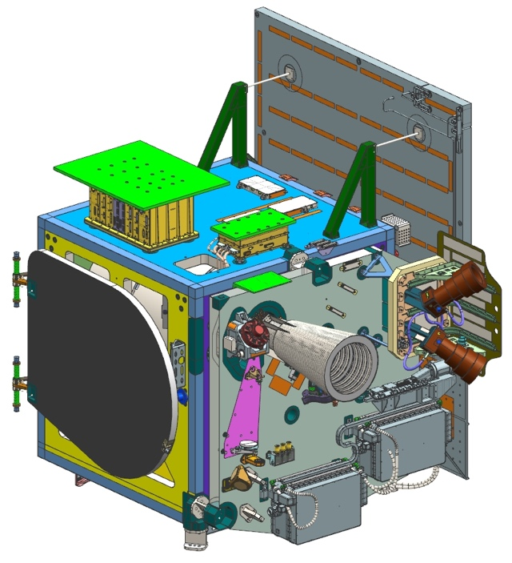
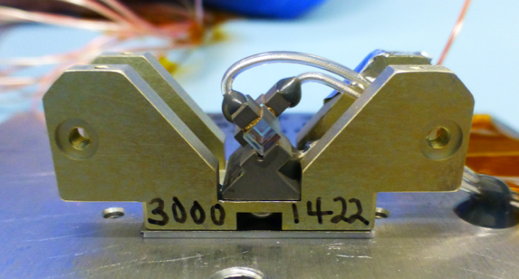
ATLAS Challenges
Laser Overview
ATLAS Instrument
ATLAS Laser (2)
50 cm
30 cm
Laser Electronics Module (LEM)
1.7 m
15 cm
Laser Optics Module (LOM)
LASER 2
LASER 1
LOM
Laser Functional Description:
Pulsed operation
  10-kHz Pulse Repetition Frequency
  1.2-ns pulse width
  ~250 µJ – 900 µJ/pulse
Master Oscillator – Power Amplifier (MOPA)
  Diode laser end-pumped Nd:YVO₄ gain media
Oscillator : Bent linear cavity
  Volume Bragg Grating (VBG) output coupler for wavelength control
  Active (RTP) Q-switch
Amplifiers (2)
Pre-Amplifier
45 mm
Q-Switch Assembly
(shown without cover)
Master Oscillator

Slide 21
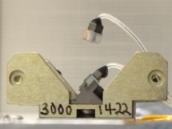
ATLAS Challenges
Laser Q-Switch
Q-Switch Function: To rapidly switch laser resonator quality factor (Q) to allow generation of short duration laser pulse by applying electric field across orthogonally mounted electro-optic crystals, in this case 2.5 x 2.5 x 5 mm rubidium titanyl phosphate (RTP).
  Bonds from crystal to mount and wires must be conductive, so silver epoxy is used.
  Co-alignment of crystals is critical. Optical contrast ratio test is used to assess bond integrity during screening and life testing.
3 out of 15 Q-switch crystals disbonded from mounts during screening
  Issues with bond surface and crystal surface quality observed during investigation
New lid with spacer (SN3)

Slide 22
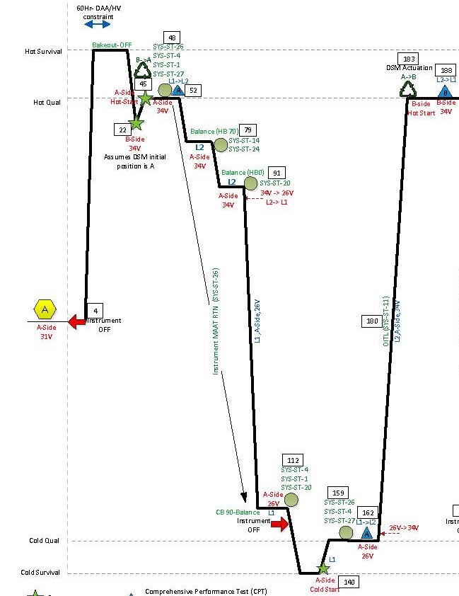
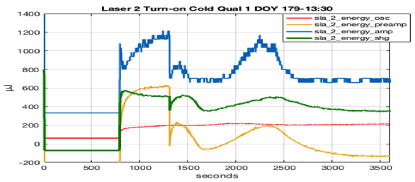
ATLAS Challenges
Laser SN2 Anomaly
ATLAS TVAC PROFILE
During ATLAS instrument level thermal vacuum testing, laser 2 was turned on at the end of the first hot qual soak and remained on for the two hot balance soaks
      Performance was nominal for the first TVac hot qual soak and two hot thermal balances
At the end of the 2nd hot balance, laser 2 was turned off and remained off through cold balance (CB90) and first cold survival soak
After cold survival laser 1 operated nominally for ~72 hours while laser 2 remained off and at a temperature of 20°C.
After what appeared as a normal start, laser 2 pre-amp, amp, and SHG energy monitors dropped suddenly.
The telemetry values for the oscillator energy monitor (q-switch) were nominal
After the drop, the pre-amp, amp, and SHG energy levels increased, and started to oscillate
FRB investigation determined that the pre-amplifier slab in laser 2 had fractured
L2 turn on #2 & Anomaly Occurred
L2 turn off #2
L2 turn on #1
L2 turn on\ff #1
ANOMALY

Slide 23
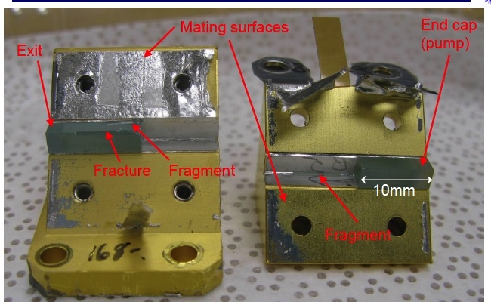
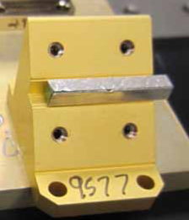
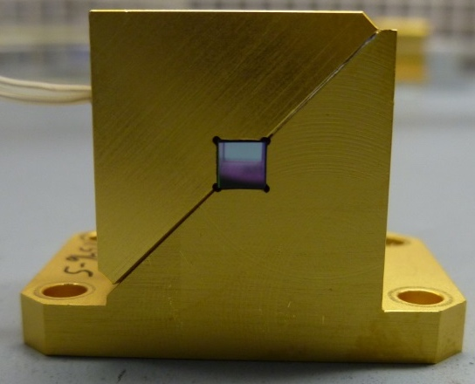
ATLAS Challenges
Laser SN2 Anomaly - Slab Fracture
Slab
Wrapped in Indium
Mount
Clamp
22mm
3mm
Slab
3mm
Pre-Amp crystal slab fractured near the middle of the slab. Laser SN2 morphology indicates that the failure was likely from a combination of overstress (thermal/mechanical) and surface flaws from grinding.
Mount
Photo of an assembled pre-amp

Slide 24
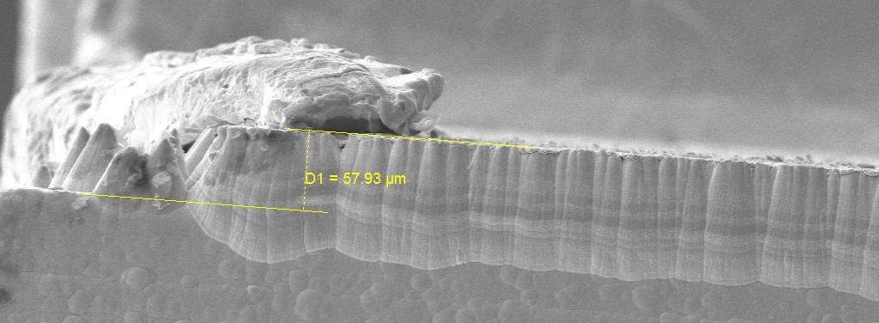
ATLAS Challenges
Gold Indium Intermetallics
Indium Foil Serving as a Compliant Thermally Conductive Material Peeled Back Exposing Intermetallic Cones
Flat Surface in Contact with Crystal
Edge of Gold Plated Copper Mount for Crystal
Crystal Rests
Here
Body of Gold Plated Copper Mount
Gold Indium Intermetallics Growing as Cones through Indium
51um Indium Foil Transformed into Gold Indium Intermetallics now Occupying 58um (15% to 20% more) Thickness than the Raw Indium and Gold
As the emerging cones “transform” gold and indium to AuIn₂ intermetallics, they occupy more volume than the original material. The surrounding malleable indium is incompressible so the additional volume will increase pressure on the crystal.

Slide 25
ATLAS Challenges
Factors that Contributed to the Crystal Slab Fractures
Externally applied stresses:
  Clamp/mount packaging-induced stresses that were exacerbated by non-uniform growth of gold-indide intermetallic (Direct cause)
  The clamping force was on the crystal, not on the clamp, as it was intended (Contributing cause)
  Mount to clamp preload can cause the clamp to bend (Contributing cause)
  Slab defects (Contributing cause):
  Testing of the crystals showed a distribution of crystal strength that was wider than expected
    Flaws and micro-cracks reduces the strength
        Design did not account for the standard factor of safety over the wider range
      Slow crack growth may degrade strength
Internally generated stresses (Contributing cause):
  Crystals have residual stress
  The manner in which the slabs are pumped induces thermal gradients, which results in stress on the slab
BOTTOM LINE: INADEQUATE MARGINS
Residual Stress
Mount Induced Stresses
Slab Strength
Thermally Induced Stresses
When the residual, mount induced, and thermally induces stresses exceed the slab strength, it cleaves

Slide 26
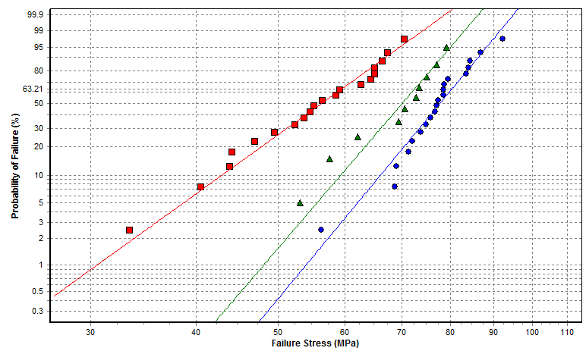
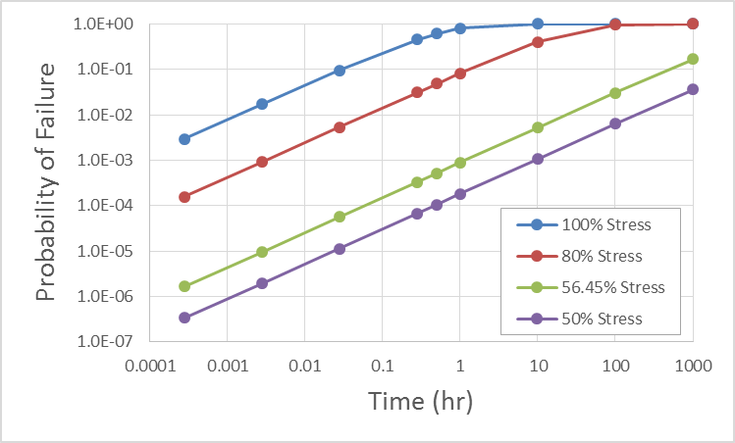
ATLAS Challenges
Slab Analyses - CARES
Ceramics Analysis and Reliability Evaluation of Structures (CARES) is a general-purpose integrated design software tool that provides an innovative, cost-effective approach to systematically optimize the design of brittle material components using probabilistic analysis techniques.
CARES applies the Weakest-Link model which captures the Weibull Size Effect of Brittle Material Reliability
Brittle Material Reliability Analysis Features:
  Time Independent (Fast Fracture)
  Time Dependent (Slow Crack Growth)
    Creep or Static Fatigue (Constant Stress)
    Monotonically Increasing or Dynamic Fatigue (Constant Stress-Rate)
  Transient - Time Dependent Reliability of components subjected to transient (multiple load step) thermomechanical loading
CARES is a post-processor of Finite Element Analysis (FEA) stress at temperature results
CARES was applied to evaluate the Weibull Characteristic Strength of the Preamp and Oscillator Slabs.
The Weibull Characteristic Strength was used to calculate a Load Case Dependent B-basis Allowable.
Crystal Material
Neodymium: Yttrium Orthovanadate - Nd:YVO₄
Jonathan A. Salem/ Glenn Research Center

Slide 27
ATLAS Challenges
Laser Slab Mounts – Corrective Action
Eliminate gold plating
Minimize mount induced stresses on slab
  Provide “relief valve” limiting mount induced stresses
    Spring loaded to apply deterministic preload
    Reduce / eliminate Intermetallic growth
  Minimize clamping force
  Maintain adequate thermal contact to slab
  Maintain beam quality & pointing
Select crystals with the least flaws
  Add bakeout step to drive out moisture
Demonstrate margin and factor of safety
  Test qualification units
  Proof test flight units
Maintain form, fit, and functionality compatible with existing design
  Do not invalidate previous testing
Amp/Preamp slabs & mounts successfully replaced in Lasers SN2 & 3
Reworked lasers installed 9/2017

Slide 28
ATLAS Planned Environmental Test Flow
CPT RFR
(In SCA- Ambient)
PER
Ambient DOOR Deployment
EMI/EMC Test
(RE/RS test)
DOOR Mechanical Stowed
Vibration Test
Acoustics Test
: Aliveness Test
DOOR Deployment
Alignment Verification
CPT
(at SCA)
: Functional Test
IMSC Functional
IMSC Aliveness
TVAC Test
(1 TB + 3 Cycles)
CPT – HOT/COLD
CPT
(at SCA)
DOOR Mechanical Stowed
PSR
DOOR Deployment
(after TVAC- final deployment at GSFC)
DOOR Mechanical Stowed
Mass Properties & CG

Slide 29
ATLAS Actual Environmental Test Flow
Avionics + Receiver TVAC
Lasers 1 & 2 installed & aligned
CPT RFR
(In SCA- Ambient)
PER 1
Ambient DOOR Deployment
EMI/EMC Test
(RE/RS test)
Feb 2015
Feb 2016
Mar 2016
Mar 2016
DEM Anomaly & Rework
DOOR Stowed
Vibration Test
Acoustics Test
Apr 2016
Apr 2016
Apr 2016
Inadvertent Door Deploy & Rework
DOOR Deployed
Alignment Verification
CPT
(at SCA)
TVAC Test
(1 TB + 2 Cycles)
CPT – HOT/COLD
Laser-2 Anomaly and Removal
CPT (Laser-1)
(at SCA)
DOOR Stowed
IIRR
Integrated with SC
Laser 2 Mass Mockup installed
ATLAS Shipped to OATK
OBS EMI/EMC Test
OBS Vibe Test
OBS TVAC Test
Removed from SC
LPT (Laser-1)
(at SCA)
Laser 1 Removed
Lasers 2 & 3 Installed
Penalty Vibe
(Z-axis)
TVAC-2
(2 cycles)
Mass Properties & CG
PSR
ATLAS Shipped to OATK
OBS self-compat & Acoustics Test

Slide 30
ATLAS Bench Checkout Equipment
BCE Primary Functions:
  Provide optical signals and background to the ATLAS receiver
    Inject via either of two signal paths:
      ATLAS receiver test ports
      ATLAS receiver aperture
    Measure & control optical signal power levels and timing
  Characterize ATLAS laser transmitter
    Beam quality, Pulse Width, Energy, Wavelength
  Verify ATLAS transmitter to receiver boresight alignment
    Provide stable retro-reflector to inject attenuated transmitted beam into receiver telescope
    Provide active beam deviation system to steer beam across ATLAS FOV
  Provide simulated star field to ATLAS Laser Reference System
  Provide independent verification of ATLAS timekeeping
    Measure ATLAS timing wrt GPS

Slide 31
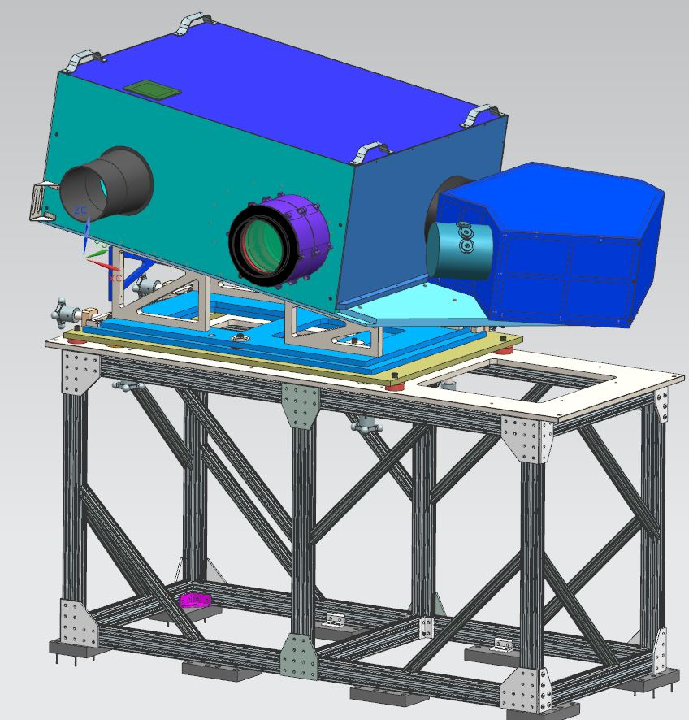
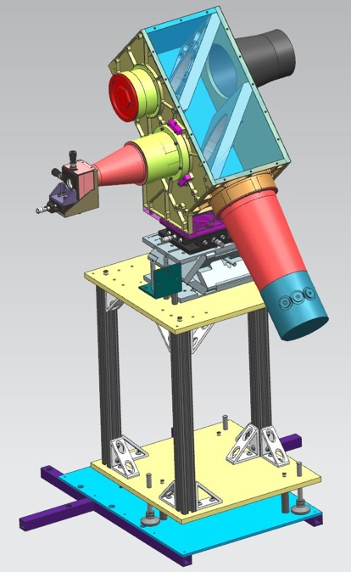
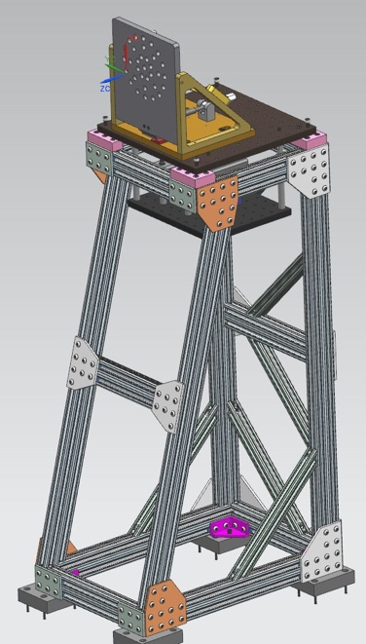
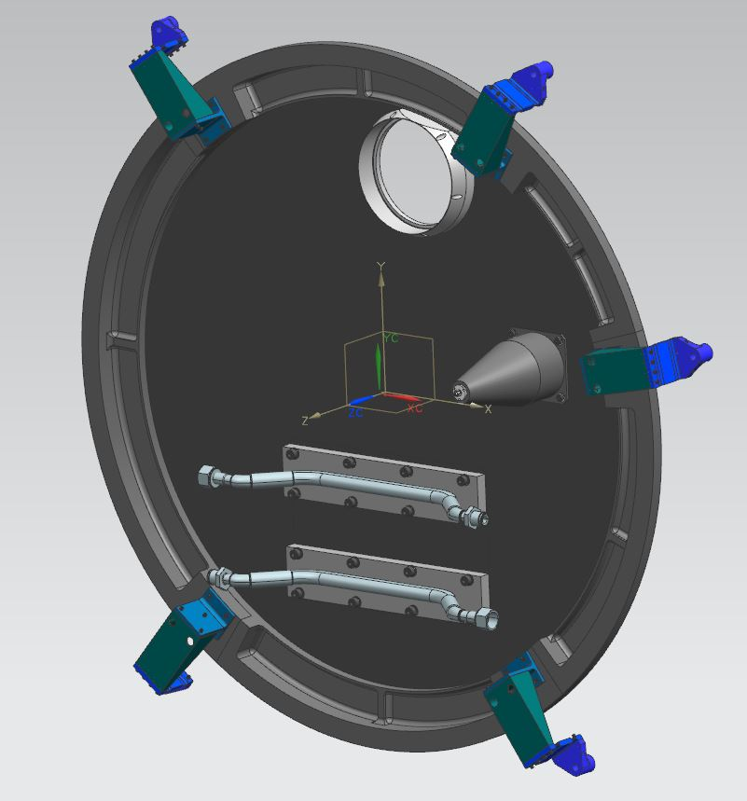
ATLAS BCE Subsystem Descriptions
LOAS
  Laser Optical Attenuator and Sampler
Attenuates/stops and samples ATLAS laser beam
    ND filter stack
    Single mode fiber pick-off
    Integrating Sphere
MAAT
  Main Alignment & Altimetry Target
  Retro-reflector & beam steering
  Laser Beam Diagnostics
    Camera, Integrating Sphere, Fiber pickoff
Star Target
Fixed star pattern for LRS
OTPSS
Optical Test Port Stimulator System
Diode laser sources, delay generators
fiber coupled to ATLAS
Receiver Telescope
Aperture Cover
Path for aperture signal sources
Showerhead
Thermal target
Stray light block
Support Racks for LOAS, MAAT, Star Target & Cover not shown

Slide 32
ATLAS Challenges
Bench Checkout Equipment (BCE)
BCE Availability
  Complex system
Optical alignment GSE
  LTR quality & stability in TVAC
  Neutral Density Filters to attenuate beam for alignment verification exhibited thermochromic response when heated by absorbed laser energy
Laser diagnostics camera
  Focus was initially set in air
    Defocused when in TVAC
      Added optic to correct, subsequently installed prior to each TVAC test
Fiber optics
  Thermal sensitivity seen with fibers injecting test signals to ATLAS
    Added heaters to fiber runs in TVAC
A separate BCE TVAC test was added to the I&T flow to verify BCE performance
BCE MAAT

Slide 33
Launch!
The last Delta-II lifts off with ICESat-2
ICESat-2 encapsulation

Slide 34
ATLAS On-Orbit Performance
Instrument Status
  Power
  Thermal
  Mechanisms
  Laser
  AMCS
  LRS
  FSW
  Algorithms
Issues
Science Results
Summary

Slide 35
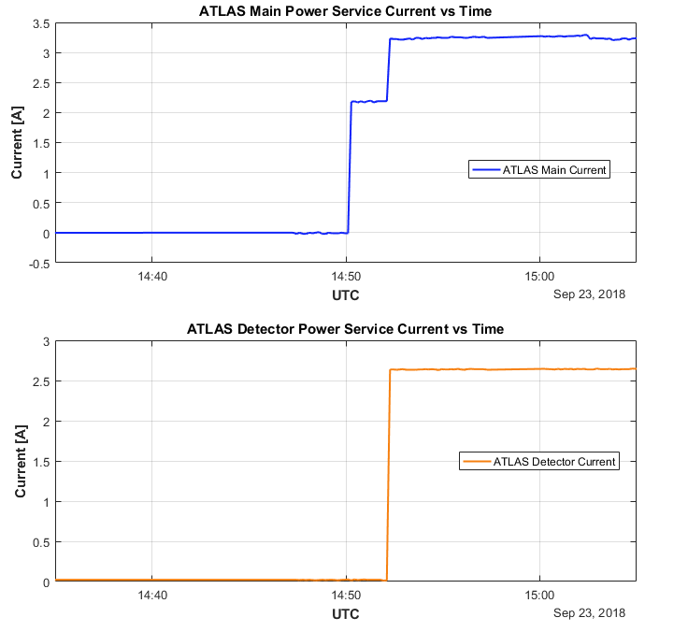
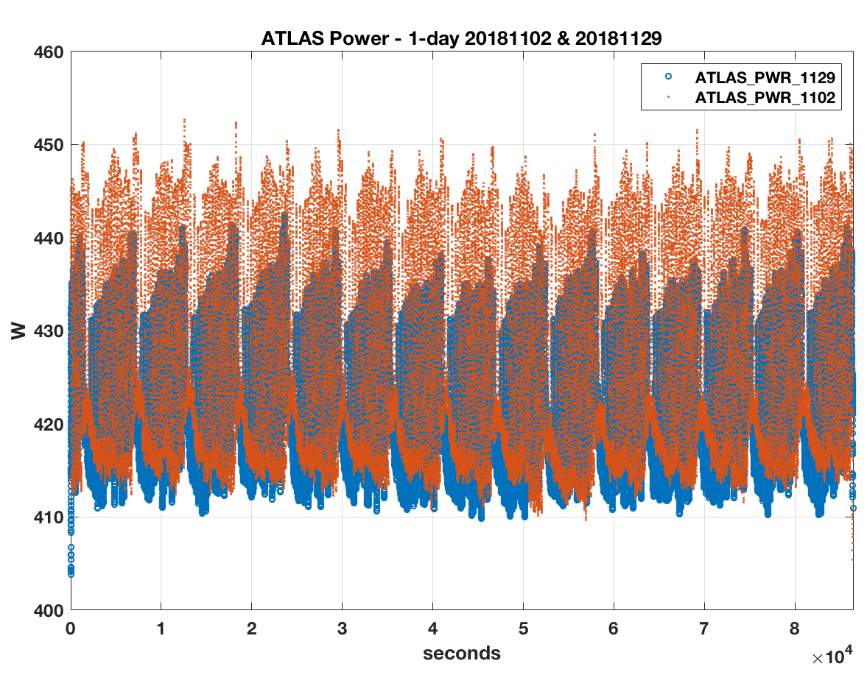
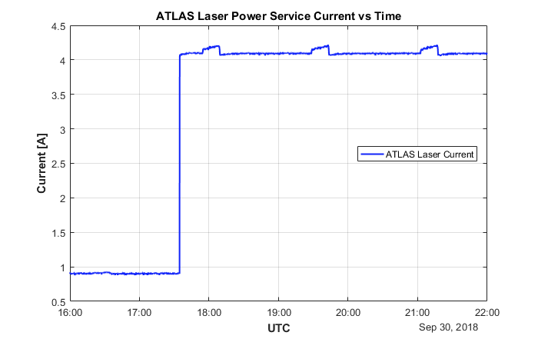
ATLAS Instrument Status
Power
ATLAS power nominal
  All secondary voltages and currents within expected ranges
  Average power ~420W
    Allocation 524W
One-day ATLAS Power 11/02 & 11/29
Current consumption of ATLAS Main, Detector and Laser Power Services nominal and within expected ranges

Slide 36
ATLAS Thermal Control System (TCS)
On-Orbit Summary
ATLAS TCS is operating nominally
Telescope setpoints had to be adjusted during early checkouts to maintain temperature control.
Loop Heat Pipe was successful through priming and startup process.
Laser temperature has been stable, as expected through ground testing, through environment changes (noon-to-night orbit)
PDU, MEB, LRS Electronics and DEM are all 5C – 8C cooler than predicted temperatures with ample operational margin on both ends (hot and cold limits)
All heater controlled components are maintain temperatures as expected
  Telescope
  DOM
  LHP
  LRS Optics
  OFAs

Slide 37
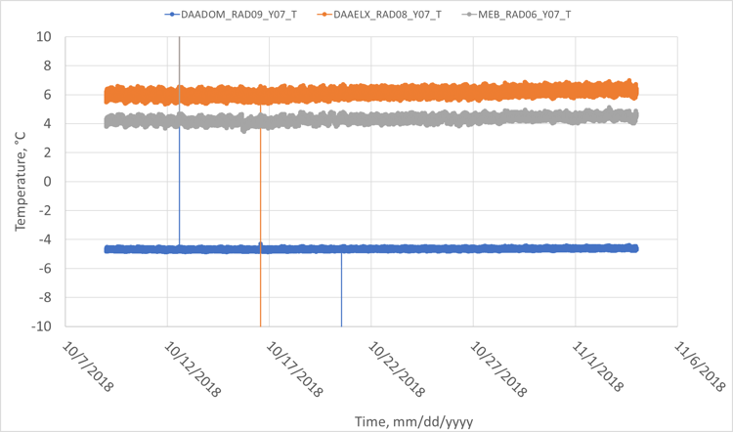
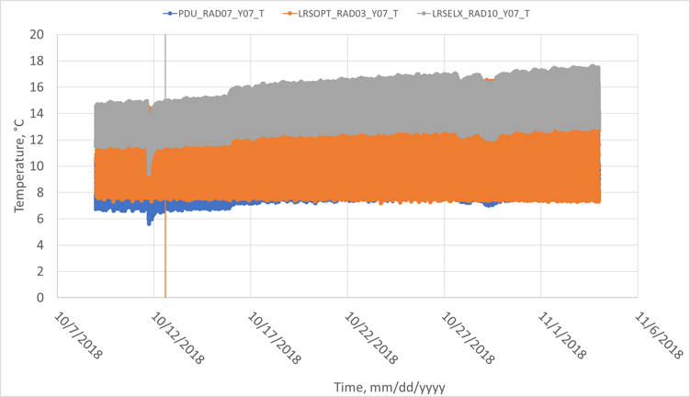
ATLAS Avionics and Heater Controlled Optics
DOM, DEM and MEB are all maintained well below their operational limits.
Vertical lines represent erroneous data points.
PDU and LRS Electronics have larger swings in temperature, compared to MEB/DEM, due to zenith pointing radiators.
Vertical lines represent erroneous data points.

Slide 38
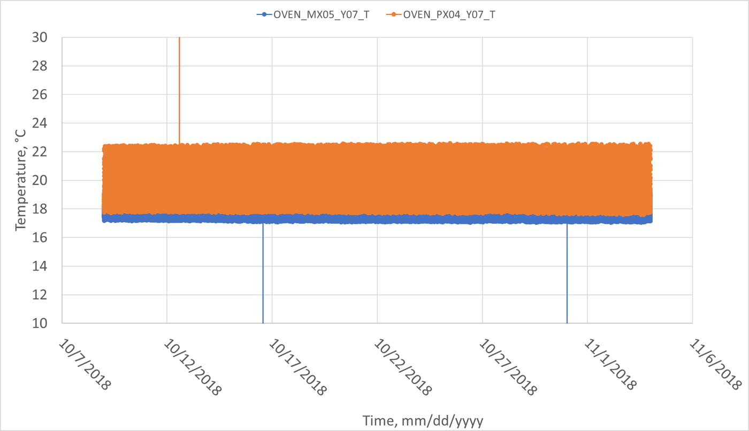
ATLAS Transmit Optics Environment
All transmit optics are maintained at goal temperature

Slide 39
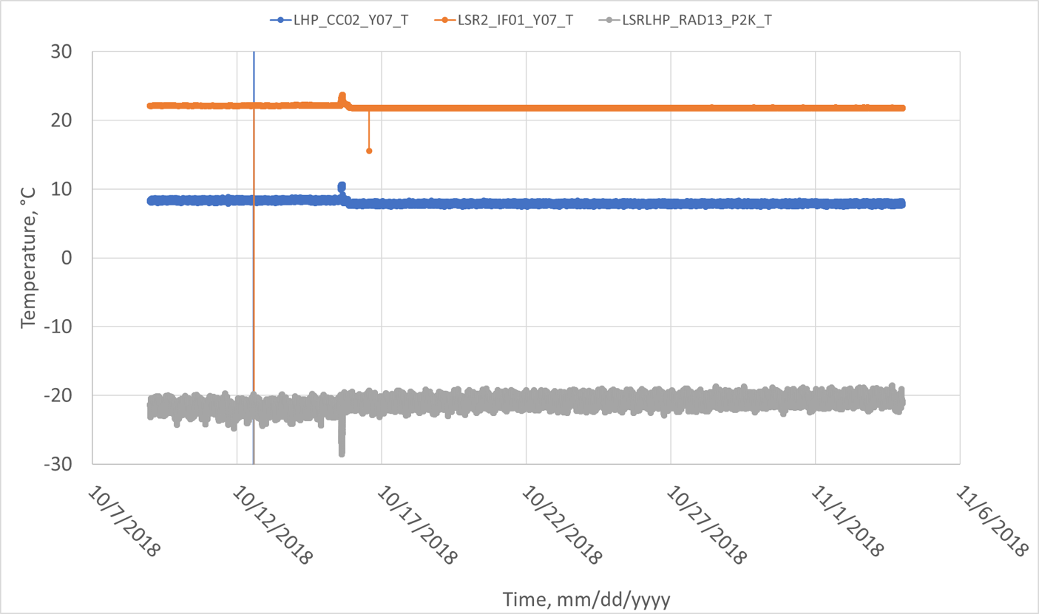
ATLAS LHP and Laser
Energy Level Change
LHP has maintained the laser temperature

Slide 40
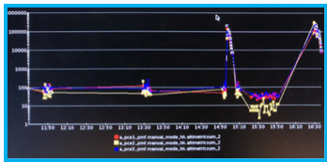
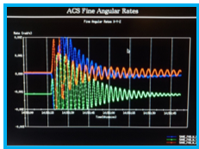
ATLAS Instrument Status
Mechanisms
Door
  Deployment successful!
Detector Select Mechanism
  Currently on A-side
    No change in position
Beam Steering Mechanism
  Performance nominal
    Successfully executed several fine search alignment sequences
    No issues maintaining Tx-Rx boresight alignment
Photon Counting Electronics (PCE) altimetric sums before the door opened, after opening (spike at ~1454Z), and during an eclipse immediately following door deploy
“Ringing” in the SIRU rates induced by the door hitting its stop after deployment

Slide 41
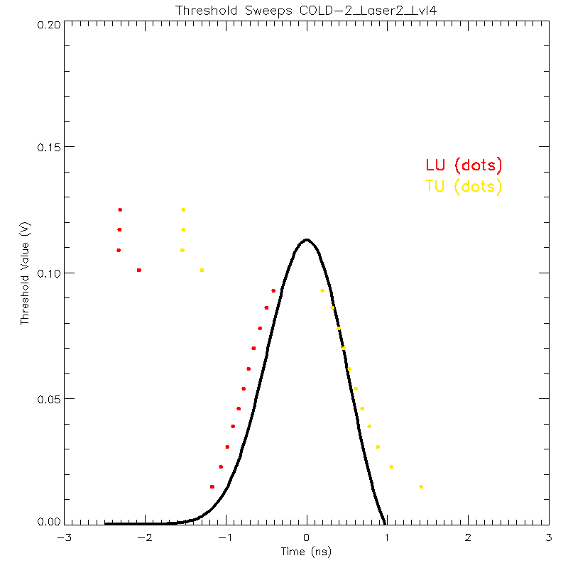
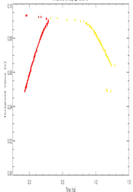
ATLAS Instrument Status - Transmitter
ATLAS Laser Pulse Energy 30-day trend
Laser performance nominal
  Energy stable within 1%
    Same as I&T values
  Pulse width
    Same as I&T values
  LOM pressure
    No change
  Housekeeping
    All values nominal
ENERGY LEVEL 4
ENERGY LEVEL 4
SHG (Laser internal)
ENERGY
SPD (ATLAS) ENERGY
SPD Sweeps – Energy Level 4
Instrument TVAC
LOM Pressure 30-day trend
On Orbit
LU
TU

Slide 42
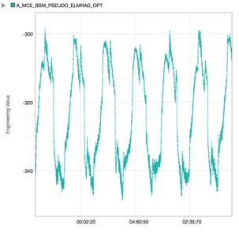
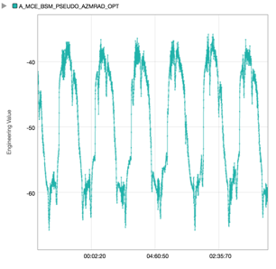
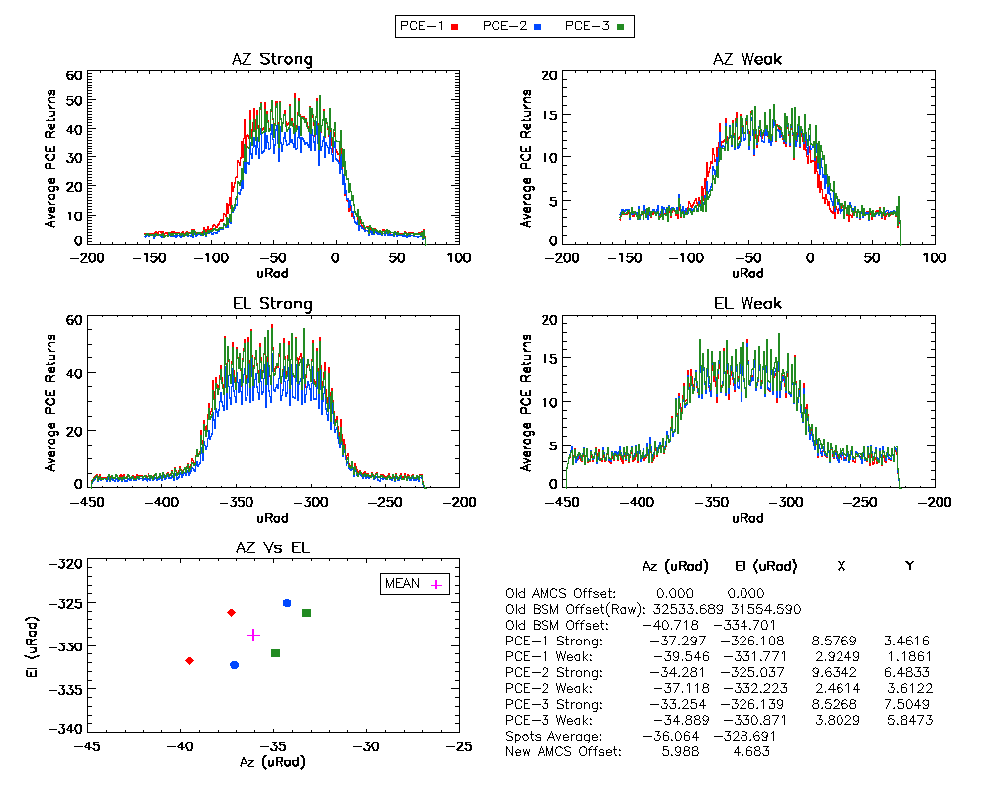
ATLAS Instrument Status - Transmitter
AMCS sweep – I&T
Beam Quality
  Nominal as indicated by slope of AMCS sweep
    Plots show transmit beam convolved with RTA FOV
Pointing
  No change post launch
  Orbit variation ~30-40 µrad p-p
AMCS sweep – On-orbit
BSM EL
BSM AZ

Slide 43
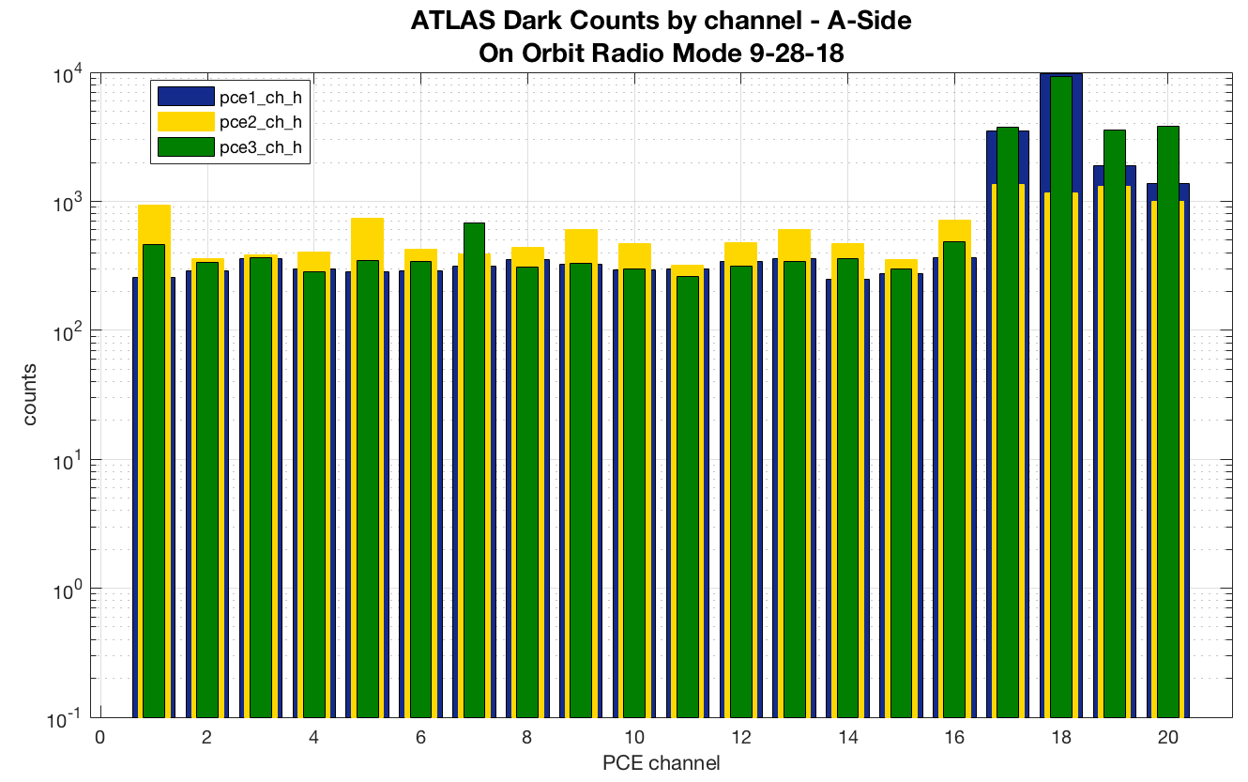
ATLAS Instrument Status – Receiver
Receiver Telescope Assembly (RTA)
  Raised operational temperature setpoint to 13°C
    Maintaining positive heater control to avoid orbit variations
Optical Filter Assemblies (OFAs)
  Performance nominal
    No change from ground temperature setpoints
Detector Array Assembly & Detector Electronics Modules (DAA/DEM)
  Performance nominal
    All DEM channels active
Photon Counting Electronics (PCEs)
  Performance nominal
    Occasional upsets over SAA cause error flags to be set
      All errors recoverable
All detector channels active
Transmit Echo Pulse
Same as ATLAS I&T response
PMTs responding to radiation over SAA
(With door closed, counts are much lower than solar background rates)

Slide 44
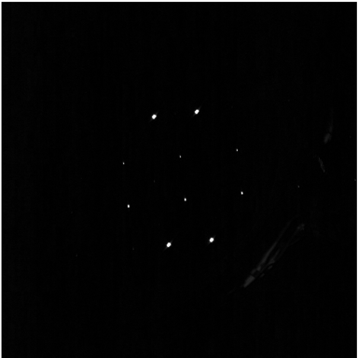
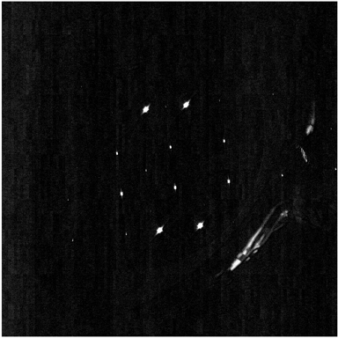
ATLAS Instrument Status
AMCS - LRS Laser Side
TAMS Performance nominal
  LRS Spot magnitudes comparable to ATLAS TVAC levels
  <1 pixel change to RTA line of sight wrt LRS
Laser Performance nominal
  Spot magnitudes comparable to ATLAS TVAC
  <1 pixel change in laser centroid position wrt LRS
Stray light observed over daytime scenes is consistent with I&T
Small perturbations in TAMS and Laser centroids observed by PPD group
  Correlated with LRS optics heater cycling on/off
LRS Laser Side On-Orbit
Centroid perturbation (red) caused by optics heater (blue)
LRS Laser Side On-Orbit
Contrast enhanced
with daylight illumination

Slide 45
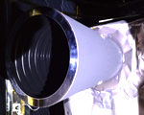
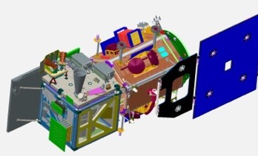













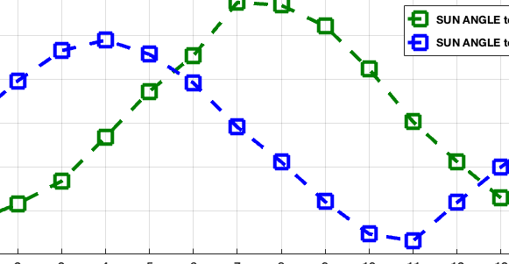
ATLAS Instrument Status
LRS Stellar Side Stray Light
“Half-ring” stray light pattern is present during ~1/2 of each orbit (7 out of 14 images below)
  Pattern is consistent with scattering from top annulus of sunshade reflecting off vanes in sunshade and optics in LRS
  Significantly affects LRS ability to track stars and deliver centroids to spacecraft ACS for on-orbit reference and PPD for post-processing on ground
    LRS FSW ”tracked” stray light when present
LRS FSW initially tracked stars during ”dark” half of each orbit, but fewer than expected
  LRS FSW changes addressed this issue and improved tracking
-Z
LRS
+Y
+X
FLT DIR
LRS STELLAR SIDE IMAGES OVER 1 ORBIT at BETA ANGLE 67.5°
Sun angle to +Y is 157° ±5°°
ANGLE (degrees)
IMAGE #

Slide 46
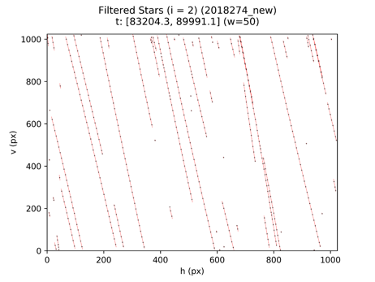
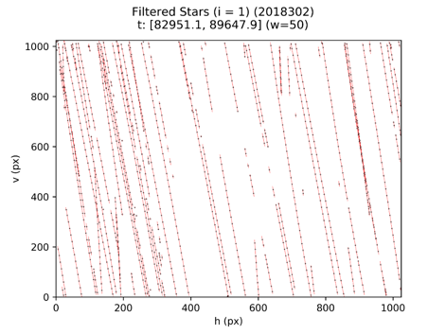
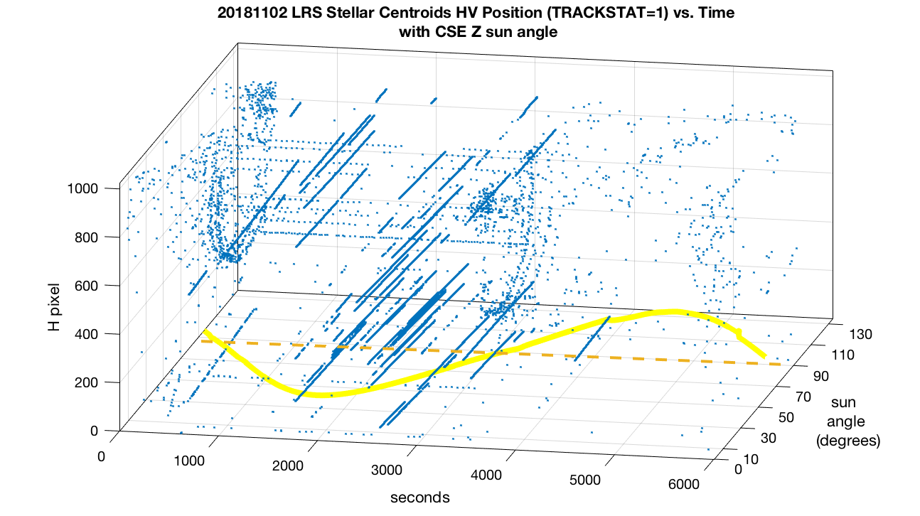
ATLAS Instrument Status
LRS Stellar Side
Tracking Performance and Warm Pixels
LRS stellar side stars tracked during “dark” half of orbit
With LRS FSW v2.3
DOY 274 (~7 full tracks)
With LRS FSW v3.0
DOY 302 (~20 full tracks)
LRS FSW Update
LRS stellar side tracking over one orbit
  Tracks when sun angle wrt Z-axis < 90°
Number of LRS stellar side “warm” pixels
steadily increasing
  Few more each week, currently at 24
  Will affect stellar tracking if not mapped
  Need to update regularly
    Once per month
V pixel

Slide 47
ATLAS Instrument Status
LRS Stellar Side Stray Light Likely Cause
Reflections from the sunshade vane edges feed the LRS with an annular ring pattern of ~10-15deg half-angle. The detector FOV is within the central “hole” with no rays, but the off-axis rays interact with LRS hardware to generate stray light.
  The ring (or rings) are from a specular reflection (glint) off the LRS internal stop surface, a 0.4-mm thick flat edge.
    Aperture stop was originally modelled as a knife edge, but was manufactured with the 0.4-mm flat edge
Stellar side not tested for stray light as as an integrated system
  LRS sunshade was tested separately to verify no stray light in detector FOV
Documentation added to SOARS database.
LRS sunshade vanes painted with z302, a glossy black finish
LRS aperture stop
Updated ray trace showing ring illumination path
LRS aperture stop
Rays from vane reflection
Updated ray trace pattern
On-orbit ring pattern

Slide 48
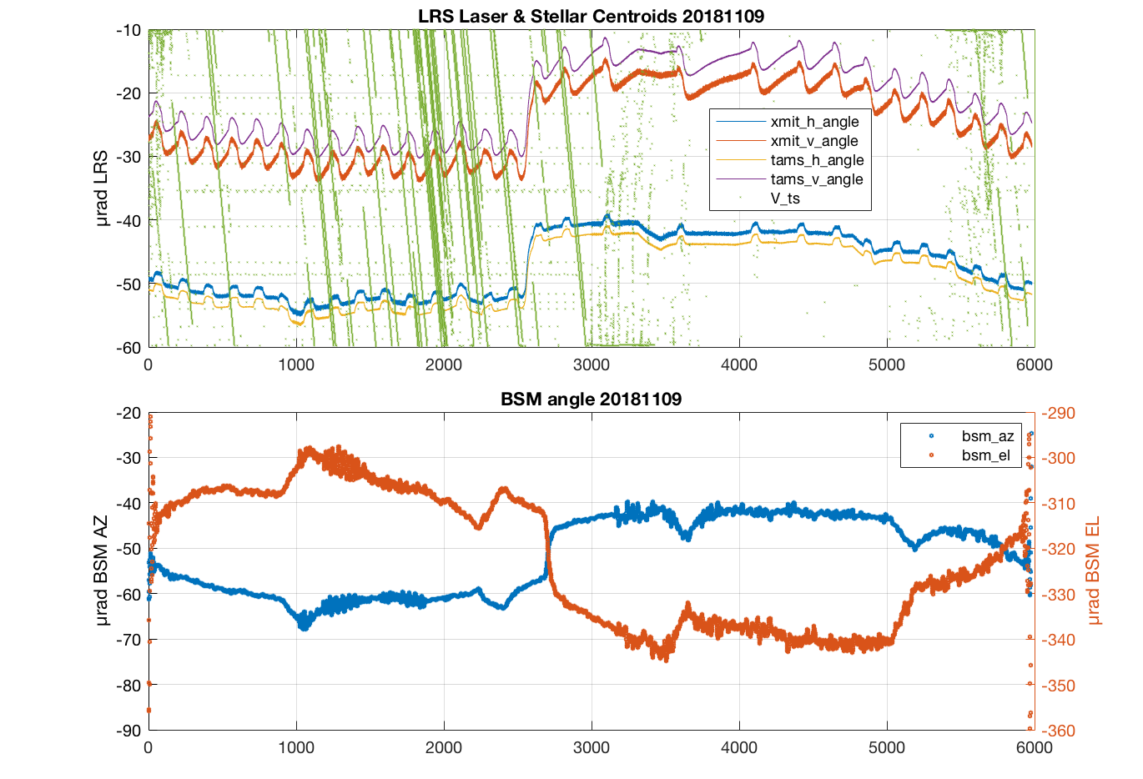
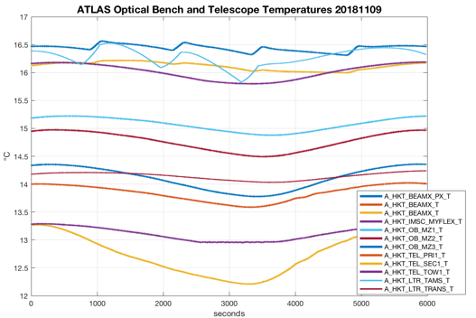
ATLAS Status
Pointing Performance
Peak-peak boresight (Tx-Rx LOS) shift 30-40 µrad in azimuth and elevation over each orbit
  BSM corrects for this shift and maintains constant offset between TAMS & Laser centroids
  Pre-launch STOP analyses predicted ~200 µrad peak-peak worst case (MUF=2)
No shift in boresight after launch
  AMCS offsets are at same values as last CPT on ground in May 2018
These observations indicate that the ATLAS structure is more stable than expected
5°C
LRS Stellar Centroids Valid
ATLAS Bench & Telescope Temperatures
seconds

Slide 49
ATLAS MEB Flight Software
The flight software on the Single Board Computer (SBC) and the three Photon Counting Electronic (PCE) boards is running smoothly and there are no recommended changes to the launch configuration.
Over the course of commission the Flight Software Sustaining Engineering team investigated a series of yellow limit violations. In all but one case, it was determined that the limit should be turned off, and is either a consequence of the space environment or a reasonable telemetry value for the operation performed.
One limit violation is still under investigation but was initially assessed as not causing any operational impact.
Trac # | Description | Disposition
3435 | Radio Mode - Did Not Finish Writing Errors (during commissioning) | Caused by radiation effect on PMTs or DEMs. Strength and frequency of bursts below threshold for flight algorithms
3436 | Latch SDI error counters at 255 | Ops member inquired as to why counters roll, feature deferred
3437 | SpW channel 18 error when changing state of AMCS/BSM | Low level driver reports timeout on state transition. This is benign.
3438 | Look into PMF_ALG_RESULTS_BUFF_LOOKUP_ERROR at 18-274-10:49:12.247000 | Caused by SEU in TEP configuration
3441 | Range Window Drop Out Errors | Caused by radiation effect on SPD (likely) or Laser Fire Command (unlikely). Frequency sufficiently low, updated limit check supplied.
3440 | Limit violation on A_SDI_HK.SDI_HW_IF_ERROR_EVENT and A_SMT_HK.SMT_CYCLE_CNT_SEQ_ERR_EVENT | Still under investigation. Effect of error is benign.

Slide 50
Status of Receiver Algorithms On-Orbit
Rx Algorithms appear to be working very well. Science Team has brought up a couple of minor issues as they examine the on-orbit data.
Signal is being found > 60% of the time although more cloud returns are being identified as signal than we had anticipated. The real percentage of surface returns found is probably about what we expected (~50%).
Rx Algorithms Team is finding that when surface returns can be seen in the atmospheric histogram, the onboard algorithms are finding and sending them down in the telemetry.
Daily data volume has been running high as was expected during Commissioning due to the testing being performed. But most days it is < 580 Gb. We are monitoring the rising of avg. background rate as solar angle increases, which will cause data volume to go up.
After Commissioning, a few onboard parameters will need to be modified to optimize performance. This will be done via CCR. This includes the required update of the onboard laser vectors from the POD team.
The ISF is running through 5 parameter modification tests for us on ATLAS from 11/4 to 11/12. These are (1) increased data volume, (2) decreased data volume, (3) increased range window, (4) offset range window and (5) additional telemetry band padding.

Slide 51
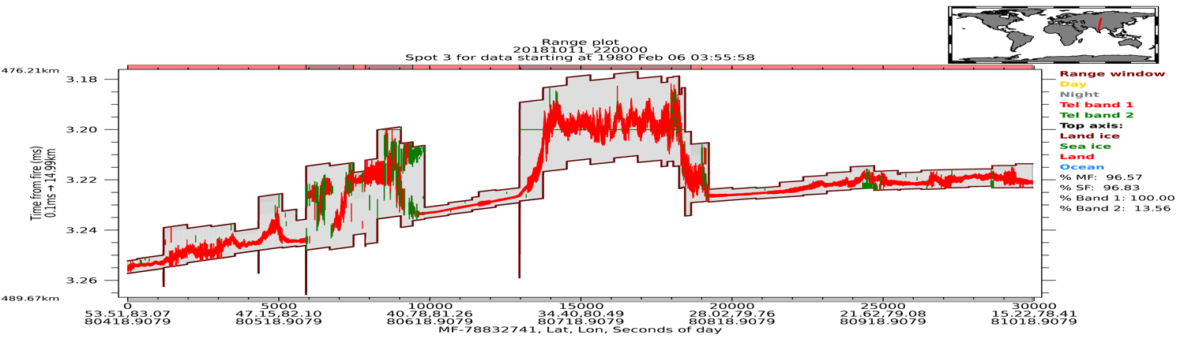

Receiver Algorithms On-Orbit Example
Track over the Himalayas
Telemetry Bands in Range Windows
clouds
surface returns
Steve Palm’s Atmos. Hist Plot

Slide 52


Receiver Algorithms On-Orbit Example
Track over the Himalayas
10/11/18 22:18:20 – 22:26:49
Telemetry Bands in Range Windows
TEP also captured
Surface returns
Time of Flight (TOF) in Telemetry Bands
(red lines are start/stop of bands)

Slide 53
ATLAS On-Orbit Issues
LRS stellar stray light
  Stellar tracking has improved with LRS FSW updates
    S/C ACS folks are assessing performance on ground after latest LRS parameter updates before allowing ACS to utilize LRS data on orbit
    PPD assessment ongoing as more data becomes available
  Almost no stars tracked when sun angle is above the plane of the sunshade aperture (CSE_Z > 90°)
    Still ~ ½ orbit (from beta 70° to beta <30°)
      FSW update done at beta 45°
    May see more stars on sunlit side when beta angle is once again above 45°
    Improved ray trace of LRS optics should provide insight to expected performance as a function of beta angle
LRS stellar warm pixels
  Warm pixels continue to appear at a rate of 2-3 per week
    Not a problem if updated on a regular basis
      Imager is 1024x1024 pixels
    Assessing warm pixels is currently done manually

Slide 54
ATLAS Lessons Learned
Stellar side stray light
  Insufficient testing & errors in modeling
LRS warm pixels
  Known issue with other star trackers, not planned for in operations.
VBG tuning process
  Overall average signal strength stable and consistent across all receiver FOVs
    OFA settings derived from TVAC appear to be adequate
    Signal strength variations too large to accurately assess wavelength matching across all 6 spots in the time allotted at each setting
Software error flag limits set too low
  Minor error limits set too low for observed error rate from SEUs
Data processing not done in same manner as I&T
  Data path and analysis tools differed from I&T for some commissioning activities:
    SPD sweeps
    VBG sweeps
    AMCS calibrations
Pointing vector & coordinate axes documentation was inconsistent
  Too many sources for information, not all updated consistently
  Took extra time and effort to verify spot pattern on ground
I&T lessons learned meeting held at VAFB 9/14/18
  Results on MIS: ICESat-2-MGMT-RARCH-5520

Slide 55

ATLAS Observations
Ocean surface waves
With the strong beam, there is a well defined wave structure
This example depicts wavelengths on the order of 140 m
~700 m along track
Figures courtesy of Brad Klotz

Slide 56



ATLAS Observations
Trees in Russia, daytime acquisition

Slide 57

ATLAS Observations
Australian Coast (NW) ATL03 Transect
land
Trees at coast
More photons under the water surface due to volume scattering
Waves on ocean
9 m
Lots of amazing bathymetry
?
~26 m

Slide 58


ATLAS Observations
Ice Sheet Elevation - Antarctica
First three weeks of observations over Antarctica
B. Smith, U. Washington

Slide 59

It’s just like the poster!

Slide 60

ATLAS Observations
Antarctic Sea Ice Elevation
Scale is 0-3 m (Vertical)

Slide 61

ATLAS Observations
Greenland Sea Ice Freeboard
Sea Ice Freeboard of the Arctic Ocean in the Late Fall from 14 days of ICESat-2 data

Slide 62

Atmospheric Observations: smoke from CA fires
Steve Palm SSAI/GSFC
Yuekui Yang GSFC

Slide 63






Yosemite Valley from ICESat-2
John Robbins – Craig Tech, Code 615, GSFC

Slide 64
ATLAS Instrument Performance Summary
Laser
  Performance has been very stable
  Energy reduced ~20% from initial setting to optimize link (Level 6 to Level 4)
Signal detection and timing
  Signal strengths initially higher than expected. Laser energy reduced.
  Timing performance nominal
  Receiver algorithm successfully tracking ground and downlinking returns
Wavelength tuning
  Wavelength Tracking performance nominal
  Received signal strengths consistent across channels
Solar background levels
  As expected based on receiver testing
Alignment and Pointing
  No change, maintaining Tx-Rx boresight alignment very well
    Periodic AMCS sweeps show little change in boresight during commissioning
Command and telemetry
  Performance nominal, no issues
  Downlink data volume within expected values
Spacecraft interfaces
  No issues

