Slide 1
The Final Step: Communicating Your Science and Engineering
C. Alex Young
Associate Director for Science
Heliophysics Science Division
GSFC Systems Engineering Seminar, August 2019

Slide 2
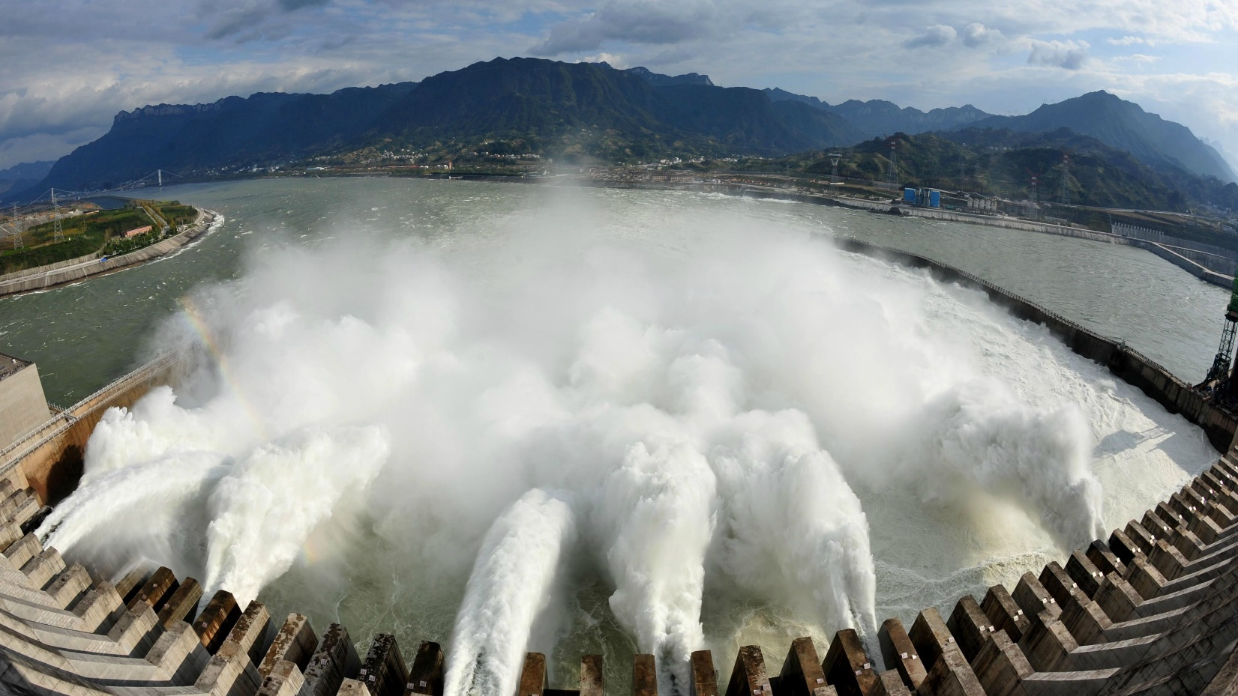

Slide 3
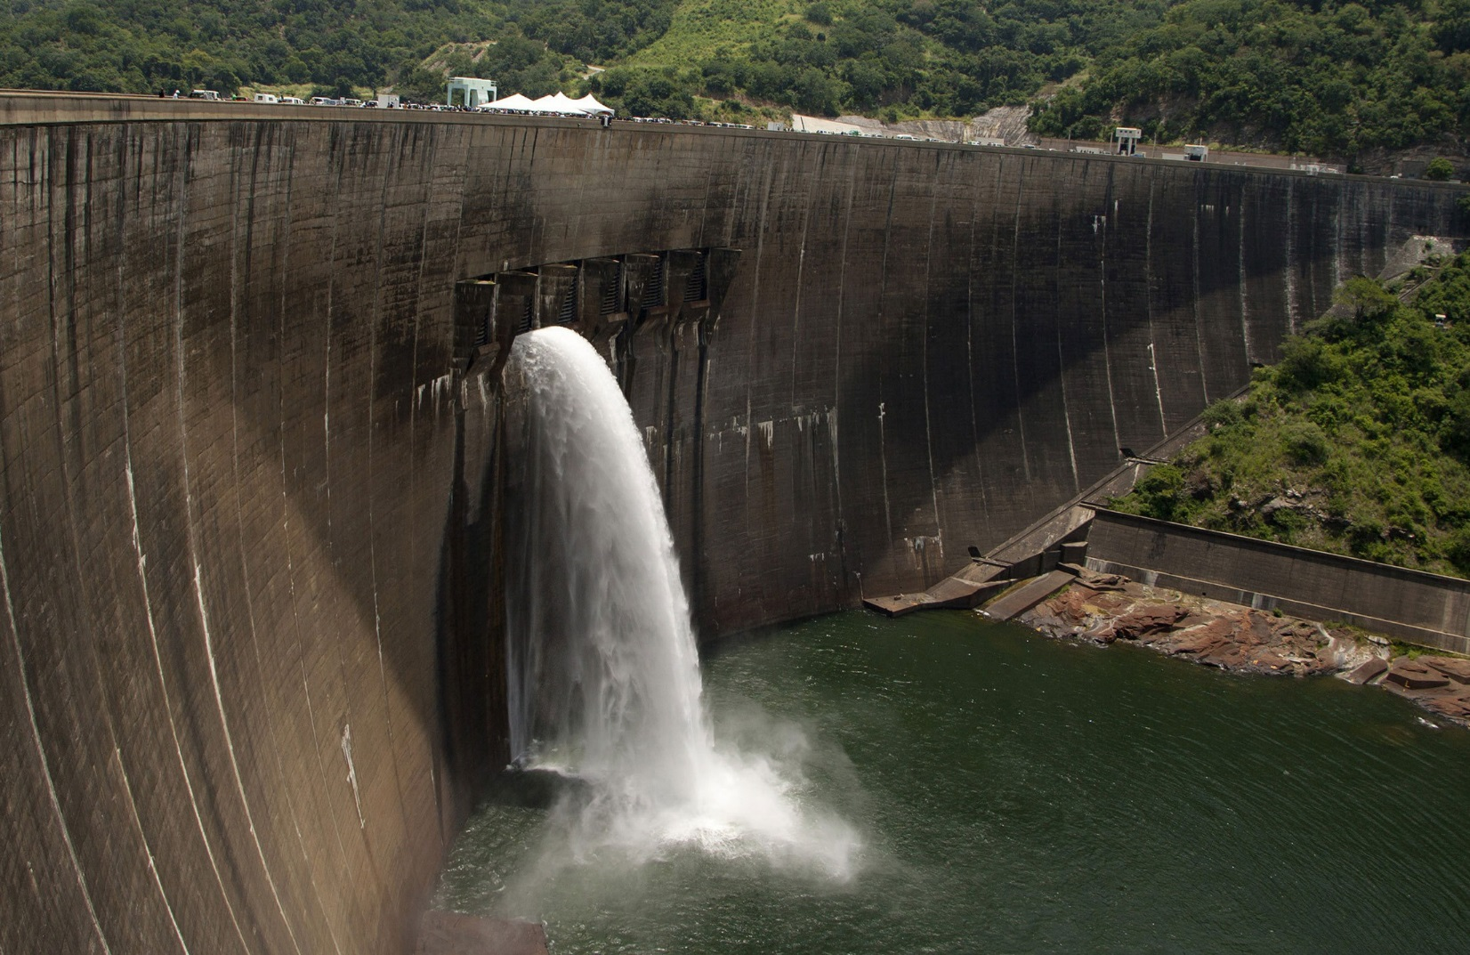

Slide 4
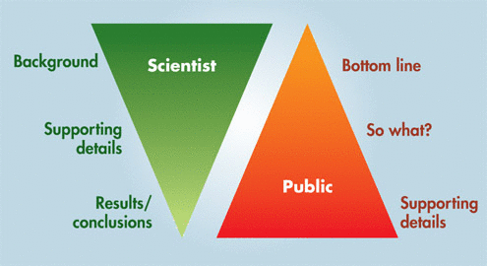
Get to the Point
Communicating the Science of Climate Change, Physics Today, Somerville & Hassol, 2001.

Slide 5
The Curse of Knowledge
What is anthrax?
Bacillus anthracis, the etiologic agent of anthrax, is a large, Gram-positive, nonmotile, spore-forming material rod. The three virulence factors of B. anthracis are edema toxin, lethal toxin and a capsular antigen.
CDC website FAQ 2001

Slide 6
What matters to your audience
Anthrax is a disease caused by bacteria. It can be fatal but usually is curable.

Slide 7
Start with the Story
Know Your Audience
Know Your Goal
Distill Your Message

Slide 8
START WITH THE STORY
What makes the story exciting?
What makes it meaningful to your audience?
You know the backstory. It's interesting!
Make it personal! Be Yourself

Slide 9
KNOW YOUR AUDIENCE
What does my audience want?
Find a way to connect with them or they will do it themselves
(and stop listening to you.)
People will listen to you if they care about you.
Notes:
Metaphors, similes, and analogies are POWERFUL!
(create visuals in one's head)
How does this apply to ME?
ASK your audience a QUESTION.
Get there early, talk to people.
Your energy is reflected back to you:
-suprise -eye contact -vulnerability -attention -body language
JARGON? if you need to use it,
Set it up first!
*Use everyday language *Evoke emotion *Get personal and be vivid *Tell stories

Slide 10
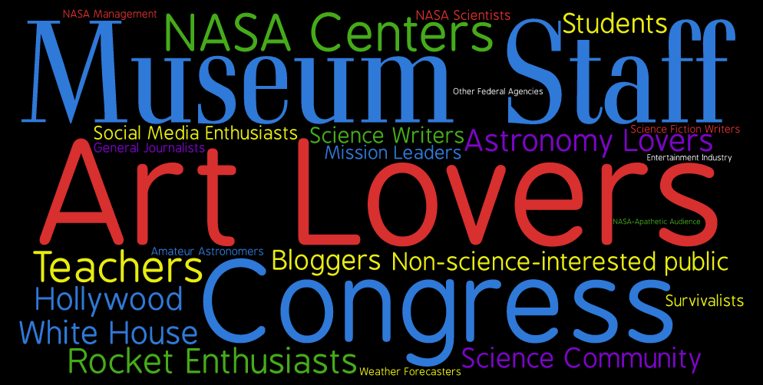
KNOW YOUR AUDIENCE
Notes:
Metaphors, similes, and analogies are POWERFUL!
(create visuals in one's head)
How does this apply to ME?
ASK your audience a QUESTION.
Get there early, talk to people.
Your energy is reflected back to you:
-suprise -eye contact -vulnerability -attention -body language
JARGON? if you need to use it,
Set it up first!
*Use everyday language *Evoke emotion *Get personal and be vivid *Tell stories

Slide 11
KNOW YOUR GOAL
I want my audience to ...
Set an appropriate goal!
Remember ~1 - 3 things. THAT'S IT!
Communication doesn't happen unless your audience receives your message.

Slide 12
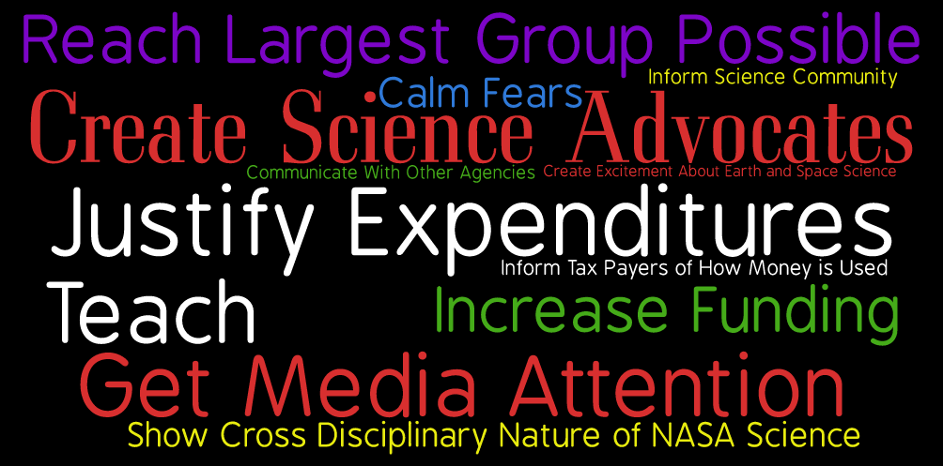
KNOW YOUR GOAL

Slide 13
Distill Your Message
Talking about science/engineering — and why it matters
— in clear, vivid, conversational language that your audience understands

Slide 14
The basics of Distilling
Stress meaning, not details
Tell us why it matters: So what?
Use everyday language
Tell Stories

Slide 15
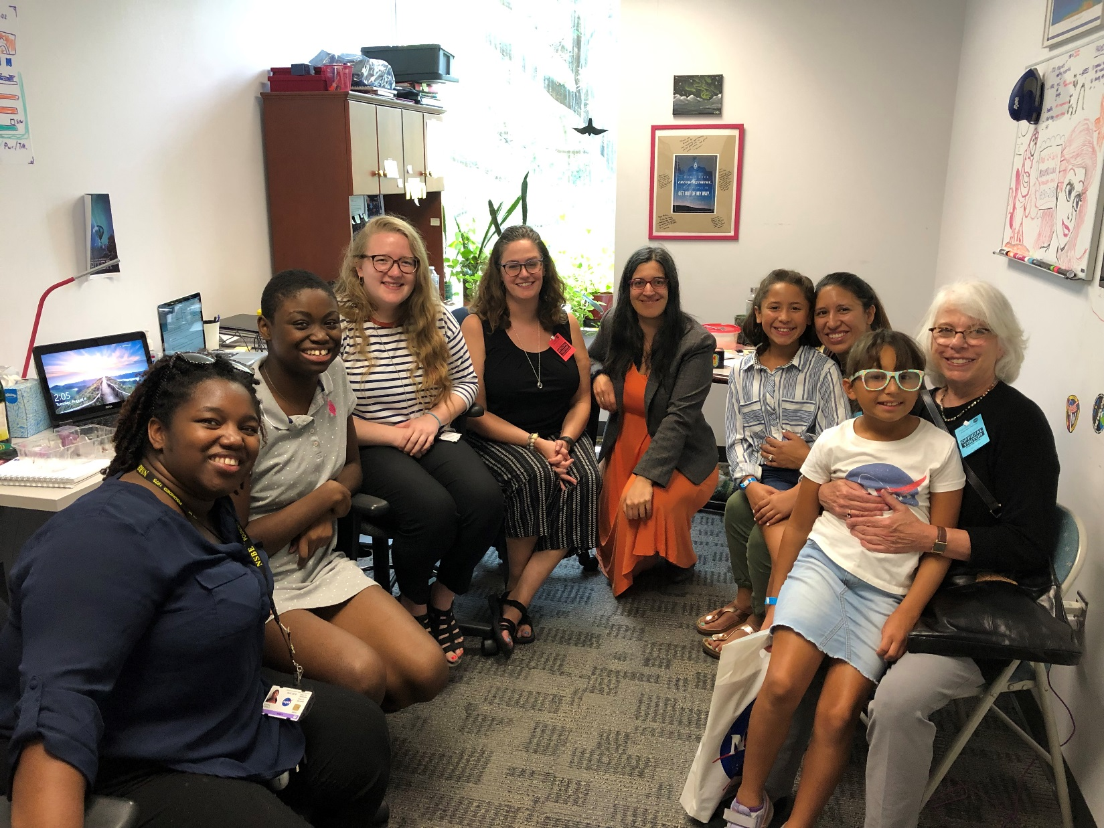

Slide 16
Make Us Care by Evoking Emotion
Make it personal
Talk about what is surprising, funny, exciting, difficult, mysterious
Examples, analogies, comparisons
Concrete, visual, specific, language
Props AND Improvise

Slide 17
Comparisons
The Solar Dynamics Observatory (SDO) satellite's cameras will generate 67 megabits/sec of data or 1.6 terabytes a day.
SDO’s cameras generate 200 DVDs worth of images a day. That amount of data is equivalent to about 160,000 mp3 songs.
(KNOW YOUR AUDIENCE)

Slide 18
Memorable
I study Didymonsphenia geminate, an invasive riverine species that impairs the recreational and ecological values of waterways.

Slide 19
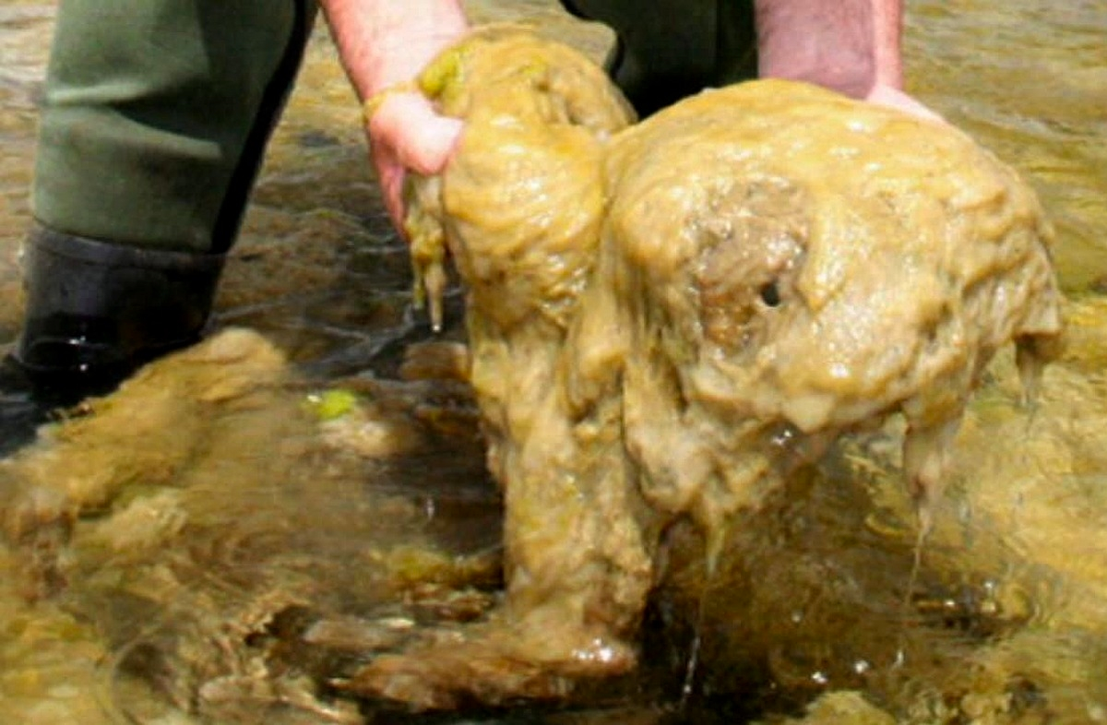
I study "rock snot", a kind of alga that forms brown, oozing masses that look like a sewage spill. These get so big that they block rivers and kill fish.

Slide 20
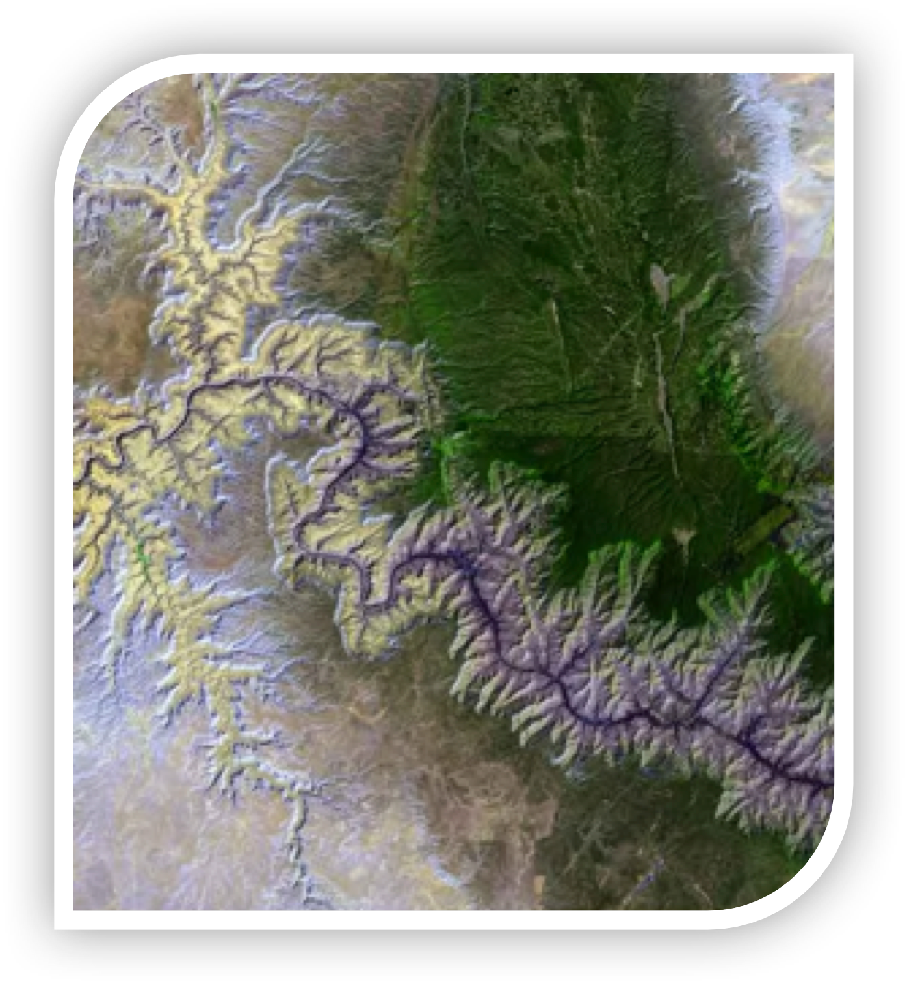
Many of the instruments aboard the Magnetospheric Multiscale Mission (MMS) have unprecedentedly high – on the order of milliseconds -- time resolution and accuracy.
Imagine flying by the Grand Canyon in 0.03 seconds – less time than it takes to blink an eye – and having to record what you see.
That’s what MMS must do.
It flies through regions just a kilometer across at speeds of 50-100 kilometers a second.

Slide 21
Start with the Story
Know Your Audience
Know Your Goal
Distill Your Message

Slide 24
Get to the Point
Communicating the Science of Climate Change, Physics Today, Somerville & Hassol, 2001.

Slide 25
What matters to your audience
Anthrax is a disease caused by bacteria. It can be fatal but usually is curable.

Slide 27
www.aldacenter.org
www.aaas.org/resources/communication-toolkit
procomm.ieee.org/communication-resources-for-engineers/
sharingscience.agu.org

Slide 28
Thanks!
c.alex.young@nasa.gov @thesuntoday

