Slide 1

Systems Engineering Seminar
3/21/19
Matt Garrison, ISE

Slide 2
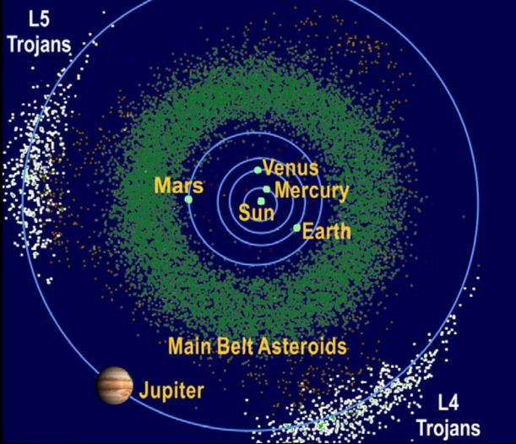
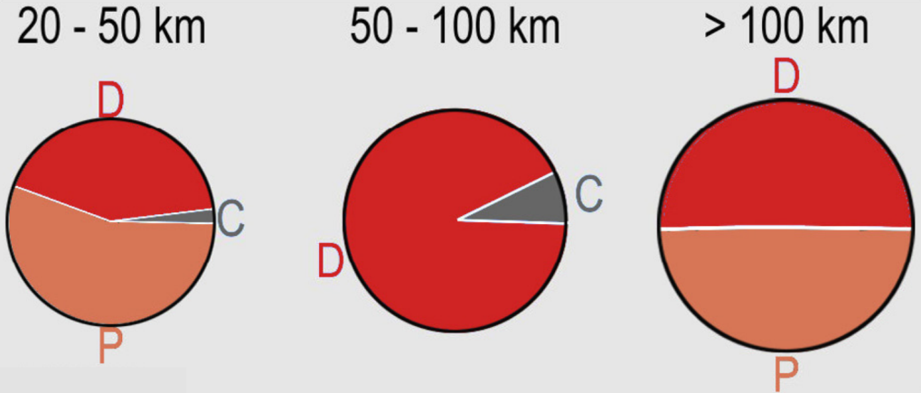
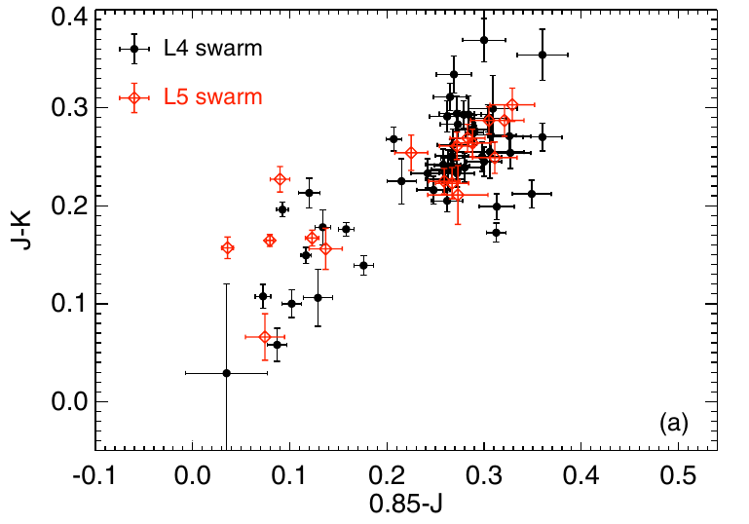
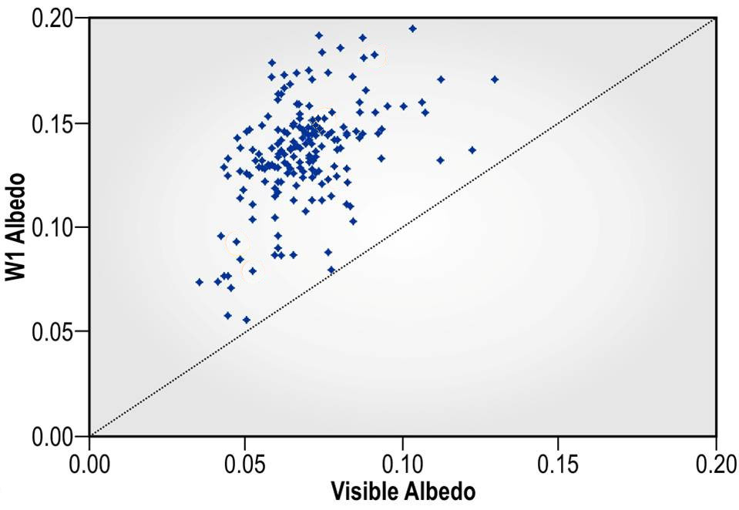
Lucy Overview
Trojans are remnants of giant planet formation
  They should be low density and volatile rich below a
  desiccated surface layer with complex surface chemistry.
But they are not a homogeneous population
  Contain C-, D-, and P-type spectral types
  Have visible albedos from ~4 - ~15%
  Wide range of colors.
(DeMeo et al.)
(Emery et al.)
(Grav et al.)
Trojans are very diverse, which makes them particularly exciting
  None have been viewed up close
2

Slide 3
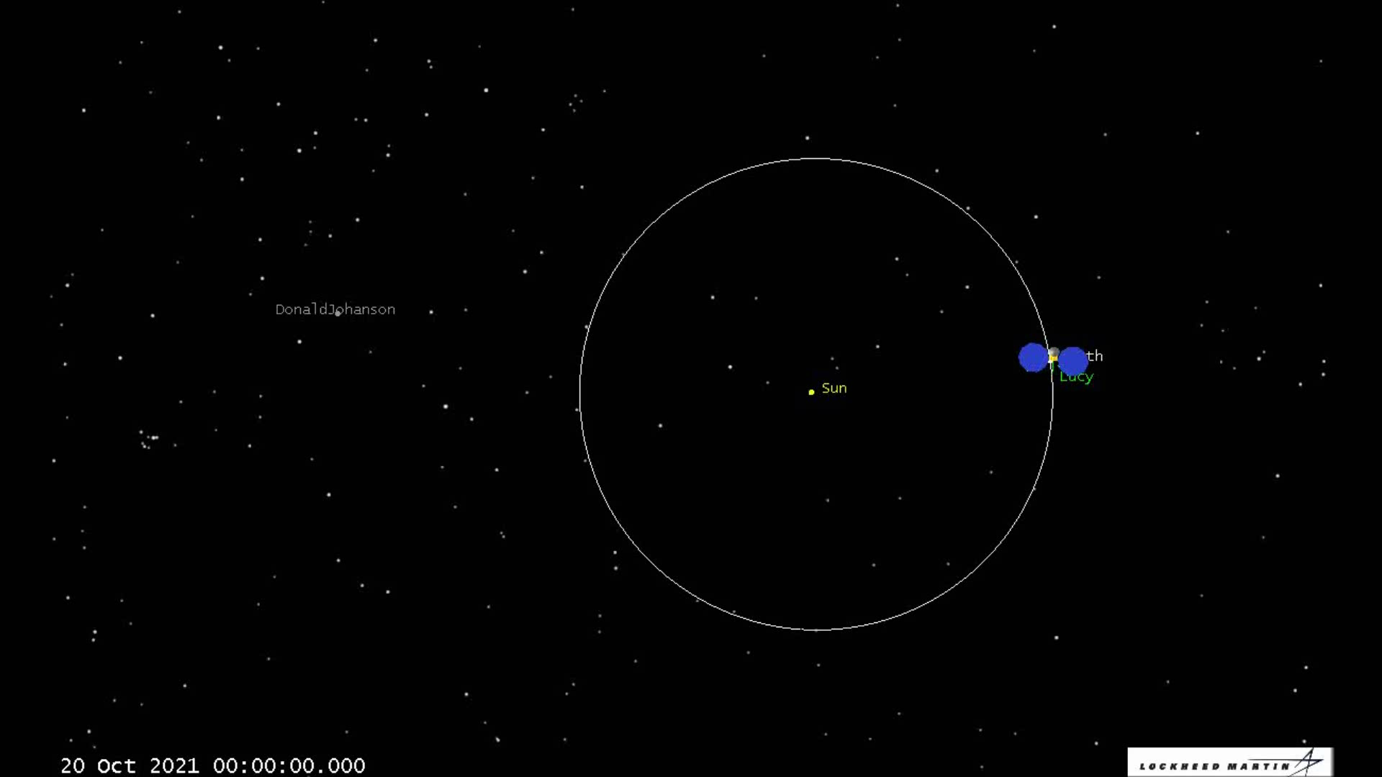
An Amazing Trajectory
We have found a trajectory that visits 6 Trojans and 1 Main Belt Asteroid.
Lucy’s unique trajectory is the key aspect of the mission
Notes:
Walk through the Lucy trajectory in a Frame rotating with Jupiter with sun/jupiter line fixed

Slide 4
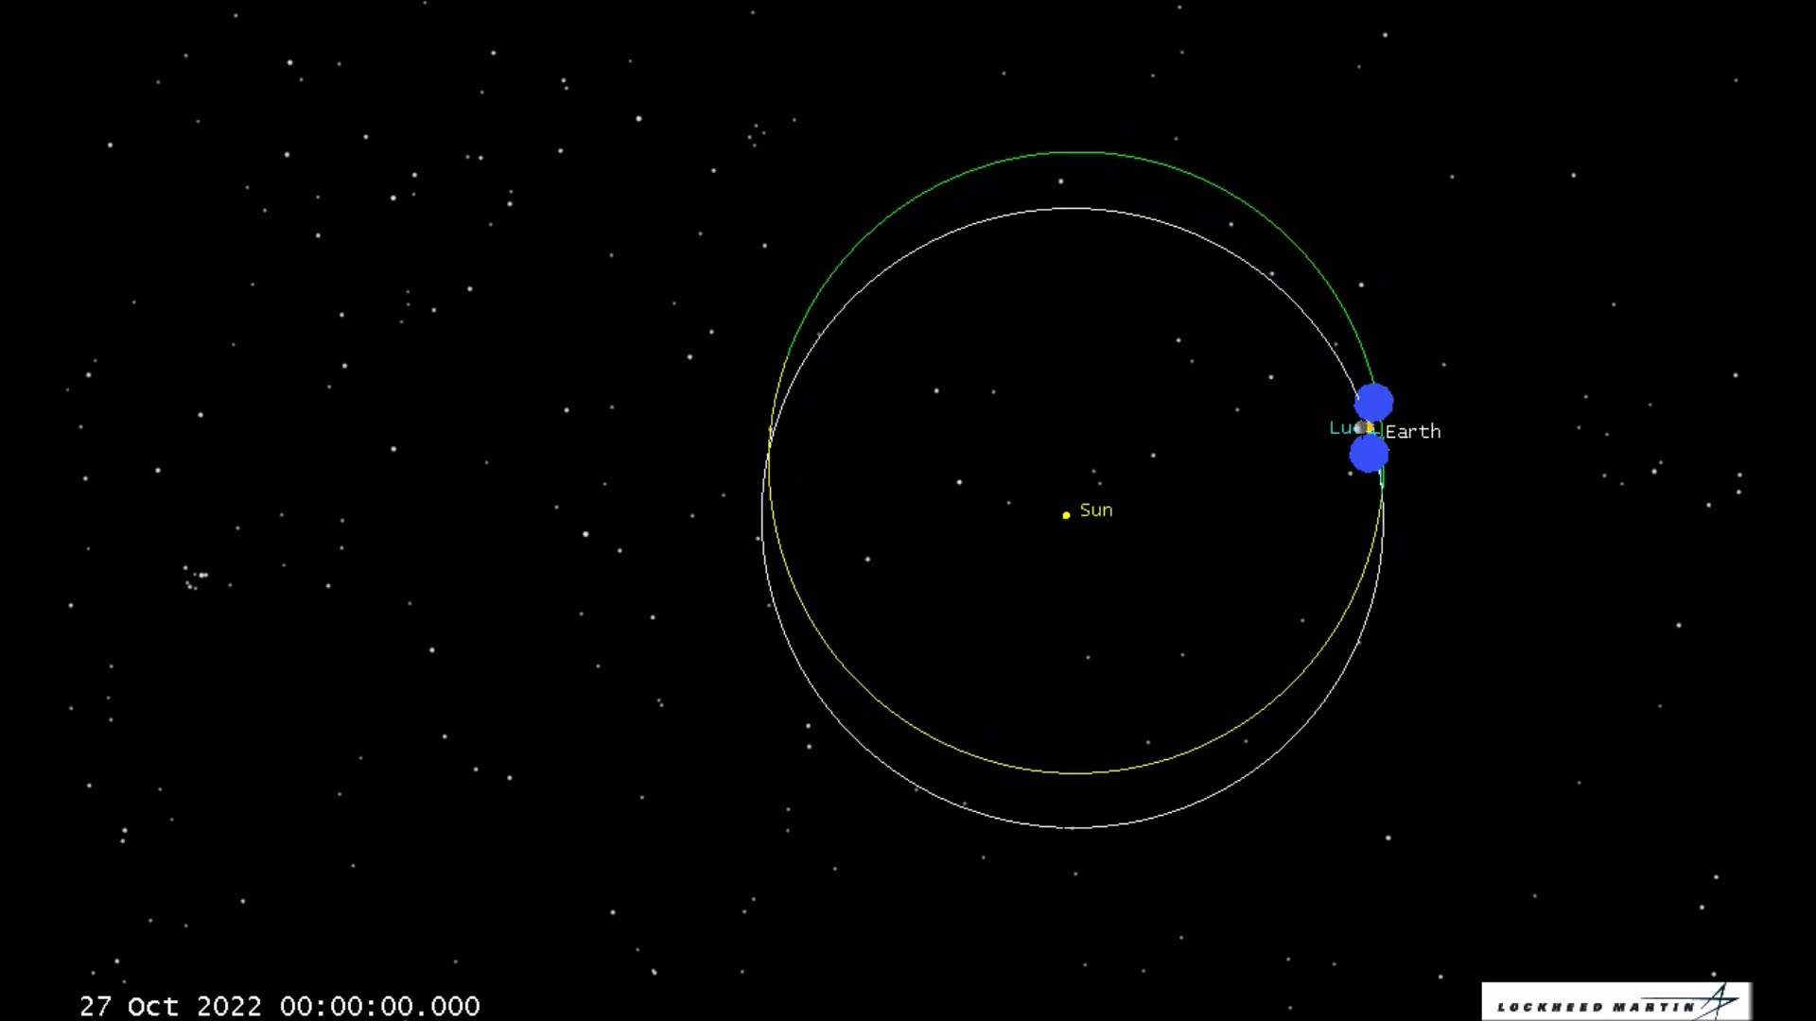
An Amazing Trajectory
We have found a trajectory that visits 6 Trojans and 1 Main Belt Asteroid.
Lucy’s unique trajectory is the key aspect of the mission
Notes:
Walk through the Lucy trajectory in a Frame rotating with Jupiter with sun/jupiter line fixed

Slide 5
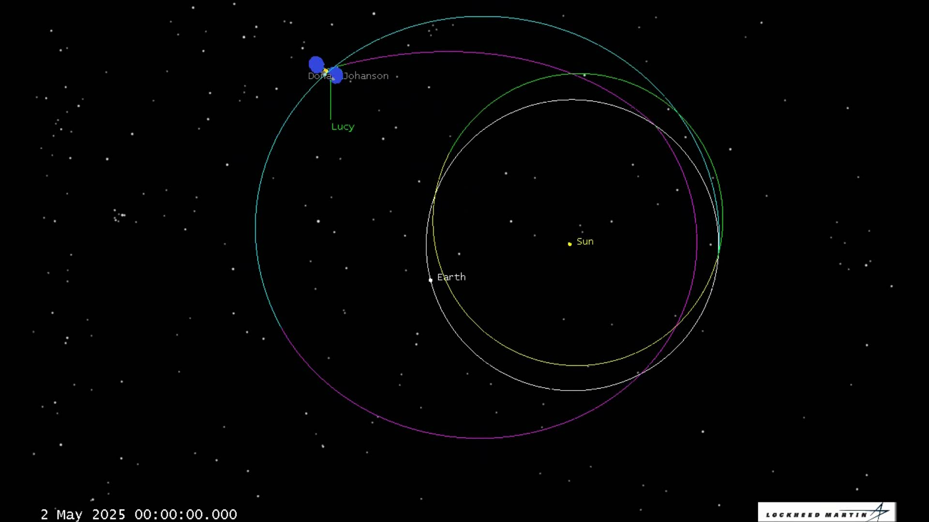
An Amazing Trajectory
We have found a trajectory that visits 6 Trojans and 1 Main Belt Asteroid.
Lucy’s unique trajectory is the key aspect of the mission
Notes:
Walk through the Lucy trajectory in a Frame rotating with Jupiter with sun/jupiter line fixed

Slide 6
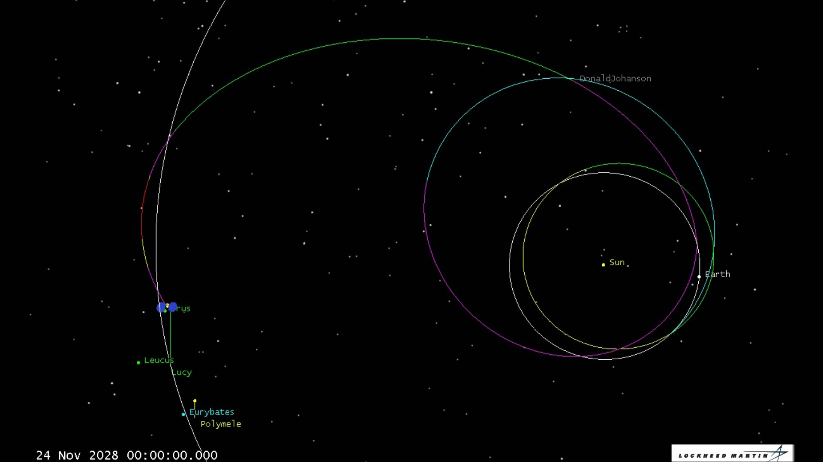
An Amazing Trajectory
We have found a trajectory that visits 6 Trojans and 1 Main Belt Asteroid.
Lucy’s unique trajectory is the key aspect of the mission
Notes:
Walk through the Lucy trajectory in a Frame rotating with Jupiter with sun/jupiter line fixed

Slide 7
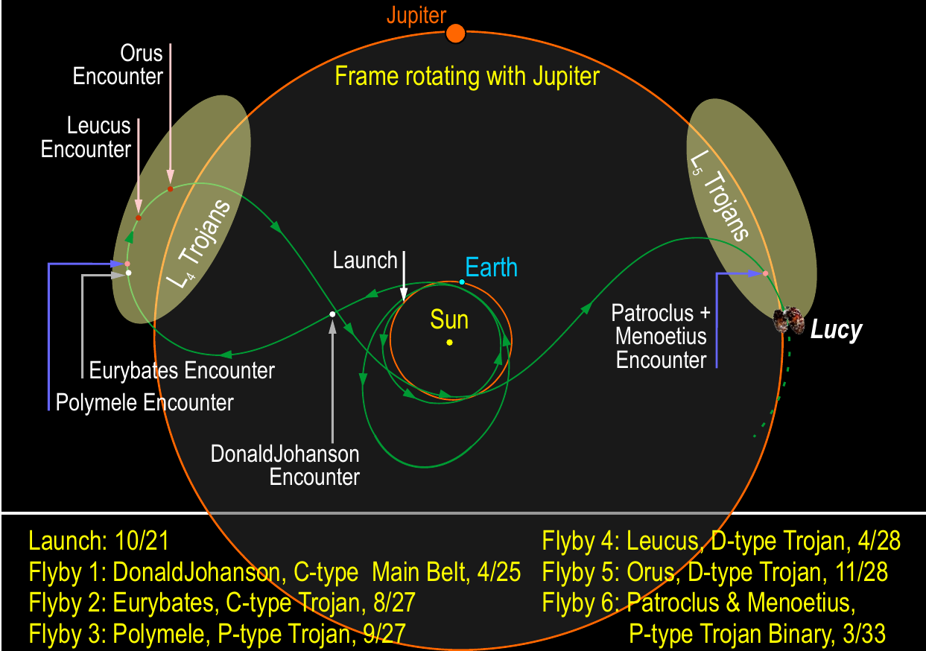
Lucy Overview
Planetary mission: Schedule is king!

Slide 8
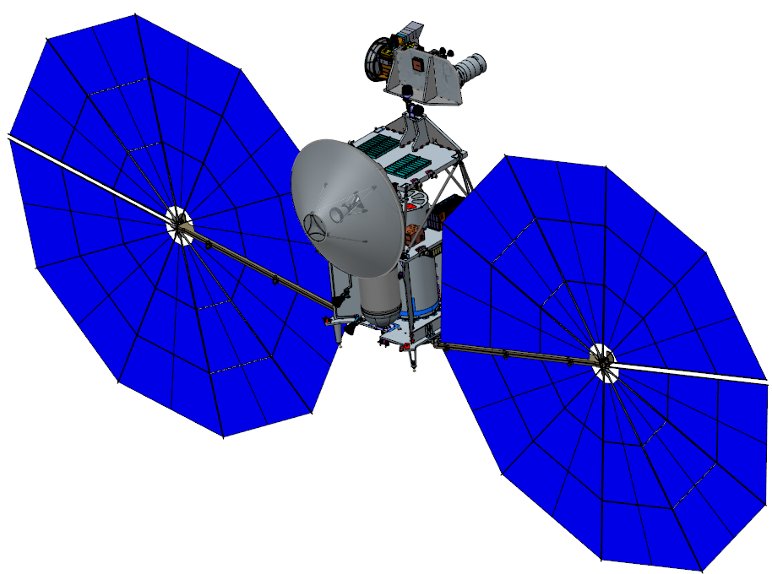
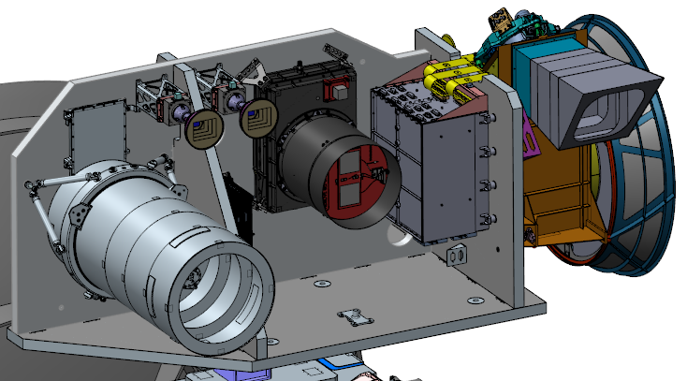
Payload and Spacecraft
L’LORRI
LOng Range Reconnaissance Imager (LORRI)
High spatial resolution visible imager
Heritage: NH
TTCam
Terminal Tracking Camera (TTCam)
Visible imager used for target centroiding
Supplier: Malin Space Systems
Radio Science
SC Telecommunications link with DSN provides Doppler measurements which enable mass density determination of each trojan
SDST Heritage: MAVEN/OREx/InSight
L’Ralph
Multi-spectral Visible Imaging Camera (MVIC)
Linear Etalon Imaging Spectral Array (LEISA)
Color visible imager (MVIC) and
infrared imaging spectrometer (LEISA)
Heritage: NH, O’REX
L’TES
Thermal Emission Spectrometer (TES)
Point FTIR spectrometer
Heritage: O’REX, MGS
Notes:
3 instruments accommodated on IPP, instruments coaligned for target viewing
IPP has 2 ranges of motion on a gimbal (pitch yaw, horiz, vert direction) 2 dOF to handle PM binary and keep the instruments pointed at the target based on ephemeris updates and performs surface motion compensation.
SC in deployed position, RF system is used for science – mass densities of the Trojans can be determined on the ground using DSN Doppler data as part of the radioscience.
TTCam used for terminal tracking near closest approach to do autonomous fine pointing as Lucy acquires the trojan targets, need TTCam to take out residual navigation delivery error

Slide 9

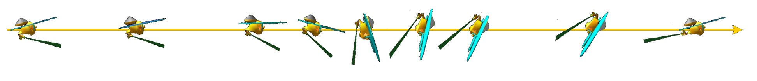
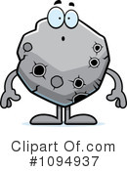
Encounters
Sun
Spacecraft tracks the target Trojan and IPP handles precision pointing
  SC target tracks in a nadir pointed attitude
  IPP surface tracks and precision points
Y
X
Z
Shows relative
motion during a
”feet-first” encounter.
Trojan

Slide 10
L’Ralph Overview (Summary)
Instrument Description | L’Ralph combines a VIS/NIR multispectral and panchromatic imager (MVIC) with a SWIR spectral mapper (LEISA).
Instrument Mass | 29.4 kg CBE (21% margin)
Instrument Power | 24.3 W CBE (19% margin)
Field of View | 145 mrad x 56 mrad
Scan Angle | 140 mrad
MVIC IFOV | 29 μrad
LEISA IFOV | 80 μrad
LEISA Wavelength | 0.95-3.95 μm
MVIC Wavelength Bands | Band 1: Panchromatic (370-905) Band 2: 375-480 nm Band 3: 480-520 nm Band 4: 520-625 nm Band 5: 625-750 nm Band 6: 750-900 nm
Calibration | Solar Cal, Filament and Black Body
Surface FOV
TDA
Scan
Mirror
Mechanism
(SMM)
Scan
Fold
M1
M2
M3
Detector
Fold
MVIC
Detector
Data
MVIC
Detector
Dichroic
Color Filter
MVIC
Detector
Data
Main
Electronics
Box
(MEB)
FPE-VIS
LEISA
Detector
Data
LVF
LEISA Detector
FPE-IR

Slide 11
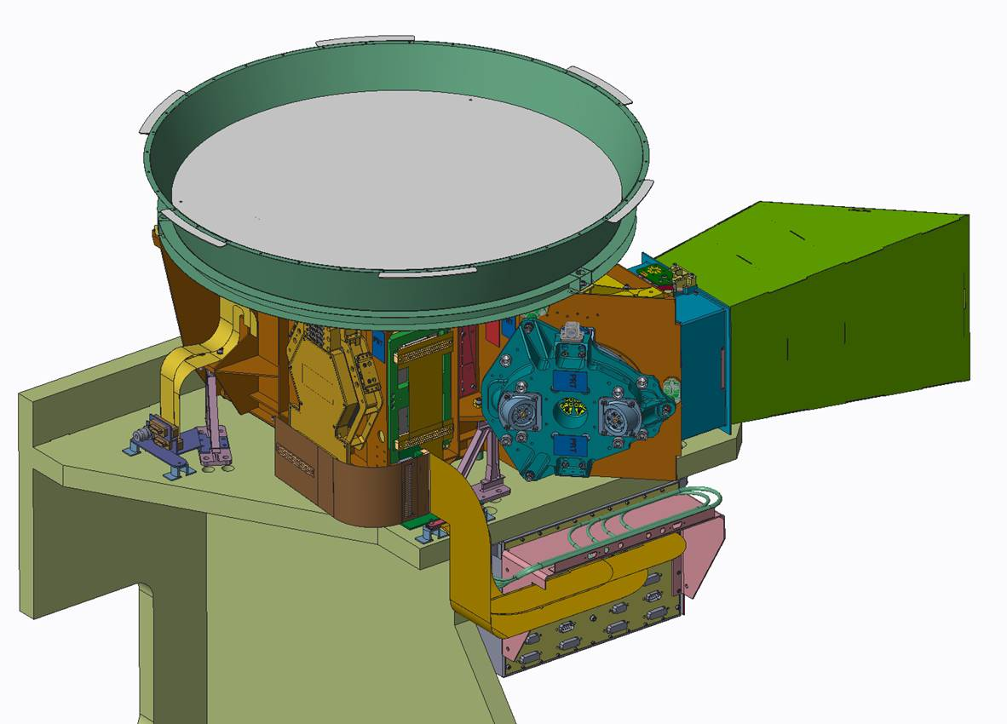
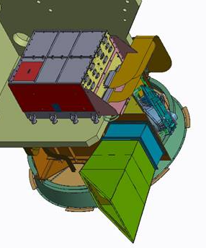
L’Ralph Physical Design

Slide 12
L’Ralph Driving Requirements
ID | Requirement | Drives
LR-INST-12 | The L'Ralph instrument shall scan the FOV along-track with a range >=140 mRad. These angles are the optical angle; mirror angles are 1/2x the values given. | Scan mirror, scan mirror sensors
LR-INST-09 | The L'Ralph instrument shall provide a LEISA ensquared energy specified in Table 1 over the wavelength range from 1.0 to 3.4 um. | Optical design, alignment, stability, scan accuracy
LR-INST-10 | The L'Ralph instrument shall provide a MVIC ensquared energy specified in Table 2 over the wavelength range from 0.40 to 0.90 um. | Optical design, alignment, stability, scan accuracy
LR-INST-20 | The L'Ralph LEISA shall have an SNR > 25 for spectral features with FWHM of 0.07 um in the range 1.0-3.4 um given an input source of the black body spectrum and the allowed time for scans. | Optical through-put, QE, electrical noise, TDA temperature
LR-INST-28 | The L'Ralph MVIC shall have an SNR > 25 in each color channel given an input source of the black body spectrum and the allowed time for scans. | Optical through-put, QE, electrical noise
See Features
Dark Target

Slide 13
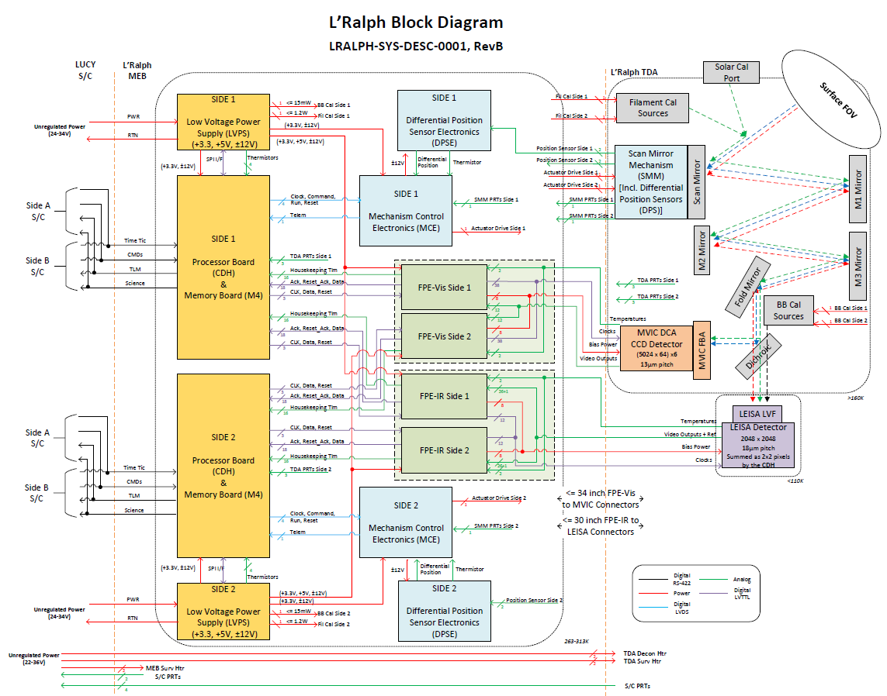
Block Diagram

Slide 14
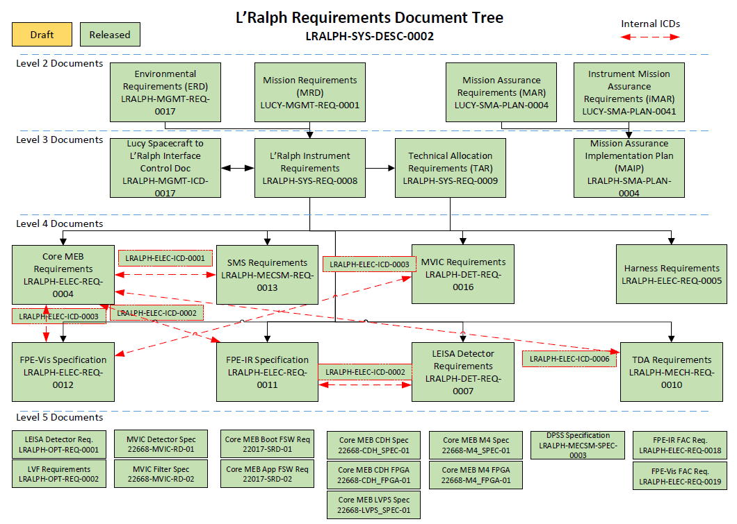
Requirement Status

Slide 15
L’Ralph Field of View
Band 6
Band 5
Band 4
Band 3
Band 2
Band 1
Shown to scale.
Not to scale. Locations are approximate.
Scan Direction
LVF3
2.57-3.95um
LVF2
1.541-2.605um
LVF1
0.952-1.615um
LEISA
Band Definitions
Band 6: Panchromatic
Band 1: 0.375-0.480um
Band 2: 0.480-0.520um
Band 3: 0.520-0.625um
Band 4: 0.625-0.750um
Band 5: 0.750-0.900um
Cross-Track
Along-Track
MVIC

Slide 16
State Diagram
Htrs On/Off
Any state can go to OFF through unannounced removal of power
OFF
DECON
Power On
BOOT
Boot complete
STANDBY
Completed
Command
MVIC Cal
MVIC Sci
LEISA Sci
LEISA Cal

Slide 17
MVIC Data Flow
Raw Image Data
Position Data
FPE-Vis
MCE
C&DH
Buffer
Buffer
Pan and color
EDAC
M4
Read Request
FPGA Command Processing
Read Request
EDAC
Spacecraft
Positions
Images

Slide 18
LEISA Data Flow
Raw Image Data
Position Data
FPE-IR
MCE
C&DH
Buffer
Buffer
FPGA Subtraction
CDS Image Data
EDAC
M4
Read Request
FPGA Command Processing
Read Request
EDAC
Spacecraft
Positions
FPGA Super-Pixeling
Images

Slide 19
LEISA Processing
H2RG channels arranged horizontally
<= 23 of the 32 channels read out by FPE
M4 stores image and reset frames
C&DH subtracts reset from image to get 512x1472p CDS frame
(Correlated Double Sampling)
FPE reads 512x1472p reset frame (start of integration)
FPE reads 512x1472p image frame
(end of integration)
Raw
Processed or CDS
Mode
H2RG Rows
M4 stores CDS frame
H2RG Columns
Read Request from Spacecraft
No
C&DH eliminates dead pixels per map
Yes
Bad Pixel Map?
Processed
C&DH bins pixels into 2x2 super-pixels to get 256x736p reduced frame
Mode
CDS
C&DH transmits CDS frame
C&DH transmits Processed frame

Slide 20
Lucy Org Chart
SCIENCE
Project Scientist (Noll/GSFC)
Deputy PS (Marchi/SwRI)
Principal investigator
PI (Levison/SwRI)
Deputy PI (Olkin/SwRI)
Management Advisory Group
(Burch/SwRI), (Scolese/GSFC), (Callahan/LM)
Communication and Public Engagement (Kretke/SwRI)
Project Management
PM (Donnelly/GSFC)
DPM (Douglas-Bradshaw/GSFC)
DPM/R (Elliott/GSFC)
Payload DPM (Andrews/SwRI)
Procurement
Aqueche, Moore/GSFC
Office of Communications
(Neal-Jones/GSFC)
Systems Engineering (GSFC)
PSE (Thompson)
Deputy PSE (Sekerak)
SC Systems Lead (Hageman)
Payload SE (Vincent/SwRI)
Contamination Ctrl (Lorentson)
Encounter SE (Starin)
Risk Manager (Tillard)
Con Ops (Wasiak)
Verification & Validation (Pevear)
S/W Systems Manager (Wilson)
Launch Vehicle (Carson)
Safety & Mission Assurance (GSFC)
CSO (Haskell)
EEE Parts (Williams)
Reliability (Knapp, Alimardani, Sindjui)
Materials (Mohammed)
Radiation (Casey)
Safety (Hill)
S/W QE (Whitelock)
H/W QE (Dimarco, Knight, Ott)
Project Office (GSFC)
Finance (Bradel, Crigger, Bond)
Project Support (Pszcolka, McCall)
Scheduling (Rogers, Hegarty)
EVM (Smith)
CM/DM (R. Berry, Prats)
FLIGHT DYNAMICS
FD Lead (K. Berry/GSFC)
Navigation (Stanbridge/KinetX)
Mission Design (Sutter/LM)
Optimization (Englander/GSFC)
Ground & Operations
GS&O Manager (Wasiak/GSFC)
SOC (Parker/SwRI)
MOC (Effertz/LM)
NOC (Hoffman/KinetX)
DSN (Monson/JPL)
Spacecraft
SC Manager (Jenkens/GSFC)
PM (Halbrook/LM)
Eng Mgr (Lipe/LM)
CSE (Altonen/LM)
Payloads
Launch Segment
LSM
(Carson/GSFC)
LSP/MIM
(Calero/KSC)
L’LORRI (APL)
IPI (Weaver)
DPI (Dello Russo)
IPM (Adams)
IS (Spencer/SwRI)
ISE (Wilson)
L’TES (ASU)
IPI (Christensen)
DPI / IS (Hamilton/SwRI)
IPM (Patel)
ISE (Mehall)
L’Ralph (GSFC)
IPI (Reuter)
DPI (Simon)
IPM (J. Simpson)
DIPM (Dolch)
IS (Howett/SwRI)
IS (Grundy/Lowell)
ISE (Garrison)

Slide 21
Payload Office and PLSE Role
Instrument | Payload | Mission or Spacecraft
Oversight
Risks
Risks
Oversight
L3 Requirements
L2 Requirements
ICD
Oversight
ICD
Requirements
Inst. Applicability
GOLD Rules
Inputs
GOLD Compliance
GOLD Compliance
Inputs
Payload Con Ops
Mission Con Ops
Resource Requests
Payload CCB
Resource Request
Resource Allocations
ICDs
Resource Allocations

Slide 22
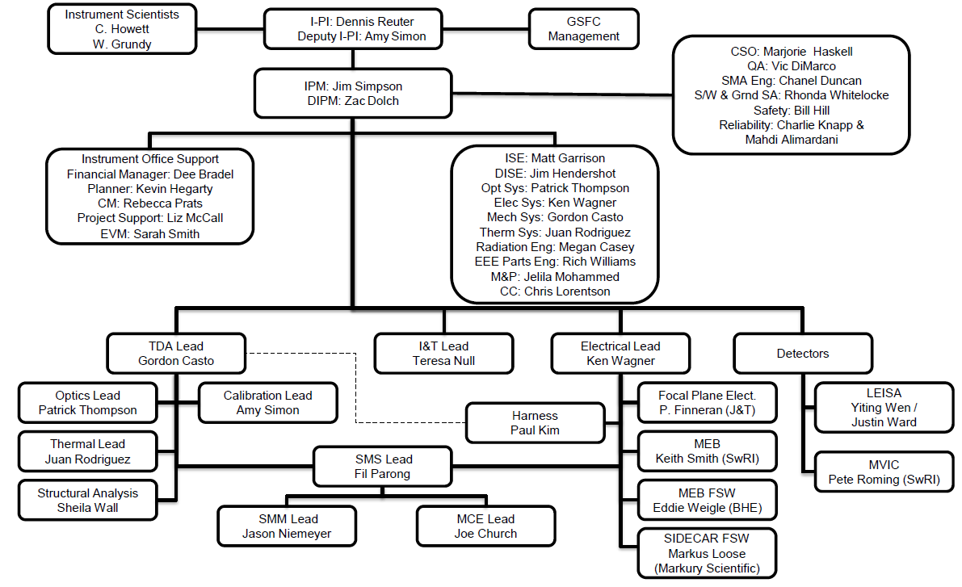
L’Ralph Org Chart
L’Ralph’s Org Chart shows clear lines of responsibility

Slide 23
Flexible Fault Management
Since we can never revisit a target…
…We want to make sure we don’t go into safehold during a critical time
  Instrument is tasked with identifying faults but not safing itself, just sending a “safe me” message to the spacecraft
  Depending on project risk posture and encounter timeline, the spacecraft may be configured to reset the instrument, switch sides, or do nothing
  Side-effect: we’ve had to add this fault management into our GSE since the instrument can’t safe itself

Slide 24
Memory Redundancy
Since we can never revisit a target…
…We want to make sure that science data isn’t lost or corrupted
  Instrument records science data on flash memory in the MEB
  Instrument sends a copy of that science data to the Spacecraft as soon as possible, but maintains the original copy until the group commands it to erase
  If an error in science data is found on the ground, science data can be replayed from spacecraft memory OR instrument memory
  Cross-strapping allows the spacecraft to access science data from either side of the instrument

Slide 25
Saving More Than We Need
Since we can never revisit a target…
…We can’t decide we want more data than we took
  Instrument records LEISA data in CDS format before super-pixeling
  Super-pixeled data is sent to the spacecraft and ground
  Un-summed data is maintained in instrument memory in case the ground later requests higher-resolution data
  Instrument records all 6 MVIC bands for all observations
  Only the desired bands are sent to the spacecraft and ground
  All bands are maintained in instrument memory in case the ground later requests the others

Slide 26
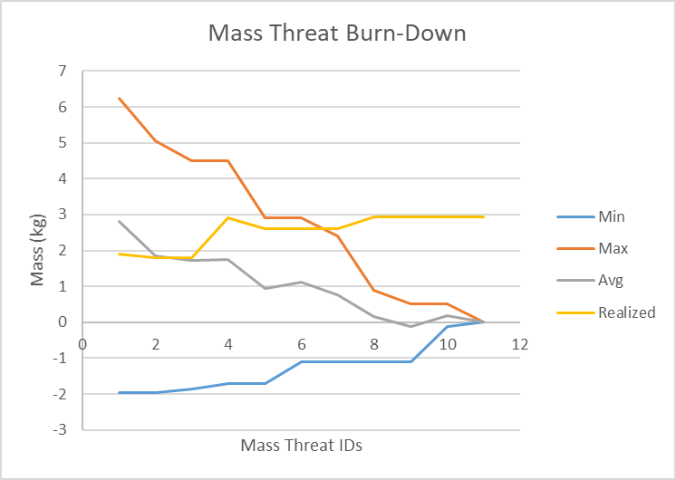
Mass Threat Burn-Down
Since we launch on an interplanetary trajectory…
…Mass has to be tightly managed
Mass threats/opportunities were tracked from SRR through December 2018 (when the final mass threat was retired)
  Initial estimates ranged from -2kg to +6kg, with a probability-weighted average of 2.8kg MEV
  Final realized mass change was 2.9kg MEV

Slide 27
Ralph Technical Reporting
Mission
PI
Mission
PI
TDMS
Same hallway
Mission Systems
Mission Systems
Payload Systems
PIMS
Payload Systems
Same hallway
1700 miles Away
Sharepoint
DOORS
TDMS
Ralph Systems
Same group lead
Ralph Systems
Spacecraft Systems
1620 miles Away
Former same group lead
Core MEB
SE
PIMS
Core MEB
SE
Confluence
FSW
Lead

Slide 28
Different Info in Different Homes
Confluence
FSW requirements
FSW design details
DOORS
L3 requirements
L3 verification
Sharepoint
Rec/Del List
Pointing information
Spacecraft tech info
Badge + PIN + 2xPassword
Badge + PIN + Password
Password
TDMS
L3, L4 requirements
Typically-CM’ed stuff (plans, procs, reports, analyses, etc)
Risks
Password
Auto
Ralph Systems
2x RSA Token + 2x Password
Password
PIMS
SwRI RFAs
SwRI CM
Payload change requests
Flight rules
Core MEB
SE
Auto
SwRI can’t access their own systems while VPN’ed into GSFC for TDMS

Slide 29
Project Change Process
Change Originates
CRB may:
Approve
Reject
Approve with adjustments
Proceed via PSE direction
PSE/CSE Vets Change Paperwork
Project Systems
Informal Change Paper Generated, Vetted with Systems Engineering working group
Word
PowerPoint
DOORS Output
DOORS Administrator inputs Proposed Change(s) in DOORS
From/To CCR generated via DOORS export, input to TDMS as Pre-LM SDT CCR
DOORS Administrator
Payload
CRB Reviews Change Request
Spacecraft
SDT to review CR (derived from the Lucy CCR) impacts and adjust other documentation or other impacts accordingly
ECB to review LM CR for approval
Responsible SC SE receives direction from CCR
CCR to drive new Revision in TDMS
Supports contract dates
Incorporates all approved From/To CCRs
Full document generated via DOORS export
CCR Approved in TDMS
CCB Approval
CCRs Collect and await next release per Contractually driven dates
Released when Approved
Update Requirements in DOORS based on CCR

Slide 30
Controlling Communication
Conscious effort to maintain lines of communication
  If the MSE and I work something out in the hallway, we typically call/email the payload systems engineer for his take on things
Lots of standing meetings:
  PDL one-on-ones, Payload to L’Ralph tagup, Payload weekly, SC ICD working group, SEWG, SDT…
Technical reviews are faster if you email the files to non-GSFC teammates and they email their approval or comments back to the originator and CM
  Faster response time but risk of multiple unofficial versions living in email
Continuing effort to improve our processes

Slide 31
Meetings and Communication
Meeting | Owner | Participants | Topics | Cadence
L’Ralph team meeting | IM | PDLs, SE team, PIs, IM | Status, concerns, announcements | 1/week
L’Ralph Technical Topics | ISE | PDLs, SE team, PIs | Announced special topics | 2/week
Risk Board Meeting | IM | SE team, PIs, IMs | Risks, issues | 2/month
MEL Control Board | ISE | PDLs, SE team, PIs, IM | Mass and Power MEV increases | 1/month
PDL 1-on-1s | IM | PDL, ISEs, IMs | Status, concerns | 2/month/PDL
Payload/L’Ralph Weekly | Payload Manager | Payload, ISEs, IMs, PIs | Status, concerns, CRs | 1/week
Payload Weekly | Payload SE | Payload, ISEs, IMs, PIs, other instruments | Cross-payload topics | 1/week
Spacecraft ICD Working Group | ISE | Payload SE, ISEs, SC SE | Spacecraft ICD special topics | 2/month
Communication is regular and efficient

Slide 32
Tech Topics
No standing systems team meeting outside of weekly L’Ralph team meeting
Tech topic meeting structure
  2x a week
  Whole team is invited
  At least a day ahead of time, a topic is announced and the invitation list is pared down to only the required people
Example topics are:
  Future plans (ETU MEB to EM detector interface test planning)
  Work problems (FPE power growth and possible design solutions)
  Close trades (SC thermal harness design decision)

Slide 33
Concerns Process
Concerns process is used to capture any concerns that could impact operations, performance, requirements verification, or the availability of hardware.
Captures items that can’t be solved in a single discussion; some concerns have a long horizon based on the planned availability or need date of information.
Example concerns:
  Questions tabled until later (Need to determine if GSE mounting plate for TVac needs active cooling)
  Problems being worked (MVIC video signal characteristics and optimized gains)
  Pre-risks (Imported jitter from spacecraft might be too high for mechanism)
Concerns, status, and closure are logged on a SharePoint Action Item site that is accessible by anyone within the GSFC firewall
New, near-term, or actively-worked concerns are statused at the L’Ralph team weekly and the weekly report
Closed concerns remain accessible as a record of outcome

Slide 34
Polling for Process Improvement
After each major review, we’ve polled the whole team:
  What went well?
  What didn’t?
  What could we do to improve?
Answers were anonymously gathered and sent to ISE
Discussed with PI, dPI, IPM, dIPM
There is a professional group on center that will help do this for larger teams

Slide 35
After SRR
Weekly technical special topic meetings work well paired with statuses from the weekly team meeting
A detailed scrub of the MEL right before SRR found significant missing mass. This should have been done sooner.
Communications with the spacecraft team through the payload office led to errors and miscommunications. Set up a bi-weekly spacecraft ICD discussion with spacecraft systems and payload systems.

Slide 36
After PDR
Systems participation in bi-weekly PDL one-on-one meetings were a good venue to understand progress and concerns
Systems concerns process helps organize cross-disciplinary and long-term problems
TDMS access for off-site PDLs has been difficult. For near-term reviews, have to email them the file and have them email response to CM
Some weekly status meetings are run without agendas or announced topics, aren’t very efficient
Discipline SEs (thermal, mechanical, electrical, optical, contam) need to be comfortable reaching out to the PDLs; PDLs need to seek them out for discipline-specific guidance
PDLs spend a lot of their day on programmatic planning and statusing; IPM and dIPM streamlined process with PDL one-on-one meetings

Slide 37
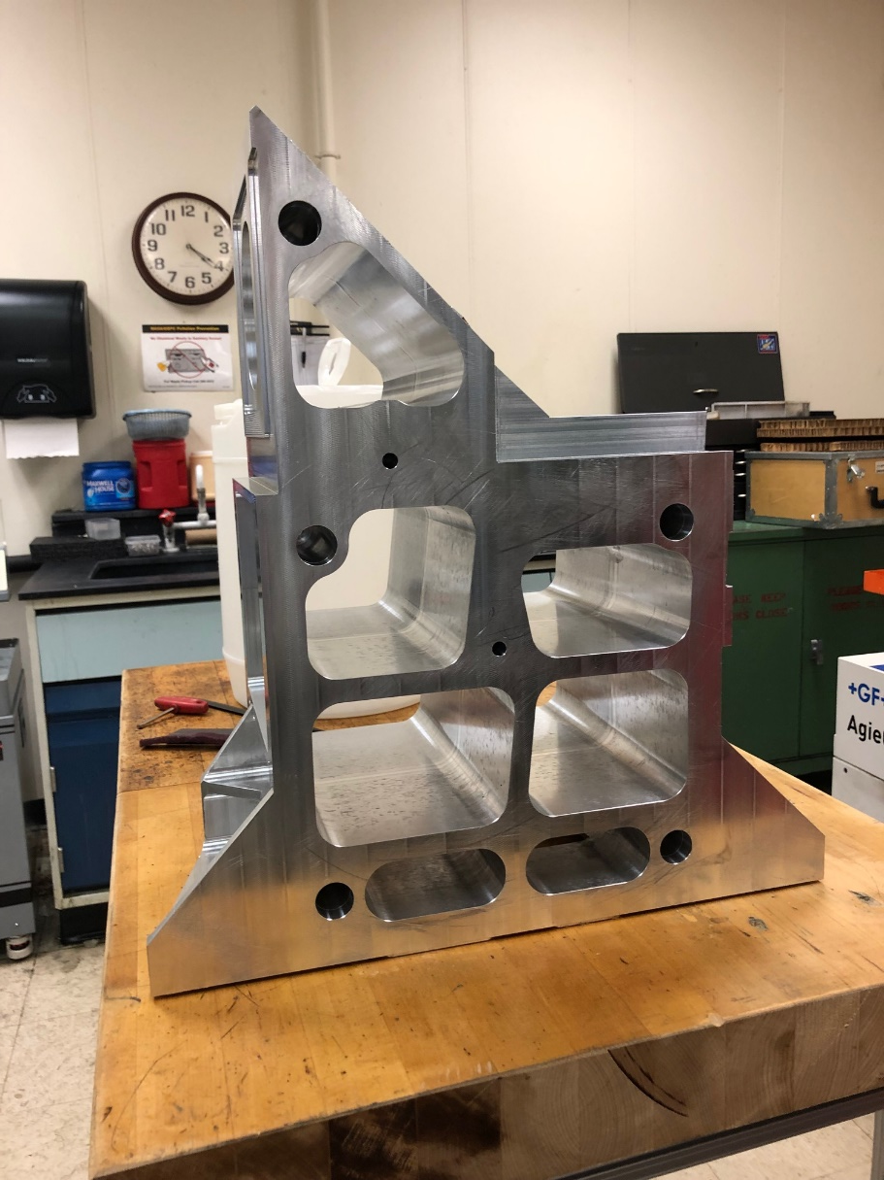
Conclusion
Lucy is a cool mission to the Trojans enabled by a twice-in-a-lifetime trajectory
L’Ralph is a critical, multi-purpose science instrument
The mission architecture has driven specific features into the instrument design
The project organization has forced us to be more strategic in planning communications
L’Ralph is starting to build flight hardware

