Slide 1
NASA IceCube: CubeSat Prototyping of a 883-GHz Radiometer for Cloud Ice Mapping
Jaime Esper*, Dong Wu, Jeffrey Piepmeier, Negar Ehsan, Kevin Horgan, Brian Abresch, Brooks Flaherty, Chris Purdy, Ted Daisey, Scott Heatwole, John Hudeck, Juan Rodriguez, Robert Stancil, Alexander Coleman, Thomas Johnson
NASA Goddard Space Flight Center
Greenbelt, MD 20771 USA
NASA Goddard Space Flight Center, Systems Engineering Seminar Presentation
Tuesday, November 12, 2019
* IceCube Mission Systems Designer and Technical Project Manager

Slide 2
CubeSats are great prototyping vehicles. Given the right scope, they can even be great research and exploration tools.
But they do not stand alone, small satellites (<500 kg), and micro-satellites (<100 kg) have had already decades to mature.

Slide 3
Abstract
On April 18 2017, NASA Goddard Space Flight Center’s IceCube 3U CubeSat was launched by an ATLAS V rocket from Cape Canaveral Air Force Station on board a Cygnus resupply spacecraft, as part of NASA’s CubeSat Launch Initiative. Onboard IceCube was an 883 GHz radiometer tuned to detecting ice content in clouds, marking the first time such frequency was used from low-Earth orbit. IceCube successfully demonstrated retrieval of ice water path, generating the first ever global cloud ice map at 883 GHz. The Nano-satellite marks the first official NASA Earth Science CubeSat technology demonstration mission, and was completed in about 2½ years starting April 2014 through launch provider delivery in December of 2016. The mission was jointly funded by NASA’s Earth Science Technology Office, after competitive selection, and by NASA’s Earth Science Directorate. IceCube re-entered Earth’s atmosphere on October 2018 and during its mission lifetime, provided a pathway to advancing the understanding of ice clouds and their role in climate models; quite a tall order for a tiny spacecraft.

Slide 4
Presentation Expectations and Outlook
In what follows, I will present the as-built system, the lessons learned during integration and test, what was learned during operations, and finally provide a preview of science results.
IceCube’s miniature instrument is expected to provide a pathway to advance the understanding of ice clouds and their role in climate models.

Slide 5

That Week at NASA
This Week @NASA – March 3, 2017

Slide 6
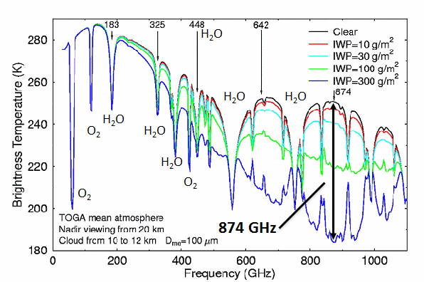
Motivation – Importance of Ice Clouds
Ice clouds play a key role in Earth’s climate system, primarily through regulating atmospheric radiation and interacting with dynamic, energetic, and precipitation processes.
Sub-millimeter wave remote sensing offers great depth of cloud penetration and volumetric sensitivity to cloud ice mass.
NASA’s ER-2 aircraft showed large brightness temperature depression centered at around 874 GHz, which can be used to retrieve vertically-integrated cloud ice water path (IWP) and ice particle size.
Cloud-induced radiance, proportional to IWP

Slide 7
IceCube Objectives
TRL 7 Definition: Detailed Design and Assembly Level Build
Raise the technology readiness of 873 GHz receiver technology for use in a future space flight mission (up to TRL 7).
  The project shall yield the first ever 873 GHz measurement of ice clouds from space.
  The project shall directly benefit sub millimeter-wave imaging radiometers on future Earth Science missions.
TRL 7 Hardware Description: Assemblies near or at planned operational system. TRL 7 is a significant step beyond TRL 6, requiring an actual prototype
demonstration in a space environment. The prototype should be near or at the scale of the planned operational system, and the demonstration must take place in space environments. Examples include testing the near flight-like assemblies in an environmentally realistic test bed.

Slide 8
Instrument Overview
Key performance parameters of the IceCube radiometer.
  A noise figure of 15 dB with a Noise Equivalent Differential Temperature (NEDT) of 0.15 K for a 1-second dwell time.
  The instrument is both externally and internally calibrated using views of deep space and an internal Intermediate Frequency (IF) noise source and reference state.
Category | Value
Frequency Band | 862-886 GHz with fc at 883 GHz
Input RF Channel | V Polarization
NEDT | 0.15 K
Calibration Sources | Noise Diode/Reference Load (internal)
IF Band | 6-12 GHz
IF Gain | 50-55 dB
A/D Sampling | 10 KHz
Integration Time | 1 second
Mass | ~ 1 kg
Power | ~ 6 Watts

Slide 9
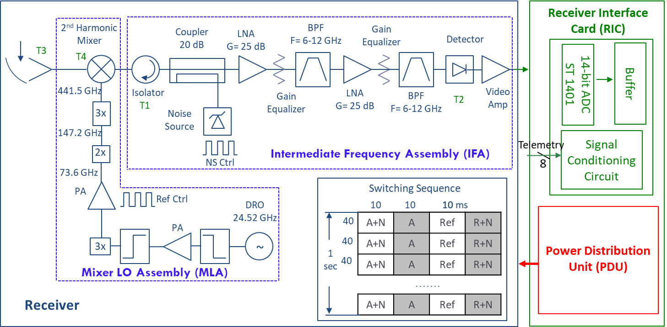
Instrument Components
The radiometer front-end is comprised of an 883 GHz mixer local oscillator (LO) assembly. Intermediate frequency (6-12 GHz) calibration by noise injection provides the means of discriminating the calibration state of front-end components, referenced to extended observations of space.
The RF input to the mixer is a GSFC-designed antenna, which is a straightforward ~ 2 cm offset-fed paraboloid yielding a 1.7-degree half-power beam-width.
There are also supporting circuit boards including the Receiver Interface Card, instrument Power Distribution Unit, and command and data handling (C&DH), which is shared with the spacecraft.
Mixer Local Oscillator Assembly (MLA)
Intermediate Frequency Assembly (IFA)
Receiver Interface Card (RIC)
Instrument Power Distribution (iPDU)
Courtesy of A. Pellerano (Code 563) and Daniel Lu (555)

Slide 10
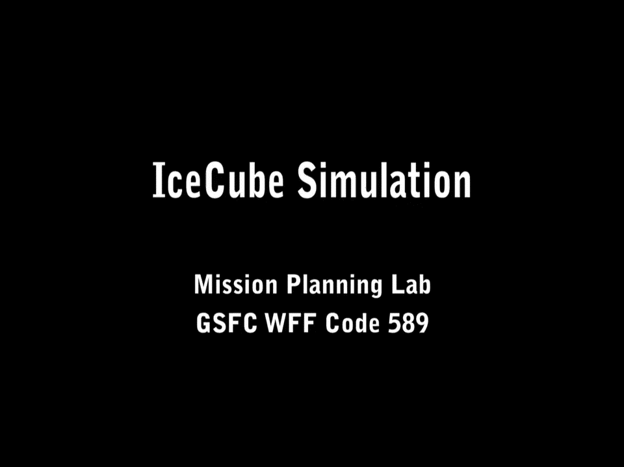
Instrument Operation and Calibration
Calibration of the radiometer is achieved by both internal electronic (in the IF stage) and external natural target means (space). The noise source coupled into the IF path is used to estimate IF section gain.
The calibration uncertainty is ~3K as measured from deep-space observations.
Mission requirements:
Required In-flight operation 28 days
  (operation 1 ½ year)
Periodical views of Earth (science) and space (calibration) within an orbit
Science data 30+% (8+h /day)
  Operated a minimum of 61%, or 15h per day at maximum eclipse times (low beta).
Pointing knowledge < 25 km
  (achieved ~ 31km)

Slide 11
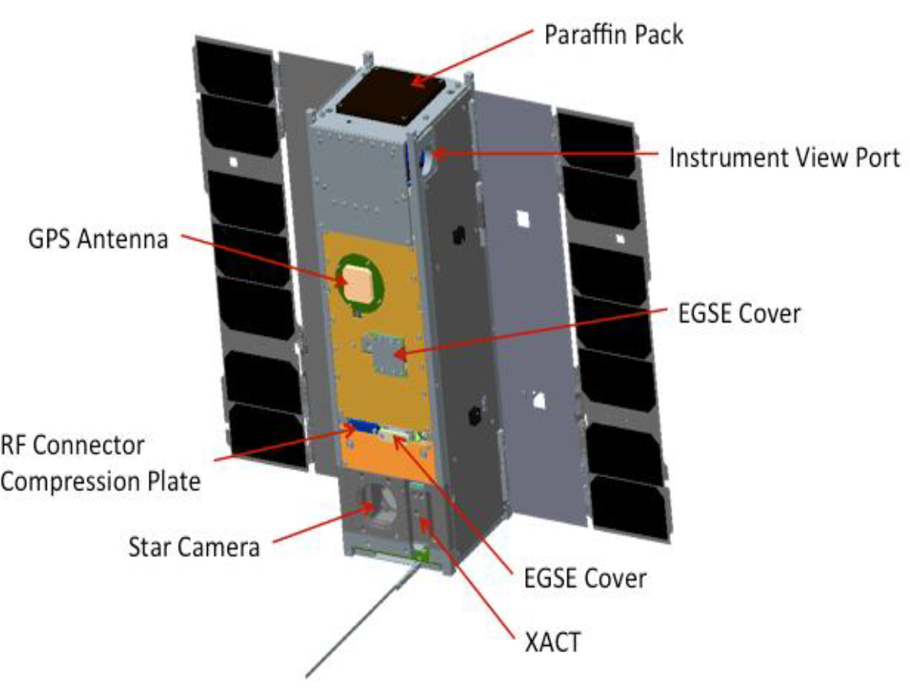
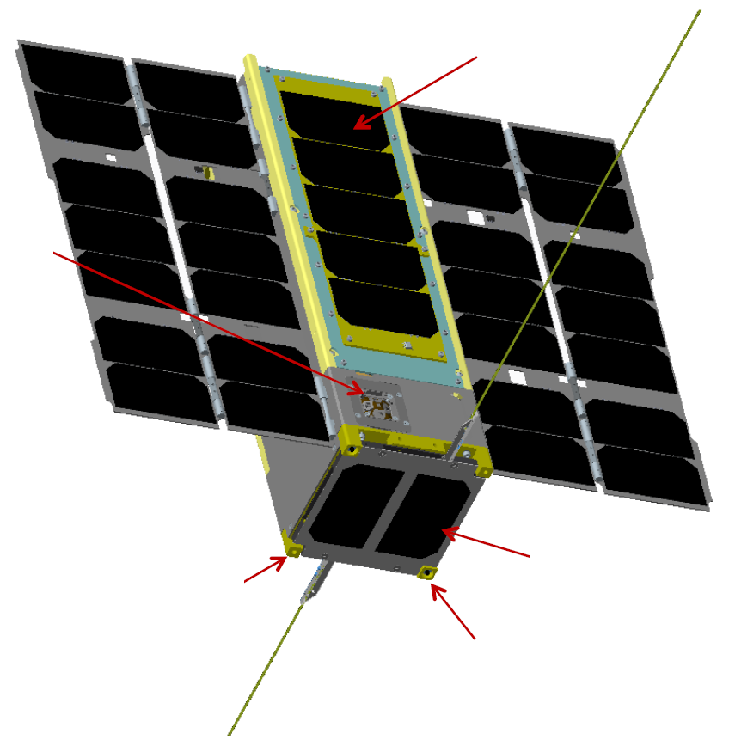
Spacecraft
Paraffin Pack
The instrument was accommodated in a 3U CubeSat, following the general volume and mass guidelines of the CubeSat specification standards
Ultimately requirements levied by the NanoRacks Dispenser used to deploy the vehicle from the International Space Station (ISS) were used. This allowed for slightly more mass (maximum 4.8 kg instead of 4.0 kg).
Instrument Aperture
GPS Antenna
EGSE Cover
RF Connector Compression Plate
Star Camera
EGSE Cover
Component | Mass (kg) | Volume (U)*
Payload | 0.8 | 1.3
Structure and Mechanisms | 0.9 | 1.7
RF Communications | 0.2
Electrical Power | 1.4
Guidance, Navigation, and Control | 0.9
Command and Data Handling | 0.2
Thermal Control | 0.1
Total | 4.5 | 3
* 1U = 10x10x10 cm Cube
2U Solar Panel
ACS Unit
Coarse Sun Sensor Pyramid
Spring Plunger (x2)
1U Solar Panel
Deployment Switch (x2)

Slide 12
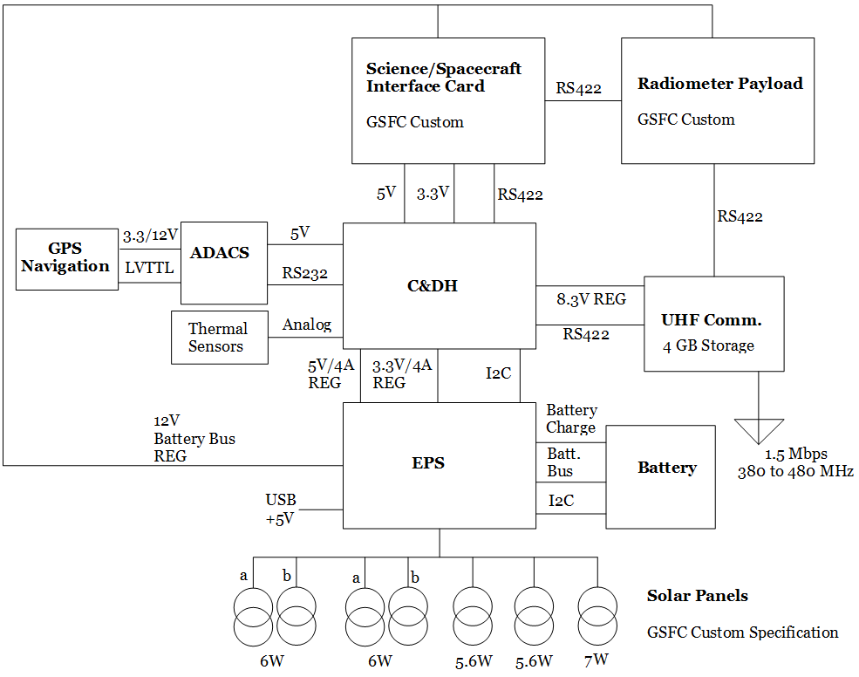
Design Approach
The original idea was to use Commercial-Off-The-Shelf (COTS) components with proven flight heritage
  but that proposition was not quite as valid once electrical incompatibilities were discovered, even within components provided by the same vendor.
Only one bus system card was to be custom manufactured at GSFC, and was necessary to provide data interface to the instrument and other bus components.

Slide 13
Practical Cautions
Following is a more detailed description of each spacecraft subsystem, with an emphasis on highlighting issues discovered during their respective Integration and Test (I&T).
With this the authors hope to convey some of the pitfalls inherent to components intended for general use, i.e., “COTS”, that may or may not meet specific safety, reliability, or interface requirements.
Care should be exercised in ensuring all documentation is provided prior to purchase, and that it is clearly written so as to avoid any miss-understandings during I&T and operations.
With NASA testing practices in mind, care should also be exercised not to “over-test” a component that is intended for single or limited use (more on that later).
Finally, any known modification expected of a COTS component immediately renders such component inoperable as a true “COTS” part, and both schedule and budget should be planned accordingly.

Slide 14
Experience Highlights

Slide 15
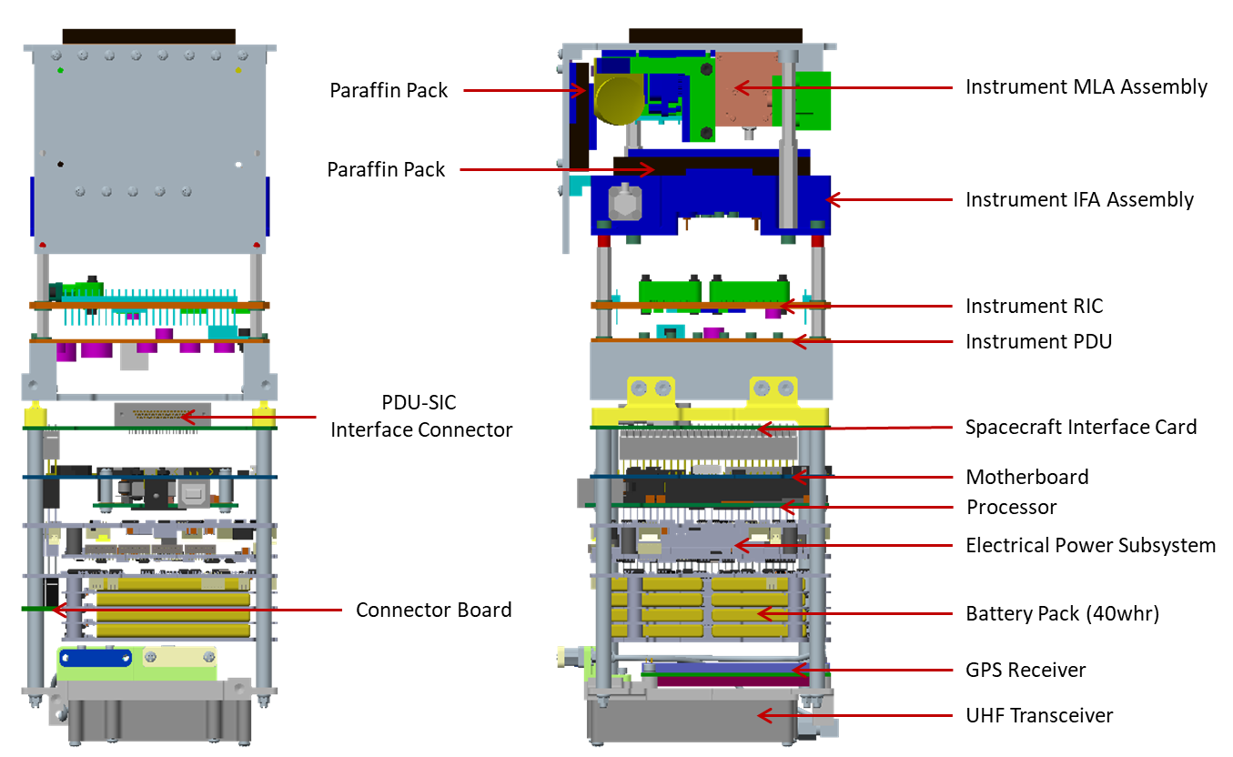
Structure and Mechanisms
The primary structure of the spacecraft is comprised of custom machined aluminum walls, cross plates, and closeout panels.
The bus electronics stack uses a threaded rod and spacer combination to tie the various printed circuit boards together.
Interface brackets are used to join the science payload to the spacecraft bus.
Mechanisms include two double deployable solar arrays, a deployable Ultra-High Frequency (UHF) antenna with two elements, and roller-type mechanical power-inhibit deployment switches.

Slide 16
Power Inhibit Switches
Post vibration, one of the three separation power switches failed and required replacement.
In hindsight, IceCube roller-type mechanical separation switches should have all undergone workmanship (vibration) testing prior to integration into the spacecraft due to their inherent unreliability and criticality: any one (out of three) switch failures could have prevented the spacecraft from powering-up resulting in mission failure.
Alternative approaches to the ISS (or launch vehicle) 3-inhibit requirement using mechanical switches should be considered a high-priority in the CubeSat community. At the very least, use of sealed switches is a must to prevent debris or external contaminants from entering and jamming the mechanism.

Slide 17
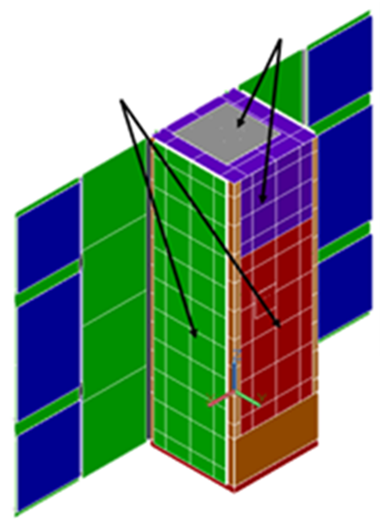
Thermal Design
Passive thermal control (except for battery heaters).
The design implements the use of phase change material (PCM) in order to dampen the transient temperature response.
Implementation was a relatively significant cost driver for a Cubesat project, but it did help dampen the temperature response.
Instrument operated between 16°C and 29°C.
MLA/IFA Radiators
Spacecraft Radiators
Courtesy of M. Solly (Code 562)

Slide 18
Electrical Power Subsystem (EPS)
The IceCube power subsystem consisted of two 3U double deployable solar arrays and a 2U body-mounted array for power generation.
A 40Wh battery was used during eclipse operations (only 15 Wh. required).
The solar panels yielded 30 W at BOL.
The lowest battery voltage during night-time science operation (instrument on) iswas ~ 7.7V, corresponding to a 35% depth of discharge.
Subsystem | Component | Power (W)
Instrument | Power distribution, Interface Card, Instrument | 6
GNC/C&DH | GPS | 1.2
 | LNA | 0.1
 | ADACS | 3.3
 | Processor Board | 0.1
RF Comm. | Transmitter | 12.0
 | Receiver | 0.04
 | Antenna | 0.02
Power | EPS | 0.4
 | Battery Board | 0.1
Thermal | Battery Heater | 0.8
Total |  | 24.0

Slide 19
EPS Notes
Long-lead purchases must be held-off until the interfaces and operation are well understood. However, existing public documentation is vague enough that becomes insufficient in determining electrical compatibility until the units are in-hand. Catch-22? Vendors should improve their documentation.
There was a need to update the COTS component to make it compatible with ISS safety standards. This caused project delays.
The EPS had to be modified to be compatible with the same vendor solar panel deployment circuitry: individual switch current capability was insufficient for dual-wing deployments. Switch current limits had to be increased to allow for redundancy.
Limited funding meant that Engineering Test Units (ETU) were not always available, which fed into delayed discovery of interface and compatibility problems. This risk is hard to overcome in resource-strapped projects.

Slide 20
Solar Panels
Required new design, and a change from COTS solar panels.
  Attitude control and science operations favored CubeSat “square-facing” arrays (as opposed to edge-deployed).
Schedule and cost impact was relatively significant.
Burn wire failure taught some lessons on single-use circuits.
Re-wire to allow for redundant deployment saved the mission.
Specified (left) and As-Built Solar Panels (right)

Slide 21
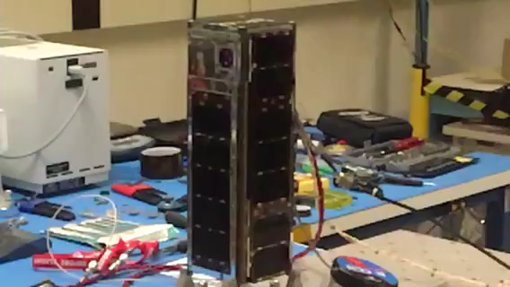
Burn-Wire Failure
Test, test, test?

Slide 22
Attitude Determination and Control
The IceCube GNC system consisted of a XACT Attitude Determination and Control Subsystem (ADCS), and a Novatel OEM615 GPS receiver for position and velocity determination.
Occasional noise in GPS data resulted in an invalid XACT orbit ephemeris causing the orbit propagator to lock-up. A software fix was not possible due to flight software constraints. This did not impact the technology validation.
The solar panels were held within 5º of the Sun, and the spacecraft spun about the sun line at 1º/s.
Geolocation was determined to be about 31 km on the ground.

Slide 23
Flight Software
The flight software implemented the following three distinct spacecraft modes:
  Deployment Mode (DM): has a built-in 30 minute delay (per ISS requirements) before appendages are commanded to deploy, and the transceiver is switched on.
  Safe Hold Mode (SHM): Spacecraft subsystems are powered on, while the instrument is off. The ACS is commanded to Sun Point Mode, and the transmitter is commanded to broadcast an autonomous status message every 3 minutes (beacon) during the day.
  Science Mode (SM): The Instrument is powered on. The ACS is in Fine Reference Mode.

Slide 24
Communications System
The IceCube communications system was a bi-directional UHF link consisting of a COTS half-duplex radio and deployable dipole antenna on the spacecraft, coupled with an 18m parabolic dish and a Software Defined Radio (SDR) located at NASA’s Wallops Flight Facility (WFF).
Due to National Telecommunications and Information Administration (NTIA) regulations, the spacecraft Effective Isotropic Radiated Power (EIRP) is limited to 1W, which provided marginal link budget at low elevation angles.
The effective downlink data bit rate achieved was ~412 Kbps (maximum ~ 1 Mbps).

Slide 25
System Integration and Test
IceCube system-level integration and test required a careful balance between available resources, and the clear desire to identify mission-ending problems. There were several key decisions, repairs, and replacements that in the end ensured mission success. These were:
  Re-wiring of the spacecraft harness to allow the use of redundant solar panel deployment switches, and the accompanying increase in switch current capacity.
  Replacement of failed solar panel burn-wire resistors, and insistence in leaving one circuit pristine. Only electrical continuity was tested. This saved the mission as it was the redundant circuit that deployed the panels.
  Replacement of failed flight battery board component with ETU. The ETU was flight-qualified to NASA ISS safety standards in a matter of days after the problem with the flight unit was discovered.
  Re-wiring of triple-redundant inhibit switch connection to ground, which was the suspect in battery board component failure.
  Replacement of failed mechanical deployment switch, and workmanship qualification (vibration) of replacement unit (also carried out in a matter of days).
  Updating of flight software to include a daytime-only operation, ability to update instrument operating thermal thresholds during flight, and ability to verify validity of decision-point sensors, with ground-override capability if necessary.

Slide 26
Solar panel deployment during TVAC test
Leading into TVAC testing, it was decided that only the primary circuit would be used during panel deployment tests, and the redundant circuit (and resistors) were to be left pristine, and only verified through electrical continuity prior to panel integration.
The actuation time was reduced to 10 seconds after burn-wire failures during I&T. This duration proved insufficient once it came time to deploy the panels in the chamber (cold deployment) as one of the solar array wings failed to open.
A test was devised to energize the circuit for as long as it took to deploy the additional wing. Results showed actuation after about 15 seconds.
The flight software was then adjusted to command actuation for as long as 30 seconds on orbit.

Slide 27
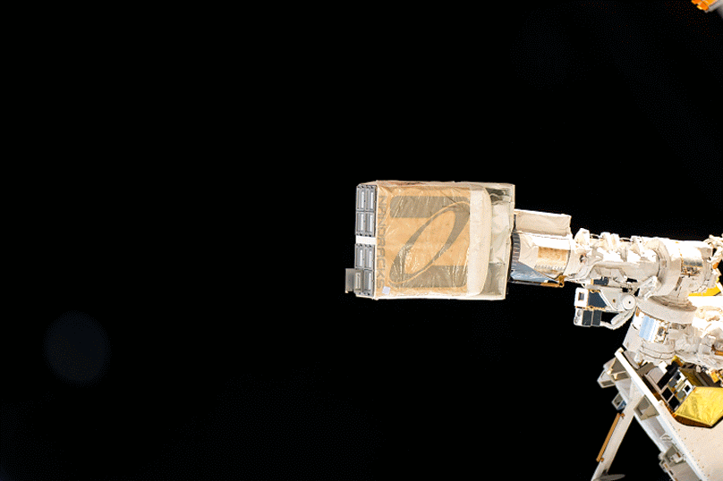
ISS Deployment and Commissioning
NASA CubeSat Launch Initiative (CSLI)
International Space Station (ISS)
  ~410km altitude, 51.6° inclination near-circular orbit
  β angle variation: 0-75°
CubeSat Launcher
  NanoRacks CubeSat Deployer

Slide 28
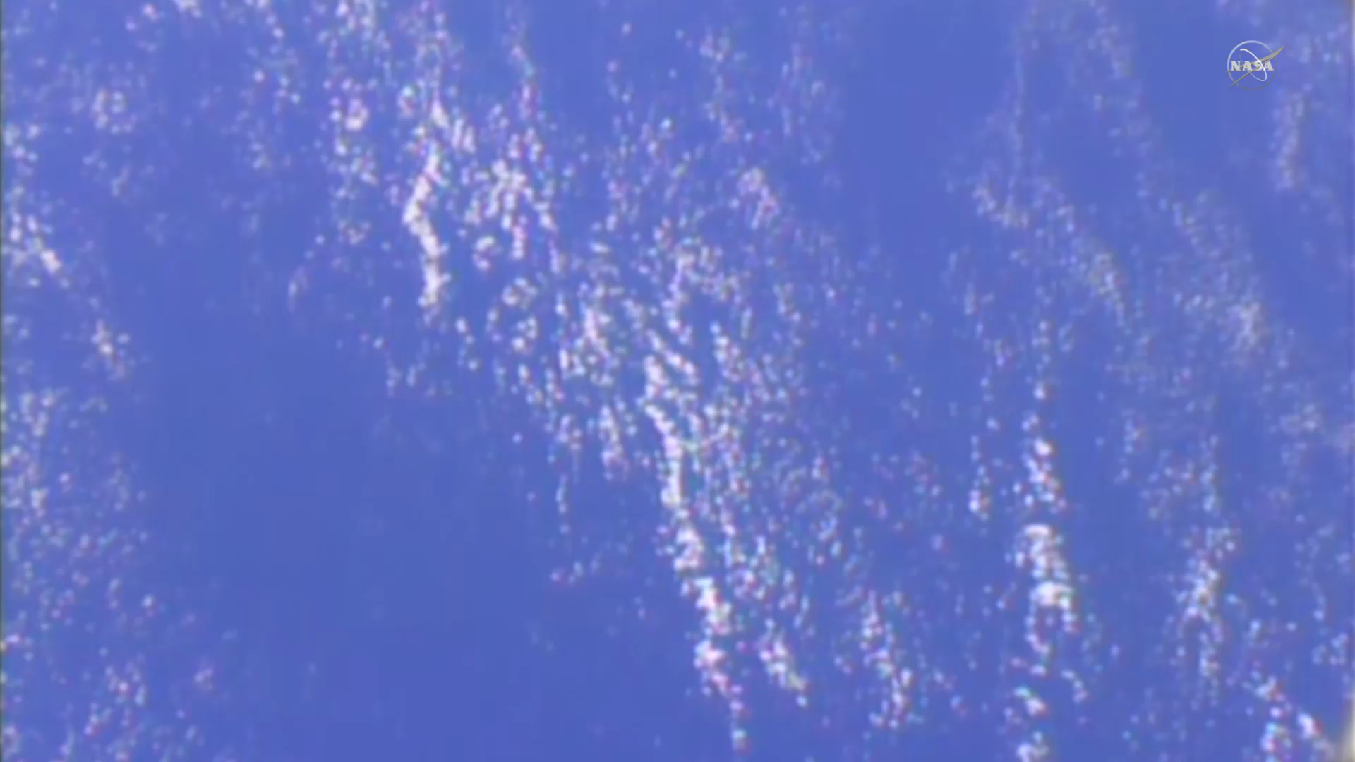
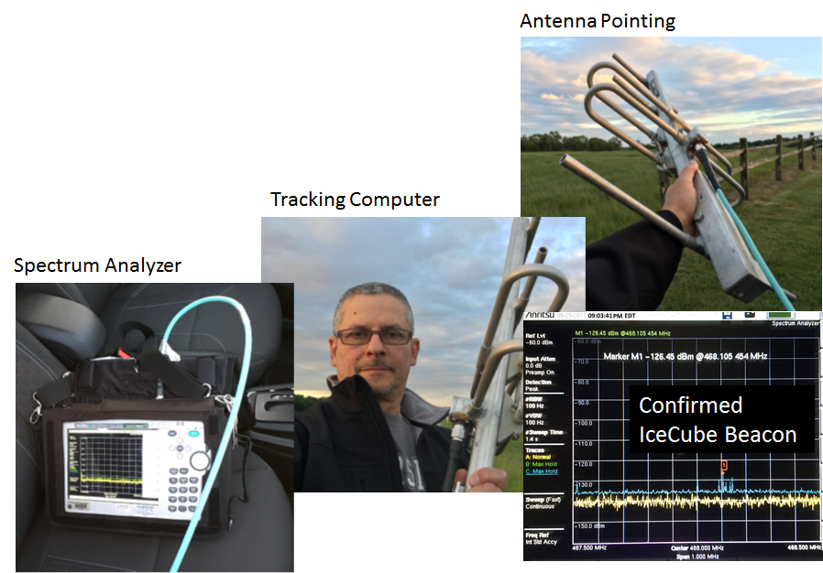
Find and search again
Multiple spacecraft launches at the same time can complicate their orbit determination (NORAD TLE).
Narrow (3-degree) 18m ground antenna beam width required precise orbit knowledge.

Slide 29
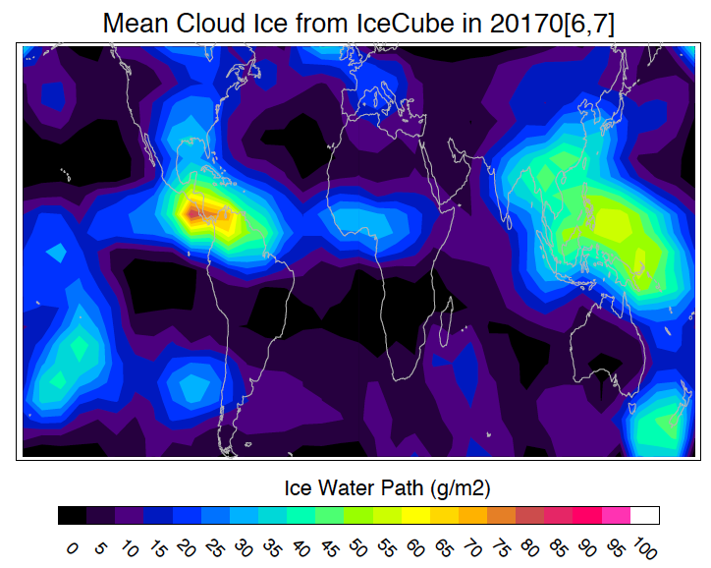
Conclusion
IceCube was NASA’s Science Mission Directorate (SMD) first Earth science-related CubeSat mission.
It completed its technology validation, and continued to provide technical and science data well beyond its design life.
It not only retired risks associated with development of larger, more expensive instruments, but also continued to demonstrate the utility of Cubesats as technology precursors.
First ever global cloud ice map at 883 GHz

Slide 30
Acknowledgments
NASA ESTO, SMD and CSLI supports
IceCube Team
PI | Wu, Dong (GSFC)
Deputy-PI | Piepmeier, Jeffrey (GSFC)
Tech Manager | Esper, Jaime (GSFC)
Mission Sys Engr. | Mast, William (WFF)
Mgt. Support | Johnson, Tom (WFF)
Instrument (Greenbelt, MD)
Inst. Scientist | Racette, Paul
Inst. Lead | Ehsan, Negar
Antenna Engr. | Du Toit, Neils
Integration | Horgan, Kevin
IF subassembly | Lucey, Jared
Power | Pellerano, Armi
Power | Ortiz-Acosta, Melyane
Mechanical Engr. | Solly, Michael
Parts Support | Fetter, Lula (Lu)
DSP Engr. | Wong, Mark (Englin)
Inst Video Amp/RIC | Lu, Daniel
RF Engr. | Hersey, Ken
Thermal Analysis | Choi, Michael
CubeSat, Ground System, Op (WFF, VA)
Power Systems | Purdy, Christopher
Power Systems | Corbin, Brian
Software/Avionics | Daisey, Ted
Software/Avionics | Lewis, Christopher
Mechanical/Thermal | Hudeck, John
Mechanical/Thermal | Smith, Sally
GN&C | Heatwole, Scott
874-GHz Receiver (Virginia Diode, Inc)
Tech POC | Hesler, Jeff
LO Drive Module Design | Bryerton, Eric
Integration and Testing | Retzloff, Steven
CAD and Mechanical | Neff, Chuck

