Slide 1
TIRS-2 instrument lessons learned through I&T
Laurie Mann
Synthia Tonn

Slide 2
Agenda
Overview of TIRS-2 instrument
Lessons learned during instrument I&T
  Example #1: Harness Risk Assessment/HRB
  Example #2: SSM LOI
TIRS-2 and observatory I&T

Slide 3
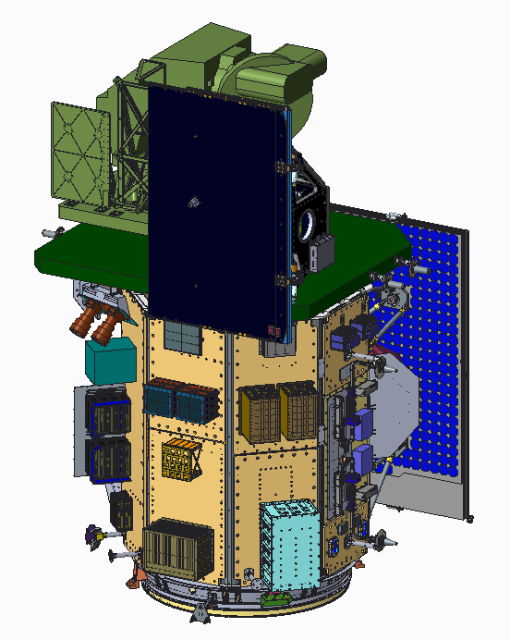
TIRS-2 Project Overview
TIRS-2 will fly on LandSat 9
  16 day re-visit cycle (So 8 days revisit when combined with TIRS on L8)
  Current plan is that L7 will be decommissioned after L9 launch
TIRS-2 will produce radiometrically calibrated, geo-located thermal image data
  TIRS-2 operates in concert with, but independent of, the Operational Land Imager (OLI-2)
  Final scene data generated as part of the Data Processing and Archive Segment at the United States Geological Survey/ Earth Resources Observation and Science (EROS) facility in Sioux Falls, South Dakota
USGS responsible for operational code
  TIRS-2 will deliver algorithms and parameters necessary to evaluate data and produce required outputs
  No changes expected from process used for TIRS on Landsat 8
TIRS-2 image data will have the same performance characteristics as that of TIRS on Landsat 8
  Except better
TIRS-2 Sensor Unit (ES stowed for launch)
FIB
CCE-A &B
MEB-A &B
Velocity
+X
+Z
L9 S/C
Nadir
+Y

Slide 4
TIRS-2 Instrument Overview
Instrument Characteristics
  2 channel (10.6-11.2 um and 11.5-12.5 um) thermal imaging instrument
  Quantum Well Infrared Photodetector (QWIP) detector/FPA
    Second flight use of GSFC developed QWIPs (First was TIRS)
  100 m Ground Sample Distance
  185 km ground swath (15º field of view)
  Operating cadence: 70 frames per second
  Precision scene select mirror (SSM) to select between nadir view, onboard variable temperature blackbody and space view
    Repeatability better than 10 microradians
  Passively cooled telescope assembly operating at ~190K (nominal)
  Actively cooled (BATC cryocooler) FPA operating at ~38 K
  Thermal stability key to radiometric stability
  (NEΔT < 0.4 K @ 300 K (required), NEΔT < 0.1 K @ 300 K (expected))
Notes:
4

Slide 5
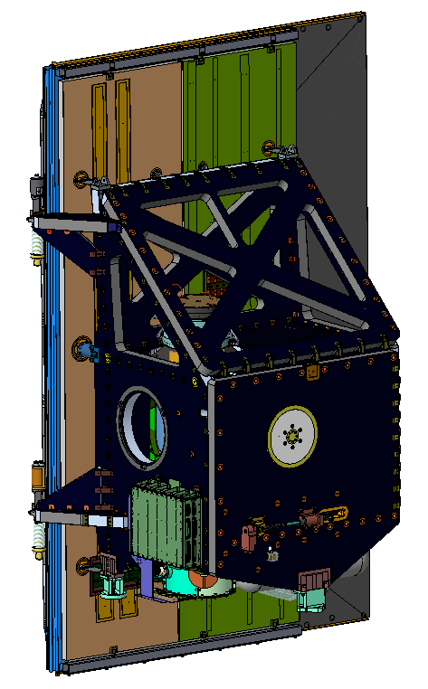
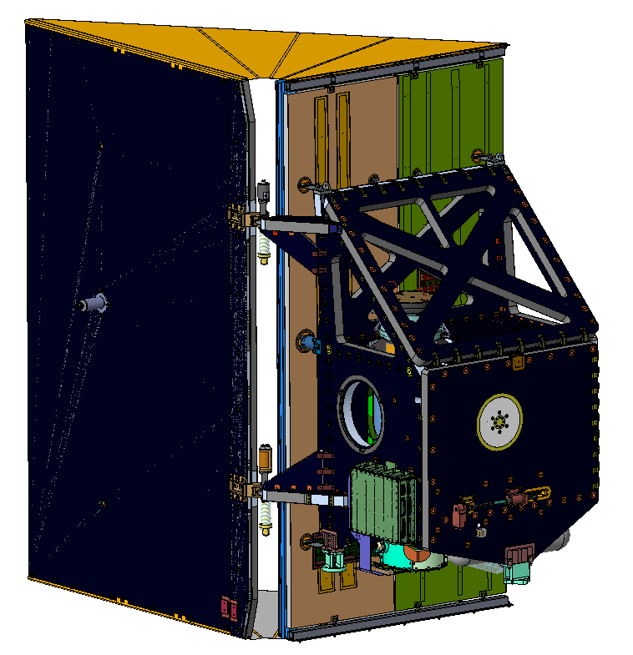
TIRS-2 Sensor Unit Design Overview
TIRS-2 Stowed
TIRS-2 Deployed
Radiator
Flexures
Earth Shield Wing
Telescope
Radiator
Earth Shield
Cryocooler
Radiator
Structure
Earth Shield
Deployment
Hinges
Black Body
Nadir
View
Structure Feet
(I/F to S/C)
Earth View Port
Cryocooler
Launch Lock System
Focal Plane
Electronics (FPE)
Notes:
-update with new wing bracket

Slide 6
TIRS-2 System Block Diagram
TIRS-1

Slide 7
TIRS-2 Development Background
TIRS-2 leverages the TIRS design, but is not a build to print re-build
  Improved accuracy through reduced stray light effects
  Increased redundancy of electronics and critical thermal functions
  Increased robustness of the system to survive environments
  Risk reduction for imaging performance and integration schedule
  Address encoder reliability
Tests to date have validated the changes to the system design
  TIRS-2 is built and tested with the protoflight strategy
Major Review Timeline
  L9 MCR: June, 2016
  TIRS-2 PDR: June, 2016
  TIRS-2 CDR: Feb, 2017
  L9 MPDR: Sept, 2017
  L9 MCDR: April, 2018
  TIRS-2 PER: Aug, 2018
  TIRS-2 PSR: Aug, 2019
  L9 SIR: March 3rd-5th , 2020
  Upcoming L9 PER (date TBD)

Slide 8
Verification Strategy – Top Level Flow
MEB Test Bed
Elec Sys Test Bed
Test Bed EMI/EMC
SSM Test Bed
Structure Coupons
TIRS-2 Imaging Performance Cryoshell Evaluation (TIPCE)
(Performed in Thermal Vacuum)
Subsystem Level Tests
(Protoflight)
Telescope Stray Light
Measurement
Cryoshell Isolation Performance
Risk Mitigation Tests
Component / Box Level Testing
Telescope – Detector Focus
Performance
Environments
PER
TRR
TRR
TRR
TRR
Instrument
Level Tests
(Protoflight)
Ambient Checkouts
Thermal Vacuum 1
Vibration / Acoustics
(Sensor Unit)
Thermal Vacuum 2
EMI/EMC
Performance
Calibration
Thermal Cycle
Thermal Balance
Self Compatibility
Performance
Calibration
Thermal Cycle
Thermal Balance
Self Compatibility
Ambient Checkouts
EMI/EMC
Vibration / Acoustics
Thermal Vacuum
Observatory
Level Tests
Performance relative to internal sources
Self Compatibility
TRRs are held before each test to ensure environmental test plans and procedures have been clearly documented and all liens and actions have been dispositioned

Slide 9
Instrument Powered Test Flow
TIRS-2 test program was constrained such that instrument performance could only be measured in TVAC with a cold detector
The instrument environmental test flow was designed to accommodate TIRS-2 test constraints by bookending vibration testing with the baseline and final thermal vacuum test on each end.
  Typical 4-cycle Instrument TVAC was divided into 2 cycles before Vibe and 2 cycles after
15 LPTs were performed over the course of the environmental test program (7 ambient and 8 in TVAC)
  ** Added LPT to the original plan (pre-dynamics) to verify numerous reworked harness
Dry Run
LPT
PER
Move to
EMI
Baseline
LPT
CCLL & ESDS Deployment
(Full Instrument)
Perform
EMI
Move to
TVAC
Pre-TVAC-1
LPT
8/1/18 –
8/24/18
10/23/18 –
10/24/18
10/29/18
2/5/19 –
2/6/19
TVAC-1
CCLL Deploy, ESDS Fuse plug
CPT on HQ1, CQ1, HQ2, CQ2
**Post-Harness-Rework LPT
Pre-Dynamics CCLL & ESDS Deployment
(SU Only)
Acoustics/Vibrations
Testing
(SU Only)
Post-TVAC-1
LPT
Move to
SCA
03/19/19 -
03/21/19
04/03/19
2/7/19 – 3/18/19
04/08/19 -
04/09/19
Post-Dynamics CCLL & ESDS Deployment
(SU Only)
Post-Dynamics-LPT
TVAC-2
CCLL Deploy, ESDS Fuse plug
CPT on HQ1, CQ1, HQ2, CQ2
Move to
TVAC
Pre-TVAC-2
LPT
Post-TVAC-2
LPT
05/14/19
05/28/19
5/24/19 – 7/1/19
07/12/19

Slide 10
Risk Mitigation / Testbed Testing
Subsystem / System | Hardware | Test Name | Timeframe | Risk Mitigation
Structure | Composite coupons | Coupon strength test | Prior to Insert Bonding | Validate allowables used in the analysis to assess the design relative to the structural loads before structure strength test
Telescope | Flight Spare | Ambient stray light measurements | Complete | Validate baffle design and stray light analysis results
Cryocooler | Dev. CCE TMU ETU | Development CCE functional test with Bench Cooler and TMU ETU | Complete | Electronics design validation Control algorithm validation (including back EMF control)
 | CCE, RSE EM TMU ETU | CCE and RSE EM functional test with TMU ETU | Complete | Electronics design and control algorithm validation
SSM | Testbed MCE Encoder EM | MCE Testbed functional test to control Motor and with Encoder EM | Complete | Electrical interface validation Functional test
 | TB, FLT MCE SSM Testbed | MCE Testbed and Flight card functional test with SSM Testbed | Before FLT Card, SSM I&T | Electronics design and control algorithm validation Functional test
FPE / FIB | ETU FPE ETU FIB | Functional test, detector image through FPE and FIB | Complete | Function of detector read and noise with addition of FIB Cross strap function of FIB
MEB Cards | PCB | Functional test with BTE | Before FLT Fab | Validate function and card design
 | CDH | Functional test with BTE | Before FLT Fab | Validate function and card design
 | HSIB | Functional test with BTE | Complete | Validate function and card design
 | TCB | Functional test with BTE | Before FLT Fab | Validate function and card design
MEB Test Bed | CDH, PCB, HSIB, TCB, MCE in TB | MEB Testbed functional test with all of the cards | Before FLT MEB I&T | Validate design change to MEB cards CE/CS test with the MEB testbed
Electrical System Test Bed | CCE, RSE, CDH | CDH Sim – CCE, RSE interface test | Before FLT Fab | Validate electrical interfaces/ dataflow
 | FPE, FIB, MEB | MEB – FPE functional test | Before FLT I&T | Validate electrical interfaces/ dataflow
 | CCE, RSE, MEB | MEB – CCE functional test | Before FLT I&T | Validate electrical interfaces/ communication
 | SSM TB, MEB | SSM – MEB functional test | Before FLT I&T | Validate electrical interfaces, function, and control algorithm
 | STE, MEB, CCE | MEB-Spacecraft Interface Test | Prior to I&T | Electrical interface validation, functional test
Cryoshells | Flight Cryoshells | Cryoshell thermal isolation | Prior to I&T | Validate cryoshell workmanship
Tests Underway Now
Tests Complete

Slide 11
Testing Campaign
Pre-conditions to starting instrument/project I&T campaign
  Rigorous acceptance review process of subsystems/sub-elements
  Piecewise ability to test functional paths of instrument as risk reduction prior to instrument I&T
  Agreement with the project on area such as # of thermal cycles at each level of assembly, # of operating hours prior to delivery, SC bus voltage range for testing, EMI redundant side deferral of certain test to OBS (test primary side at OBS)
“Test often and test early”
  All subsystems qualified and delivered to I&T, integrated in to the overall system
    Total of 24 thermal vacuum tests (17 number of thermal vacuum test in 2017 and 7 in 2018)
    Total of 16 Vibration tests (11 Vibe Tests in 2017 and 5 in 2018)
  Performed three subsystem level type test:
      Earth shield cold deployment
      TIPCE (telescope/detector) – round 1&2 used EM FPE, round 3 including the flight FPE
      Cryo Radiator balance TVAC (horizontal)
  Worked well for the team in identifying issues and re-working them with less schedule impact
    Earth shield cold deployment
      Identified need for replacement of survival circuit
      Added another survival circuit based on test correlated model
    TIPCE as a risk reduction test for instrument TVAC
      Preparations for TIPCE and TIPCE testing revealed some unknown configuration and functional characteristics of the Imaging System (FPE – FPW – FPA)
        Changed from SN 01 to SN 02 as prime Flight Focal Plane Assembly
      Improved stray light scan range in TIPCE from 13 deg to 28 deg to fully capture any feature
Notes:
-Pre-conditions
Rigorous acceptance review process of subsystems
Piecewise ability to test functional paths of instrument as risk reduction prior to instrument I&T
Agreement with the project / SC on # thermal cycles, # of operating hours

Slide 12
Testing Campaign – Process & Workflow
Create shared/version controlled workflow early
  Need a location for the team to collaborate and gather information easily
  Multiple subsystem/team member inputs used by many
    Calibration curves
    Limits
  Create grounding log and mass log at the beginning of the I&T phase
    Create a step for QA to verify that information is logged at the end of each WOA - Add to WOA structure
Develop a standard WOA title for easy search
Develop an automated trending tool
Devise an agenda centered on TRR checklist with topics rotation for planning purpose
Involve facilities early in the team meetings
Entering facilities PR was good process to help document issues and aid in organizing discussions
EGSE is critical to the success of the test - Treat them as flight hardware and make sure that you have redundancy

Slide 13
Example #1: Harness Risk Assessment/FRB

Slide 14
Harness Issues Since PER
Issue | How This Was Found | Cause of Issue | PR/PFR Resolution | TIRS-2 Risk
Lack of service loop inside backshell | Broken wires in science data path harness (found via testing) | Lack of appropriate strain relief/service loop of wires inside backshell | Built SN#2 of MEB-FIB-FPE harnesses (total of 18), Encoder harness (W16B), and MEB-CCE H harnesses (W25A/B) | TIRS2-00074
Lack of backshell strain relief | Concern based on review of design | Selection of Somner backshell and attachment method does not provide strain relief to wires | NA | TIRS2-00086
Braid Band clamp loosening | Backshell-grounds of (W25A) and (W25B) failed measurement criteria (TIRS2-INT-0439-1) | Incorrect clamp band installation tool and methodology used in certain instances | Criteria: harnesses that failed grounding measurements were reworked (W25A and W25B) | TIRS2-00088
Winchester Connector Short | Short of Operational heater- 6 (FPE operational Heater) found during testing (P-TIRS-2-WOA-TIRS2-INT-0428-4) | Contacts not insulated from conductive wrap over body of Winchester | Rework Winchester | TIRS2-00087
Wire splices short in clamp band area | W22A extension-harness short (intermittent) during powered testing/OP8 and TCB- PFR# INT-0481-2 | Wire splices too close/under clamp band area; when clamp applied wire became exposed | Harness X-ray confirmed splice in clamp-band. Reworked particular harness | TIRS2-00090
S2 posibands missing | Unexpected measurement (Open) during harness # W22A STM of harness - TIRS2-INT-0481-2 | posibands missing on 6 contacts in W022A, P105 (shown via CT) | Pin traction test performed on all connectors | TIRS2-00089
Inner shield termination and short to chassis | J114 failed STM/IRC- TIRS2-INT-0473-1 | Inner shield drain wire splice exposed, shorted to outer shield and chassis | Rework flight harness | TIRS2-00088

Slide 15
Harness Issues Since PER
Issue | How This Was Found | Cause of Issue | PR/PFR Resolution | TIRS-2 Risk
Drain wire loose | X-Ray inspection failure for W22A found during- PR#TIRS2-ELEC-0587-1 | Drain wire not captured under backshell entry clamp band area | Rework flight harness | TIRS2-00074
Possible stress on thermal sensor leads | Independent harness assessment outcome from temperature sensor build evaluation (TIRS2-SYS-TN-019) | Possible stress on electrical leads with less than anticipated strain relief | Independent qualification test on flight spare sensors | TIRS2-00092
No rework on warm stage temperature control harness due to access | Independent harness assessment outcome (TIRS2-SYS-TN-019) | Heater power and sensor wires are packaged in tight space behind connector, bent against radius-ed edge of the metallic housing | Use-As is due to access Performed additional TVAC test for possible loss of heater | TIRS2-00091

Slide 16
Harness Issue Resolution Timeline
Independent team reviewed build records and recommended harnesses to inspect (0086, 0090)
SU - Inspect identified cables for splices in clamp, strain relief, and loose clamp bands (0086, 0090)
Assess likelihood of insulation failure for warm stage control (0091)
Perform ‘qual’ test on large sample of bonded thermal sensors (0092)
Inspected, re-worked cables to improve strain relief (0086)
Made SN02 cables for MEB-FIB-FPE train (0086)
Ambient Checkouts
Thermal Vacuum 1
Vibration / Acoustics
(Sensor Unit)
Thermal Vacuum 2
EMI/EMC
Performed test of performance with warm stage control off to determine consequence (0091)
Inspect and re-work all Winchester connectors to eliminate short vulnerability (0087)
Inspected all cables for posibands (0089)
Reworked SUDP connectors for inner to outer shield short (0088)
Inspect ‘high risk’ cables for splices in clamp
EP - Inspect and X-Ray all cables for splices in clamp, strain relief, posibands, and loose clamp bands (0086, 0089, 0090)
Inspected MEBs for posibands (0089)
Penalty vibe of MEB-A post re-work

Slide 17
Flight MEB-A Rework
Problem Description: At approximately 2018-355-14:26 during procedure tirs2_tcb_ol_ambient_funct (as part of the A-side aliveness test) heater OP8 was commanded to Flux mode with 50% duty cycle but the heater did not draw any current.
Root Cause:
  Workmanship issue in W022A-Ext harness created a short between Pin 9 and chassis (splice area has a sharp edge placed in the clamp band area)
Path Forward:
  Stress analysis concluded that only stressed OPTO-FET part in TCB-A
  Removed MEB-A from e-pallet and repaired OPTO-FET in TCB-A
  Harness W022A-EXT SN-01 reworked, W022A-EXT SN-02 fabricated
  Assessment of all harnesses via XRAY and fabrication pictures; quantified risks associated with a short
    Adding fuse plugs to TCB and CDH on both boxes to mitigate any external short to the MEB boxes (ground test only)
  Performed workmanship vibe test between TVAC-1 and TVAC-2
  Revisited EGSE power supply current limiting implementation/capability

Slide 18
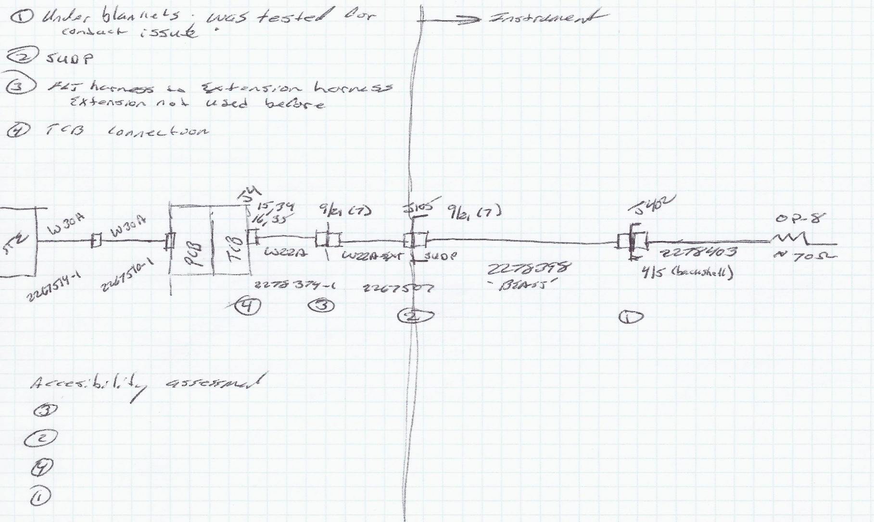
Cable Connection Diagram
New harness/first use:
Isolation/Continuity
Hipot Ok
Reworked
HiPot after rework (2: one failed, one passed)
STE Power Supply Investigation
-PCB part test
-Box CE test
-TCB in-rush meas.
Use diagrams/function blocks to develop the fishbone
Remove and
Inspect for short
Investigations focus on this side of hardware as the
magnitude of the current spike indicates a short close to the TCB.
Avoid zero-in on a root cause too soon
Often there are multiple causes and rework needed

Slide 19
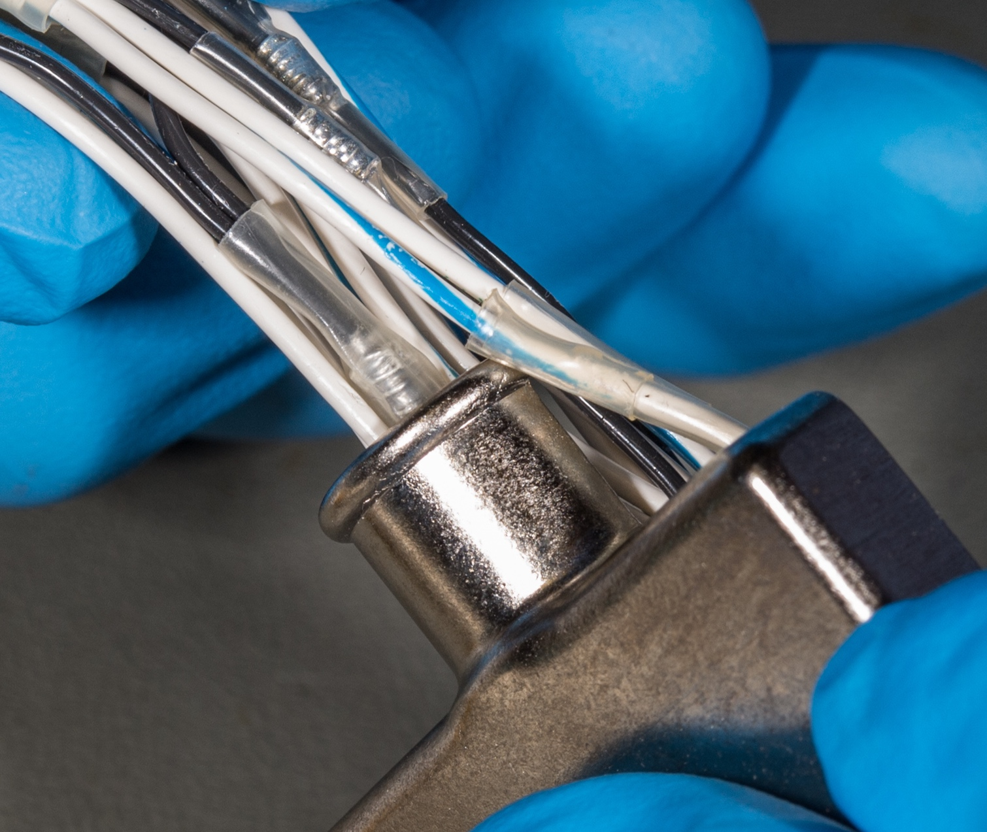
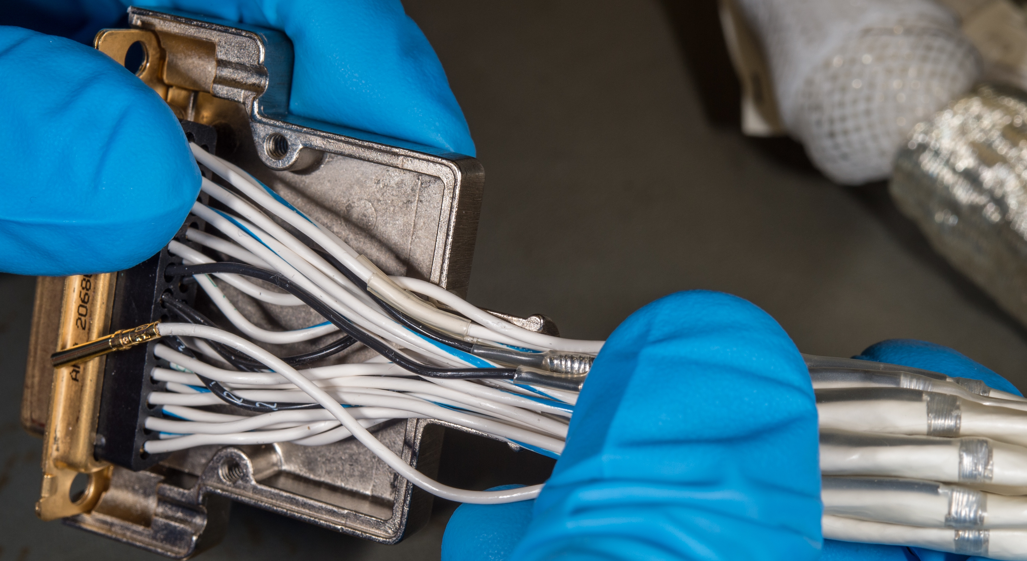
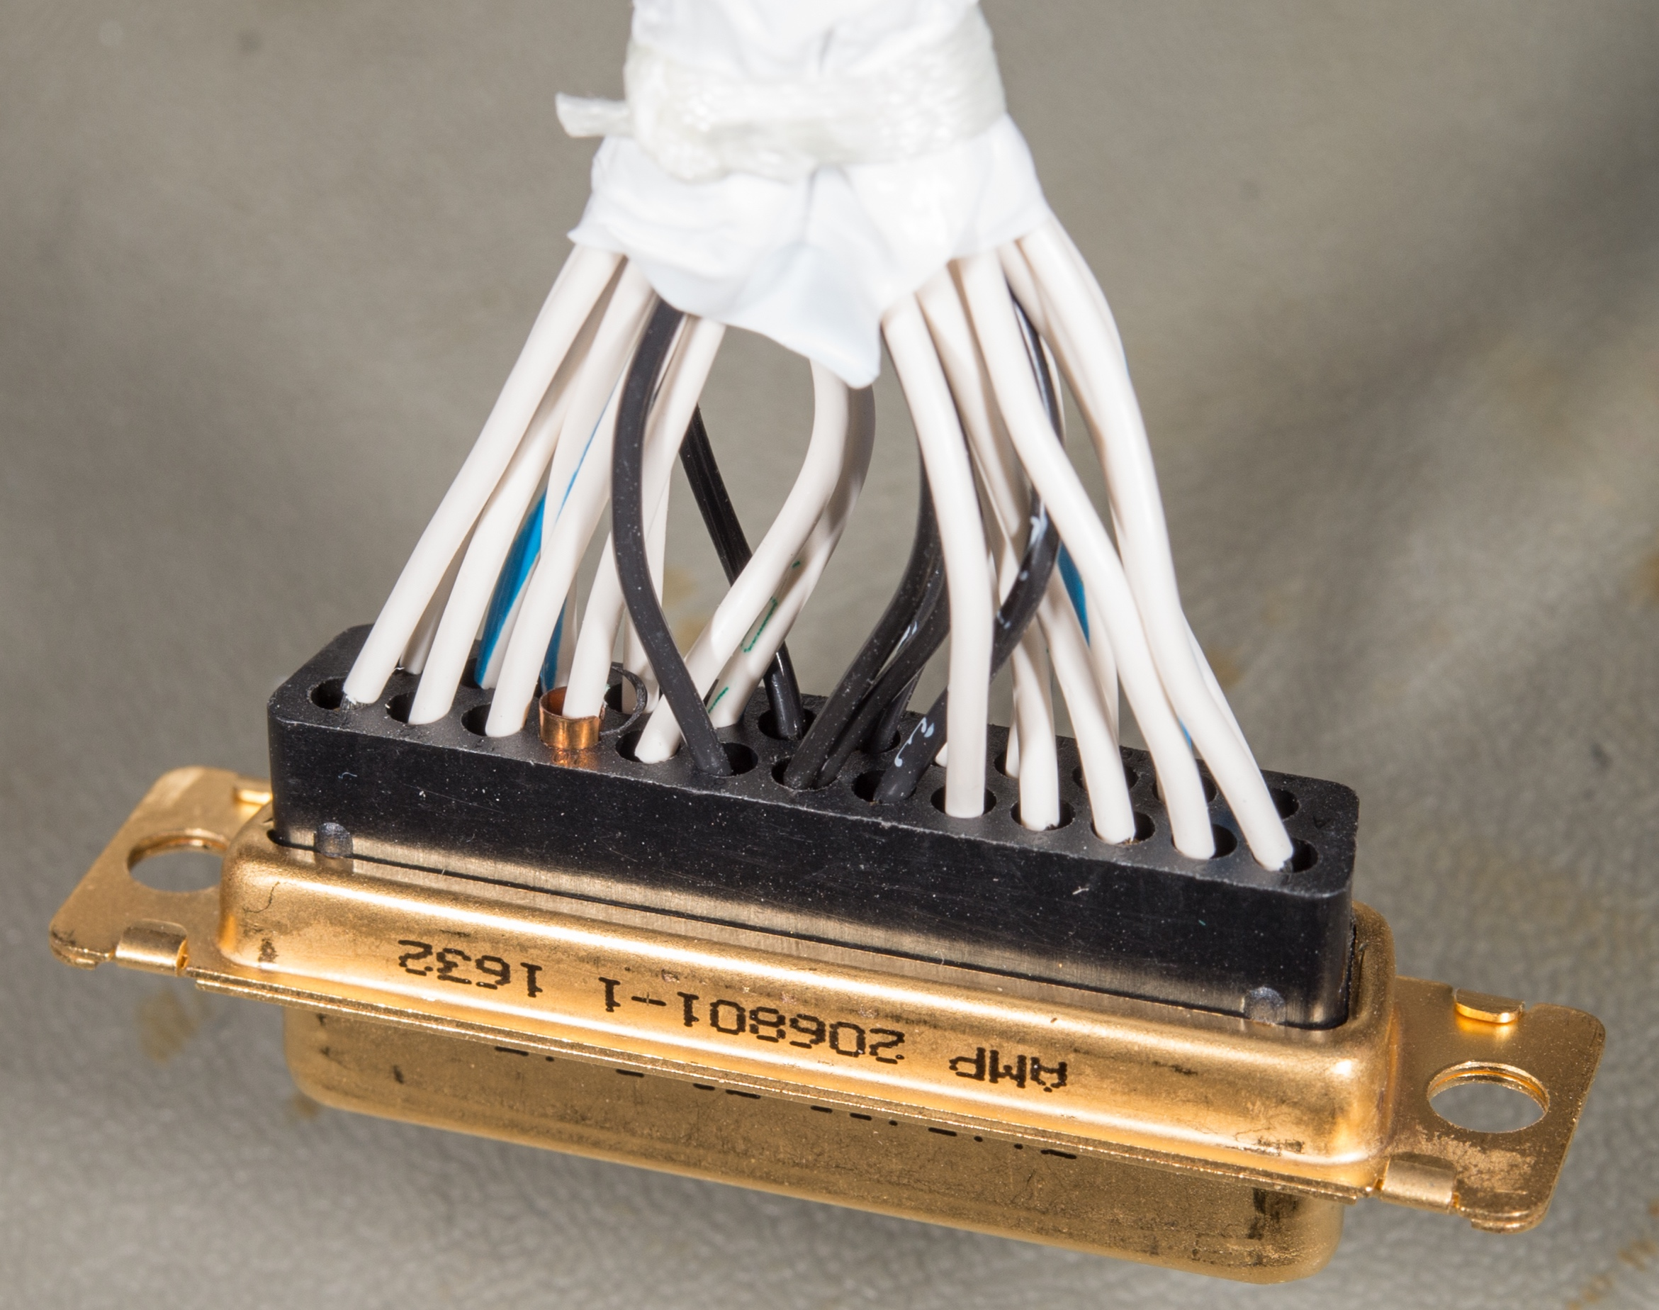
Backshell Retention Band & Short Location
Teflon Wrap removed in this photo
Teflon Wrap removed in this photo
Teflon Wrap around wires

Slide 20
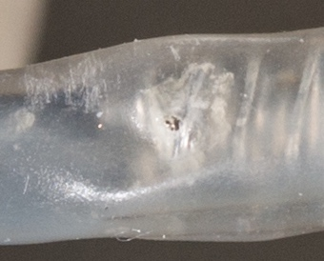
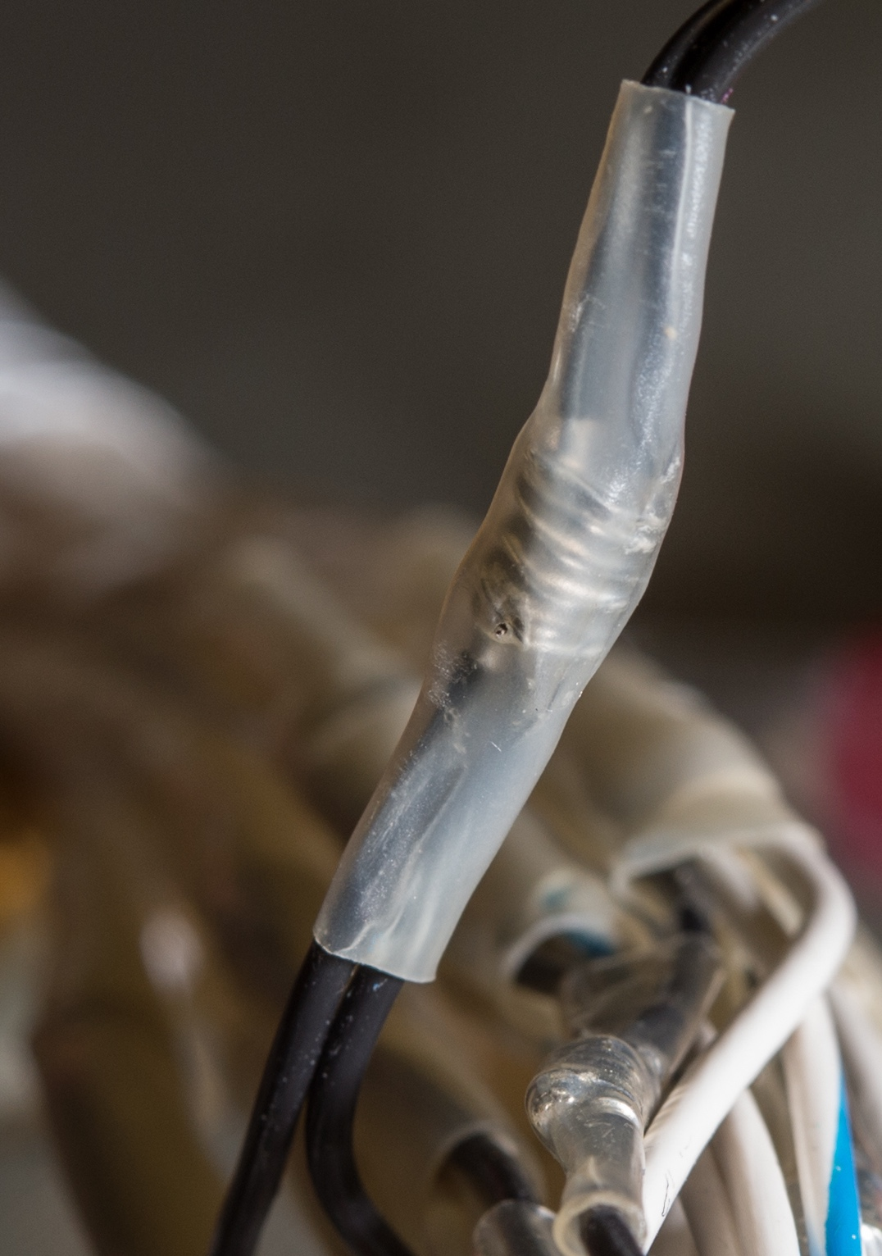
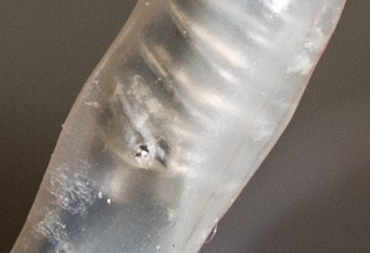
Puncture in Inner Shield Connection
Photos are critical when an anomaly arise
Floor engineer/QA and WOA need to direct photo team on exactly what they need taken

Slide 21
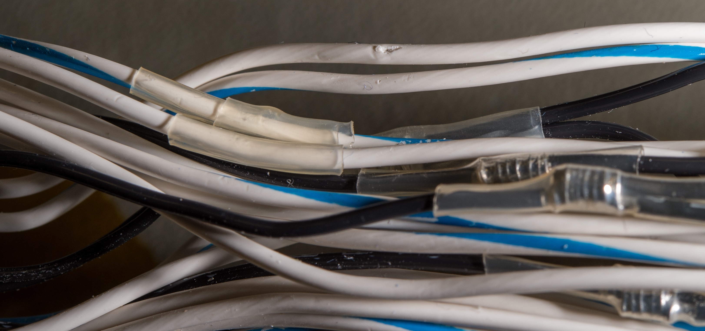
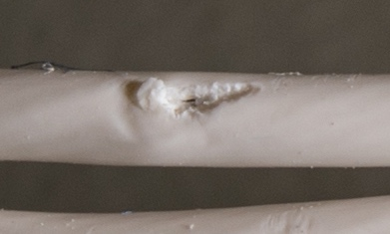
Puncture in Pin-9

Slide 22
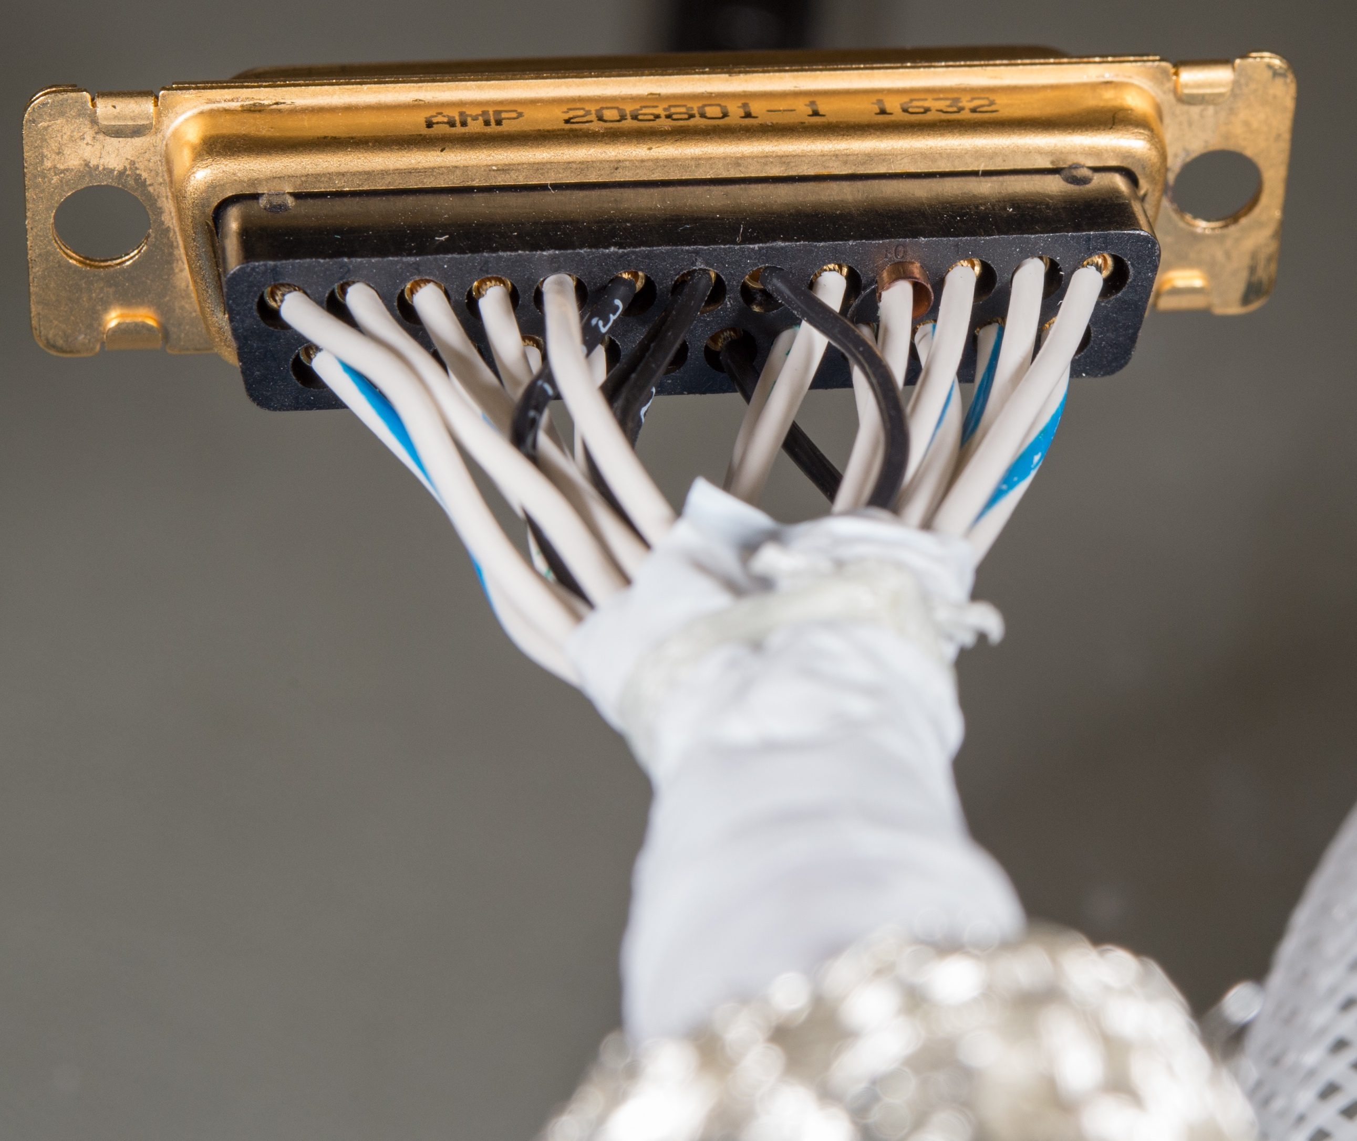
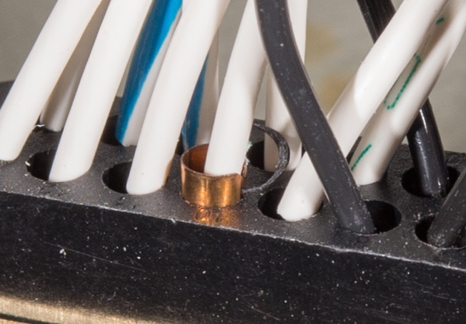
Pin 10 Observation
Pin-10 pushed back, black plastic (appears to be socket retaining ring) also visibly broken free
socket retaining ring?
  Identify key experts ahead of time
    Team pulled from a finite set of experts on center with the proper expertise for the various FRB which was very useful in resolving the various anomalies

Slide 23
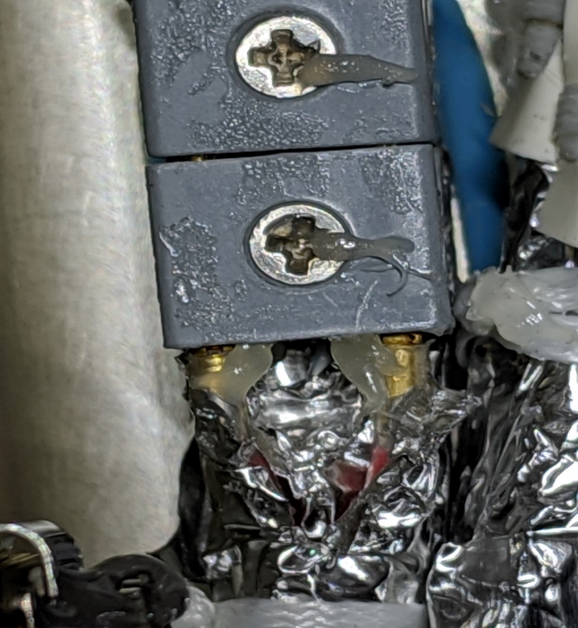
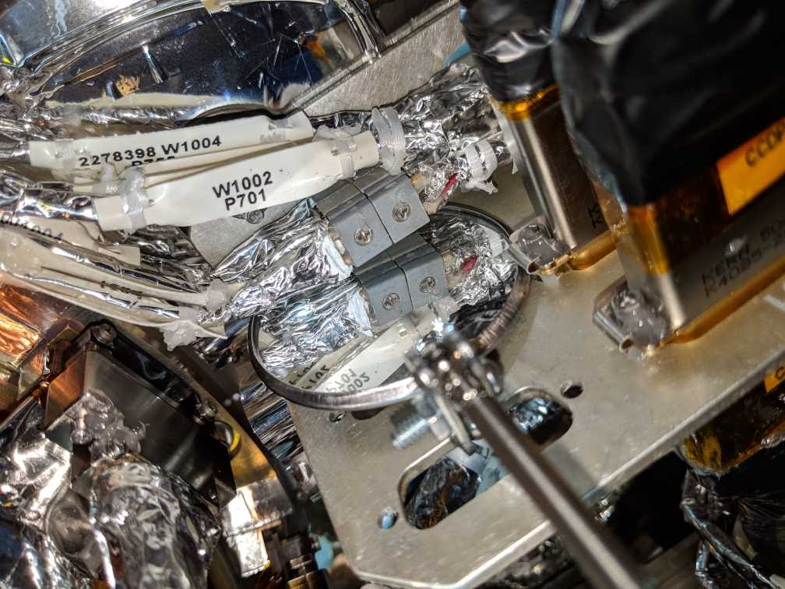
Winchester J622 inspection
Devil is in the details: enforce color code in the wiring when possible

Slide 24
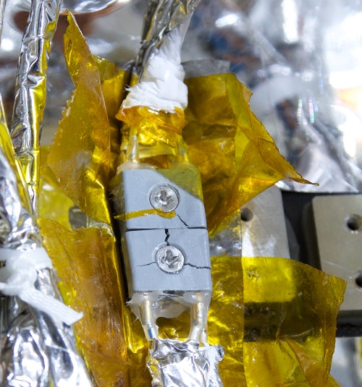
Post-Rework: Cracked Winchester
Need to ensure QA is briefed to expectations on the floor
  - What is the workmanship process agreed upon, what is their role (inspection key points and woa step signature prior to end of shift)
  - Avoid vague statement in the WOA
  - Make sure they know who to call in case of a deviation of process
  - Understand background/expertise of the QA team
Need to have a floor engineer as well in addition to QA and Technicians to help with directing the work and calling systems when needed

Slide 25
Example #2 SSM LOI

Slide 26
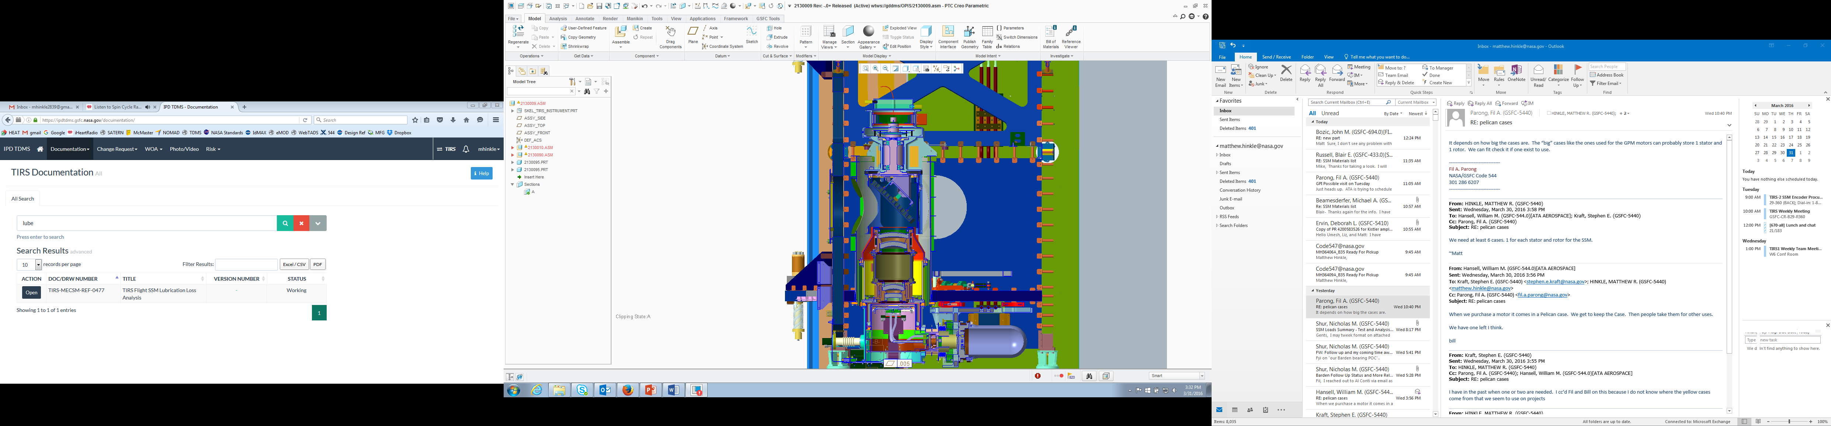
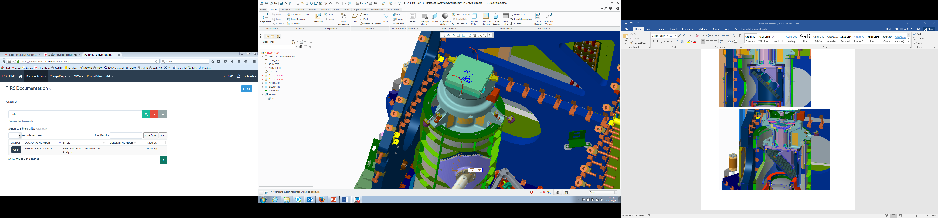
SSM Design Overview
SSM Mount Cone
SSM/Instrument Interface (3 point mount)
SSM
Telescope
Cryo-Cooler
Earthshield &CC LL NEA
Notes:
543 responsible for NEA/ERM
We will talk about MCE interface to NEA later on in presentation

Slide 27
SSM Encoder Anomaly History
During Cold Qual (CQ) #3 in instrument TVAC-2 - Geometry survey at -5 deg offset from NADIR, on Encoder A), error when commanding the SSM back to Nadir
  SSM had lost index inquire/control.
  Team was able to recover and reacquire index (small movement of the mirror) and resume science testing at that same location without any issue
  Determined that the issue was reset of Read Head 2 (RH2) on encoder A
  Additional testing/characterization was done in transition to CQ#4 and after CQ#4
Started testing with Qual SSM in B11 and found a location where Encoder B exhibited LOI as well at ambient:
  Traced issue to a feature in the ADC (Analog to Digital Converter) when the analog signal is at a value near bit boundary decision:
    VREF is near the MSB bit boundary value and occasionally can jump to a 5V value instead of its nominal 2.5V due to this ADC feature
    Converted VREF signal is subtracted to the encoder signals used to determine encoder position by the FPGA. When this ADC glitch occurs, the converted signals will fail logic checks and the FPGA will issue a loss of index and zero out the upper index value.
  This ADC feature was confirmed by our encoder vendor GPI, the parts branch and the ADC part vendor TI

Slide 28
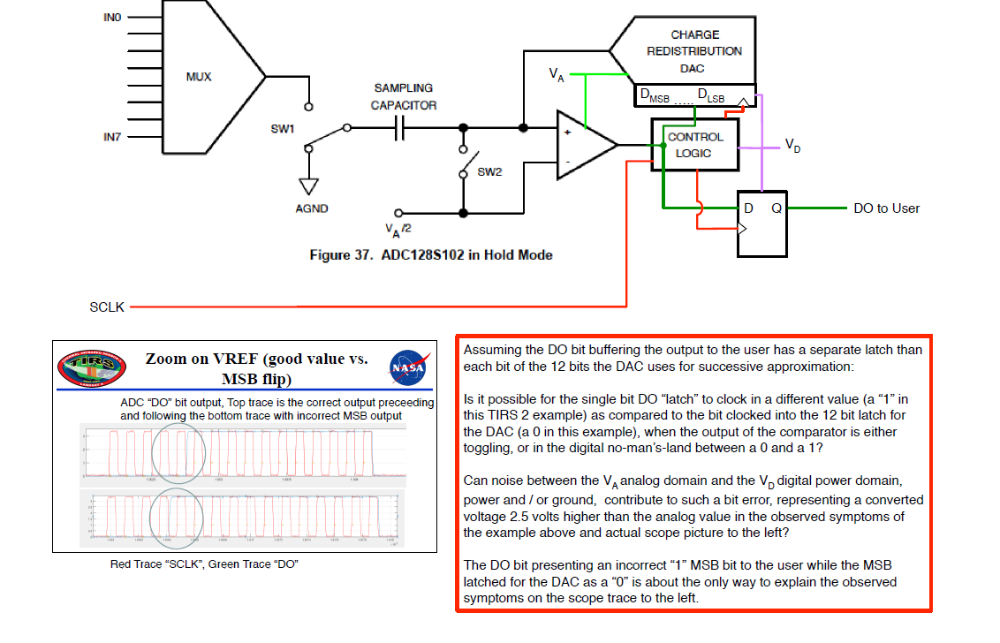
ADC Bit Flip Hypothesis

Slide 29
Path forward decision and mitigations
Selected Option “use as-is” at PSR timeframe:
  On the flight unit, we have never seen an LOI during TVAC-1 or TVAC-2 at our planned NADIR position (on either Encoder A or Encoder B – Confirmed with LOI susceptibility mapping)
    37+hours of uninterrupted stare at NADIR during our COLD balance on Encoder A during TVAC1
    13+hours of uninterrupted stare at NADIR during our COLD balance on Encoder A during TVAC2
  Unable to get flight Encoder B to generate an LOI
  Mitigation if it does occur in flight:
    Move to a position where FPGA logic is not susceptible to ADC feature
    Control position with Mode 10:
      During TVAC-2, Team successfully tested another control mode (Mode 10) controlling on the lower bit portion of the position which is not reset when there is an LOI event

Slide 30
Action Items Status - Continued
Investigate risk of part being stressed or degrading with time:
   GPI is performing radiation testing - Completed
    Parts was graded for a radiation level many times our expected radiation level
    GPI tested board with 25kRAD TID and 33kRAD TID (2 x TIRS-2 flight exposure): radiation exposure either reduces the number of ADC glitches or has no impact at all.
   Parts branch is looking at EOL voltage - Complete
   Parts branch is measuring current during the glitch - Complete
Investigate if noise/crosstalk is source/factor:
   Clean analog signals were found during VREF glitch on the qual unit
   Parts branch, GPI testing and TI team were all able to reproduce the VREF glitch in different environment and testing layout
   Performed power/signal integrity analysis
Investigate if input circuit is source/factor:
   Parts branch, GPI testing and TI team were all able to reproduce the VREF glitch in different environment and testing layout

Slide 31
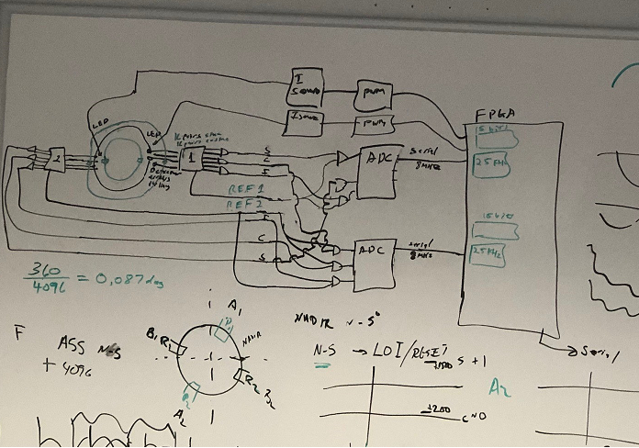
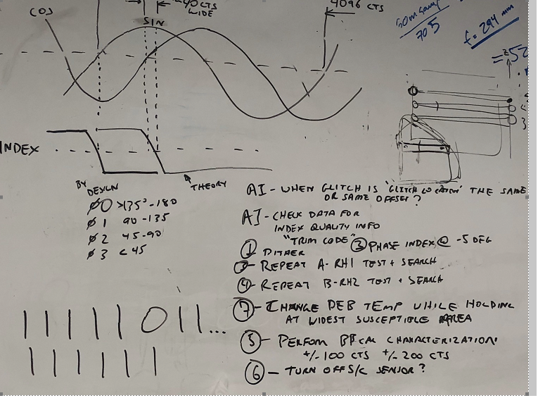
Initial process
Use diagrams/function blocks to develop the fishbone

Slide 32
Portion of Original FishBone
Causes | Bone | Sub-Bone | Exonerate Status
Electrical Noise from external to TIRS-2 | Noise from TVAC env to SSM | - | Unlikely- CDH TLM (highest accuracy/susceptible sensors) were trended during LOI event- All stable
Thermal/Mechanical Disturbances | Thermal Snap | - | Unlikely- Thermal TLM confirmed stable env
 | Mechanical disturbances | - | Unlikely- Cryocooler TLM confirmed stable env
STE | STE Power glitch to the MEB | - | Unlikely- MEB Main current and voltage stable during LOI
MEB abnormal Operation | MCE Brownout | - | Unlikely-Stripchart recorder data confirmed no brownout event from MCE to Encoder
 | MEB controller Issue | - | Unlikely- Encoder should have been initiazlied after reset. Also confirmed via TLM
Flight Harness
Read head
Encoder | Encoder Power On Reset (POR) |  | Unlikely - should have re-initialized both read heads after event
 | FGPA Issue | Clock issue
 |  | Faulty logic
 |  | Signal integrity
 |  | wire bond
  Fine balance between having couple of team members drill in on a possible cause while keeping the search space open
  Make sure all stakeholders are informed and involved

Slide 33
TIRS-2 and observatory I&T
TIRS-2 successfully completed Integration and planned Environmental tests
Flight Instrument to the spacecraft mechanical and intra-harness integration completed (Dec 2019- Jan 2020)
Awaiting electrical integration with the spacecraft
Many more lessons learned gathered so far and will be gathered during this next phase of integration and testing:
  Many more interfaces and stakeholders involved (different culture and processes)
TIRS-2 systems team gathered many lessons learned during the I&T phase some of which have been captured in this presentation. This phase of a project is especially rich in lessons learned as you reconcile the design, early decision with the as-built hardware/final product.

Slide 34
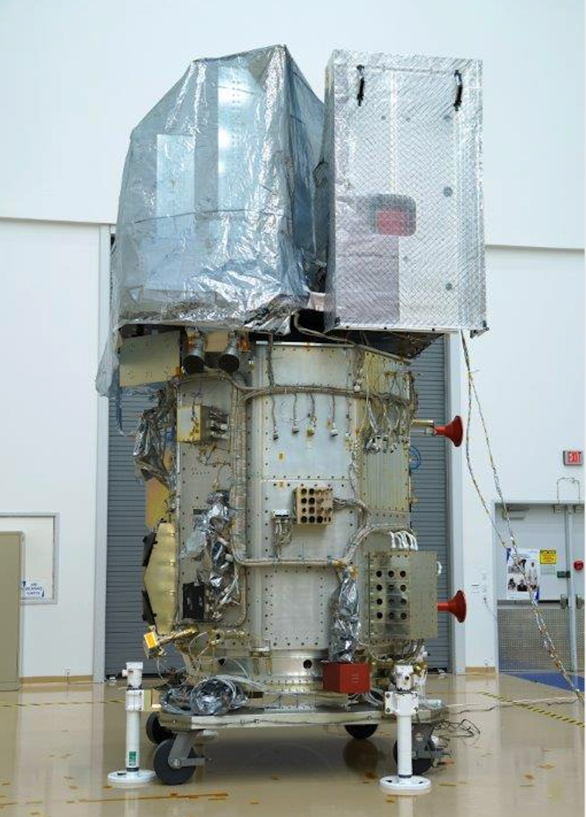
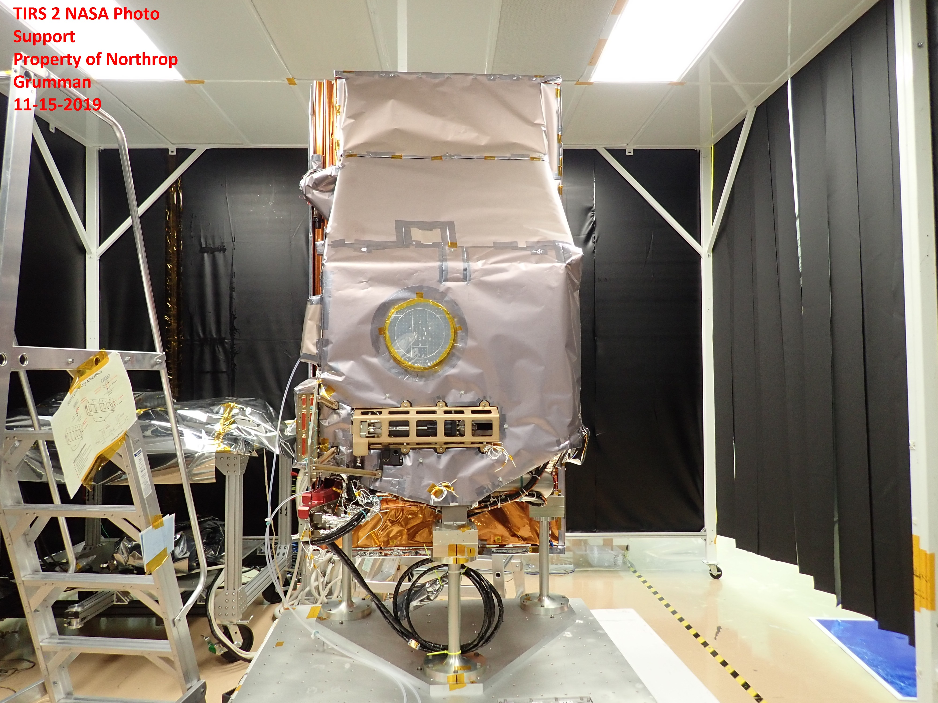
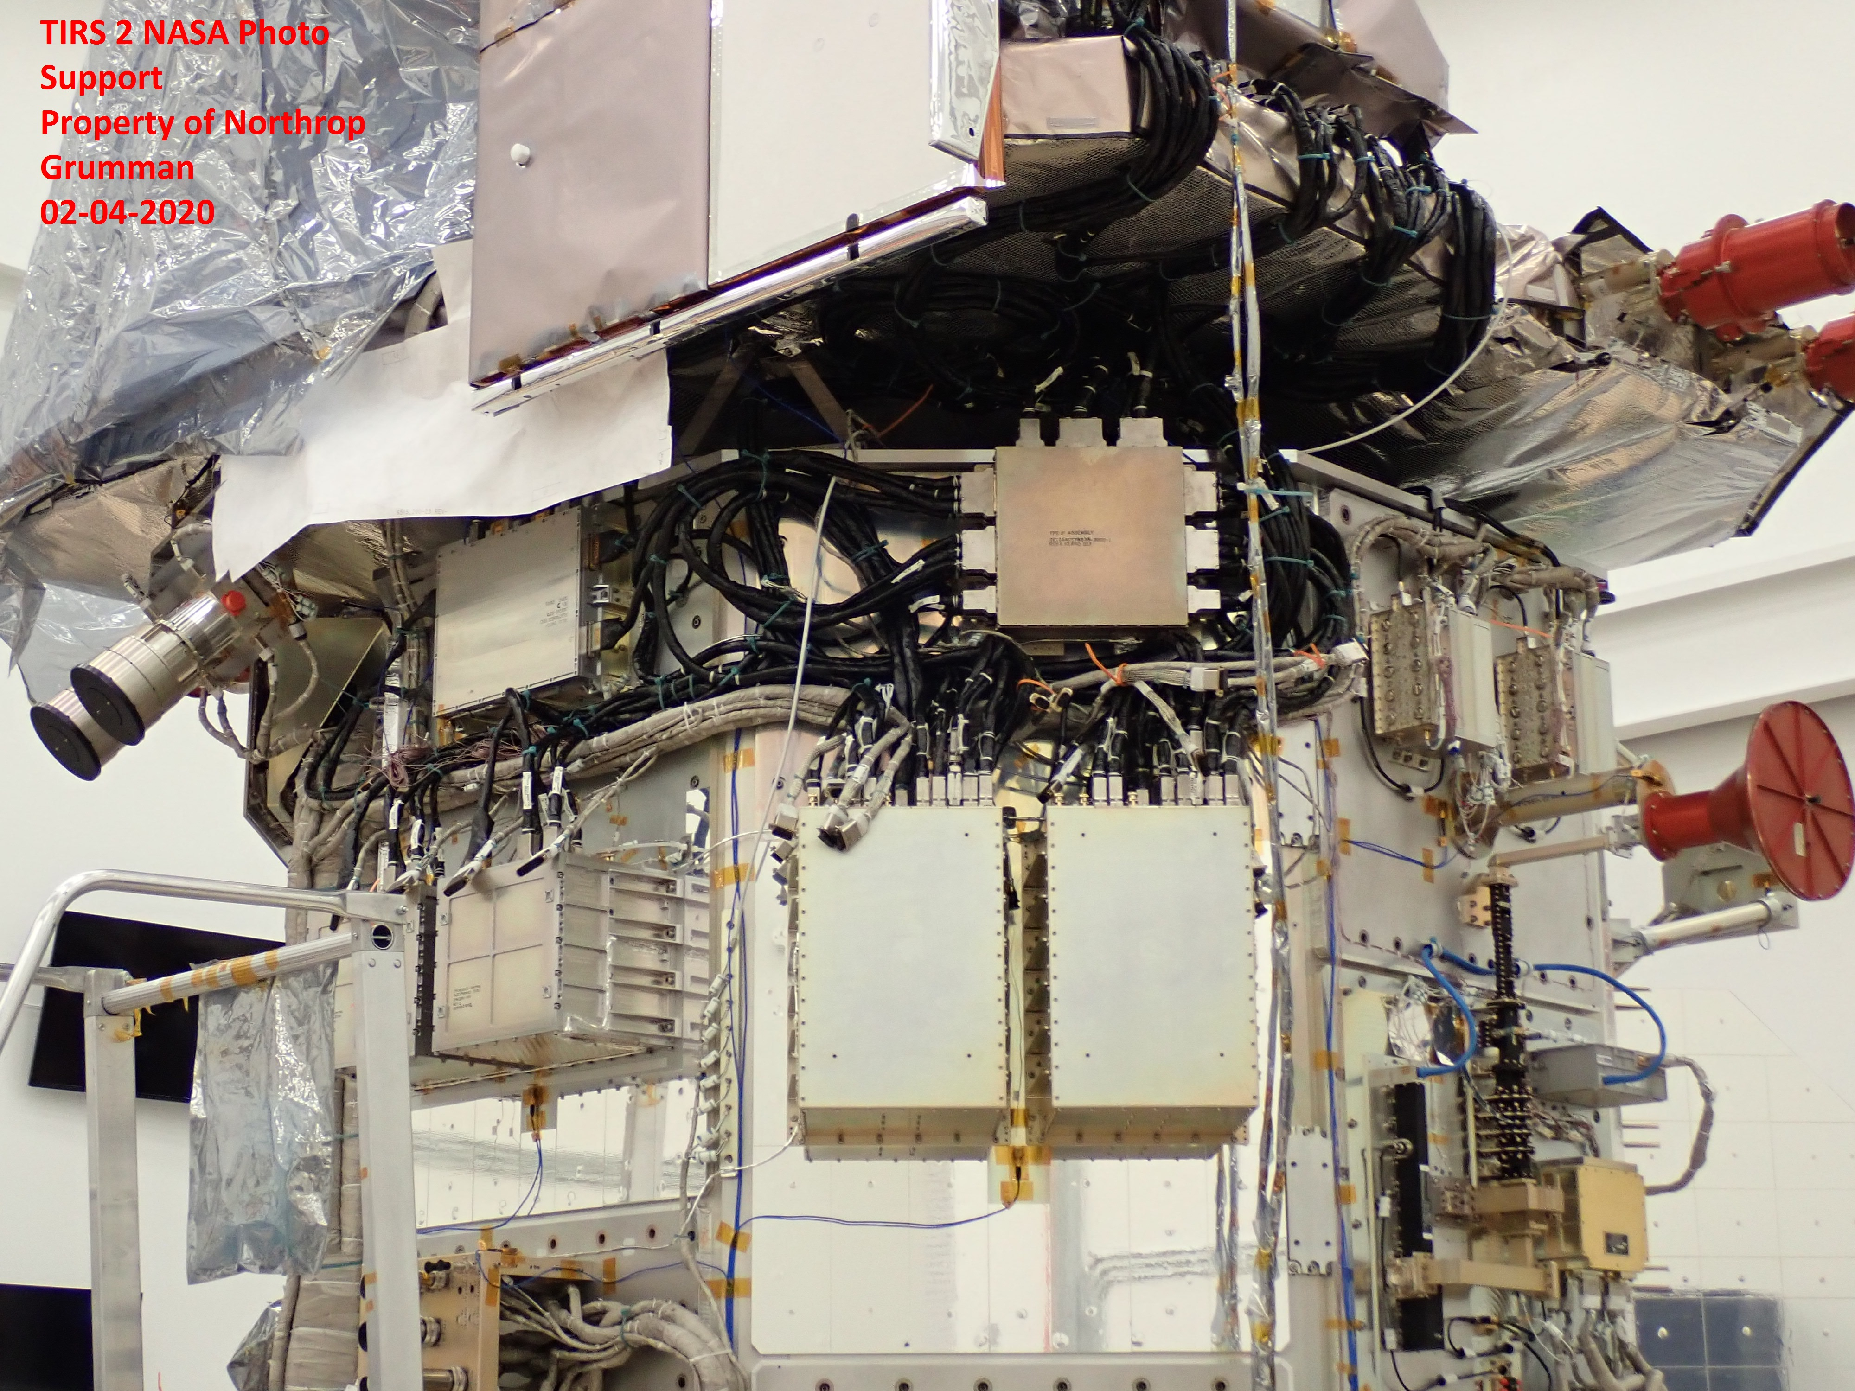
TIRS-2 Road since PSR
“Photos have been approved for public view by the GSFC Export Control Office”

