Slide 1
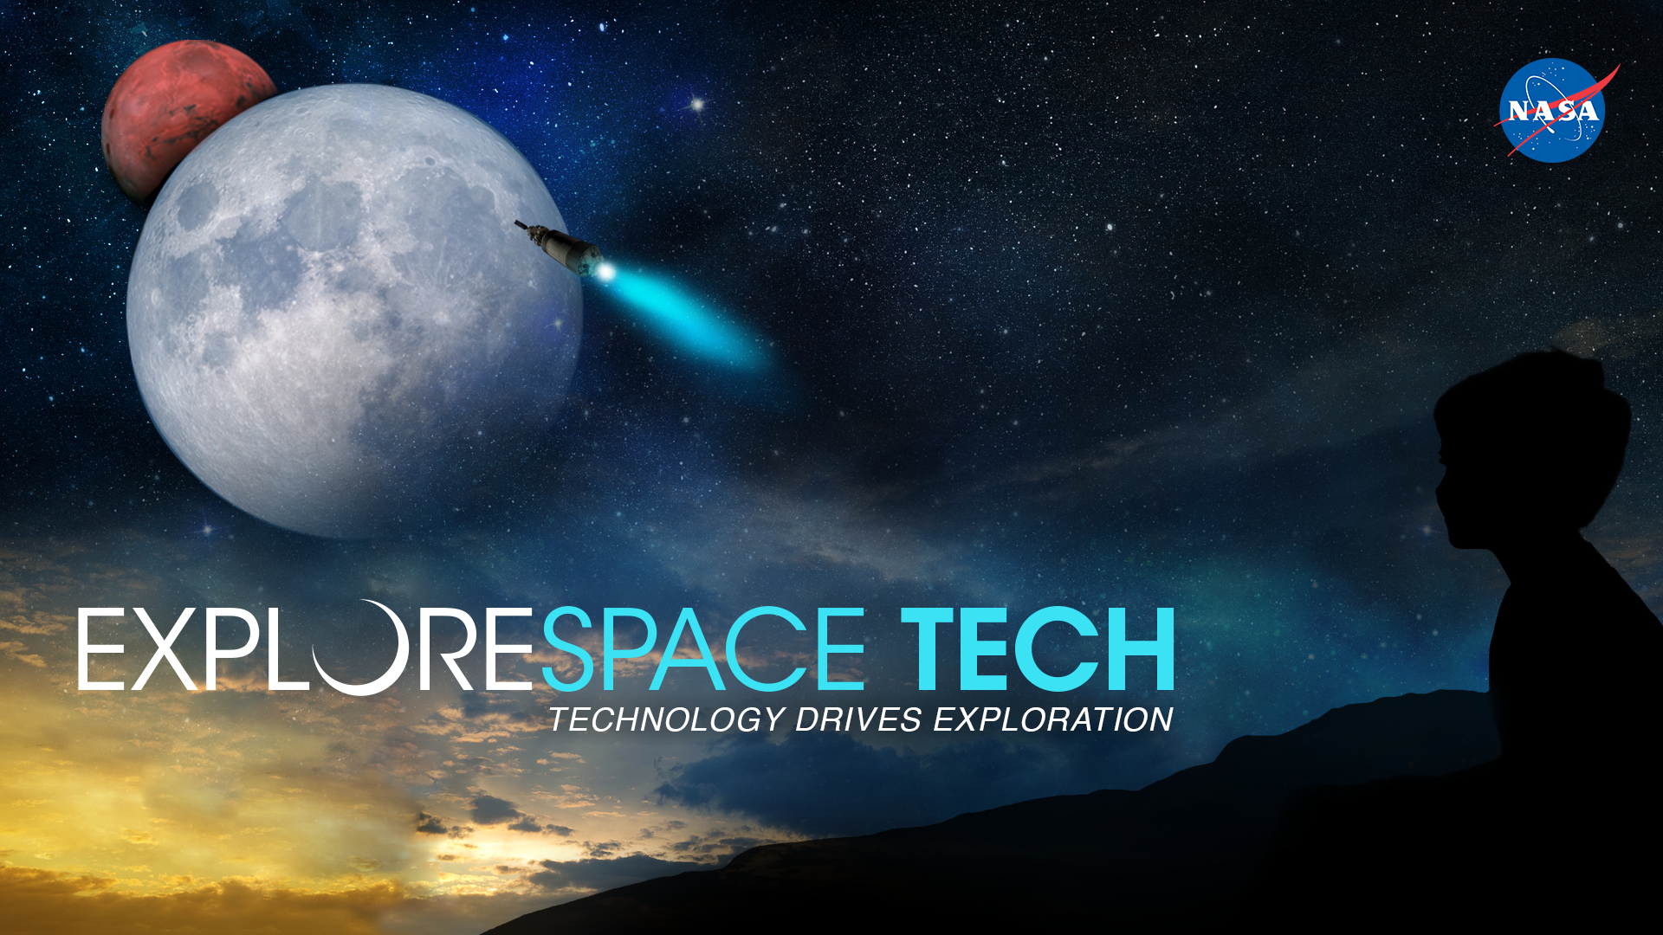
Jaime Esper ⁽¹⁾, Buzz Aldrin ⁽²⁾
(1) NASA Goddard Space Flight Center, Greenbelt MD, USA
(2) Chairman, Human Space Flight Institute, Space Port Houston TX, USA
Mars Small-Spacecraft Human Exploration Resource Prospector with Aero-braking (SHERPA): Demonstrating an End-to-End Mission to Phobos Distant Retrograde Orbit
This material is declared a work of the U.S. Government and is not subject to copyright protection in the United States. All other rights reserved.
Disclaimer: Opinions expressed in this presentation and accompanying video are not necessarily official NASA views.
This presentation is based on the similarly titled paper. I may be found at https://ntrs.nasa.gov/search.jsp?R=20190032243 or at https://iafastro.directory/iac/paper/id/52765/summary/
NASA GSFC Systems Engineering Seminar Presentation – 21 July 2020 – Jaime Esper

Slide 2
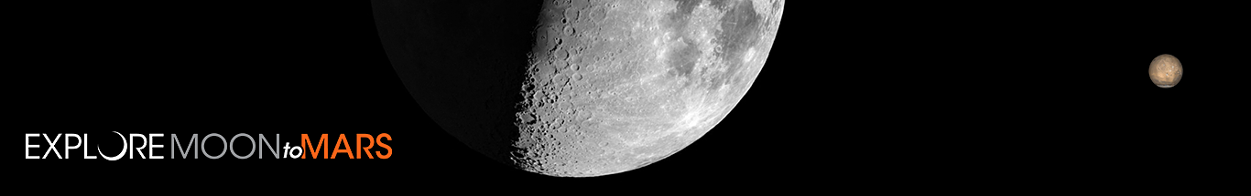
Keeping sight of our target
MARS

Slide 3

“Pure logical thinking cannot yield us any knowledge of the empirical world; all knowledge of reality starts from experience and ends in it.” Einstein, Albert. Ideas And Opinions.
https://youtu.be/aHiYc7MtLJE

Slide 4
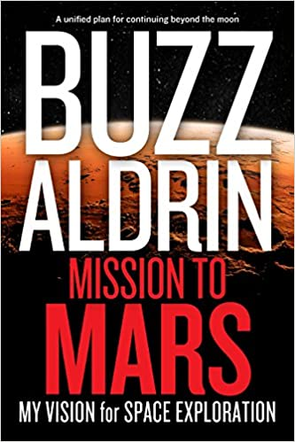
Mission to Mars
Why should we go to Mars?
Why did we go to the moon, and what did we learn from it in the process?
As Buzz would say (and honestly many of my friends), because “it is there.” And being there first is of course, always nice.
We are explorers, and in our curiosity we find that the things we do that are outside of our comfort zone actually benefit us, personally, nationally, as a species.
There are so many spin-offs from space exploration that would be hard to quantize. Spaceflight is the seed that feeds progress.
We will become not just an Earth species, but also a solar system species, and Mars is our closest ally.

Slide 5
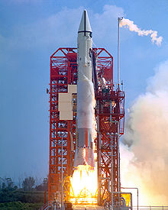
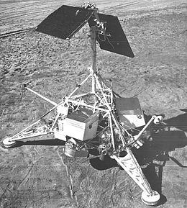
First Lunar Precursors to Human Landings
First Lunar impactor: Luna 2 (Soviet), 1959. Launch mass 390.2 kg.
First Lunar Lander: Luna 9 (Soviet), 3 February 1966. Launch mass 1580 kg, Landing mass 99 kg. It used a landing bag to survive a 22 kph (14 mph) impact.
First Soft Lander: Surveyor I (USA), 2 June 1966. Launch mass 995.2 kg, Landing mass 292 kg.
Surveyor 1 Launch on Atlas Centaur

Slide 6
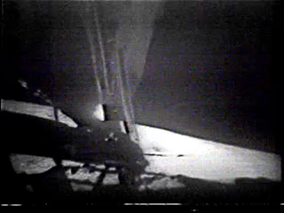
“Magnificent Desolation”
July 20, 1969. 51 years and 1 day ago.
Humans follow robotic craft. It was true then, and it is true today.
Those robotic craft must work on several different aspects of exploration, and not just focus on a few: from the search for life to the technological and logistic means to sustained human landings.
Today with miniaturization technology we can reach much further than just a decade ago.

Slide 7
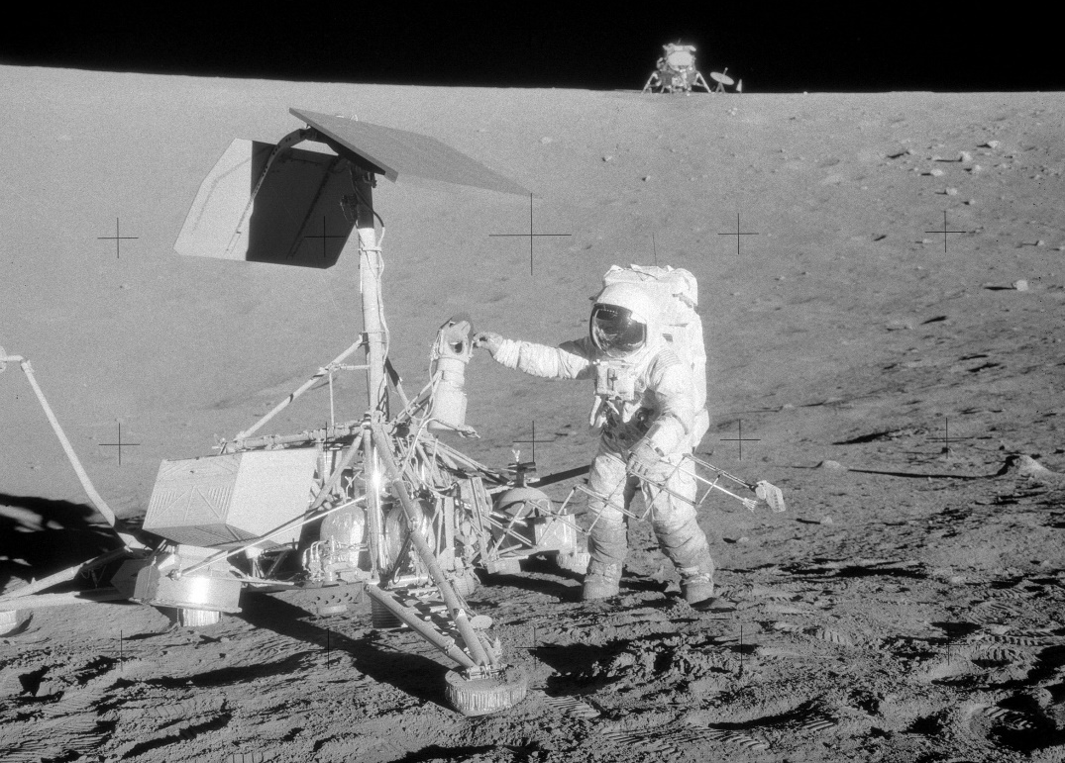
Surveyor III Astronaut Visit
First Lander visited by humans on another celestial body: Surveyor III (USA), Landed 20 April 1967. Launch mass 1026 kg, Landing mass 296 kg.
When we will so bold again to repeat the feat completed by Apollo 12 almost 51 years ago (Nov. 1969), but on Mars?
Let’s use all available tools to pave the way.
AS12-48-7133 (OF300). Pete Conrad at the Surveyor III spacecraft. Apollo 12 Lunar Surface Journal.

Slide 8
Combined Initiative
A proposed mission that combines elements of the NASA Human Exploration and Operations Mission Directorate (HEO), the Space Technology Mission Directorate (STMD), and the Science Mission Directorate (SMD), setting forth a scenario for science acquisition, technology verification, trajectory validation, and in-situ resource exploration of the Martian system.

Slide 9
Study objectives
Develop and presents an end-to-end mission design as a contextual stage for demonstrating feasibility of using small satellites together with aero-capture to achieve Mars orbit insertion, and subsequent injection into a Phobos-stabilized (or distant retrograde) orbit.
  NASA SMD perspective: the study of Phobos attempts to resolve the debate concerning its composition (and likely origins) and its relevance in understanding the early history of Mars.
  NASA HEO perspective: this paper brings attention to the use of Phobos as a logistics and possible resource stage-point for the human exploration of Mars (but not as a necessary step to a first Mars landed mission).
  NASA STMD perspective: the use of aero-capture technology to achieve orbit insertion about another planet has never been tried before.

Slide 10
Why Phobos?
Based on the proposed architecture outlined in Buzz Aldrin’s book, a number of studies were carried out exploring the benefits of using Phobos as a staging point for a human Mars landed mission, its use for in-situ resource utilization, and for tele-robotic and logistic operations.
From a fuel perspective, using Phobos as a staging point represents little advantage as compared to a mission landing from High-Mars Orbit (HMO). In fact it takes more fuel to first reach Phobos, then drop back down to the surface.
However, advantages result from logistic and operational perspectives, if radiation protection, resource utilization, low-latency teleoperation, and other pragmatic sustaining activities are considered.

Slide 11
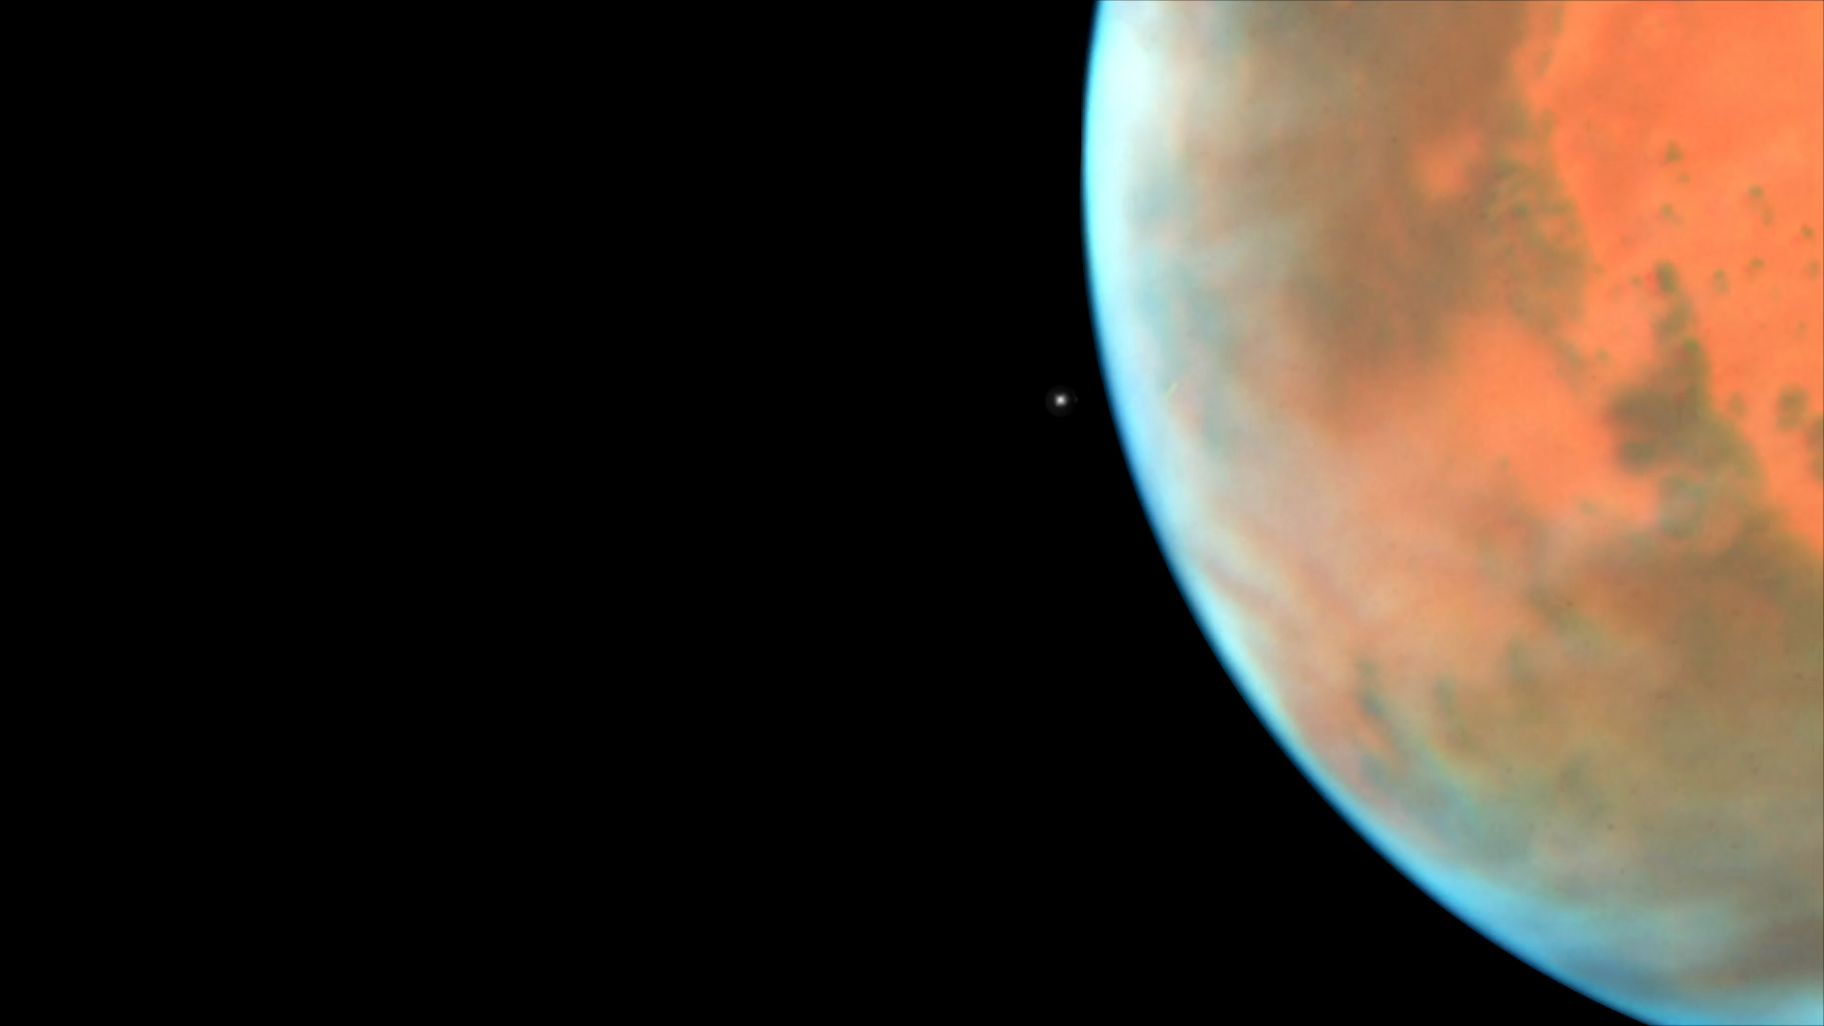
Phobos Orbit
Hubble Space Telescope observed Mars near opposition in May, 2016

Slide 12
Phobos Science and Resources
A reference science investigation includes answering several questions related to Phobos:
  What is its composition? What is its origin? Is Phobos related to Mars? How has Phobos evolved over time? What is its internal structure? What regolith processes occur? How did the grooves form?
  And related to human exploitation: Is there enough hydrogen content to provide in situ resources? Is there water ice? What are the mechanical properties of the moons' surface?

Slide 13
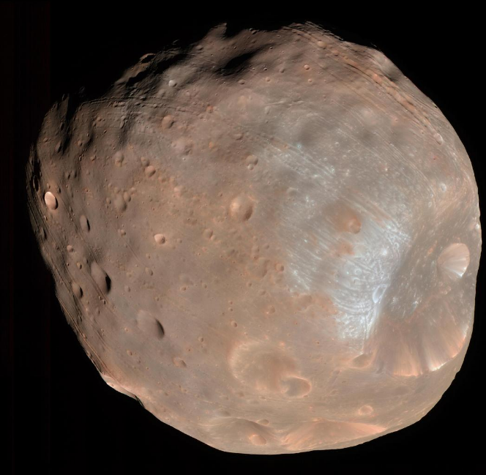
Sub-meter-Scale Survey
Some of the best resolution images of Phobos have been acquired by the High Resolution Imaging Science Experiment (HiRISE) camera on board the Mars Reconnaissance Orbiter (MRO).
The Mars Global Surveyor achieved a resolution of about 4 m/pixel.
However, no spacecraft has ever carried out a sub-meter-scale survey of Phobos in the Visible/Near Infra-Red (VIS/NIR) and Short Wave Infra-Red (SWIR) spectral bands.
This information is not only of scientific interest, but essential to identifying specific areas where resources may be mined during future human missions, and for identifying potential landing sites for robotic and human exploration.
Composite picture acquired by HiRISE on 23 March, 2008 from a distance of 6800 km at a resolution of about 6.8 m/pixel. Image credit: NASA/JPL-Caltech/University of Arizona.

Slide 14
Measurement needs
Sub-meter-scale survey of Phobos in the Visible/Near Infra-Red (VIS/NIR) and Short Wave Infra-Red (SWIR) spectral bands for morphology and mineralogy.
  Phobos composition and structure.
  Identifying specific areas where resources may be mined during future human missions.
  Identifying potential landing sites for robotic and human exploration.
  Detection of water deposits on Phobos for In-Situ Resource Utilization (ISRU).
  Surface consistency (image plume-impingement on surface).

Slide 15
Phobos Survey Imagers
Assuming a 35 km nominal altitude DRO:
  The camera/telescope spatial resolutions are ~0.2 m/pixel for the VIS/NIR color camera, and ~ 0.4 m/pixel for the SWIR monochrome camera.
Dropping the altitude to the minimum stable DRO orbit of 20 km:
  the resolutions increase to ~ 0.1 m/pixel (VIS/NIR) and ~ 0.3 m/pixel (SWIR).
(a) VIS/NIR Sensor Response (Color)
Water ice absorption spectra at SWIR with temperature (Grundy and Schmitt)
It is foreseen that such spatial resolutions coupled with spectral responses shown (a and b) will lead to a wealth of information on Phobos mineralogy and morphology.

Slide 16
Telecomm Package and Close Approach Imager
An antenna size of 0.8m is selected to provide a worst-case (slant range ~378M km) data rate in Ka-Band of ~ 21kbps. This assumes transmission to the DSN 70-meter antenna.
If the DSN 34 m antenna is used instead, the worst-case rate drops to ~ 13 kbps.
Inflection Area
At the end of the mission, SHERPA will be commanded to approach Phobos enough to disturb its regolith with the spacecraft’s main engine without actually touching down.

Slide 17
From Earth to Mars
Minimum-energy trajectory to Mars.
Geometric estimation of target altitude for Hohmann transfer arrival trajectory.

Slide 18
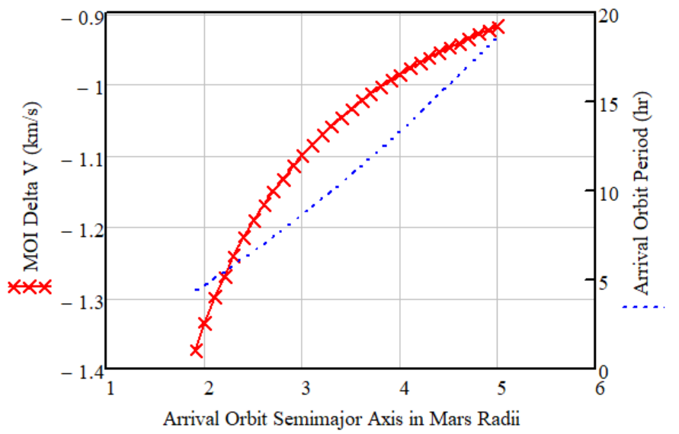
Getting to Phobos for “free” with Aero-Capture?
Not quite, but with aero-capture the fuel requirement is dramatically reduced.
The graph shows the MOI ΔV (change in velocity) required to achieve an apoapsis from Phobos (9,518km) to 33,800km, starting from an initial 30km entry altitude (periapsis).
We can definitely achieve this
But let’s get “ambitious” and go here instead, and have aero-capture cover this ΔV.

Slide 19
Mars to Phobos with Aero-Capture
Total onboard ΔV requirement ~ 1,149 m/s.
ΔV provided by aero-capture ~ 1,373 m/s.
Total effective ΔV ~ 2,522 m/s.
Parameter | Value
Injection ΔV (Launch Vehicle) | 3.6 km/s
C₃ | 8.7 km²/s²
Transfer Time | 8.5 months
Mars arrival (entry) speed | 5.7 km/s
Trajectory Correction Maneuvers | 8.6 m/s
Mars Orbit Insertion (Aero-Capture ΔV) – To Phobos apoapsis | 1.373 km/s
Periapsis raise maneuver 1 and Plane Change – to 2030 km altitude (Phasing Orbit) | 797.7 m/s
Periapsis raise maneuver 2 – to Phobos periapsis radius | 297.4 m/s
DRO Orbit Station Keeping, Momentum Unloading, and close approach operations | 45 m/s

Slide 20
SHERPA Configuration
 | Mass (kg) | Peak Power (w)
Orbiter
Experiment Payload | 9 | 71
Structure and Balance (incl. Solar Array) | 25
Thermal | 4 | 26
Power and Harness | 8 | 7
C&DH | 2 | 22
RF Communications (DTE) | 8 | 14
Guidance, Navigation and Control | 5 | 39
Propulsion Module (excl. Tank and main engine) | 16 | 22
Subtotal Dry | 77.2 | 202
Contingency, 30% | 23.2 | 60
Propellant | 84
Tank | 17
Main Engine | 2
Total Orbiter Wet | 203 | 262
HIAD | 186
Total Launch Mass | 389
Falcon 9 (v1.0) capacity to C3 of 8.7 km²/s² | 1417
Solar Array Power (BOL) |  | 633
Margin | 264% | 141%

Slide 21
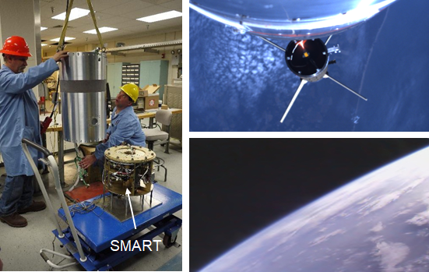
Heritage Technology
Small Rocket/ Spacecraft Technology (SMART) Platform
Industrial-grade cameras and telescope (SMART)
Functional Technology Prototyping
Regolith impingement imager onboard SMART used for SHERPA’s close proximity

Slide 22
Comparison of Earth and Mars Atmospheric Densities
Mars’s atmosphere is extremely thin.
Atmospheric pressure on the surface of Mars is about what we would encounter at around 120,000 feet on Earth.
Entry spacecraft do not have a lot to “push against” to be able to decelerate.
Reference Geoid Altitude (m)

Slide 23
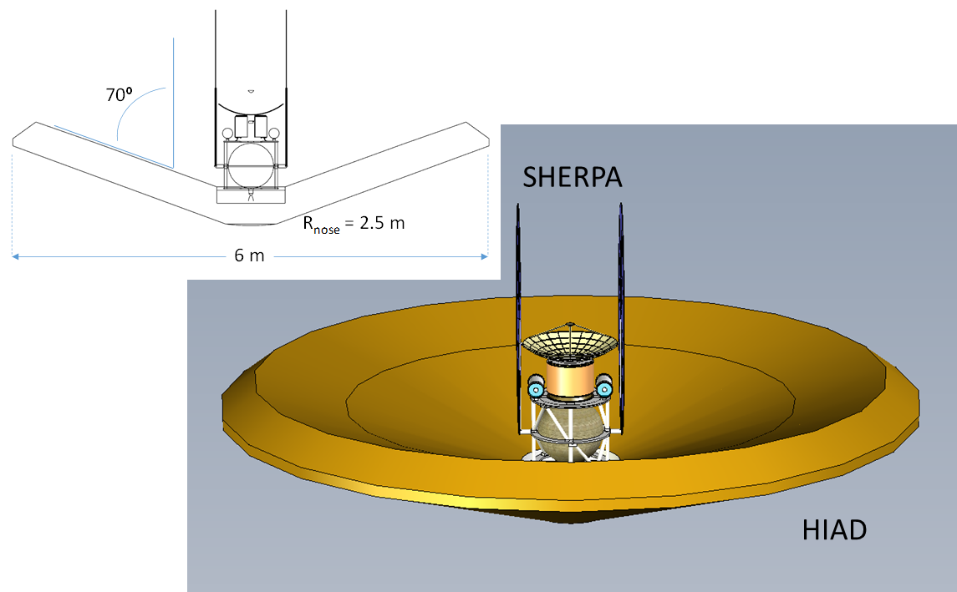
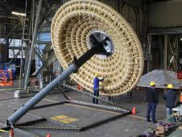
Hypersonic Inflatable Aerodynamic Decelerator
The use of LaRC’s HIAD (others possible) results in significant mass savings, even after considering the propulsion system (including fuel) required to carry out a Mars Orbit Insertion (MOI).
  HIAD mass ~186 kg.
  Propulsion system mass for MOI ~ 389kg.
  Net mass savings of ~203 kg
HIAD
Image credit: NASA Ames

Slide 24
Aerodynamic Parameters and Entry Heating
Parameter | Value
Ballistic Coefficient | 10 kg/m²
Entry Flight Path Angle | -1.91º
Lift/Drag | 0.24
Pressure Drag Coefficient | 1.44
Pressure Drag Force | 30.5 kN
Deceleration | 8 G
Pull-up Altitude | 68 km
Skip-entry approximation for aero-capture. ΔV is given by the difference between exit and entry velocities: ΔV = V_{ex} – V_{e} ≈ 1.4km/s
Entry heating results are based on skip-entry assumptions, and engineering correlations for stagnation point.
Aerodynamic parameters
Parameter | Values
Reynolds Number | 9216
Skin Friction Coefficient | 6.917 x 10⁻³
Total Heat Load | 13 MJ
Max. Body Average Heating Rate | 17 W/cm²
Critical Velocity (@ γ_{e} = 0) | 4926 m/s
Stagnation Point Heating – Convective | 3.5 W/cm²
Stagnation Point Heating – Radiative | 4.4x10⁻⁷ W/cm²
Radiation Adiabatic Wall Temp. @ Stagnation Point | 923K (~650º C)
Entry heating results

Slide 25
Computational Fluid Dynamics
In order to estimate the effects of atmospheric flight on the spacecraft within the HIAD, the system was analyzed using a CFD tool.
The point in the trajectory chosen for the analysis corresponds to the maximum density, or pull-up altitude, reduced 26% for “good measure.”
Since the atmospheric density is greater at 50 km than 68 km, the aerodynamic effects will be more “severe,” and the results more conservative.
Parameter | Values
Altitude above Mars | 50 km
Density | 6.54E-05 kg/m³
Viscosity Coefficient @ 135K | 6.61E-06 kg/m-s
Pressure | 1.66 N/m²
Mars Atmospheric Gas Constant | 192 J/kg-K
Ratio of Specific Heats | 1.3
Flow Speed | 4926 m/s
Reference Area | 26.7 m²
Moment Reference Length | 2.7 m
System Weight @ Mars | 1444 N
Angle of Attack | 0º
Boundary conditions used in CFD analysis

Slide 26
CFD Results
High-speed super-heated flow impinging on the solar panels will result in localized heating, as will be turbulent flow reflecting back onto the back-side of the HIAD housing the spacecraft.
The pressure is low given the rarified atmosphere encountered at Mars. The maximum pressure around the vehicle (including the wings) is a modest ~138 N/m², or ~0.0014 kgf/cm².
Pressure flow-field is small around SHERPA
Velocity flow-field around SHERPA

Slide 27

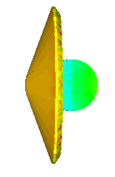

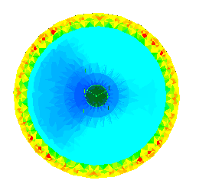
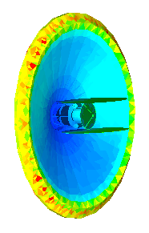
Steady-Sate Temperature Results 50km
CFD steady-state radiation-boundary temperature solutions are scaled to the maximum radiation adiabatic wall temperature (923 K).
Spacecraft surface temperatures ranging from about 7º C at the body of the bus to roughly 192-283º C at the tip of the high-gain antenna and upper half of the solar panels. The front of the HIAD is mostly at ~ 428º C.
Kelvin

Slide 28
CFD Results in Perspective
Although a maximum solar panel temperature of ~283º C would cause concern if sustained flight at 50 km altitude were to be assumed, it is clear this condition will not be met.
  The entire atmospheric flight (from 195 km to 195 km entry interface) lasts approximately 400 seconds through varying atmospheric densities and speeds; hence this is inherently a transient state analysis.
Nonetheless, steady state “frames” provide a worst-case assessment of the expected thermal conditions, and help to point out locations where relatively high temperatures are likely to occur.
Risk-mitigating measures may need to be taken to ensure materials are not exposed to temperatures that could cause structural damage. These may include a larger HIAD, or smaller spacecraft. A transient state analysis would shed additional insight into whether these measures are needed.

Slide 29
Conclusions
An end-to-end mission was designed to provide context on which to analyze the feasibility of using small satellites together with aero-capture technology in order to carry out scientific exploration of Phobos ahead of human arrival.
We believe the results successfully advocate for the use of small satellites to carry out scientific exploration of the Mars system, and to test out technologies and operational concepts needed in the sustained human exploration of Mars.

Slide 30
Questions and Answers
July 21, 2020 1:23 PM Can you define what you mean by "small satellites", i.e., maximum mass?
  A. Some 20 years ago, when small satellites were being proposed as the next generation of vehicles, We were defining a small satellite to be under 1,000kg. Mini-Satellites were under 500kg. Micro-Satellites under 100kg. And Nano-Satellites under 10kg. I defined small spacecraft in general to be under 500 kg-class.
  ref: Esper, J., Neeck, S., Slavin, James A., Leitner, J., Wiscombe, W., Bauer, Frank: “Nano/Micro Satellite Constellations for Earth and Space Science,” 3rd International Academy of Astronautics, Symposium on Small Satellites for Earth Observation, Berlin, Germany, April 2001.)

Slide 31
Questions and Answers
July 21, 2020 2:00 PM Is it because transient CFD analysis is time consuming? Can a thermal engineer use the heat transfer coefficient calculated by CFD and apply to a thermal desktop model?
  A: In reference to why I only carried out a steady-state analysis. First, steady state provides a far more conservative assessment of the situation, as explained in the presentation, which is appropriate for a first-order approximation. The second reason is that GSFC is not traditionally involved in these types of analysis, which are generally the purview of Ames and LaRC, so I do not have their sophisticated models. Having said that, using the heat transfer coefficient can indeed help “fake” some of the real-time problems of transient analysis, and even also of ablation. But this requires further discussion.

Slide 32
Questions and Answers
July 21, 2020 2:02 PM Thanks for advocating for this fascinating concept. What is the guidance method used for flight control during the aero-capture maneuver to account for navigation, atmospheric, mass properties, etc. uncertainties?
  A: This is an excellent question and one that was not fully explored in this first look. My take is that we could use CG offsets to help modulate the L/D parameter of the HIAD and hence make slight adjustments to the atmospheric flight trajectory. This combined with sensors (the simplest one being an IMU), that compares a predicted deceleration with the actual deceleration, and adjusts the trajectory accordingly (making sure we do not crash on the surface, of course!).

