Slide 1

Development and SE&I at Intuitive Machines
Dr. Timothy Crain
Vice President of Research and Development

Slide 2
Discussion Overview
Introduction to IBX – Ben Reed
Introduction of Tim Crain
Overview of Activities at Intuitive Machines
SE&I Concepts and Examples

Slide 3
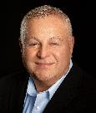




Leading the way with a Legacy of Success
Energy
Space
Innovation & Investment
IBX is an innovation investment firm committed to advancing the state of humanity and human knowledge. We explore new frontiers in space, technology & energy to push human potential and make a positive impact in the world.
Dr. Kam Ghaffarian
Founder & Executive Chairman
Philanthropy
Emerging Light Foundation
Emerging Light Foundation, which is dedicated to improving the condition of humankind through a variety of charitable endeavors was established to support, educate and inspire great purpose while helping transcend limitations all over the world.
Limitless Space Institute
Inspires and educates the next generation to travel beyond our solar system and to support future interstellar human space exploration.
New frontiers in space, technology & energy

Slide 4
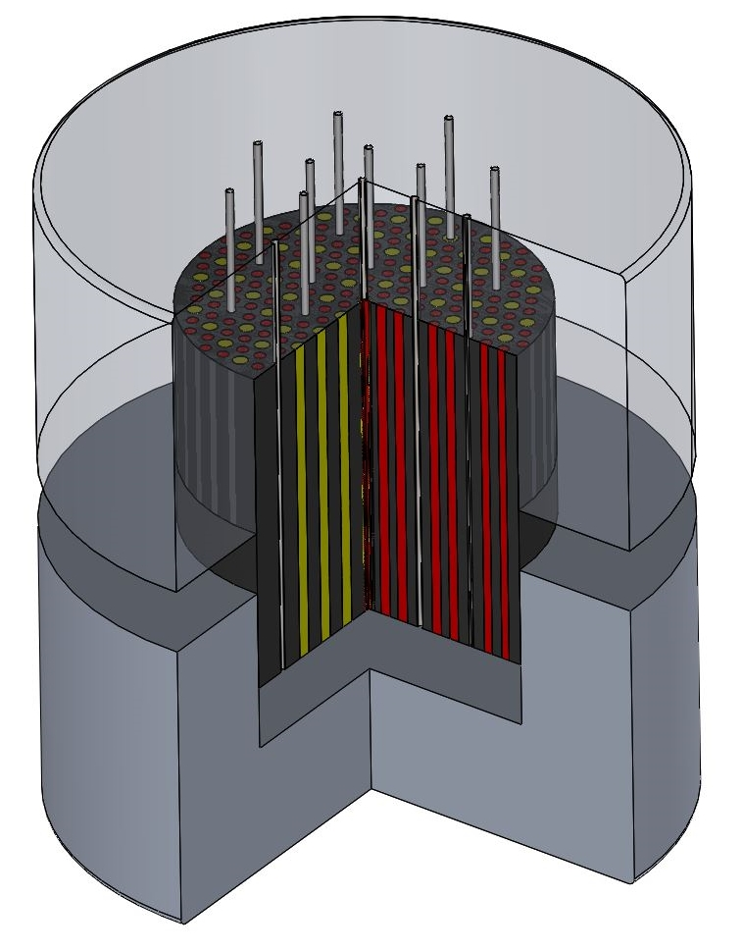
X-energy Efforts toward Terrestrial and Space Nuclear Solutions
Commercial Power Gen.
Nuclear Thermal Propulsion
In-Space Fission Generated Power
NTP enables deep space travel with much shorter transit times through high Isp (>900 sec.)
NASA has flown only one fission reactor, the SNAP-10A mission, in 1965
Design based on High-Temperature Gas Reactor (HTGR) technology utilizing ceramic-coated uranium fuel – enables core to survive very high operating temperatures (>2500C) with multiple short-duration cycles
Design based on advanced materials (beryllium, hydride moderator, ceramic coated fuel, high-temp heat pipes) for a long-life (10+ years) solution that delivers 10 kW of power to lunar habitats
Design based on High- Temp. Gas Reactor (HTGR) technology utilizing spherical “pebble” fuel
X-energy’s expertise with small, high performance power reactors and high-temperature uranium fuel production promise a new era of available power on space missions
Super-heated H2 gas is channeled through a nozzle to create thrust
Few moving parts and straightforward construction
80 MWe Reactor combined into 4 or 8-reactor plants
Key Attributes – no exotic materials; straightforward design; ground testable; buildable today

Slide 5
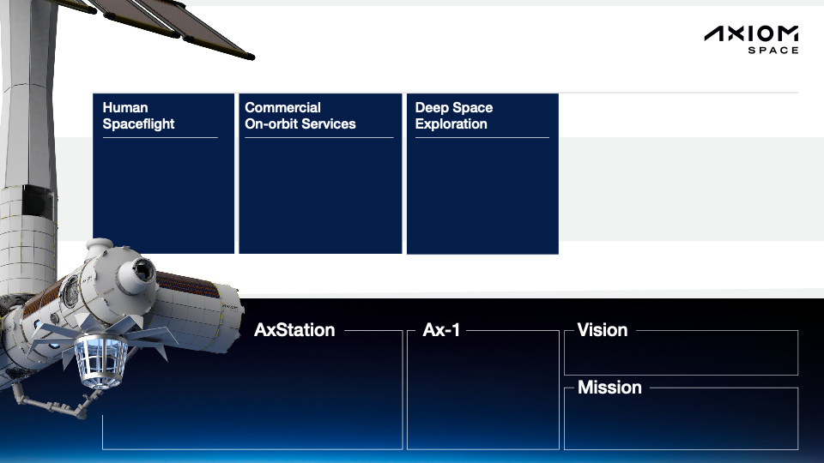
The next step off the planet starts with Axiom Space
Access to the ISS for:
Professional astronauts
including ISS partner
nations
Private astronauts for
7-10 day missions
Simple, fast, and cost-effective
access to space for:
Research
In-Space Manufacturing
Brand, Media and
Entertainment Partnerships
A near-Earth platform for:
Integrated systems testing
Human performance
studies
Sub-system technology
demonstration
Diverse Global
Market Segments
A thriving home in space that benefits every human, everywhere.
Starting in 2028, Axiom Station will be a orbital platform that has pressurized and unpressurized payload
capacity comparable to the ISS.
It is the cornerstone — the origin — of a permanent, prosperous human presence and a thriving network
of commercial activity in Low Earth Orbit.
World’s first private crew
to the ISS
Expected to launch January 2022
Improve life on Earth and foster possibilities beyond it by building and operating the
world’s first commercial space station.

Slide 6
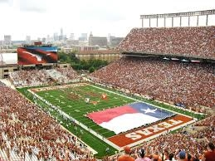
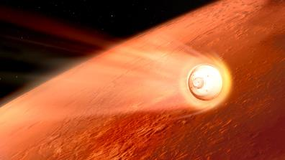
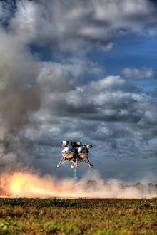
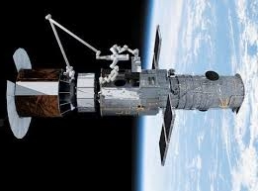

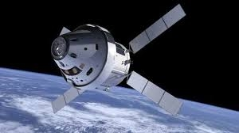
How Did I Get Here?
Entry, Descent, & Landing
PLHA, GNC, SE&I
Automated RPOD
Longhorn Offensive Line
Aerospace BS, MS, PhD
Dr. Jeremy Rea
Ron Sostaric
Orbit GNC
Misspent Time Well Spent

Slide 7
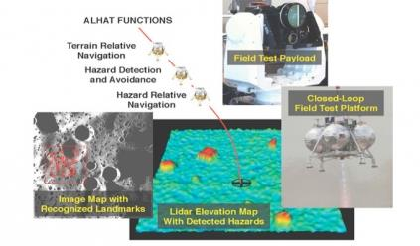
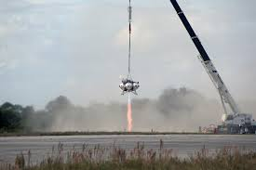
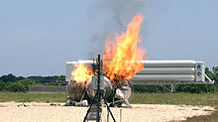
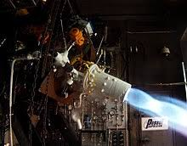
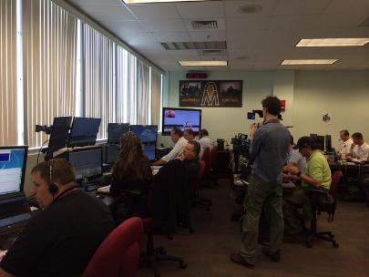
NASA Morpheus Project
Free Flight 14 / 15

Slide 8
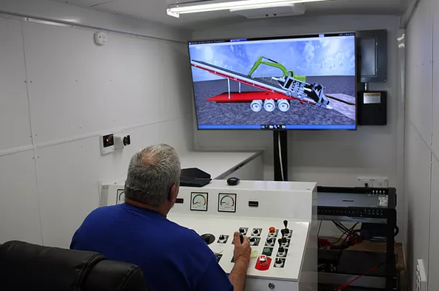
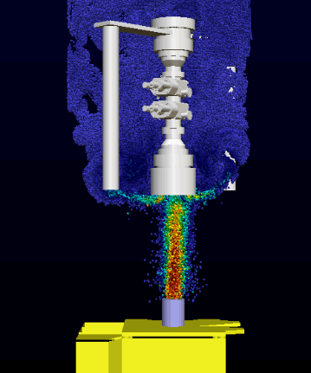
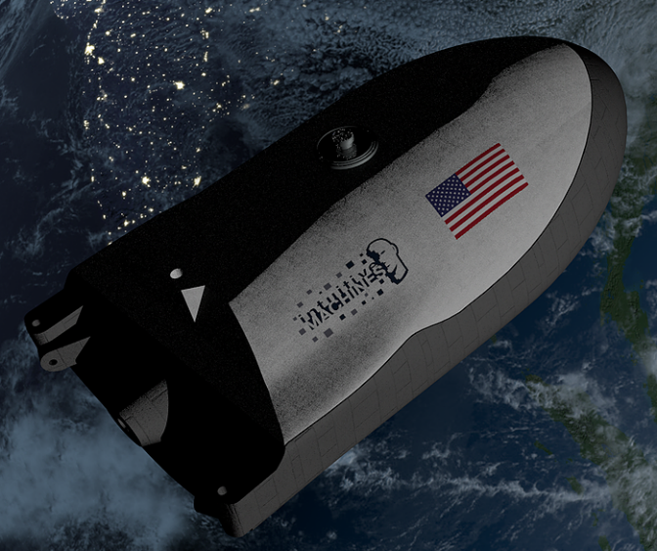
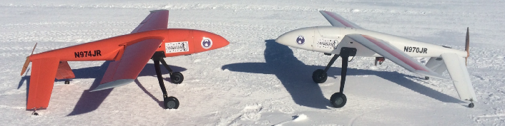
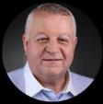
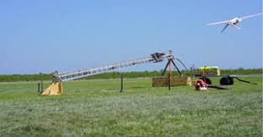
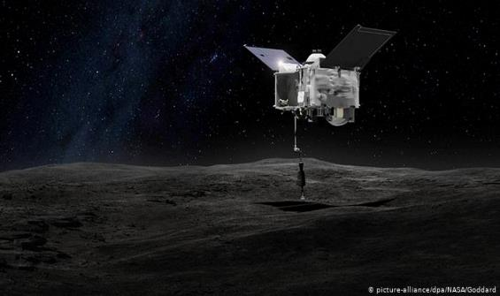
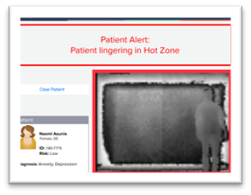
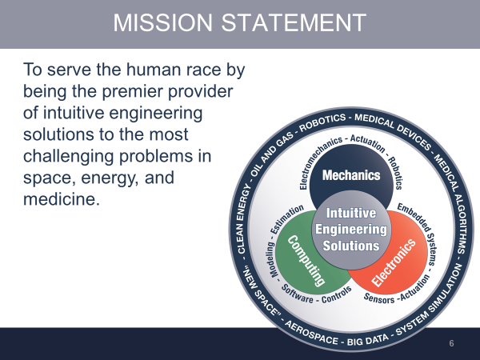
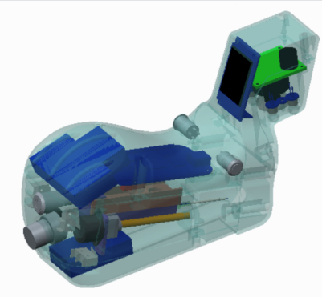
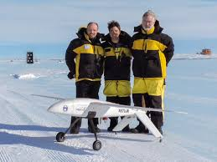
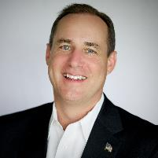
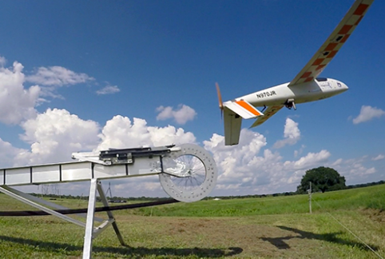
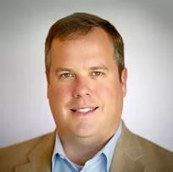
IM 2013-2017: Think Tank Years
Founded by Kam Ghaffarian, Steve Altemus, and Tim Crain in 2013
Shape model method development
Vision navigation design validation

Slide 9

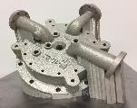
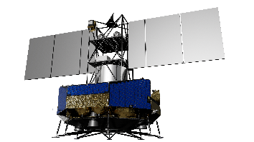
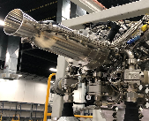
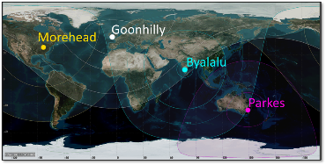
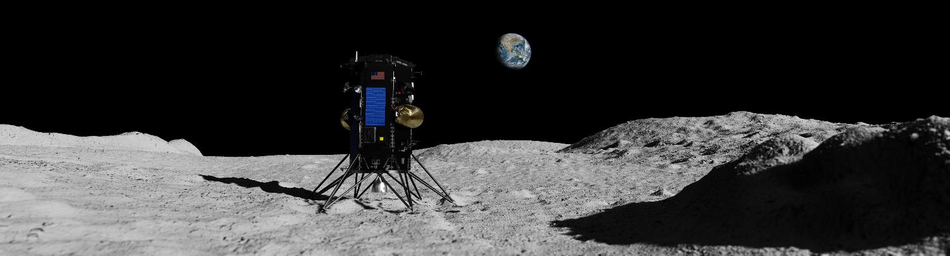
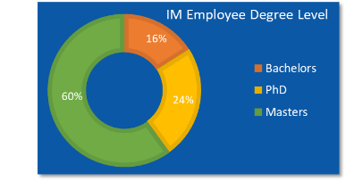

Intuitive Machines | Provides technology solutions and services in . . .
Intuitive Machines develops aerospace systems and services that unlock extraordinary value for NASA’s Exploration goals and Industry
Space Products
End-to-end Lunar Missions
Space Communications
Engineering services
Space nuclear (IX JV)
Founded in 2013 by NASA innovators & leaders
110 highly educated & experienced engineers
AS9100D & ISO 9001 2015 Registered
Small Business classification
Management and Technical team fully staffed and executing with proven performance

Slide 10
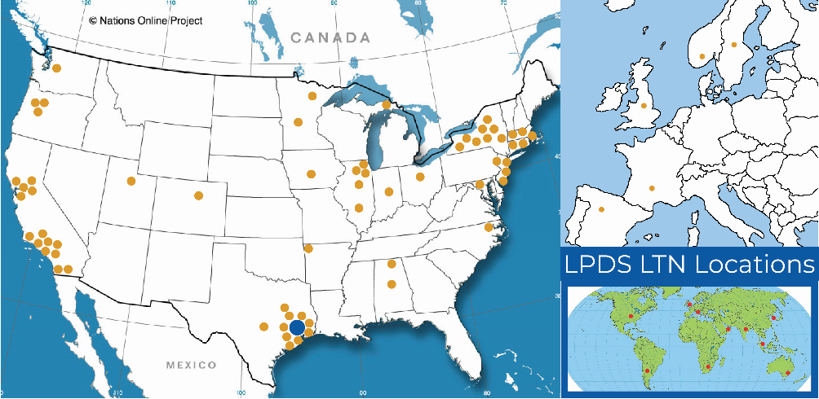
Intuitive Machines | Footprint
University Affiliates/Partnerships
Supply Chain
Embry Riddle Aeronautical University
Texas A&M University
University of Texas, Austin
University of Colorado, Boulder
Colorado School of Mines
Arizona State University
Utah State University
Rensselaer Polytechnic University
Morehead State University
University of Houston
San Jacinto College
Australia National University
47 Congressional Districts, 12 Universities and 14 Different Countries

Slide 11



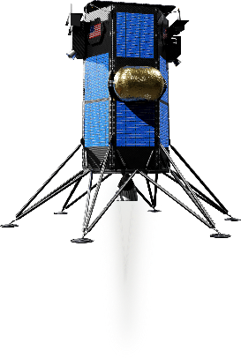


Intuitive Machines | Transforming for Growth
2018
2019
2020
2021+
Fission Surface
Power
Nuclear Thermal Propulsion
X-energy
Propulsion
Systems
Additive Manuf.
IM-1 Manifested
Space Nuclear
CLPS T.O.#2 Award
(May 2019) Nova-C Lander
First Commercial Lander on the Moon
Space Products
End-to-End Lunar Missions
Space Communications
IM-2 Manifested
CLPS Award (November 2018)
(10-yr multi-award IDIQ)
CLPS Prime-1 Award
(16 Oct 2020) Nova-C lander
First to the South Pole
First to drill for volatiles on the Moon
Space & Tech Solutions
Nova Control
LTN
2020 Tipping Point
(14 Oct 2020)
Boeing App E (May 2019)
2019 Tipping Point
NextSTEP-2 Appendix E
Lox/Methane Engine & Tanks
PLHA S/W Development
2019 Tipping Point
Thin VPU
Micro-Nova Hopper
Nokia (LTE)
Alpha Space (SSTEF-1)
Advanced Technology Development (B&P and IRAD)

Slide 12
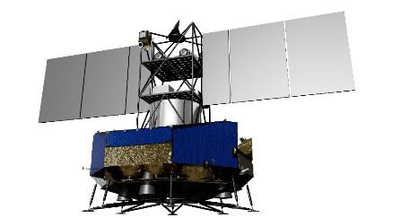
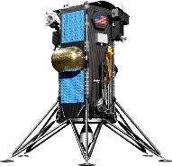
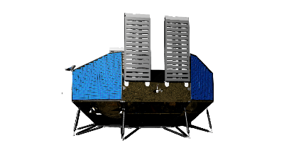




Intuitive Machines | Lunar Payload and Data Services Program
Nova-C
120 kg P/L
(Nov 2021)
Nova-D
500+ kg P/L
(2024)
Nova-M
3500-5000 kg P/L
(2026)
End-to-End Lunar
Missions
Extreme Environment Surface Mobility
South Pole (SP)
Hopper
1 kg P/L
(Nov 2022)
Reiner Gamma (RG)
Hopper
7 kg P/L
(Proposed 2023)
Nova
Control
Ready
Space (Lunar) Communications
LTN
Ready

Slide 13




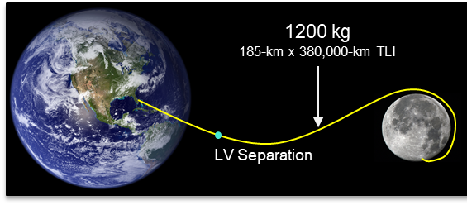
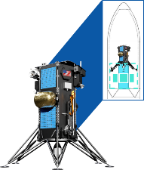
Intuitive Machines | Annual Lunar Mission Launch Cadence
2021 | 2022 | 2023 | 2024 | 2025 | 2026
IM-1 | IM-2 | Scheduling IM-3 | Nova-D + IM-4 | IM-5 | Nova-M + IM-6
IM-1 Manifest
NASA CLPS Payloads
  NDL
  LN-1
  LRA
  SCAPSS
  ROLSES
Commercial Payloads
  ILOA
  Spacebit
  INFN MoonLIGHT
  Galactic Legacy Lab
  EagleCam
  LSU Radiation Sensor
IM-2 Manifest
NASA CLPS Payloads
  Prime-1 Drill
  MSOLO
NASA Tipping Point
  Hopper (IM)
  Nokia LTE
Commercial Payloads
  50 kg available to surface
  1,200 kg available to TLI
NASA
CLPS / PRISM Missions
Tipping Point Payloads
Supply / Cargo Missions
Data / Imagery
Commercial
Rideshare (with IM)
HLS Demos
Technology Demos
Rovers
LLO Satellites
Resource Surveys
Space Force (DoD)
Optical Satellites
Optical Payloads
SIGNT
Data / Imagery
Annual Missions
120-kg Lunar Surface +1200-kg TLI
Other Governments
Rovers
Payloads
Market Growth Requires a Regular Cadence with Schedule Certainty and Flexibility

Slide 14
SE&I Concepts
Q: How to get the best blend of the agility of “New Space” with the rigor and quality of traditional “Big Aerospace”?
Determine What’s Important
Use the Good Stuff
Drive the Schedule

Slide 15
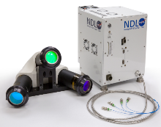
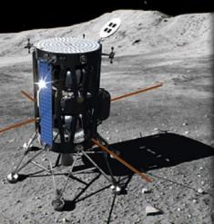
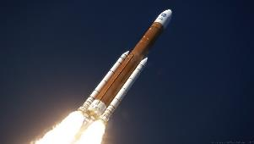
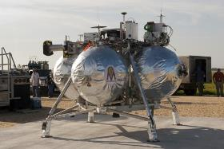
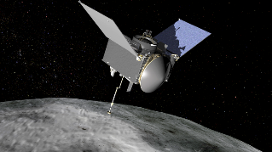
Determine What’s Important
What kind of project are you on?
What’s the Coin of the Realm?
  Cost, risk, schedule?
  Revenue, profit?
Culture >> Tools and Processes
  Without a common culture you can find yourself at odds with your tools and processes

Slide 16
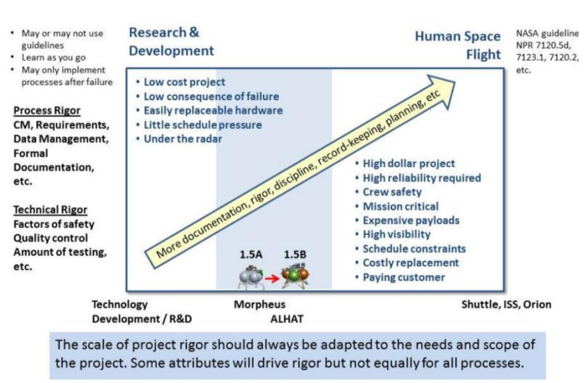
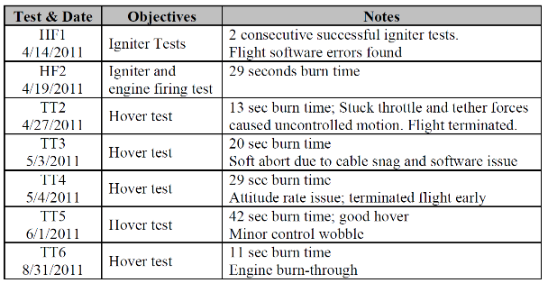
Determine What’s Important: Sliding Scale of Rigor
Can be applied at project or subsystem level
Guides investment of resources and risk management process
Project Morpheus example
Olansen, et al, “Project Morpheus: Lessons Learned in Lander Technology Development,” NASA JSC, 2014, JSC-CN-29378
https://ntrs.nasa.gov/citations/20140001410
Early Test Recovery

Slide 17
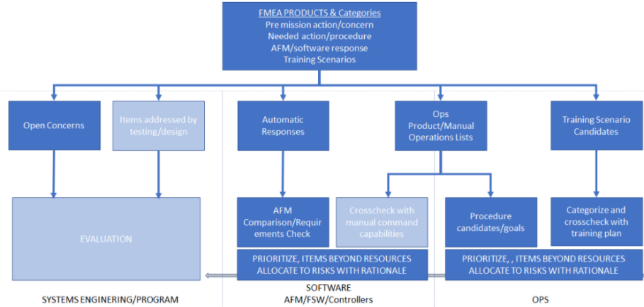
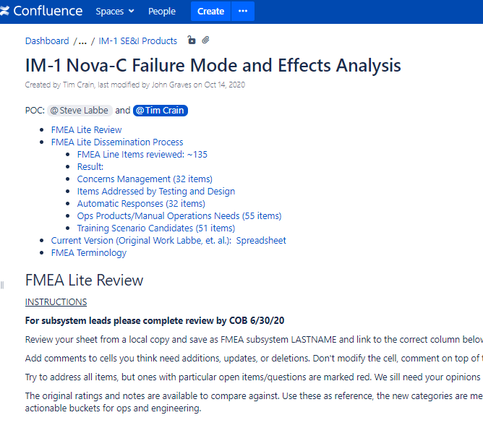
Determine What’s Important: Examples
  LPDS FMEA
  Failure Modes and Effects Analysis
  How are we managing redundancy on IM-1?
  Across LPDS?
  Team experience with failure management and redundancy spanned “none” to “Space Shuttle”

Slide 18
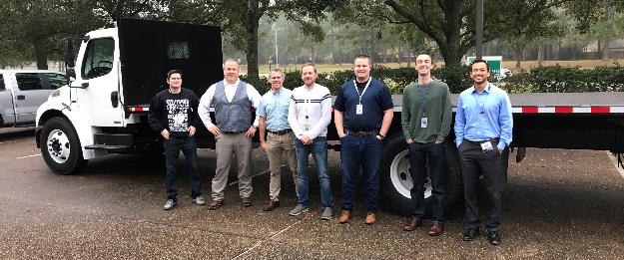

Determine What’s Important: Examples
  LITER Process
  Low Impact to Test, Evaluation of Readiness
  Think “delta-TRR”
  Series of tests similar in nature
  Accommodates nature of development tests and uneven field ops
  Balance team willingness to go extra mile vs. cost, schedule, and SAFETY
IM-QMS-PRC-ENG-002 Project and Test Review Processes

Slide 19




Determine What’s Important: Examples
  LITER Process
  Low Impact to Test, Evaluation of Readiness
  Think “delta-TRR”
  Series of tests similar in nature
  Accommodates nature of development tests and uneven field ops
  Balance team willingness to go extra mile vs. cost, schedule, and SAFETY
Perfect safety record on 43 Hotfire and 4 Coldflow deployments
Qualified igniter/RCS LOX/LCH4 units
Set MSFC record with VR 3500 engines (3x)
Hundreds of VR 900 engine tests
IM-QMS-PRC-ENG-002 Project and Test Review Processes

Slide 20
Use the Good Stuff
Adapt 7120 and Adopt TAILORED Program Technical Reviews (PTRs)
Trade good options…too wide a net regresses to the mean
LxC scoring gets everyone on the same page
Model Based Systems Engineering should be more about philosophy than orthodoxy

Slide 21



Use the Good Stuff: AIAA Standards for Mass Management

Slide 22
Use the Good Stuff: Commercial S/W Multi-platform DevOps
Product Line SW
Continuous Integration
Nightly Device Testing
Development
Device 1
Device 2
…
Device N
Staging
Deploy / Production

Slide 23
Use the Good Stuff: Commercial S/W Multi-platform DevOps
IM-1
Nova-C FSW
GSW / Ops
GSE / Testing
Simulation
Continuous Integration
Nightly Device Testing
Development
SIL
Trick/CFS
Shared Mem
PIL
Trick/CFS
Socket I/O
Nova Control
Viz
Consoles
Trick/CFS
FlatSat
Trick/CFS
Avionics
Payloads
Mobile Test Stand
Staging
Deploy / Production

Slide 24
Drive the Schedule
Arbitrary and Inflexible Milestones
Early Hardware / Software Integration
Risk Management not Risk Avoidance

Slide 25

Drive the Schedule: Arbitrary and Inflexible IM PTR2
  Modeled after standard PDR
  Uneven system and element readiness
    Some more mature, some less
  Tailored entrance/success criteria
  Served as a forcing function for project integration
  PTR3 followed with focus distilled to identified issues and open items
  PTR4 was a scheduled integration checkpoint
  End result: successful CDR at PTR5

Slide 26


Drive the Schedule: Early HW/SW Integration
  MTS / Engine Dev
  Began Mobile Test Stand integration before SRR
  Components include propulsion h/w, actuation, flight computer, CFS prop code, procedures, and ground console s/w
  Built up to our agreed-to risk tolerance
    We burned through some combustion chambers and let the magic smoke out of a data acquisition computer
  Early integration and testing broke down hidden interface barriers between our matrixed Prop/GNC/Avionics/SW/Assembly teams
  Advances in Prop, SW, and Avionics paid forward in terms of better systems requirements and test plans at PTR2

Slide 27

Drive the Schedule: Risk Management not Avoidance
  Risk avoidance is incompatible with innovation and development
  Understand your risk posture and exposure
  The standard LxC language is very useful with a rich toolset
  Resist parallel risk reduction activities separate from development team
    the best risk mitigation folds effort into responsible team’s work plan
  Be diligent with a Continuous Risk Management process that visits the risk garden for regular pruning and care

Slide 28
Conclusion
Determine What’s Important
Use the Good Stuff
Drive the Schedule
  We are at a unique time in the aerospace industry where a rich legacy of processes and methodologies can be revisited, mined, and tailored with new concepts, perspectives, and technologies to create previously unimagined capabilities for space exploration and commerce.

Slide 29

Lunar Landings
IM-1 Nov 2021
29
Notes:
Getting new figure from skip.

Slide 30
Conclusion
Determine What’s Important
Use the Good Stuff
Drive the Schedule
  We are at a unique time in the aerospace industry where a rich legacy of processes and methodologies can be revisited, mined, and tailored with new concepts, perspectives, and technologies to create previously unimagined capabilities for space exploration and commerce.

