Slide 1
MBSE for Mars2020
Elyse Fosse
July 14th, 2021
Jet Propulsion Laboratory, California Institute of Technology
© 2021 California Institute of Technology. Government sponsorship acknowledged.

Slide 2
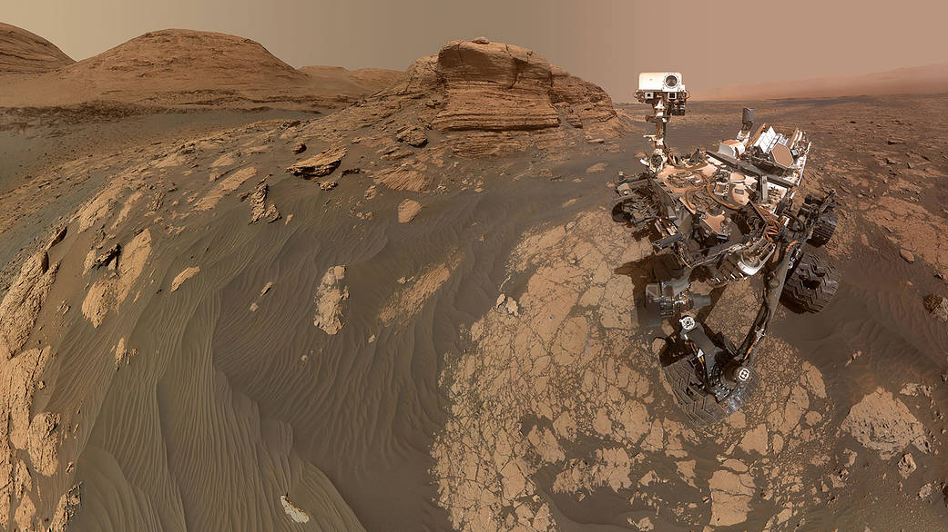
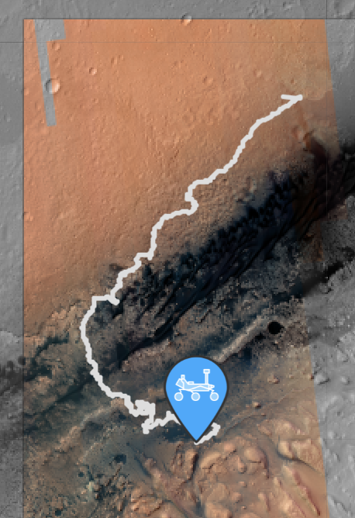
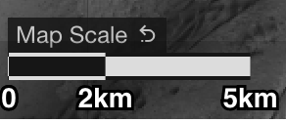
Mars Science Laboratory (MSL) Overview
In operations since 2012 Pursues evidence of a past environment well-suited for microbial life Sol 3170 was recent Drill activity
Credit: NASA/JPL-Caltech/MSSS
where is the rover
Mont Mercou (Mar 30 2021)

Slide 3
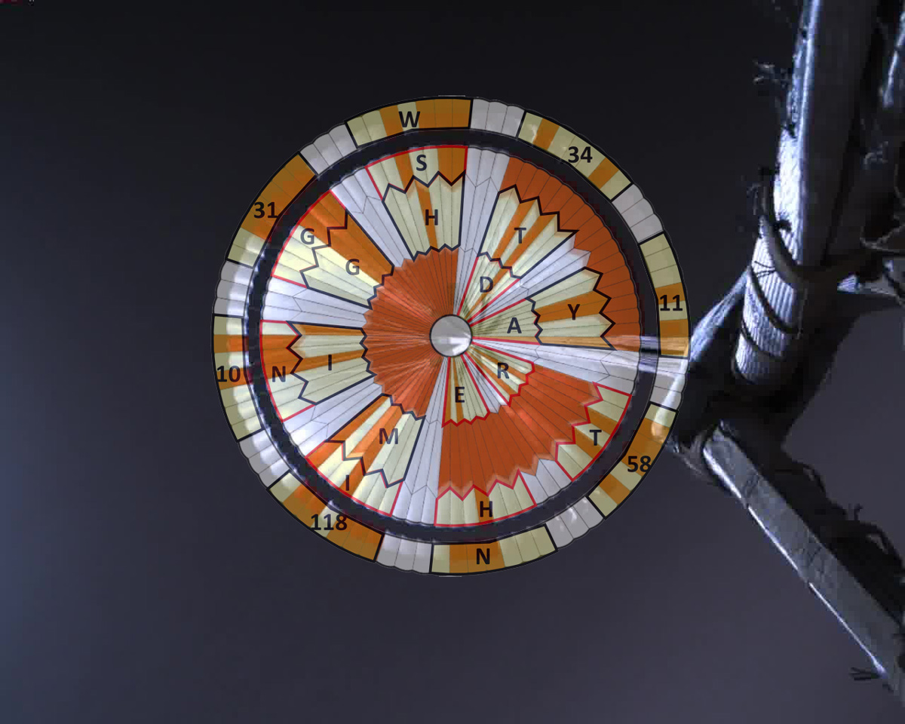
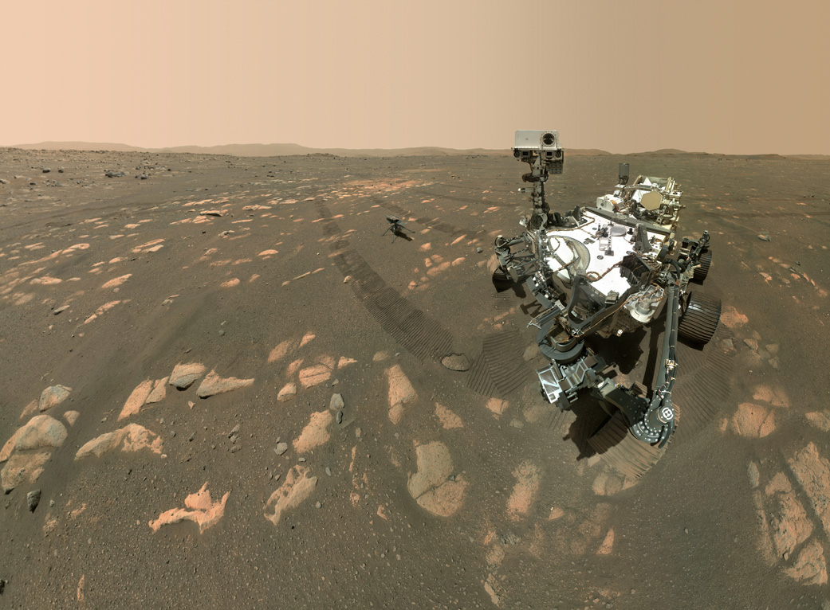
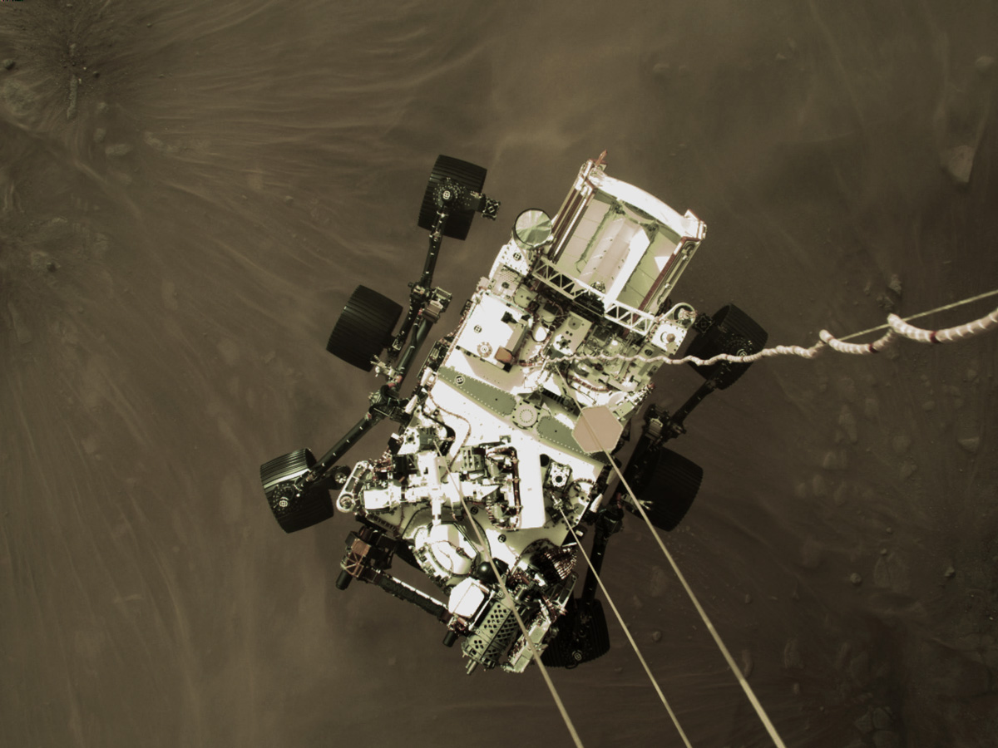
Mars 2020 Flight System Overview
High Heritage Cruise Stage & Parachute
Landed February 18th 2021
Seeks signs of past life via geological characterizations
Payload includes human exploration tech demo… and helicopter!
Sample Caching System collects, caches, & deposits soil and rock samples
April 6, 2021
Modified/New Rover
New Helicopter
High Heritage Descent Stage

Slide 4
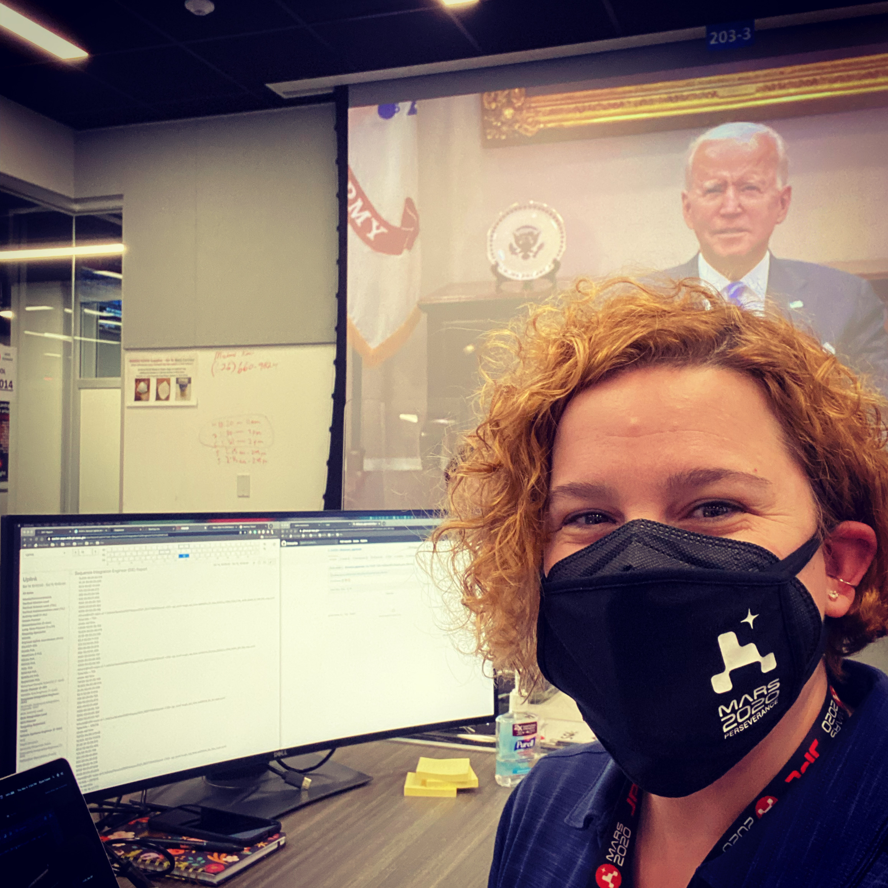
Mars2020 Operations Overview
end
Martian Day
Orbiters relay Rover data
start
Martian Night
Primary Mission Objective: Collect and deposit 20 Martian samples in 1.25 Mars Years
A Martian day (Sol) is ~24 hrs and 40 min in Earth time
Ops Team plans the rover’s activities during the Martian night
Reliant on orbiter relay times to assess YesterSol’s activities and to plan ToSol
First ~70 Sols are operated on Mars time
Earth shift start time moved everyday to accommodate the Martian night shifting as well as orbiter relay return times

Slide 5
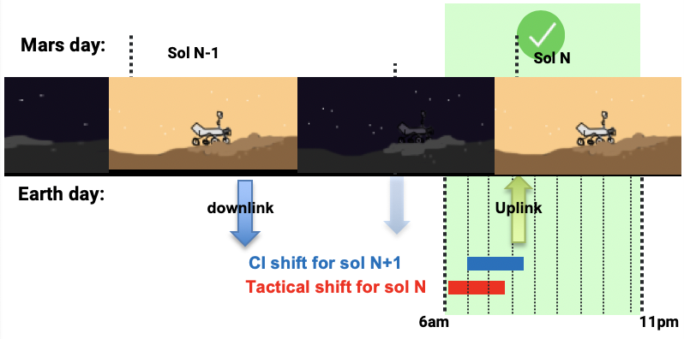
Mars2020 Operations Overview
Post first ~70 Sols, the Earth shift start times are arbitrarily restricted to start between 6:00 and 12:00 PDT
Currently takes ~10 hours to from receipt of downlink to build and validate next Sol’s activities
Can know strategically when data will be received later than 12:00 PDT
In these cases the planning team reacts to stale downlink data to plan ToSol’s activities (called Restricted Sols)
Introduces operations inefficiencies due to restrictions put on mechanism usage (Driving, Robotic Arm motion, etc.)
Challenge is to reduce the 10 hour timeline to 5 hours: this will reduce the number of Restricted Sols
end
16:00 – 22:00 PDT
Orbiters relay Rover data
start
6:00 - 12:00 PDT

Slide 6
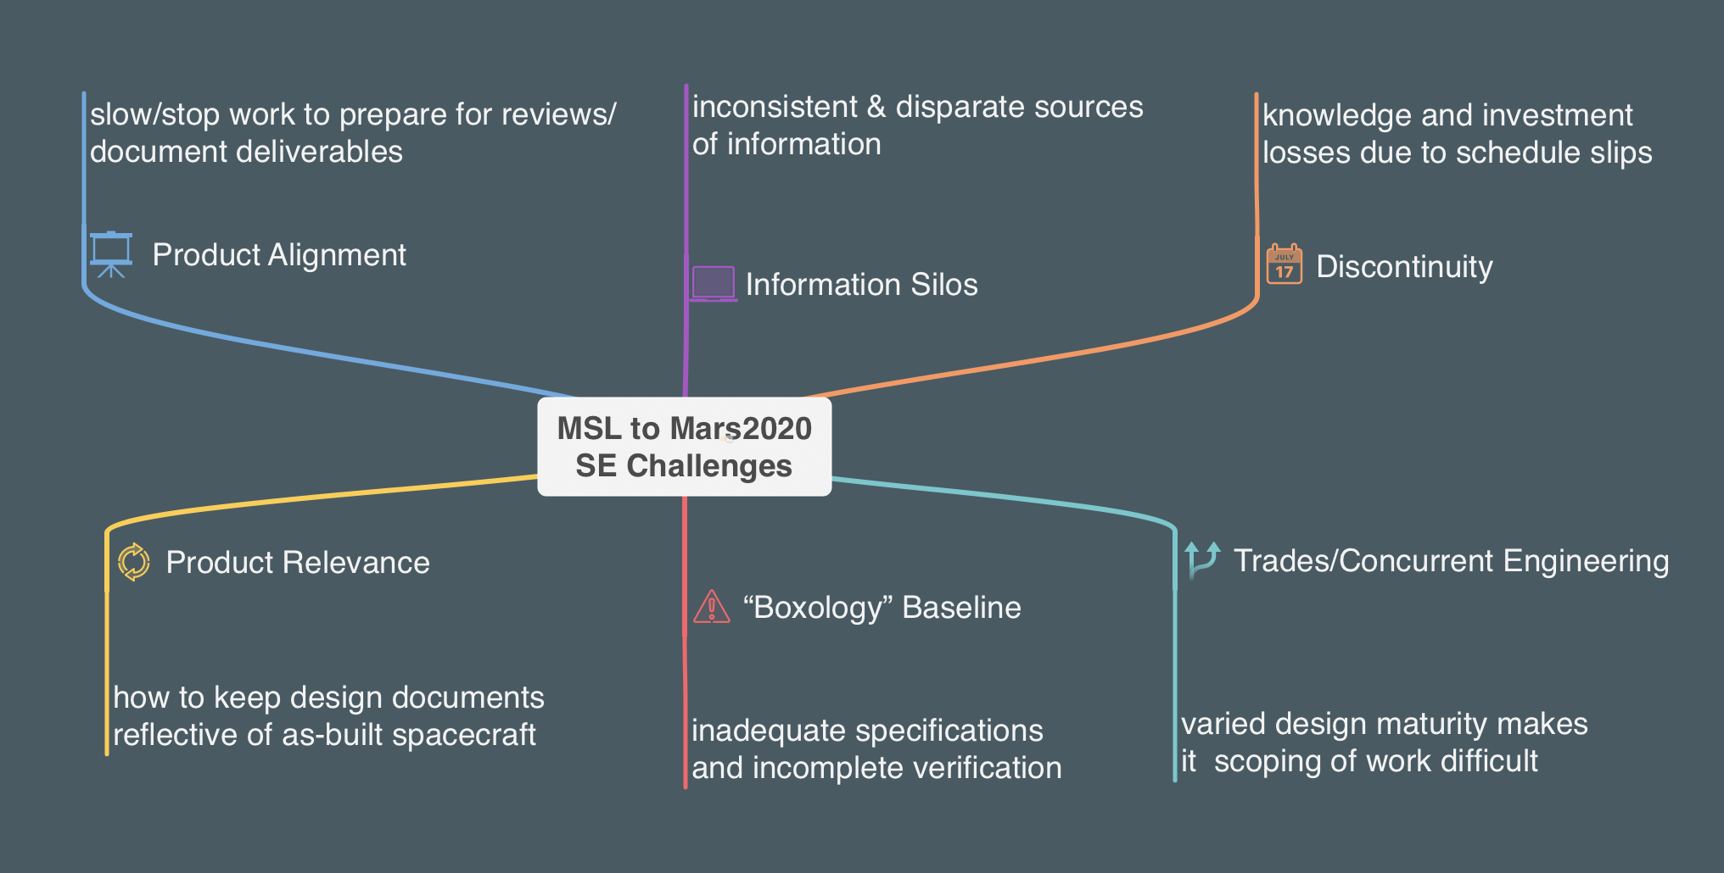
How Does This Relate to MBSE?
When Mars2020 was funded, the core Systems Engineering team identified 6 key Systems Engineering Challenges from MSL:
The Team decided to pursue a model-based approach to solve these challenges

Slide 7
MBSE Infusion Through the Mars2020 Lifecycle
Enabled trades/concurrent SE
Reduced Knowledge Discontinuity
Aligned SE work with gate product development
Ensured product relevance
Reduced “Boxology” Baseline
Reduced Information Silos
Pre-Phase A
Phase A
Phase B
Phase C
Phase D
Phase E
Mars2020’s MBSE infusion consisted of two separate models:
Flight System Systems Model defined in SysML and Mission System Process Model defined in BPMN
Both efforts utilized COTS software wrapped into institutionally developed add-ons and plug-ins
Both efforts informed institutional MBSE development

Slide 8
Pre-Phase A
Started with 3 interns and 2 MBSE early adopters
Created scripts to seed SysML Flight System model from disparate heritage documents
Leveraged and adapted semantic patterns
Reduced Information Silos

Slide 9
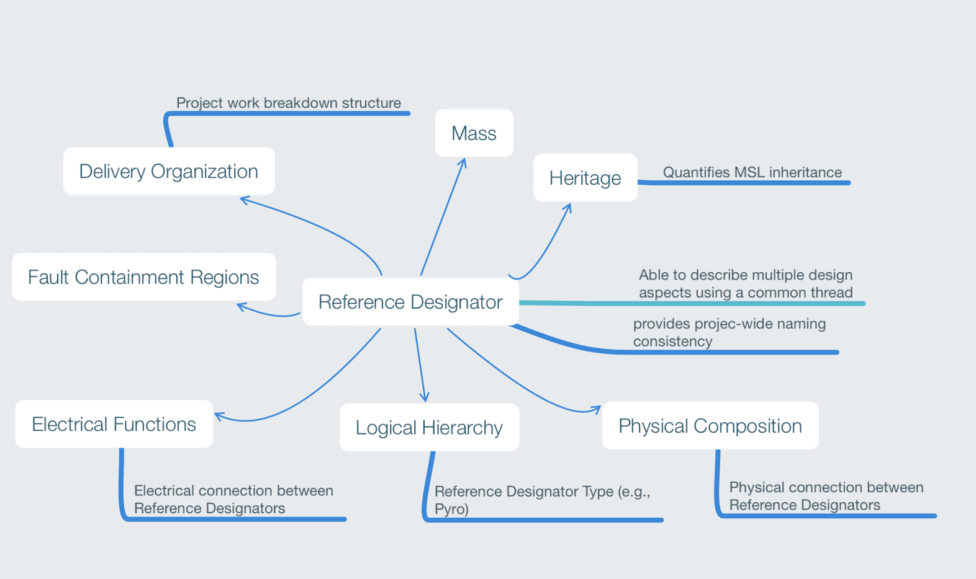
Mars2020 Patterns
The patterns enabled scripts to validate the inherited documents as they were ingested into the SysML model
Created a feedback loop where SMEs were engaged and helped the team work through information disconnects
Disconnect resolution was work that already needed to be done by the SMEs, the effort was helping them identify disconnects
Adaptation of institutional patterns to align with Mars2020 nomenclature
Mars2020 Pattern Example

Slide 10
Phase A
Fall of 2013 effort was downsized to be 1 FTE
Demonstrated document generation directly from Flight System SysML model and began training FSSEs
Reduced Information Silos
Reduced “Boxology” Baseline
Ensured product relevance
Aligned SE work with gate products

Slide 11
Model Generated Documents
The Flight System model development was scoped to create content needed for upcoming design reviews and decision gates
Decision gate deliverables generated from the model:
Reference Designator List
Electrical Function List
Electrical Switch List
Electrical Resource Metrics
Mass Equipment List (descoped)
Mass Trending Report (descoped)
Model generated documents:
Relied on the patterns to generate queries of SysML model
Transformed the queries into read only tables
Were web deployed thanks to institutional collaboration
Mars2020 document examples
1. Electrical Function List
2. Web deployed model generated document list
1
2

Slide 12
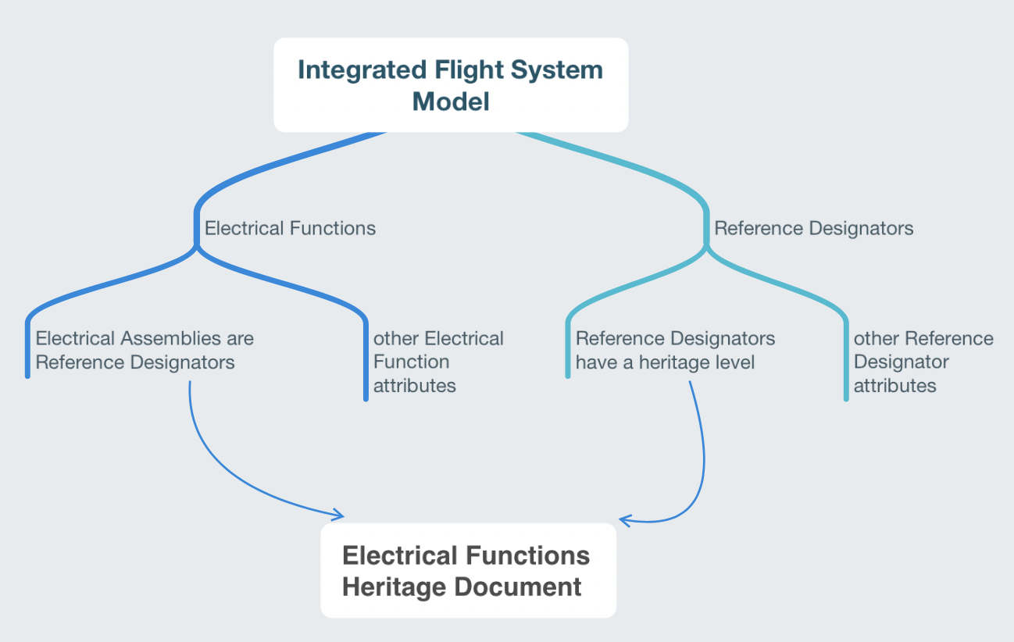
Information Silo Reduction
The electrical team wanted to understand which cabling diagrams had a high likelihood of remaining unchanged from MSL
FSSE was concerned about the time it would take to complete the task: combing through 1000s of electrical functions to determine heritage
Instead, we took less than a day to generate a new model-based document: “Electrical Functions Heritage Document”
Leveraged information that was already populated in the model and the patterns to provide a first order answer to the electrical team’s request
Electrical Functions Heritage Document

Slide 13
Phase B
Phase B effort was reduced to .5 FTE
focused on routine document generation
Created model validation framework
FSSEs maintained the information they owned in the model
Reduced Information Silos
Reduced “Boxology” Baseline
Ensured product relevance
Aligned SE work with gate products
Reduced Knowledge Discontinuity
Notes:
mention the training

Slide 14
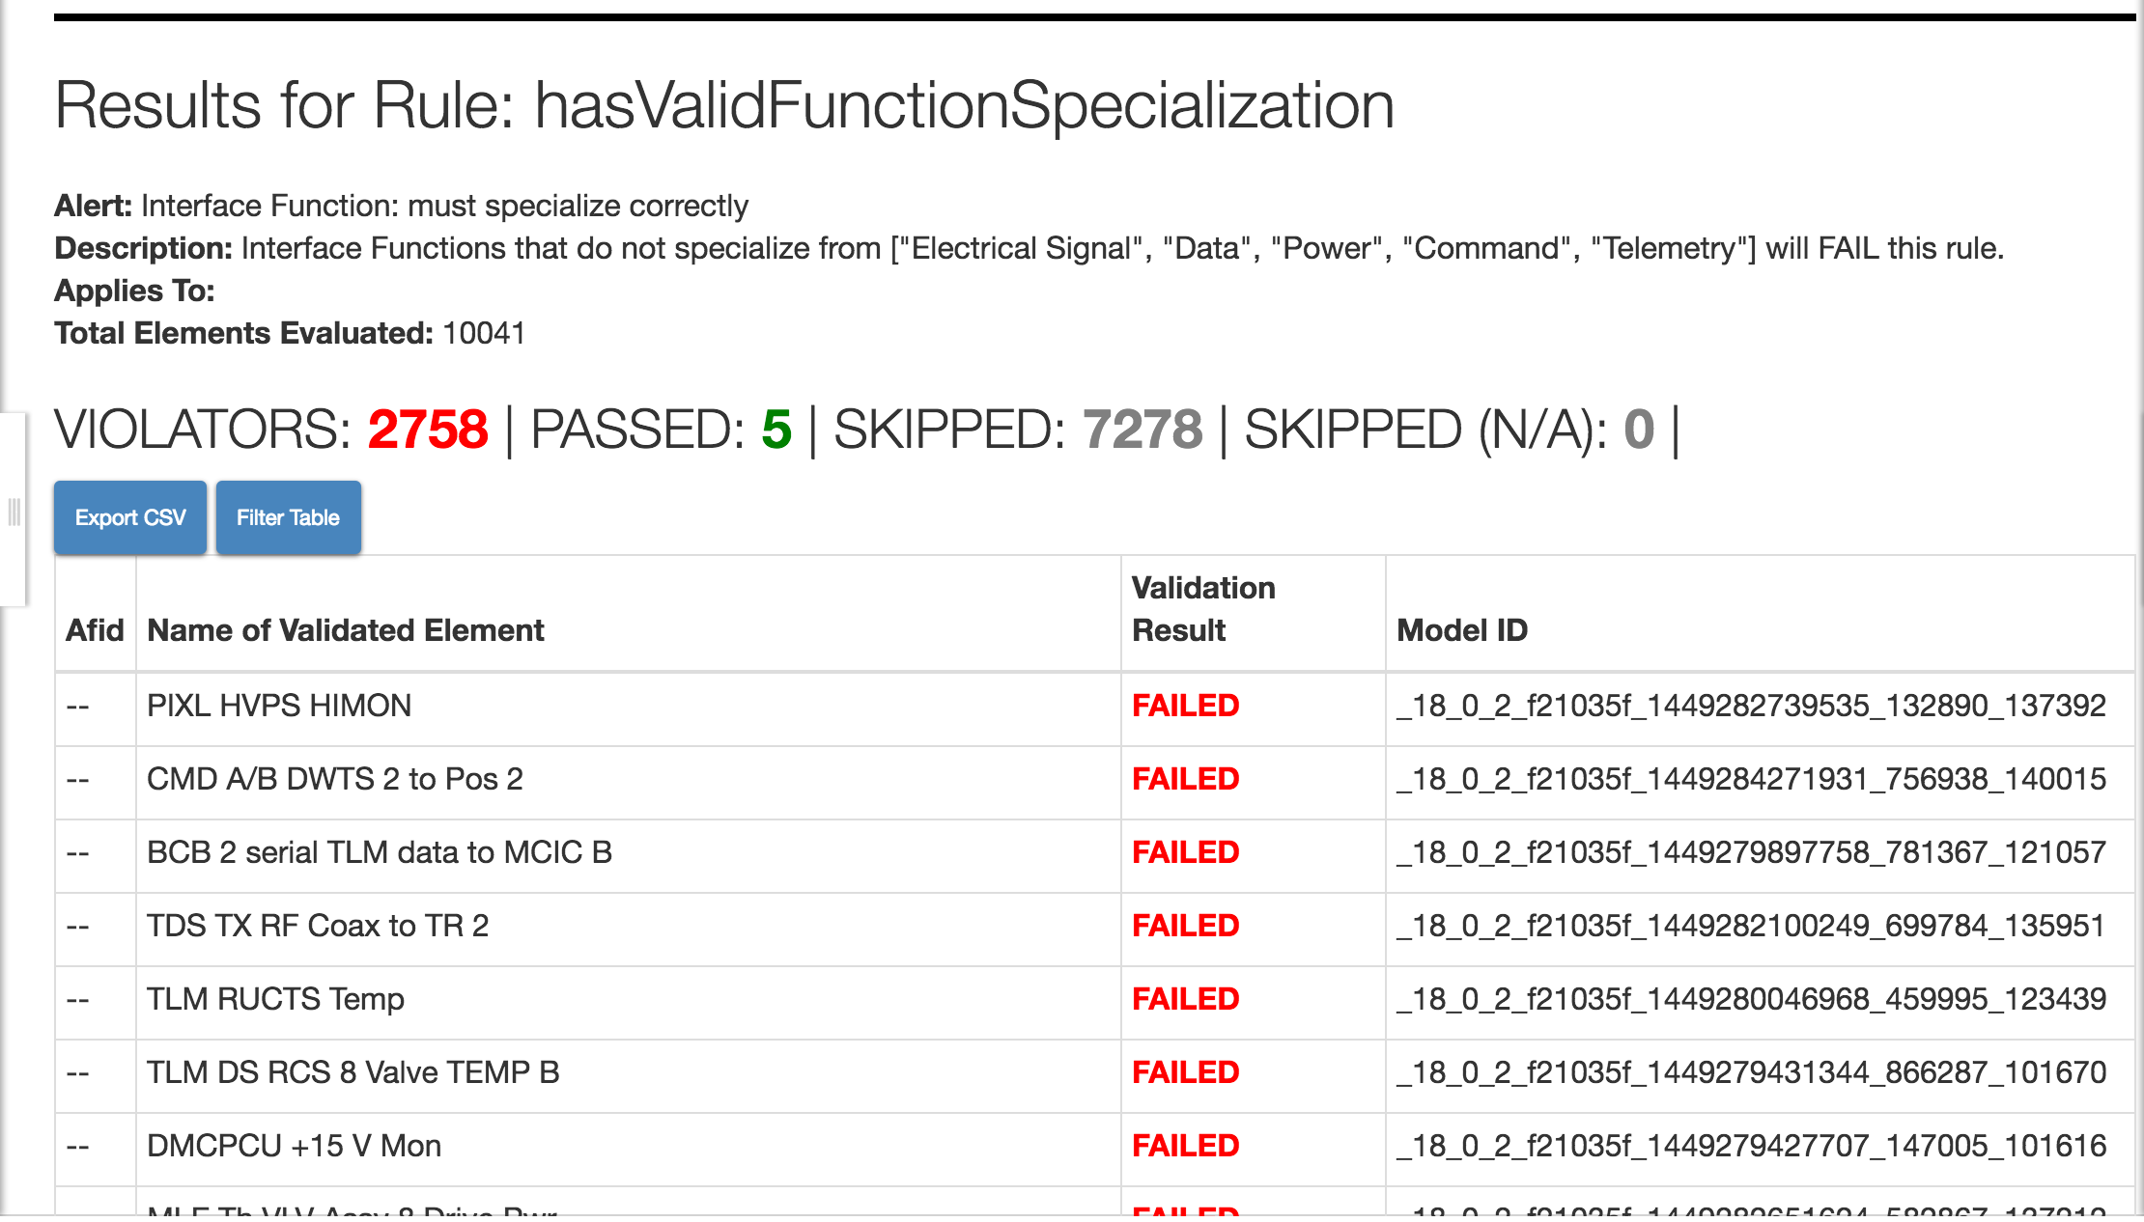
Model Validation Framework
Standardized language coupled with domain specific patterns gives greater situational awareness about the design
Re-usable validation rules can be written against the model
Can ask questions about completeness and work left to go in a quantifiable manner.
Validation can be displayed as a report or within the modeling environment
Accessible to anyone on the team
Validation rules and infrastructure based off of institutional patterns & was adapted from another project (Europa Clipper)

Slide 15
Phase C
Flight System modeling effort stayed at .5 FTE
Demonstrated web-based interactive diagram auto generation directly from Flight System SysML model
Mission System began model-based effort at .5 FTE
Started Mission System process model and demonstrated automated MMR reporting
Reduced Information Silos
Reduced “Boxology” Baseline
Ensured product relevance
Aligned SE work with gate products
Reduced Knowledge Discontinuity
Enabled trades/concurrent SE

Slide 16
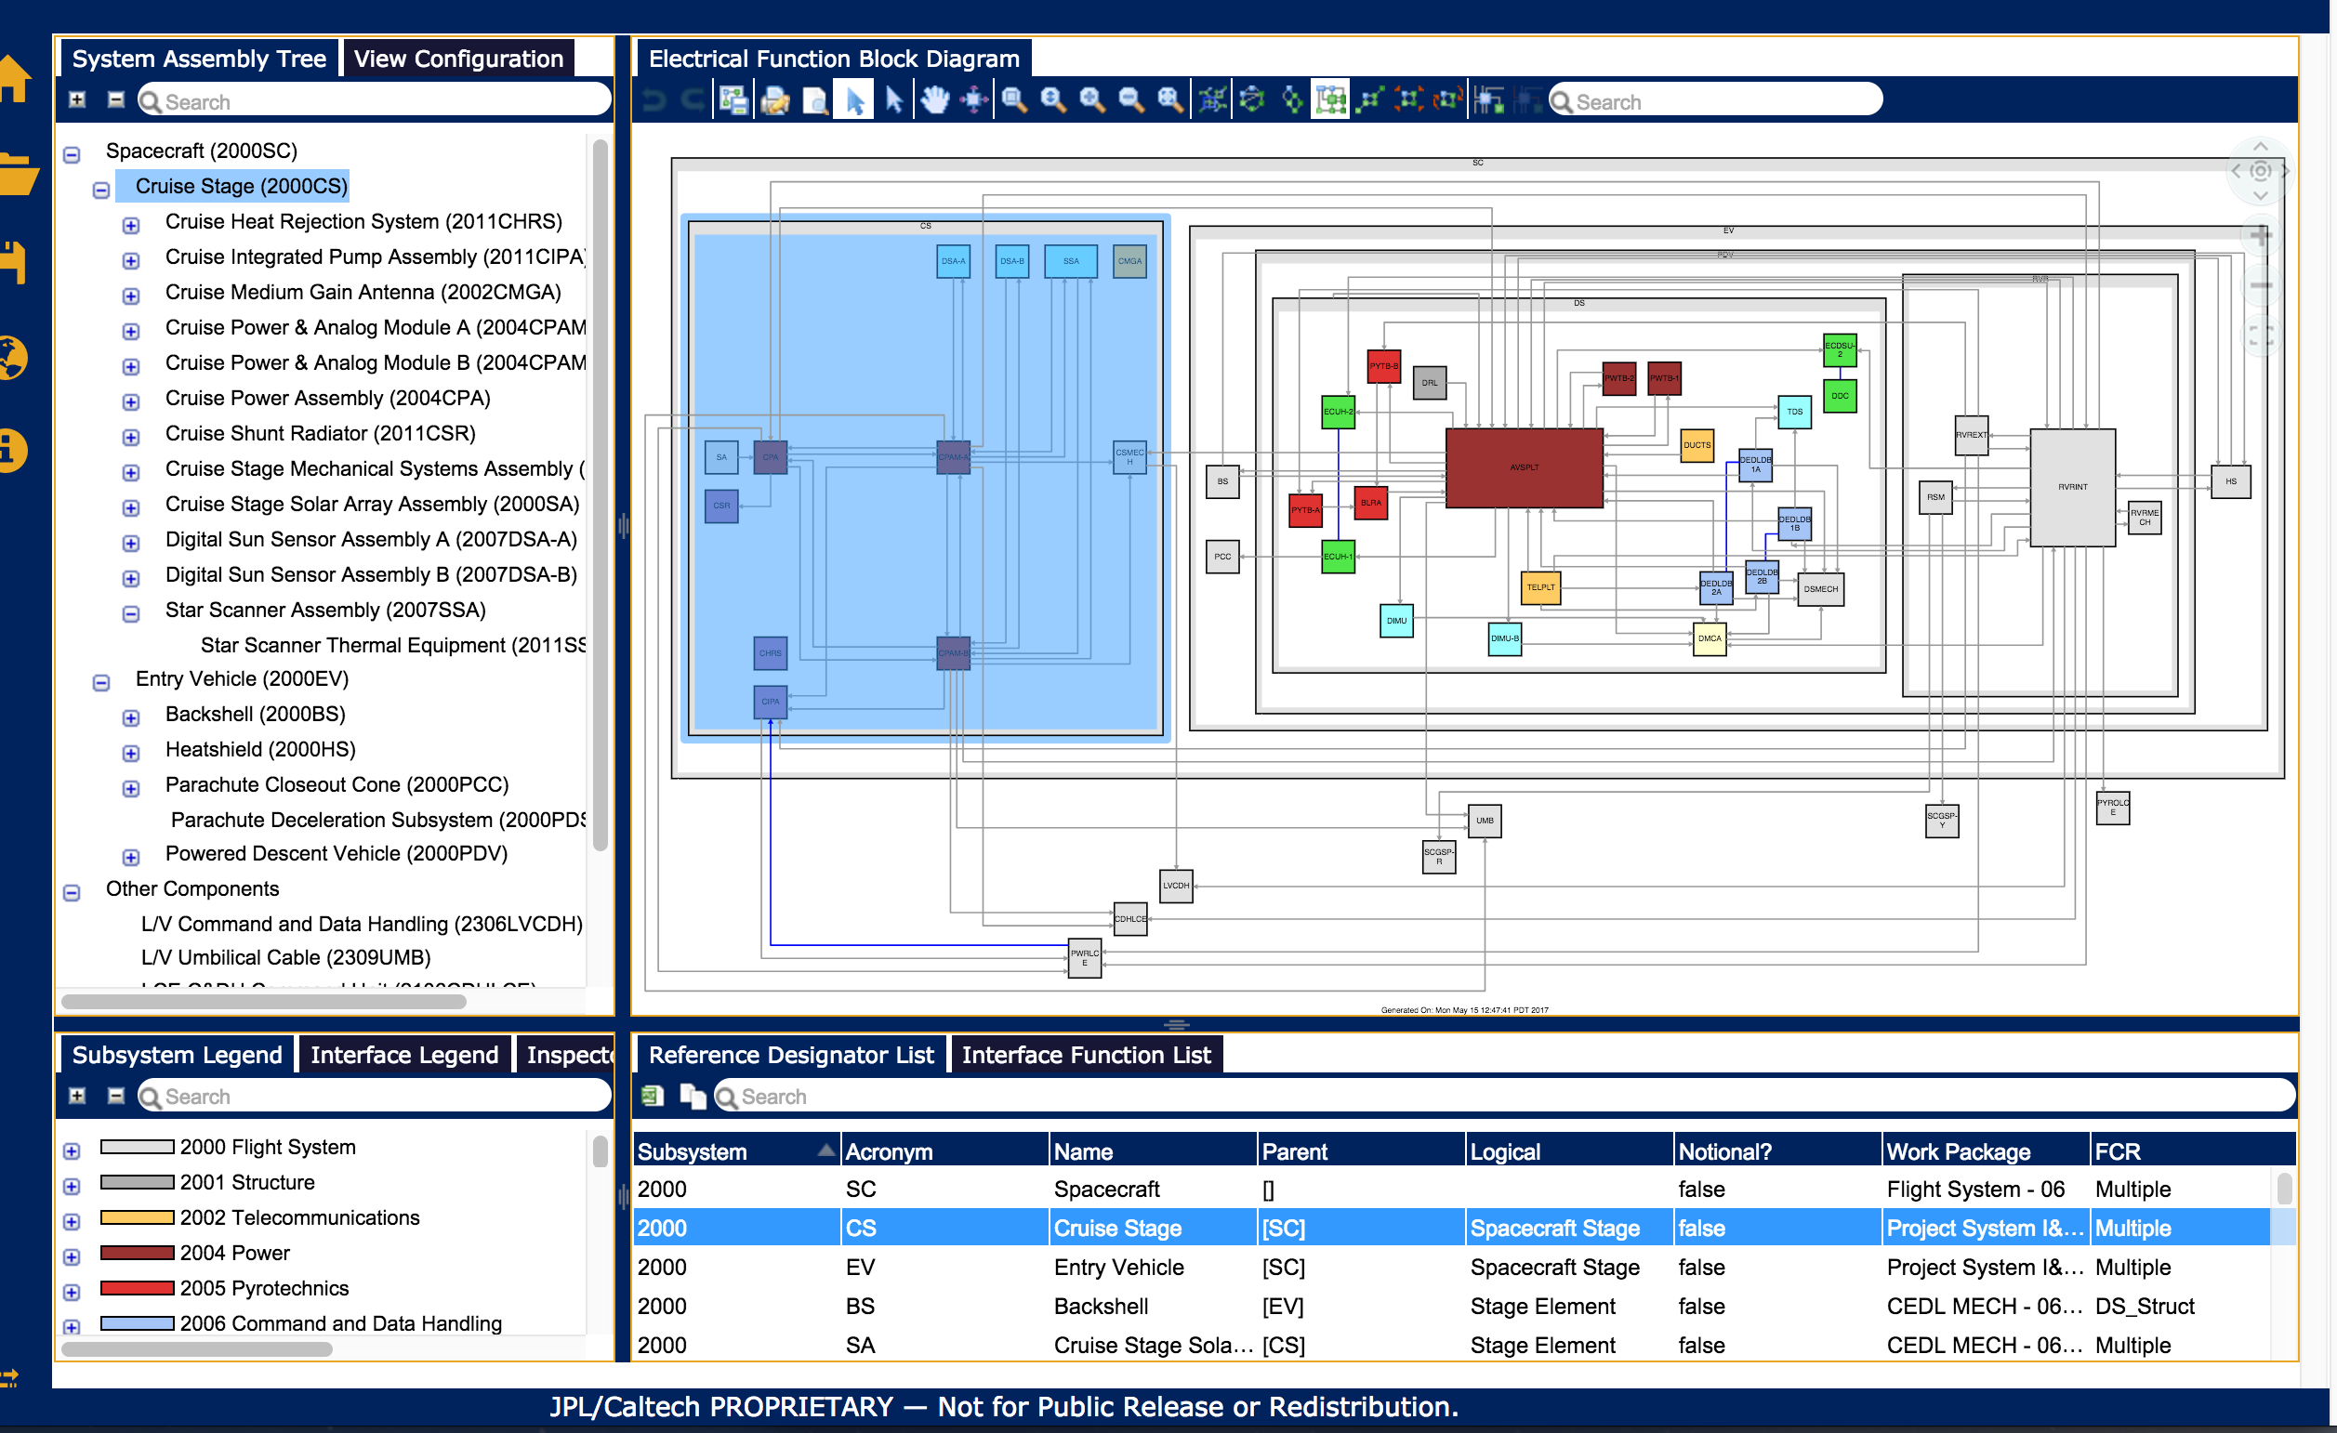
Model-Based Diagram Creation
Visual representation of model info (IBDs, BDDs) were typically created by hand
Decays as information evolves
Technical information representations often communicate poorly to stakeholders/reviewers
No way to validate that what is being shown is completed
Wanted to create rules that dictate the layout of elements on a diagram
”All rover avionics boxes should be inside the rover structure”
Wanted to create presentation rules
“All 1553 data connections are shown as dashed lines”
Wanted the visual representation as either static diagrams or interactive applications
These features have since been incorporated into SysML v2 scope

Slide 17
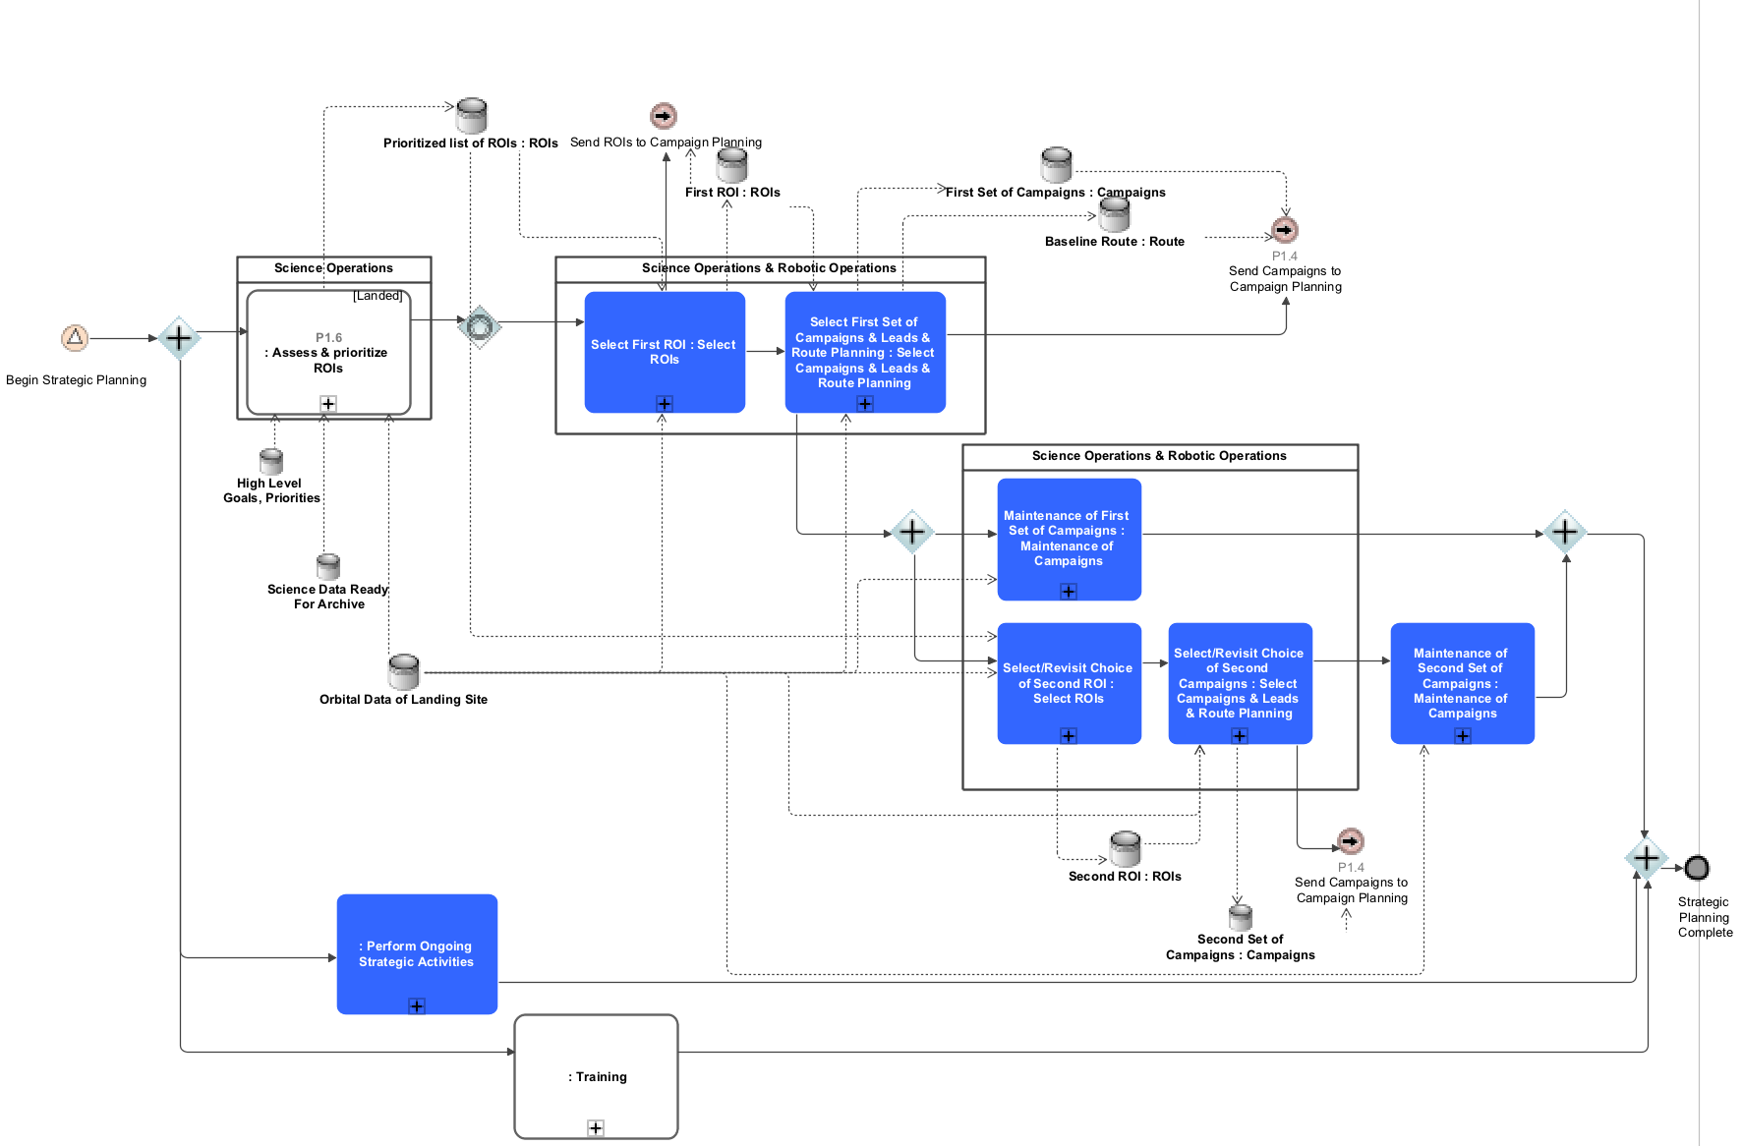
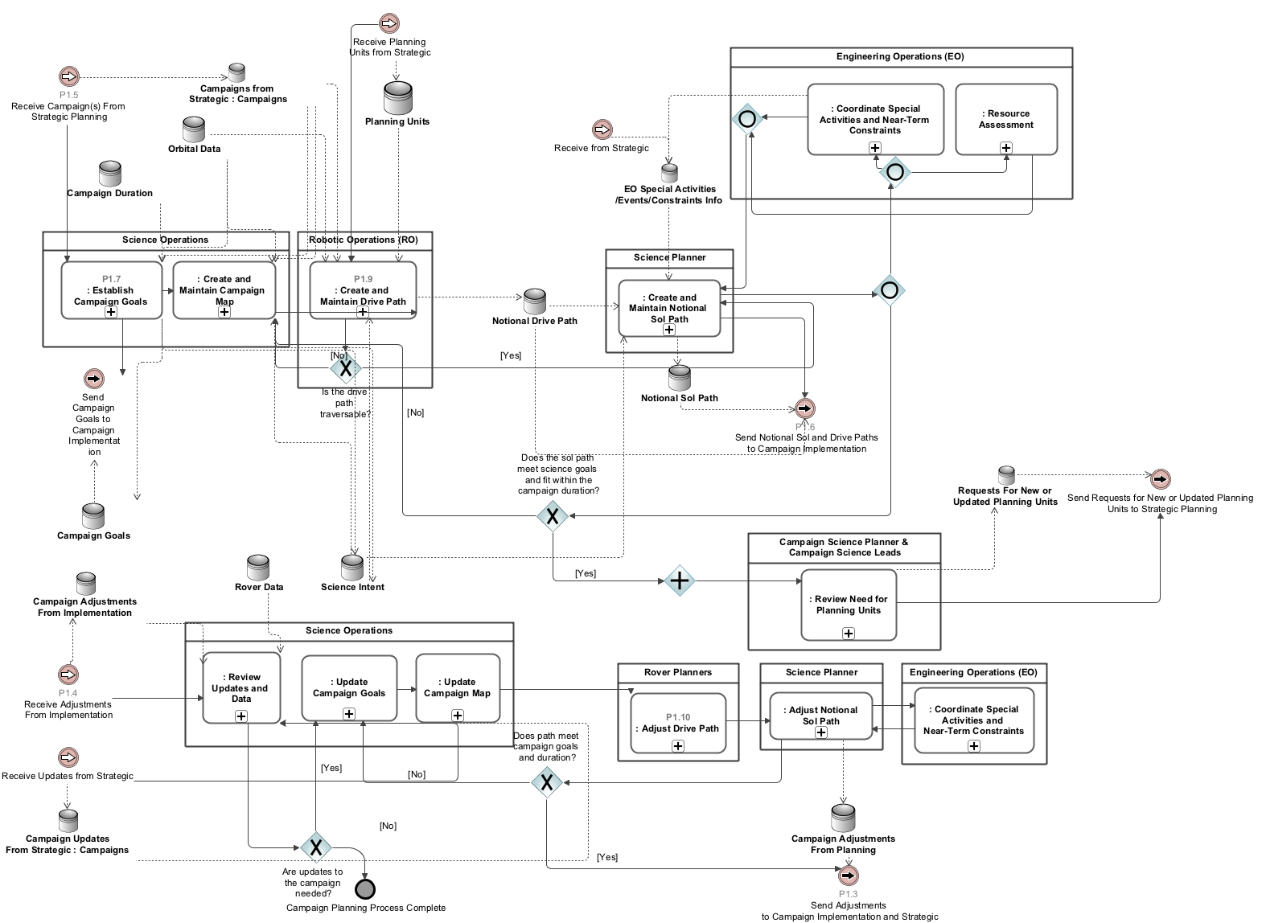
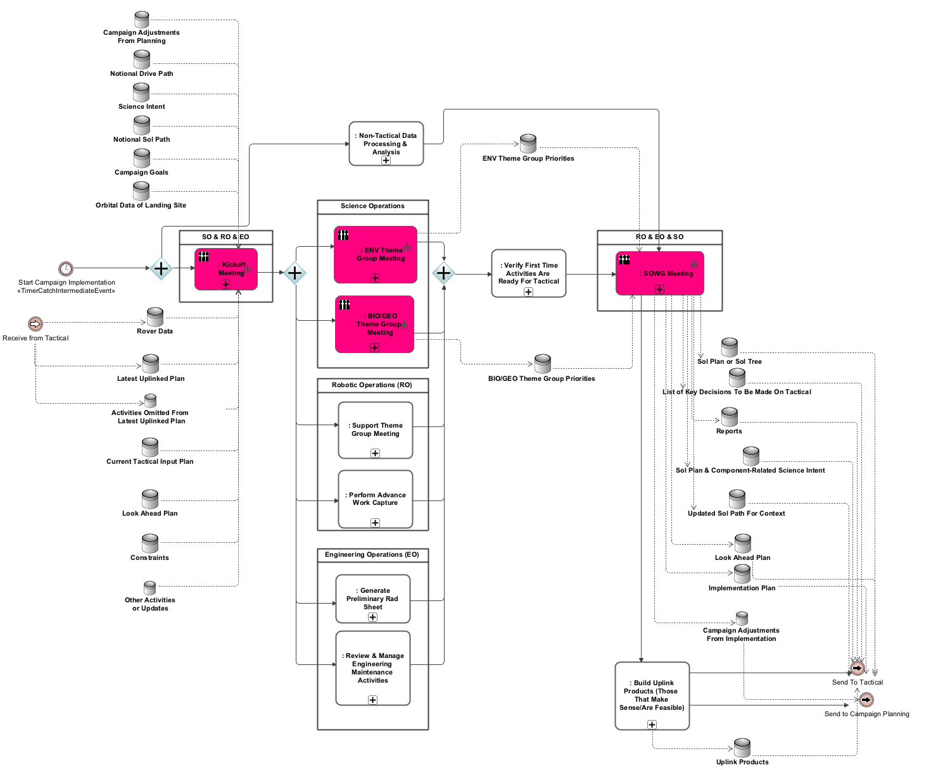
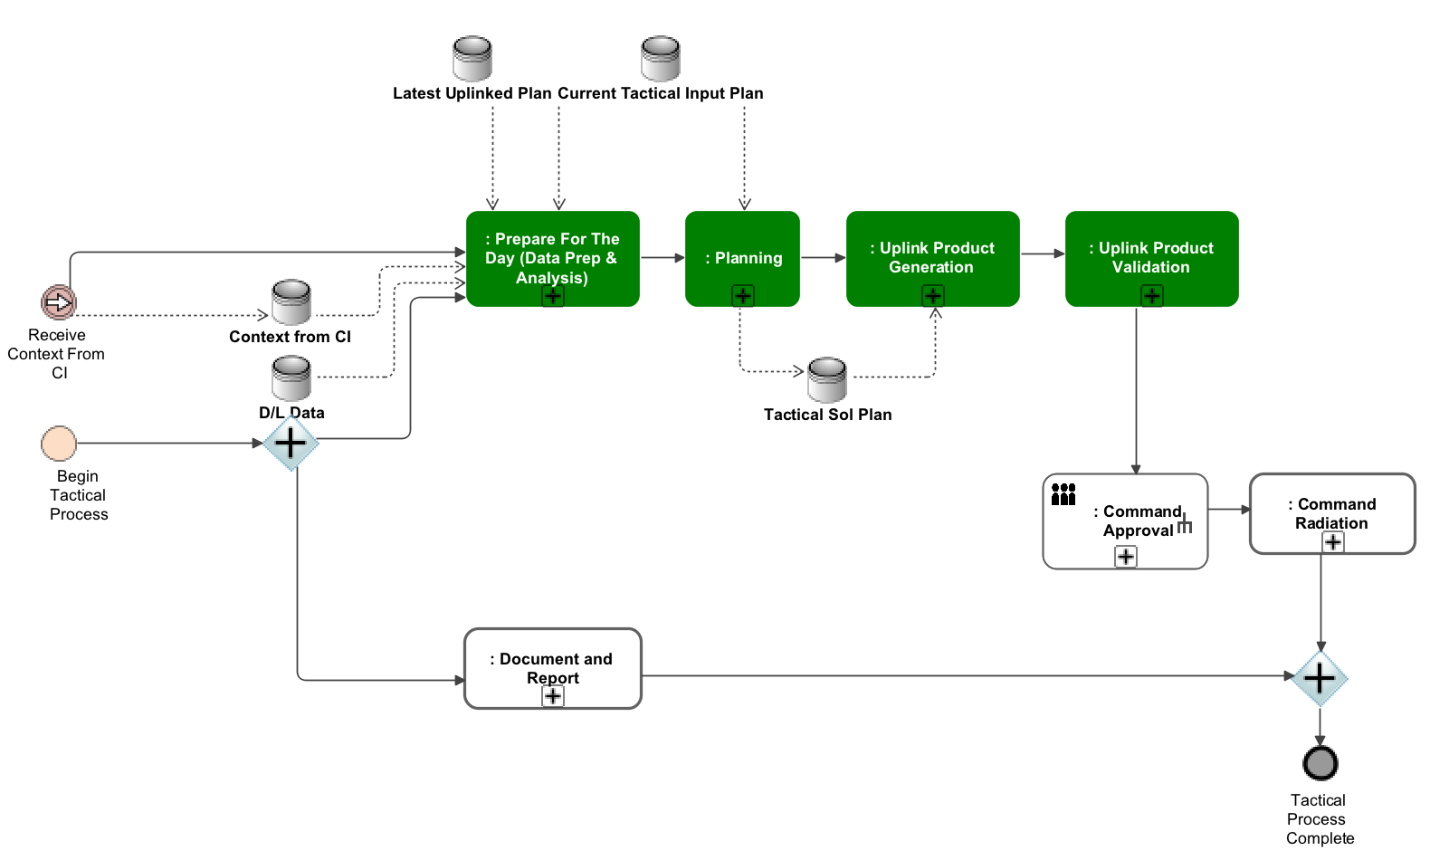
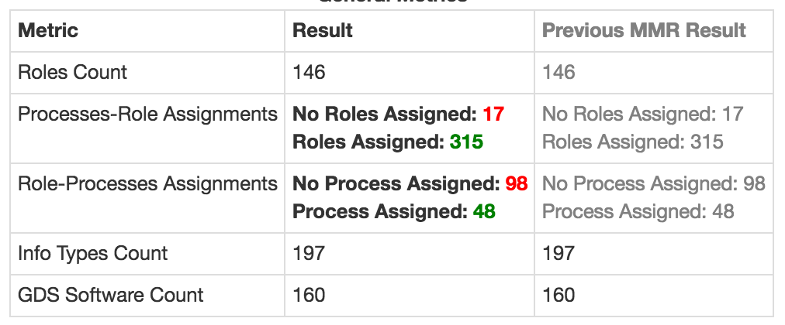
Mission System Trades
Goal was to understand what was needed to transition to the 5 hour timeline and what was 5 hour timeline enabling
Required inputs from various teams to identify key decision points, operational roles, and required information among all of the processes
Model creation was facilitated via a series of working groups
These working groups would have needed to occur regardless of an model-based approach
The integrated model replaced meeting notes
Design progress was reported at MMRs with supporting model-generated reports
Strategic
34 sub processes
Campaign Planning
13 sub processes
Identifying processes, roles,
I/O, information, decision
Cpgn Implementation
31 sub processes
Tactical
60 sub processes

Slide 18
Phase D
Flight System Model enters maintenance mode. Focus is on testing and integration.
Maintenance is handed over to institutional support team
Mission System modeling effort continues at .25 FTE
Mission System expands to link to Ground Software Capability schedule
Reduced “Boxology” Baseline
Ensured product relevance
Reduced Knowledge Discontinuity
Enabled trades/concurrent SE

Slide 19
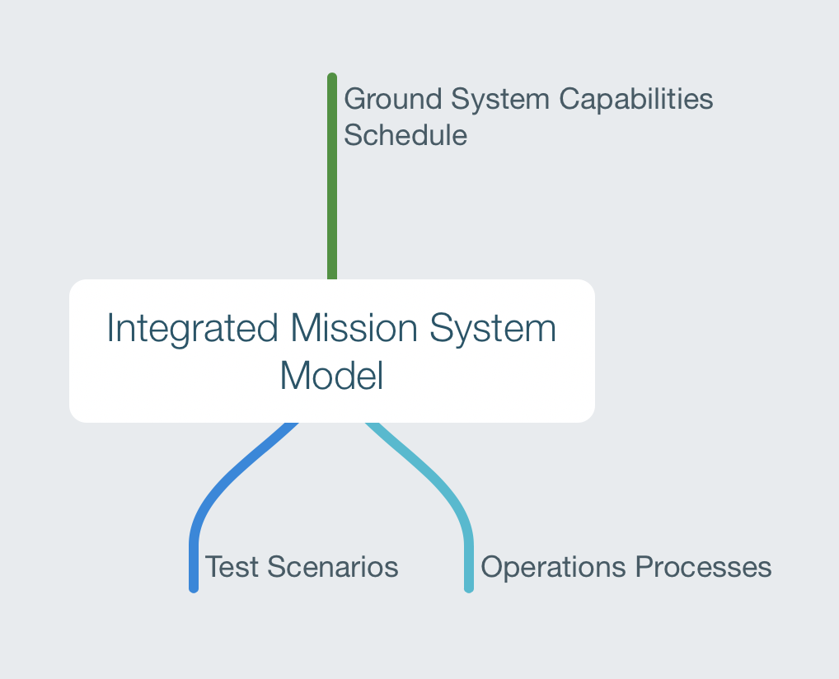
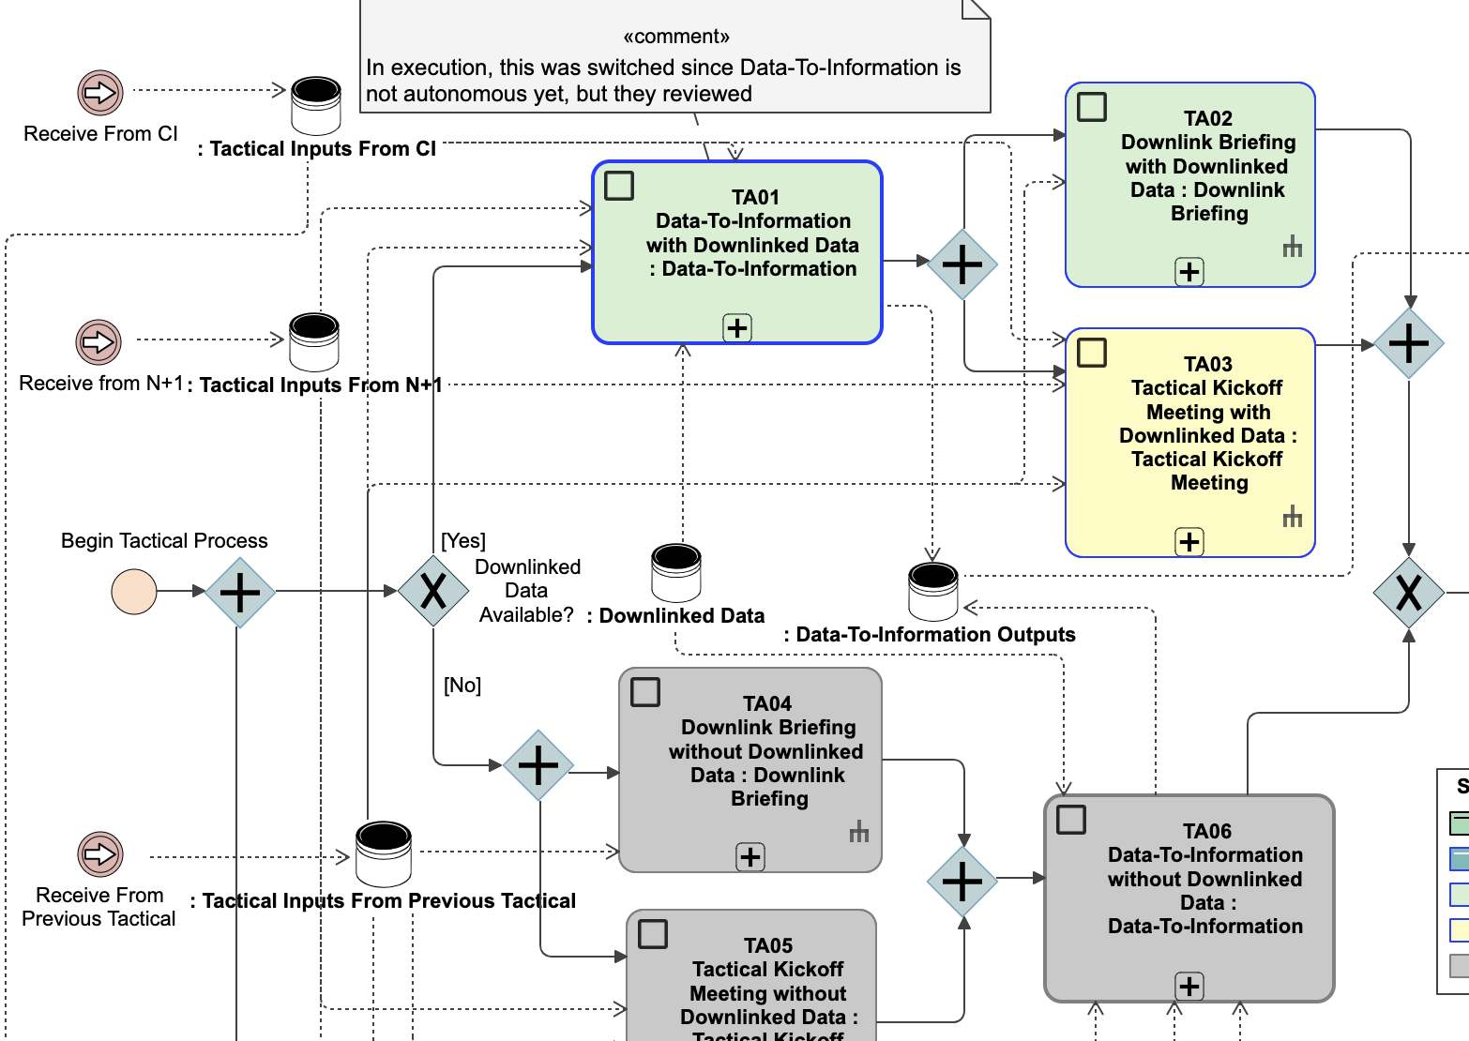
Mission System Capabilities Testing Scope
The team wanted a way to understand when an operations process was ready for test
Most processes were reliant on GDS Software capabilities
The team was able to link GDS Software capability information to the process model and derive the fidelity of the process for upcoming test scenarios

Slide 20
Phase E
Flight System Model is retired
All references are static model-generated documents/diagrams
Model, model-generated documents, and scripts are still hosted by the institution
Mission System model is retired
All references are static model-generated documents/diagrams
Model, model-generated documents, and scripts are still hosted by the institution

Slide 21
Infusion Through the Mars2020 Lifecycle
Enabled trades/concurrent SE
Reduced Knowledge Discontinuity
Aligned SE work with gate product development
Ensured product relevance
Reduced “Boxology” Baseline
Reduced Information Silos
Pre-Phase A
Created scripts to seed SysML Flight System model from disparate heritage documents
Phase A
Demonstrated document generation directly from Flight System SysML model and began training FSSEs
Phase B
Created model validation framework
FSSEs maintained their information
Phase C
Demonstrated web-based interactive diagram auto generation directly from Flight System SysML model
Started Mission System process model and demonstrated automated MMR reporting
Phase D
Flight System Model enters maintenance mode. Focus is on testing and integration.
Mission System expands to link to Ground Software Capability schedule
Phase E
Flight System Model is retired. All references are static model-generated documents/diagrams
Mission System model is retried. All references are static model-generated documents/diagrams

Slide 22
How Well Did We Do?
What follows is a score card, evaluating Mars2020’s MBSE solution against the 6 primary challenges defined:
1
Good ideas and concepts but no deliverables
2
Initial demonstration of feasibility, not maintainable
3
Solution is maintainable, not in use by other missions
4
Solution in use by other missions infusing MBSE
5
Infused in JPL’s technical baseline, repeated use by missions

Slide 23
MBSE Infusion Scorecard
2
4
3
4
Mass-related gate products chain of intellectual custody hindered development
No formalization of Mission System reporting efforts
Scripts and patterns fed into institutional effort for formalizing Electrical Systems Modeling
Mission System reverted back to power point/wikis
Scripts and patterns fed into institutional effort for formalizing Electrical Systems Modeling
Models and products are hosted by the institution
4
4
2
Model-based document generation architecture is mature and available for other missions
Mars2020-specific viewpoints and codebase have been shared with the institution
Model-based document generation architecture is mature and available for other missions
Mars2020-specific viewpoints and codebase have been shared with the institution
Mars2020 effort did not formalize any methodology

Slide 24
Flight System Lessons Learned
Crucial to understand document dependencies/impact
Integrated source of information coupled with model-generated documents means there needs to be a greater understanding of how model changes impact documents
Not every document that sources the same information has the same update cycle
Electrical functions might be updated to complete an ECR update but Motor Controller folks have a meeting in twenty minutes and the information changes
Crucial to communicate what filters are applied during generation of model documents
There were late breaking realizations that rows were missing in model-generated documents due to them being filtered out automatically
Disconnect between viewpoint author and document owner
Need to revisit the right level of CM for the information
Project CM is done at the document level (e.g. ”columns A-H are under CM”)
As non traditional design documents are generated from the model, the Abstracted Flight System Block Diagram, there will be changes requested that might affect documents under CM

Slide 25
MBSE Infusion Barriers
Difficult to support “sandbox” type work/analysis
A reason why Mass Equipment List (MEL) is not maintained in the model
Not conducive to “what-if” analysis during meetings
Opening up the SysML model, navigating to the mass information, re-calculating the MEL
Instead the MEL owner duplicates information and performs such work outside of the model
Attention must be paid to communicating usefulness of new tools
Training for Tom Sawyer, how to interpret the deployed visualization
Training for M2020-specific framework
Transition to a model-based approach has growing pains
Requires SE, management, planning, and discipline
There is upfront work that needs to be recognized

Slide 26
Takeaways
An MBSE environment is showing it’s utility but is balanced by it’s ease of implementation and work force knowledge
It is crucial to have management support and to lay out a path to show incremental value added
Can not forget that Systems Engineering is the focus – not the model
As the pace of the project quickens the patience for de-bugging on tooling issues dwindles
Any perceived issue re-introduces the thought that the model is incorrect/can’t be trusted
A lot of pathfinding work done for the Flight System SysML model
Drove out inconsistencies/assumptions early
Visualizations, resource lists, etc. are applicable to the Mission System and other domain models
The risks to Mission System would not be addressed by these artifacts – less valuable
Cross-training experience for earlier-career engineers

Slide 27
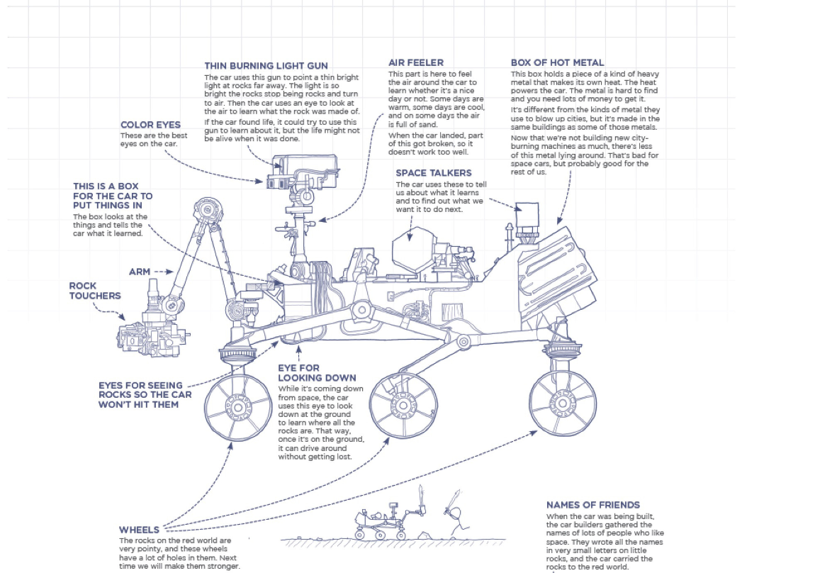
Thanks!
Randall Munroe, Thing Explainer: Complicated Stuff in Simple Words
Notes:
NEW

