Slide 1
Landsat 9 – OLI-2
Washington DC Area
Lessons Learned in Systems Engineering Availability and Recommendations for Mission Technical Leaders
Charles Baker
Dave Everett
Systems Engineering Seminar
February 17, 2022
Notes:
Popocatépetl volcano—the name is Aztec for “smoking mountain”—is one of Mexico’s most active volcanoes. The glacier-clad stratovolcano has been erupting since January 2005, with daily low-intensity emissions of gas, steam, and ash. On January 2, 2021, the Operational Land Imager (OLI) on Landsat 8 captured this image of a plume rising from Popocatépetl (nicknamed El Popo).

Slide 2


What is Systems Engineering Availability?
Availability is more than just time; it is openness to listen to concerns and questions.
It begins by building a level of trust in the team and stakeholders that it is safe to ask questions or share concerns without the fear of blame or additional workload.
It also requires enabling informal conversations (over lunch, coffee, in the clean room, or at the team member’s desk, etc.) where key information can be exchanged, and team members may even provide an easy-to-implement mitigation idea for another subsystem.

Slide 3



What is Value and Purpose of Availability?
Availability is a highly valuable commodity and completely non-obvious to protect and prioritize.
  Leading and attending meetings and individual focused time can consume all available attention if you let them.
The natural tendency of engineers is to keep themselves busy with solving problems that they know about.
  Lead Engineers are generally promoted after demonstrating that they were effective Discipline Engineers.
This presentation is encouraging Systems Engineers to resist this tendency to try and solve all the complex problems themselves or spend all your time in meetings and actively devote daily time to learning and solving problems that are found with informal communications with other team members.
Individual Focus
Status and working groups
SE Availability

Slide 4


Why is Systems Engineering Availability so Difficult to Manage?
NASA Mission Systems Engineers and segment lead Systems Engineers are increasing leading more complex space missions with less support systems engineers and discipline leads.
This is because more and more missions are cost constrained missions or build to cost type missions.
Likewise, management and organizational tools and higher-level meetings increasingly place demands on SEs to report status and manage tool inputs.
SE needs to make a conscious effort to make sure there is dedicated time in their schedule to interact with the discipline engineers to learn about potential hardware issues and risks.
Not discovering these mission level hardware issues would have significantly impacted development schedule on the ground or performance in flight.

Slide 5


What is the risk if Availability isn’t valued?
The job of the MSE or lead segment SE is to be the overall technical lead of the project, therefore a conscious leveling of the risk through the project.
It is important to not neglect the other areas of the project that are not perceived as high risk but will be critical to complete the project.
Often the areas these area are not adequately staffed, nor is attention paid to these areas because of the area’s perceive straight forward nature. Perceptions and reality diverge without conscious attention.
Then it is possible that issues are missed on the ground that impact the mission in flight, or the issues become a major impact to the development schedule.

Slide 6
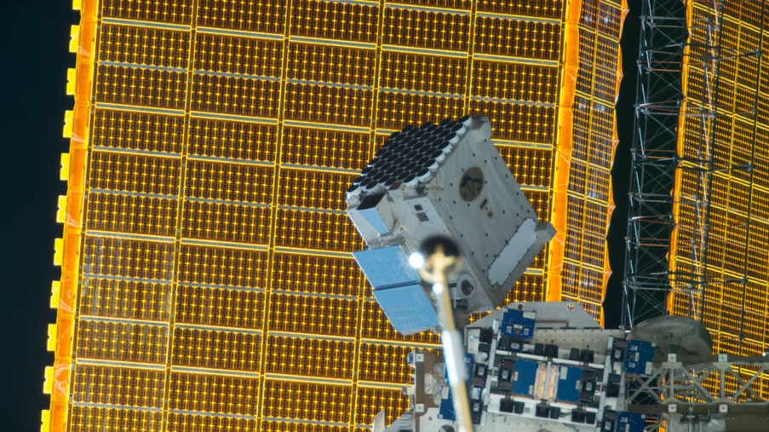
Examples from Neutron Interior Star Composition Explorer (NICER)
Mission Overview
  ISS ESPA Payload
  Dragon Transport Vehicle
Issues Discovered and Resolution Path
  There was a discussion with an EVA expert about the Font and Markings on the NICER Pointing system so that an Astronaut would be able to manually stow NICER in the event of an actuator failure. This drove a third iteration (with the cost and schedule associated with that) to a meticulously developed EVA markings drawing.
  After the meeting was completed the EVA expert offered to stay and talk, while we waited for the next meeting to begin.
  The discussion turned to a complicated mechanism we were thinking of incorporating on NICER that would pin NICER between the Active and Passive ExPA, effectively rigidizing the slots so that NICER would be firmly attached to its base.
  During the discussion the EVA expert mentioned that the Passive ExPA (hard mounted to the ISS) had magnets in it that interfaced to metal plates in the NICER side active ExPA.
  The Magnets and metal plates in the ExPA are completely undocumented by the ISS.
  This discussion eliminated the need for this complex mechanism addition.
Objective | Measurements
Structure — Reveal the nature of matter in the interiors of neutron stars | Neutron star radii to ±5%. Cooling timescales
Dynamics — Uncover the physics of dynamic phenomena associated with neutron stars | Stability of pulsars as clocks. Properties of outbursts, oscillations, and precession
Energetics — Determine how energy is extracted from neutron stars. | Intrinsic radiation patterns, spectra, and luminosities

Slide 7
Examples from Neutron Interior Star Composition Explorer (NICER)
Mission Overview
  ISS ESPA Payload
  Dragon Transport Vehicle
Issues Discovered and Resolution Path
  Due to an earlier unexpected failure on the ELC spare avionics at KSC for an earlier ISS routine test, these types of interface tests receive tremendous scrutiny by the ISS.
  Testing is scheduled months in advance for certain windows on the calendar. Our test was scheduled from a Tuesday to a Friday.
  We then tried to use the ethernet link, which NICER uses to downlink its science data. There was no response. And then the troubleshooting began.
  The NICER team would meet at night to have dinner together and plot the troubleshooting approaches for the next morning.
  We didn’t want to go into the test harnesses so he had made a trip to Home Depot and bought some commercial Ethernet cable so that we could swap the wires with a quick extension he made. But time was running out.
  We (MSE and another SE) had to go personally to each of the KSC employees supporting the test and ask them if they could support for 6 hours on Saturday.
  This enabled us to complete testing and not impact critical path.
Objective | Measurements
Structure — Reveal the nature of matter in the interiors of neutron stars | Neutron star radii to ±5%. Cooling timescales
Dynamics — Uncover the physics of dynamic phenomena associated with neutron stars | Stability of pulsars as clocks. Properties of outbursts, oscillations, and precession
Energetics — Determine how energy is extracted from neutron stars. | Intrinsic radiation patterns, spectra, and luminosities

Slide 8
Examples from Neutron Interior Star Composition Explorer (NICER)
Mission Overview
  ISS ESPA Payload
  Dragon Transport Vehicle
Issues Discovered and Resolution Path
  NICER engineers and MSE were at an End Item Data Review for the NICER Star Tracker near Copenhagen.
  The NICER Star Tracker vendor stated compliance with the in-rush requirement.
  But when the verification artifact was examined, it showed the in-rush for the star tracker exceeded the requirement.
  This was a total surprise for a star tracker that consumed a handful of watts.
  The star tracker was already built and tested at this point and couldn’t be re-designed to minimize the in-rush.
  The in-rush was substantial enough that the ISS switch providing NICER power would likely have tripped every time the star tracker was turned on.
  The electrical lead gave the MEB vendor a phone call.
  Within a week, the MEB vendor had offered a different type of switch which would give the Star Tracker a “soft start” to lower the in-rush without impacting the MEB schedule.
Objective | Measurements
Structure — Reveal the nature of matter in the interiors of neutron stars | Neutron star radii to ±5%. Cooling timescales
Dynamics — Uncover the physics of dynamic phenomena associated with neutron stars | Stability of pulsars as clocks. Properties of outbursts, oscillations, and precession
Energetics — Determine how energy is extracted from neutron stars. | Intrinsic radiation patterns, spectra, and luminosities

Slide 9
Examples from Neutron Interior Star Composition Explorer (NICER)
Mission Overview
  ISS ESPA Payload
  Dragon Transport Vehicle
MSE Skills that contributed to Resolution
  We realized the importance of partnering with difficult but knowledgeable experts who provided unexpected expertise
  Systems Engineering has open lines of communication to request accommodations that are atypical.
  With trust and mutual respect, unexpected obstacles can be overcome with minimal programmatic impact with vendors who are willing to work with you.
Objective | Measurements
Structure — Reveal the nature of matter in the interiors of neutron stars | Neutron star radii to ±5%. Cooling timescales
Dynamics — Uncover the physics of dynamic phenomena associated with neutron stars | Stability of pulsars as clocks. Properties of outbursts, oscillations, and precession
Energetics — Determine how energy is extracted from neutron stars. | Intrinsic radiation patterns, spectra, and luminosities

Slide 10
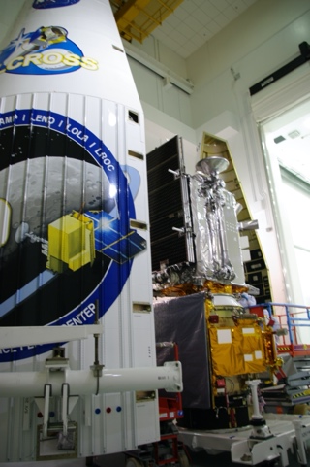
Examples from Lunar Reconnaissance Orbiter (LRO)
Mission Overview
  Currently in its 13th year (14 month design life)
  50 km mean Lunar Polar Orbit (currently in low maintenance elliptical orbit with periapsis around 50 km at the south pole, apoapsis at 216 km
  LRO mission objective is to conduct investigations that will be specifically targeted to prepare for and support future human exploration of the moon
  Locate Potential Resources
  Safe Landing Sites
  Understand the Space Environment
Issues Discovered and Resolution Path
  An undocumented change to a test fixture resulted in a fastener punching through into a lubricated section of a mechanism on one of the instruments.
  The team needed to decide whether to try to vacuum any contaminates out through the hole or take the additional time to completely disassemble the mechanism and replace all the grease inside.
  It was a system-level decision because of the large impact on schedule.
  With input from the MSE and mechanical experts, the project manager chose to take the schedule hit and fully clean the mechanism.

Slide 11

Examples from Lunar Reconnaissance Orbiter (LRO)
Mission Overview
  Currently in its 13th year (14 month design life)
  50 km mean Lunar Polar Orbit (currently in low maintenance elliptical orbit with periapsis around 50 km at the south pole, apoapsis at 216 km
  LRO mission objective is to conduct investigations that will be specifically targeted to prepare for and support future human exploration of the moon
  Locate Potential Resources
  Safe Landing Sites
  Understand the Space Environment
Issues Discovered and Resolution Path
  The transponder vendor discovered during testing that 6% of the time the receiver would not lock up to a 1010 bit pattern as quickly as required.
  The vendor understood the cause of the problem, but the fix would require several months of delays. The vendor also showed that a 11001100 pattern would lock up within the time required.
  The MSE needed to work with the communications team and the ground systems team to determine the solution that would have the least impact on the mission, both during development and in flight.
  Instead of fixing the transponder, the MSE decided that the ground system would make the change in the idle pattern, allowing the receiver to reliably lock within the time allotted.

Slide 12

Examples from Lunar Reconnaissance Orbiter (LRO)
  Currently in its 13th year (14 month design life)
  50 km mean Lunar Polar Orbit (currently in low maintenance elliptical orbit with periapsis around 50 km at the south pole, apoapsis at 216 km
  LRO mission objective is to conduct investigations that will be specifically targeted to prepare for and support future human exploration of the moon
  Locate Potential Resources
  Safe Landing Sites
  Understand the Space Environment
Issues Discovered and Resolution Path
  During system-level testing of the CSS’s, the engineers who were performing the test noticed a very small discrepancy in the current flow (on the order of a few micro amps).
  The MSE encouraged these engineers to keep digging into the source of the discrepancy, even though he expected it was just some bookkeeping mistake.
  The engineers scheduled multiple tests on the spacecraft, to the point where the I&T manager started to complain about their chasing of what appeared to be nothing, but the MSE defended them.
  Eventually, they tracked the issue to a flaw in the circuit that read the CSS’s. Although subtle in the test, this flaw was big enough that the sensors would have been essentially useless in flight.
  The project needed to remove the C&DH box and change some resistors.

Slide 13

Examples from Lunar Reconnaissance Orbiter (LRO)
  Currently in its 13th year (14 month design life)
  50 km mean Lunar Polar Orbit (currently in low maintenance elliptical orbit with periapsis around 50 km at the south pole, apoapsis at 216 km
  LRO mission objective is to conduct investigations that will be specifically targeted to prepare for and support future human exploration of the moon
  Locate Potential Resources
  Safe Landing Sites
  Understand the Space Environment
MSE Skills that contributed to Resolution
  Balance Risk amongst the subsystems.
  Pay attention to casual conversations (and foster them).
  Ensure you understand the cause of anomalies however slight as they may be indicating a larger problem.

Slide 14
Examples from Landsat 9
Mission Overview
  LEO 705 km, 10:11 am MLT descending node
  Landsat provides multispectral imagery supporting key science and societal benefit areas:
  Mapping Land Use & Change
  Forest Dynamics
  Agriculture & Evapotranspiration
  Ecosystem Science
  Surface Water Quality
  Glacier & Ice Sheet dynamics
  Geology and Natural Resources
  Landsat remains the most widely cited land remote sensing system in the peer-reviewed literature and provided $2.06B of economic benefits to the U.S. in 2017*.
Issues Discovered and Resolution Path
  Heritage Test Environments were observed to be fairly high for the Observatory Radiated Susceptibility Levels.
  The level was putting the instruments in a test environment that was exceeding what they were qualified for.
  This drove the MSE to question where the level came from.
  Team modeled actual X-band exposure
  Test Limit was lowered to something that simplified the test setup
MSE Skills that contributed to Resolution
  This required a good relationship with the seasoned project engineering team and the contractor, both who I had only been working with for a few months.
  Convincing the test engineering team the advantages in not over testing.
Forest Change

Slide 15


How to build Availability and Trust Conclusion within the team (1 of 4)
Building relationships within the team from systems engineering to subsystem leads to partners requires time and care.
The MSE can earn trust by participating in informal reviews, have an open-door policy, request advice and provide direction as appropriate.
  Re-direction is best performed first in person, outside of large forums where re-direction could be seen as lack of confidence.
  We all need to learn, be mentored, and grow in our careers.
  How we manage our own home-to-work-life balance plays into our availability for connection.

Slide 16

How to build Availability and Trust Conclusion within the team (2 of 4)
At MSE level it is very easy to let process, reporting, endless list of meetings “that you must attend”, and emails that “must have a reply” overwhelm the time that is available to build relationships and casual interactions with partners and subsystem leads.
  Take time for weekly informal get togethers, periodic picnics and parties, daily sharing of hot drinks.
  Personal relationships with partners that are geographically dispersed requires additional techniques such a weekly one on one telecoms, monthly visits, listening carefully to the needs and wants of the partners.
  Be fair with evaluating impacts (cost and schedule) to changes that come from external interfaces to the partners.
Be worried if you aren’t having any time to plan for/talk through the future.

Slide 17

How to build Availability and Trust Conclusion within the team (3 of 4)
Being trusted also requires emotional availability for other’s concerns.
  This requires active management in every individual. Emotional availability requires taking time off and doing non-work activities.
  It also means opening up your daily and weekly schedule for impromptu meetings and unexpected discoveries.
  As your availability diminishes, it can then be difficult to determine a clear course of action as the inevitable unexpected surprises occur.

Slide 18

How to build Availability and Trust Conclusion within the team (4 of 4)
Whenever there was a big decision to make, the MSE, SEs, and or the PI often would take a walk outside to make sure we had looked at all the sides thoroughly enough but using the length of the walk to ensure we made decisions decisively to move the project forward.
  This is objectively achieved by managing your own schedule to prevent back-to-back meetings.
  It also has a subjective portion: don’t forgo relationship building and taking time off to think inside and outside the workplace.

