Slide 1
Technical Oversight of the Nancy Grace Roman Space Telescope Optical Telescope Assembly (OTA) Element Procurement: Opportunities, Challenges, & Lessons Learned
April 2022 Systems Engineering Seminar
OTA Systems Lead | Joshua Abel
OTA Systems Deputy | Mathew Kline

Slide 2
Abstract
Nancy Grace Roman Space Telescope Optical Telescope Assembly (OTA) is an out-of-house procurement from L3Harris currently being integrated and tested in Rochester, NY. Building upon L3Harris’s decades of success producing world-class optical systems for government and commercial customers offers NASA a proven partner and a tremendous opportunity for high performance and value. Inheriting significant portions of the telescope (including the primary and secondary mirror, composite metering structures and alignment drives) from a previous program presents the opportunity to save cost and schedule but constrains the design space for the unique challenges of the Roman mission. This seminar will cover a brief description of the OTA and its history, some of the challenges posed by incorporating an established product line and inherited hardware into a Class A mission, and some approaches and lessons learned that may be helpful for those structuring new missions or providing technical oversight of out-of-house procurements.

Slide 3
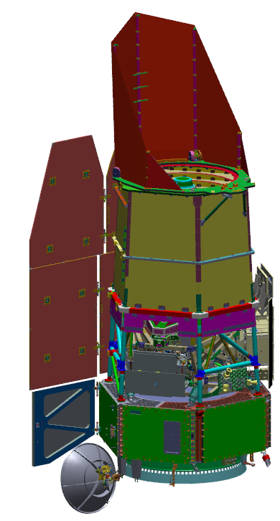
Overview
What is the Roman Space Telescope?
What are the science goals?
What are the technical drivers for the OTA?
Where are we in development? How does the OTA fit in?
How is it organized?
What is an Optical Telescope Assembly (OTA)?
How is it configured?
What are the technical challenges?
Opportunities, Challenges, & Lessons Learned!
The Roman Space Telescope Observatory

Slide 4
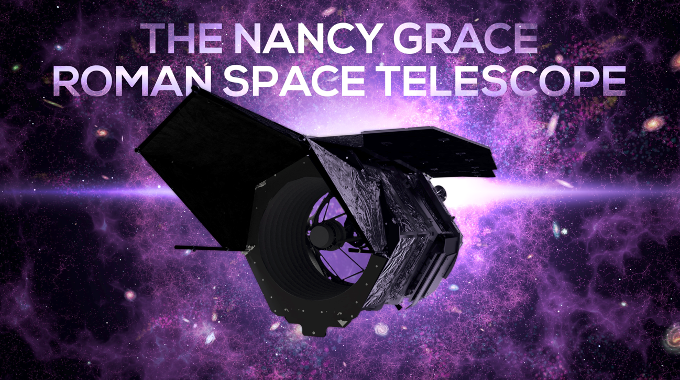
What is the Roman Space Telescope? What are the Science Goals?
Science Description
Determine the nature of the dark energy that is driving the current accelerating expansion of the universe Perform statistical census of planetary systems through microlensing survey Survey the NIR sky Provide the community with a wide field telescope for pointed observations
Project Description
A NASA observatory designed to perform wide-field imaging and slitless spectroscopic surveys of the near infrared (NIR) sky for the community
Key Information
Mission Phase: C Launch Date: Mid 2020s Mission Life: 5 years Category: 1 Class: A tailored Launch Vehicle: TBD Summer 2022 (Falcon Heavy, Vulcan)
Instruments
Wide-Field Instrument (GSFC in-house and Ball Aerospace (WOMA)) Coronagraph Instrument (JPL) - technology demonstration
Partners & Contractors
Partners: ESA, JAXA, CNES, LAM, MPIA NASA Centers: GSFC (lead), JPL, KSC/LSP Significant Subcontractors: AURA/Space Telescope Science Institute Ball Aerospace L3Harris Technologies Teledyne Imaging Systems
We are a very large field near-IR survey telescope with a hosted coronagraph demonstration.
Our project scientist, Julie McEnery, provides a great overview of the science case here:
https://youtu.be/QIHxdXxGDsc

Slide 5
What is the Roman Space Telescope? What are the technical drivers for the OTA?
 |  | Expansion, Structure, NIR Survey |  | Expansion | Exoplanet
 |  | HLWAS - Imaging | HLWAS - spectroscopy | HLTDS | GBTDS
Surveys & Data | Area/Survey Speed | 0.20 deg²/hr (>1,700 deg²) | 0.34 deg²/hr (>1,700 deg²) | 16, 5.3 deg² (Img) 3.4, 1.1 deg² (Spec) >100 SNe/Δz=0.1 | 586 deg²-day Over 6+ seasons
 | Redshift | 0≤z≤3 | 1.1 < z < 1.9 (2.9 w/OIII) | 0.2≤z≤1.7
 | Sensitivity | S/N≥18 @ 24.4/24.3/23.7 (AB J/H/F184) r_{eff}=0.18” | S/N≥6.5 for 1.0x10⁻¹⁶ erg/cm²/s | S/N≥13 (brightest filters at peak) | S/N>100 for H_{AB}=21.4 star
 | Cadence |  |  | ~ 5 days | 15 min
 | Data Vol. | ≥6 reads/exp | ≥6 reads/exp | ≥6 reads/exp | ≥6 reads/exp
PSF | Quality | EE50 ≤ 0.12” (J) | EE50≤0.21”@1.5 μm | EE50 ≤ 0.12” (J) | EE50 ≤ 0.15” (wide)
 | Knowledge | 2nd moment ≤7.2x10⁻⁴ Ellipticity ≤5.7x10⁻⁴ |  | 0.2%
Flux Calibration Relative Over | Time | 0.5% /observing program | <2% rel spect-photometry | <0.5% / 2 wk | <0.1%/season
 | Wavelength | <2% abs/0.5% photo zeropt | <2% rel over bandpass | <2% abs/ 0.5% photo zeropt | <3% abs <1.4% photo zeropt
 | Dynamic Range |  |  | <0.3% 15<AB<26 | <0.1% over 2 mag
 | Area | <10 mmag | <2% rel over survey area
Color | Filters | 4 NIR bands for photo-z, 3 reddest for shapes | Overlap with HWAS imaging for 3 filter imaging | 6 filters 0.5-2.0μm | Wide filter, & 1 short, 1 longward of 1μm
 | Dispersion |  | 10-12 Å/pix | 70 < R < 170
Drives Stability
Optical
Thermal
Mechanical
Key mission drivers of OTA requirements are:
Color (with NIR driving low temperatures)
Image quality (driving wave front error, etc.)
Stability (driving CTE & thermal control)

Slide 6
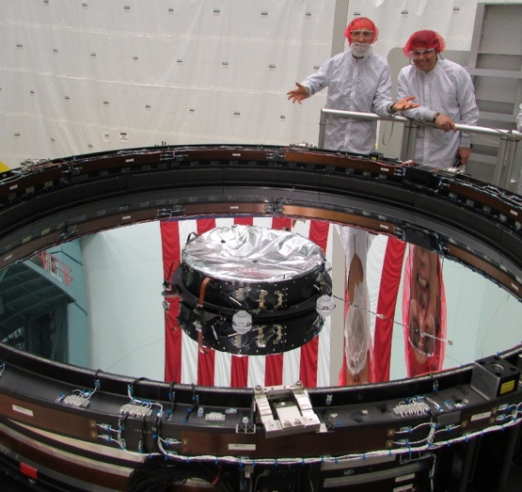
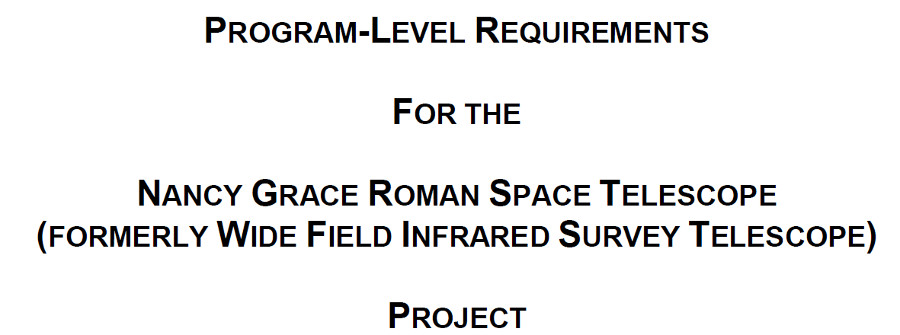
What is the Roman Space Telescope? The Twist… “Level 1” Baseline Technical Requirement
Photo: “Inherited” 2.4m telescope (approved for release)
Use of the inherited OTA is a Level 1 requirement, but the NIR survey mission effectively dictates that the mission environment be quite different than the original program
Caution: Some Assembly Required.
While using the existing hardware has many benefits, it comes with additional challenges that we’ll discuss.

Slide 7
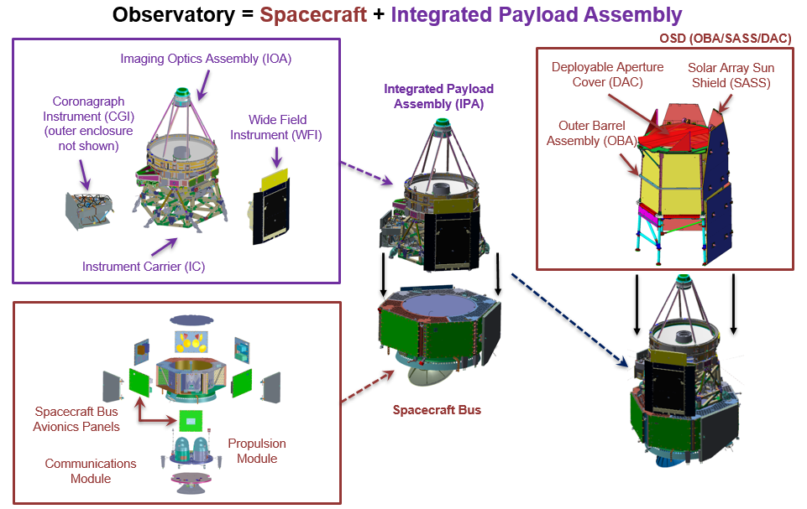
What is the Roman Space Telescope?
Critical Design Reviews
Both the OTA element and Mission CDR are complete
OTA Component Status
OTA components are long lead procurements, so optical elements and large composite structures have been in fabrication for years
All optical elements are complete
OTA I&T
Subassembly I&T is underway
How does the OTA fit in?
Where are we in development?
Telescope Control Electronics
The OTA consists of the Image Optics Assembly (IOA) and the Telescope Control Electronics (TCE). The IOA mounts to the GSFC supplied Instrument Carrier (IC). The TCE is housed within the GSFC’s Spacecraft Bus.

Slide 8
What is the Roman Space Telescope? How is it organized?
Project Manager
J Dunn
Deputy Project Manager
J Townsend
Deputy Project Manager, Technical
D Content
Deputy Project Manager, Resources
C Steeley (155.5)
Mission Systems Engineer
M Melton (599)
Deputy Mission Sys Eng
L Bartusek (599)
Payload SEs/PL
T Casey (ATA) - IFA/IPA Prod. Lead
B Witherspoon (ATA) - IFA/IPA
J Abel (592) - OTA
S Andrews (592) - WFI
R Boucarut (551) - CGI
Spacecraft SE
M Vess (599) - SC SE
T Aland (592) - Dep SC SE
Ground SE
E Mak (581) - Ground SE
J Leibee (JLC) - Ground
Project Scientist
J McEnery (661)
Deputy Project Scientist
J Kruk (665)
Flight Segment/Observatory Mgr
J Hylan
DeputyFS/Obs Mgr
R Kilgore
Deputy FS/Obs Mgr - Technical
D McGuffey
H Smith (Stargazer)
Safety & Mission Assurance
Project CSO – M Samuel (383)
IPA CSO - Vacant
Launch Services Program
C Nguyen (KSC)
Launch Vehicle
K Griswold (Stellar)
Oversight SEs
T Casey (ATA) - IFA/IPA Prod. Lead
B Witherspoon (ATA) - IFA/IPA
Optical Telescope Assembly Mgr
S Smith
Deputy OTA Mgr
D Alexander(SSAI)
Wide Field Instrument Mgr
M Walker
WFI Deputy IM
A Whipple (CA)
Spacecraft Manager
B Forsbacka
Deputy Spacecraft Manager
Vacant
Observatory I&T Mgr
J Baker (568)
Deputy I&T Mgr
M. Drury (GES)
Ground Segment
P Crouse (441)
J Abel (592) - OTA System Eng
Mission Operations Center
H Tann (581)
Instrument Carrier Mgr
A Harper (543)
IC Deputy
W Alexander (543)/A. Herrera (543)
Propulsion
A Rao (597) - PDL
Flight Dynamics
Operations Area
C Webster (595)
Structures & Mechanisms
J Parker (543) - PDL
T Colangelo (ATA) - Dep PDL
Near Space Network Mission Mgr
D Bitner (457)
M Dinardo (SGT) - LLVIS Lead
M Oetken (NGC) - IC I&T
Harness
D Ferro (SSAI) - PDL
V McCarter - (SSAI) Dep PDL
Science Operations Ctr
R Van der Marel (STScI)
Coronagraph Instrument Mgr
T Luchik (JPL)
Deputy CGI Mgr
F Zhao (JPL)
WOMA
M Coon (Ball)
Thermal
J Hawk (545) - PDL
R Chalmers (545) - Dep PD
Coronagraph
Technology Ctr
T Koch (JPL)
Science Support Ctr
R Akeson (IPAC)
L Armus (IPAC)
ICDH
B Sahin (568)
Software
K Luu (582)
R Boucarut (551) - CGI System Eng
T Groff (551) - Prism & Polarizer PDL
SORC
S Wake (551)
Software
N Yanchik (582)
Power
D Kim (563)
Attitude Control System
L Sacks (591) - PDL
O Hsu (591) - Deputy PDL
OTA Systems: We support the MSE as the OTA subject matter experts during mission-level trade studies, observatory I&T, and mission planning.
Harness
M Klappenberger (GES)
Focal Plane System
J Gygax
RF Comm
M Powers (567)
Grism/Prism
J Chambers (551)
C&DH
P Brown (587) - PDL
S Pursley (561) - Dep PDL
Deployment & Propulsion
Electronics
J Badgley (596) - PDL
RST-MGMT-DESC-0011_Rev J
Effective Date: 2/22/2022
Signature: Approved by Jamie Dunn
OTA Systems: Our job is to provide technical oversight for the OTA procurement and to work requirements development/flow down, interfaces and verification with our mission-level stakeholders.
Goddard Dynamic Simulator
J Gallun (581)

Slide 9
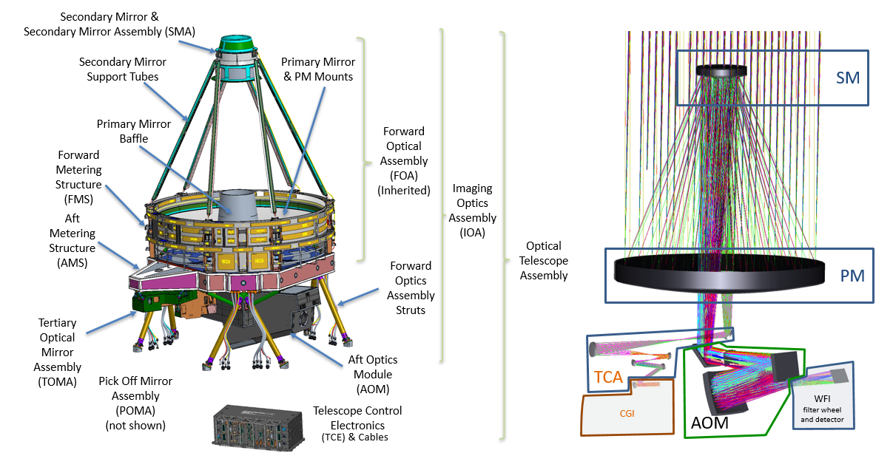
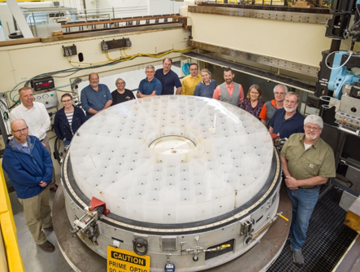
What is an Optical Telescope Assembly (OTA)? Configuration Overview
Photo: 2.4m primary mirror after full tool polish (approved for release)
The OTA supports a light-weighted 2.4m primary mirror (PM), light-weighted secondary mirror (SM) and Aft Optics Module (AOM) optics, and smaller solid Tertiary Collimator Assembly (TCA) optics. OTA thermal and actuator control is provided by the Telescope Control Electronics (TCE).

Slide 10
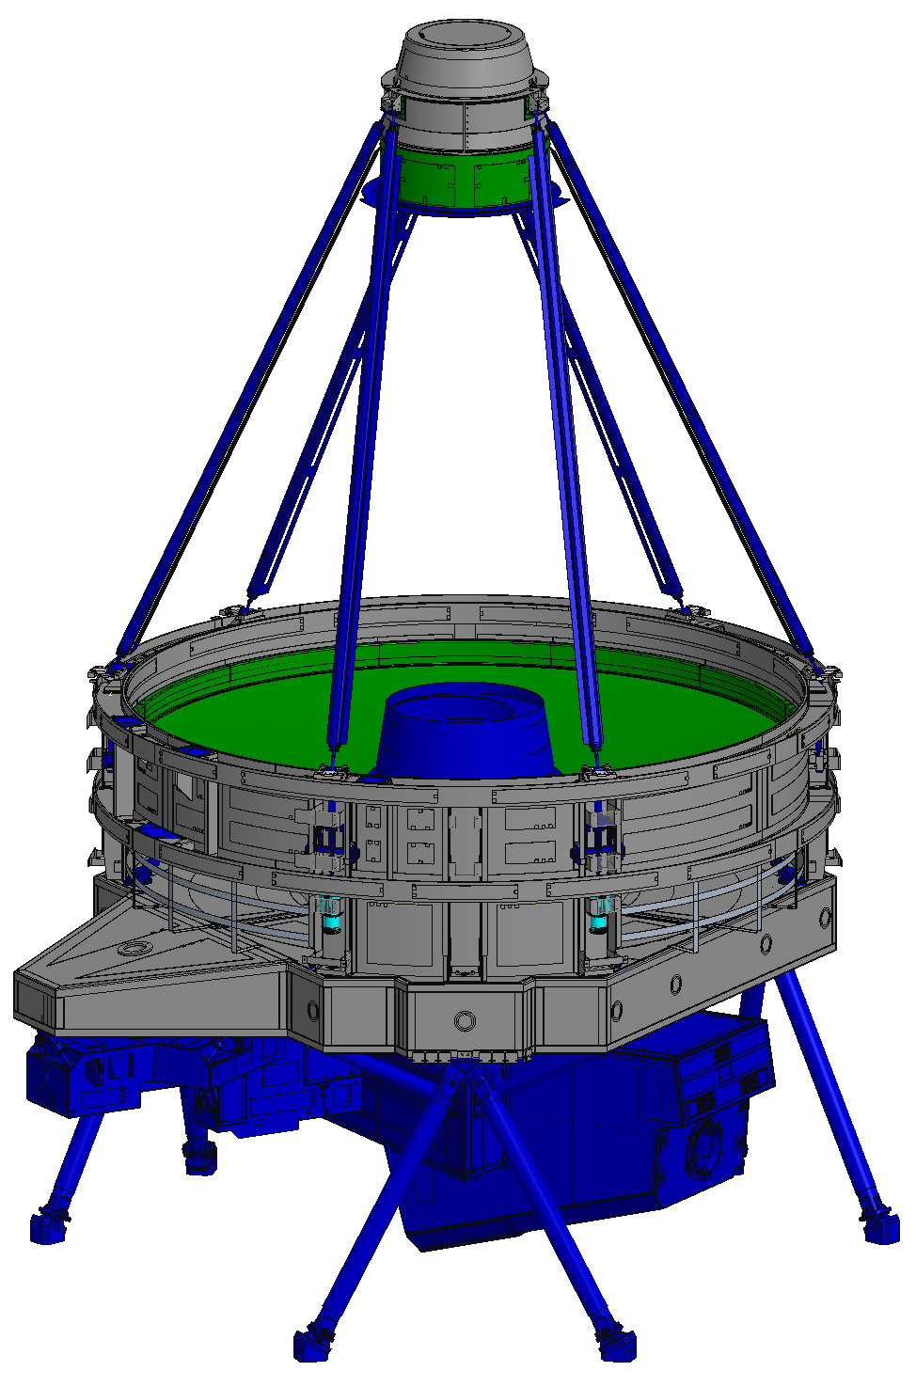
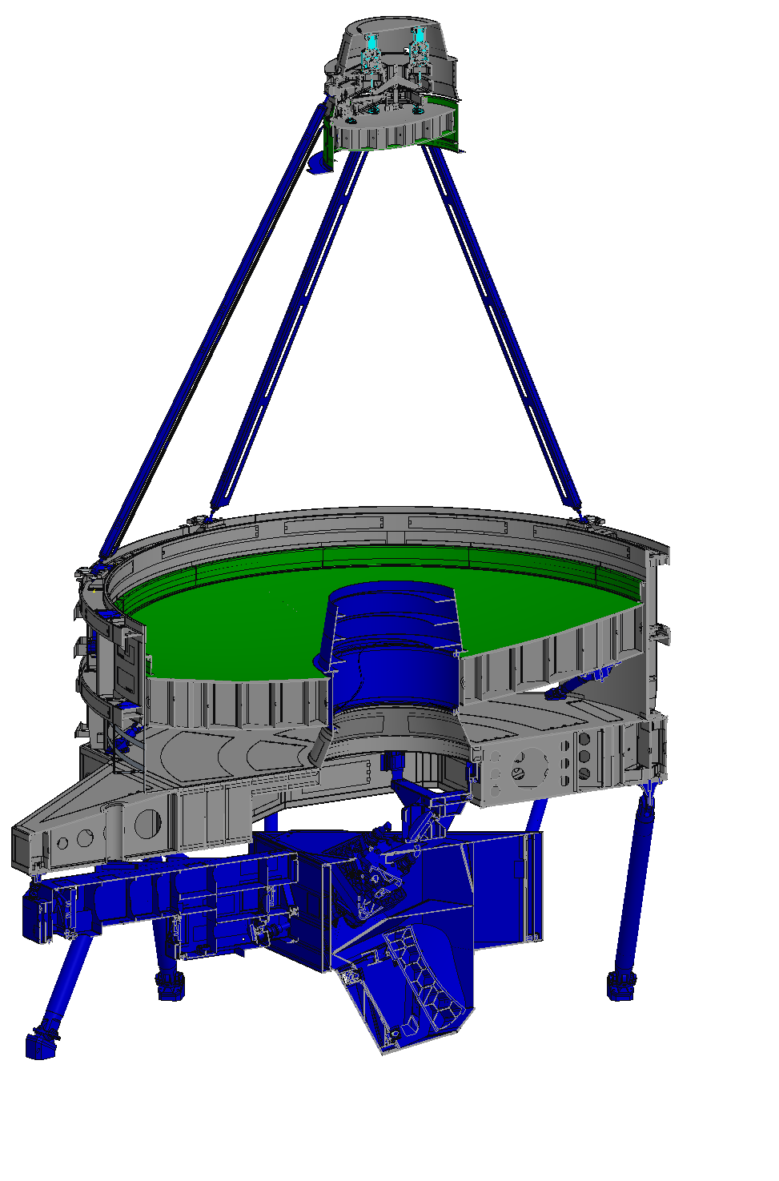
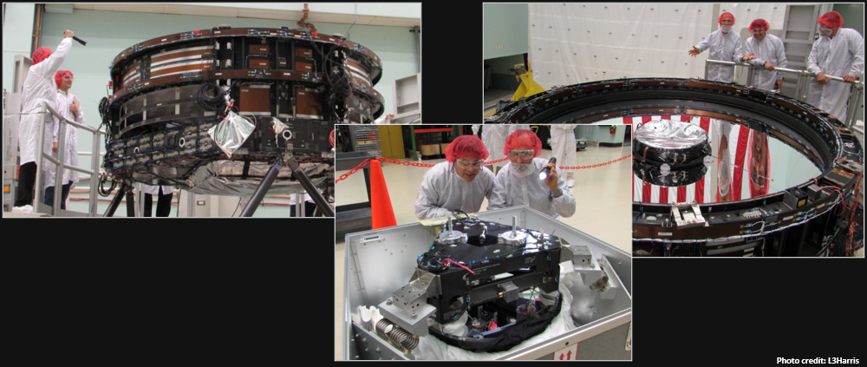
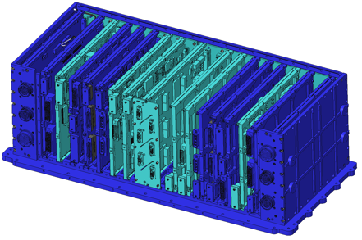
What is an Optical Telescope Assembly (OTA)? What are the OTA technical challenges?
Maximizing hardware reuse is required to meet both our L1 requirement and cost/schedule profile
The large cost of these items constrain sparing
Ensuring the inherited telescope meets both the enhanced optical requirements AND the required temperature range for Roman is a major challenge
New
Modify
Reuse
Build to Print
Photo: Inspection of the as-received hardware. The “inherited” telescope needed to be completely stripped to structure, with the PM and SM refigured, and qualified to new environments. Approved for release.
Imaging Optics Assembly
Telescope Control Electronics

Slide 11
What is an Optical Telescope Assembly (OTA)? What are the OTA technical challenges?
We are cold (Rochester cold)
Supporting the near-IR mission drives the OTA temperatures as low as possible, within hardware limits
Our temperatures are in the range of 250-265K… this is a cold winter’s day in upstate New York (~-10°F)
L3Harris optical testing, mechanical stress analysis methods, test facilities, support test equipment, and procedures and processes are largely directed toward room temperature systems
Incorporating inherited hardware built for room temperature is a challenge…
Predicting mechanical property and CTE changes
Assessing adhesive bond strength
Measuring optical element figure changes, etc.
… but we are not “cryogenic.”
Knowing when/how to apply JWST lessons-learned and cryogenic design/analysis techniques can be its own challenge
Wintery Sunset, Rochester New York, Credit: https://montanusphotography.com/nmphoto/winter-scenes4/index.htm
We’ll discuss some of our experiences designing and adapting to cold temperatures in later slides.

Slide 12
What is an Optical Telescope Assembly (OTA)? What are the OTA technical challenges?
We are precise
Our optical performance parameters are very challenging; mapping to very tight surface figure and alignment budgets at our operating temperature
Unlike typical resource allocations (mass, power, etc.) where verification is by test and the measurement error is small, uncertainty in measuring the parameters in the optical budgets is often comparable in magnitude to the measurement itself
Requirements are tight and booking all uncertainty as error is untenable, so uncorrelated errors are booked as root sum square
Monte Carlo simulations are used to assess the performance of potential “OTA’s” after actuator alignment
The need for certainty in critical performance parameters drove the addition of ANOTHER large optic for the OTA. A 2.4m auto-collimating flat capable of operating during thermal vacuum testing was added to the test program in Phase B.

Slide 13
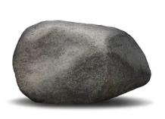
What is an Optical Telescope Assembly (OTA)? What are the OTA technical challenges?
We are stable
Our stability specifications are too tight to verify by a simple end-to-end testing
This drives us to a verification by analysis using modeling informed by various tests at both subassembly and top-assembly levels
Model integrity is ensured by a rigorous integrated modeling process
Established model validation plan
Optical verification peer reviews with an external review board
Cross-checks of key optical tests with other methods
Thermal model correlation to thermal balance data, including correlating to controlled temperature transients
Optical performance measurements at thermal balance
Special transient optical testing
The predicted optical response due to operational temperature changes are within the noise of our measurements. We added special tests to induce a sinusoidal temperature change and frequency filtered optical measurements to obtain transient model correlation data.

Slide 14
Lesson Learned: A work in progress
We’re not across the finish line …
Currently more than a year past CDR and more than a year to delivery
There will be more lessons to learn, but we’re happy to share what we have. Some wounds are still fresh.
But we’re well into the race …
All structural, thermal, optical design analysis is complete and there are currently no open technical liens
We are in subsystem I&T, just prior to top-level assembly
Strength qualification of composite structures is largely finished
Subassembly environmental testing is underway
And there have been stumbles …
We are actively chairing/co-chairing six failure/anomaly reviews
We have taken programmatic risks. Most have panned out. Some have not.
But we’re going to get there.
The Simpsons Sideshow Bob steps on rakes. Over and over. Maybe you don’t have to.
The following lessons learned represent our personal perspective as of today, and are humbly offered …

Slide 15
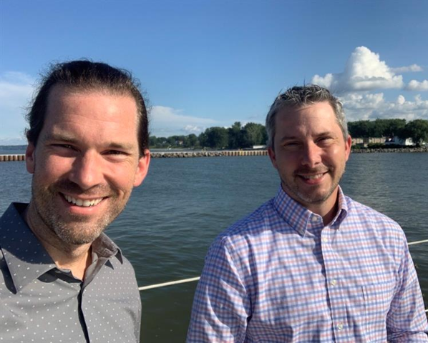
Vendor Communication
What works…
Coordination between the SE and PM. Standing united under pressure and providing clear direction.
Working with the engineering team to establish the “do’s” and “don’ts” for working with the vendor
Establishing formal working groups early in the program for “getting into the weeds”
Getting “for review” copies of all vendor reports, but limiting contractual approval for key documents only (“high fence and a small yard”)
What doesn’t…
Stovepiping communications to the vendor through only the SE/PM
Subject matter experts directing work without coordination with PM and contractual scope
Lots of ad hoc meetings that impact vendor execution
Overwhelming the oversight team with approval of hundreds of vendor documents causing bottlenecks and unreasonable expectations
Scott Smith, OTA manager, and myself on a trip to the vendor. Site visits and TEMs are a great way to bond with both the NASA and vendor team.
We’ll share some specific examples from the OTA experience.

Slide 16
Vendor Communication Examples from OTA Development
As the WFIRST program matured into Phase A and the team grew quickly, it became clear that communication could not be bottlenecked through management
Communication during contractual document development can be tough… stakes are high and coordination is key
Lots of growing pains as both our team and our vendor learned how to solve problems within the contractual scope. We’ll share some strategies we’ve found effective.
Our oversight team is small and there is a huge number of documents to review, especially at PDR/CDR. Let’s talk about some ideas.
Once trust is established, targeted engineer-to-engineer working meetings can often resolve issues with a win-win, limiting cost impacts for changes. We have found these meetings to be effective:
Subject Matter Working Groups (standing)
Systems (waivers/deviations, action items, ...)
Mechanical (design and analysis details, strength test loads, ...)
Optical (optical test data deep dives, optical budget for performance and uncertainty, ...)
Contamination (particle budget audits, “how” details, ...)
I&T (hand-offs for shipping/GFE equipment, “how” details, …)
Tag-Ups (as-needed)
Thermal (math modeling, hardware “how”, ...)
Interfaces
Jody Davis and her team run effective meetings to negotiate and define interfaces
Reference Jody’s Sept 2019 SE Seminar!
Integrated Modeling
Alice Liu coordinates interfaces of the math models with all element teams and manages their impact key mission level budgets
Reference Alice’s April 2021 SE Seminar!
Your project will be different!
Trust is key. Developing effective communication between our teams has taken years. Some of that is unavoidable, but we hope these thoughts get you there faster.

Slide 17
Technical Oversight
What works…
Determining non-negotiables early
What are our “red lines” for design choices and verification? Consider mission class.
Where are technical margins tight at the mission level? Does some relief exist?
Understanding and respecting the vendor’s perspective, constraints and motivations
Are schedule pressures high?
Are there contractual milestones at play?
Are they constrained by contractual scope?
Are there personality or technical conflicts with the oversight SMEs?
“Help me understand this” attitude
The “right” team is crucial (more to come)
What doesn’t…
Moving forward with significant design/verification liens
Optimism on waivers/deviations from GOLD rule owners
Disconnects with required analysis methods
Chasing a technical solution, driving cost/schedule when relief may be available
Adversarial vendor relationship
Assuming the worst during crucial conversations
Holding grudges or tracking gives vs. takes
“This is the right way to build it” attitude (i.e. my way)
Inability to tolerate/communicate risk
Unwillingness to listen to other approaches
Approach the vendor as a trusted partner after selection. It’s their job to build the hardware.

Slide 18
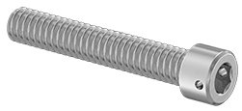
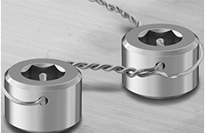
Technical Oversight Team Examples from OTA Development
Case Study: OTA Fasteners
Secondary locking features (ex. lock wire, thread staking, etc.) is a GOLD rule requirement
“Critical” fasteners (single point failures) disclosure and proof testing is a Code 540 design requirement (540-PG-8072.1.2)
Other organizations and companies do not design to our rules and heritage designs are often not compliant
We won’t discuss who is “right” today, but the decision to levy these in-house rules on the inherited OTA had consequences and lessons learned that we’ll discuss
Thoughts on building an oversight team…
It’s not for everyone. If working flight hardware is your passion and you enjoy managing the details of your project, this may not be for you.
Want to work on some of NASA’s largest missions? Like building consensus? Love a win-win? Interested in other ways to do things? Can you navigate programmatics without frustration? Sign up!
A wide variety of experience from both industry and NASA is a plus
Having on-site experts with DEEP experience in the specifics of the vendor’s organization or product is highly valuable (ex. former employee or customer)
There are ways to make fasteners very costly…

Slide 19
Inherited Hardware
What works…
Following the pedigree review (or inheritance review) process with an external board or SMA representative
Understand what you have…
Incomplete assemblies? Unfinished testing? Upgrade from spare or EDU status?
NCRs? Liens? GIDEPs? Action items from reviews?
Leveraging existing facilities and test equipment from past/current programs (Rent Free Non-Interference Use agreements)
Employing the original inherited hardware vendor/design team for the new application
What doesn’t…
Relying upon cursory or overly optimistic assessments by the proposal team
Pushing inherited hardware beyond original design environment (without understanding risks, appropriate mitigations, etc.)
Relying on RFNIU equipment without tracking these items as a cost risk
Get RFNIU agreements as early as possible
Identify high risk/consequence items
Review maintenance and qualification support equipment
Consider all the impacts and risks when predicting costs of implementing inherited flight hardware or using expensive or long-lead test equipment or facilities

Slide 20
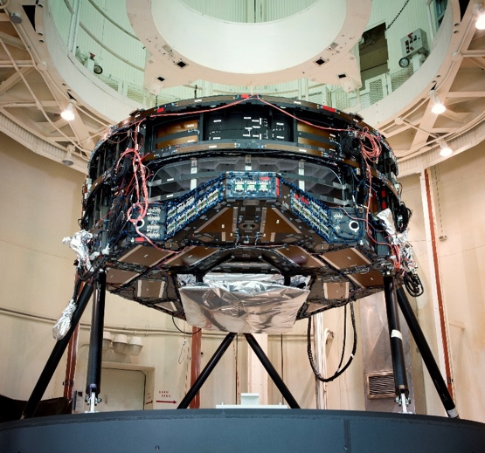
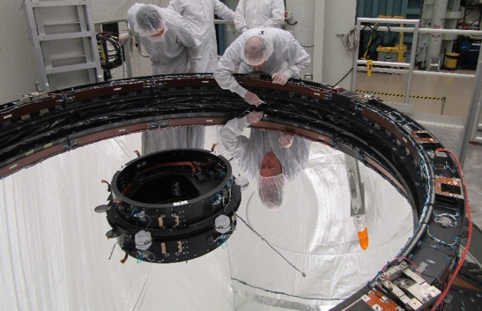
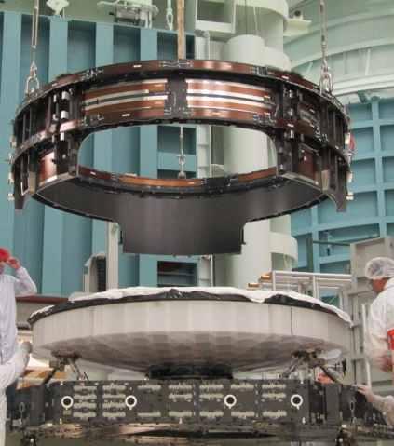
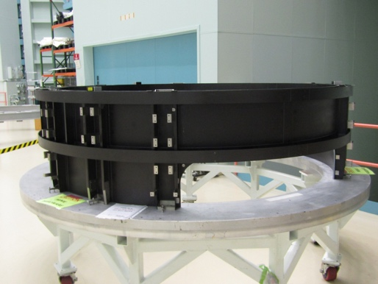
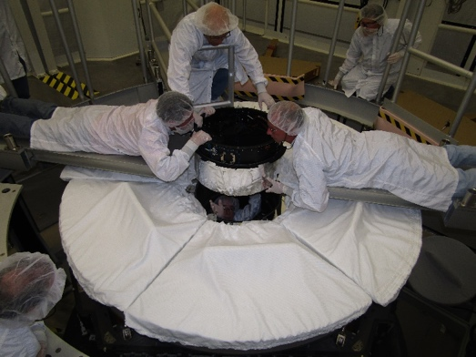
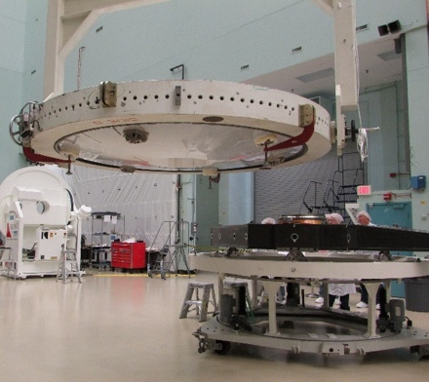
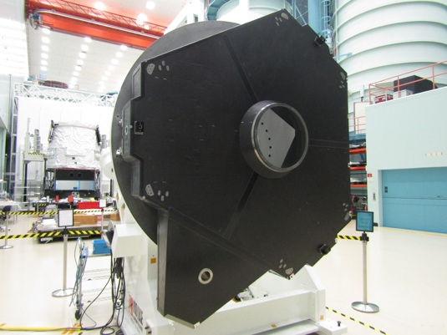
Inherited Hardware Examples from OTA Development
Disassembling the hardware required specialized procedures and support equipment
Having personnel from the original program available was crucial
Developing these resources and equipment from scratch would have been wildly expensive
Removal of PM Scraper 7/2018
Forward Metering Structure June 2019
Forward Metering Structure Removal 7/2018
Primary Mirror Assembly +
Forward Metering Structure
At SRR/Pedigree Review
Removal of PM Baffle Adaptor 7/2018
Removal of Spare PM from Aft Metering Structure May 2019
Aft Metering Structure June 2019
Images approved for release.

Slide 21
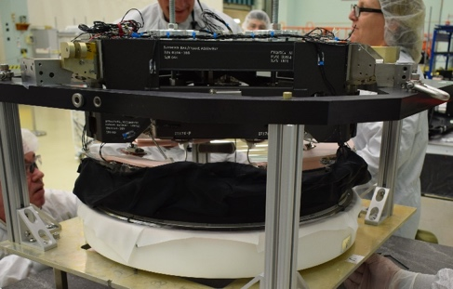
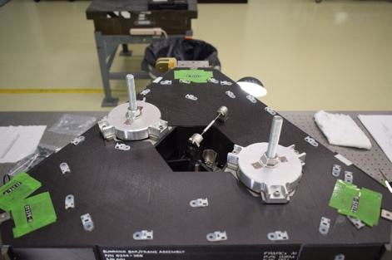
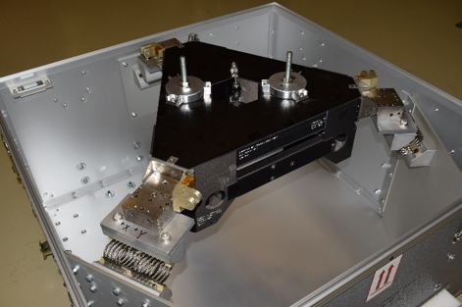
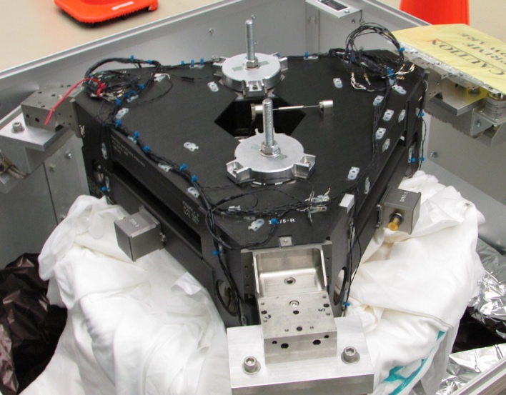
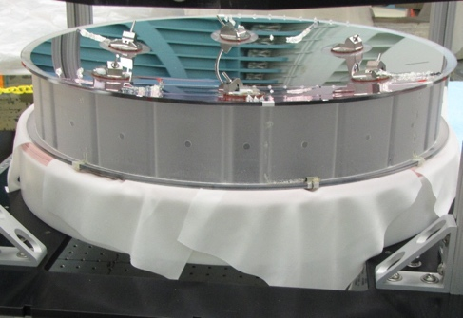
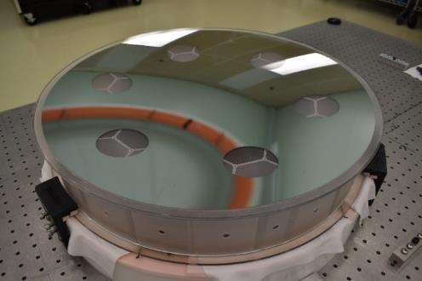
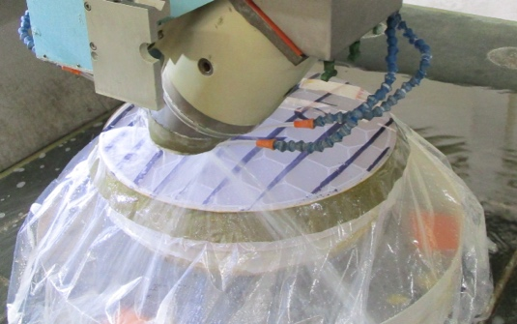
Inherited Hardware Examples from OTA Development
Some life-limited items needed to be removed (ex. Kapton heaters)
Optics needed to be re-figured to the Roman prescription
Disassembly of support structure from mirror
Removal of thermal-electric hardware
Secondary Mirror Support Structure (SMSS) ready for re-use
Secondary Mirror Assembly
At SRR/Pedigree Review
Back Pad Removal
In process shaping of SM to WFIRST prescription

Slide 22
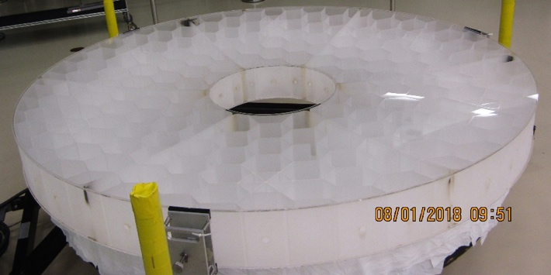
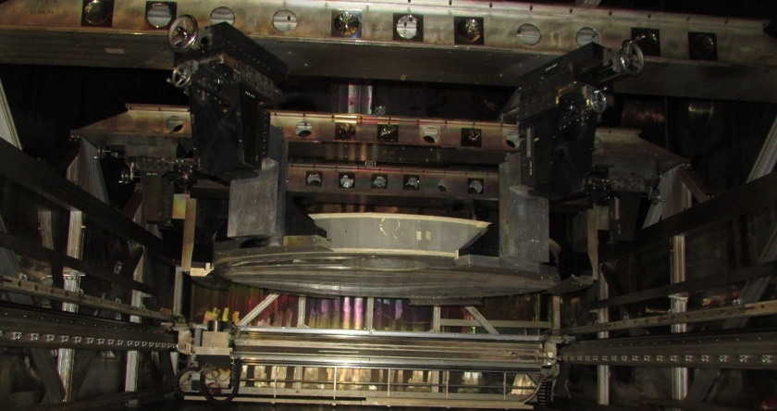
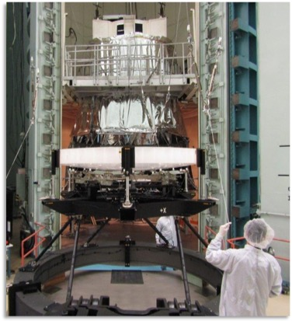
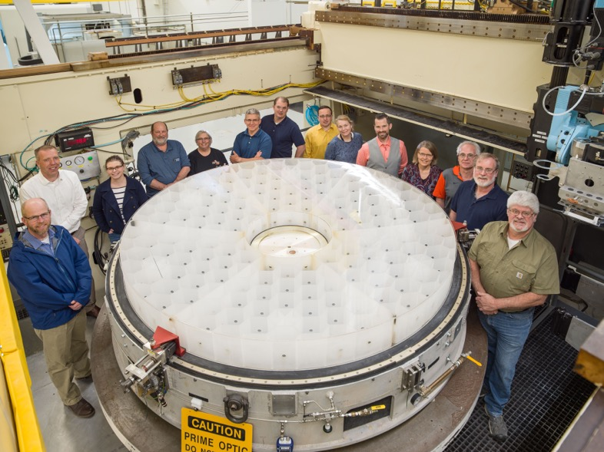
Inherited Hardware Examples from OTA Development
Using the inherited hardware allowed a wide array of fixturing, containers, dollies, lift fixtures, and facilities to be leveraged
Since many of these were developed for other government customers, they are available as rent free, however they can only be used on a non-interference basis
This requires coordination across programs and risks delays
Flight Primary Mirror
Ion Beam Figuring
Full Tool Polish May 2019
Image Credit: Chris Gunn/NASA
Cold Optical Testing of the Primary Mirror

Slide 23
Analysis
What works…
Building trust & identifying analytical weaknesses of the vendor early in the program
What is “in their wheelhouse”?
What is new or an extension of heritage?
Who are the “star players”?
What are real weaknesses vs. communication problems, etc.?
Setting expectations for materials properties and allowables early in the program
Testing of properties vs. published data?
Coupon testing vs. accepting vendor historical data?
Scatter factor for composites? Allowable flaws?
Referencing a model validation plan
Model correlation to test data is a big cost driver, so decide what you need in advance
What doesn’t…
“We’re from NASA and we know better”
Often vendors have vastly more experience than NASA for their hardware
We can learn things from analysis done by industry
“Well, they’re the experts…”
Our missions ARE unique, and oversight IS our job
Understand when enhanced analytical techniques are called for over heritage methods
Assess when engineering judgement and “it’s always worked before” may not be sufficient our environment or use-case
We’ll share some specific examples from the OTA experience.

Slide 24
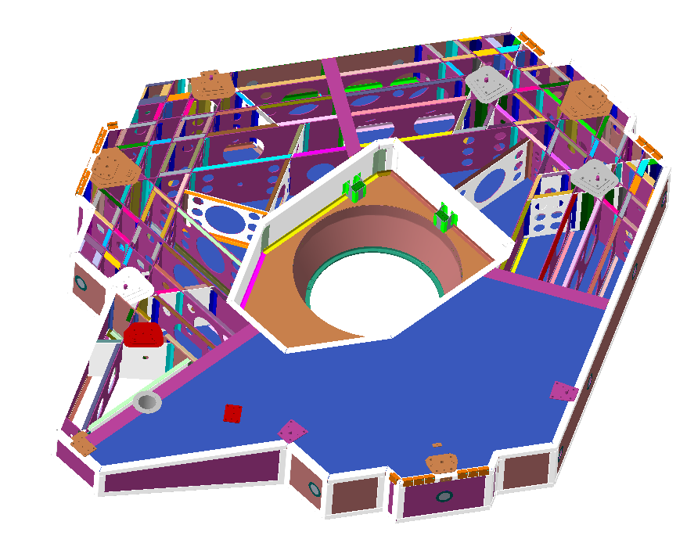
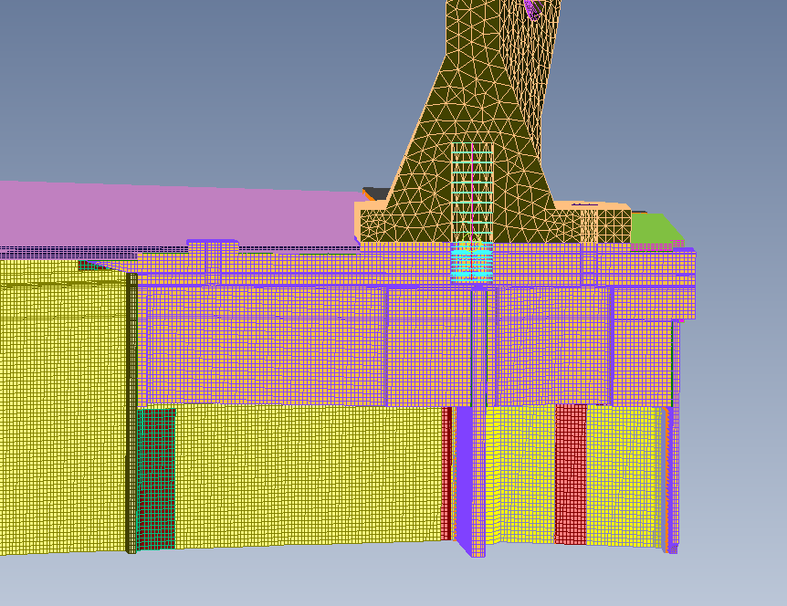
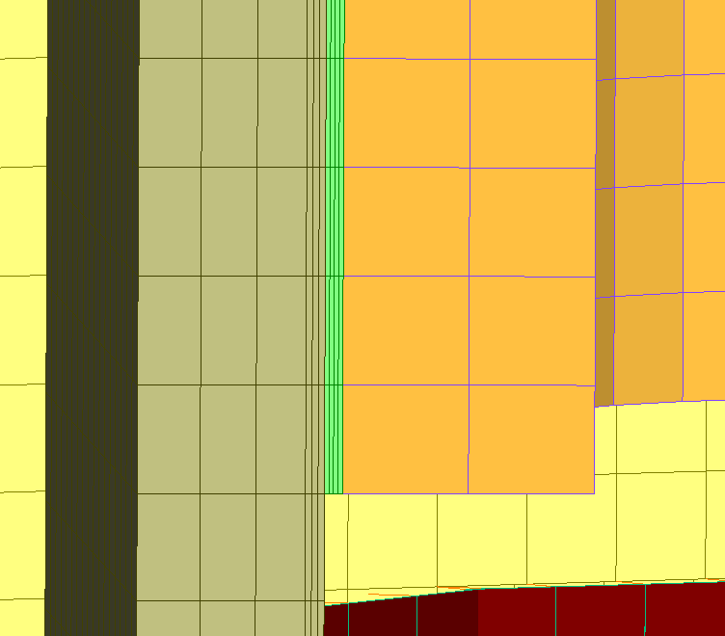
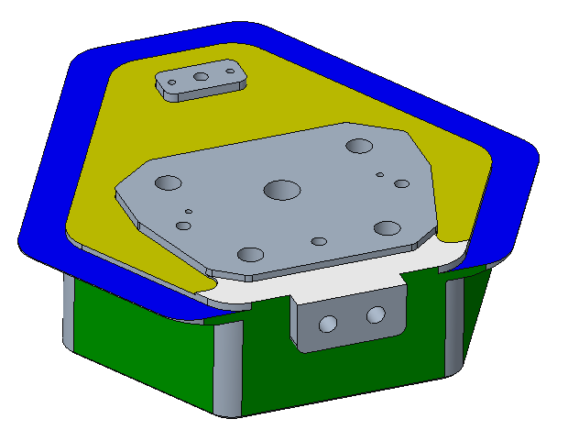
Analysis Examples from OTA Development
Aft Metering Structure
Case Study: Stress Modeling of Composite Bonds
Verification matrices often cite “A” for analysis for mechanical design requirements… but what type?
JWST-style 3D FEM modeling? 2D FEM? Hand calculations? The answers to these questions can drive cost in a major way
How are approach/margins/factor/etc. conflicts between vendor command media and GSFC guidelines handled?
We can briefly discuss the OTA experience with composite bond analysis as an example of a more general case and how we worked through it (without getting into the specifics… that deserves its own forum!)
JWST-Style 3D Bond Analysis
(A)
(C)
Aft Metering Structure Fitting
Titanium Fitting
0.01” Adhesive
First 3 plys
Laminate
(B)
(D)
(A) Large composite structures like the Aft Metering Structure can have many fittings and bonds and (B) each fitting can have multiple bond faces. (C) Making 3D breakout models (shown) is expensive and time consuming, (D) requiring detailed meshing through the bond and laminates. Understand if this will be required early on.

Slide 25
Materials and Processes (M&P)
What works…
Early pathfinder and development unit testing to increase TRL
Early assessment of M&P for program-specific environments and use-case
Triage M&P concerns to focus on most critical areas first (risk-based approach)
Careful attention to all variables in the M&P (for example, bonding…)
Substrates and surface finishes
Surface preparation/specific technician
Mix ratios and lot acceptance/quality control
Bond line control and surface alignment
Fillets/tooling
What doesn’t…
Insufficient scrutiny of pathfinder “successes” (confirmation bias)
Relying on analytical “it works on paper” until late in the flow
Qualification by similarity without a full understanding of the variables
Moving forward with hardware build up while developing “low risk” M&P
“NASA knows how” because it’s been done on another NASA mission/vendor/etc.
“The devil is in the details”
Workmanship dependent procedures need continuous training and practice for consistent results
Propriety processes, personnel changes, organizational roadblocks, etc. are all challenges to transferring M&P between programs (but we shouldn’t stop trying)
The “recipe” is more than just the ingredients. If your project can’t afford to develop processes, how can you afford a failure during I&T?

Slide 26
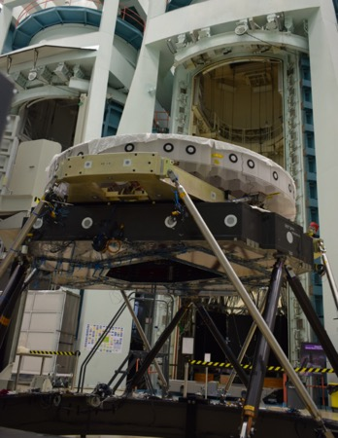
Materials and Processes (M&P) Example from OTA Development
There are MANY instances where we’ve been highly successful, but it’s probably more helpful to discuss our challenges. Nailing down all M&P down in Phase A/B is not always practical as your project manager will have legitimate funding limitations and will be trying to burn risks down all over the project, but a miss here can have large cost impacts in I&T.
Case Study: SMA and PM Pathfinder Tests
Cold performance/survival was identified early on as a major risk in the mission concept
Both technically and politically, showing the hardware “working” at temperature was key
These were large and expensive tests that increased confidence, but did not represent a true qualification of M&P. We can talk about some specific impacts…
Thermistor to Glass Bonds (Open Anomaly Review Board)
Disbonds after survival cycling showed an M&P problem undetected in pathfinders
Parameters such as surface condition (etched/ground/polished), adhesive size/shape, etc. can be important
Thermoelectric Bonds (Tie downs, clips, etc.)
Contract negotiations removed development testing for “low risk” bonds assuming JWST lessons could be applied and noting successful pathfinder testing
Risk was identified and M&P tests added, but results were inconsistent, forcing a year of parallel M&P development during I&T
Controlling key variables and knowing when to give up heritage to enable solutions has been a challenge
Primary Mirror after completion of cold testing. Pathfinders and demonstrations may be necessary but may not uncover all issues. (approved for release)

Slide 27
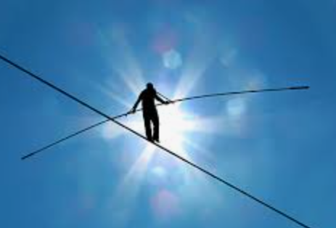
Risks
What works…
Allowing the vendor to work/mitigate risks that fall fully within “their” scope
Set the expectation that reserve should be used to burn down these appropriately and monitor this process
Regularly review the overall risk picture and ask probing questions (“Should we be looking at…?”)
Encourage the vendor to suggest areas that may reduce risk at higher levels of assembly (may be out-of-scope, but wise to invest in with project concurrence)
What doesn’t…
Micromanaging vendor risks (loses “buy-in”)
Forcing the vendor to accept “our” risks, such as…
Delays for NASA approving documents/plans
Late arrival or function of GFE, etc.
Unnecessarily accepting the vendor’s risks
Should this risk have been foreseen during the proposal? If so, perhaps this is the vendor’s risk.
Is it a result of new direction from NASA for “non-standard” design mods, tests, reduced sparing, reduced early testing, etc.? If so, accepting may be appropriate. If not, allow them to work it.
Avoid duplicating accepted vendor cost/schedule risks at the higher levels of assembly (better to combine into one “what if my vendor is late?” risk at the mission-level)
Understand who should “own” the risk. If something fails and the risk is realized, who is truly at fault?
Does that party “own” the consequences?

Slide 28
Conclusion
Performing a technical oversight role for a high-profile program can be difficult, but it is also highly rewarding
Acting as the technical oversight representative for the NASA mission and the US taxpayer is a significant responsibility
As the technical spokesperson for the many accomplishments of your vendor, it is a privilege to represent the hard work of hundreds of dedicated engineers, scientists, technicians, and technical managers
Our continued success is only made possible by the hard work of the whole Roman and OTA team Special thanks to L3Harris and…
Roman and OTA Management
Our Roman MSE Stakeholders
Our NASA OTA Systems Team
Our OTA Technical Oversight Team
Our External Review Board Members
Our On-Site Technical and QA Personnel

