Slide 1
Systems Engineering Challenges for GSFC Space Science Mission Operations (SSMO)
Keeping up with a Large Fleet of Spacecraft
Julie Halverson, SSMO Systems Engineer

Slide 2
AGENDA
Overview of SSMO organization
Missions
Issues
Selected spacecraft issues
Conclusions

Slide 3
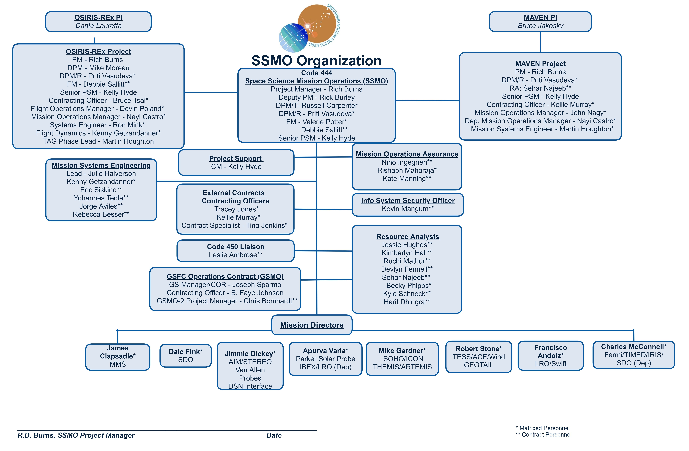
Space Science Mission Operations (SSMO) Code 444
Deputy MSE
Toni Deboeck**
Joe Cavaluzzi**
Wayne Yu*
John VanEepoel*
Swift/LRO (Dep), SDO (DEP)
Manages astrophysics, heliophysics, and planetary science missions for the NASA Science Mission Directorate

Slide 4
Space Science Mission Operations (SSMO) Code 444
Toni Deboeck**
Joe Cavaluzzi**
Wayne Yu*
I would like to acknowledge the engineers on the Systems Team. They make my job easy. Amazing team of engineers that provide exceptional support to SSMO!
John VanEepoel*
Swift/LRO (Dep), SDO (DEP)

Slide 5
21 SSMO Missions (27 Spacecraft)
Mission (Orbit) | Launch, Lifetime | Mission (Orbit) | Launch, Lifetime | Mission (Orbit) | Launch, Lifetime
ACE* (L1) | 1997, 2 | LRO* (Lunar) | 2009, 2 | PSP (Helio) | 2018, 7
AIM (LEO) | 2007, 2 | Lucy (Helio) | 2021, 12 | STEREO (Helio) | 2004, 2
ARTEMIS (Lunar) | 2007, 2 | MAVEN (Mars) | 2013, 1 | Swift (LEO) | 2007, 2
Fermi* (LEO) | 2008, 5 | MMS* (HEO) | 2015, 2 | TESS (HEO) | 2018, 2
IBEX (HEO) | 2008, 2 | O-REx (Asteroid) | 2016, 7 | THEMIS (HEO) | 2001, 2
ICON (LEO) | 2019, 2 | SDO* (GEO) | 2010, 5 | TIMED (LEO) | 1994, 3
IRIS (LEO) | 2013, 2 | SOHO* (L1) | 1995, 3 | WIND* (L1) | 1994, 3
*Mission operations centers (MOC) at Goddard, others external
Spacecraft range from 125 kg to over 4000 kg
Orbit regimes cover Low Earth, geosynchronous, highly elliptical, libration point, heliocentric, lunar, Mars, asteroid

Slide 6
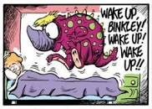
Many Challenges from the Wide Fleet of Spacecraft
Star tracker issues
  LRO, MMS, IRIS, Fermi, IBEX, TESS, ICON
  Radiation, poor star fields, occultation, hot spots, temperature, SEU
Gyro issues
  SDO, STEREO, SOHO, LRO, MAVEN, Swift
  Elevated currents, failures
  Gyroless algorithms on LRO, MAVEN, Lucy, O-REx, planned for SDO and TESS
Battery and Solar Array Issues/Concerns
  AIM, Fermi, IRIS, SDO, Swift, LRO
Reaction Wheel Degradation/Concerns
  Swift reaction wheel failure, LRO wheel stopped, Fermi Ithaco B wheels
Fuel Remaining
  ACE, LRO
Flight software issues
Space debris, micrometeoroids, conjunctions
Covid …

Slide 7
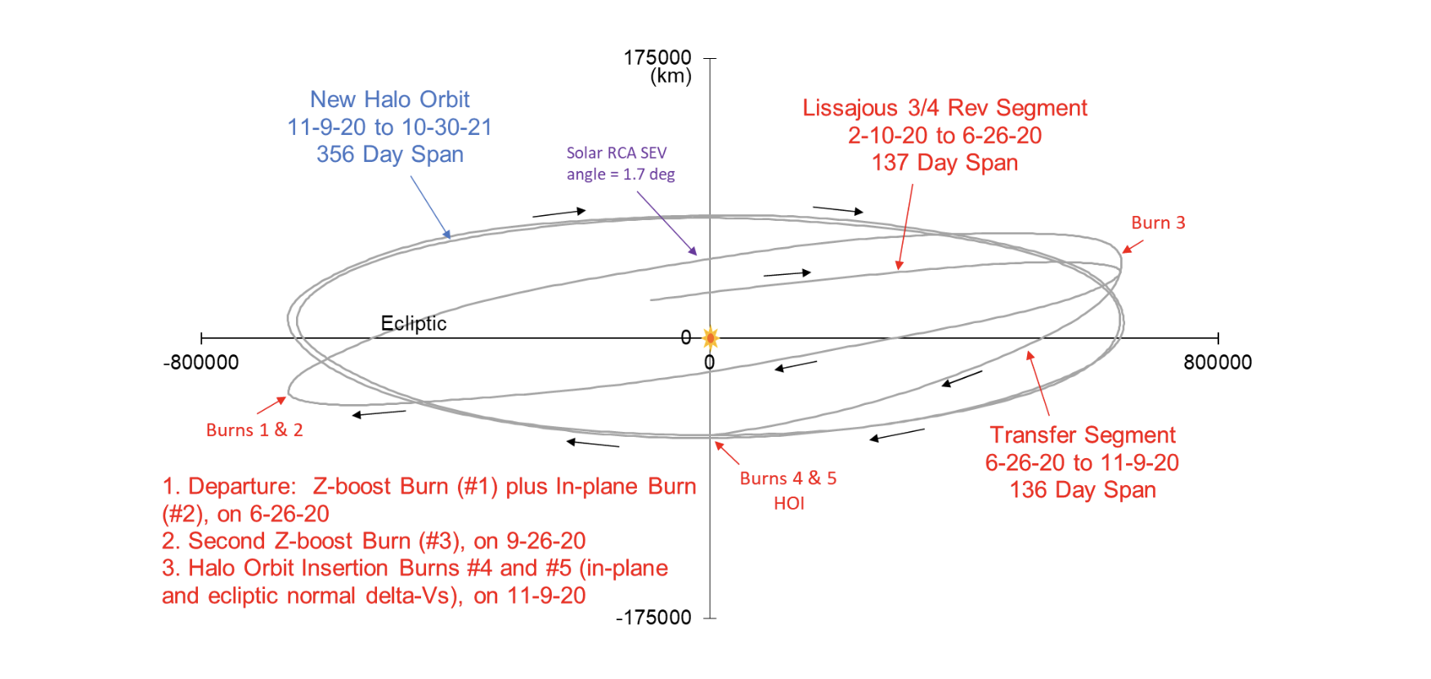
Wind (1994)
Spin-stabilized spacecraft that was placed in a Lissajous orbit around L1 Lagrange point in 2004 to observe the unperturbed solar wind
In 2020, the Wind orbit resulted in the spacecraft entering the Solar Exclusion Zone (SEZ), loss of contacts and telemetry
Proposal to maneuver to a new orbit to permanently eliminate the SEZ crossings
Required thrusters that hadn’t been fired since 2002
Wind successfully transferred to a new Halo orbit in late 2020
From the Wind Wikipage:
Mission duration:
3 years (planned)
28 years (in progress)
Last contact:
2070 (planned)

Slide 8
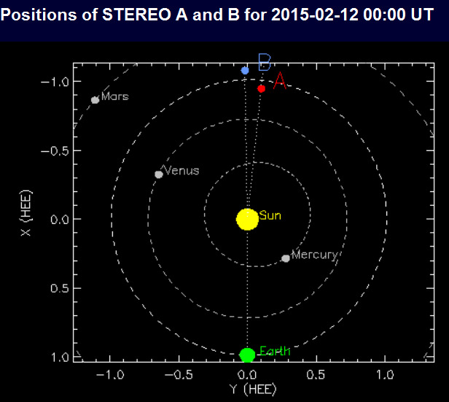
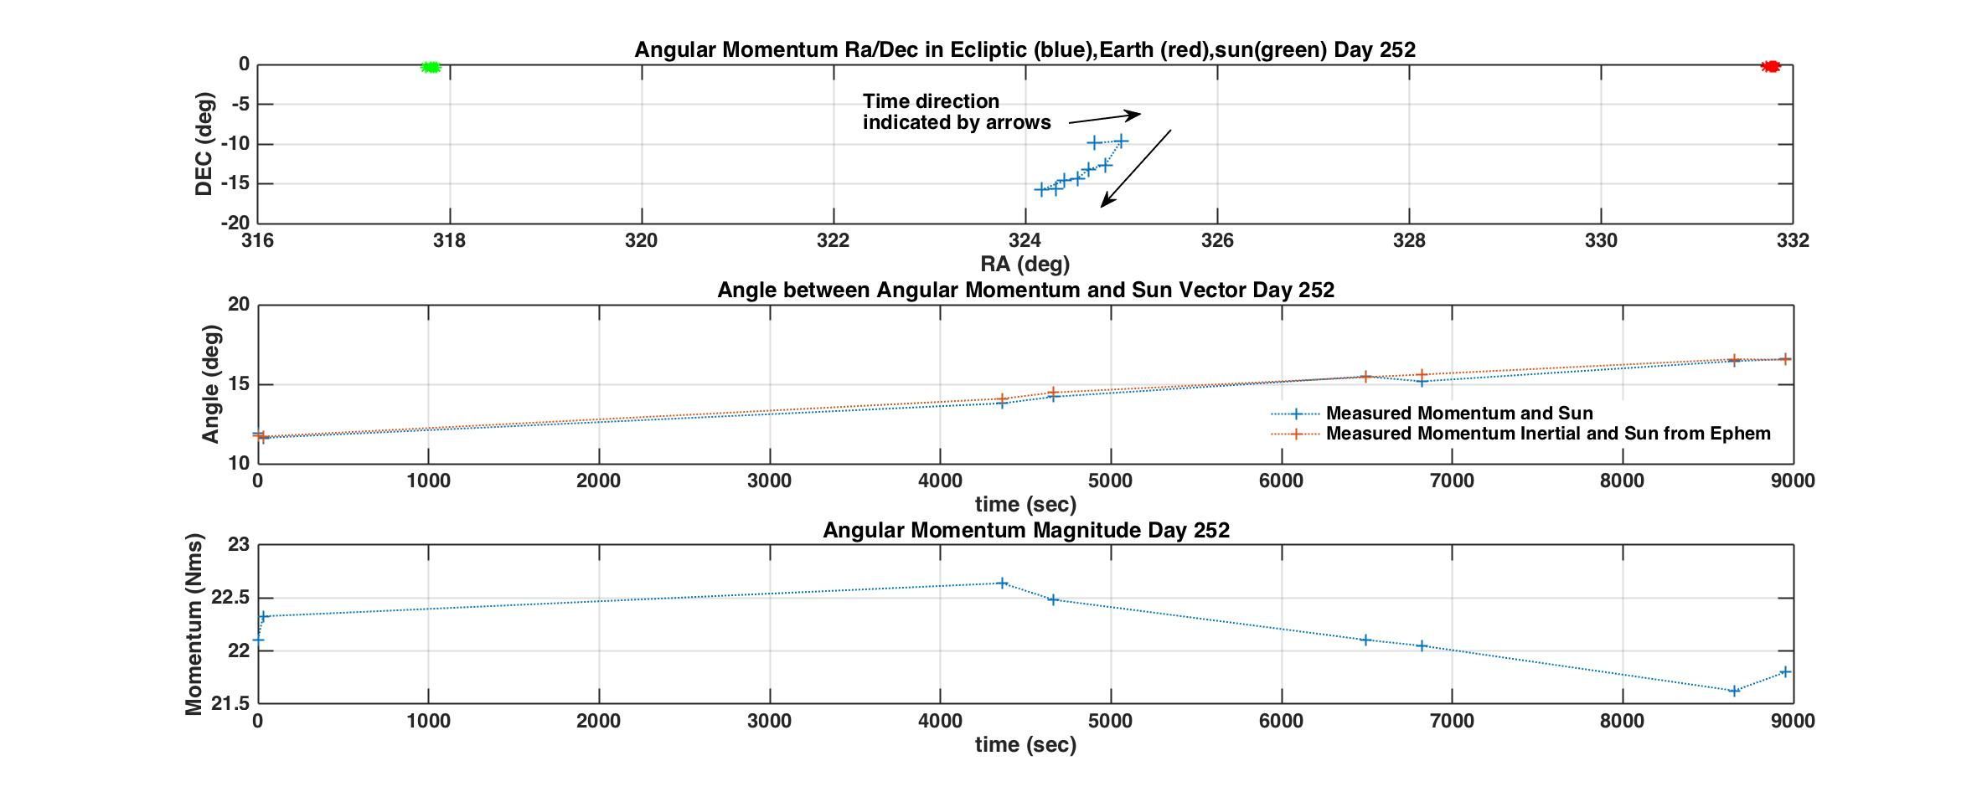
STEREO (2006)
Solar Terrestrial Relations Observatory (STEREO) provides stereoscopic measurements to study the Sun and coronal mass ejections
Two spacecraft in heliocentric orbits, A and B
MIMU-1 failed on A, MIMU-1 on B nearing end of life in 2012, MIMU-2 failed on B in early 2014.
Gyros powered off except for special observations, or if the star tracker fails to acquire after power on.
Conjunction ops tested on B in September 2014, lost communications
Cause was the failure of the MIMU-1 X axis
Contact made with STEREO B in August 2016
Attempted to recharge the battery and thaw hydrazine. Comm difficult.
Could not decrease system momentum, possible problem with prop system – leak or frozen lines.
Lost contact

Slide 9
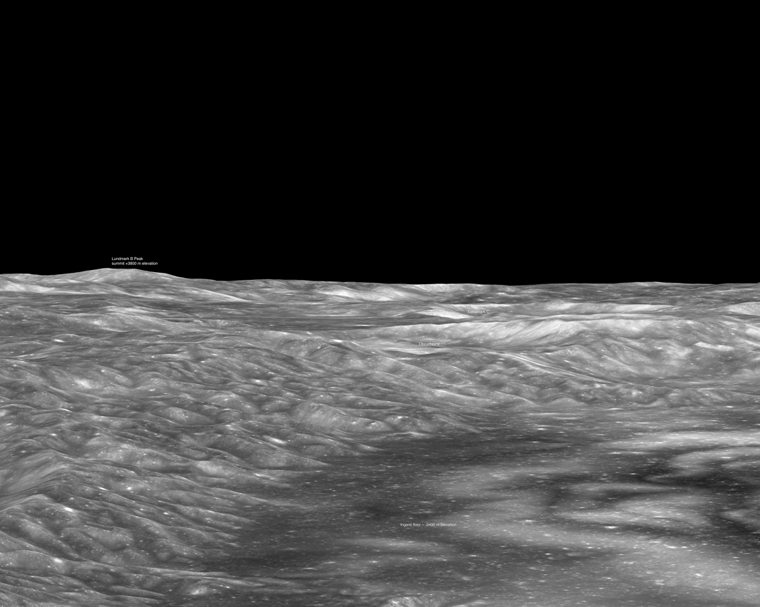
LRO (2009)
Lunar Reconnaissance Orbiter (LRO) contains seven instruments and has made numerous groundbreaking discoveries of the moon
MIMU showed signs of decline in late 2017, powered off in 2018 and used for critical operations
Gyroless algorithm uploaded Dec 2018, returned to slewing Jan 2019
Some issues with LROC and increased noise, completing a study on an update to controller parameters
Fast Slews to avoid star tracker occultations
Partnership with Naval Postgraduate School and NESC
FastMan algorithm based on an ‘agility envelope’ that incorporates dynamic model and constraints
Enabled more than 200 unique science observations
FastMan safely allowed this observation by satisfying all occultation, thermal, and power constraints
Lundmark B Peak
+3800 m
Mare Ingenii
-3400 m

Slide 10
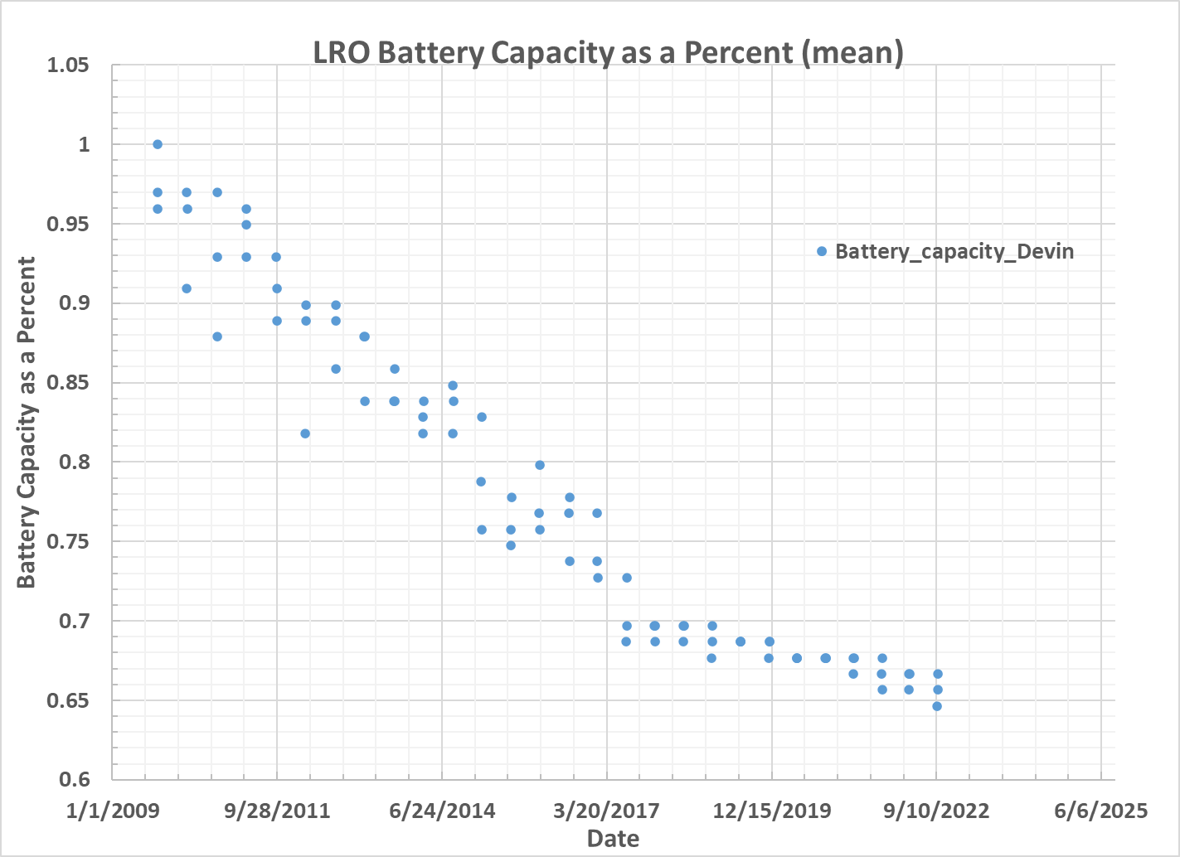
LRO Power System
LRO has gone through several long eclipses, including 4 without the MIMU
Battery capacity declining (from Tom Spitzer ‘we are in uncharted territory’), but still significant margin over spacecraft load
Solar Array trending also conducted
Conduct similar trending for SDO
Tools developed to model spacecraft load and predict battery performance
Also checks thermal constraints
Valuable tool to make sure battery voltage stays above trip to Safe mode

Slide 11
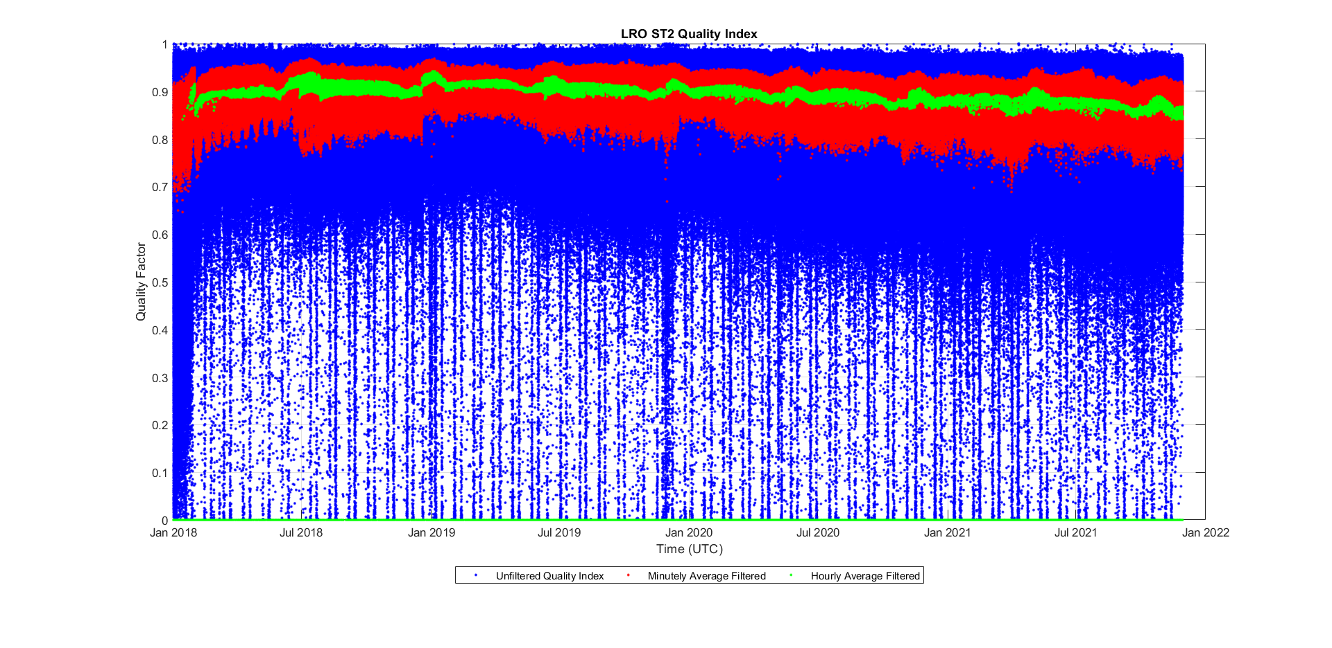
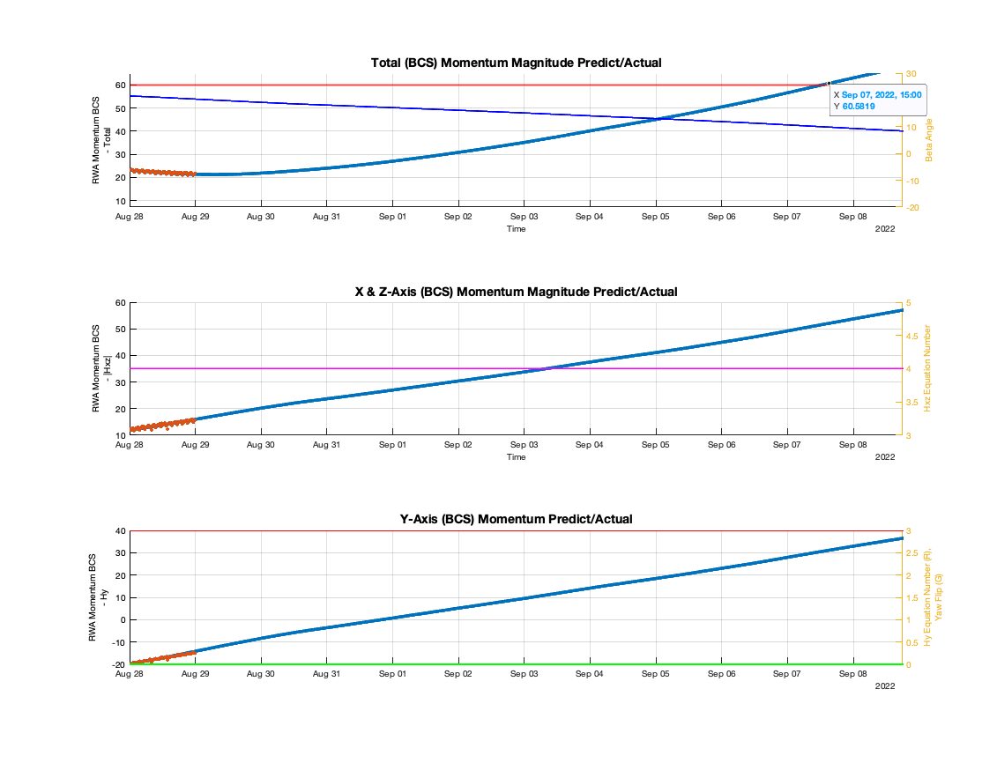
Star Tracker Issues
LRO has had many star tracker resets, some are due to radiation events, a couple EEPROM issues
  TEC set point reduced to -7 deg C (2018), -10 deg C (2022)
Slow degradation observed in quality index, particular in Star Tracker 2
Momentum Trending
Momentum unloading with one shots after MIMU powered off, also conducted one shot phasing maneuvers ahead of eclipse
Tool developed to predict momentum growth, optimize unload profile
Slewing to reduce momentum to save fuel (~5 years of fuel remaining)

Slide 12
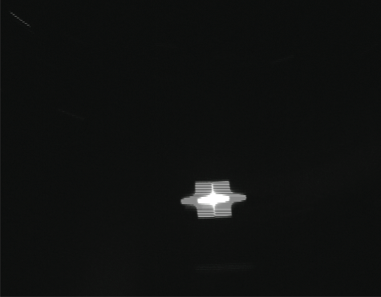
MMS (2015)
Magnetospheric Multiscale System (MMS) mission is contributing to our understanding of the processes of magnetic reconnection.
Four identical spacecraft, in highly elliptical orbits, form a tetrahedron at apogee.
Star trackers have 4 heads, axial boom has blinded one camera head on each spacecraft, had to remove that head from onboard processing
Star tracker reboots caused by single event upsets, tuning performed in tracker software to help mitigate
Another head (A) failed on MMS1, not able to recover
Recent event resulted in loss of power to star tracker on MMS2, likely an SEU. Powered back on and has been operating nominally.
During 7km formation, star tracker imaged another MMS spacecraft.

Slide 13
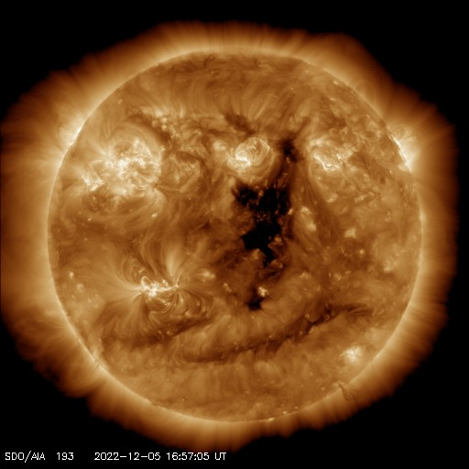
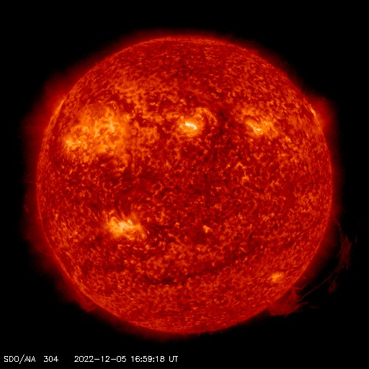
SDO (2010)
Solar Dynamics Observatory (SDO) is the first mission in NASA’s Living with a Star Program. SDO is contributing to the understanding of the sun’s influence on earth and near-earth space. Inclined geosynchronous orbit, downlinks continuous 130 Mbps.
https://sdo.gsfc.nasa.gov/

Slide 14
SDO Gyro Heaters
3 Kearfott Two-Axis Reference Assembly (TARA) Inertial Reference Units
Designed to operate at 70 deg C using heaters, heaters not used because of battery concerns
IRU1 current started to increase in 2010, reached the red limit in late 2013, removed from the control loop
GPM conducted a high frequency load study on a similar battery, found no degradation
In 2016, heaters turned on resulting in a noticeable improvement, onboard parameters updated to reflect change
Instrument Stabilization System
Gyro Biases

Slide 15
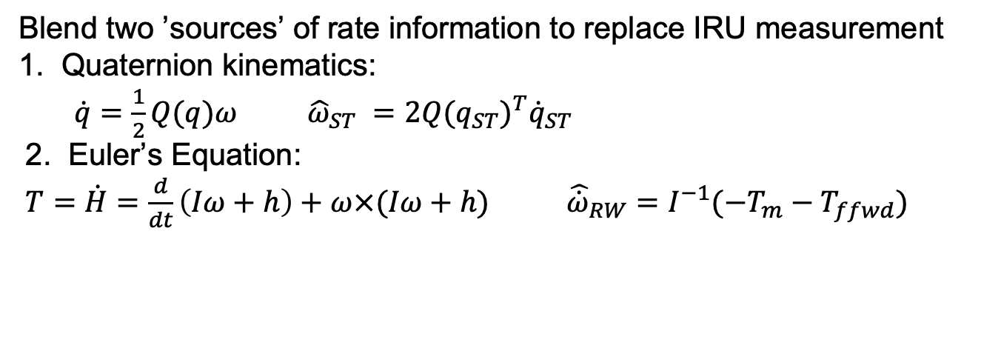
Gyroless Operations
Current rose on IRU3 in early 2021, powered cycled in June 2021
Current rose on IRU2 in Nov 2022, will be powered cycled in Jan 2023
Based on LRO experience, gyroless algorithm in development for SDO
SDO has the same Leonardo star trackers as LRO, experience fewer resets
Complementary Filter Algorithm adapted from LRO
Blend two ’sources’ of rate information to replace IRU measurement
1. Quaternion kinematics:
  $\dot{q}=\frac{1}{2}Q(q)ω$ ${\hat{ω}}_{ST} =2{Q(q_{ST})}^{T}{\dot{q}}_{ST}$
2. Euler’s Equation:
$T=\dot{H}=\frac{d}{dt}\left(Iω+h\right)+ω×(Iω+h)$ ${\hat{\dot{ω}}}_{RW}=I^{−1}(−T_{m}−T_{ffwd})$

Slide 16
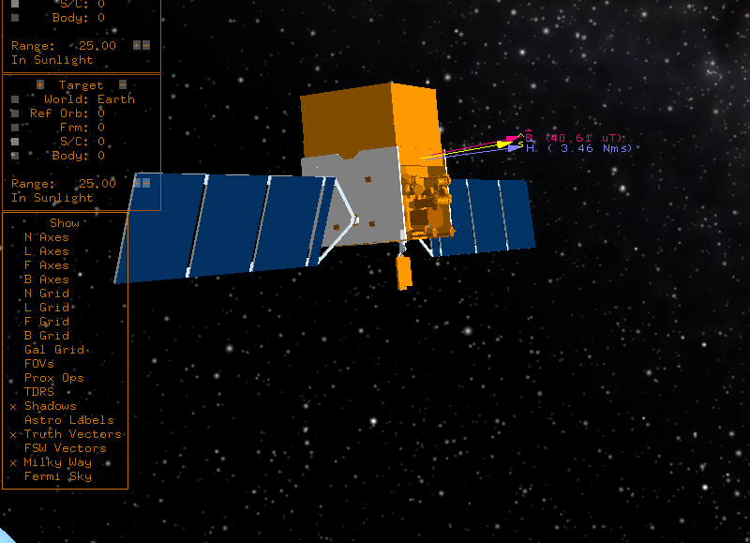
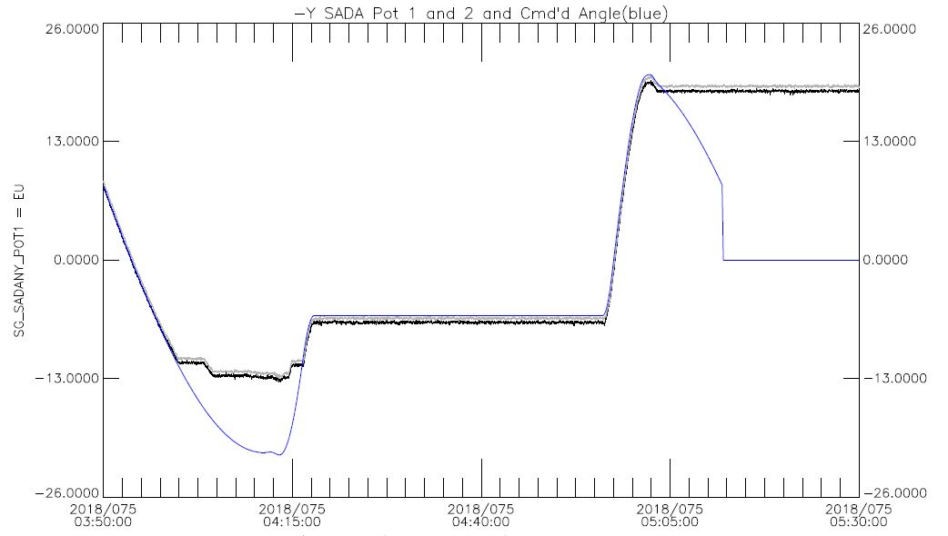
Fermi (2008)
Fermi Gamma Ray Telescope studies the most extreme environments in the Universe
In March 2018, the –Y Solar Array Drive Assembly (SADA) stopped moving at 19 deg (should have gone to 0)
Several attempts to restart unsuccessful
Fermi altered observing profile to manage power, disabled autonomous repointing
-Y SADA Angles

Slide 17
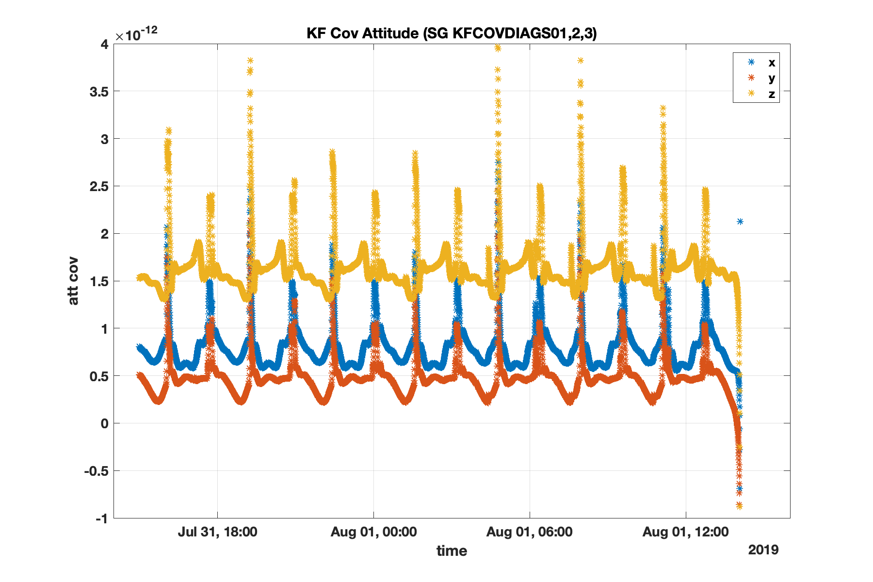
Fermi Kalman Filter Issue
In Aug 2019, the Kalman filter diverged causing Fermi to enter Safe mode
It was discovered that the covariance matrix was not forced to be symmetric and errors built up over time
A Kalman filter reset allowed for a return to science and eventually a FSW patch uploaded to fix permanently
Covariance main diagonals went negative

Slide 18
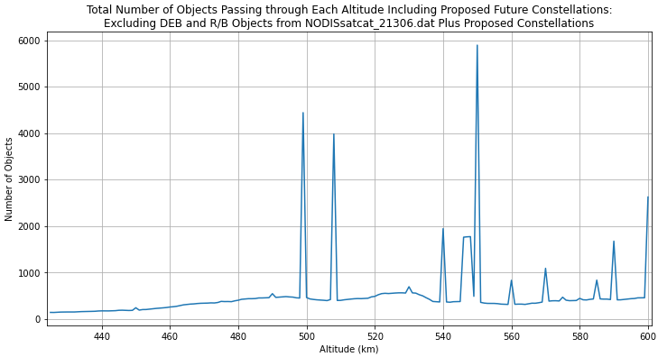
Fermi Collision Avoidance
Fermi has numerous conjunction predictions with high probability of occurrence
  Conducted one CA maneuver in 2012
  Increase lately is a burden on the ops team, often late nights and weekends preparing and coordinating with CARA
Starlink
Proposal to raise the orbit above Starlink
Fermi propulsion system intended for de-orbit only
Working through plan to raise Fermi orbit above the Starlink constellation
Need to leave enough fuel to de-orbit at end of life
Fermi now
Proposed Fermi altitude

Slide 19
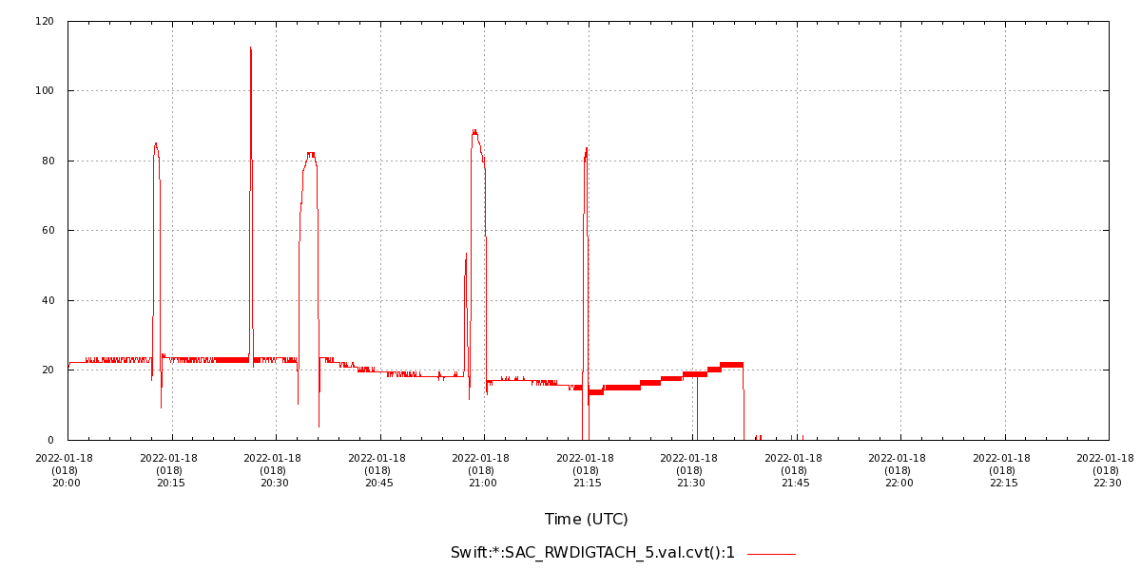
Neil Gehrels Swift Observatory (2007)
Swift is dedicated to the study of gamma ray bursts
Swift has 6 reaction wheels to provide fast slewing to burst locations (most missions have 4)
In Jan 2022, reaction wheel 5 was drawing high current and was powered off. Attempts to power back on were unsuccessful. Likely lubricant issue. Ops team monitoring behavior of other wheels. Proposal to rest another wheel that has similar behavior.
Swift operating on 5 wheels with some performance degradation
Reaction Wheel 5 Tachometer Data

Slide 20
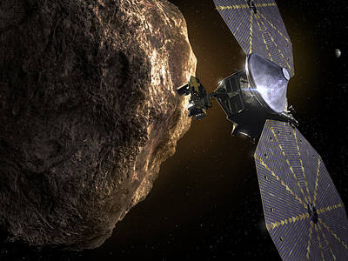
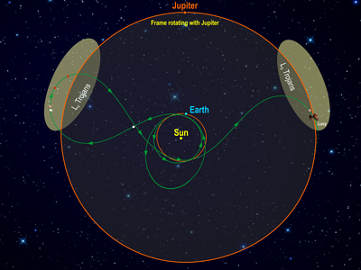
Lucy (2021)
Lucy will be the first mission to visit the Trojan asteroids
After launch, the +Y Solar Array (SAPY) didn’t fully deploy
Anomaly team formed
  Performed ground tests to simulate what may have happened
  Analysis on using the array as is (Use As Is)
  Completed two attempts so far to latch the array, third attempt underway
SAPY
Images from https://www.nasa.gov/mission_pages/lucy/main/index

Slide 21
ICON (2019)
Ionospheric Connection Explorer (ICON) – The goal of ICON is to understand the tug-of-war between Earth’s atmosphere and the space environment. (https://icon.ssl.berkeley.edu)
Last contact with ICON was on Nov. 25 for a Santiago pass
Since then the Ops team has attempted several blind acquisitions with no success
ICON has an 8-day command loss timer that will result in an avionics power cycle
Preliminary cause analysis is focusing on single fault issues within the avionics or RF system, but without any telemetry cause may not be determined
Attempts to detect a signal are ongoing as are discussions with CARA
The Berkeley team is working closely with the spacecraft vendor, Northrup Grumman

Slide 22
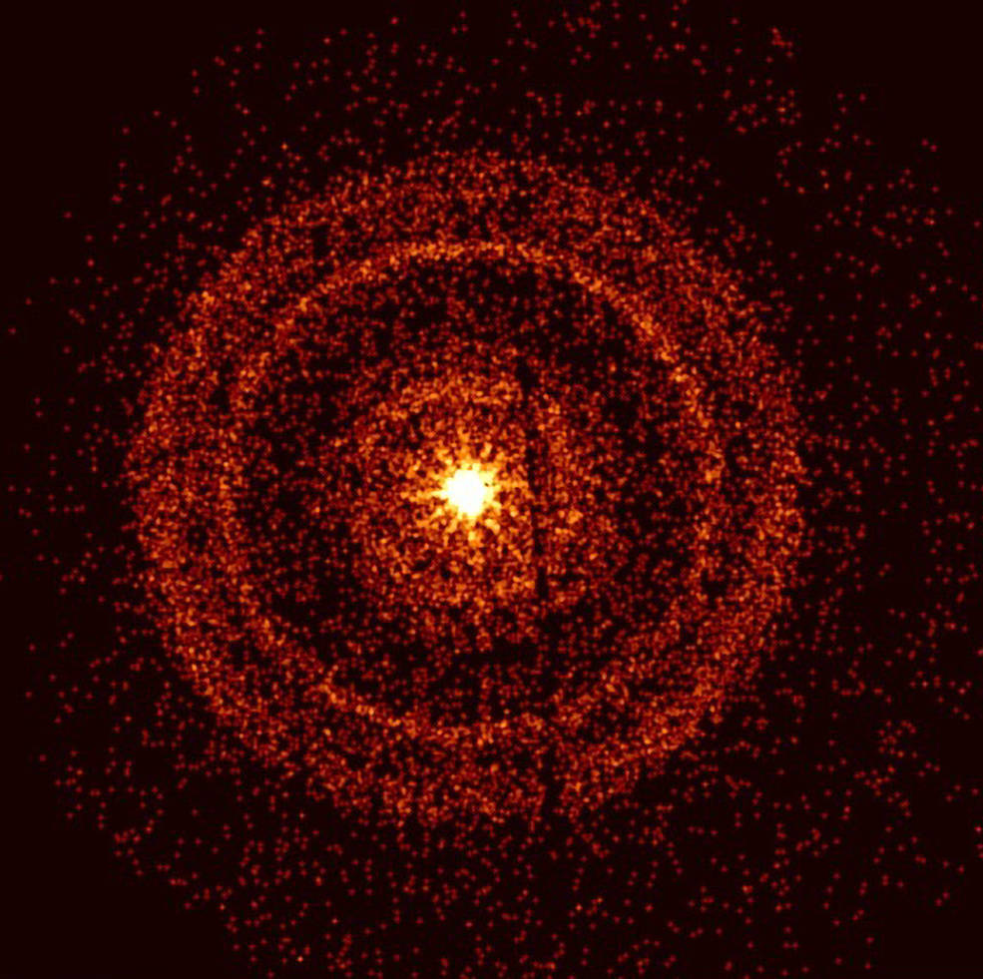
Conclusions
SSMO manages and operates a large, diverse fleet of spacecraft.
Spacecraft range in age, size, orbit regime; spinners, three-axis stabilized, nadir pointing.
Constant challenges in responding to anomalies, monitoring trends, looking for improvements.
Rewards come from exciting scientific observations and discoveries of the Sun, Moon, Mars, Black Holes, Exoplanets, Asteroids, Earth.
Oct 9, 2022: Swift’s X-Ray Telescope captured the afterglow of GRB 221009A about an hour after it was first detected. The bright rings form as a result of X-rays scattered from otherwise unobservable dust layers within our galaxy that lie in the direction of the burst.
Credits: Credit: NASA/Swift/A. Beardmore (University of Leicester)

Slide 23
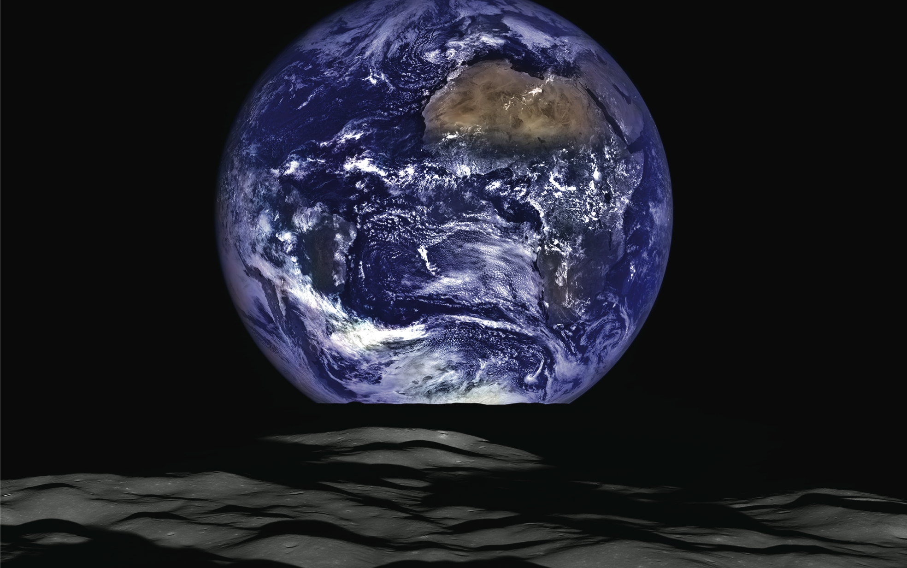
LRO – View of Earth from LRO Camera

