Slide 1
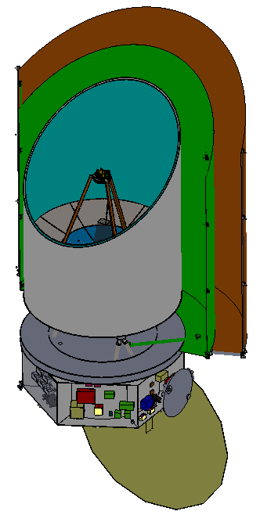
The Origins Space Telescope:
The Predecessors and Unique Challenges of a 4 K Telescope
Mike DiPirro/NASA-GSFC
For the OST Study Center and the OST STDT

Slide 2
Outline
Introduction to OST
Predecessors
Editorial: Cryogenic Engineering is not the same as Low Temperature Thermal Engineering
The OST Challenges and Trades
Technology Development
Summary

Slide 3
Intro to OST
Originally the Far-InfraRed Surveyor
=> Origins Space Telescope when Mid-Infrared Instrument Added
  Key to biosignatures in transiting exoplanets
Follows Spitzer (0.85 m diameter, cold for 5.5 years) and Herschel (3.5 m diameter, but warm 80 K)
General Observatory with 5 Year nominal mission duration with 10 years of consumables, designed for servicing
Covers wavelengths from 3 microns to 600 microns

Slide 4
Top three themes
(I) Are we alone? OST question: How common are life bearing planets around M dwarf stars? With sensitive mid-infrared transit spectroscopy, OST will measure biosignatures, including ozone, carbon-dioxide, water, and methane in the atmospheres of Earth-sized habitable exoplanets.
(II) How did we get here? OST question: How do the conditions for habitability develop during the process of planet formation? With the sensitive and high-resolution far-IR spectroscopy OST will map the water trail in our Galaxy.
(III) How does the Universe work? OST question: How do galaxies form stars, make metals, and grow their central supermassive blackholes from reionization to today? OST will spectroscopically 3D map wide extragalactic fields to measure simultaneously properties of growing super-massive blackholes and their galaxy hosts across cosmic time.

Slide 5
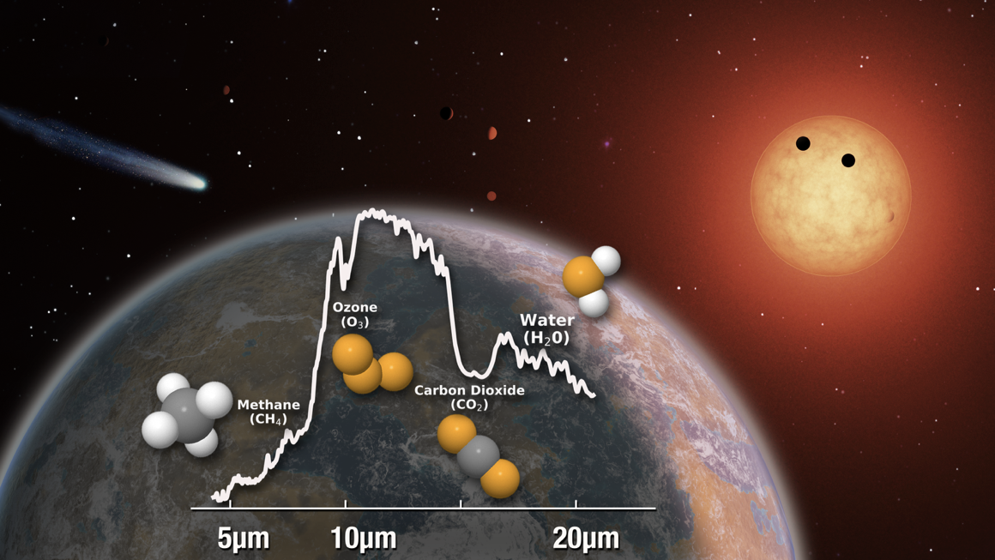
How common are life bearing planets around
dwarf stars?
Advantages to characterizing habitable zone transiting planets in the mid-IR
Precisely determined masses and radii -> bulk densities
Favorable planet-star flux & size contrasts
Mid-IR be sensitive to key spectral signatures (H₂O, CO₂, O₃, CH₄, N₂O) for HZ planets with Earth-like atmospheres transiting mid-to-late M dwarfs
Temperature constraint at apparent surface

Slide 6
How do the conditions for habitability develop during the
process of planet formation?
Science Objective 1: Measure the water mass at all evolutionary stages and across the range of stellar mass tracing water vapor and ice at all temperatures between 10 and 10,000 K.
OST will make the definitive statement on
the disposition of water as stars and planets are assembled.

Slide 7
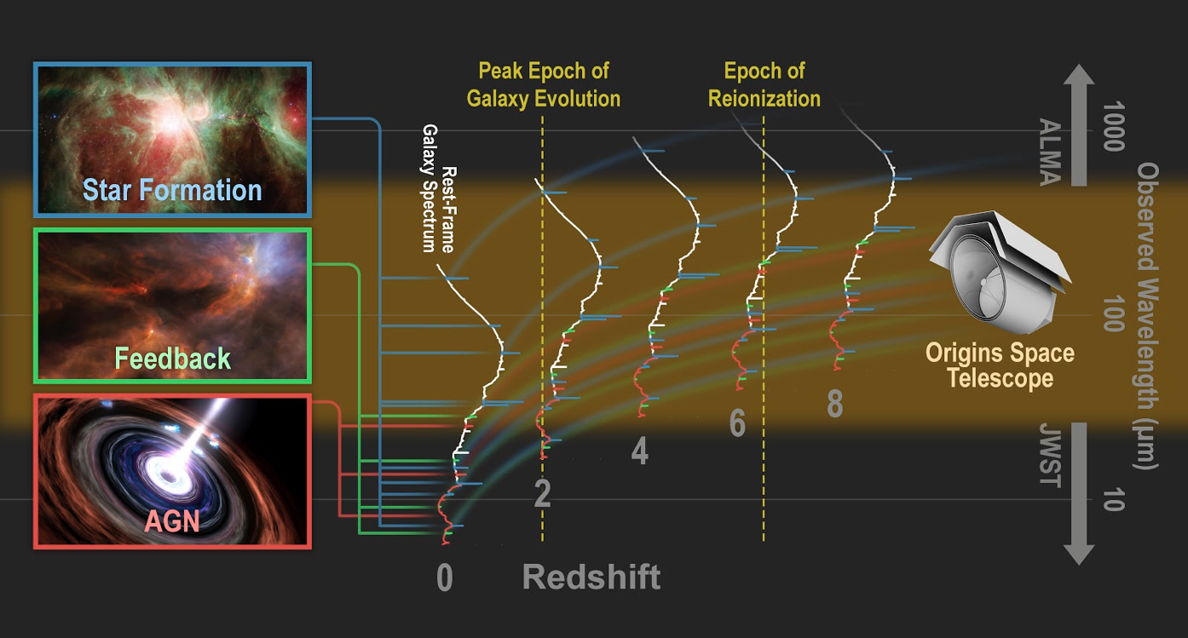
How do galaxies form stars, make metals, and grow their central
supermassive blackholes from reionization to today?

Slide 8
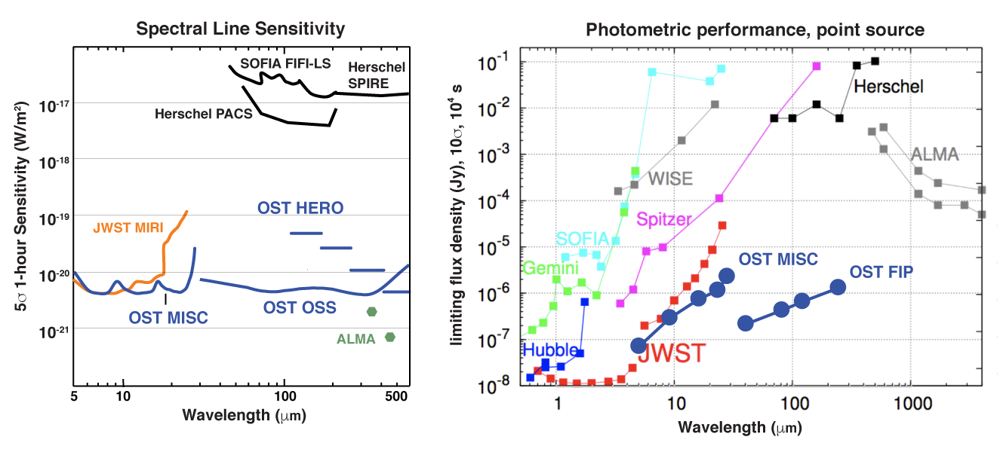
Sensitivity Improvement

Slide 9
Architecture Features
Concept 1 (Open, JWST-like)
  Pros: Easier to fold to stow for launch
  Cons: stray light suppression is more difficult, Larger sunshield is more difficult to deploy and demonstrate on the ground
Concept 2 (Closed, Spitzer-like)
  Pros: suppression of stray light, ground demonstration of thermal performance, can be fully deployed at launch
  Cons: limits the primary size to the fairing diameter
Operating Temperature
  4.5 K, allows sky background-limited performance
  Compatible with mechanical cryocooler and sub-Kelvin cooler technology

Slide 10
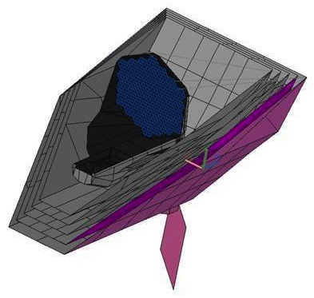
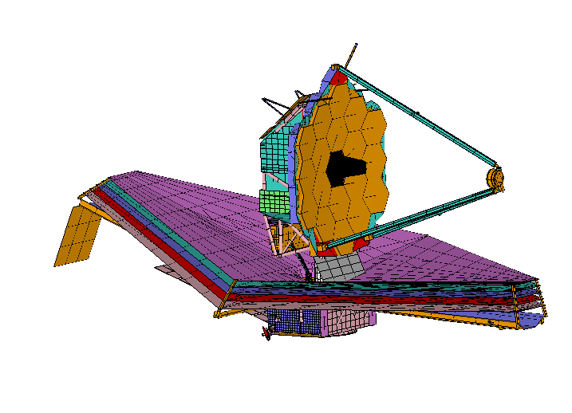
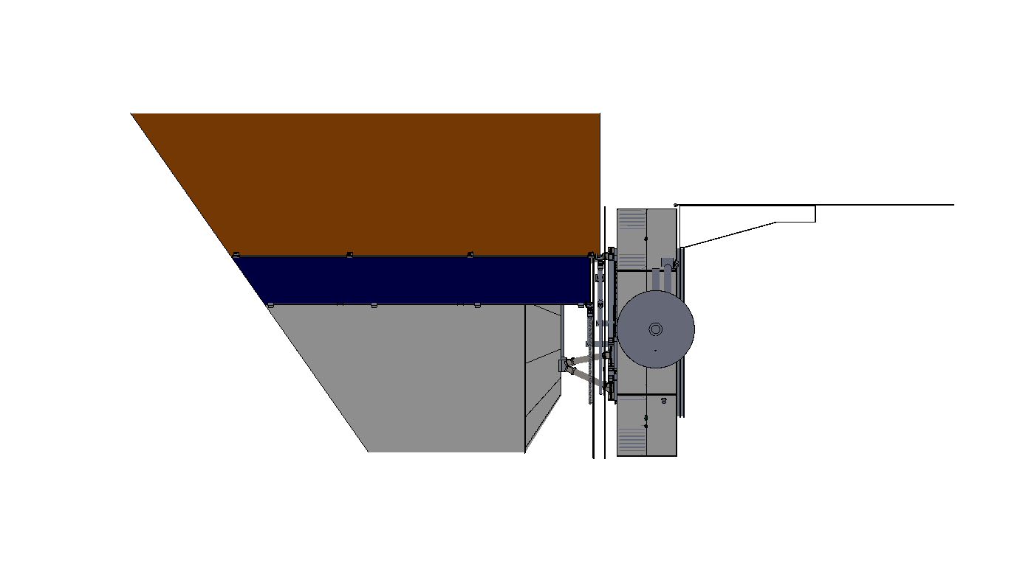
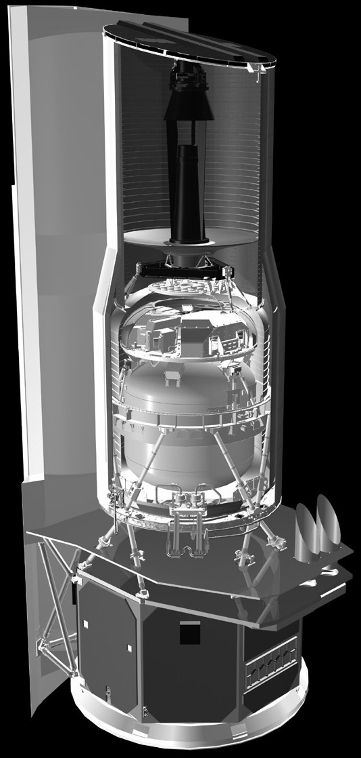
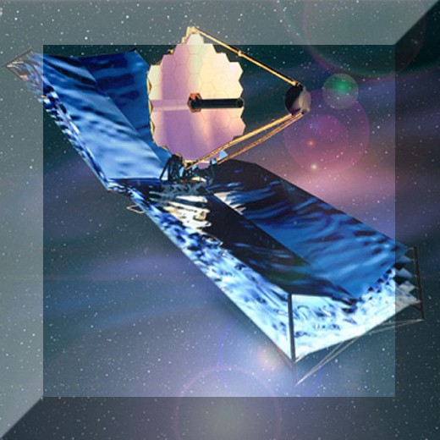
Overall Architecture
JWST
25 m²
OST Concept 1
52 m²
Spitzer-like rather than JWST-like
Cold Baffle is more forgiving for stray light
Cold radiator gives extra 35 K cooling
Simple shield deployment that can be demonstrated on the ground
OST
Concept 2
Spitzer
0.5 m²
25 m²

Slide 11
Why Do We Need a 4.5 K Telescope?
OST will cover the wavelength range from 5 µm to 600 µm
  The goal is to be background limited – limited by the cosmos rather than self emission from the telescope

Slide 12
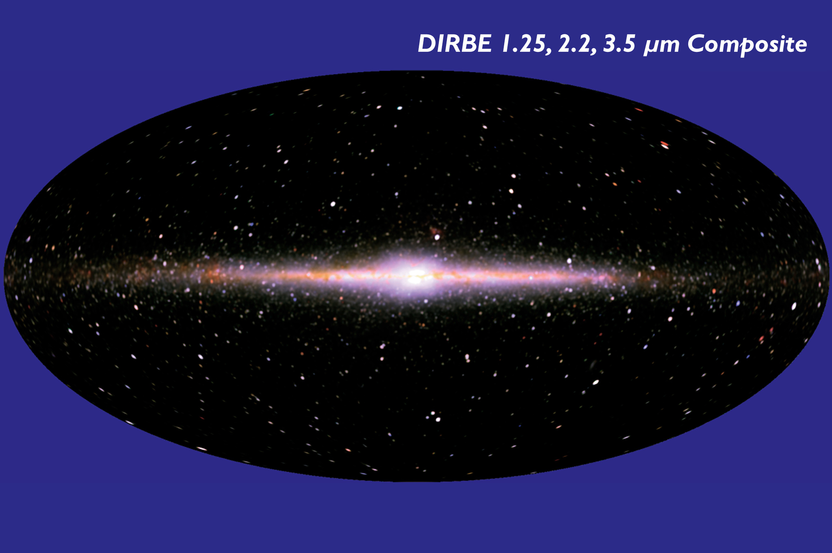
Predecessors
IRAS
  57 cm dia primary
  Liquid helium cooled
  Launched 1983, duration 10 months
COBE
  DIRBE has 19 cm primary
  Liquid helium cooled
  Launched 1989, duration 10.5 months

Slide 13
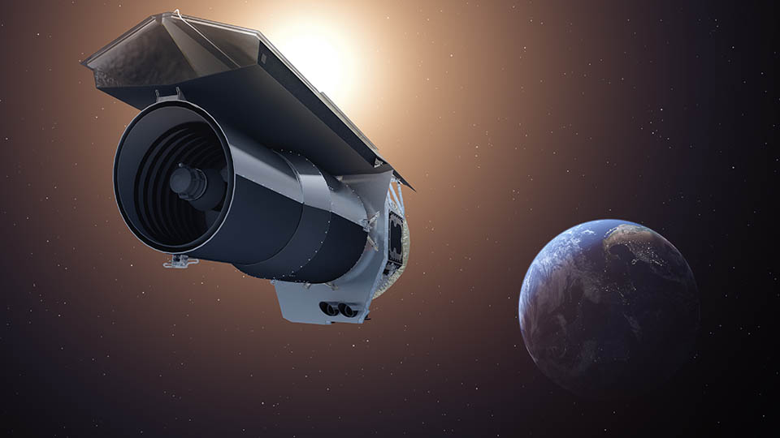
Spitzer

Slide 14
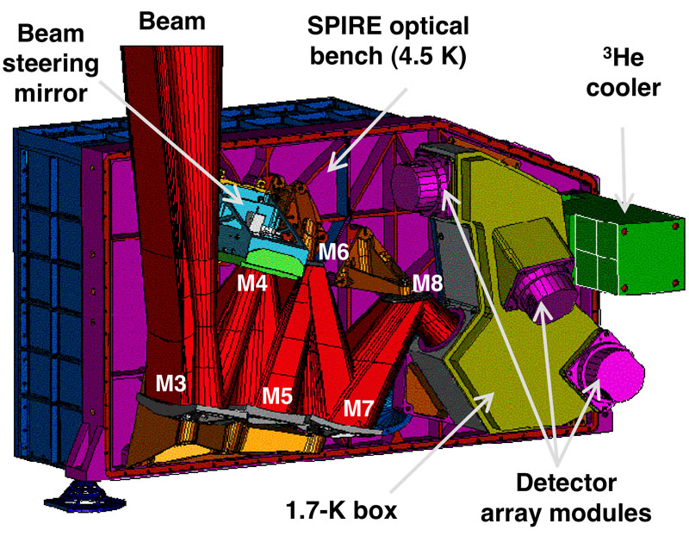
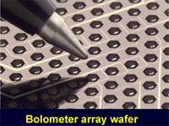
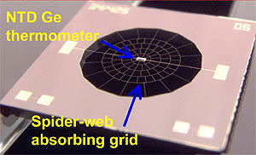
Herschel-SPIRE

Slide 15
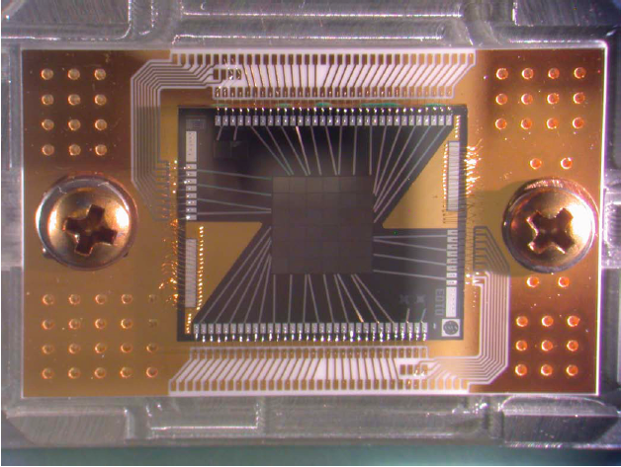
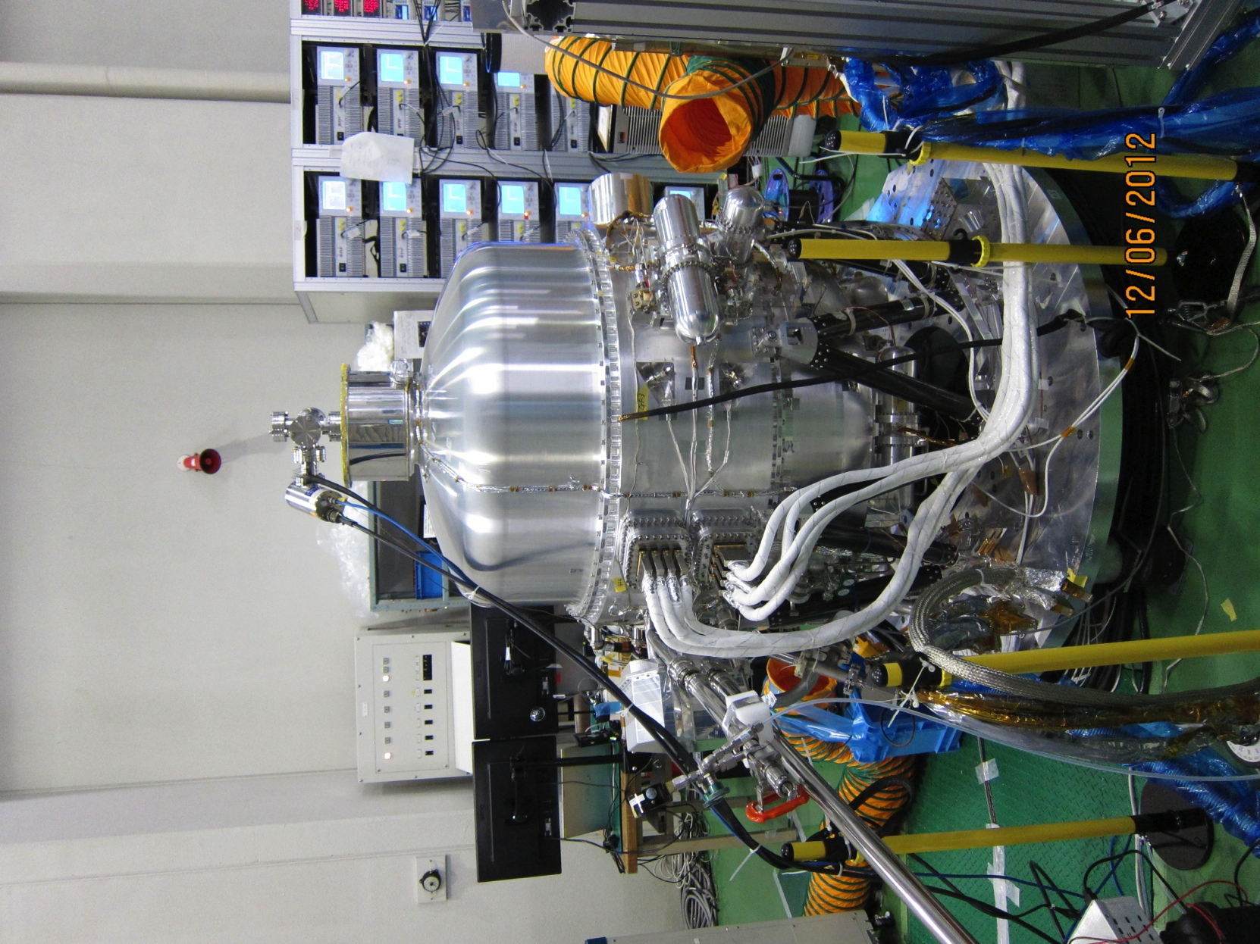
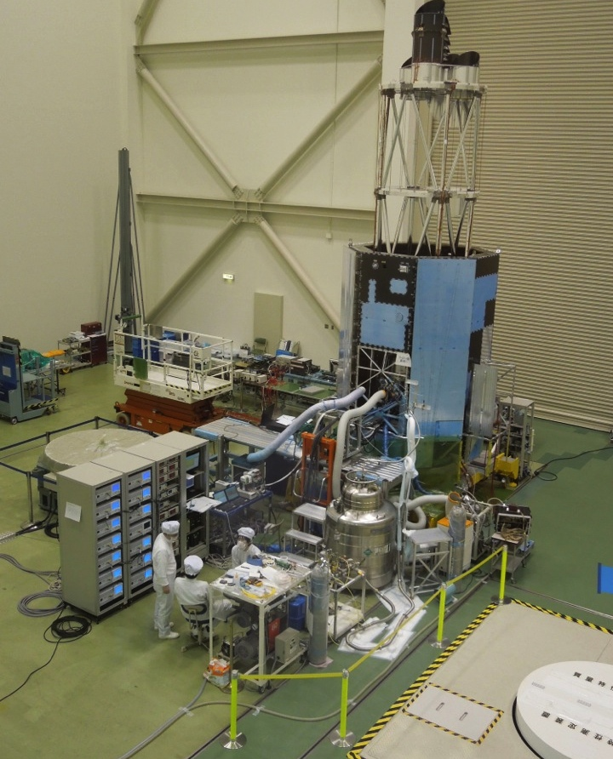
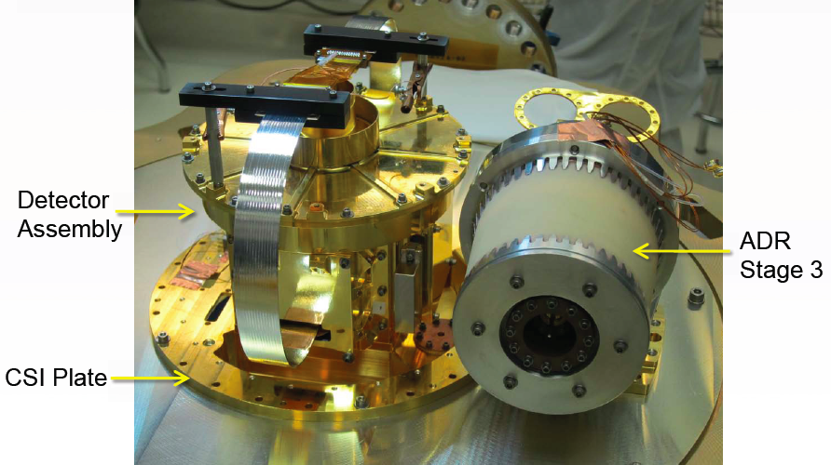
Hitomi Cryogenic System

Slide 16
Mid-Far IR Predecessors
Name | Effective | Wavelength | Temp. (K) | Year
 | Aperture | Coverage
 | Meters | µm
Human Eye | ~0.01 | 0.39-0.75
IRAS | 0.57 | 5-100 | 1.6 | 1983
COBE-DIRBE | 0.19 | 1.7-118 | 1.5 | 1985
MSX | 0.33 | 4.3-21 | 6 | 1996
ISO | 0.60 | 2.5-240 | 2.2 | 1996
Spitzer | 0.85 | 3-180 | 5.5 | 2003
Akari | 0.68 | 2-200 | 1.6 | 2006
Herschel | 3.5 | 60-672 | 80 | 2009
WISE | 0.40 | 3-25 | 12 | 2010
JWST | 6.5 | 0.6-28.5 | 40 | 2021

Slide 17
How Does OST Differ from JWST?
Wavelength
  3-600 µm vs. 0.6-28 µm
  Temperature of telescope (4.5 vs. 40 K) enables sky-limited performance
Wide Field of View
Closed vs. Open Geometry
  Better at suppressing stray light
  No optics deployment
Fast detectors and nimble spacecraft enable mapping of relatively large areas
Instrument designed specifically for transiting exoplanets
OST comes later so makes use of potential targets in mid-IR discovered by JWST

Slide 18
Cryogenic Engineering is Not the Same as
Low Temperature Thermal Engineering!
Properties of materials change
Be aware of approach to absolute zero
  Everything (almost!) goes to zero there
The physics changes
  Gases condense and freeze, superconductivity appears
Low temperature physicists make use of these changes
  Getters for gases, use of superconductivity for sensors, motors, and magnetic shields, etc.

Slide 19
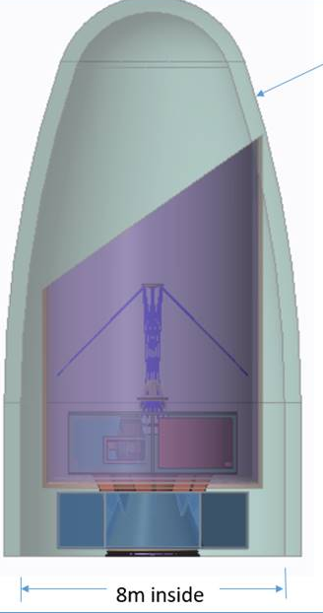
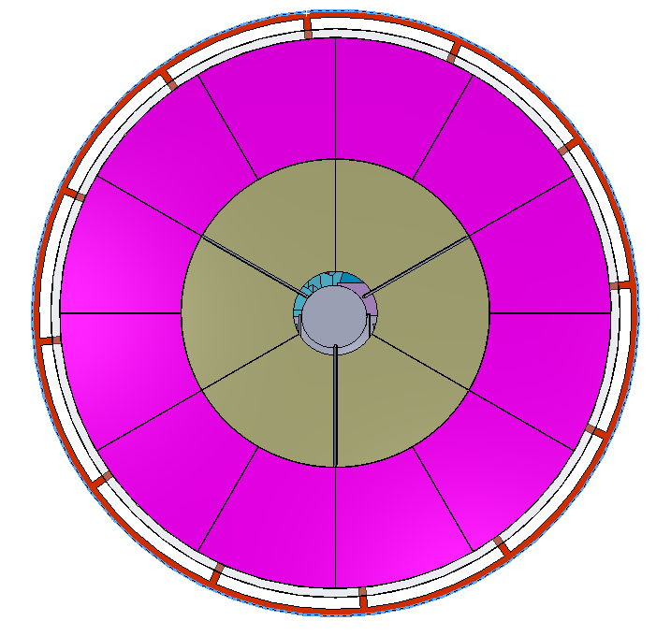
Major Architecture Trades-1
Telescope size
  JWST collecting area to capture transit spectroscopy from enough Earth-like planets
Deployed vs. Non-deployed
  Non-deployed optics for simplicity
  SLS (or BFR) required but viewed as less risky than deployment
On- vs. off-axis
  On axis for ease of packaging
Size of primary mirror segments
  JWST size, but forming circular aperture
    18 segment with only two prescriptions
    Manufacturing facilities exist

Slide 20
Major Architecture Trades-2
3-mirror vs. 2-mirror design
  3 mirror allows use of Field Steering Mirror
Beryllium vs. Silicon Carbide and other materials
  Beryllium chosen over silicon carbide for mass savings and higher thermal conductivity (isothermal structure and mirrors)
Instrument Complement
  OSS (Far IR Spectrometer)
  MISC (Mid Infrared Transit Spectrometer)
  FIP (Far-IR Imager and Polarimeter)

Slide 21
Cryogenic Design
Staged cryogenic system provides immunity to external disturbances
  2 layer sunshield (~140 K)
  Deep space radiator (35 K)
  3 stage cryocooler (70 K, 20 K, 4.5 K)
    4 TRL4-5 cryocoolers in parallel gives 100% margin over current heat loads
    Higher TRL chosen over larger, somewhat more efficient cryocoolers
      NASA has 20 years of technology development in this kind of cryocooler
      Jitter requirement is met with standard soft-mount techniques
  Nothing warmer on the colder side of a shield
    Thermal analysis is simpler and more amenable to back-of-the-envelope calculations
  Use cold amplifiers to bring low level signals to room temperature
Thermal analysis shows > factor of 2 margin at each cooling stage

Slide 22
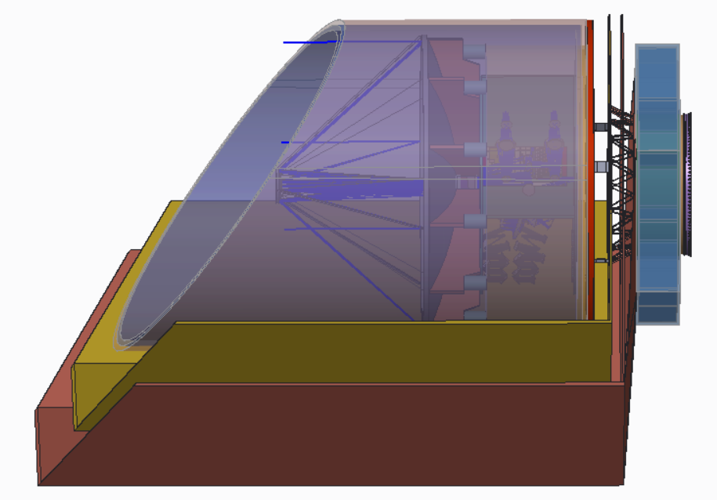
Thermal Zones
Single Stage Radiator
30-35 K, 1.5-2.9W
Inner Baffle (4K)
Room Temperature
(Spacecraft, Instrument electronics)
Outer Barrel
32-35 K
Sunshields

Slide 23
ACS Driving Requirements
Absolute Pointing: 0.15 arcsec (OSS, Inertial Point)
Onboard Pointing Knowledge: 0.15 arcsec (OSS, Inertial Point)
Jitter: 50 mas RMS > 1 Hz (MISC Transit Spectrometer)
  MISC will further stabilize to TBS mas
  Transit Spectrometer: 50 mas RMS > 1 Hz
Scanning Rate: 60 arcsec/sec (OSS Large Survey)
  Definitive (i.e. after ground processing) Attitude Knowledge: 150 mas
  Onboard pointing knowledge driven by absolute pointing accuracy of 2 arcsec
    Achievable using only star tracker and gyro

Slide 24
Momentum and Torque Requirements
13 Nms Storage for Survey
  60 arcsec/sec, 45,000 kg-m^2
170 Nms Storage for SRP Torque
  Assuming unload once/day
  ~14 minutes required to unload 170 Nms at 0.2 Nm
0.5 Nm Torque Capability for Survey
  Allows reversal of raster direction in ~60 sec (for 60 arcsec/sec rate)
These requirements may be met by a set of 6 HR18-250 reaction wheels
  0.2 Nm, 250 Nms each, arranged in “pyramid”
  Variant models trade momentum for torque capability
  No CMGs needed

Slide 25
Slew Rates
Mass properties and wheel complement are comparable to WFIRST
Max slew rate ~0.12 deg/sec
90 deg slew in < 15 minutes
Assume settle times ~30 sec
  Solar array flexibility

Slide 26
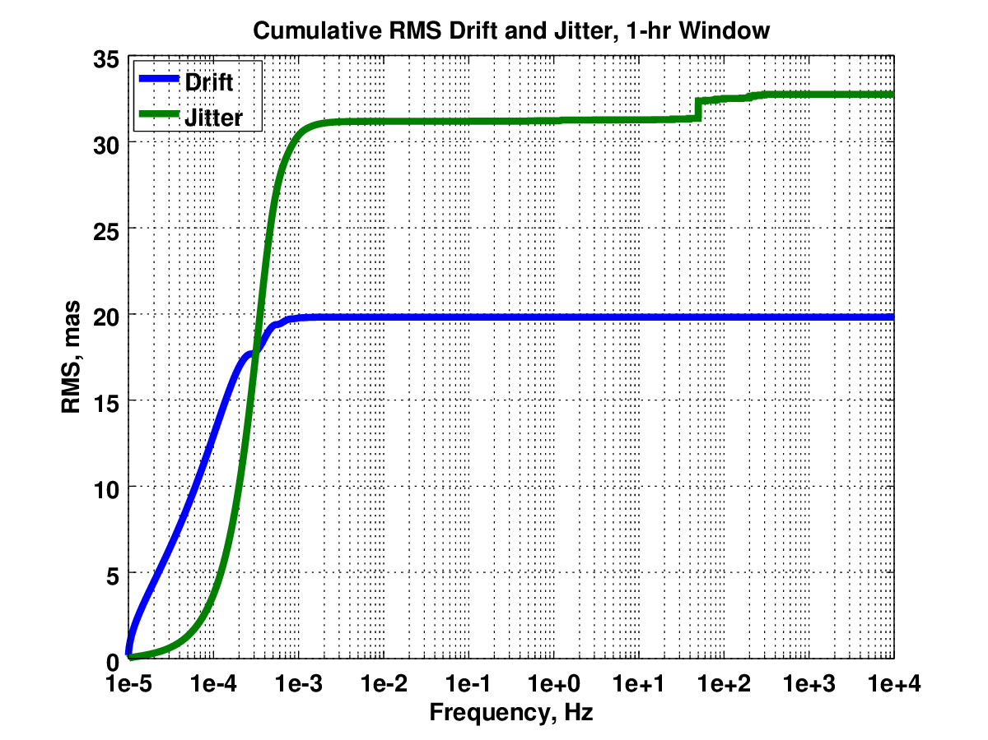
Drift and Jitter for Inertial Pointing
Assumptions
  Star Tracker NEA 2.0 arcsec
  Field steering mirror
  Some arbitrary structural modes
Star tracker noise is largest contributor
Cryocooler at 50 Hz is largest step increase
Other step increases are reaction wheels hitting structural resonances
Window | Drift (mas) | Jitter (mas)
30 min | 26 | 27
1 hr | 20 | 33
10 hr | 7 | 36

Slide 27
Sunshield
Very simple deployment with 4 actuators and spring-loaded mechanisms similar to those used in other missions
Sunshield design minimizes distance between center of pressure and observatory center of mass
  Decrease fuel and overhead required for momentum unloading
Deployment can be demonstrated on the ground
  Test-as-you-fly

Slide 28
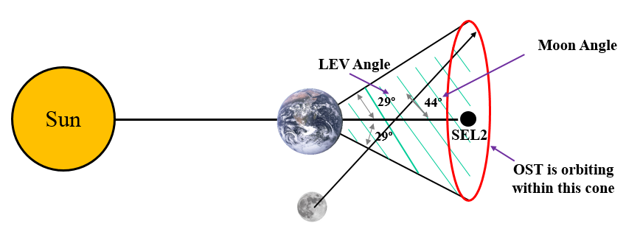
Field of View and Orbit
+5/-45° pitch, +/- 5° roll, +/-180° yaw
  Same as JWST
Quasi halo orbit at L2
  Similar to JWST
  Orbit dimensions chosen to optimize
    Fuel use to mission operability
  20% of time Moon will rise over sunshield in extreme pointing directions

Slide 29
Propulsion
Biprop maximizes propulsion force per mass and uses high TRL
Allows mid-course correction pointing toward sun
  Reflective cover on aperture protects until ejection at ~L+24 hours

Slide 30
Power
Was 7654 W fully margined before descope
  Of this 2500 W for cryocoolers -> 1800 W
  3400 W for instruments -> ~1700 W (my guess)

Slide 31
Communications and Data Storage
Data rate: ~20 Tb per day
  Optical com chosen

Slide 32
Thermal Analysis
Power is dissipated by body mounted radiators connected by heat pipes to high power sources
  Cryocoolers (450 W each x 4)
  Instrument electronics (OSS ~ 1000 W)
  However, fixed radiators can handle the full 7654W before descope

Slide 33
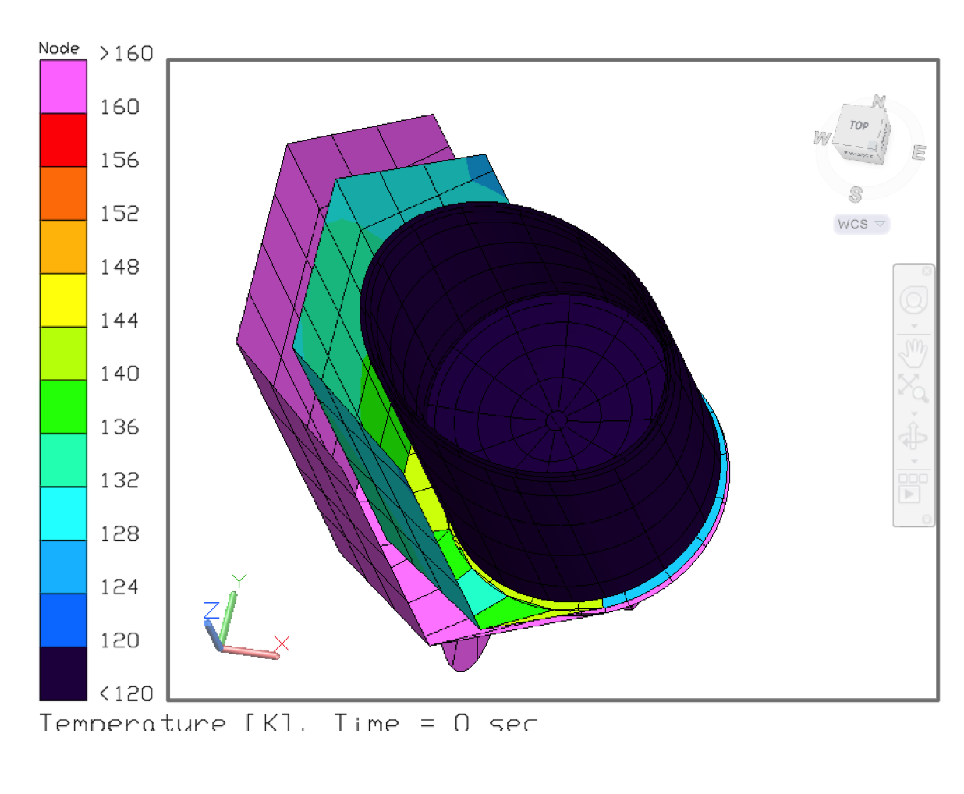
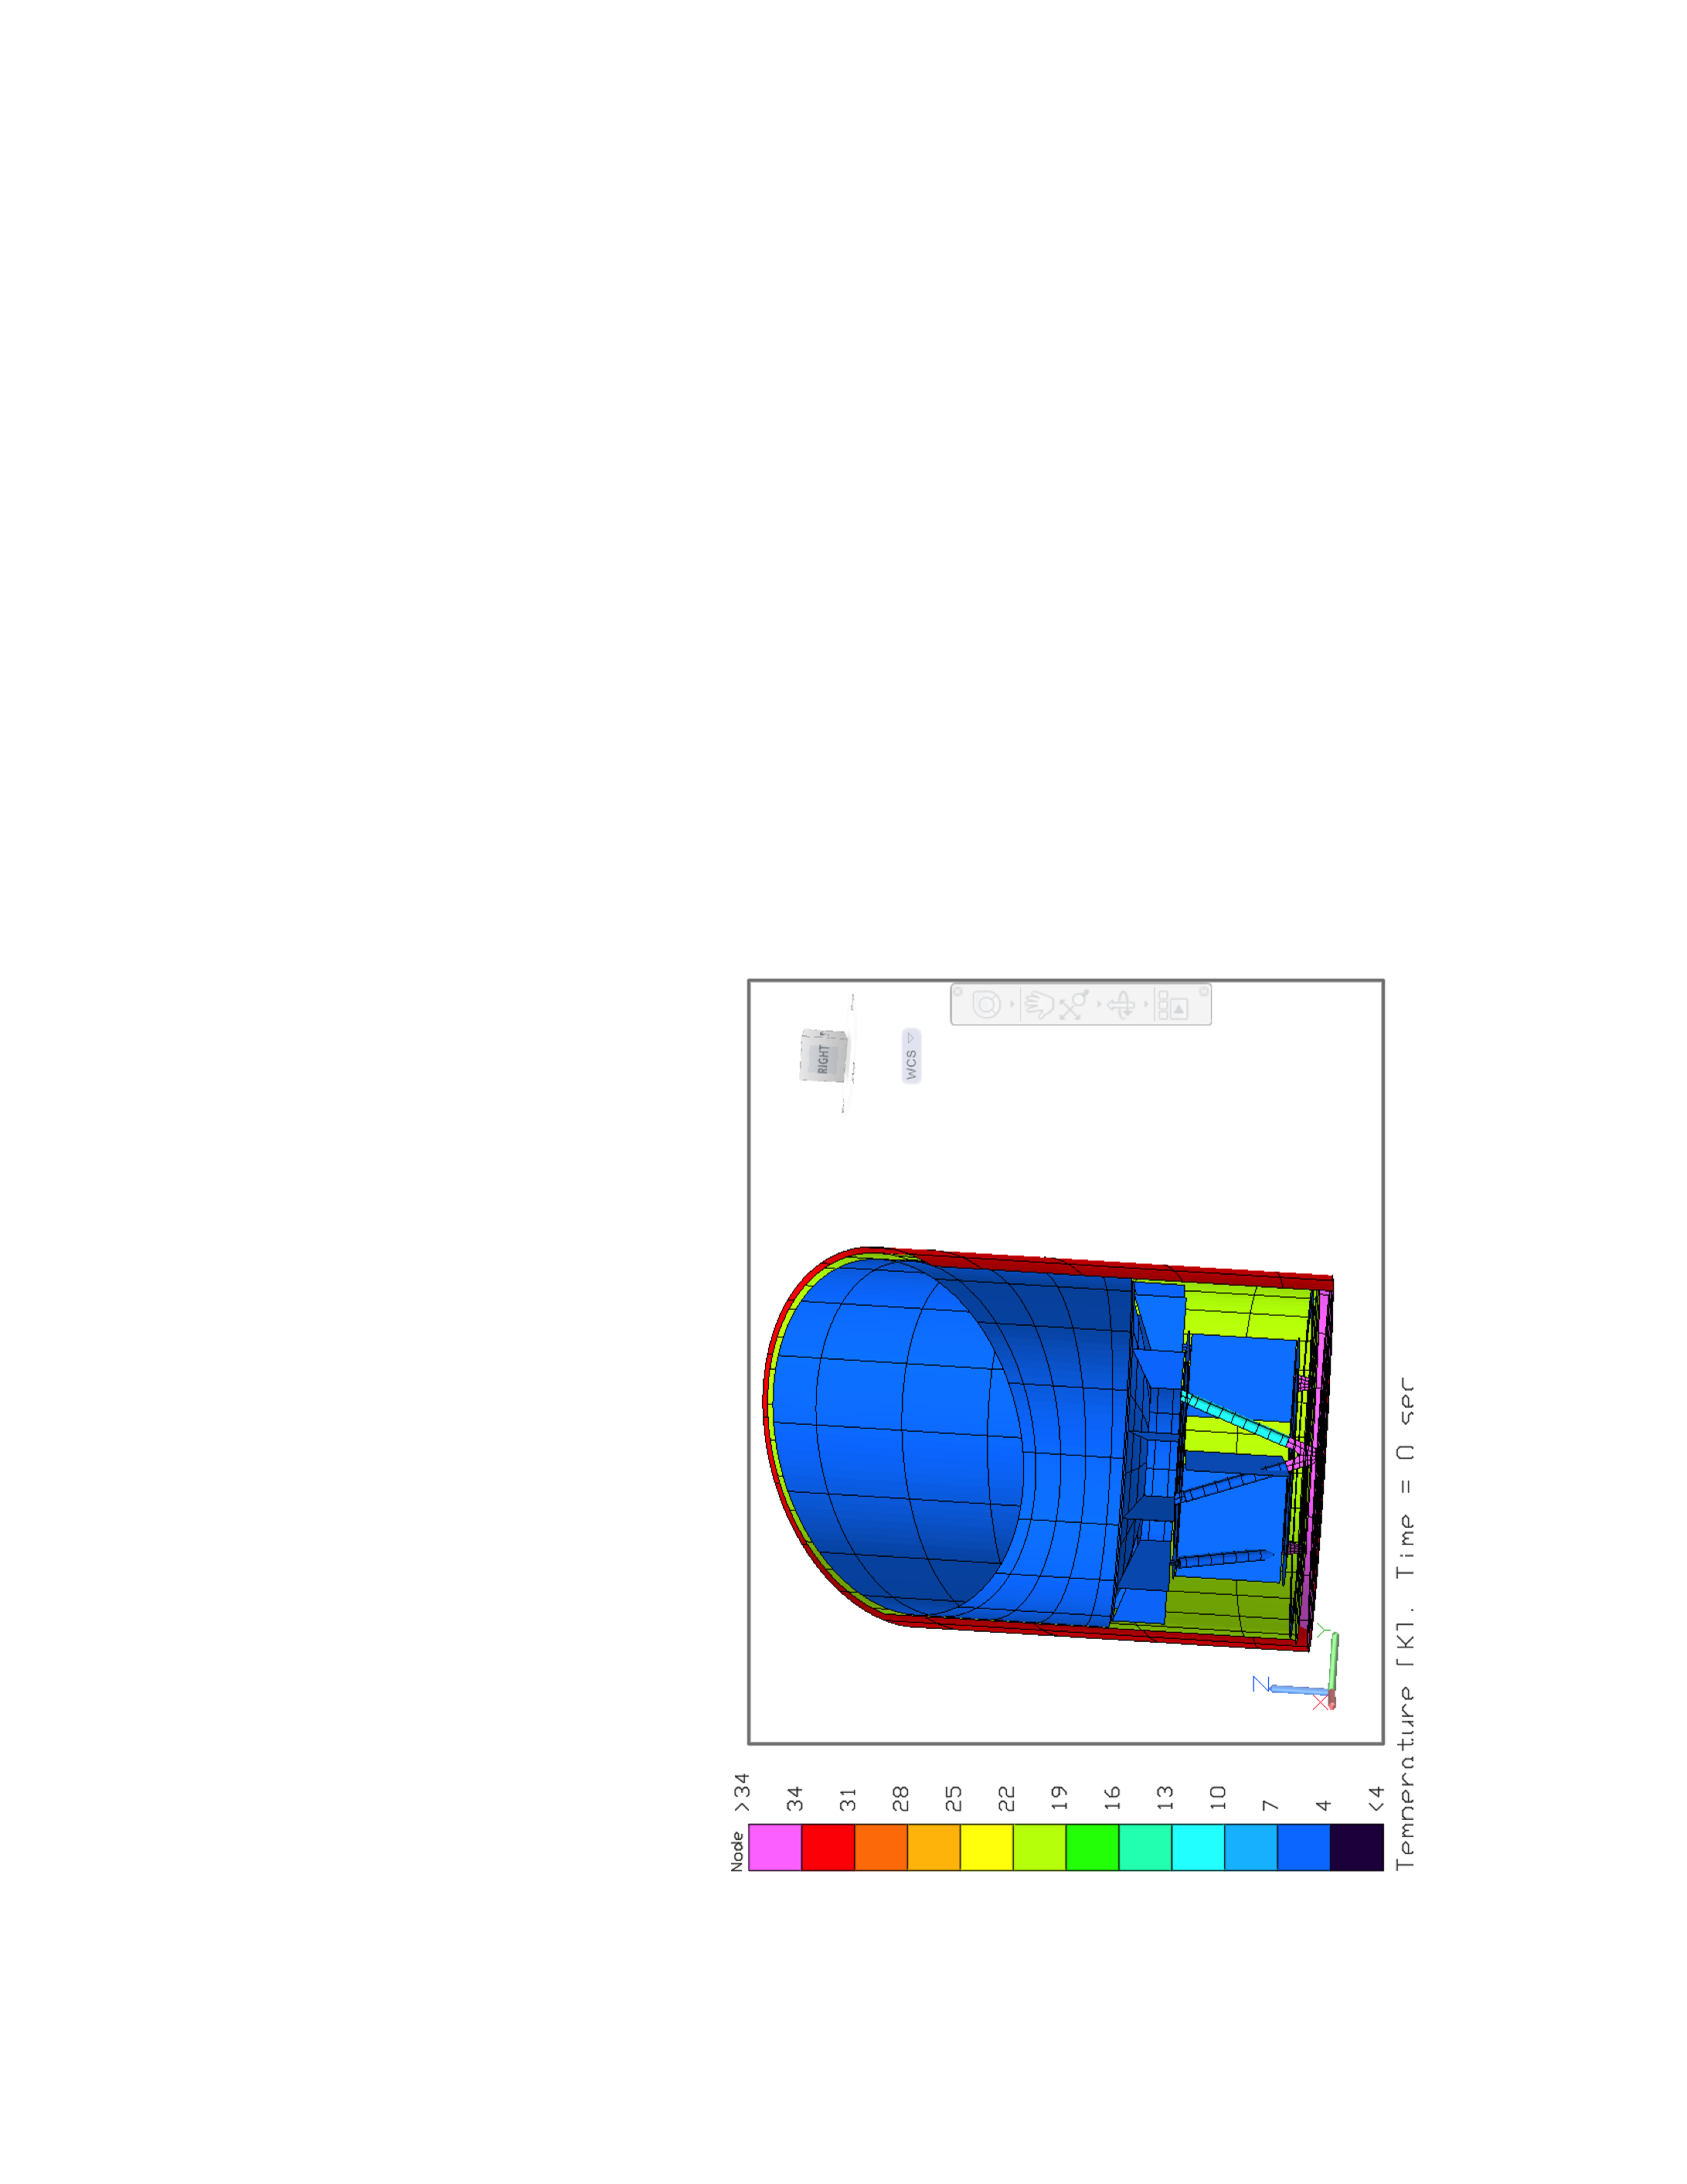
Thermal Radiation Analysis
Inside of Barrel lined with Al “sandwich”
held at 20 K by cryocooler upper stage
Only two sunshields needed

Slide 34
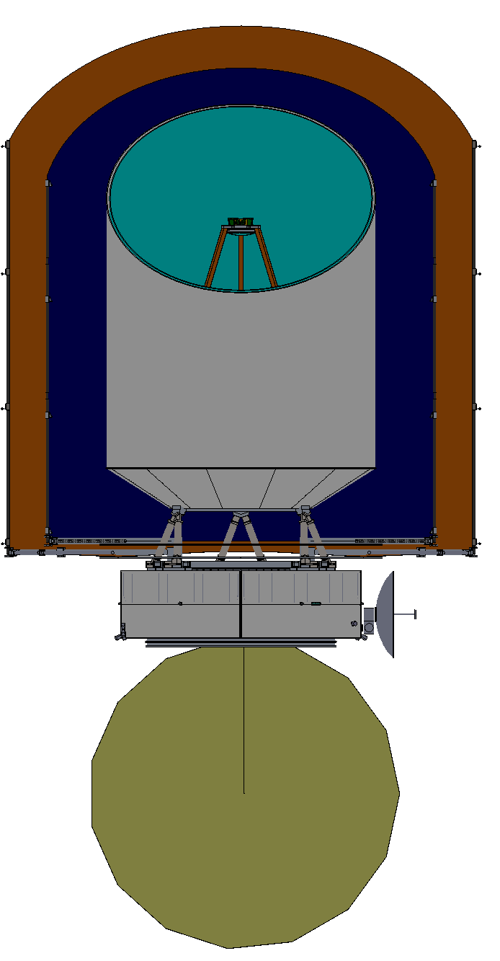
Instruments

Slide 35
OSS Optical / Functional Block Diagram
Red boxes are mechanisms.
Interferometer engaged via sliding mirrors intercepting beam. M2
B1:
25-44
B3:
71-124
R=300 Grating Modules
B5:
200-350
D
D
Tel
Beam-steering mirror
Pol. Grid
B6:
335-588
D
D
Interferometer
B2:
42-74
B4:
119-208
Etalon
Single long slit on the sky which couples all 6 bands
Each with 3 grating bands coupling the same position.
FTS engaged when desired -- serves small sub-field only
Etalon has fine scanning stage. M3
(D=dichroic beamsplitter)
Etalon carriage slides in and out of interferometer beam. M4
Interferometer has long scanning stage. M1

Slide 37
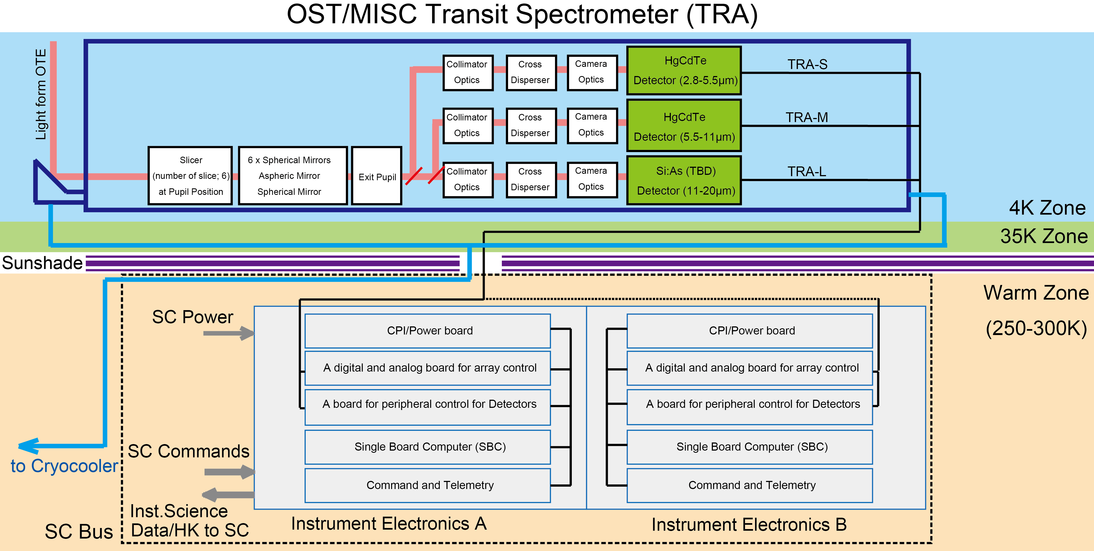
Instrument Description - MISC
Designed to measure the spectra of transiting exoplanets from 3-28 µm
Potential up-scope to camera and spectrograph

Slide 38
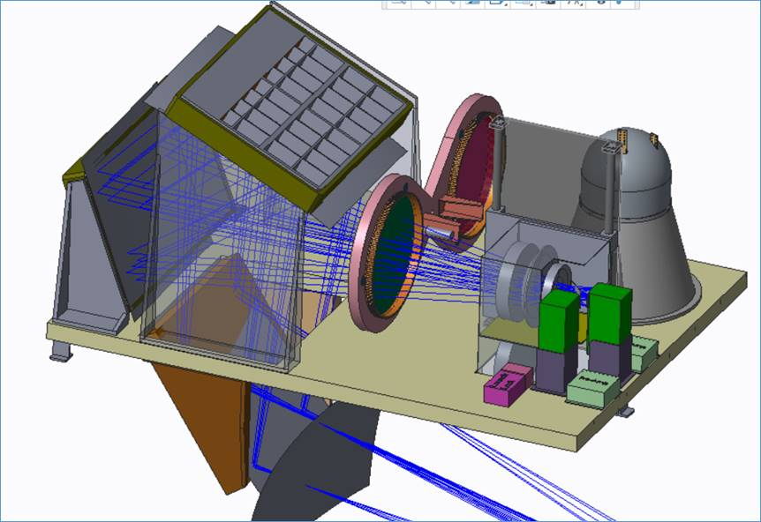
Instrument Description - FIP
4.5’ x 3’ field of view
50 and 250 µm bands
Can map at speeds up to 60 arc sec/sec
Can dwell to obtain deep field
Arrays of 120 x 120 pixels
Pixel NEP 3 x 10⁻¹⁹ W/√Hz

Slide 39
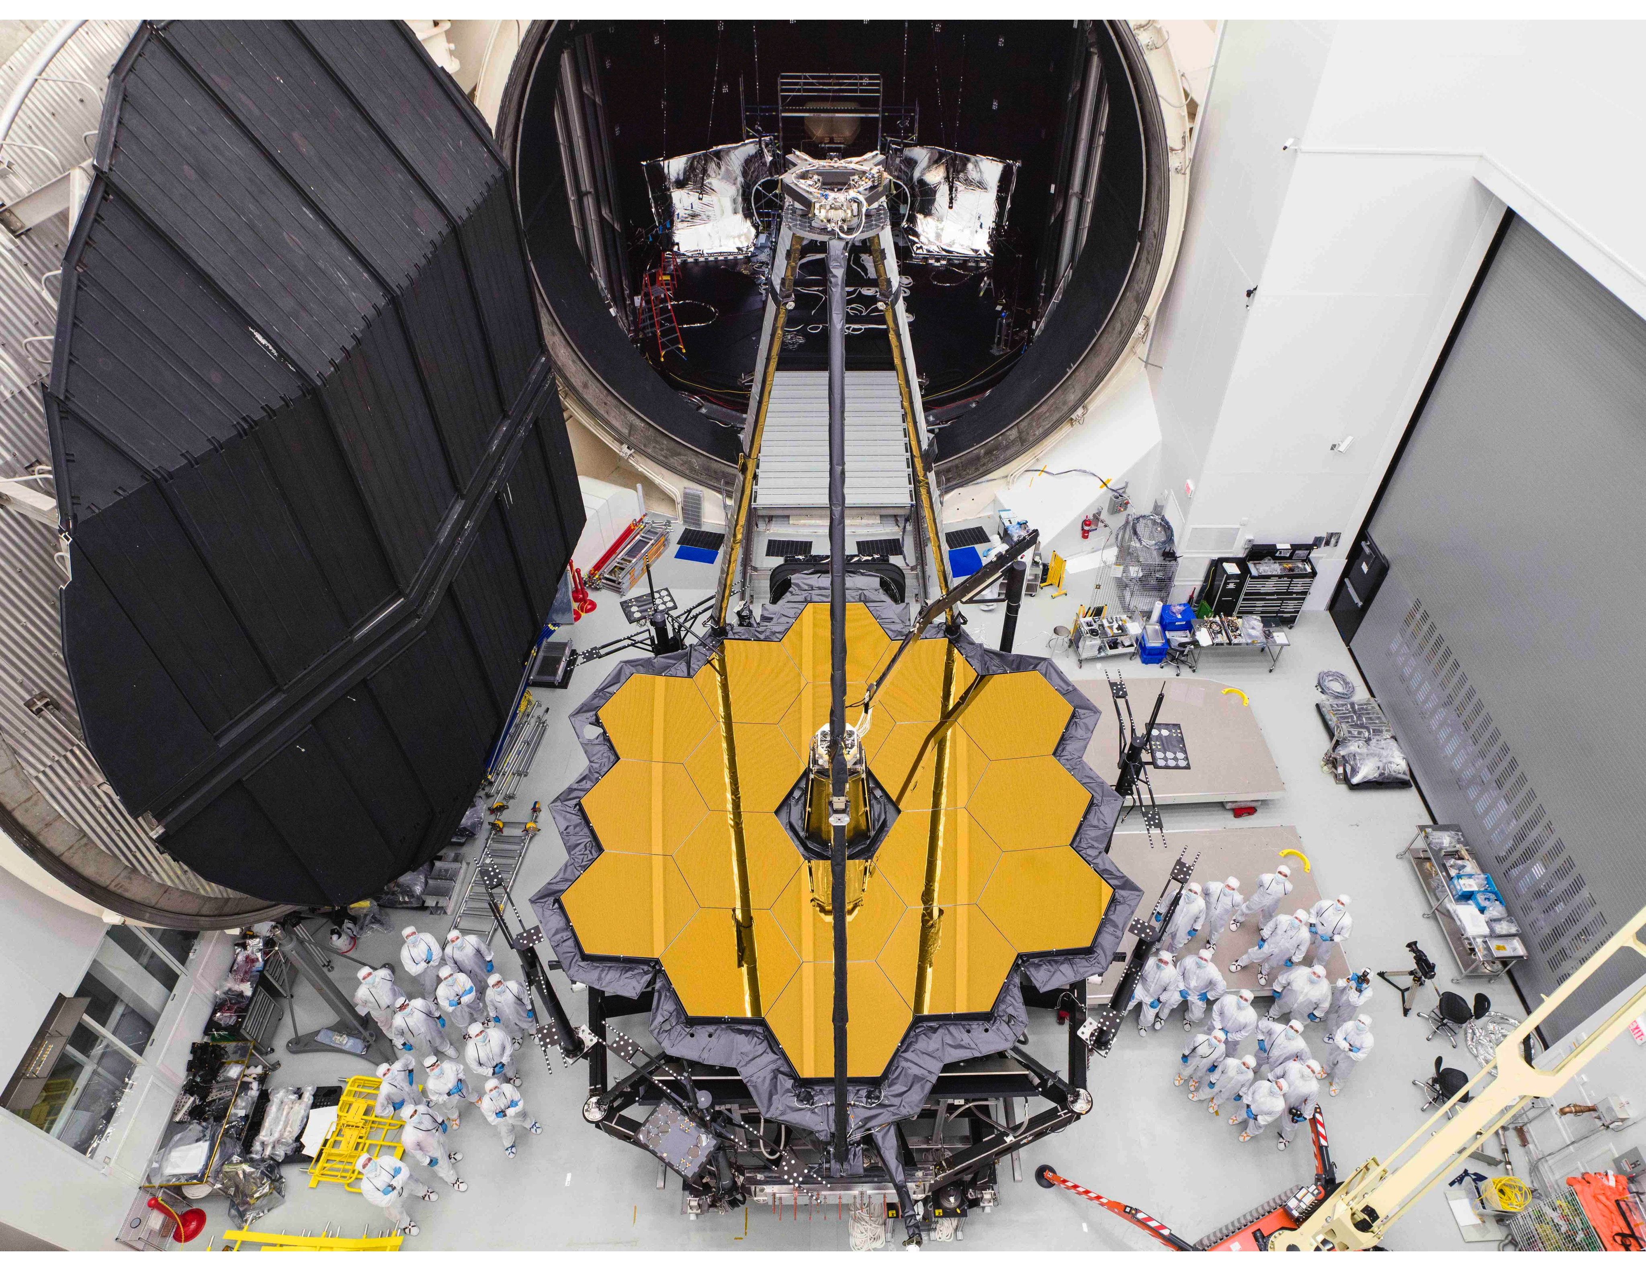
Testing/Verification
JSC Chamber A, which was used for JWST, is large enough and cold enough to thoroughly test OST
  13 m inner diameter
  Tested to 11 K
  With software change capable of 10 K
Full sunshield deployment will also be tested on ground
Full end-to-end test of entire observatory in thermal/vac is planned – “test-as-you-fly”
Shorter I&T overall than JWST because intermediate ISIM step is not needed and Infrastructure at Chamber A already exists

Slide 40
Enabling Technologies for OST
Far IR Detectors -- FIP, OSS
Mid IR Detectors -- MISC transit channel
4.5 K Cryocoolers -- FIP, OSS, HERO, telescope
  Several qualified vendors (NGAS, Ball, Lockheed,and Creare)
  SHI 4.5 K cryocooler with required specs has flown on Hitomi
SubKelvin Coolers -- FIP, OSS
  Ongoing SAT to develop continuous ADR from TRL 4->6

Slide 41
Far IR Detectors
Focal Plane Array
Require
  10⁴ scalable to 10⁶ pixels with <3x10⁻¹⁹ W/√Hz NEP (imaging) (10⁴ pixels is enabling)
    Reduce readout frequencies / electronics power dissipation
  <3x10⁻²⁰ W/√Hz NEP (spectroscopy) (enabling, OSS) with 3x10⁻²¹ background limited detection (enhancing)
  Reaching enabling numbers decreases the observing time by factor of ~100 and increases areal coverage by 10-100 times
SOA
  325 bolometers with 4x10⁻¹⁷ W/√Hz NEP (TRL9 Herschel/SPIRE)
  5120 pixels with low x10⁻¹⁶ W/√Hz NEP (TRL 5 SCUBA 2)
  Sensitive (NEP low 10⁻¹⁹ W/√Hz), fast detectors (TES bolometers, and MKIDs in kilo pixel arrays) are at TRL 3.
Path to get there: Develop MKID, TES, and QCD detector technologies in parallel
Three technologies offer multiple paths to required resolution and array size.

Slide 42
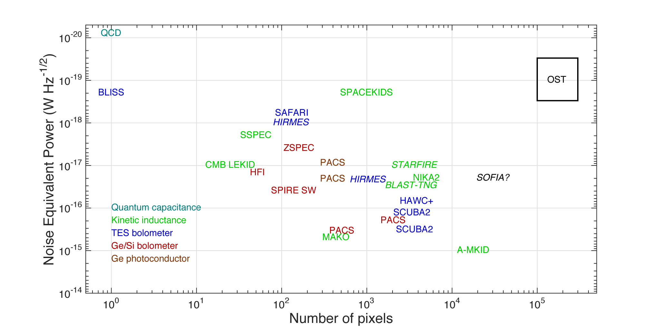
State-of-the-art NEP and Array Size

Slide 43
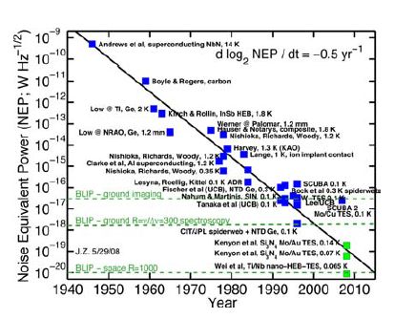
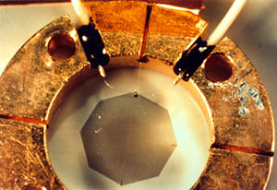
Far IR Detector Heritage
COBE FIRAS Bolometer

Slide 44
Far IR Detectors
Multiplexing and Amplification
Require
  4 GHz Bandwidth per 2000 pixels
    Microwave SQUIDs and/or discreet resonators for frequency domain multiplexing
  Low dissipation at 4 K (0.3 mW per 2000 pixel amplifier)
SOA
  LNF HEMT is commercial part
  SQUIDs under development at NIST and SRON have demonstrated necessary resonator spacing but for smaller total numbers (<200)
  LNF HEMT shows proper noise and gain for 0.3 mW/channel
Path to get there
  Continue testing SQUID multiplexers and LNF HEMTs
  X-ray microcalorimeters for Athena and Lynx require similar technology advances
Follow x-ray microcalorimeter SQUID developments and test LNF HEMTs

Slide 45
Far IR Detectors
Room Temperature Readout
Require
  Low dissipation at per readout channel
SOA
  FPGA requires 40 W per channel
  Emerging RFSoCs (specialized FPGAs) need ~10 W (mobile phone 5G technology)
Path to get there
  Hardware RFSoC codes adapted for our use
  Follow with ASICs to lower power by another >factor of 4
Leverage 5G technology to lower input power required

Slide 46
Mid IR Detectors
Require: 5 ppm stability over 1-2 hours
SOA: 30 ppm (JWST/MIRI), HgCdTe tests
Path to get there: More HgCdTe testing, develop calibration sources with required stability
Excellent background stability measured in HgCdTe

Slide 47
4.5 K Cryocoolers
Require: 200 mW cooling at 4.5 K + 400 mW cooling at 20 K + 20 W cooling at 70 K with input power of 2250 W
  Includes 100% margin
  Note that expected cryocooler-induced jitter has been shown to be not an issue even for the most sensitive instrument, MISC
SOA: MIRI cooler has 65 mW cooling at 6 K + 203 mW cooling at 18 K 425 W input power
Path to Get There: use 4 MIRI coolers with ³He as working fluid (to reach 4.5 K) or use Ball, Lockheed, or Creare coolers
Multiple manufacturers with TRL 4+ technology offer multiple paths to success

Slide 48
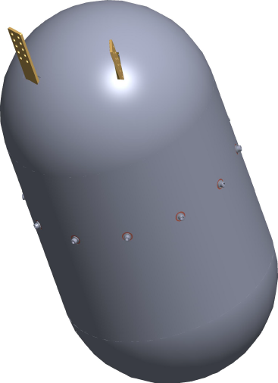
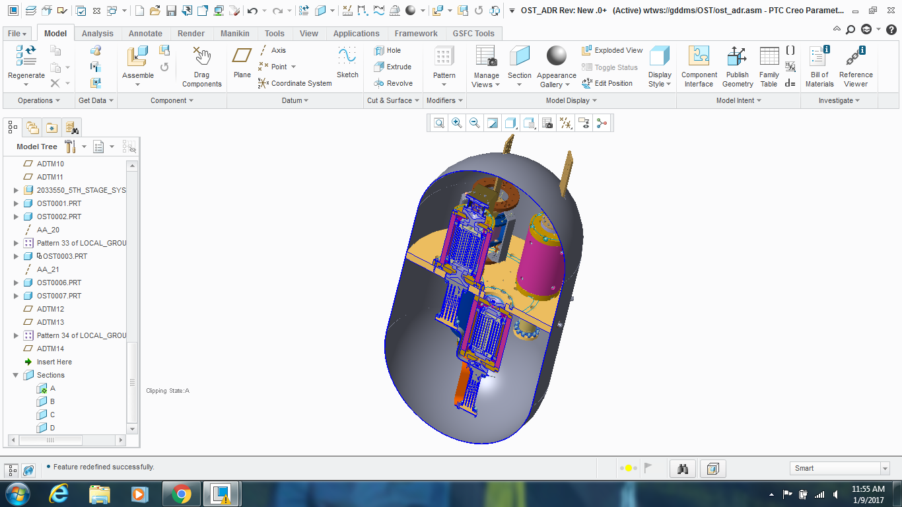
Sub-Kelvin Coolers
Require: 6 µW of cooling power at 50 mK
SOA: 0.4 µW@ 50 mK demonstrated on orbit by Hitomi. Lab demo 6 µW@50 mK of cooling power at TRL4. Electronics at TRL 6 (same cards have flown)
Path to Get There: SAT-funded development to achieve TRL 6 for a continuous ADR cooling to 50 mK with 6 µW of cooling power. Use same electronics as Hitomi.
255 mm
~ 1K interface
50 mK interface
486 mm
4K Interface
Superconducting
Nb Shield
TRL 4 demonstrated, TRL 6 funded for 2019 demonstration. High cooling power at
lower T also provides another path for meeting Far IR NEP resolution in TES.

Slide 49
Summary
OST addresses three astrophysics themes:
  Are we alone? (biosignatures in transiting exoplanets)
  How did conditions for life develop? (“follow the water”)
  How does the universe work? (“the rise of metals”)
OST’s architecture is simple, and is “test-as-you-fly”
Cooling technology has rapidly evolved and will be ready by 2020
Detector technology has a clear path to be ready by 2025

Slide 50
Back Up

Slide 51
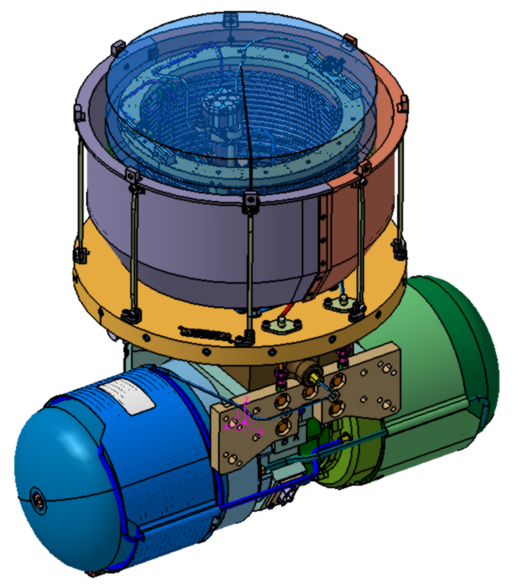
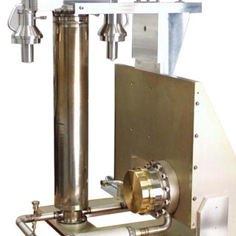
NICMOS and MIRI Coolers
HST/NICMOS Cryocooler
JWST/MIRI Cryocooler
JT Stage Heat Exchanger
Compressors

