Slide 1
PACE OCI Systems Engineering Lessons Learned Through CDR & ETE ETU Testing
Or perhaps better tilted “Adventures in a HQ-GSFC design to cost experiment”
Maybe more appropriate “How to decompose a highly integrated system”
Even Better… “How to navigate design cycles and testing in an over-constrained system”
Nope still not right, “Lessons in TRL & Calibration” … yea… That’s the one!
OCI Systems Engineering Team
Eric Gorman
Brian Clemons
Joe Knuble
Marcello Rodriguez
Jim Lobell

Slide 2
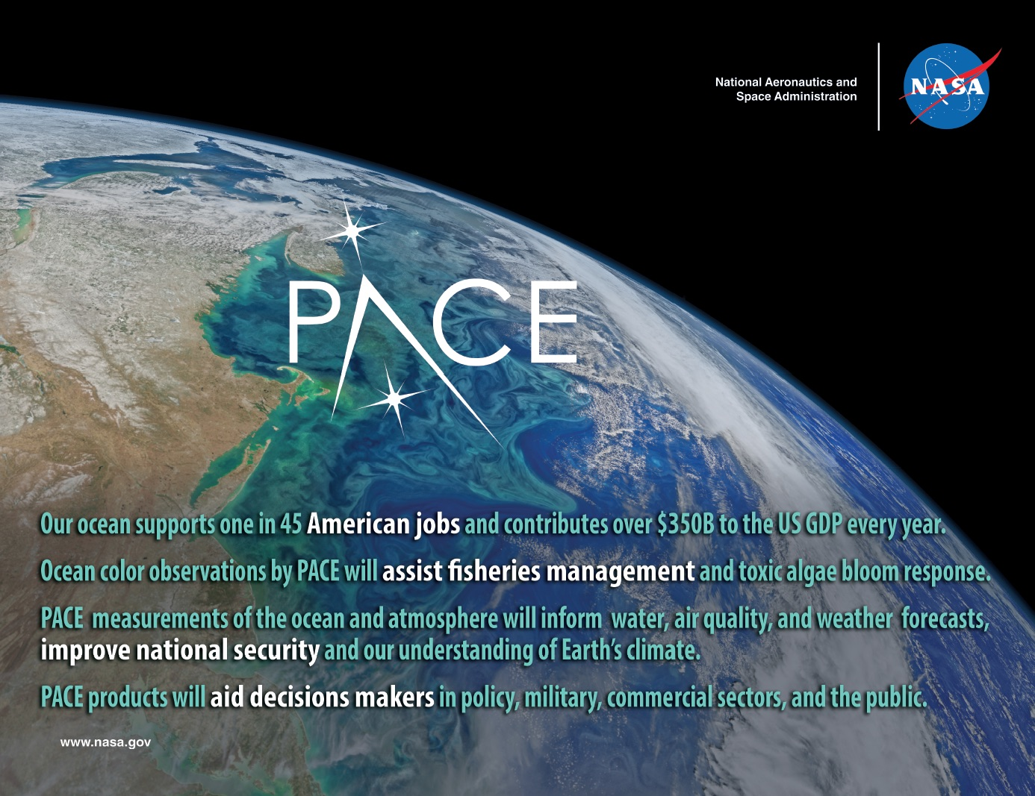

Slide 3
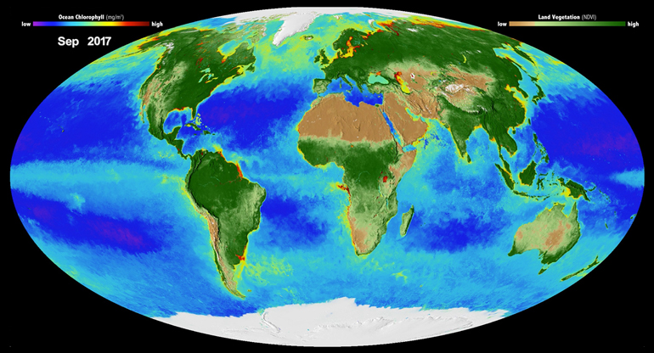
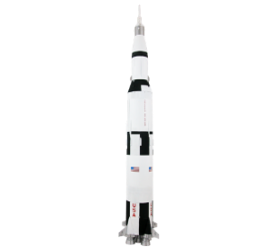
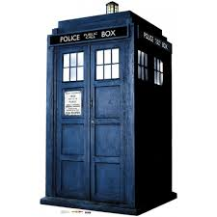
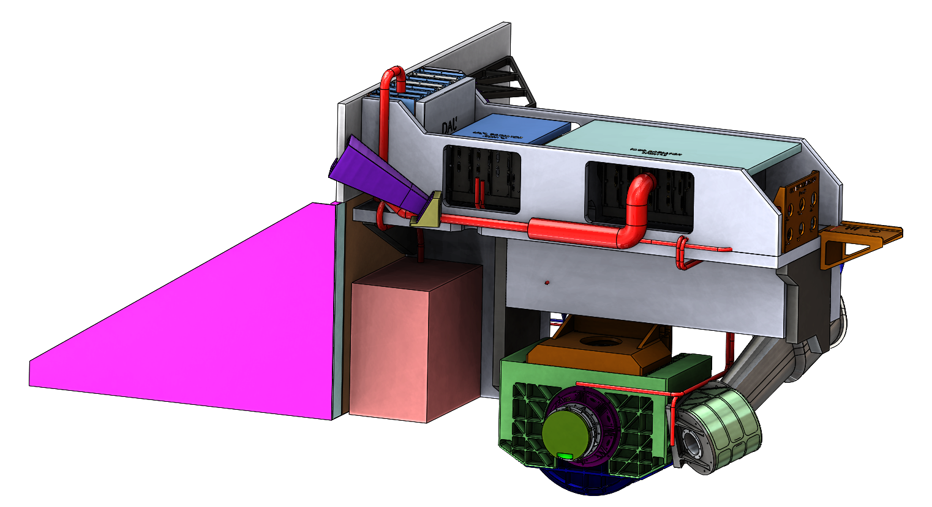
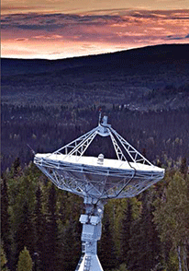
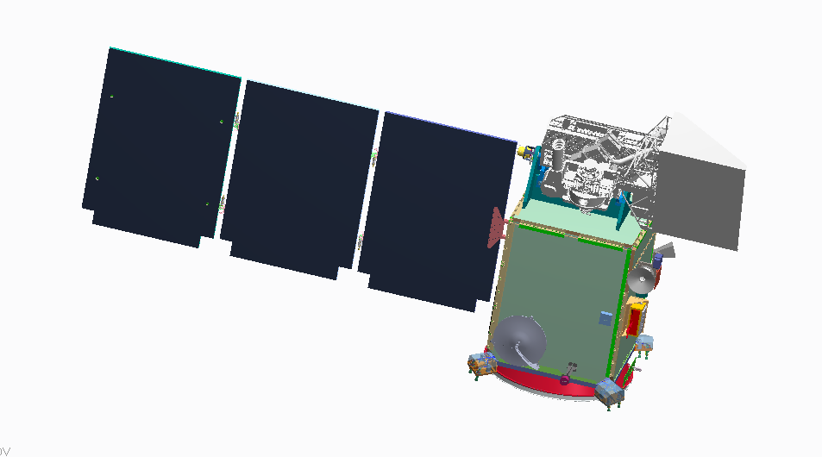
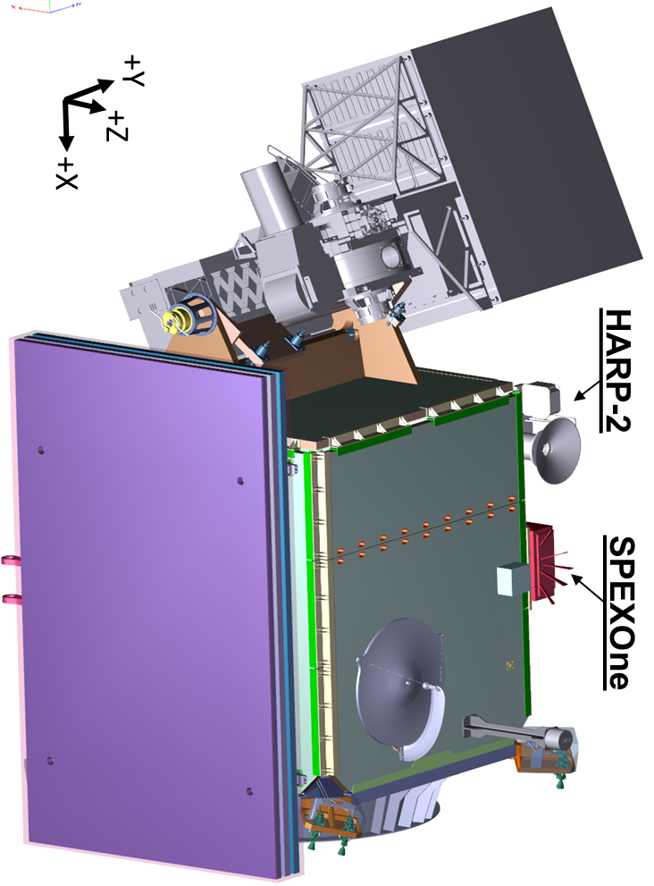

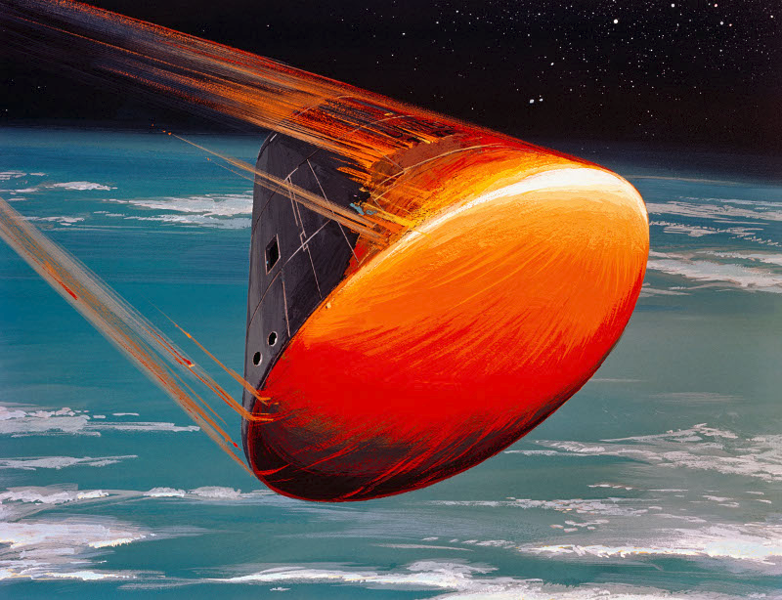
Plankton, Aerosol, Cloud, ocean Ecosystem (PACE)
PACE Science
New opportunities to monitor fisheries and respond to toxic algae blooms, and key ocean and atmosphere data for forecasting air quality and weather that will improve our understanding of Earth’s climate.
Mission Elements (Organization)
Competed Science Team (NASA ESD)
Vicarious Calibration (NASA ESD)
Ocean Color Instrument (GSFC)
Science Data Analysis (GSFC)
Spacecraft – (GSFC)
Polarimeters – (SRON, UMBC)
Launch services (LSP-SpaceX)
Mission Complement:
HyperSpectral Scanner
Two Polarimeter Instruments
Spacecraft Earth Pointing Platform
OBPG Science Data Segment (SDS)
Vicarious Calibration System
You Are Here
Feb 2020
Mission CDR
(LRD-37 months)
Key Mission Parameters
98° inclination; ~676.5 km altitude
  Sun-Sync (1pm MLT AN),
  2 day global coverage
Class C Mission
PRD Dec. 2022/LRD Mar. 2023
3 years^{Ͳ} Phase E & Controlled Reentry
10 years fuel*
OCI
CDR
Observatory I&T
Spacecraft
PDR
Grd &
SDS
CDR
Project Readiness
Date (PRD)
Dec. 2022
Phase A
Launch
Readiness
Date (LRD)
Mar. 2023
Grd &
SDS
PDR
OCI
PDR
Mission
PDR
Mission
CDR & LV
Award
Decommission
CY16
CY17
CY18
CY19
CY20
CY21
CY22
CY23
CY24
CY25
CY26
Phase A
Phase B
Phase C
Phase D
Phase E
Phase F
June 16, 2016
July 13, 2017
August 2019
October 2021
June 2023
PM-1
* Fuel only, design life is 3 years, the extra 7 yrs is ~9% of the required mission fuel budget
^{Ͳ} Baseline Requirement
3

Slide 4
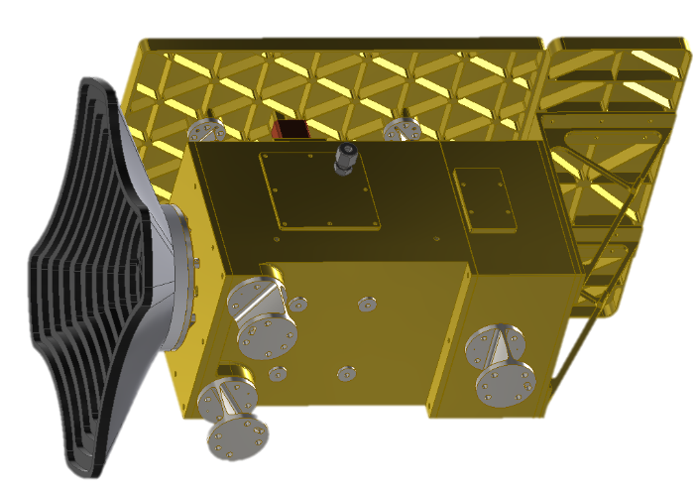
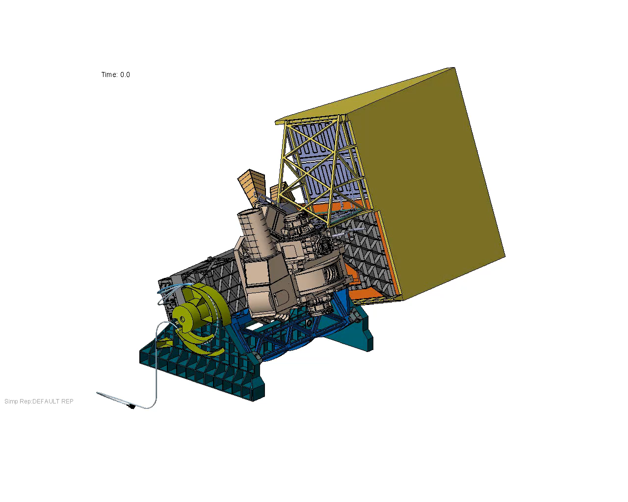
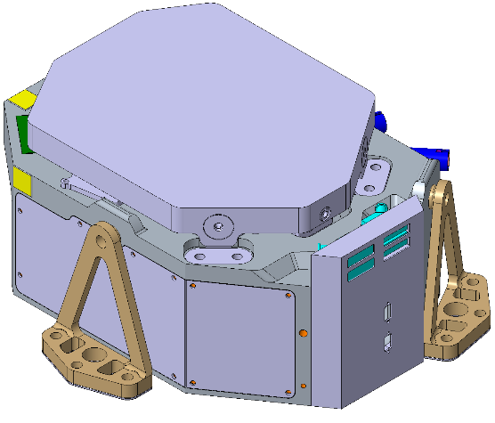
PACE Instrument(s) Critical Parameters
Ocean Color Instrument (GSFC):
340nm – 890nm at 5nm bands
SWIR bands 940, 1038, 1250, 1378, 1615, 2130, 2260 nm
Wide swath ±56° cross
1km GSD
Avg Data Rate: 20 Mbps
Mass ~ 260 kg CBE (includes portion of tilt structure)
$±$20 deg tilt for Sun glint avoidance
HARP2 Polarimeter (UMBC)
440, 550, 670 & 870nm Bands
10-60 viewing angles
Wide swath ±47° cross-track
GSD 700m binned to 3km
Avg Data Rate 10 Mbps
Mass ~10 kg CBE
300mm
240mm
485mm
SPEXone: Polarimeter (SRON)
385 to 770nm at 2nm Bands
5 viewing angles
Narrow swath ±4.5° cross
GSD approx. 2.5km
Avg Data Rate 5.3 Mbps
Mass ~ 11 kg CBE
360mm
150mm
280mm
TM-2

Slide 5
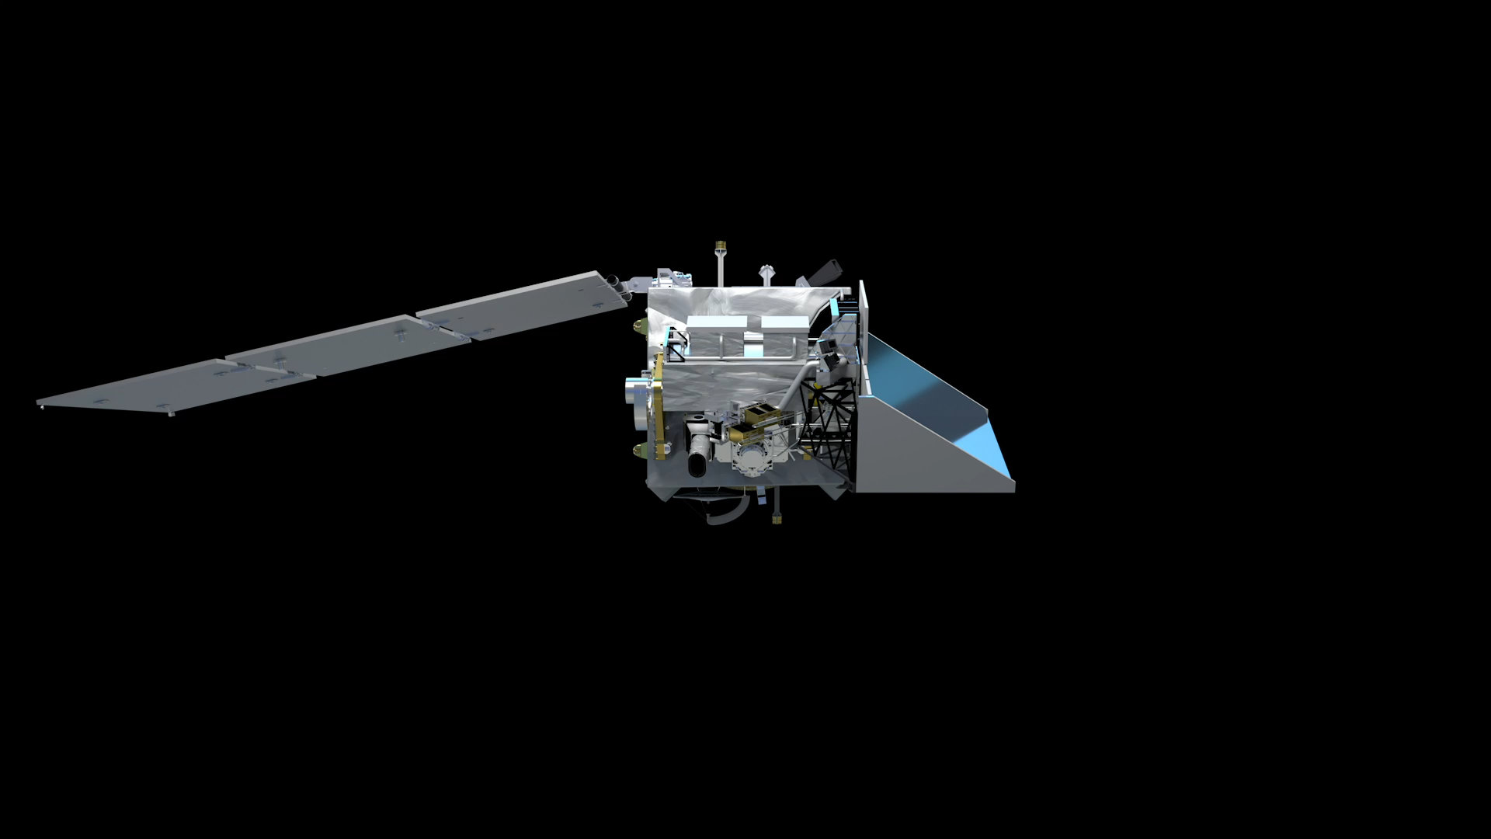
Ocean Color Instrument
HARP2
Polarimeter
SPEXone
Polarimeter
5
Notes:
General observatory overview

Slide 6
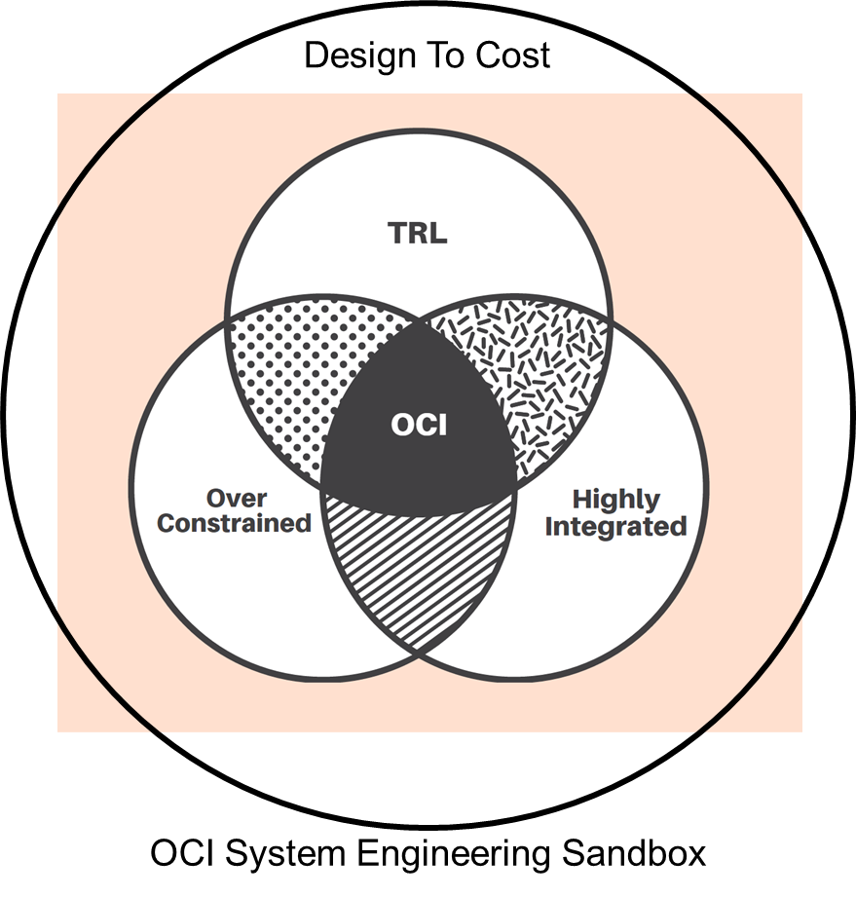
“Adventures in a HQ-GSFC design to cost experiment”
Eric Gorman

Slide 7
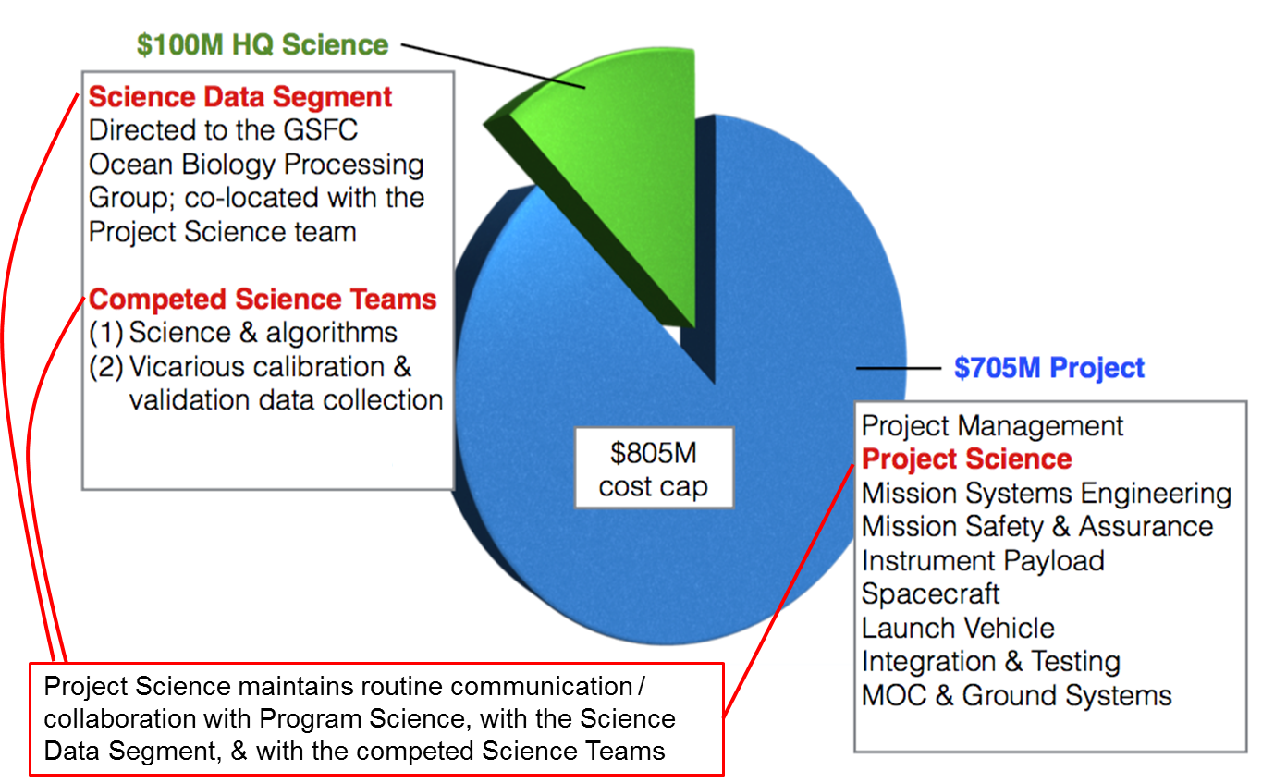
What is design to cost (DTC)?
PACE is a GSFC managed, HQ directed DTC earth science mission
  Budget (pre furlough and COVID impacts)
  Requirements
    HQ defines the threshold L1 “requirements”
      Minimum for mission success
    PACE defines the baseline L1 “capabilities”
      How much more science can we get and stay within budget?
  Evaluation Criteria
    PACE must maintain a 65% JCL at KDP-C while showing compliance to threshold requirements
    The baseline capabilities become the requirements at a “to-be agreed” upon point in the project
      For PACE, baseline is codified after OCI is delivered.
Why DTC on PACE?
  Maximize HQ science ROI
  Enable a more deterministic mission cost and prevent overruns
  PACE was asked to lead the way in working through this new management process

Slide 8
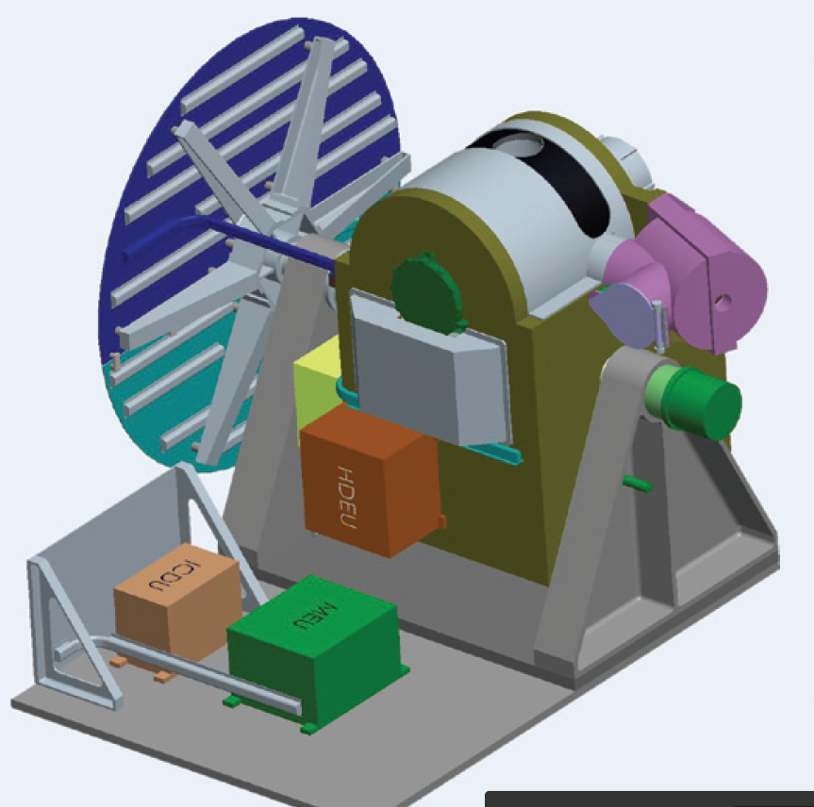
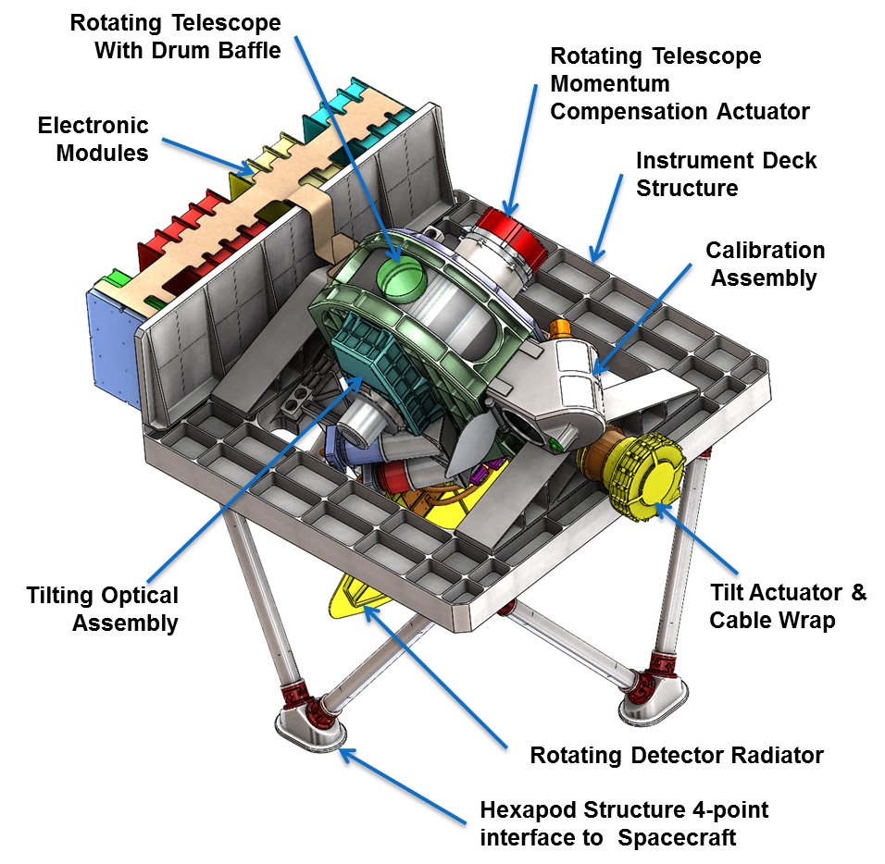
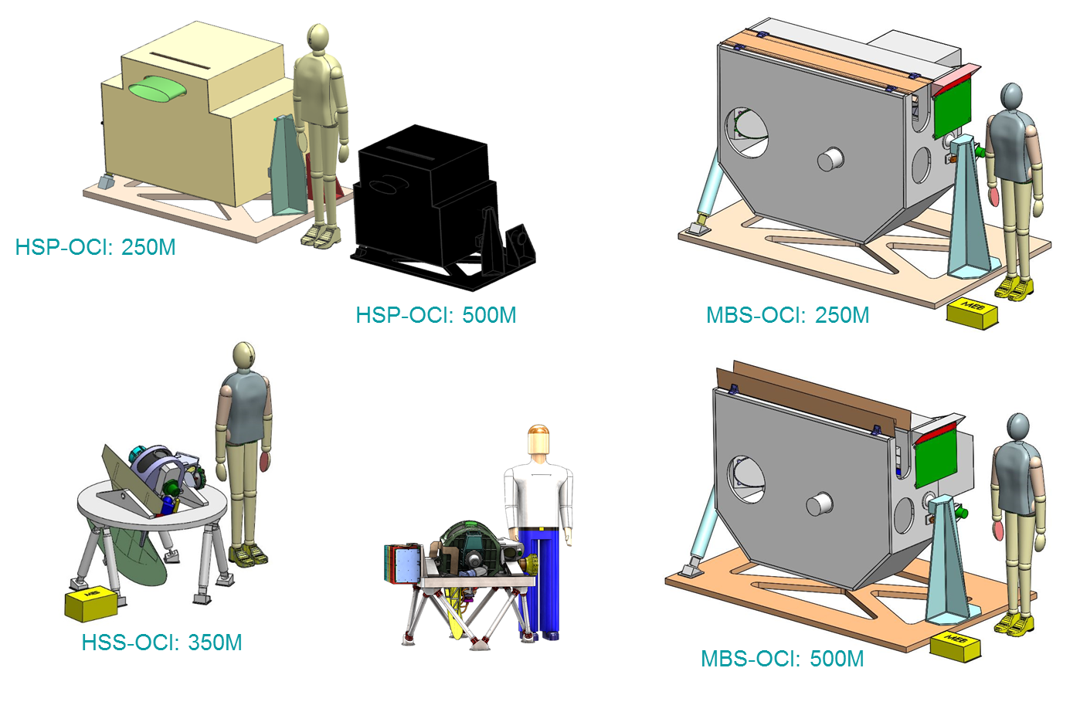
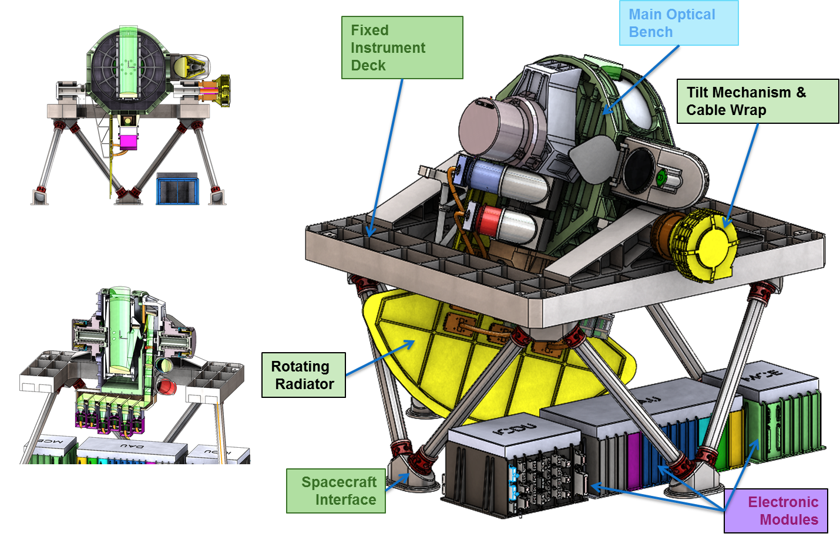
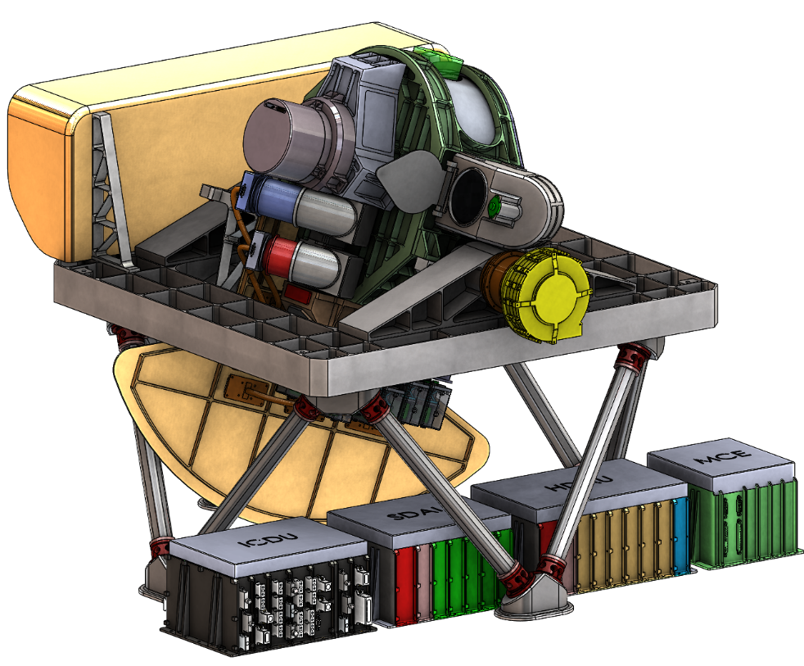
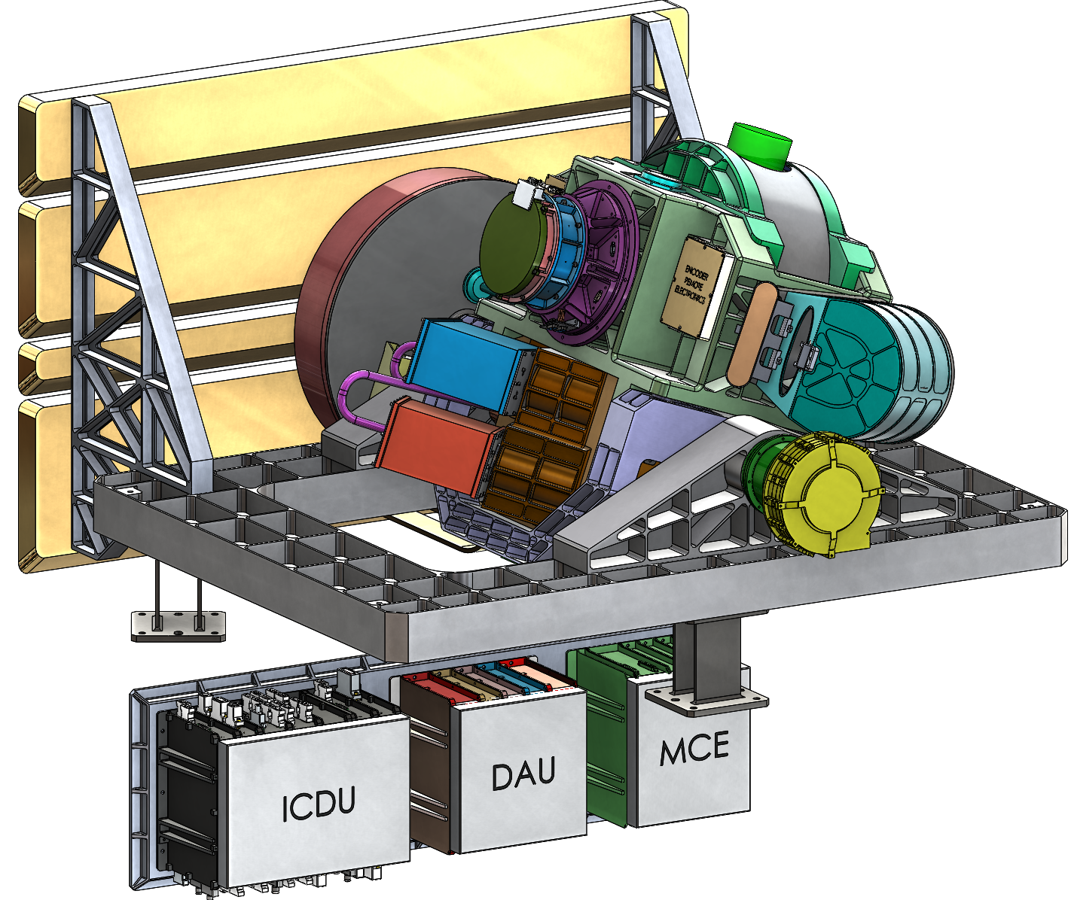
OCI DTC Design Evolution
PACE Start
ORCA Proposal
PACE/ORCA TMR
OCI Pre-Phase A
OCI TMC
PACE MCR
OCI SRR

Slide 9
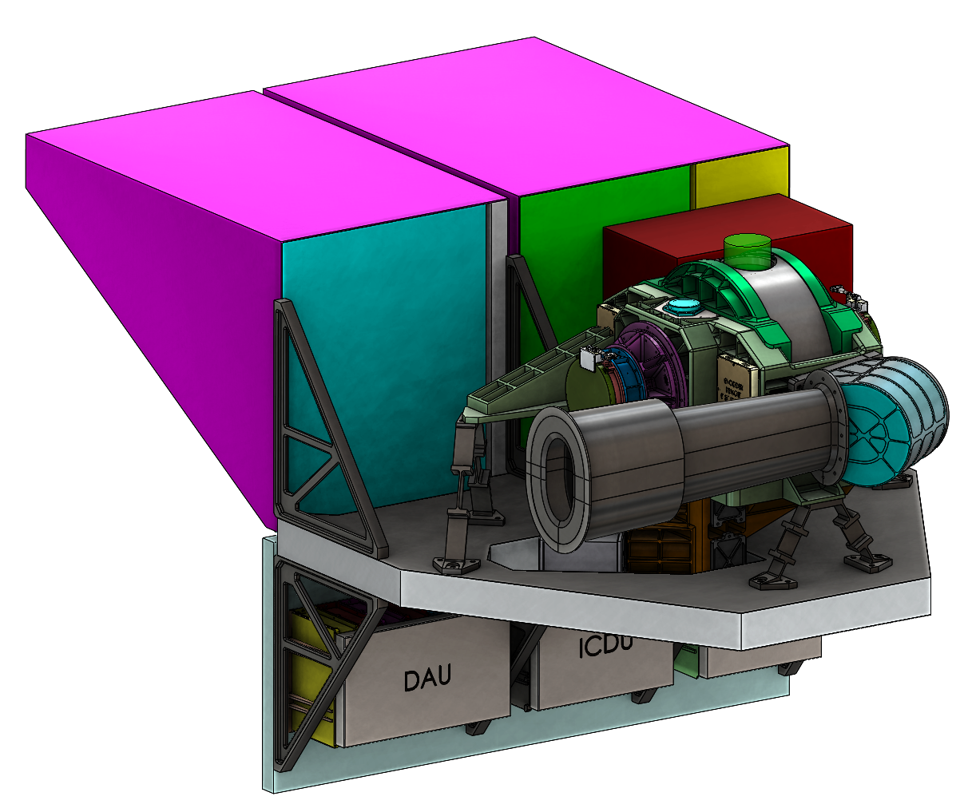
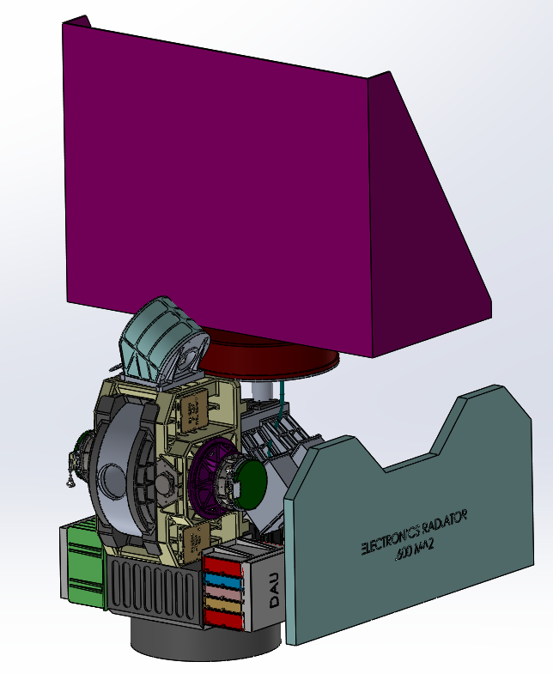
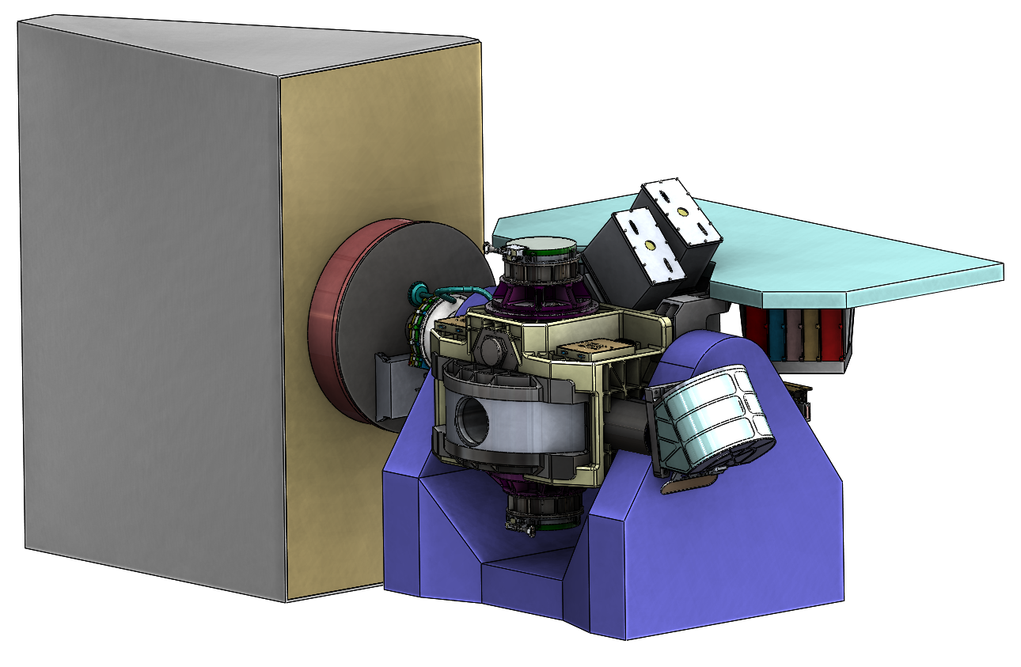
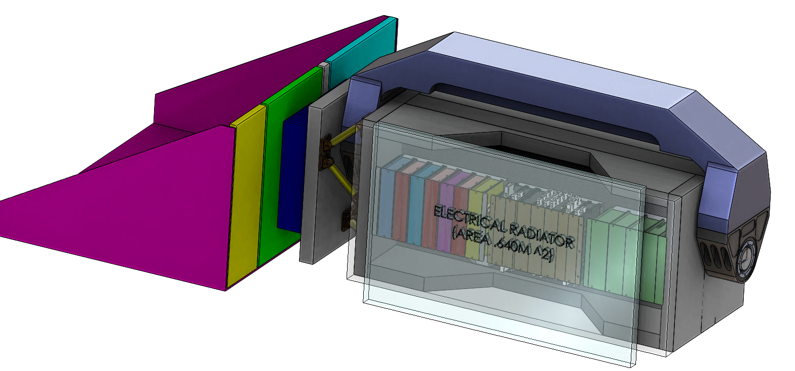
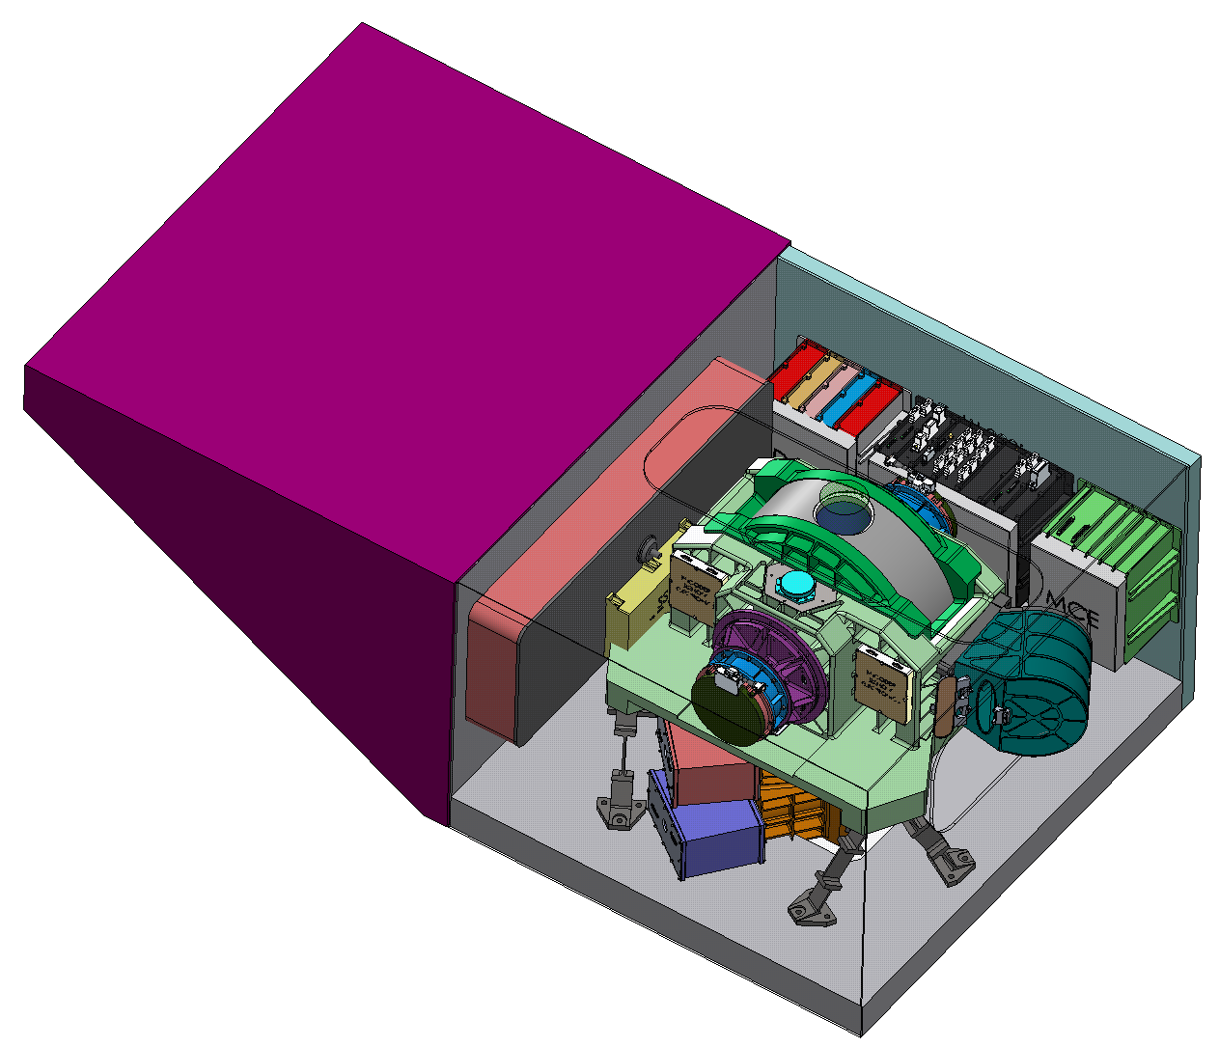
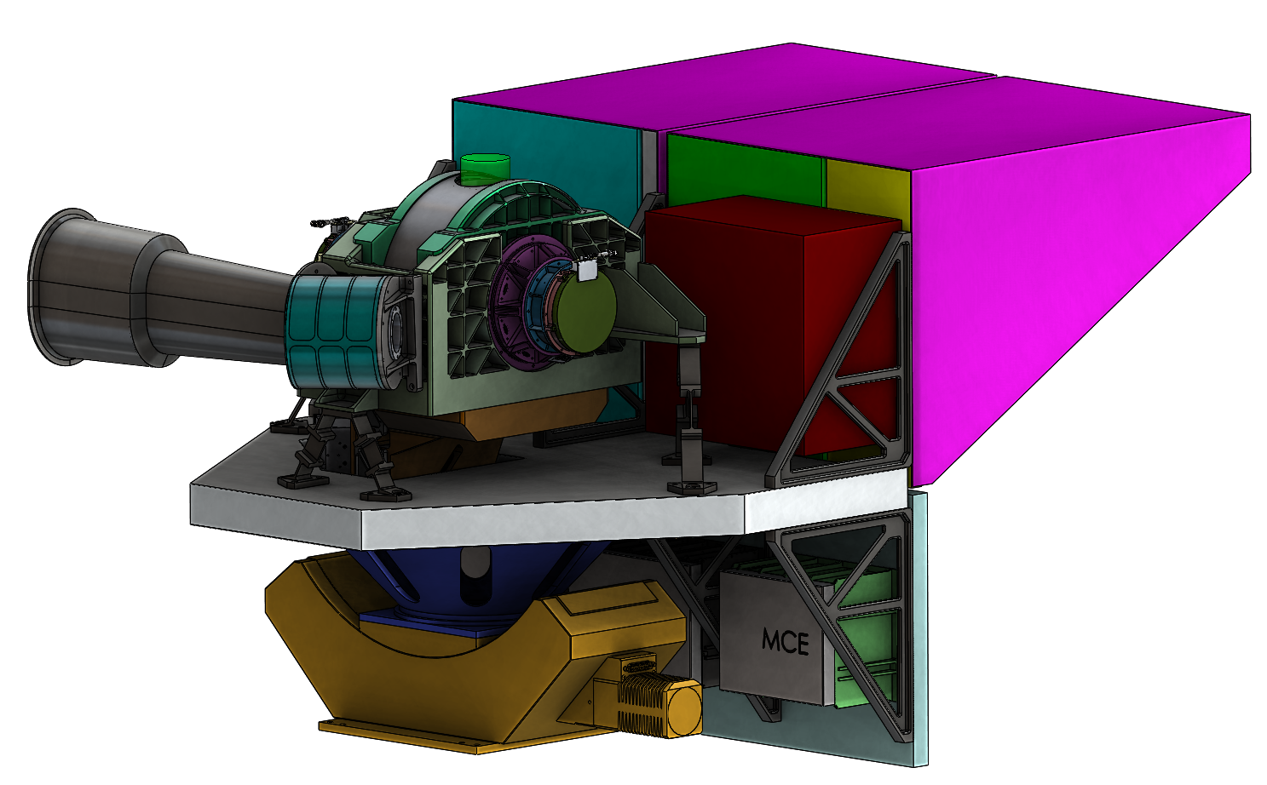
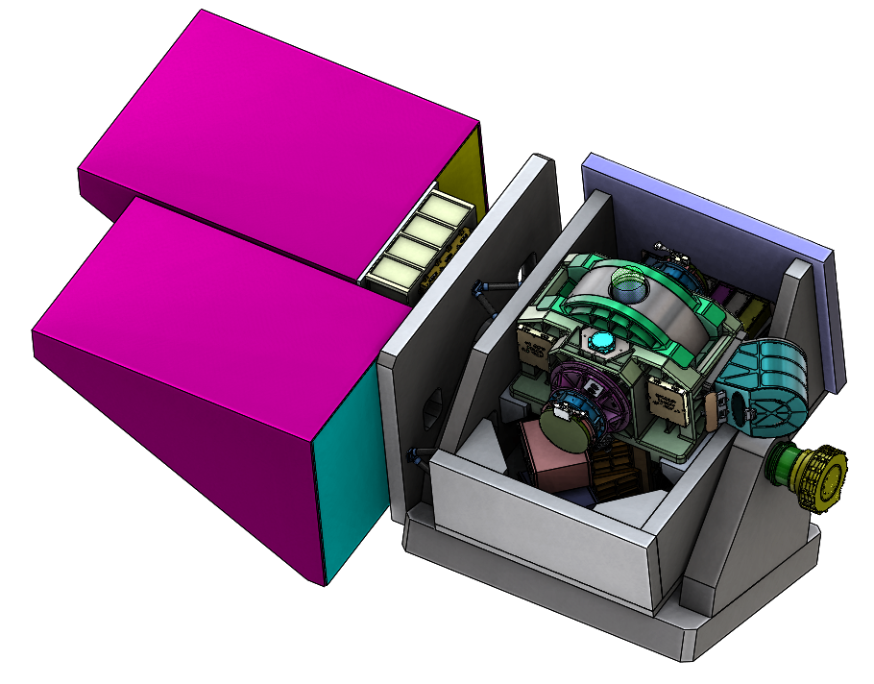
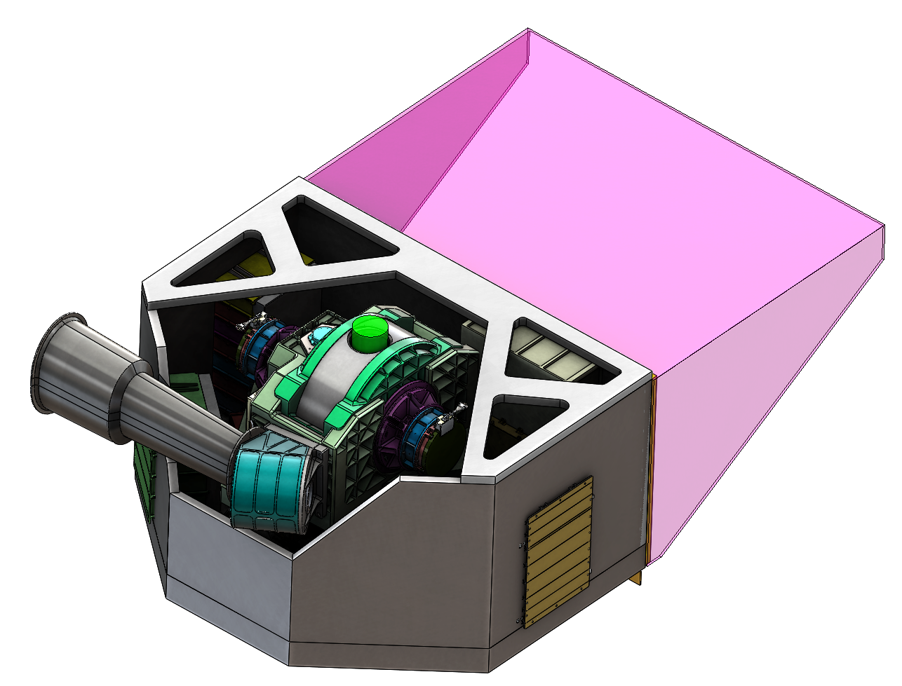
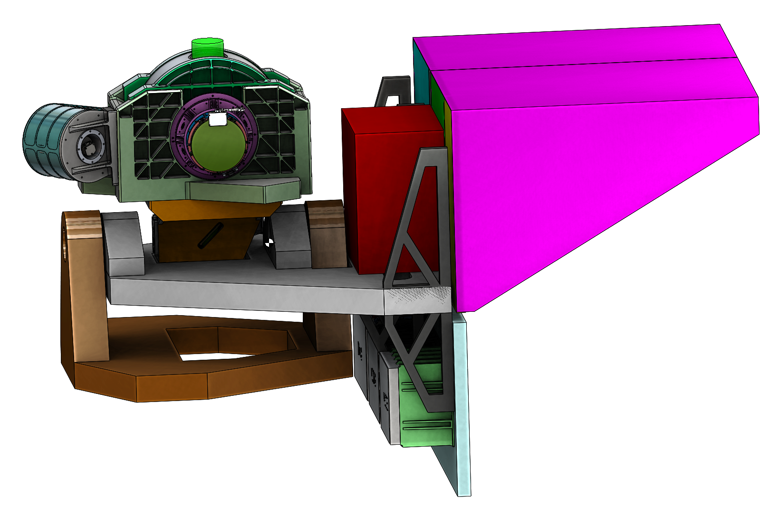
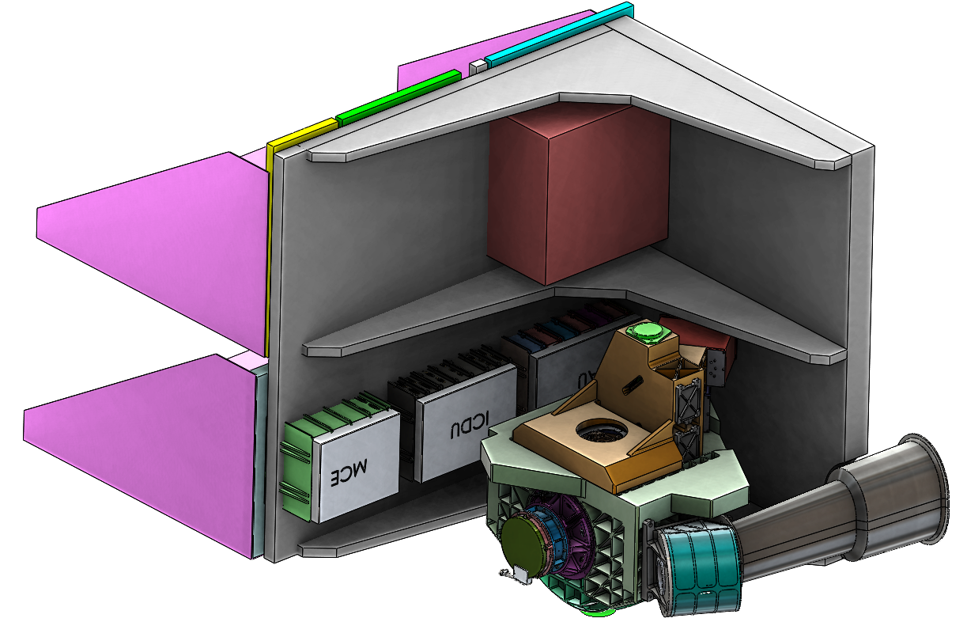
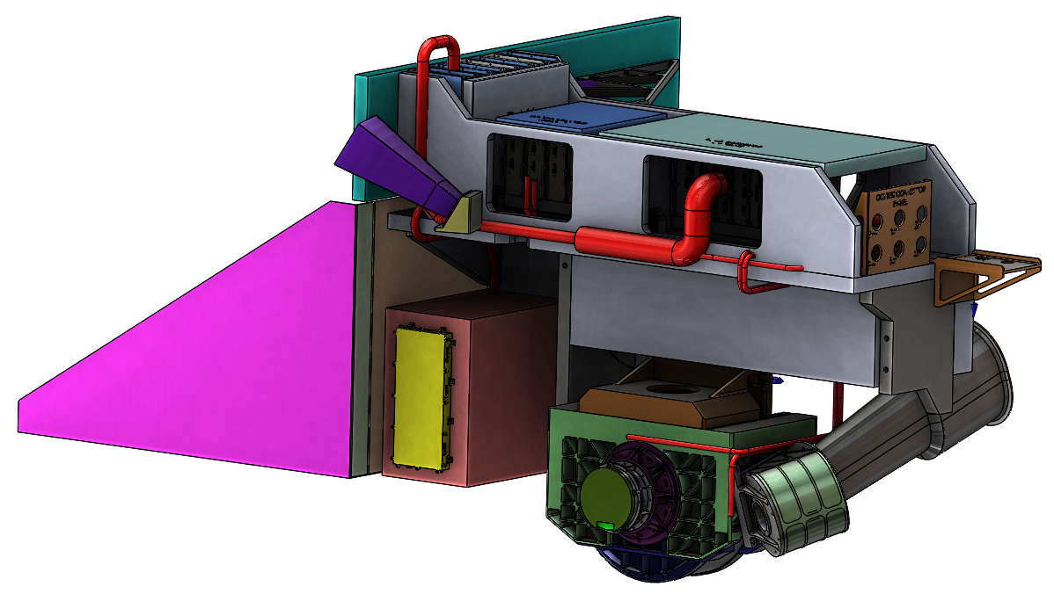
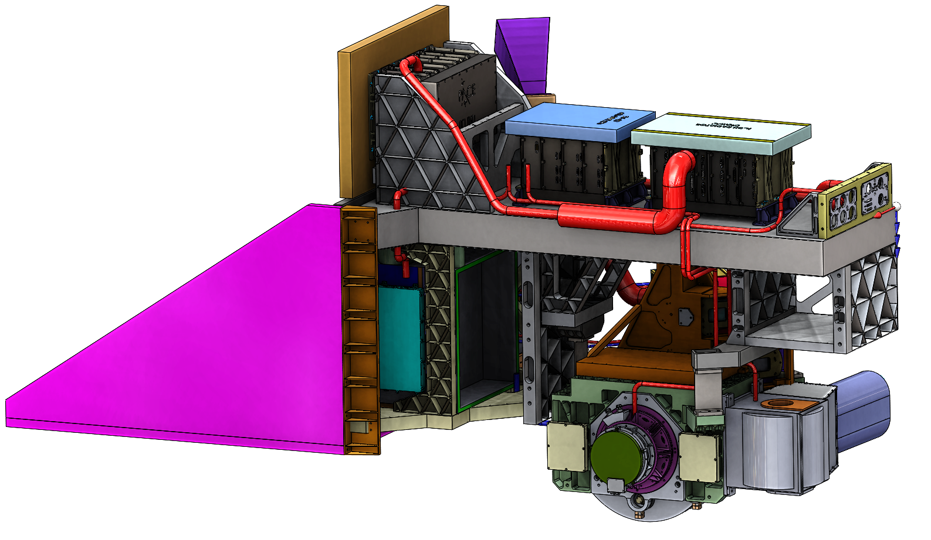
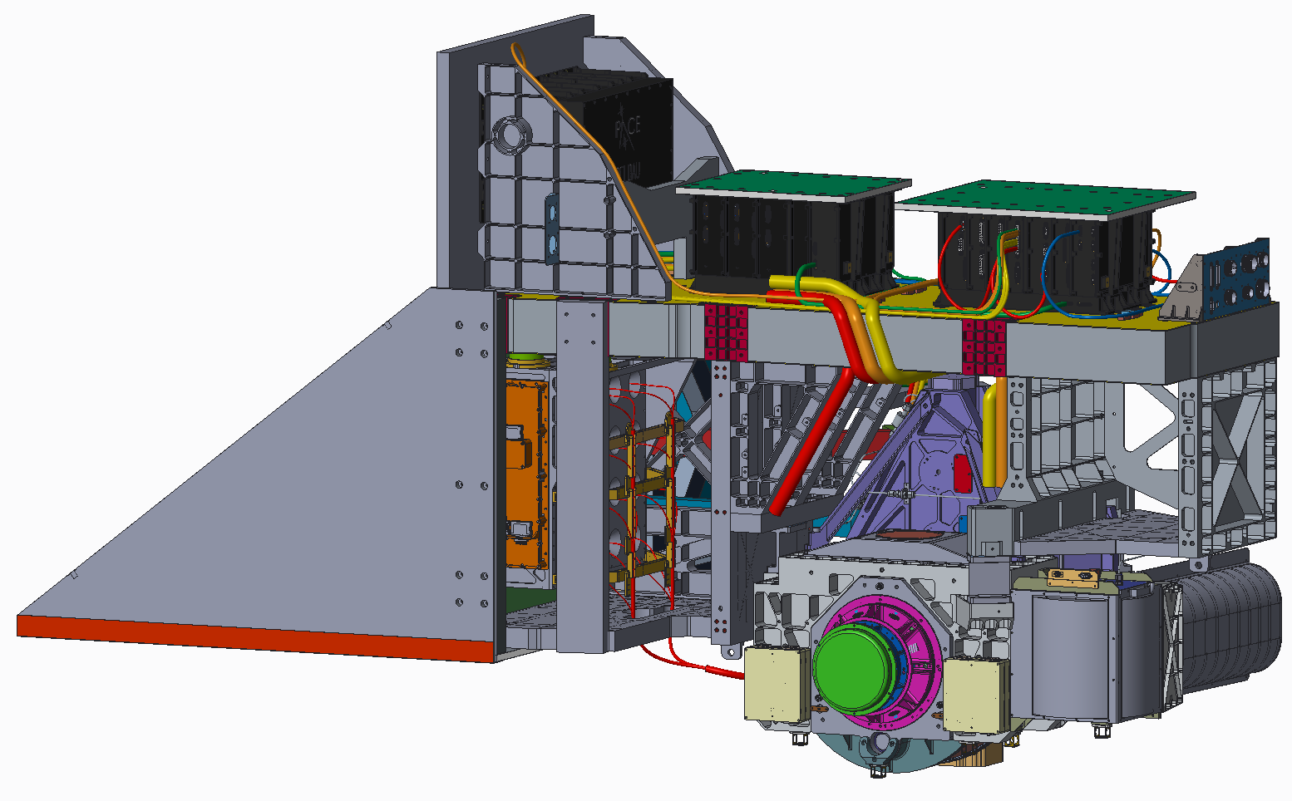
OCI DTC Design Evolution
Tilt Trades – Post SRR
OCI PDR
OCI CDR

Slide 10
What did DTC look like on PACE & OCI at KDP-C?
Threshold L1 Requirements Baseline Mission Capabilities
Ground sample distance of 1 ± 0.1 km² at nadir
Equatorial crossing between 11:00 to 13:00 local time
2-day to solar zenith ≤ 75º & sensor zenith ≤ 60º
Sun glint mitigation (<9% of the 2-day global coverage missed)
Once-monthly characterization of instrument stability, including lunar observations through the earth viewing port that illuminate all detector elements
Daily characterizations of OCI instrument changes using an independent, on-board capability that illuminates all detector elements
An OCI with center wavelengths from 350-820 nm at 5 ± 1 nm resolution
An OCI with bands centered on 865, 940, 1250, 1378, 1615, 2130, and 2260 nm at atmospheres performance levels
Multi-angle polarimeter(s)
18-month mission life
Ground sample distance of 1 ± 0.1 km² at nadir
Equatorial crossing between 11:00 to 13:00 local time
1-day to solar zenith ≤ 75º & sensor zenith ≤ 60º
Sun glint mitigation (<8% of the 2-day global coverage missed)
Twice-monthly characterization of instrument stability, including lunar observations through the earth viewing port that illuminate all detector elements
Daily characterizations of OCI instrument changes using an independent, on-board capability that illuminates all detector elements
An OCI with center wavelengths from 350-865 nm at 5 ± 1 nm resolution
An OCI with bands centered on 940, 1038, 1250, 1378, 1615, 2130, and 2260 nm at atmospheres and ocean performance levels
Multi-angle polarimeter(s)
36-month mission life
Data Product | Uncertainty
Water-leaving reflectances from 350 to 400 nm | 0.0083 or 30%
Water-leaving reflectances from 400 to 600 nm | 0.0024 or 6%
Water-leaving reflectances from 660 to 710 nm | 0.00084 or 12%
Total aerosol optical depth at 380 nm | 0.06 or 40%
Total aerosol optical depth at 440, 500, 550 and 675 nm over land | 0.06 or 20%
Total aerosol optical depth at 440, 500, 550 and 675 nm over oceans | 0.04 or 15%
Fine mode fraction of aerosol optical depth over oceans at 550 nm | ±25%
Cloud layer detection for optical depth > 0.3 | 40%
Cloud top pressure of opaque (optical depth > 3) clouds | 60 hPa
Optical thickness of liquid clouds | 25%
Optical thickness of ice clouds | 35%
Effective radius of liquid clouds | 25%
Effective radius of ice clouds | 35%
Data Product | Uncertainty
Water-leaving reflectances from 350 to 400 nm | 0.0057 or 20%
Water-leaving reflectances from 400 to 600 nm | 0.0020 or 5%
Water-leaving reflectances from 660 to 710 nm | 0.0007 or 10%
Total aerosol optical depth at 380 nm | 0.06 or 40%
Total aerosol optical depth at 440, 500, 550 and 675 nm over land | 0.06 or 20%
Total aerosol optical depth at 440, 500, 550 and 675 nm over oceans | 0.04 or 15%
Fine mode fraction of aerosol optical depth over oceans at 550 nm | ±25%
Cloud layer detection for optical depth > 0.3 | 40%
Cloud top pressure of opaque (optical depth > 3) clouds | 60 hPa
Optical thickness of liquid clouds | 25%
Optical thickness of ice clouds | 35%
Effective radius of liquid clouds | 25%
Effective radius of ice clouds | 35%
Notes:
Reiterate that baselines are “capabilities” not “requirements”
Point out that we’ll discuss “% tilt” later
Point out “high gain”

Slide 11
What did DTC look like on the OCI design at KDP-C? aka – What are the baseline capability descopes the mission can take to maintain cost/schedule?
Tilt System (not pictured)
Increase allowable time to tilt and settle
UVVIS & VISNIR Focal Plane Assemblies (FPA) (not pictured)
Relax SNR requirements
Relax absolute calibration requirements
Relax relative calibration requirements
Solar Calibration Assembly
Descope from 3 calibration targets to 1 calibration target
Remove carousel mechanism
SWIR Detection Assembly
Descope from 32 FPAs to 12 FPAs
Descope from 16 fibers to 6 fibers
Relax SNR requirements
Relax absolute calibration requirements
Relax relative calibration requirements
Optical System
Remove bands between 320nm – 340nm

Slide 12
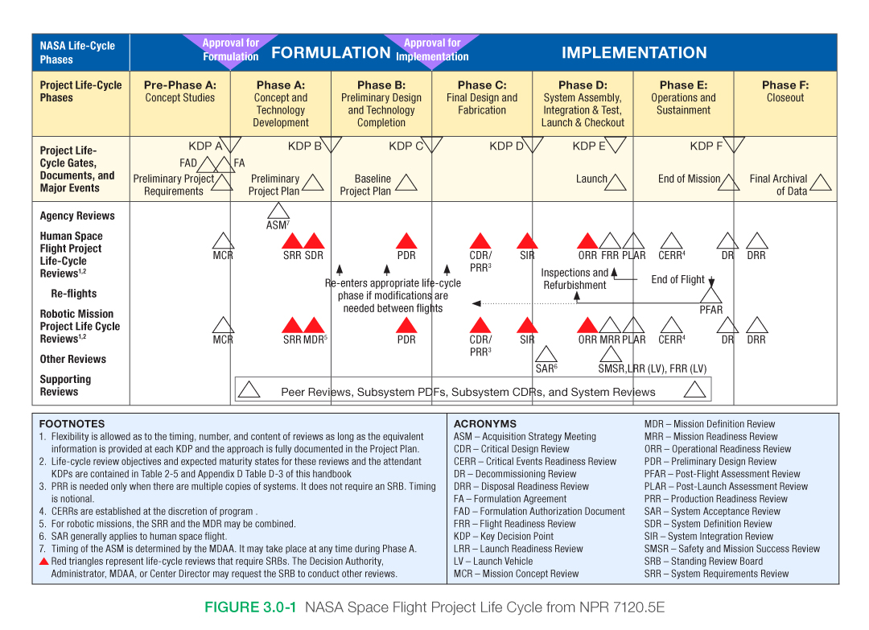
What are the systems engineering DTC lessons?
DTC matters most in the early project phases
  Requires an early ramp up of team with more detailed trades & more budget roll ups
  Identify increased capabilities within the design
    Be skeptical of scientists with big eyes and not an understanding of what it means to implement what they are asking, but don’t be condescending – “Why cant you add deep UV capability??”
    Prepare for confusion & frustration amongst the engineering team - “Is it a requirements or not??”
    With management/science involved, identify descopes and trigger dates for the “build to plan” section
DTC turns into “build to plan”
  The handoff is somewhere around CDR
  Implementing the design feels like a standard GSFC project
  Maintaining cost and schedule requires quality descope decision making with science involved
What prevents a race to the bottom and taking early de-scopes?
  Systems is caught in the middle between management who is threshold requirement focused and science who is baseline capability focused – enjoy the tension!
  Constant open/honest communication with both management and science groups
  Requires relationship building and trust with the science group
What does DTC mean to systems engineering process?
  Control the conversation – PACE framed the “Threshold Requirements vs Baseline Capabilities” paradigm
  Multiple requirement sets to manage, be ready to explain DTC… a lot
    Engineers are binary and don’t like ambiguity in the design space. “Design for deep UV…unless its to hard/costly…, if it is, let me know...”
  Review panels do not like multiple requirement sets – Prepare for confusion
    Everybody had a different opinion/expectation of what DTC is and how they want the info presented.
    At CDR we only presented compliance and margin to threshold requirements
  DTC will not solve TRL problems
    To enable successful DTC, you will need high confidence in TRL levels of components, subsystems, and instruments – This is priority 1 in Phase A
    An early review of TRL with a diverse group of the right experts is a necessity
    Look for the test data backing up the TRL - ask the team to prove it - don’t take their word
      Relate that test data to the driving requirements – “Beware of oversold proposals”
Build to Plan
Design to Cost

Slide 13
“How to decompose a highly integrated system”
Eric Gorman

Slide 14
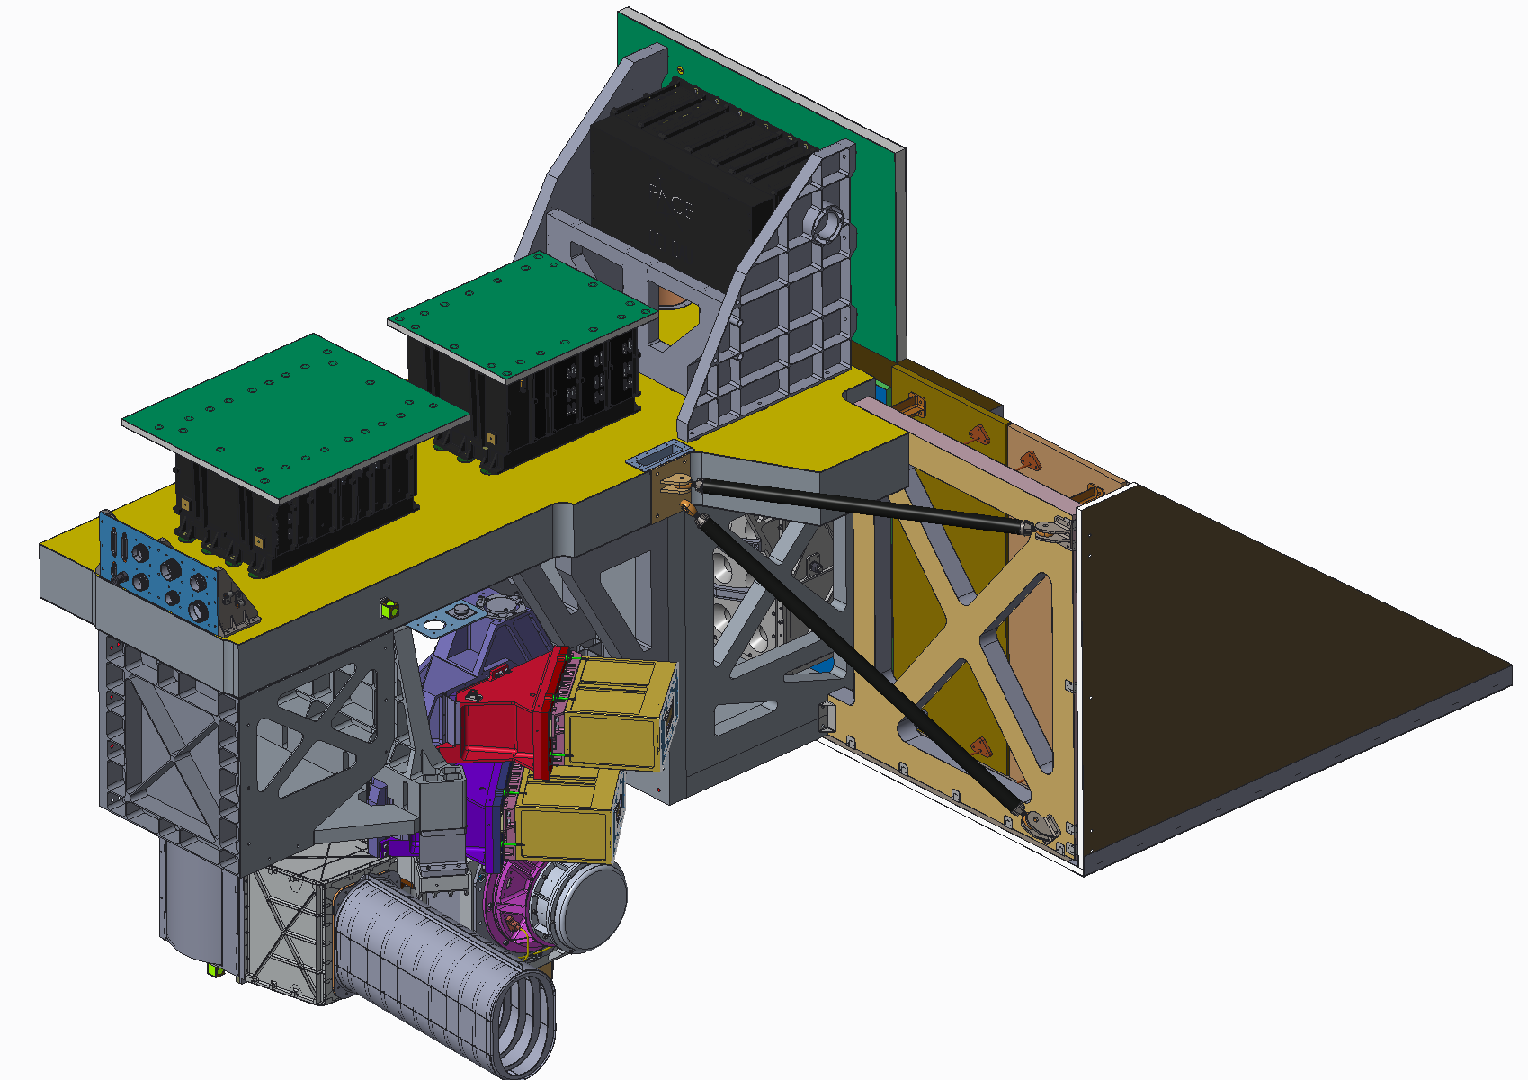
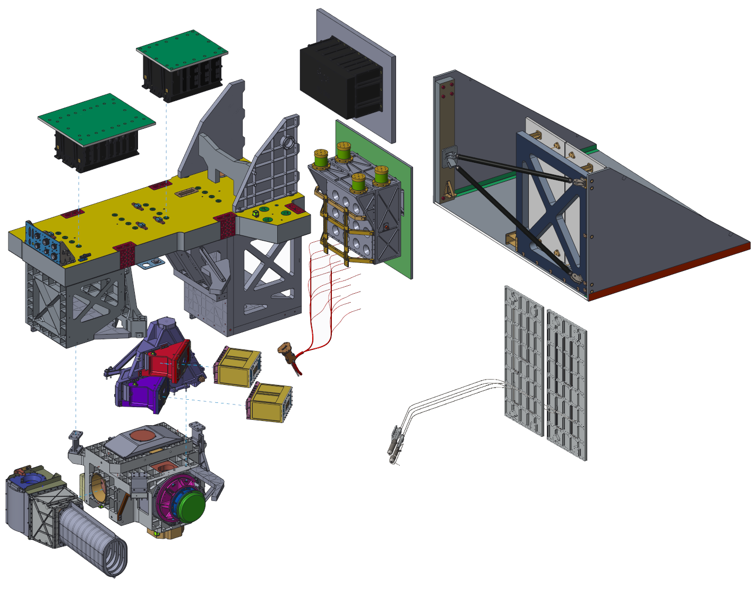
What is a highly integrated system?
MCE
DAU
OCI
FSW
ICDU
RSS, ES & Support Structure
Structure
OCI design is highly integrated
  Interfaces are intertwined, not obvious, and/or messy
  Many requirements can’t be decomposed or easily verified until system level
  Complex operations
  Multiple ETD divisions needed to deliver a product to I&T
  Increased risk to higher levels of assembly
SDA (Procurement From Space Dynamics Lab)
MLA/Fiber
MOSB
BLUE FPA
RED FPA
UVNIR LHPs/ Radiators
OCI CDR Subsystem Decomposition
SCA
MOB

Slide 15
What is OCI? - Subsystem Description (1/2)
+Y
Electrical Interface
+X
+Z
Instrument Deck Structure
SWIR Detection Assembly (SDA)
NIR-SWIR (0.94um – 2.2um) Fiber Coupled Multiband Filter Spectrograph
32 InGaAs/HgCdTe Photo Diode FPAs with Digital TDI
Integrated SIDECAR ASIC (SSM)
Solar Calibration Assembly (SCA)
Integrated carousel mechanism with 3 calibration targets and reusable door
Optical Module
Main Optical Bench (MOB)
  Rotating Telescope Assembly
  Half Angle Mirror Assembly
Main Optical Sub-Bench (MOSB)
  Slit Grating UVNIR Hyperspectral Spectrograph
  Slit - Fiber Coupled NIR SWIR “Light Bucket”

Slide 16
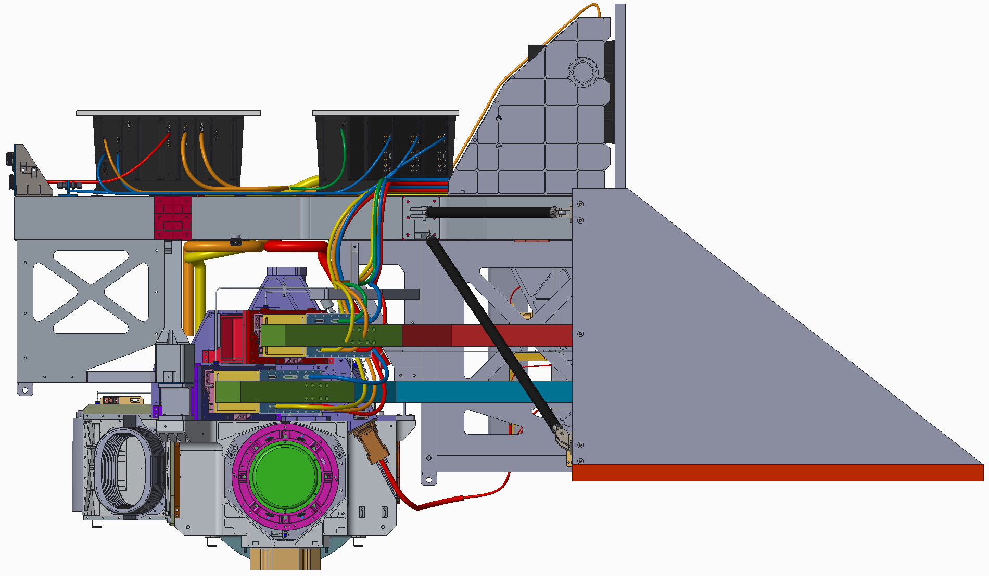
What is OCI? - Subsystem Description (2/2)
+Y
Instrument Command & Data Unit (ICDU)
Processor, House Keeping, Thermal Control, Power Distribution
Motor Control Electronics (MCE)
RT, HAM, SCA Actuator Control
+Z
Data Acquisition Unit (DAU)
CCD Clock and Bias
SDA Power
Data Processing
Radiator Earth Shield
UVNIR FPA Loop Heat Pipes
UVNIR (0.34um – 0.87um) Focal Plane Assemblies (FPAs)
CCD with On-Chip TDI and Front End Electronics w/Integrated ADC
Synchronized with Rotating Telescope and Half Angle Mirror

Slide 17
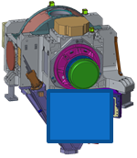
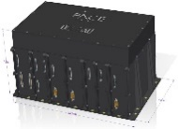
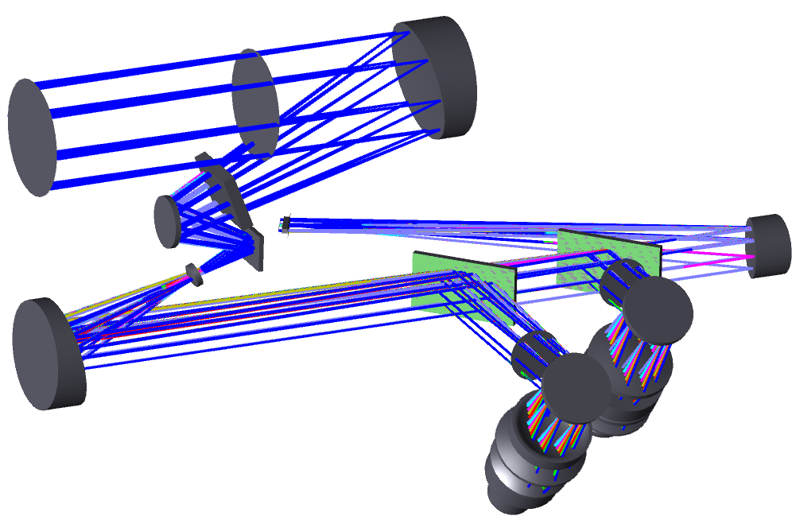
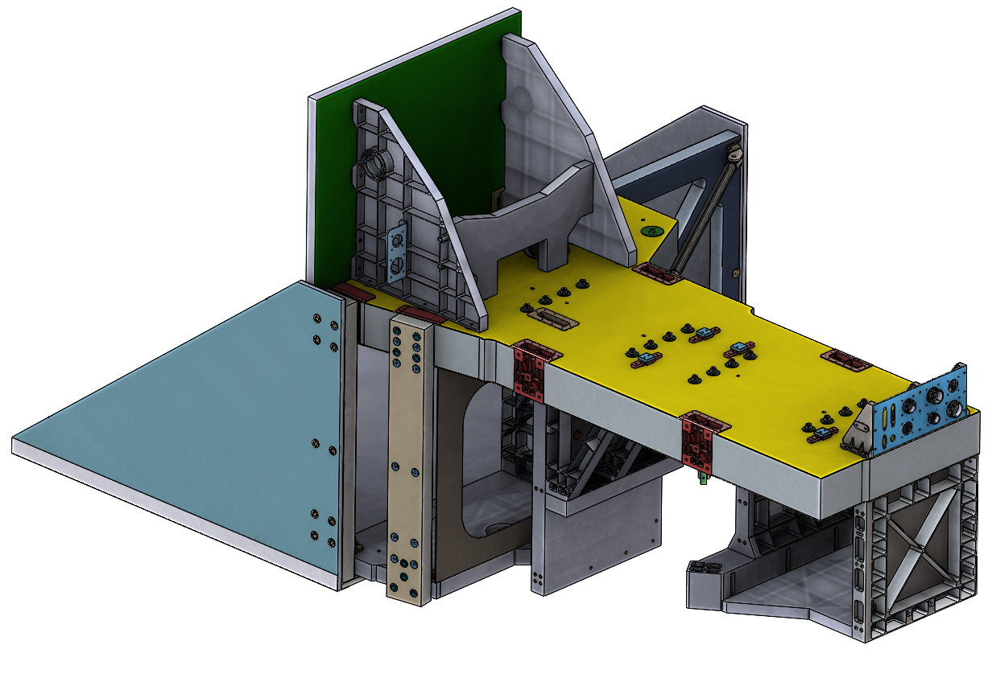
The OCI testing spiral – decomposition, test planning challenges, & increased risk (1/2)
The MOB rotating telescope actuator and half angle mirror actuator requirements need optics for verification
I need an MCE Ebox to drive the actuators
Measuring optical performance while the telescope is spinning requires an FPA that is TDI sync’d
The MOB and MOSB optical and mechanical design are tightly coupled - the alignment of one impacts the other
The FPA doesn’t TDI sync without the DAU
High Risk
Due To Late Verification &
Validation
The optical system doesn’t have an obvious breakpoint for verification
I cant verify the FPA performance without the DAU… and harness length meters
May as well add the structure to hold it together
Need independent thermal control zones for calibration
If I have an MCE and DAU, I may as well add the ICDU and interface through I&T/ITOS
Example of the circular conversation the engineering team navigated writing L4 requirements, decomposing, and test planning

Slide 18
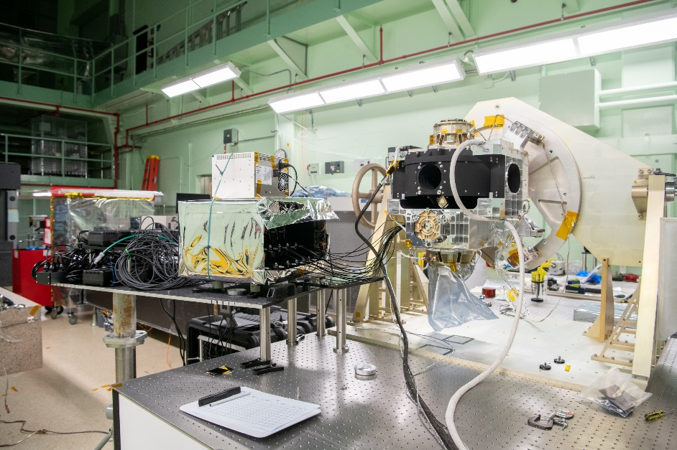
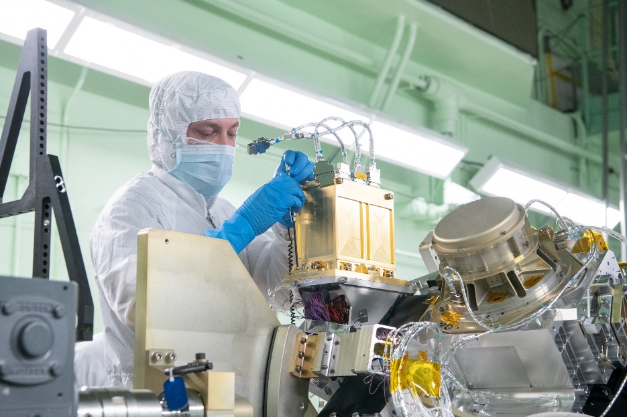
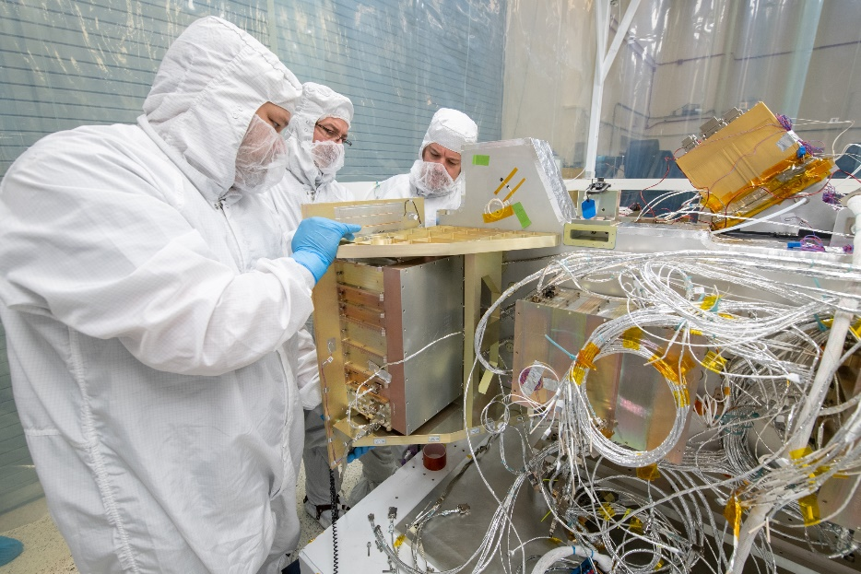
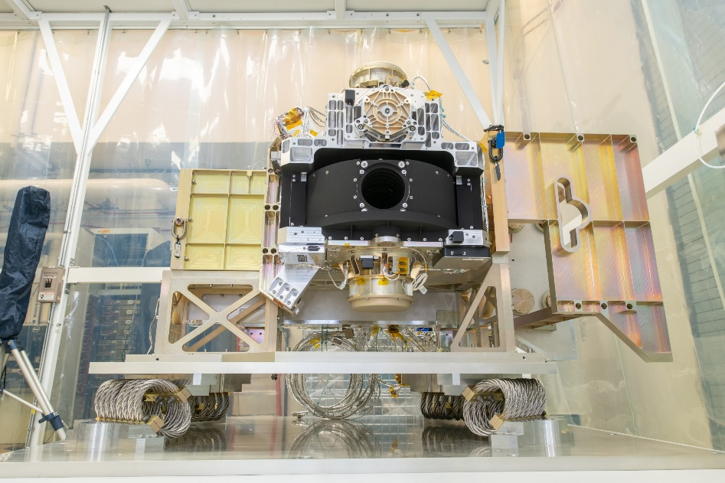
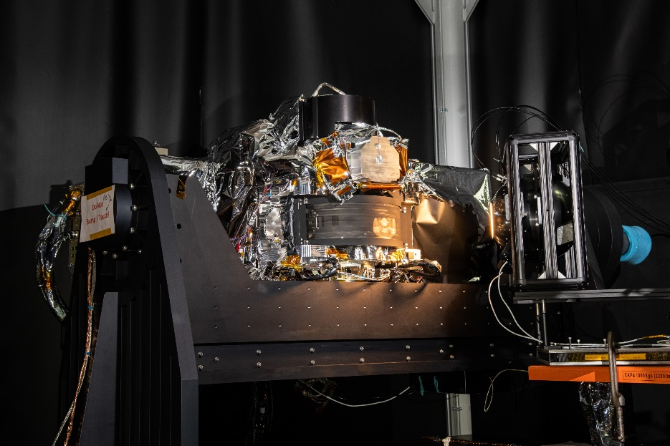
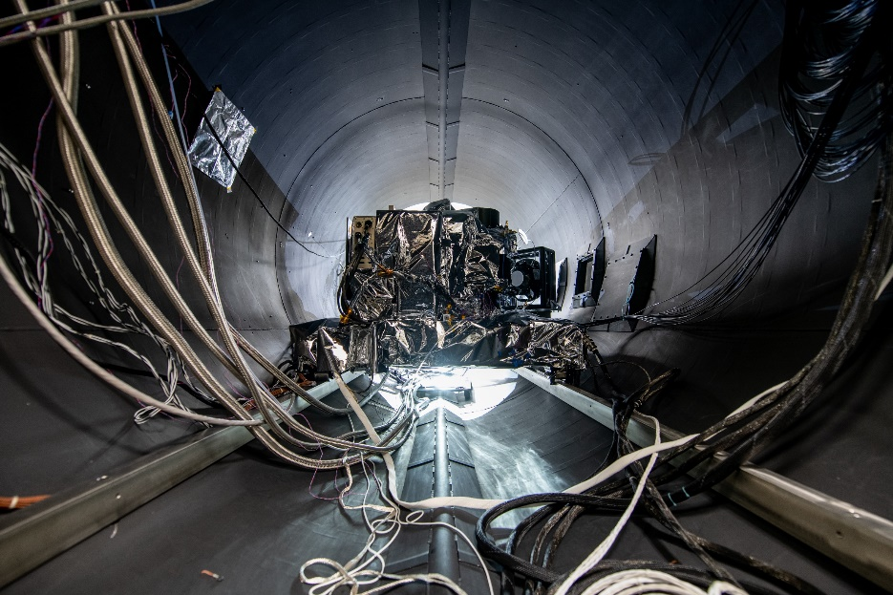
The OCI testing spiral – decomposition, test planning challenges, & increased risk (2/2)
Photos contained in this album have been reviewed by the Export Control Office and are released for public view
We didn’t know if the OCI architecture/design would work until 1 month before MCDR when we got end to end 1st light

Slide 19
Highly integrated system decomposition lessons learned (1/3)
Align the project management and system management strategy such that everyone communicates in products (I&T deliverables):
  Work Break Down Structure (WBS) = Product Breakdown Structure (PBS) = Requirements Document = ETD Division Deliverable
  Enables effective & efficient instrument management and systems engineering
  Enables obvious functional interfaces and better/optimized requirement derivation & focused testing
  This is harder than is sounds … Why?
    Highly integrated systems require multiple disciplines (Optics, Opto-Mechanical, Mechanisms, Thermal, Electronics…) & strong leadership
    Organizational boundaries (optics v mechanical – detectors v electronics) may make it challenging to find a product owner (PDL)
    Management styles need to overlap
    A product owner with adequate technical skills and management abilities is hard to find
Product based OCI decompositions examples: Camera System (DAU-FPA), Optical Module System (MOB-MOSB & MCE), Structure, Thermal, ICDU/FSW
  Focused testing, obvious Interfaces, with centralized leadership
  Avoids a design by committee and enables programmatic accountability
  Need a product PDL or a dedicated duo-Management/Systems leadership (who have adequate technical understanding)
Discipline/Consultant based OCI decompositions examples: Optics, Opto-mech, Mechanisms, MCE, Detectors, FEE, DAU, Structure, Thermal, ICDU
  Testing becomes discipline focused and can miss the bigger picture/requirement
  Design by committee and reduced programmatic accountability
  May require additional SE overhead to subdivide requirements and interfaces
See backup for organizational examples

Slide 20
Highly integrated system decomposition lessons learned (2/3)
What do you do when most requirements can’t be decomposed or verified until system level?
  It may take time before you realize you are highly integrated
    “you don’t know what you don’t know”
  Be patient, roll up your sleeves, iterate
    If in-house: don’t be afraid to rewrite requirements, interfaces, and test plans
      The MOB-MOSB requirements weren't in good shape until after CDR
    If out-of-house: be careful – you can still change scope just make sure all programmatic impacts are evaluated
      After award, we changed the SDA scope to include thermal hardware and the SIDECAR ASIC – a big change that was the right move in hindsight
  Build a strong modeling team with independent checks and reviews
    OCI had 3 system radiometric & signal response modelers – independent derivations and comparisons
    A full STOP modeling team
    Multiple stray light and optical modelers
    Gives confidence in the design while waiting for high level tests results
  Communicate risk to stakeholders
    If there is a late verification/test make sure it is known the potential impact if you get bad results
    Use the risk system to your advantage - get money & support for key lower level tests
  Advocate for ETU hardware and end to end testing
    This requires early planning and foresight
    Identify the requirements and risks that require end to end testing – use this to justify the system ETU throughout the inevitable budget cuts
    Protect the ETU from “flight upgrade” – this adds time & defeats the purpose
    OCI ETU objectives where identified early, used to identify required hardware & testing, and used for decision making when schedule got tight
      OCI ETU Goals: 1) Optical alignment plan and adjustments, 2) System timing, sync, and optimization, 3) End to End -> Light in to DN out at temp, 4) Pre-launch cal program pathfinder

Slide 21
Highly integrated system decomposition lessons learned (3/3)
How do I organize my team to enable effective systems engineering in a complex highly integrated systems?
  Align around systems engineering functions
    Examples: FDC Lead, V&V Lead, Pointing Lead, Calibration Lead, Radiometric Lead, PR/PFR Lead, S/C Interface Lead, CPT Lead, CMD/TLM lead….
  Align system technical oversight around products (requirements documents), not disciplines
    Enables a cross cut of engineering
    Identify a prime and backup for all assignments
  Give ownership of document or task
    Examples: TVAC test plan, Technical allocations, MEL, GOLD rules…..
  Build up your team and give them accountability and recognition by leading meetings and presenting at gate reviews
  Divide up ownership of the instrument system requirements – assign an SE owner for each system requirement
    They are responsible for ensuring it is met and tracking its risk through development
  Leverage product based meetings as opposed to discipline meetings and a standalone “systems” meeting
  Revisit and reorganize your team as the design matures, interests change, and new problems arise
  Find the “Glue” who can connect the dots between software, firmware, hardware, testing, & operations
    Looking ahead as to how the instrument will be used and configured in testing environments and on orbit is critical
    Operational inputs may drive implementation therefore must be addressed early enough to limit design changes late in development

Slide 22
Backup
Examples Of Organizational Optimization

Slide 23
GN&C Systems: A Well Structured Organization
590/GNC is well structured for spacecraft & missions
Single division oversight
Clear ownership
Efficiency with lower level requirement development
Supports systems engineering decomposition
GNC Systems PDL
Reports to MSE
Owns Budget & Schedule
Delivers Product
Technical Authority Through 590
L3
591
ACS
595
Orbits & Navigation
596
GNC Hardware
597 Propulsion
L4
Analysis
Simulations
Software
Analysis
Simulations
Software
Optical
Electrical
Mechanical/ Mechanisms
Thermal
Software/Firmware
Fluids
Electrical
Mechanical
Thermal
L5
GSFC GN&C highlights efficient organization of a complex subsystem

Slide 24
GN&C Systems: Organized Like GSFC Instrument Development
Divisional boundaries
Multiple division oversight
Unclear ownership
Challenging lower level requirement development
Requires specialized systems engineering decomposition
GNC Systems PDL
Reports to MSE
Owns Budget & Schedule
Delivers Product
Technical Authority Through 590
L3
590
ACS
580
Orbits & Navigation
560
GNC Hardware
540 Propulsion
L4
Analysis
Simulations
Software
Controls
Jitter
Analysis
Simulations
Software
Long term support
Optical
Electrical
Mechanical/ Mechanisms
Thermal
Software/Firmware
Fluids
Electrical
Mechanical
Thermal
L5
How would GN&C efficiency be impacted within this organizational structure?

Slide 25
Telescope Deliverable Highlights Product Based Organizational Struggle
Who manages, builds, & delivers a telescope to I&T?
490? 540? 550? 560? 590?
Receiver (Telescope)
550
Optical Design
550
Error Budgets
550
Stray Light Analysis
540
Opto-Mechanical
560
Alignment Integration
540
Coatings & Baffles
540
Thermal & STOP
550/560/590
Optical Testing
Consultant based ETD instrument organization:
  Reduces accountability
  Increases systems engineering overhead
  Challenges in capturing and implementing lessons learned
GSFC project culture requires systems engineering to fill gaps
How does this organizational structure enable efficiency in cost and schedule?

Slide 26
  “How to navigate design cycles and testing in an over constrained system”
Eric Gorman
Marcello Rodriguez
Jim Lobell
Brian Clemons

Slide 27
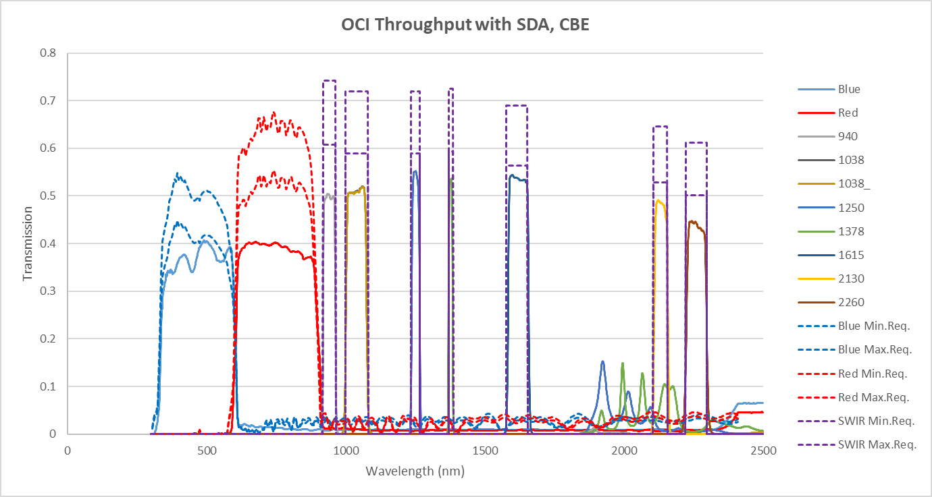
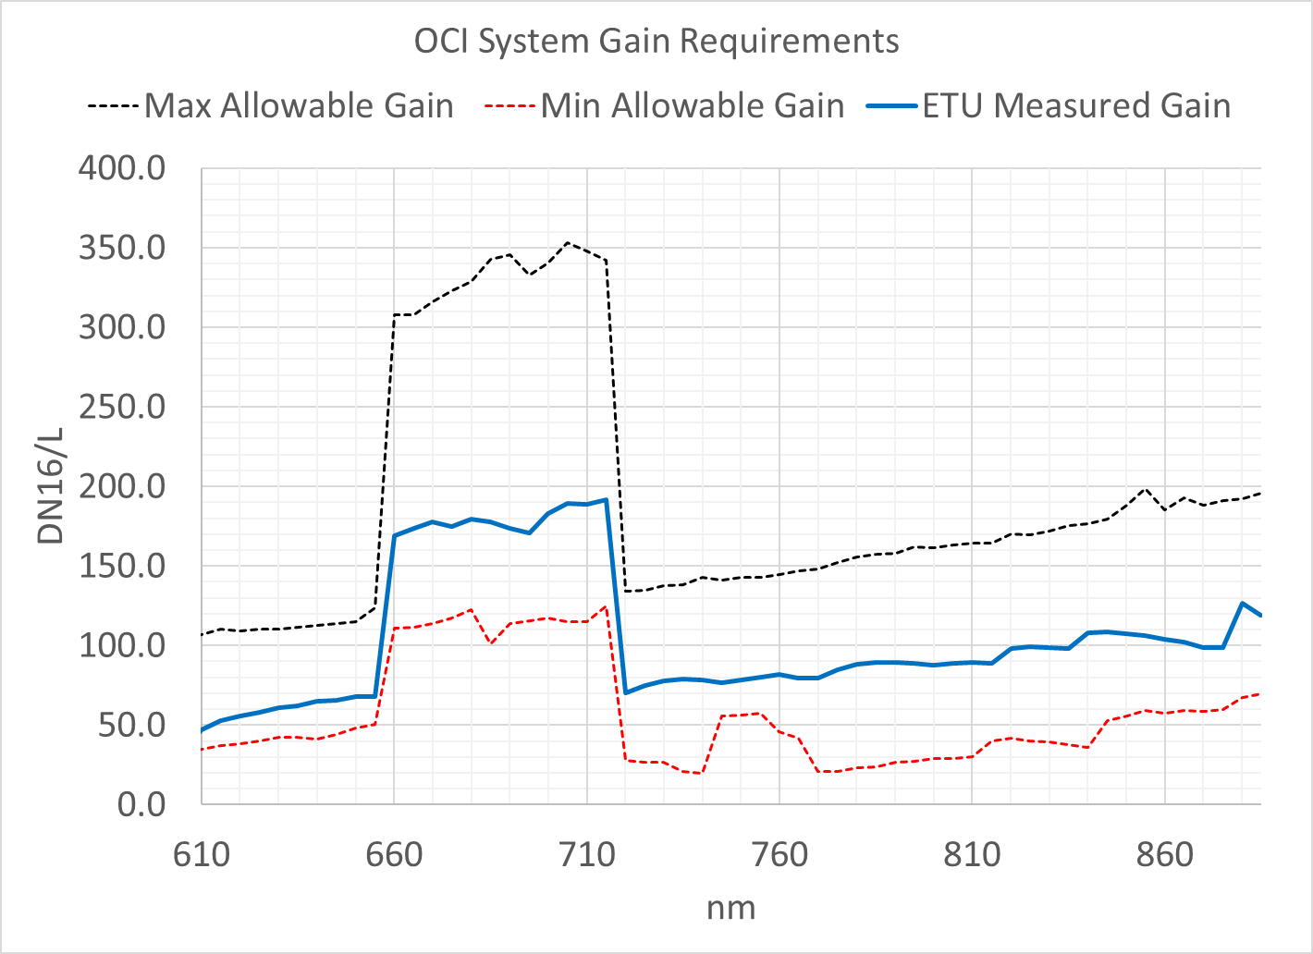



What is an over constrained system?
How do I know if my system is over constrained?
  Ambitious science goals
    Wide dynamic range, wide spectral range, daily global coverage, TB of data
    Minimal de-scopes
  Prescriptive L1 requirements
    Initial PACE OCI L1 requirement: “Uncharacterized differences in the responsivity of multiple detector elements larger than the sensor noise (NedL) within a common spectral band shall be less than 0.1% of top of atmosphere calibrated radiances at Ltyp.”
  Technology limitations
    Detector operating speed and sensitivity
  Subsystem performance has to be met on the nose
    A little more or a little less performance will fail and the system will not work or meet expectations
    No obvious breakpoint for requirement allocations
    Causes interface ripples
OCI over-constraint examples :
  Throughput, Gain, Diffusor BRDF
  GSFC - SDA spectral out of band
  DAU-FPA bias, tuning, and ADC sample point
Max Req
Min Req
Throughput, gain, and diffusor BRDF
tightly coupled to avoid saturation
Out of Band Interaction
2) Out of band & coatings had to be designed as a system
Reset Sample Point
Signal Sample Point
3) Fast CCD read out means sampling on a slope.
sensitive to noise, jitter, and environments

Slide 28




What do I do if my system is over constrained?
1st step is identification
  What is over-constrained, by how much, and why (technology, requirements..)
  This can take time to fully quantify
  Make sure the over-constraint is really important to science and not a “nice to have”
Communication is key
  Communicate over-constraints to stakeholders and PDLs.
    Let them know that there may be lots of changes along the design path as a result
    Use the risk system to your advantage
  Communicating changes across the team is key
    It is hard to keep a team of >100 engineers on the same page when the design is rapidly evolving
    Its better to over communicate and sound like a broken record than assume everybody is on the same page
Requirement management techniques
  More requirements will not solve over-constraint –
    it may make it worse by losing sight of the big picture
    OCI has ~40 key requirements
  You will need a rapid assessment of hardware performance as it becomes available
    L4 requirement document pointers to: TAR, Radiometric Models, & Error Budgets where PDLs could find allocations
    Updated and reallocated the “rapid assessment” documents once a month between SRR and CDR
    Forces the team to look across the system once a month
    Causes discipline engineering frustrations - moving target
Technical Allocations & Resources
2) Radiometric, Noise, & Signal Response Modeling
3) Error Budget Management

Slide 29
Leverage parallel paths to mitigate and spread out the over-constraint risk (1/3)
Parallel paths are a good thing!
  Used to mitigate technology & performance risk (Early Project Phases A-B)
    Can help lock in the design architecture and evaluate different technologies
    Enables diverse engineering to determine the right architecture and reduce unknown risks in the later project phases
  Used to mitigate procurement schedule delay & quality control risks (Later Project Phases C-D)
    Multiple vendors building same h/w to mitigate risk – keeps the project from stopping due to single vendor delays - keeps options open
  OCI parallel paths examples to mitigate proposal inadequacies (pre-phase A to phase B)
    Optical System Design – 3 options
    NIRSWIR Photodiodes – Many Options
  OCI parallel path examples to reduce schedule & quality control risks
    Examples: LHPs (ETU Upscreens), Lens assembly (ruda vs corning), mechanisms (honey bee vs thin gap)
    Even if simple, get h/w in quickly!
The downsides of parallel paths
  More to designs and potential interfaces to manage
  Costs more money upfront & requires more management and tracking
  Can confuse the team who might not see the whole picture - communication is key
Parallel path decision making is not straight forward – See the next few charts on OCI lessons and how to deal with these questions
  When do I close a trade to make progress?
  When do I keep design space open?
  How do I mange a team with many design options through parallel paths?

Slide 30



Parallel Path Example – OCI Optical Architecture & Design (2/3)
OCI solution space at PDR had just down selected from 4 options to 1
The lesson is to stay patient and open minded – set up the project in the right design space
  Even after ORCA proposal and hardware development – the design still wasn’t where it needed to be
  It was very tempting to “plow ahead” to make “progress”
Configuration 1: Full in-house optics design (front-end and back-end)
  Minimum disruption to current design
  Red Channel: not viable
  Blue Channel: looks viable, with possible degraded performance
Configuration 1A: Full in-house with biconic surfaces
  Minimum disruption to opto-mechanical design
  Additional fabrication and alignment challenges
  Red Channel: no solution found
  Blue Channel solution found
Configuration 2: In-house front-end + vendor back-end
  Slight disruption to opto-mechanical design
  Red Channel: solution found
  Blue Channel: solution found
Configuration 3: TNO front-end and back-end
  Major disruption to OCI architecture and opto-mechanical design
  Red Channel: solution found
  Blue Channel: solution found

Slide 31
Parallel Path Example – InGaAs vs HgCdTe Detectors for 0.94um – 2.2um (3/3)
OCI solution space at CDR had just down selected from 6 options to 2
A few months before CDR PACE OCI was at risk of violating L1 threshold requirements
  HgCdTe diodes tested to date had a input frequency dependent non-linearity that produced uncertainties greater than requirement
Photodiode detector lessons learned
  Maintain consistent detector package interface – to enable late swapping
  Keep lots of EEE parts (JFET in this case) on hand
  Have 2 independent groups verify the measurement/performance (Vendor/SDL/GSFC)
  TAYF – Don’t overfill a photodiode, keep the illumination spot flight like.
    There are many technical details to share – just ask offline
  Don’t stop talking to vendors and looking for options until you have the flight solution
  Stay patient & communicate the risk
Pre-CDR detector trade space (photos omitted to stay ITAR free)
  Discovery InGaAs
  TJT LPE (Liquid Phase Epitaxy) HgCdTe
  TJT MBE (Molecular Beam Epitaxy) HgCdTe
  Discovery Extended InGaAs
  TJT InGaAs: 0.94um – 1.38um
  LMW MOCVD (metal organic chemical vapor deposition) HgCdTe: 1.6um – 2.2um

Slide 32
Parallel Path Lessons
Get example hardware as early as you can
  Gives you a jump on many important things:
    What GSE you need
    What facilities you need
    What processes you need to develop
    What personnel you need
    Vendor selection/contracts
  Demonstrates incorrect assumptions
    Expected materials are no longer available
    Required expertise is no longer available
    Expected capabilities lost or not present
    Expected facilities not available or not present
    What you thought you needed isn’t what you actually need
  Identifies risk that can demonstrate need for alternative paths/providers
  To get most of these benefits, you don’t need flight-like hardware!

Slide 33


Navigating test as you fly challenges for subsystem development
Optical Module (OM)
SWIR Detection Assembly (SDA)
“Ideal” Test Plan: Rotating image at all wavelengths
Challenges: Fast image speed and GSE readout speed
Actual Test Plan: Static optical image measurements w/limited wavelength/bands
Risk: Image blur, MTF, scatter/ghosts/SL
“Ideal” Test Plan: DAU power w/moving image
Challenges: Out vs In-House Subsystems
Actual Test Plan: GSE power and static image
Risk: EMI/EMC, Telescope and TDI synchronization, SIDECAR data processing
UVNIR Focal Plane Assembly (FPA)
Data Acquisition Unit (DAU)
“Ideal” Test Plan: DAU backend and moving image
Challenges: Organizational boundaries, Optical GSE complexity and cost
Actual Test Plan: GSE backend & static optical image
Risk: EMI/EMC, timing, data processing
“Ideal” Test Plan: FPA frontend
Challenges: Organizational boundaries
Actual Test Plan: ETU FPA frontend
Risk: EMI/EMC, timing, data processing
Key Lesson Learned: Manage the camera (DAU-FPA) as one system with one PDL

Slide 34


Navigating Requirements and V&V
Distinguishing NASA & GSFC Standard requirements from hardware specific performance requirements helps organize linkages (DOORS) and V&V
Keeps the focus on design driving requirements
  Keep within <50reqts or less
Minimize repeating of requirements
  NASA/GSFC standard requirements are referenced, not repeated
  PDL responsibility to ensure compliance throughout their sub-system
L4 example:
Clearly Distinguish NASA/GSFC Standard Reqt From Your Design Driving Reqts
Lessons Learned In Instrument Development

Slide 35








Navigating the Test Documentation - Plans, Procedures, PROCs, WOA’s, and P/F Reports
Plan(s)
Proc (STOL)
Pass / Fail Reports
OCI
Development
Phase
STOL Proc Generates the ITOS Report
STOL Proc sets the XINA Markers
ITOS generated P/F report
Plan/Procedure dictate the content in the STOL Proc and WOA
WOA calls the STOL Proc(s)
Paperless Option
Signature-free procedure embedded into the PLAN
Electronic WOA execution
The WOA may call out sections of Plan/Procedure/Outline
Procedure
XINA Trending P/F plots
All P/F Reports attached to WOA
Sci generated P/F reports
Final V&V artifact!

Slide 36
Navigating Test Documentation - Plans, Procedures, WOA’s, and PROCs , and P/F Reports
Set expectations for ETU. Ensure team (systems, I&T, QA, and anyone following the test) is aware of the maturity of the governing documents as we go along
  Procs changing on the fly while PLANs are approved and supposedly “controlled”
  Caused confusion among teams members on whether we were executing things as planned and not missing anything
Understand your Pass / Fail and Consent To Proceed points in the Test, and your mechanism to quickly capture that information and document
  Getting PDLs to provide those products can be challenging
Can go completely paperless through the test via detailed signature-free Plan/Procedure, careful implementation into the STOL Procs, procedural execution through the WOA, and proper Consent To Proceed or Pass/Fail implementation
  Better suited for the COVID (and post-COVID?) virtual environment
Paperless Procedures via the WOA
Pros | Cons
Not prone to get lost like paper procedures | WOA may be longer and more detailed than typical
Easier to search and scroll through | More WOA steps mean longer WOAs and more difficult to close
Keeps all procedural signature steps in one place – the WOA | TDMS may lack certain features that are better suited for traditional word document procedure
No redundant steps in multiple documents | Harder to make redlines if WOA is not detailed enough
Forces you to review STOL proc for details Set system of checks on STOL procs – review process under the radar
Clearly map out chain of documents needed for properly prepare, run, complete, and document your Test

Slide 37



Navigating the WOA Process
WOA system should serve as your last line of defense in preventing “RadiatorGate” like occurrences
  Exposed that appropriate signatures were not being required on WOA deviations
  WBS level selected in opening the WOA is what drives who is automatically placed as a signee
    Corrected action: asked whoever is opening and leading the WOA to use their WBS number
  Not using appropriate WOA Level is common
    OCI-B often used - only requires PDL and QA signature on deviations
    At OCI level I&T, should use OCI-D Level.
  For OCI-D level deviations, Consent to Proceed from PM when all signatures are obtained.
    PM will sign at the end to close the WOA.
Interference of 1.1in
Understand your WOA approval process and tool and adjust/customize to make it work for you

Slide 38


Navigating OCI Level Testing (Instrument Characterization, LPT, CPT)
Dry Runs
Dry Runs are limited without the instrument but will still minimize the pain later
  Helps develop STOL procs, work out the networking kinks (on controls and data infrastructure), and check all your GSE control loops
Be as thorough and test-like as possible
  LN2 issues not found in TVAC b/c the dry run did not stress the system enough
Control Room
Set people and noise controls in the control room during development and testing
  Find a nearby area for meetings
Speak up when something doesn’t look right
  TCs should be encouraged to point things out as they are mostly familiar with past regularities and irregularities performed and displayed
ETU vs FLT Documentation
Maintain clear configuration management of heater and sensor label and numbering ETU vs FLT vs FSW vs ITOS vs Operational vs Decontamination
  Caused a mis-wiring on 2 heaters in ETU TVAC
  Caused several iterations while running our functional test procedures.
  Dry run of the test in the FSW lab would have worked out most of these kinks.
STOL Proc Development
Centralize STOL Proc development platform (GIT) early on for easier transition/development of OCI level procs
Establish early a default instrument state to work from during early testing and live proc development.
  Clearly communicate updates when default state is changed.
  Start and end at this state when running functionality tests
Test Setup Planning
Have all your troubleshooting options made available, especially when testing the system for the first time

Slide 39
PR/PFR Process Lessons
The PR/PFR process has a number of purposes/values:
  Primary
    Flag problems as they arise, and track them to resolution
  Secondary
    Identify similar (class) problems
    Identify recurrent problems
    Identify need for process improvement
    Identify implications for other parts of the system
Utility beyond the primary purpose requires a little more data
When entering a PR, take the perspective of a reader who wasn’t present when the problem occurred.
  Provide enough context and detail so that the problem can be understood by a trained reader (subsequent approvers)
  State the obvious. It may only be obvious to the writer, and even that can fade quickly
Provide a title that describes the problem clearly
  System-generated titles are too vague to be useful. Edit them.
  Helps a lot when you’re searching the database
Enter the required data, and approve the PR to move it to the “PR-PDL” stage
  Approval at the PR stage provides formal notification to the PDL, who is responsible and should be aware.
  Nebulous or distributed ownership can lead to forgotten PRs (“I thought you had it !”)
  PRs left at the PR stage get orphaned, become zombies, and come to your house while

Slide 40
PR/PFR Process Lessons
Close PRs as quickly as practical
  PRs that languish unnecessarily take more work to close
    Relevant data gets harder to find, lost, or forgotten
PRs with incomplete data don’t get closed, and will haunt you
  Always provide:
    Complete description of the problem
    Root cause, if known
    Complete “Actions to Close”:
      Clearly describe work required to address the problem
      Describe how recurrence will be prevented
      Point to any related updated, released drawings, EOs, processes, etc., in order to demonstrate that changes have been formalized and accepted
  With the above data, the PR system adds value
    We can resolve problems more quickly and completely
    We can see where processes need improvement
    We can prevent problems from recurring
    We can gain insight into other related problems

Slide 41
“There is an instrument within an instrument”
Brian Clemons

Slide 42

The SWIR Detection Assembly (SDA) – an Instrument within an Instrument
TCS Radiative Interface
IDS Interface 4x
DAU Interface 2x
16 X SDS (hidden)
SSM
SWIR Detection Assembly (SDA)
  Aft Optics Box (AOB)
    16 SWIR Detector Subassemblies (SDS)
      Two optical channels with photodiodes (32 total channels)
      Optical interface at fiber connectors
      Five unique variants
    Mechanically mounted to IDS
  SWIR SIDECAR Module (SSM)
    Module digitizes 32 analog channels and communicates with DAU
  Thermal Control System (TCS)
    Two sets of radiators cool the AOB/SSM to -25°C and the Optics/Detectors to -65°C
AOB
Fiber Optic Interface 16x
TCS
SDA is a challenging portion of the OCI Instrument

Slide 43

Design Evolution of OCI SWIR - Good Architecture Decisions
Around SRR time frame, ~Feb 2017, OCI decided to break off the SWIR bands with fiber optics
Free Space Optics SWIR Architecture
Highly Integrated
Alignment “Nightmare” with little lower level verification
More Cable and Harness on the Optical Module
Fiber Optics SWIR Architecture
Cleaner Optical Interface
Enable easier lower level verification
Outsourceable, reduce in house burden
Became SWIR Detection Assembly (SDA) built by the Space Dynamics Lab in Logan Utah
Fiber Interface
SWIR Design Evolution Allowed for simpler OCI Interface

Slide 44
OCI Decision to Move the SDA Out-Of-House
Initially the SDA was planned to be an in-house development effort
  A full in-house design was developed
    Helped OCI understand the level of effort/complexity and that it would be difficult for the current team to build both the UVNIR and the SWIR Instrumentation while meeting schedule
    The design evolution (ex. fiber interface) allowed for a clean separation of SWIR functions and hardware
    Generated and Request For Information (RFI) to understand whether vendor capabilities existed and to get the associated cost and schedule estimates
    Generated Request Proposal (RFP) once the decision was made to go out-of-house and to compare vendors
    The in-house design effort was extremely beneficial for evaluating RFI/RFP responses and for generating the associated Spec and SOW documents
In-house design enabled OCI to evaluate whether to develop the SDA in-house or to procure

Slide 45
Managing an Out-Of-House Instrument (1 of 2)
Treat the vendor like they are part of the in-house team:
  Constant communication
    Kick-off meeting with large group of OCI Team members and vendor at vendor site
    Technical Interface Meetings (TIMs) – 3 day face-to-face meetings at appropriate phases of development to exchange technical information. Critical at start of effort to make sure both sides are on the same page (requirement understanding, design options/constraints, interface definitions, etc.).
    Monthly cost, schedule, and technical meetings with OCI and SDL management
    Weekly technical/hot topic meetings
    Ad-hoc critical meetings as necessary
    Meeting with Vendor subcontractors as necessary (ex. TJT – Detector vendor)
  Single responsible POC on each side (OCI/Vendor)
    All communications flow through the POC so they are aware of all activities and decisions. Include management, budget and schedule leads on most interactions so they stay informed on the progress and issues. Include disciplines as necessary.
    Exchange of cell numbers for emergency contact
  Support from the OCI Management and discipline Leads
    It is extremely important to establish support from all appropriate disciplines within OCI to review/approve vendor plans and decisions (Mgmt, Sys, Therm, Mech, Elec, Opt, Struct, QA, Contam, Materials, Parts, Budget, Schedule, etc.). Management/Systems enforces priorities to make sure out-of-house effort gets appropriate attention.
    Responsible for attending appropriate meetings/reviews and reviewing/approving all relevant documents (ICDs, plans, procedures, drawings, etc.)

Slide 46
Managing an Out-Of-House Instrument (2 of 2)
Treat the vendor like they are part of the in-house team (cont’d):
  Establish mandatory inspection points where OCI QA can travel to vendor site and review their documentation, processes and hardware to set expectations. Inspections during ETU sets the stage for FLT.
  Learn their strengths and weaknesses; take advantage of their strengths and help them overcome their weaknesses. The final product is most important.
  Integrate the detailed vendor schedule into the OCI schedule so the development effort can be tracked and delays can be evaluated at the Instrument level
  Provide quick responses. Delays to their questions results in delays to their progress.
  Be involved but don’t get in the way
    There is a fine line between being involved and micro-managing. We were extremely involved at the start and then slowly reduced involvement as the design evolved and we felt comfortable that they had addressed our concerns. It also helped that we trusted them to contact us whenever they had questions appropriate for us to answer.
Treat out-of-house vendors like in-house team members

Slide 47
Lessons in Working with Space Dynamics Lab (SDL) and
Managing Teams Across Time Zones (1 of 2)
SDL was selected to design, develop, test, and deliver the SDA
  Located in Logan Utah (2 hour time zone difference - requires planning to accommodate)
  Fairly large team that includes an assortment of engineering disciplines in order to meet the needs of the SDA development effort
  Able to hold a few face-to-face meetings with all the appropriate OCI disciplines to permit a solid transfer of knowledge. Allows for creating relationships between team members so they understand whom to contact with questions (i.e. their OCI counterparts). Also establishes expectations for OCI support.
Trust is important
  The vendor needs to feel that you understand the level of effort required and that you are reasonable with your expectations. They need to trust that you are not looking to get “something for nothing” and that they can ask for help if they need it. You are a team working together to get the job done, not individual groups pointing fingers at each other to blame when things go wrong.
  Once the trust has been established, it is much easier to get difficult things accomplished
    We have revised the Spec and SOW documents many many times. Sometimes due to clarification and sometimes because we are learning as we go and need to tweak the values/wording as necessary. Both sides worked together to get the wording correct.
    SDL now trusts that we will provide appropriate cost and schedule relief when asking for changes to the scope of work
    Both sides need to feel free to ask questions and be willing to help each other

Slide 48
Lessons in working with Space Dynamics Lab (SDL) and
Managing Teams Across Time Zones (2 of 2)
Set expectations and be consistent
  The vendor needs a clear understanding of expectations
    The contract documents can be misinterpreted or may not include all the required details
    Constant communication will help avoid misunderstandings and get both sides on the same page
  Both sides need to be held accountable
    If mistakes are made, then they should be addressed to make sure they don’t happen again
    This is true for both SDL and OCI personnel; both sides are responsible for making sure that the SDA meets its requirements
    However, remember that everyone makes mistakes and that each situation should be handled in a reasonable manner
Work Together
  You can not generate a couple of contract documents and walk away and expect to get the product you want
    It takes a significant effort from both the vendor and OCI personnel to make an out-of-house development effort successful; especially if the development effort is a one-of-a-kind, complicated, instrument within an instrument
Create an environment of trust and accountability and help each other succeed

Slide 49
“Lessons in TRL & Calibration”
Joe Knuble
Eric Gorman

Slide 50

Connect the DTC to TRL dots
Reminder: Design to Cost (DTC) will not solve Technology Readiness Level (TRL) problems
  To enable successful DTC, you will need high confidence in TRL levels of components, subsystems, and instruments – This is priority 1 in Phase A
  An early review of TRL with a diverse group of the right experts is a necessity
  Look for the test data backing up the TRL - ask the team to prove it. Compare the data to defined requirements
What should have been done for the ORCA Proposal
  Instrument level TRL 6 should be black and white – ORCA should have flown
    Has it flown on a plane/field/balloon, collected data, and produced a data product?
      If Yes: Instrument TRL = 6 If No: Instrument TRL< 6
    This rings outs the fundamentals and highlights what science actually wants and shows what matters in the hardware
    ORCA was a lab demo with heavy focus on the optics
      Optical system performance was not fully tested & evaluated against PACE requirements
      Detection system performance was not evaluated against PACE requirements
      ORCA should have related the lab hardware performance to science L1 data products
      ORCA should have flown and produced a science data product
      ORCA design proposal did not meet PACE L1 requirements
        Caused need for parallel path development (OM and Detectors)

Slide 51
Moving from a proposal to a directed mission
What should have been done in PACE OCI Pre-Phase A
  To conduct HQ mandated design to cost trades, the engineering team was quickly ramped up
  In hindsight, the technology and architecture was not ready for this
  Engineers where asking for requirements before we understood our technology & the fundamentals
  Learning the science & technology while simultaneously conducting trades and managing an engineering team was challenging and not effective
  It may have been better to keep a small dedicated engineering team to iron out key optics and detection fundamentals in conjunction with the scientists before ramping up a full workforce

Slide 52
Instrument Calibration
Joseph Knuble
  EE with background in RF circuits and instruments including radiometers, radars and reflectometers for Earth science applications.
  Worked various stages of technology development
    Proposals, DDFs, IRADs, IIPs as Co-I, Project Manager and Systems Engineer
    Various airborne instruments and cubesats as flight pathfinders
  Recent spaceflight experience as SMAP radiometer front-end lead
    Launched 2015 - still functional.
  Transferred from Microwave Instruments Branch (555) to Instrument Systems Branch (592) in late 2016 to work on OCI as the systems calibration lead.
    This is my first “official” systems job.
    Although I am also the systems lead for on-orbit solar calibration, today I’m focusing on pre-launch calibration
  While calibration was an important topic in my microwave instrument experience prior to OCI, I am by no means an expert and was never an instrument scientist or data processing lead.
Goal of today’s talk: Educate other systems engineers or PMs on calibration considerations for future missions based on what I experienced on OCI.
52

Slide 53


What is “Instrument Calibration & Performance Verification”
All of the following programmatically:
  Often the majority of the instrument level requirements
    In these slides I lump “performance” and “calibration” together for brevity.
  Often majority of the time and cost during instrument level test
  The primary confluence (collision?) of science and systems teams during an instrument life-cycle pre-delivery
  Something that should be scoped, planned and lead starting at least in Phase A of a project.
All of the following technically:
  Understanding how to convert an instrument output signal (typically counts from an analog to digital converter) to the desired SI units of the mission.
    SMAP: 16bit ADC Counts -> grams of water per cubic meter of soil
    OCI: 14bit ADC Counts -> milligrams of chlorophyll per cubic meter of water
      To be clear: this conversion is ultimately performed by the science team, not systems, and goes beyond “pre-launch” cal.
  Understanding and correcting for all instrument behavior which can be mistaken for properties of a target scene… or understanding what can generally degrade the measurement (this is a systems job). Examples:
    Gain Changes vs. Temperature
    Gain / Throughput Changes vs. Scan Angle for Scanning Instruments
    Polarization Response
    SNR
      >>1 on OCI, <<1 on microwave radiometers: This fundamentally alters the calibration approach.
    All Things “Bandwidth” or Spectral
    All Things that Effect Spatial Resolution / Image Quality
      Optical System: MTF/PSF
      RF System: Antenna patterns
  Understanding which of the above must be measured pre-launch and how on-orbit cal capability influences test plan
  Understanding the limitations of the GSE to adequately measure the above properties
Where are my labels?! Call the calibration team!
Common Question: “What does the cal team do, exactly?”

Slide 54
What is Important to Understand “Calibration Requirements”?
For a systems engineer working in calibration, a working knowledge of “uncertainty” in terms of scientific measurements is important.
  Most NASA instrument evolution is defined by uncertainty improvements.
  13 out of 53 OCI L3 performance requirements are residual uncertainty requirements after a calibration correction is applied.
Understand:
  Separating GSE vs. Instrument Sources of Uncertainty
  Absolute vs. Relative Requirements
  Random vs. Systematic Uncertainty Contributors
  Which error sources are correlated and which aren’t?
    A.k.a can I just RSS these terms?

Slide 55
Why Am I Here?
Why is calibration a systems problem? A: It isn’t always. It’s project dependent.
  An instrument with evolutionary (not revolutionary) complexity and/or requirements lead by a PI with hardware I&T experience may not need much help from (or resist help from) systems for calibration. Especially if the cal campaign is “copy / paste” from previous instruments with the same GSE available. My experience: PI’s often have “their guys and girls” or subcontractors who tested their previous instruments leading to “their” mission award and don’t want interference from systems. Also for many instrument flavors (like RF), the GSE required to calibrate the instrument is almost all COTS these days.
  OCI is quite different.
  Systems was assigned “part owner” of pre-launch OCI cal responsibility with science in order to:
    Manage investigation of requirements feasibility w/ GSE performance and negotiation with science team. It was not known a-priori if the calibration GSE could meet OCI’s calibration requirements in all corner cases.
    Manage development of various custom test stations. Each of the five primary test stations required budgets, schedules, mechanical, electrical, optical and software development in order to deliver on time. This is more of a PDL roll and is not science team appropriate.
    Manage the process of turning plans developed with the science team into written procedures. Includes estimating schedule and cost for tests and working with PM to negotiate where necessary.

Slide 56
How did Systems and Science Divide Work on OCI?
Systems
Systems
Science
Pre-test
Test
Post-Test
Derive GSE Requirements
Develop Test Stations
Write Full Calibration Test Plan / Procedure with Input from Science Team
  (OCI-SYS-PLAN-0042 is 173 pages)
Verify Test Station Requirements after Assembly
Certify lab and GSE are OK to test.
Certify OCI is healthy and ready to test.
Direct test.
Analyze data against instrument requirements
Iterate test plan as required (we are post-ETU / pre-flight now)
Prep for Next Campaign
OCI Systems and Science Teams Meet Weekly to Stay Coordinated
Systems
& Science

Slide 57
How are Calibration Requirements Negotiated With Science?
After requirements release, interaction is often managed through the error budget. Margin against L2/L3 compliance should be well understood.
List and Estimate All Contributors to Measurement Uncertainty in Error Budget
Establish Instrument Requirements
Derive GSE Requirements
Measure GSE Performance and Update Error Budget
If Requirement Not Met..
Invest in Improving GSE Performance
Change to Verify by Analyses or On-Orbit*
Relax Requirement if Margin in Error Budget
*Only applies to select requirements addressed by cold sky looks, lunar looks, vicarious Earth instruments, cal-val under-flights, etc.

Slide 58

Example: Estimating OCI Measurement Uncertainty from Noise and Other Effects
Measure GSE Source Radiance (W/m2/sr/nm)
Apply Expected Losses
(Window, Polarizer, Etc.)
Test Specific Error Sources
A user-friendly system model is crucial to develop early in the program
Run Radiance thru OCI System Model
NIST X-fer Radiometers Absolute Uncertainty
Calibration of our GSE spectrometers
Lab Temperature Drift
Est. SNR Due to Instrument
Meas. SNR of Light Source
Lab Stray Light
Calculate Total Instantaneous Uncertainty (RSS)
Precision of Temp. Tlm
Average Multiple Scans (1/sqrt(n) Reduction in SD)
Possible Limitations: Correlated, Deterministic, and 1/f Noise
Other
Lamp / Radiometer Drift
(Error After Correction)
Expected Measurement Uncertainty = RSS (typically) of Above Effects
Update Error Budget as Described Previously

Slide 59
What do You Start Early on a Cal Campaign?
Start all the following early… to find the right people who can start the following early:
  User-friendly system model of key parameters
    Signal-in to counts-out including noise, gain, offset, dynamic range, BW, linearity, digitization, etc.
    A model that takes a week of interactions with developers to tell me whether lamp X will saturate the system is not a useful model.
      OCI had spreadsheet model and a more detailed physics based model in Matlab. For the latter we had meetings early to discuss how I as a user wanted to interact with it and a GUI was developed.
  GSE Requirements Derivation, GSE Assembly and GSE Performance Evaluation
    Identifies long lead parts and complexity. Early on OCI this process revealed the need for the GAToR mechanical positioning system
  Full GSE remote control via ITOS / STOL procs
    Includes all lamps, lasers, radiometers, mech positioning, etc. Device drivers for “low volume” COTS GSE can have issues. I was initially skeptical of how complex this would be vs. payoff but it has helped greatly.
    OCI has many repetitive measurements that can take more than a week to test.
  Real Time Analyses Tools
    Software to provide “instant” instrument science-data feedback during test. OCI worked with XINA group to develop various visualization tools with 1sec delay and 1sec refresh rate. This effort is non-trivial with high bandwidth instruments.
  Science Database Development
    Meet with science to develop user requirements. OCI has implemented a tagged, searchable database.
  Expected turn-around time from science team on analyses after test completion
    Helps science team determine how many analysts they need and scheduling software completion.
  Requirements for science team automated report generation
  Dry runs of calibration tests with synthesized science data

Slide 60

Who do you need for a cal campaign?
Org chart and WBS broken down by test station
OCI calibration team had 30 people meeting weekly including
  Several Science Team Members
  Systems Engineers
  Optical Engineers
  Mechanical Engineers
  Data Analysts
  Techs
  Software Engineers for
    Database construction
    ITOS/STOL procs
    XINA tools
    GSE remote operation and telemetry storage
Many but not all were full-time on calibration prep
Dark Green – Person & Roll Repeated Over Each Test Config.

Slide 61

OCI Networking & Database Architecture: Determine This Early
The above architecture was not a “turn-key” item. It was developed over a series of discussions between all stakeholders over how they wanted to interact with the data.

Slide 62




















Pictures of GSE Used for OCI Calibration
20’’ White Light Sphere & Polarizer
Limited Performance Test GSE
Line Spread Function (LSF) and Stray Light
GLAMR Tunable Laser
GAToR Mechanical Positioning System
GAToR PDR
GAToR CDR
Nikon Image of Slanted Reticle
OCI Image of Slanted Reticle

Slide 63






Pictures of OCI Real Time Analyses Tools Developed for OCI

Slide 64
General BACKUP

Slide 65

OCI Instrument Overview - Backup
Instrument Mass | 260 kg CBE , 305 kg NTE
Instrument Power | 280 W CBE , Orbital Average
Thermal System | Passive Cooling with Loop Heat Pipes
Mechanisms | Rotating Telescope Mechanism (~6Hz) Half Angle Mirror Mechanism (~3Hz) Solar Calibration Mechanism (5000 Cycle)
Deployments | Rotating Telescope Launch Lock
Ground Sample Distance | 1050m at Nadir
Aperture | 90mm
iFOV | 0.08º Along Track x 1.42º Cross Track
UVNIR System EFL | 0.134m
UVNIR System f/no | 1.49
Total Field of Regard | +/- 56.5º
Dynamic Range | SNR at L_{typ} , No Saturation at L_{max}
UVNIR Bands (nm) | 342.5nm – 887.5nm , 5nm Resolution
NIRSWIR Bands (nm) | 940, 1038, 1250, 1378, 1615, 2130, 2260
UVVIS & VISNIR FPAs | 2 CCDs, 128 x 512, 26 micron Integrated 14 Bit ADC
NIRSWIR FPAs | 16MCT/16InGaAs Photodiodes, < 250 micron analog output to SIDECAR ASIC
Relative Radiometric Accuracy | < 0.5% Pre-Launch 1-sigma
SNR @ L_{typ} | > 1000:1: 340 – 700nm > 600:1: 700 – 865nm > 50:1 940 – 2260nm
On-Board Solar Calibration Assembly | Daily & Monthly Solar Calibration Targets
Orbital Average Data Rate | 13 Mbps up to 40 Mbps
Cross-Track Rotating Telescope
UVVIS & VISNIR Slit Grating Hyperspectral Spectrographs
  2 CCD FPAs with On-Chip TDI Synchronized with Rotating Telescope and Half Angle Mirror
NIR-SWIR Fiber Coupled Multiband Filter Spectrograph
  32 InGaAs/MCT Single Photo Diode FPAs with Digital TDI
Concept follows the heritage of the SeaWiFS, MODIS, and VIIRS
+Y
+X
+Z

Slide 66


Beware Of Oversold Proposals
ORCA Measurement:
632nm source
~500m pixel mask
Y = Line Spread Function (log)
X = 128 Cross Track Physical Pixels
1E-3 extinction ratio @ 16 pixels
5E-4 extinction ratio @ 128 pixels
OCI ETU Measurement:
865nm Source
~1km pixel mask
Y = Line Spread Function (log)
X = 248 Cross Track Physical Pixels
1E-5 extinction ratio @ 10 pixels
< 5E-6 extinction ratio @ 16 pixels
LSF requirement in red - derived from stray light contamination in high contrast scenes: 5E-6 at 16 pixels
OCI Design Performance Required An Increase of >3 Orders of Magnitude To Meet Science Expectations – Need takeawy

